Slide 1
Violence: A Glossary
Lecture 2
SPRb1130
Susantha Rasnayake

Slide 2
Simple but serious few questions
1. What do you mean by violence?
2. Have you ever been a perpetrator or victimized by violence?
3. If yes, what did you feel? What was your reaction?
4. Finally, can you defend/justify your violent behaviour as being a perpetrator
We find, for example, that violence—regardless of the form it takes—is usually perpetrated for the same kinds of reasons. (Alvaxz & Bachman, 2017, P.19)
Violent people often feel they are acting legitimately and morally to protect something they value or to give an appropriate penalty to someone who has wronged them. Violent people often feel they are acting legitimately and morally to protect something they value or to give an appropriate penalty to someone who has wronged them (p. 29)

Slide 3
A preventable public health problem
Forty-Ninth World Health Assembly (1996) declared, violence a major and growing global public health problem.
An overarching definition
World Health Organization: ‘‘the intentional use of physical force or power, threatened or actual, against oneself, another person, or against a group or community, that either results in or has a high likelihood of resulting in injury, death, psychological harm, maldevelopment or deprivation’’.
How do you distinguish a road accident from violence ?????
Violence is thus distinguished from injury or harm that results from unintended actions and incidents.

Slide 4
Violence results
Injury
death
psychological harm
maldevelopment or deprivation

Slide 5
Categories
According to who has committed the violence:
  self-directed
  Interpersonal
  collective
According to the nature of violence:
  Physical
  Sexual
  Psychological
  Deprivation or neglect
Not always mutually exclusive
Eg. intimate partner violence may result P/S/P/D

Slide 6
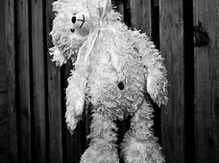

Self-directed violence
Includes suicidal thoughts or actions and forms of self-harm
Fatal suicidal behaviour- suicidal behaviour results in death
Non-fatal suicidal behaviours/attempted suicide/self-harm- suicidal behaviour does not result in death

Slide 7

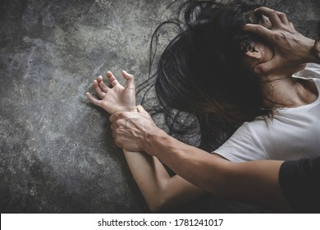
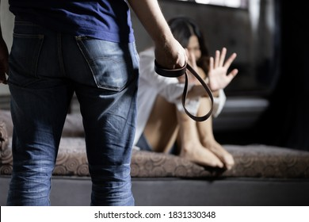
Interpersonal violence
include acts of violence and intimidation that occur between family members, between intimate partners or between individuals
Interpersonal violence may involve assault, sexual assault, neglect, abandonment and maltreatment

Slide 8

Collective violence
‘‘instrumental use of violence by people who identify themselves as members of a group…against another group or set of individuals, in order to achieve political, economic or social objectives’’.
Collective violence includes
War
Terrorism
Violent political conflict between or within states
Violence perpetrated by states (genocide, torture, systematic abuses of human rights)
Organised violent crime such as gang warfare

Slide 9
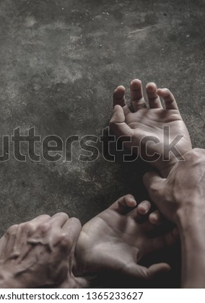
Sexual violence
can occur at an interpersonal or collective level
non-consensual sexual contact and non-consensual non-contact acts of a sexual nature, such as voyeurism and sexual harassment
Acts qualify as sexual violence if they are committed against someone who is unable to consent or refuse, for example because of age, disability, misuse of authority, violence or threats of violence

Slide 10
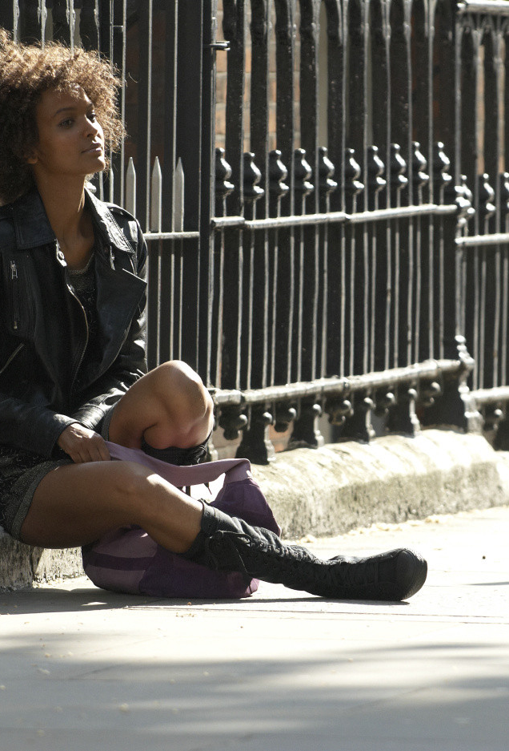
Gender-based violence
Violence that occurs within the context of women’s and girl’s subordinate status in society, and serves to maintain this unequal balance of power
Also known as violence against women
includes violence against women occurring
within the family, geographically or culturally specific forms of abuse such as female genital mutilation, ‘‘honour killings’’ and dowry-related violence as well as various sexual violence, including rape during warfare, trafficking of women and forced prostitution

Slide 11
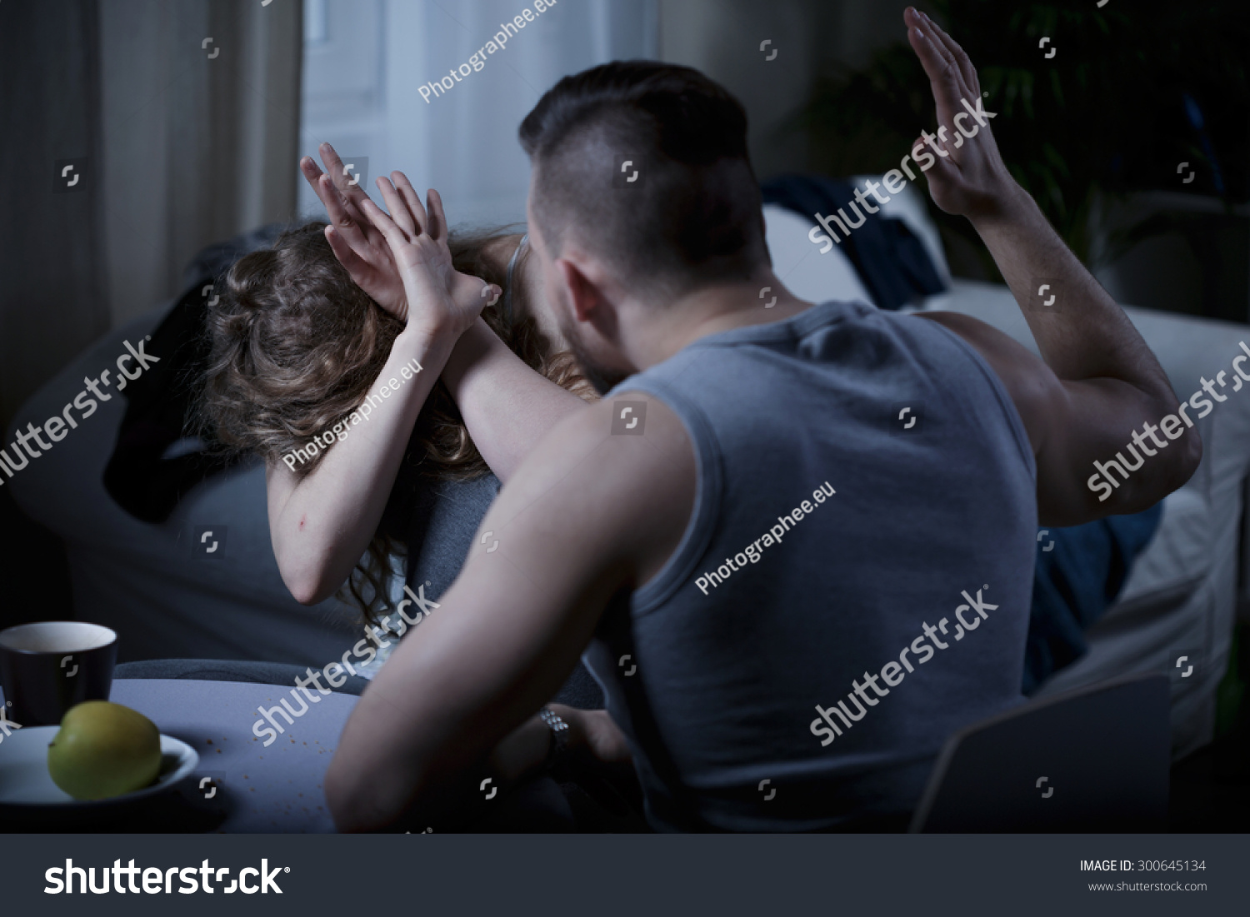
Intimate partner violence
Refers to physical, sexual or psychological harm by a current or former partner or spouse
Can occur among heterosexual or same-sex couples and does not require sexual intimacy
More commonly- women at the hands of men
Masculine identities

Slide 12
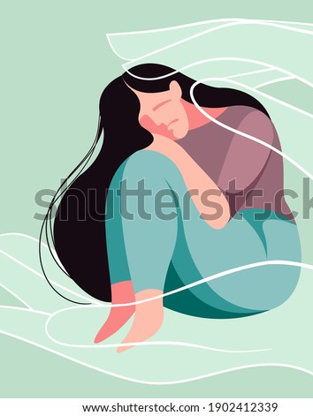
Domestic violence
Interchangeable with intimate partner violence
Not only considered physical aspect, more serious the emotional and psychological abuse the perpetrators use to maintain control over their partners.

Slide 13

Family violence
Refers to child maltreatment, sibling violence, intimate partner violence and elder abuse
The interconnectedness of family violence,
  Suicide
  Crime
  Drug and alcohol abuse
  Cycle of violence/intergenerational transmission of violence
  Poverty

Slide 14
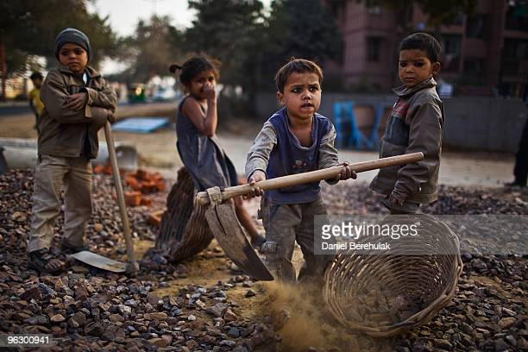

Child maltreatment
Child maltreatment and child abuse are sometimes used interchangeably
WHO- Child abuse or maltreatment constitutes all forms of physical and/or emotional ill-treatment,
  sexual abuse
  neglect or negligent treatment
  commercial or other exploitation
  resulting in actual or potential harm to the child’s health, survival, development or dignity in the context of a relationship of responsibility, trust or power

Slide 15
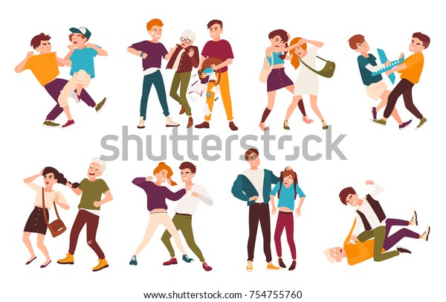
Youth violence
Youth is a significant risk factor for becoming both victim and perpetrator
WHO : ‘‘homicide and non-fatal attacks perpetrated by or against a person aged 10–29 years of age”

Slide 16
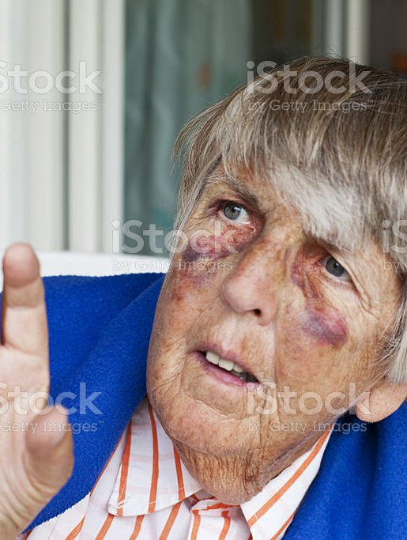
Elder abuse
An act of commission or omission and may be intentional or unintentional
The International Network for the Prevention of Elder Abuse: ‘‘a single or repeated act, or lack of appropriate action, occurring within any relationship where there is an expectation of trust which causes harm or distress to an older person

Slide 17


Workplace violence
ILO -Incidents where staff are abused, threatened or assaulted in circumstances related to their work, including commuting to and from work, involving an explicit or implicit challenge to their safety, well-being or health
Bullying within at workplace
involve threats to professional status, threats to personal standing, isolation, overwork and destabilization
Harassment at the workplace is very common
Harassment at work is any conduct based on age, disability, HIV status, sex, sexual orientation and other factors that is unreciprocated and unwanted and affects the dignity of men and women at work

Slide 18
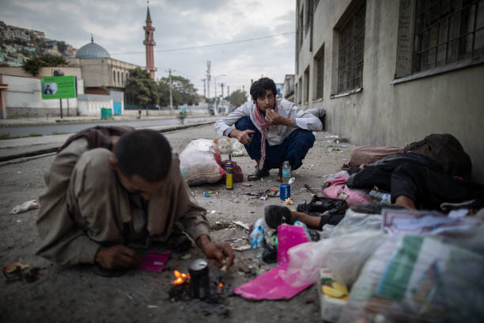
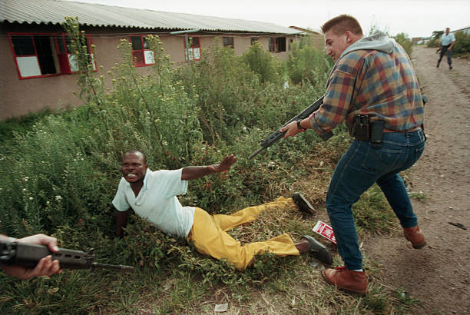
Structural violence
‘‘Structural violence’’ refers to the physical and psychological harm that results from exploitative and unjust social, political and economic systems.
Racism in America, Africa
Caste discrimination in India
Slavery
Armed conflicts
Forms of structural violence operate globally against women, children, indigenous peoples and those in poverty

Slide 19
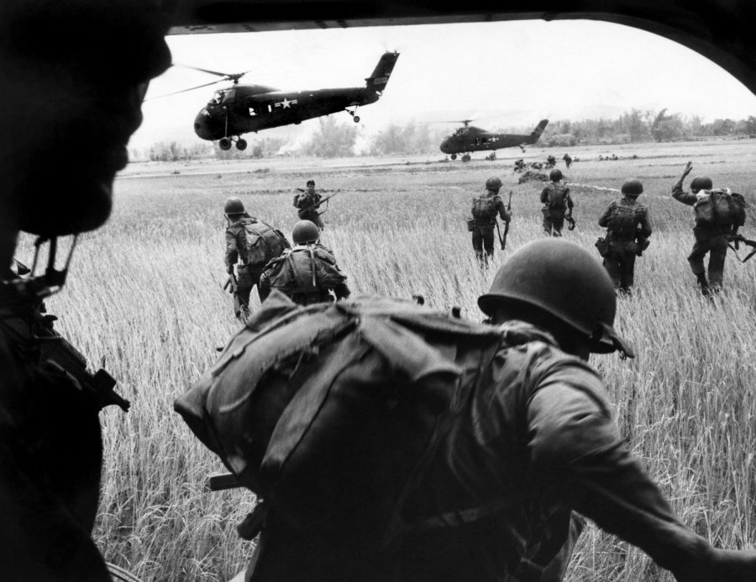
Armed conflict
The term ‘‘armed conflict’’ is often used in preference to ‘‘war’’ and changing nature of political violence
War typically suggests armed conflict between two states, but we are increasingly facing internal armed conflicts

Slide 20
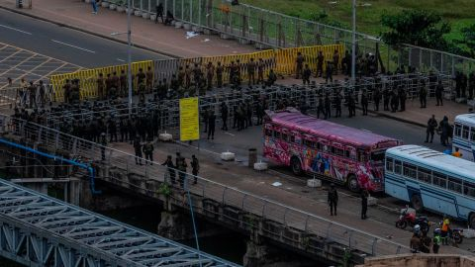
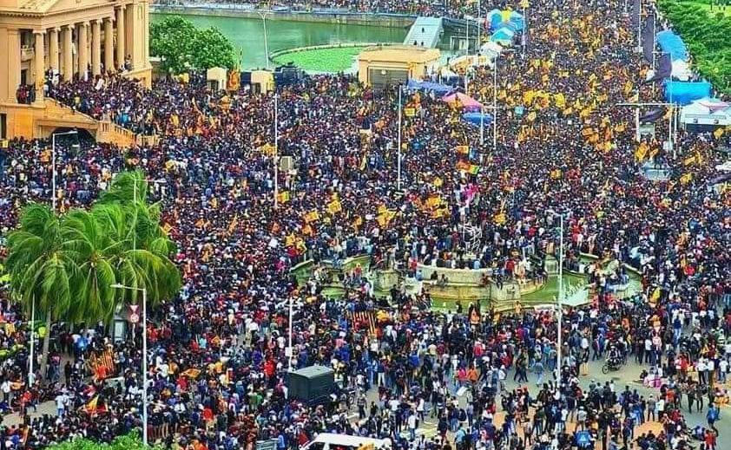
Complex emergencies
‘‘a humanitarian crisis in a country, region or society where there is total or considerable breakdown of authority resulting from internal or external conflict

Slide 21
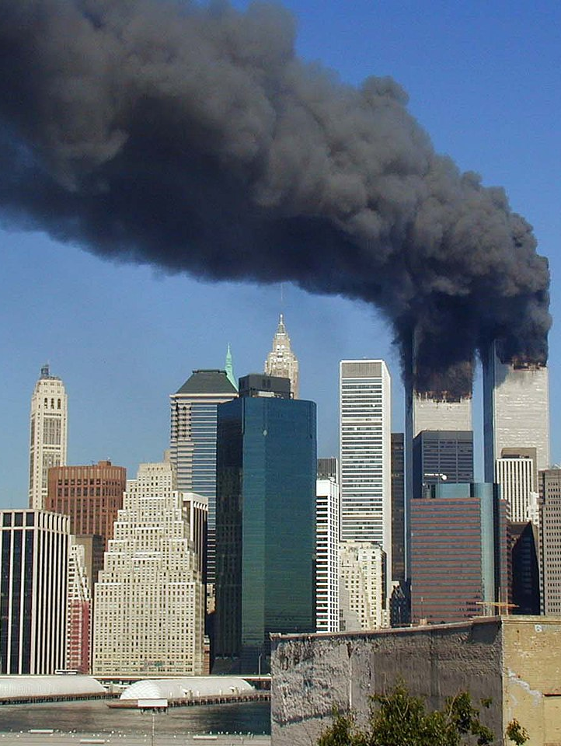
Terrorism
Violence against civilians and the state, in order to create fear and achieve political, economic, religious or ideological goals.
UN- any act intended to cause death or bodily harm to civilians or non-combatants for the purpose of either intimidating a population or compelling a government or a government institution to do or not to do something

Slide 22
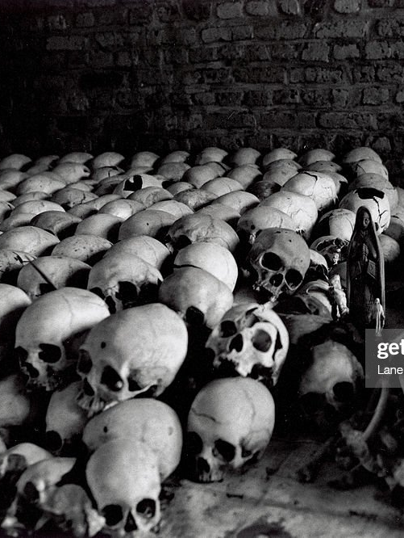
Genocide
any of the following acts committed with intent to destroy, in whole or in part, a national, ethnical, racial or religious group, as such:
(a) killing members of the group
(b) causing serious bodily or mental harm to members of the group
(c) deliberately inflicting on the group conditions of life calculated to bring about its physical destruction in whole or in part
(d) imposing measures intended to prevent births within the group
(e) forcibly transferring children of the group to another group.

Slide 23
Thank you

