Slide 1
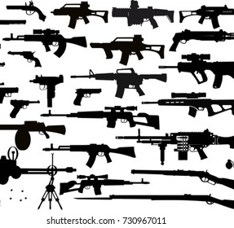
Gun Violence and Murder
Lecture 4
Susantha Rasnayake

Slide 2
Do you like to have a gun, if it is allowed in your country
Why???????????????

Slide 3
Global Scenario
Gun violence is a growing concern all over the world
In 2019 alone, more than 250,000 people died as a result of firearms worldwide
Nearly 71% of gun deaths were homicides, about 21% were suicides, and 8% were unintentional firearms-related accidents.
A smaller subset of gun deaths occur as the result of mass shootings and school shootings, which are often highly publicized.

Slide 4
Cont…
Particularly prevalent in many South American and Central American countries,
  due to either civil unrest or drug lobbies, which battle both law enforcement agencies and one another.
It is also high in several developing countries in Africa and the Middle East.
Finally, gun violence is considered an epidemic in the United States, which leads the world in mass shootings and has the highest levels of gun violence of any developed country by a wide margin.

Slide 5
Top 10 Countries with the most Total Gun Deaths, 2016
https://worldpopulationreview.com/country-rankings/gun-violence-by-country
Rank | Country | Total Gun Deaths | Homicides | Suicides | Unintentional
1 | Brazil | 43,200 | 40,600 | 1,730 | 867
2 | United States | 37,200 | 12,400 | 23,800 | 909
3 | India | 26,500 | 11,600 | 13,400 | 1,540
4 | Mexico | 15,400 | 13,800 | 841 | 740
5 | Colombia | 13,300 | 12,600 | 595 | 160
6 | Venezuela | 12,800 | 10,900 | 959 | 937
7 | Philippines | 8,020 | 7,600 | 183 | 239
8 | Guatemala | 5,090 | 4,430 | 107 | 550
9 | Russia | 4,380 | 1,670 | 1,920 | 785
10 | Afghanistan | 4,050 | 3,150 | 228 | 667

Slide 6
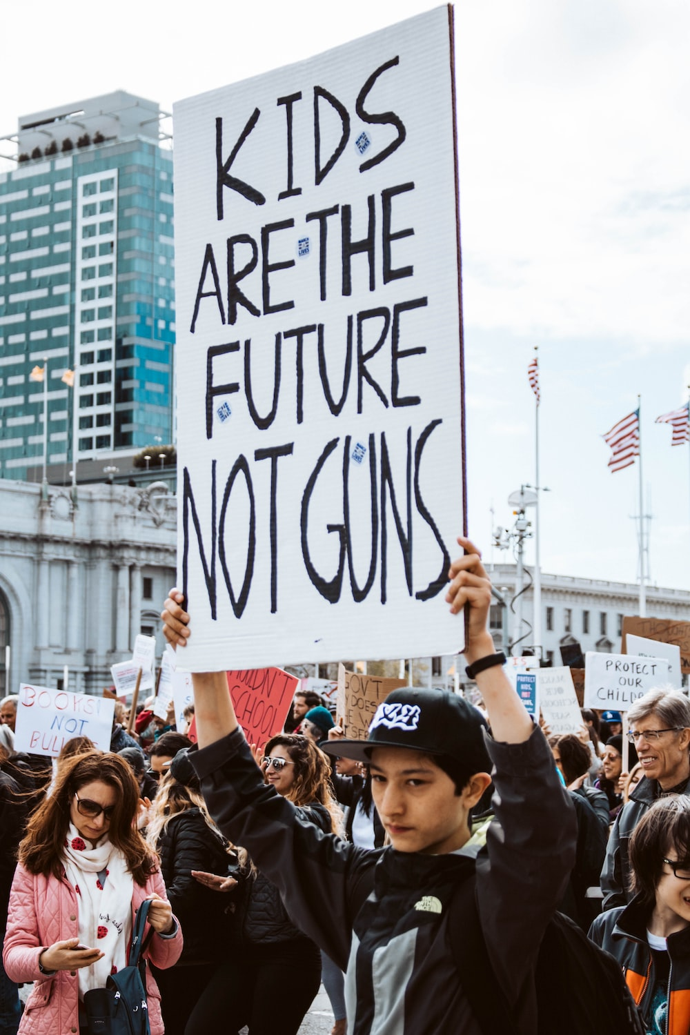
Case of the US
20 Americans die by gun violence every day
45% of men own a gun in the US
The second amendment of the US constitution says
“ A well-regulated Militia, being necessary to the security of a free State, the right of the people to keep and bear Arms shall not be infringed”
The majority of all homicides in the US are committed with a firearm, a majority are handguns

Slide 7
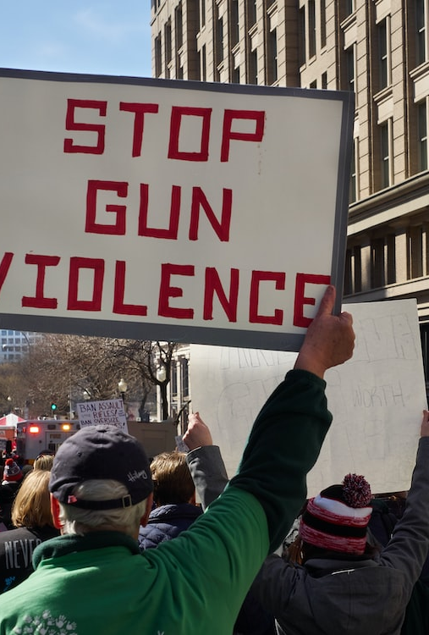
Mass murder
Mass murder is defined as when someone kills four or more victims in one location at one general point in time
The killings may stretch over a period of hours, but they are all part of the same emotional experience (with no cooling-off period)
In general, mass murders take their lives after their rampage
In the US, very frequent in Schools, Universities, and Workplaces
For more information
https://abcnews.go.com/US/mass-school-shootings-history/story?id=17975571

Slide 8
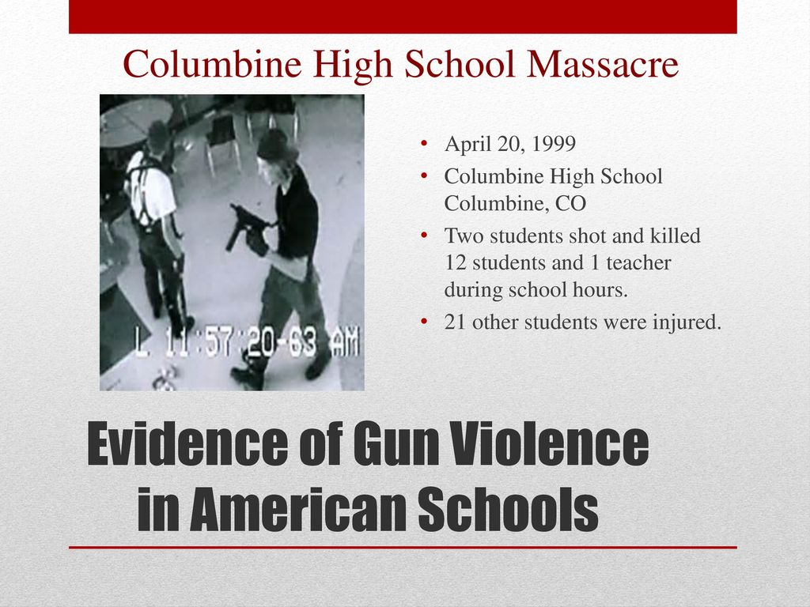

Slide 9
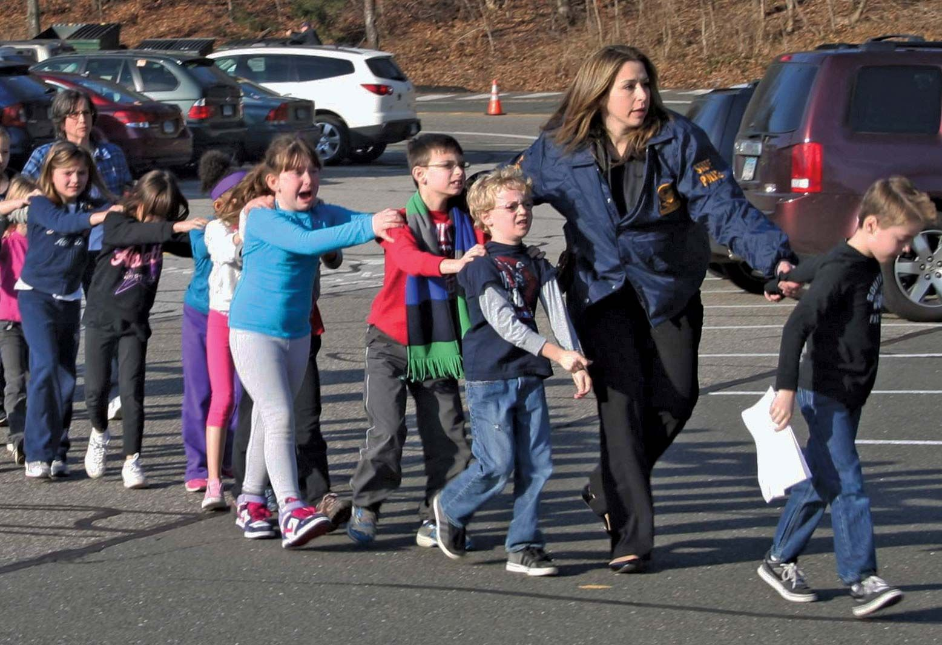
Connecticut
Twenty children and six staff members were killed in Newtown, Connecticut, on December 14, 2012.
It was the deadliest mass shooting at an elementary school in US history.
The 20-year-old (Adam Lanza) gunman also killed his mother that day and shot himself after the massacre

Slide 10
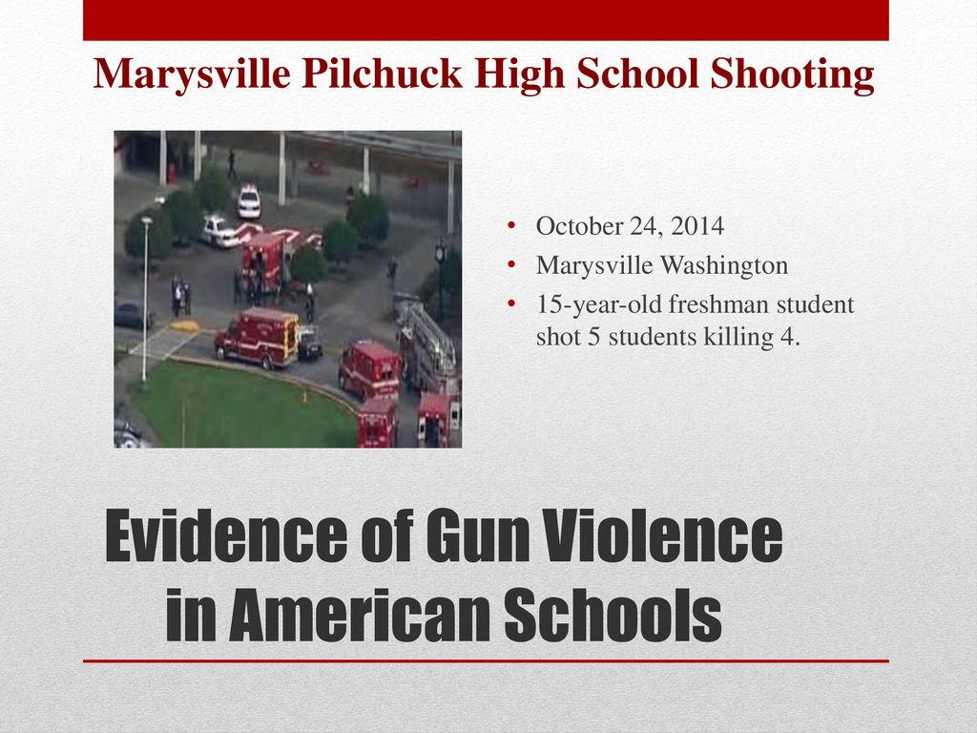

Slide 11

The New York Times
The Gun Violence Archive has counted at least 531 mass shootings so far this year, through mid-October.
The deadliest mass shooting in the country so far this year was the massacre in which 19 children and two teachers were killed at an elementary school in Uvalde, Texas, on May 24.
692 mass shootings were reported in the last year

Slide 12
Number of School Homicides for Students Aged 5–18

Slide 13
Percentage distribution for school-associated homicides for youth 5-18 by location, 2012-13

Slide 14
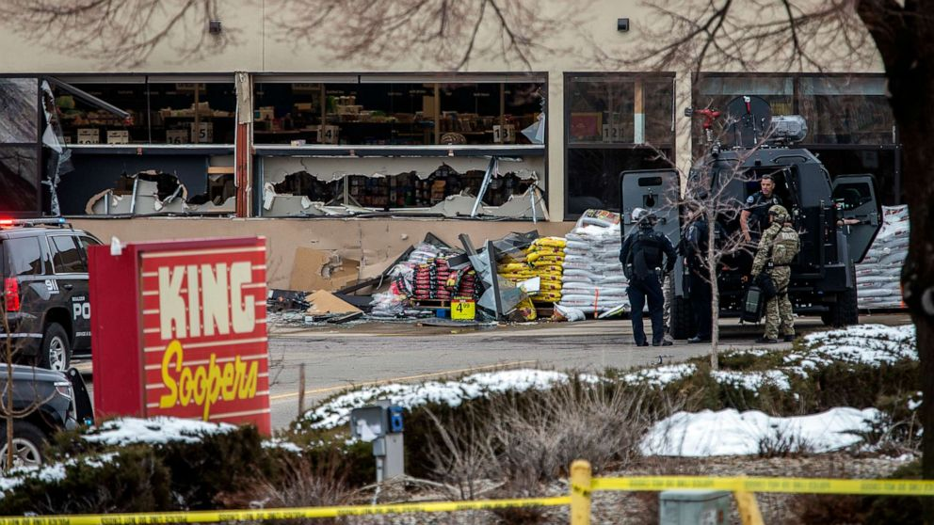
On March 22, 2021, a mass shooting occurred at a King Soopers supermarket in Boulder, Colorado
The alleged shooter, 21-year-old Ahmad Al Aliwi Al-Issa

Slide 15
Workplace shooting
Incident | Fatalities | Injured | Total
El Paso Walmart mass shooting (El Paso, Texas, 2019) | 22 | 26 | 48
San Bernardino mass shooting (San Bernardino, California, 2015) | 14 | 21 | 35
Atlanta day trading spree killings (Atlanta, Georgia, 1999) | 9 | 13 | 22
United States Postal Service shooting (Edmond, Oklahoma, 1986) | 15 | 6 | 21
Standard Gravure shooting (Louisville, Kentucky, 1989) | 9 | 12 | 21
Excel Industries mass shooting (Hesston, Kansas, 2016) | 3 | 14 | 17
Virginia Beach municipal building shooting (Virginia Beach, Virginia, 2019) | 12 | 4 | 16
Lockheed Martin shooting (Meridian, Mississippi, 2003) | 7 | 8 | 15
Buffalo supermarket massacre (Buffalo, New York, 2022) | 10 | 3 | 13
FedEx warehouse shooting (Indianapolis, Indiana, 2021) | 8 | 5 | 13
Planned Parenthood clinic (Colorado Springs, Colorado, 2015) | 9 | 3 | 12
Hartford Beer Distributor shooting (Manchester, Connecticut, 2010) | 9 | 2 | 11

Slide 16
Trends in mass killing, 2006-2020

Slide 17
Trend of mass killing incidents by type, 2006-2020

Slide 18
Characteristics of Mass Killing Offenders
What are the characteristics highlighted ????

Slide 19

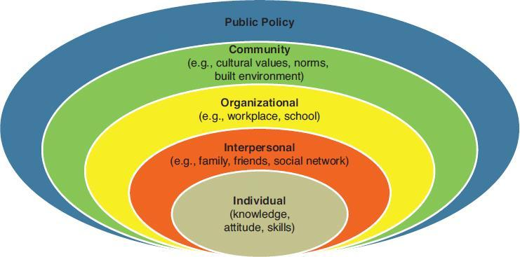
Causes of Mass Murder
PiE

Slide 20

Causes of Mass Murder
Easily accessible weapons
Cyber Abuse/Bullying
Environmental Impact
  School environment-50 of teenagers believe schools are becoming more violent
  Increasing the number of students in gangs by 24%
Neglect and abusive family life

Slide 21
Homicides by Weapon Type, 1980–2008

Slide 22
Firearm Homicides, 2010–2014, by Type of Gun y types of guns, 2010-2-14

Slide 24
Case examples
Doug Williams—who eventually went on a workplace killing rampage—was a known racist and often taunted and threatened African American employees at the Lockheed plant where he worked. In fact, many of his coworkers had predicted that he would one day do something terrible.
Matthew Beck, who killed four of his superiors at the Connecticut State Lottery, had filed a grievance contending that he was being assigned jobs outside of his work classification and that he deserved a raise. Just days before his killings, he told coworkers that he planned to sue the lottery. Larry Hensel was given various warnings about his inappropriate comments and rants about religion and politics, and when layoffs were forced on the company by hard economic times, Hensel was let go

Slide 25
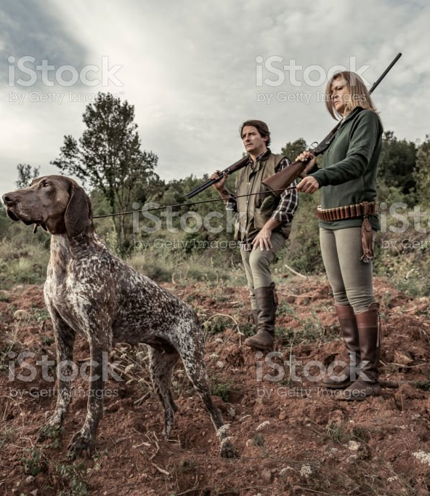
Guns, Culture and Violence
Gun remains a part of US history, pride, sport shooting, hunting, slavery, personal protection
Some collect various types of guns as a hobby
Gun owners prefer to have a variety of guns
White males prefer to own a gun than women and nonwhite males
Follow the links
https://www.youtube.com/watch?v=yxGrsxpcqeA
https://www.youtube.com/watch?v=rWPb0f9wCwQ
https://www.pewresearch.org/social-trends/2017/06/22/americas-complex-relationship-with-guns/

Slide 26
Do increases in gun availability actually lead to more violence
Many research demonstrate that they do
For example, one study found that increases in gun density did increase the rate of robberies with guns and the rate of robbery homicides
Also, studies found that the presence of a gun in the house greatly increases the likelihood of successfully attempting suicide
Some have argued that, instead of increasing rates of violence, guns allow citizens to protect themselves against predatory criminals

Slide 27
Hyper individualization
The real culprit in explaining mass murder can be found in society itself and in a trend that has affected almost everyone. During recent years, there has been an eclipse of community, a dwindling of the social relationships—family ties and neighborliness—that had protected former generations of Americans from succumbing to disaster. . . . For too many Americans who suffer, their misery has no company (Alvarez & Bachman, 2017)

Slide 28
More talks, little actions- lack of political will
Gun regulation is a hot political debate in the SU senate from time to time
But little success is achieved
Federal government and states follow various regulations
“After the rash of shootings in the fall of 2006 at Amish school, the White House held a conference on school safety on October 10, where many topics were discussed, including metal detectors, school bullies, the value of religious beliefs, and good communication between parents and schools. There was not one mention by the panelists or from President Bush of guns or gun control
(Alvarez & Bachman, 2017)

Slide 29
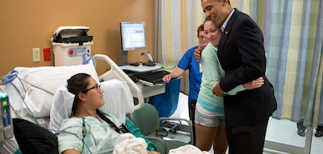
“We cannot and will not be passive in the face of such violence. We should be willing to challenge old assumptions in order to lessen the prospects of such violence in the future.”
https://obamawhitehouse.archives.gov/issues/preventing-gun-violence

Slide 30
Gun control is frequently debated after a mass shooting like school or workplace shooting, but the debate rarely leads to action
This inaction motivated President Obama to enact a series of executive actions designed to help reduce gun violence. The actions are really quite modest with the most significant actions being the following:
1 Provide “federal guidance” that seeks to clarify who is “in the business” of selling guns; the goal is to increase the number of “private sellers” who must run background checks.
2. Provide funds for the FBI to hire new examiners to process background checks to prevent delays.
3. Provide funds to research smart gun technology.
4. Provide funds to improve mental health care

Slide 31
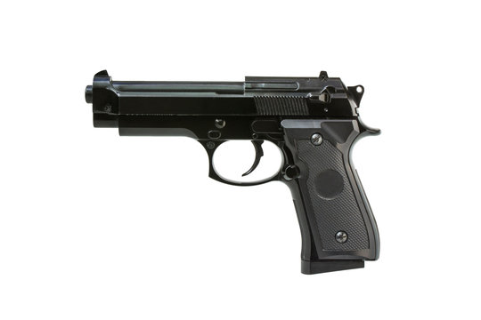
Gun regulations
People who have been convicted of crime, which sentence is over one year
Fugitives for justice
People addicted to illegal substances
Illegal immigrants
People subject to restraining orders

Slide 32
Offender and offense characteristics of a nonrandom sample of mass murderers by A G Hempel , J R Meloy, T C Richards (N=30, In Canada and the US)
Research findings
such individuals are single or divorced males
Suffered from anxiety disorders ( such as panic disorder, social anxiety disorder, and post-traumatic stress disorder) and personality disorders
The mass murder is triggered by a major loss related to employment or relationship.
A warrior mentality permeates the planning and attack behavior of the subject
Alcohol plays a very minor role.
20 percent directly threatened their victims before the offense.
Death by suicide or at the hands of others is the usual outcome for the mass murderer.

Slide 33
Number of executions 1976-2015

Slide 34
Discussion
Do you think the death penalty is a suitable method to control homicide ???

Slide 35
THANK YOU

