Slide 1
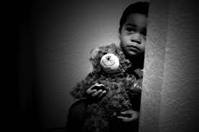
Child Maltreatment
Lecture 6
Susantha Rasnayake

Slide 2
Class activity: watch the video and answer the questions below
(25) Recognition of Child Abuse and Neglect (Training Video) - YouTube

Slide 3
Who is the mandated reporter
Abuse typically includes………………
Where child abuse occurs
What is the prominent abuse
Neglect can happen due to
What are the Indicators of neglect
What is physical abuse
What are the signs of physical abuse
What are behavioural indicators of physical abuse
How do you distinguish corporal punishment and abuse
How do you separate abuse from accidental injury
Define sexual abuse
Sexual abuse includes…………….
What are the indicators of child sexual abuse
What is the strongest indicator of sexual abuse
How should you respond to abuse

Slide 4
Definitions:
Child
a child means every human being below the age of eighteen years unless under the law applicable to the child, majority is attained earlier (Child Right Convention 1989)
Maltreatment
Child maltreatment includes all types of abuse and neglect of a child under the age of 18 by a parent, caregiver, or another person in a custodial role

Slide 5

What is Child Maltreatment?
Physical abuse
Sexual abuse
Neglect
Emotional abuse
Exploitation of children
We tend to think only of physical abuse, but child maltreatment is much broader than that

Slide 6
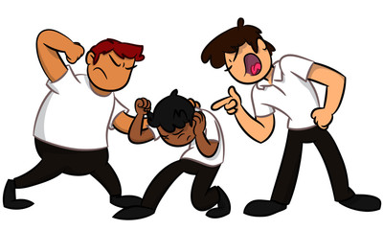
Physical Abuse
Physical abuse is the use of intentional physical force, such as hitting, kicking, shaking, burning or other show of force against a child.
Physical abuse can range from minor bruises to severe internal injuries and death

Slide 7
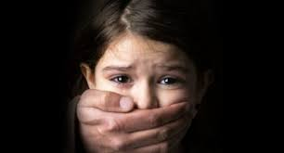
Sexual Abuse
Sexual abuse involves engaging a child in any type of sexual activity. It includes fondling, rape, exhibitionism, exposure to pornography, voyeurism and communicating in a sexual manner by
  A person responsible for a child's care
  A person who has a significant relationship with a child
  A person in a position of authority
  between two minors, where one exerts power over other

Slide 8
Gravity of the problem
Child sexual abuse is far more prevalent than we think.
Child sexual abuse is likely the most prevalent health problem children face
About 1/10 children will be sexually abused before their 18th birthday
About 1/7 girls and 1/25 boys will be sexually abused before they turn 18
only about 38% of child victims disclose

Slide 9
By whom?????
About 90% of children who are victims of sexual abuse know their abuser. Only 10% of sexually abused children are abused by a stranger.
Approximately 30% of children who are sexually abused are abused by family members.
The younger the victim, the more likely it is that the abuser is a family member. Of those molesting a child under six, 50% were family members. Family members also accounted for 23% of those abusing children ages 12 to 17.9
About 60% of children who are sexually abused are abused by people the family trusts.
Homosexual individuals are no more likely to sexually abuse children than heterosexual individuals.

Slide 10
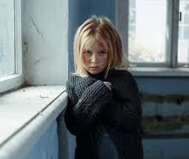
Neglect
Provide needed food, clothing, shelter, medical or mental health care, education or appropriate supervision
Protect child from conditions or actions that endanger the child
Take steps to ensure that a child is educated as required by law.
Or
Exposing a child to certain drugs during pregnancy
Causing emotional harm to a child

Slide 11
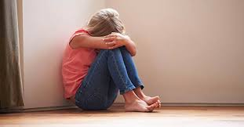
Emotional abuse
Harm to a child’s
Psychological capacity
Or
Emotional stability
Name-calling
Insulting
Threatening violence (even without carrying out threats)
Allowing children to witness the physical or emotional abuse of another
Withholding love, support, or guidance

Slide 12
Exploitation of child
Sexual exploitation
Child sexual exploitation is a form of child sexual abuse in which a person(s), of any age takes advantage of a power imbalance to force or induce a child into engaging in sexual activity in return for something received by the child and/or those perpetrating or facilitating the abuse
Labour exploitation
Child labour exploitation is the employment of children in a form that deprives them of their childhood. The nature of this work can be damaging to a child's safety, physical health, and mental health along with hindering their moral development

Slide 13
Which is the most common? Why?
Physical abuse
Sexual abuse
Neglect
Mental injury
Neglect is the most common
Substance abuse is the leading cause of child neglect
Poverty is heavily related

Slide 14
Who is most vulnerable?
the youngest children
in the u.s., 29% of child victims are younger than 3 years old
twice that rate for those under 1 year
Also vulnerable are children:
with disabilities and health problems
who have already been maltreated

Slide 15
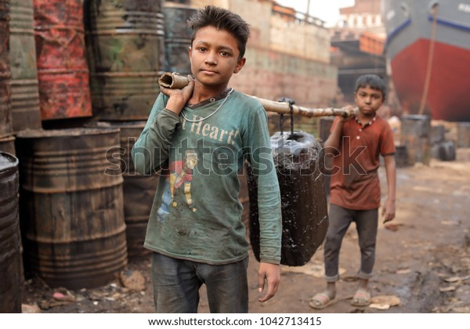
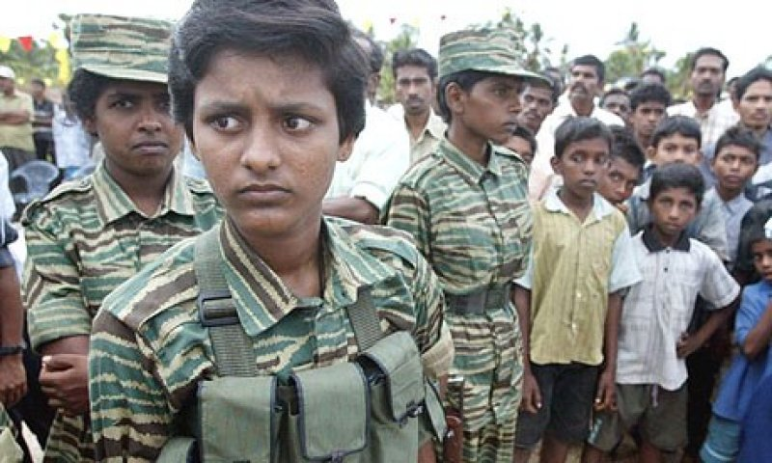
Environmental Factors (Macro)
Poverty
Social isolation
Violence in the community
Negative cultural values examples: genital mutilation, male circumcision
What is female genital mutilation and where does it happen? | Female genital mutilation (FGM) | The Guardian
WHY ABUSE

Slide 16

Micro (factors)
Parents who are young when the child is born
Parents who are poorly informed about parenting
Drug/alcohol abuse of family members
Domestic violence
Untreated mental health issues E.g., depression, antisocial personality disorder
Changes in family structure (divorce, single parenting)
NCANDS data, Children’s Bureau
Notes:
Source: U.S. Administration for Children and Families, 2017
National Child Abuse and Neglect Data System

Slide 17
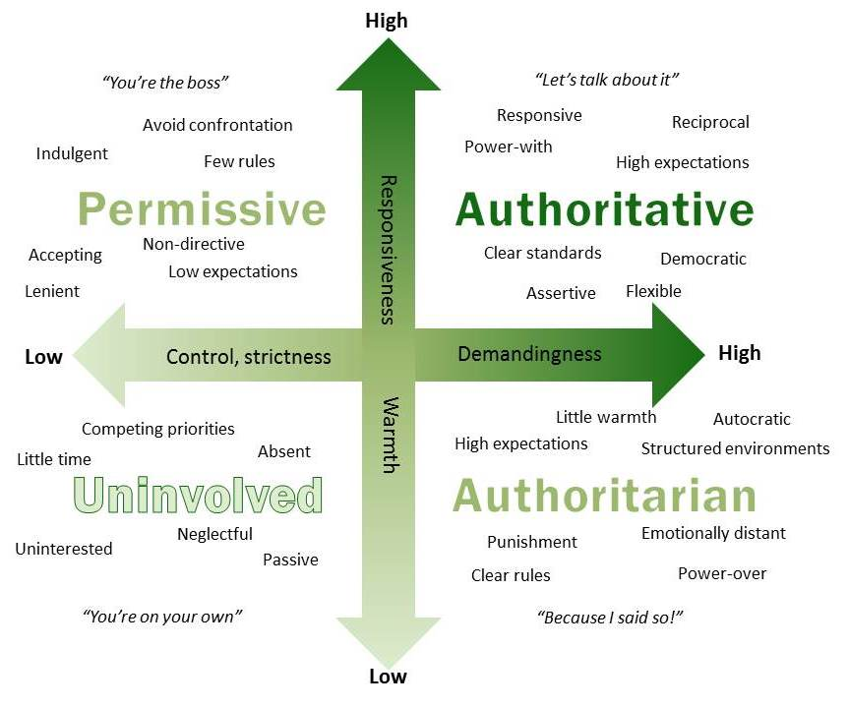
What parenting style is good

Slide 18
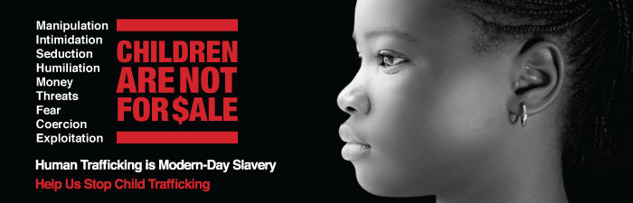
Child Sex Trafficking: A Global issue

Slide 19
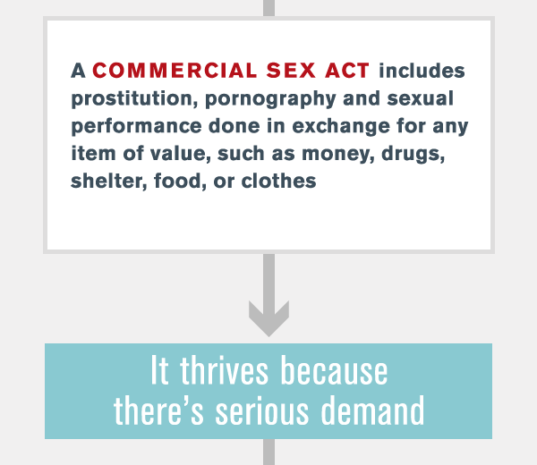
Human Trafficking
Modern-day slavery
Exploiting a person by force, fraud, or coercion
Includes sex trafficking, forced labor, and domestic servitude
Any person under age 18 involved in a commercial sex act is considered a victim of human trafficking
More than 1 million children are exploited each year in the commercial sex trade.
71% are girls

Slide 20
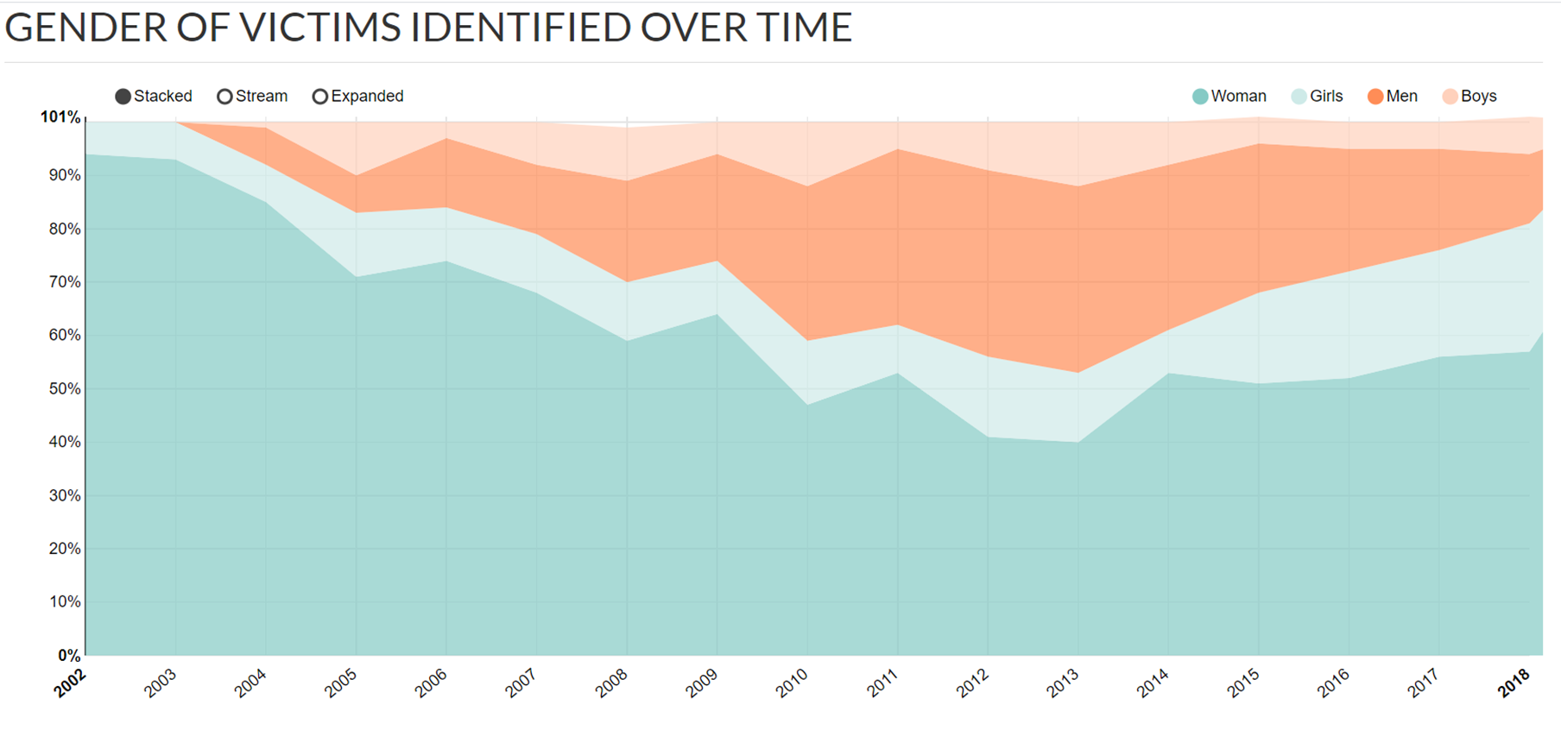
Notes:
Human trafficking

Slide 21
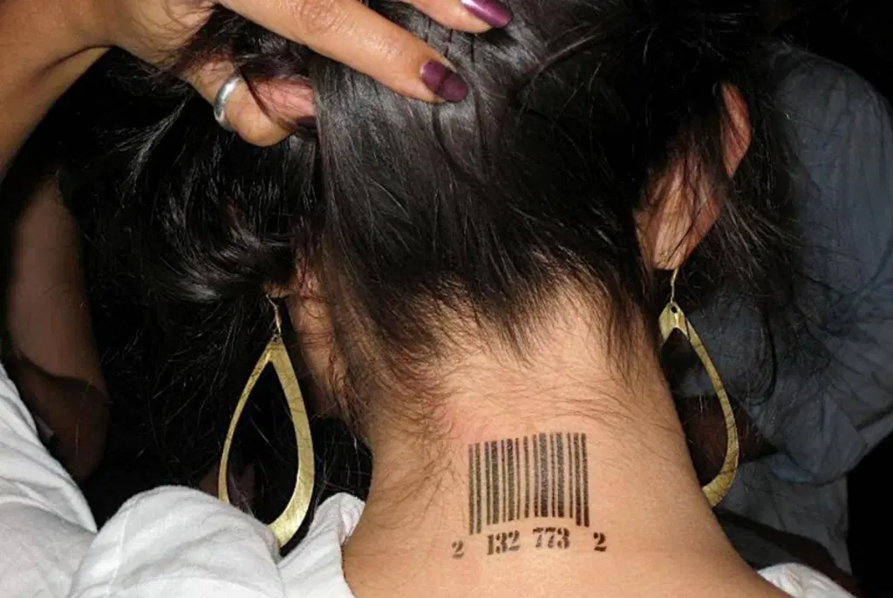
How big of a problem is Sex trafficking?
Increasing rapidly in recent years, in part due to the internet
2nd Largest Criminal Enterprise Worldwide
Estimated to overtake the global drug trade
$150 billion industry
79% of all global human trafficking is sex trafficking
Notes:
https://justaskprevention.org/learn/
https://www.ecpat.org/wp-content/uploads/2016/04/Factsheet_Czech_Republic.pdf

Slide 22
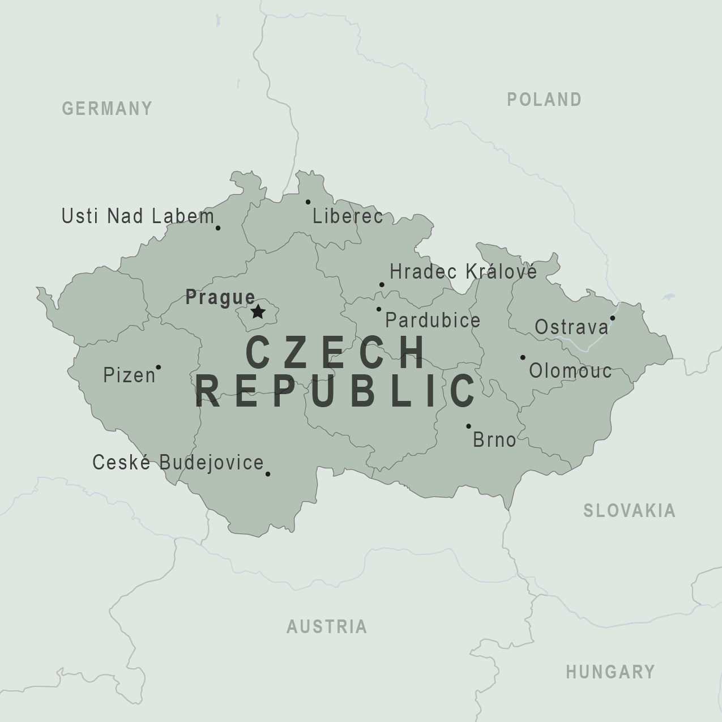
Breakout 2. Human Trafficking
Myth: Sex trafficking does not occur in the Czech Republic; it only happens in other countries
Myth: Sex trafficking victims in the Czech Republic are only foreign-born individuals and those who are poor
Myth: Sex trafficking victims will attempt to seek help when in public
Read the myths and discuss these questions:
What do you know about the truth (reality) of this?
Why do you think people believe this myth?

Slide 23
Countries fall into one or more categories:
Sending or source
Child’s originating country
Transit
The country child is moved through
Temporarily held on way to the final destination
Receiving or Target
Destination – the final country the child ends up in
Need to address the demand for child sex victims
Need to address why it is easy to pass through
Need to address why & how children leave

Slide 24
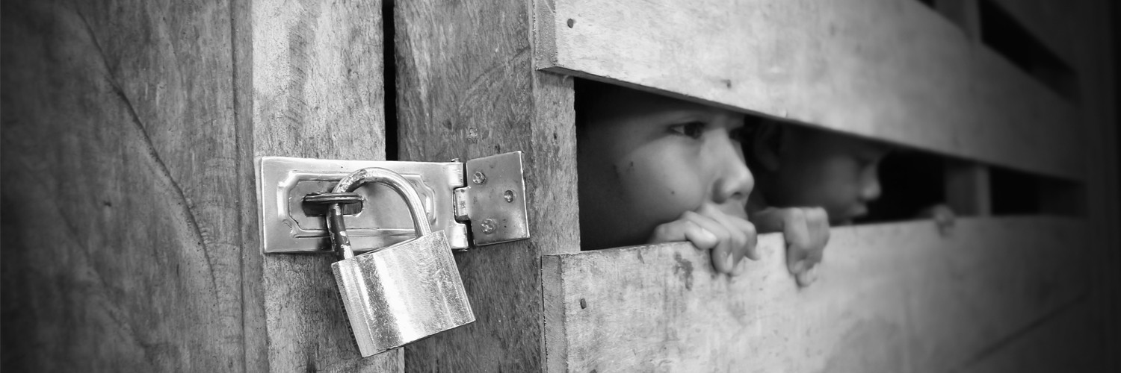
The Czech Republic is considered a Source, transit, and destination country for sex trafficking
Main source countries:
  Romania, Bulgaria, Ukraine, Slovakia, Belarus, Philippines, Vietnam, Thailand and Hungary.
  Also Czech is a source: Czech children, are trafficked. The destination countries are mainly the UK, Netherlands, Switzerland, & Denmark.
  Czech Roma children (and Roma women) are most often trafficked within the country
Notes:
https://ec.europa.eu/anti-trafficking/member-states/czech%20republic_en

Slide 25

Child Sex Trafficking:
What’s happening in the Czech Republic?
Increased substantially since the mid-1990s in the German-Czech border regions, fueled by tourism development
Most of the children are from poor families and are made to contribute to their family’s income.
Currently, child-sex tourism in Czech is more heavily focused on the prostitution of boys
  But not to serve Czech “customers” or “johns”
  Older men from Scandinavia, Britain, Germany and Austria are travelling to the Czech Republic with the intention of sexually exploiting boys in particular
  Many young boys travel abroad for short periods with tourists from Austria, Germany and Greece
A number of Czech children are also trafficked to the border regions for sexual purposes, and sometimes from there to Germany.
Girls also are brought across the border with pimps in taxis, trains or buses for a weekend or longer periods
Notes:
https://www.ecpat.org/wp-content/uploads/2016/04/Factsheet_Czech_Republic.pdf

Slide 26
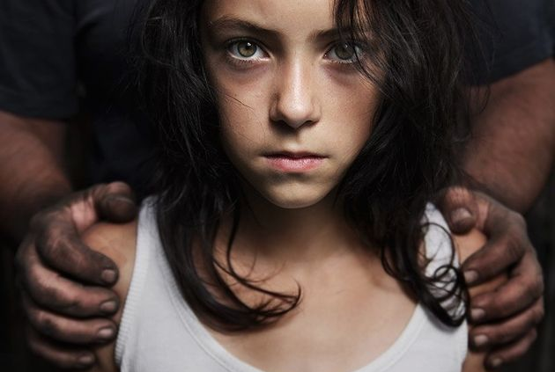
Warning Signs
Appears malnourished
Shows signs of physical injuries and abuse
Avoids eye contact, social interaction, and authority figures or law enforcement
Lacks official identification documents
Appears impoverished or lacking personal possessions
For adolescents: anxiously and continually checks text messages, often from multiple cells

Slide 27
How do they do it?
Sex traffickers are master manipulators
They target vulnerable people, including kids, people who are chemically addicted, young mothers with children, and people who have a history of abuse, neglect, or mental health challenges.
Sex traffickers may get victims hooked on drugs to control them.

Slide 28
What we must do
Mandatory Reporting
Training for professionals
Victim support
Legal resources

Slide 29
What child welfare policies are you aware of in the Czech Republic?
What you know about Child Rights Convention

