Slide 1

INTIMATE PARTNER VIOLENCE (IVP)
Lecture 7
Susantha Rasnayake

Slide 2
Let’s watch the video
https://www.youtube.com/watch?v=iiF9ays47EI
What type of abuse have you encountered from the video
What are the reasons for intimate partner violence
What are the possible interventions??????

Slide 3
What is Intimate Partner Violence?
Intimate partner violence is a pattern of abusive behavior in an intimate relationship where one partner tries to control and dominate the other. The behavior may be verbally, psychologically, physically or sexually, financially or technologically abusive with the victim left feeling scared, confused, dependent and insecure.
Partner may be the current or former or spouse
Can occur among heterosexual or same-sex couples and does not require sexual intimacy
More commonly- women at the hands of men

Slide 4
Key Facts
IPV is a major public health problems and a violation of women's human rights.
WHO indicates that globally about 1 in 3 (30%) of women worldwide have been subjected to either physical and/or sexual IVP or non-partner sexual violence in their lifetime.
Worldwide, almost one third (27%) of women aged 15-49 years who have been in a relationship report that they have been subjected to some form of physical and/or sexual violence by their intimate partner.

Slide 5
Regional information
The prevalence estimates of lifetime IVP range from 20% in the Western Pacific
22% in high-income countries and Europe
25% in the WHO Regions of the Americas
to 33% in the WHO African region
31% in the WHO Eastern Mediterranean region
33% in the WHO South-East Asia region.

Slide 6

Methods of Control
Physical abuse:
Hitting, pushing
Shoving, slapping, punching
Holding or restraining
Strangling, choking
Inflicting bruises
Welts and lacerations
Dragging, pulling by hair
Restraining
Marking, branding

Slide 7
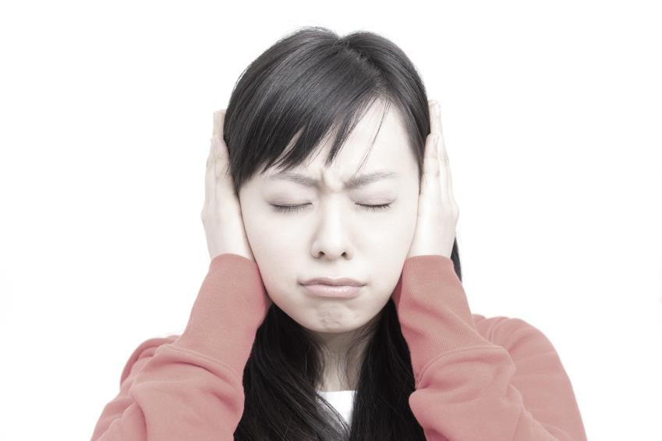
Methods of Control
Emotional abuse:
Threatening, intimidation
Humiliation
Extreme jealousy/possessiveness
Threatening acts of violence
Constant criticizing
Insulting and belittling
Ignoring or dismissing the victim
Denying, minimizing and blaming
Invading privacy

Slide 8

Methods of Control
Sexual abuse:
Coercing victim to have sex
Making victim watch pornographic movies
Sexually transmitted diseases
Demanding sexual photos
Using date rape drugs
Sabotaging birth control

Slide 9

Methods of Control
Financial abuse:
Withholding money
Pushing to stay at home
No access to bank accounts/ATM and credit cards
Ruining victim’s credit
Taking paycheck
Gambling

Slide 10
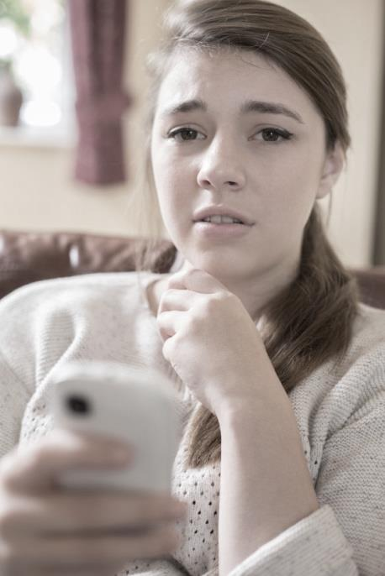
Methods of Control
Technology abuse:
Tracking location
Demanding check-ins
Excessive texts
Spyware
Monitoring communications
Posting on Facebook and
social media

Slide 11

Methods of Control
Legal abuse:
Constant threats to gain custody of children
Excessive filing of motions at court
Using parental rights to contact victim
Avoiding access to legal support

Slide 12
Factors associated with intimate partner violence and sexual violence against women
Risk factors for both intimate partner and sexual violence include:
lower levels of education (perpetration of sexual violence and experience of sexual violence)
a history of exposure to child maltreatment (perpetration and experience)
witnessing family violence (perpetration and experience)
antisocial personality disorder (perpetration)
harmful use of alcohol (perpetration and experience)
harmful masculine behaviours, including having multiple partners or attitudes that condone violence (perpetration)
community norms that privilege or ascribe higher status to men and lower status to women
low levels of women’s access to paid employment
low level of gender equality (discriminatory laws, etc.).

Slide 13
Factors specifically associated with intimate partner violence include:
past history of exposure to violence
marital discord and dissatisfaction
difficulties in communicating between partners
male controlling behaviours towards their partners

Slide 14
Factors specifically associated with sexual violence perpetration include:
beliefs in family honour and sexual purity
ideologies of male sexual entitlement
weak legal sanctions for sexual violence

Slide 15
“Why does she/he stay?”
Hope that things will get better
Disappointing friends, family or community
Lack of resources to care for self or child(ren)
Religious or cultural beliefs
Immigration Status
Belief that they can keep themselves and child(ren) safe
Fear of being hurt or killed

Slide 16
Health Consequences
Intimate partner and sexual violence cause serious short- and long-term physical, mental, sexual and reproductive health problems for women.
They also affect their children’s health and wellbeing.
This violence leads to high social and economic costs for women, their families and societies. Such violence can:
  Increase the risk of homicide or suicide.
  Lead to injuries
  Lead to unintended pregnancies, induced abortions, gynaecological problems, and sexually transmitted infections, including HIV
  violence in pregnancy also increases the likelihood of miscarriage, dead fetus, pre-term delivery and low birth weight babies
  Health effects can also include headaches, pain syndromes (back pain, abdominal pain, chronic pelvic pain) gastrointestinal disorders, limited mobility and poor overall health.

Slide 17
Your inner feelings and thoughts
Do you:
feel afraid of your partner much of the time?
avoid certain topics out of fear of angering your partner?
feel that you can’t do anything right for your partner?
believe that you deserve to be hurt or mistreated?
wonder if you’re the one who is crazy?
feel emotionally numb or helpless?

Slide 18
Your partner’s belittling behaviour
Does your partner:
humiliate or yell at you?
criticize you and put you down?
treat you so badly that you’re embarrassed for your friends or family to see?
ignore or put down your opinions or accomplishments?
blame you for their own abusive behavior?
see you as property or a sex object, rather than as a person?

Slide 19
Your partner’s violent or threatening behaviour
have a bad and unpredictable temper?
hurt you, or threaten to hurt or kill you?
threaten to take your children away or harm them?
threaten to commit suicide if you leave?
force you to have sex?
destroy your belongings?

Slide 20
Can men be victims of intimate partner violence?
What does Czech society say about the role of men in relationships?
What do you think are barriers for men getting help?
Are you aware of services for victims who are men?

Slide 21
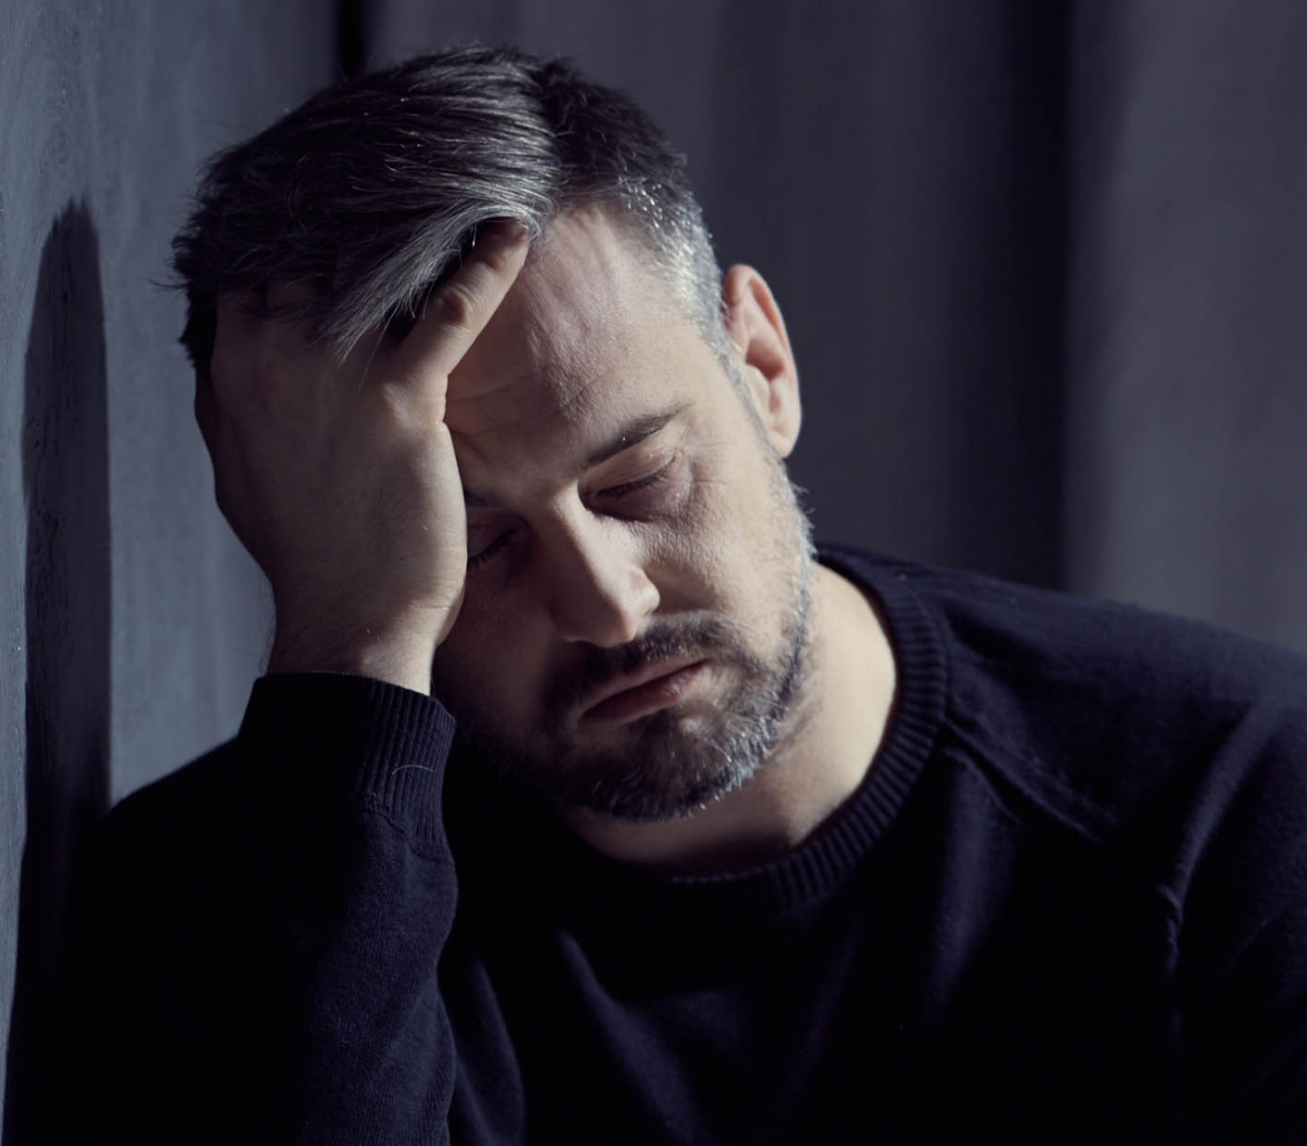
Can Men be Victims of Domestic Violence?
Abuse of men happens far more often than is generally believed and occurs in straight and same-sex relationships.
It happens to men from all cultures regardless of age or occupation.
About 15% of intimate partner violence are male
  But that is probably an under-estimate

Slide 22

When a man is the victim of abuse in a straight relationship
Tendency to expect and assume that the man is the perpetrator of abuse.
The victim himself may buy into this belief and also feel confused
In both straight and gay relationships:
It is common for the one being abused to act out verbally or physically against the abuser in defense during conflicts.
The abuser may use such incidents as proof that the other is the abusive partner.

Slide 23

Difficult to recognize intimate partner violence against men
If one is unsure…
Take a step back and examine larger patterns in the relationship.
Consider the known signs of intimate partner violence.
In an abusive relationship, the person who routinely uses these behaviors is the abuser.
The person on the receiving end is being abused.
Men in an abusive relationship need to know that they are not alone.

Slide 24
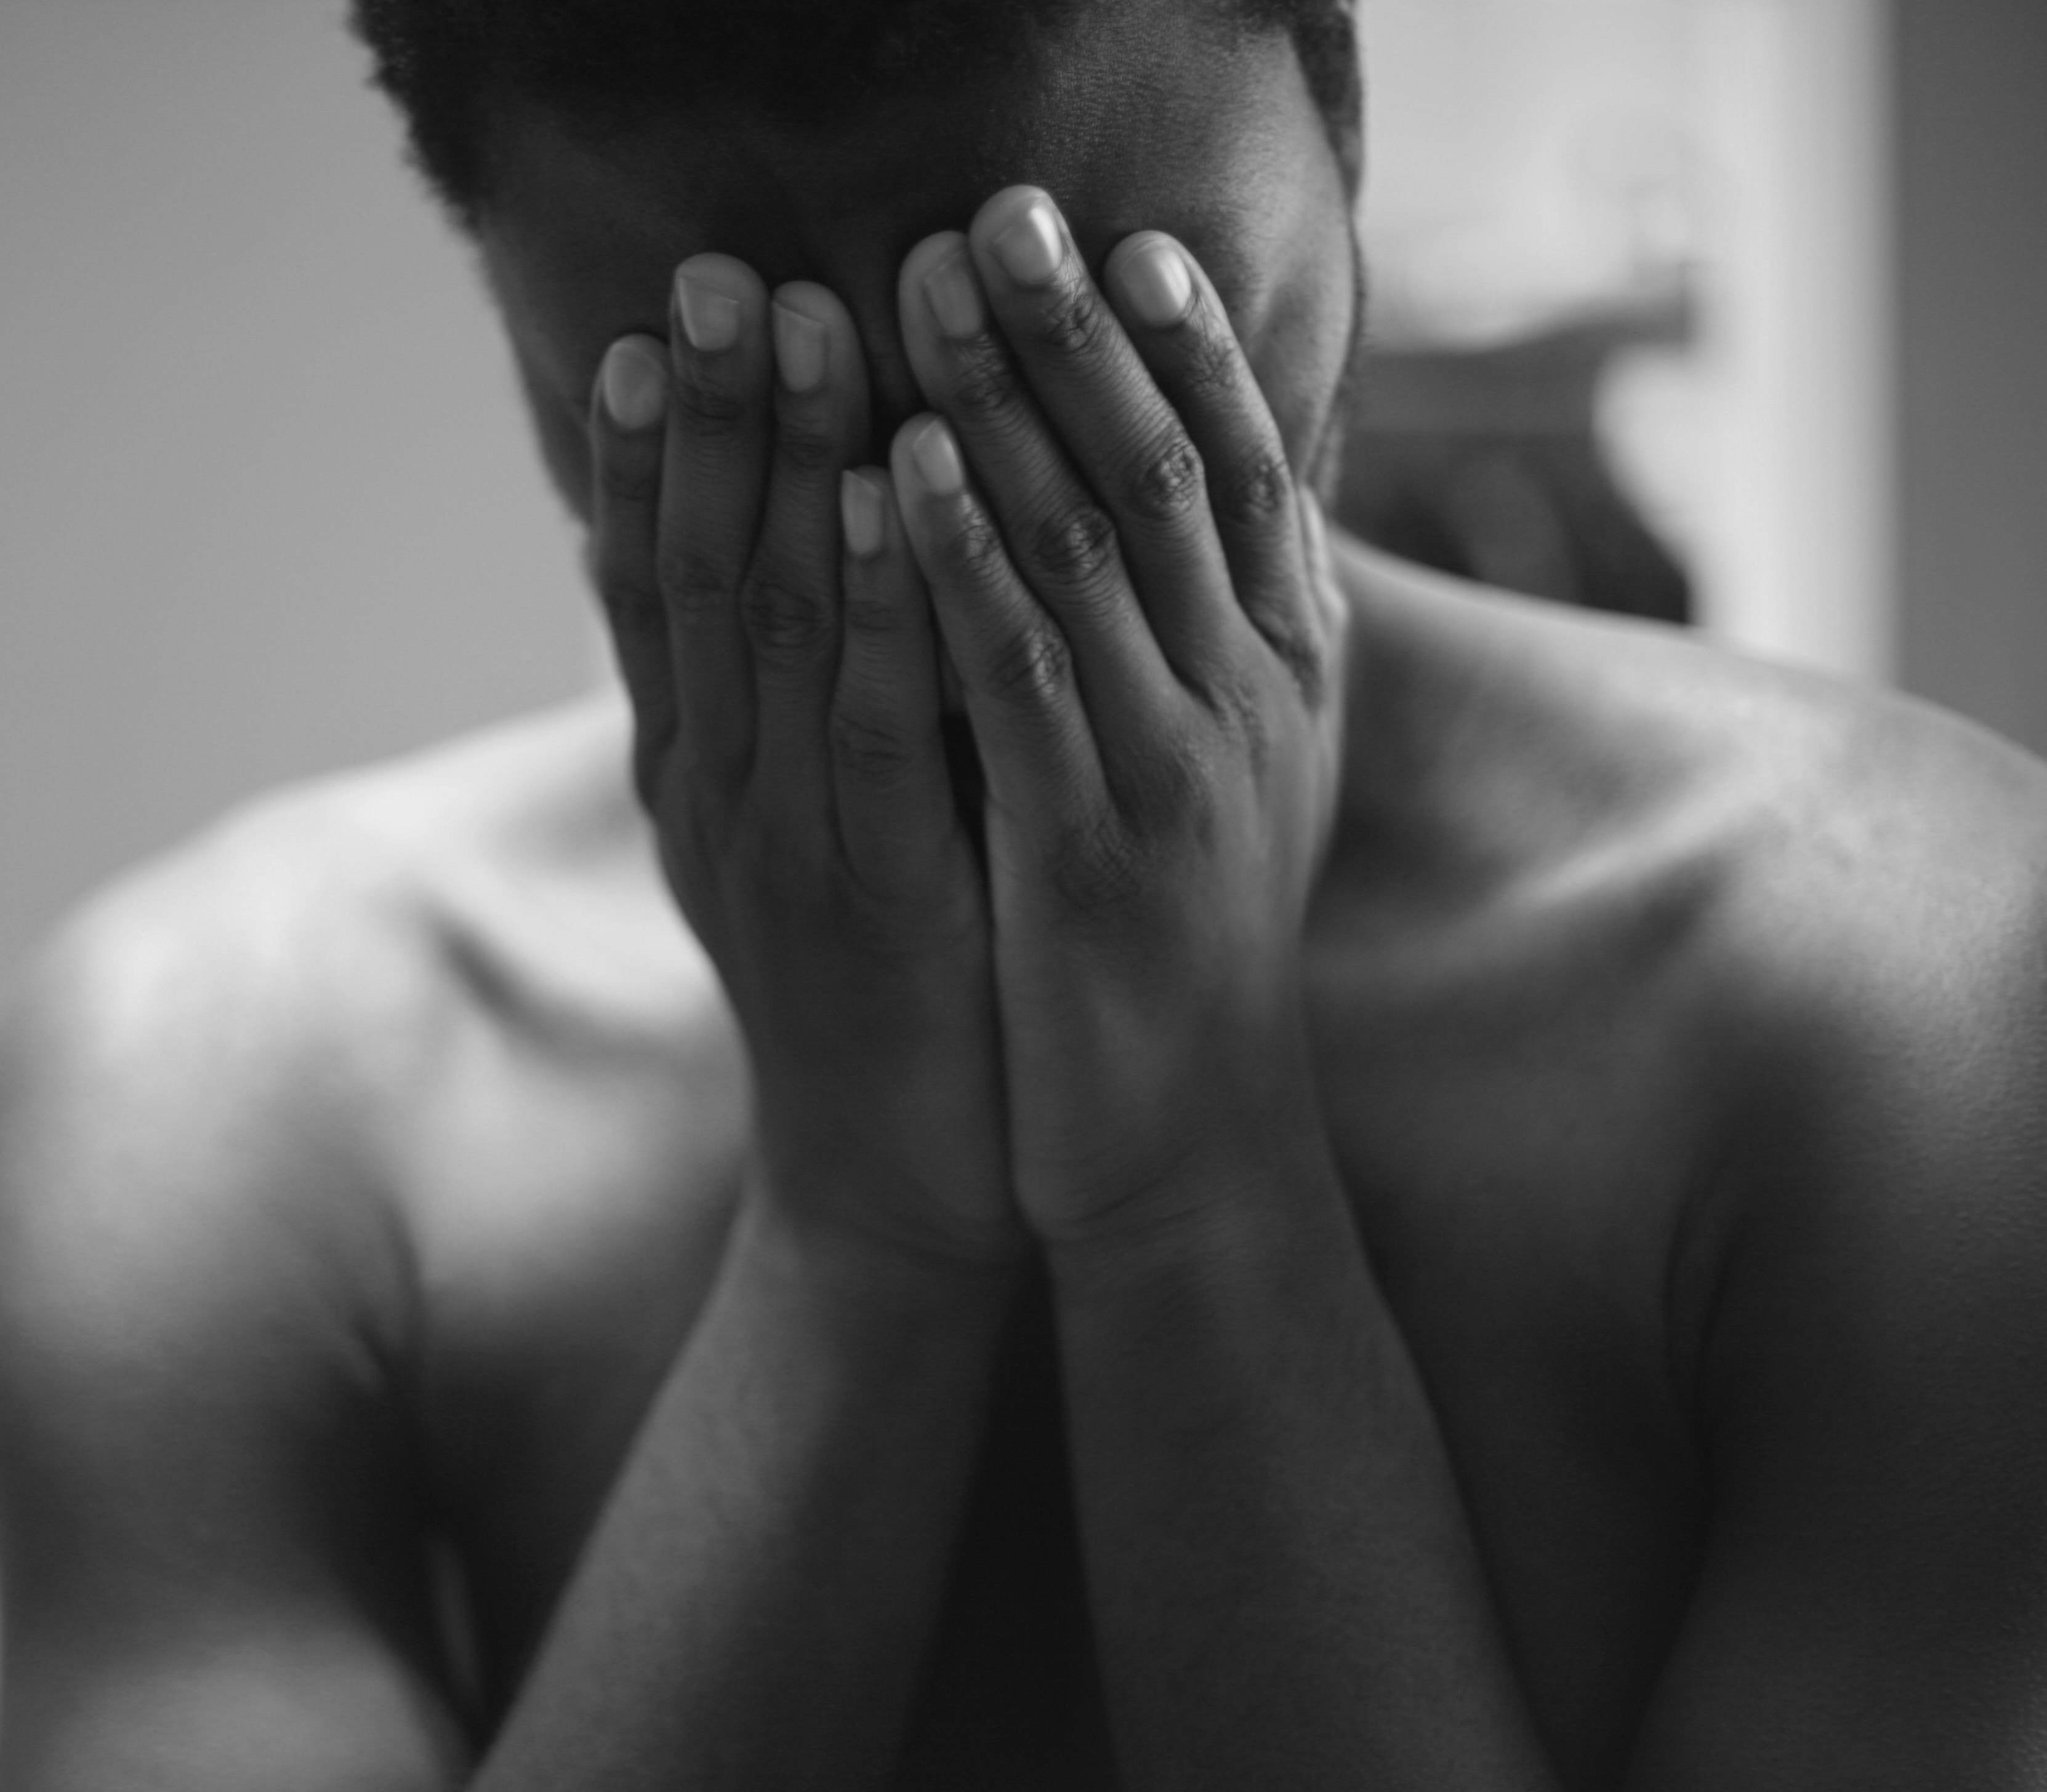
Why Don’t Men Report?
They feel embarrassed
They fear they won’t be believed
They are scared that their partner will take revenge
Men are told to fight back
They are ridiculed for “accepting” or “allowing” the abuse

Slide 25
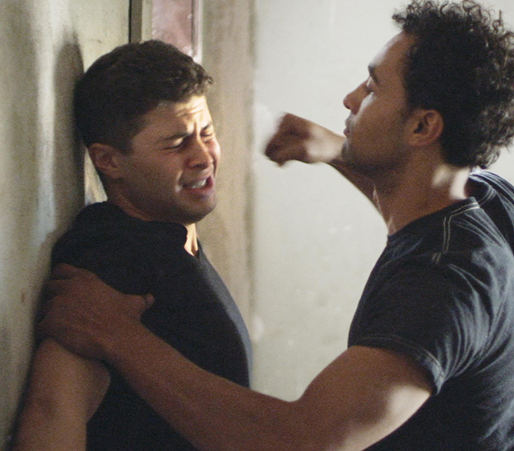
Violence in relationships that are gay or transgender
The abusive partner may:
Threaten that authorities won't help a gay or transgender person
Emphasize that leaving the relationship means admitting that gay or transgender relationships are deviant
Justify abuse by accusing one of not being truly gay or transgender
Say that men are naturally violent
Threaten to tell friends, family, colleagues, or community members about the other partner’s sexual orientation or gender identity

Slide 26
Steps to Leaving
It is difficult to leave an abusive relationship, and actually leaving will be one of the strongest things they will ever do
Start to not care for the abuser anymore
1
Disconnect emotionally from the abusive relationship.
2
Notice the effects of the abuse. Prepare to leave. Leave.
3
Return to the relationship. Leave. Return. Repeat.
Driven by need to be physically & emotionally connected again
4
Actually leave an abusive relationship
…for more than 6 months
5

Slide 27
Prevention and Response
Relationship skills strengthening
Empowerment of women
Services ensured
Poverty reduced
Enabling environments (schools, workplaces, public spaces) created
Child and adolescent abuse prevented
Transformed attitudes, beliefs and norms.

