Slide 1

MEDIA BIAS
Robert helán
Media literacy course

Slide 2
Why is media bias an important topic?
Its potential effects on society, particularly when it comes to the people making informed decisions about issues that affect them the most

Slide 3
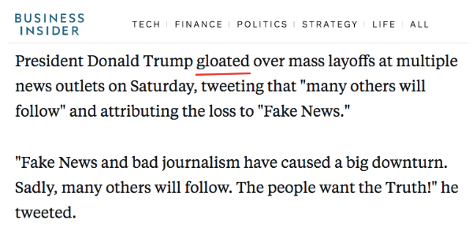
spin
THE USE OF VAGUE, DRAMATIC OR SENSATIONAL LANGUAGE
LANGUAGE IMPLYING BAD BEHAVIOUR: REFUSING TO SAY, ADMIT TO, CAME TO LIGHT
LANGUAGE SUBSTITUTING THE WORD “SAID”: MOCKED, BRAGGED, FUMED

Slide 4
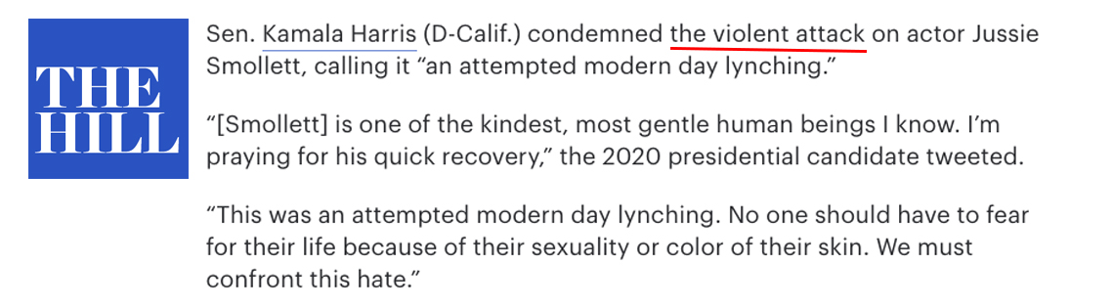
UNSUBSTANTIATED CLAIMS
REPORTING WITHOUT INCLUDING EVIDENCE
MADE UP STORIES = FAKE NEWS

Slide 5
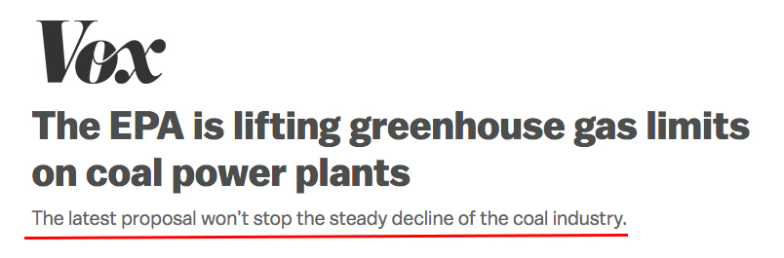
OPINION PRESENTED AS FACT
USING SUBJECTIVE LANGUAGE APPEARING OBJECTIVE
EXAMPLES OF SUBJECTIVE LANGUAGE: SUSPICIOUS, DANGEROUS, EXTREME…

Slide 6
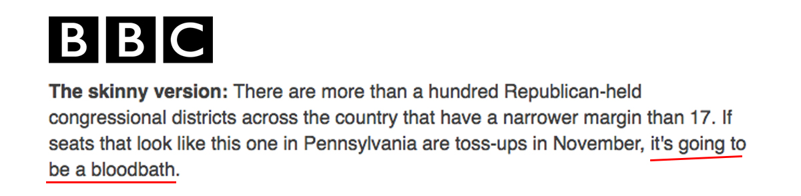
SENSATIONALISM/EMOTIONALISM
INFORMATION IS PRESENTED AS SHOCKING OR IMPRESSIVE, A SENSE OF CULMINATION
EXAMPLE: BREAKING NEWS, SHOCKING, CHAOTIC…

Slide 7
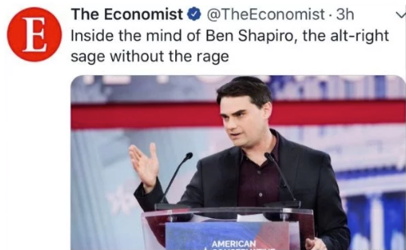
MUDSLINGING/AD HOMINEM
UNFAIR OR INSULTING THINGS THAT ARE SAID ABOUT SOMEONE TO DAMAGE THEIR REPUTATION, ATTACKING A PERSON’S CHARACTER INSTEAD OF THEIR ARGUMENT

Slide 8
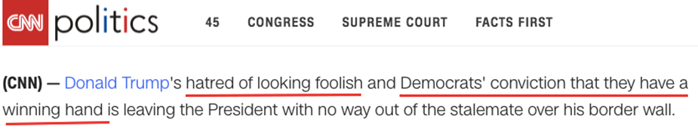
MIND READING
WRITERS ASSUMES THEY KNOW WHAT ANOTHER PERSON THINKS

Slide 9
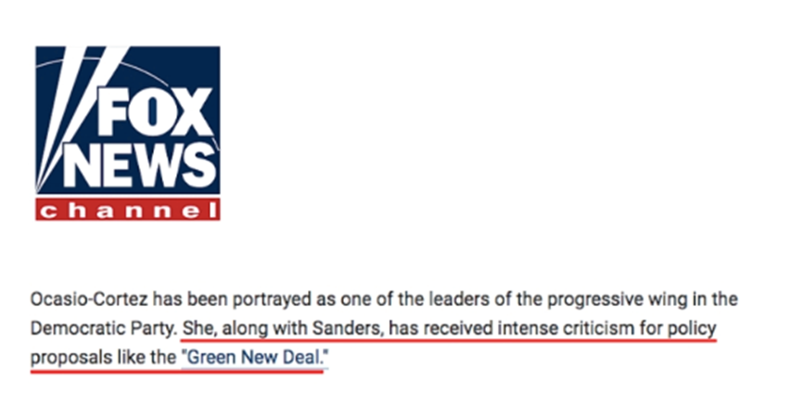
SLANT
JOURNALISTS TELL ONLY PART OF A STORY: CHERRY-PICKING INFORMATION OR DATA TO SUPPORT ONE SIDE.

Slide 10
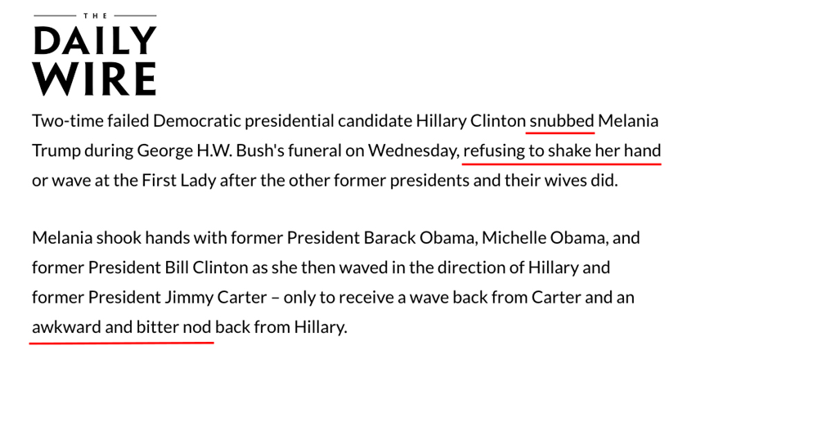
FLAWED LOGIC
ARRIVING AT CONCLUSIONS THAT ARE NOT JUSTIFIED BY THE GIVEN EVIDENCE

Slide 11
BIAS BY OMISSION
NOT COVERING CERTAIN STORIES OR OMITTING INFORMATION THAT WOULD SUPPORT AN ALTERNATIVE VIEWPOINT.
stories about Benghazi were mostly ignored by the Left, while some climate change stories have been mostly ignored by the Right

Slide 12
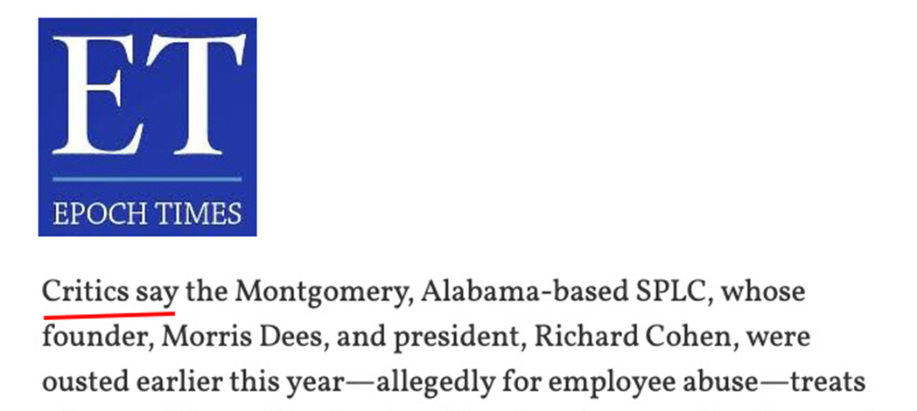
OMISSION OF SOURCE
NOT IDENTIFYING WHO THE SOURCES ARE
Examples: “immigration opponents”, “supporters of the bill”

Slide 13
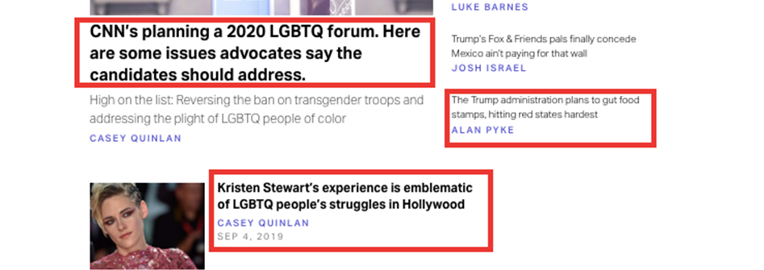
Bias by placement
Bias by story placement: featuring a story prominently
Bias by viewpoint: featuring just one perspective (left- or right- leaning)

Slide 14
Conclusion
Everyone is biased. However, media bias can become invisible.
Bias can manipulate us and blind us.
It can put important information and perspectives in the shadows and prevent us from getting the whole view.

Slide 15
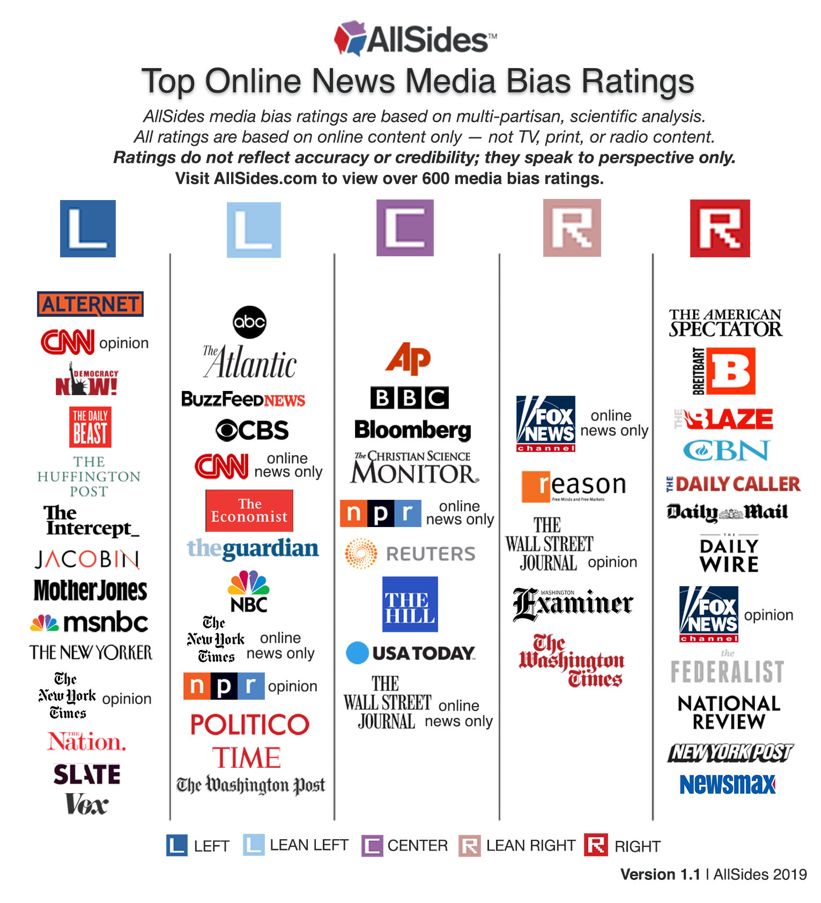

Slide 16
High quality sources
https://www.allsides.com/unbiased-balanced-news
https://fair.org/
https://mediabiasfactcheck.com/

