Slide 1
Racism

Slide 2
Race/ethnicity
Biological vs. sociological/anthropological… discourses
Essentialist vs. constructivist point of view - Race as a performative construction in certain discourse. The meaning of race categories are validated through social practices, but it is not arbitrary.
Relations of subordination between of races
Ethnicity =/≠ culture (self-understanding)
How does race/ethnicity influence your life?

Slide 3
The context of Czech Republic
National minorities in CZE – group of CZE citizens living in the Czech Republic differentiating from other in their ethnic origin, language, culture and traditions (…) they are willingly participating in labelling themselves as part of the minority due to their effort to preservation their originality, language and culture. (Czech Government)
Slovakia, Ukraine, Vietnam, Russia, … Roma minority

Slide 4
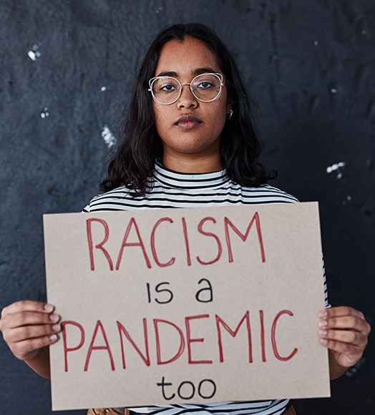
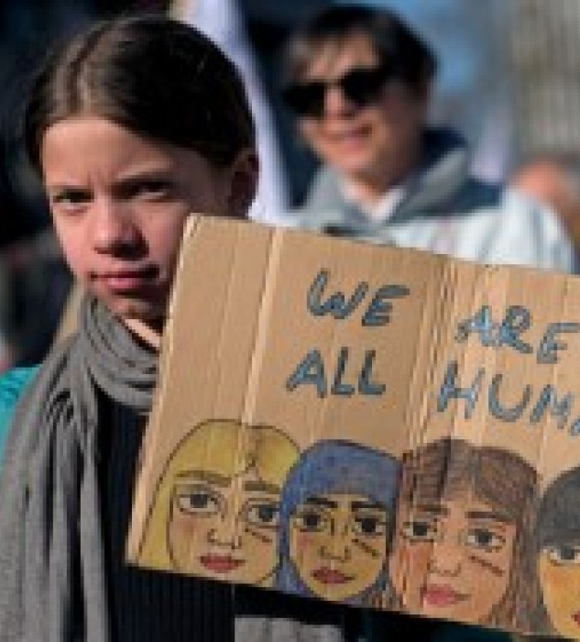
What is/are RACISM/S?

Slide 5
Common stereotypes in CZE (+ media lenses)

Slide 6
Another side: What is the problem with Bridgeton?

Slide 7
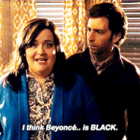
“Boundaries” of race?
SNL – “The day Beyonce turned black”

Slide 8
Activism: BLM, RLM

Slide 9
