Slide 1
International Organisations I
International Security Policy, October 2, 2023
Vendula Divišová, FSS MU, vendula.divisova@mail.muni.cz

Slide 2
Structure
International organisations and IR theory
Definitions
Types of international organisations
International security organisations (part I)
  United Nations
  NATO

Slide 3
International organisations and IR theory
Liberalism
Realism
neo-liberal institutionalism → institutions created to maximize shared interests
the role of international institutions in mitigating conflict
can change the character of the international environment by influencing state preferences and state behaviour
institutions are basically a reflection of the distribution of power in the world
based on the self-interested calculations of the great powers
established to realize and maintain domination

Slide 4
International organisations: definition
International organisations
  “organization established by a treaty or other instrument governed by international law and possessing its own international legal personality“
  promotes voluntary cooperation and coordination among its members
International regimes
  “principles, norms, rules, and decision-making procedures around which actors' expectations converge in a given area of international relations“ (S. Krasner, 1982)
  less institutionalised, narrow focus

Slide 5
Types of international organisations
Collective defence organisations [NATO, ANZUS]
  protection against a common enemy (usually a commitment to respond jointly to an external threat)
Collective security organisations [UN]
  maintaining peace and security → states will not resolve common disputes by force (or threat of force)
Cooperative security organisations [OSCE]
  efforts to reduce the risk of war and increase international security
  limiting and regulating armed force, arms control, relationship and trust building

Slide 6
United Nations: History
1920 - League of Nations
1941 - Atlantic Charter
1942 - Declaration by the United Nations
1943 - Joint Four-Nation Declaration
April 1945 - The UN Conference on International Organization
June 1945 - UN Charter adopted
October 1945 - official foundation

Slide 7
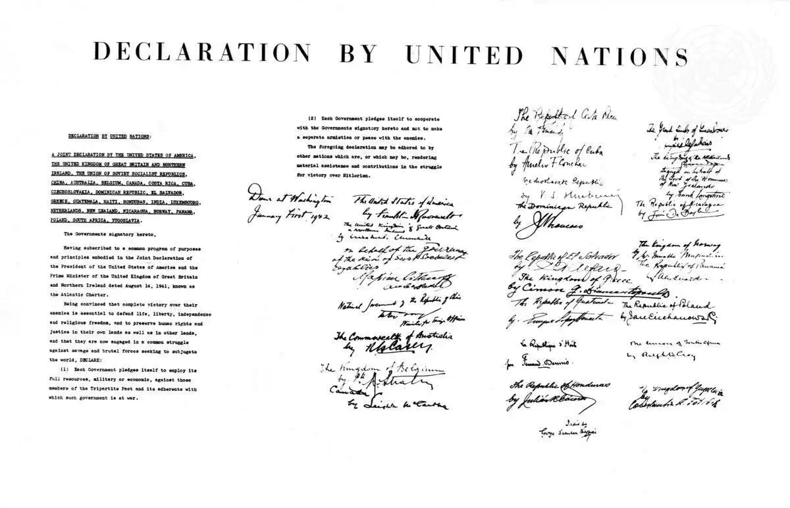
United Nations: History

Slide 8

United Nations: Key facts
founded in 1945 - 51 member states
membership: 193 member states
symbols: flag + “UN blue“ colour
founding document: UN Charter
main bodies: the General Assembly, the Security Council, the Economic and Social Council, the Trusteeship Council, the International Court of Justice, and the UN Secretariat

Slide 9
United Nations: Purpose
UN Charter - Article 1
To maintain international peace and security
To develop friendly relations among nations based on respect for the principle of equal rights and self-determination of peoples
To achieve international co-operation in solving international problems of an economic, social, cultural, or humanitarian character, and in promoting and encouraging respect for human rights and for fundamental freedoms for all
To be a centre for harmonizing the actions of nations in the attainment of these common ends

Slide 10
United Nations: Principles
UN Charter - Article 2
  The principle of the sovereign equality of all its members
  Settlement of international disputes by peaceful means
  No threat or use of force against the territorial integrity or political independence of any state
  Providing assistance to the UN in any action
  (…)

Slide 11
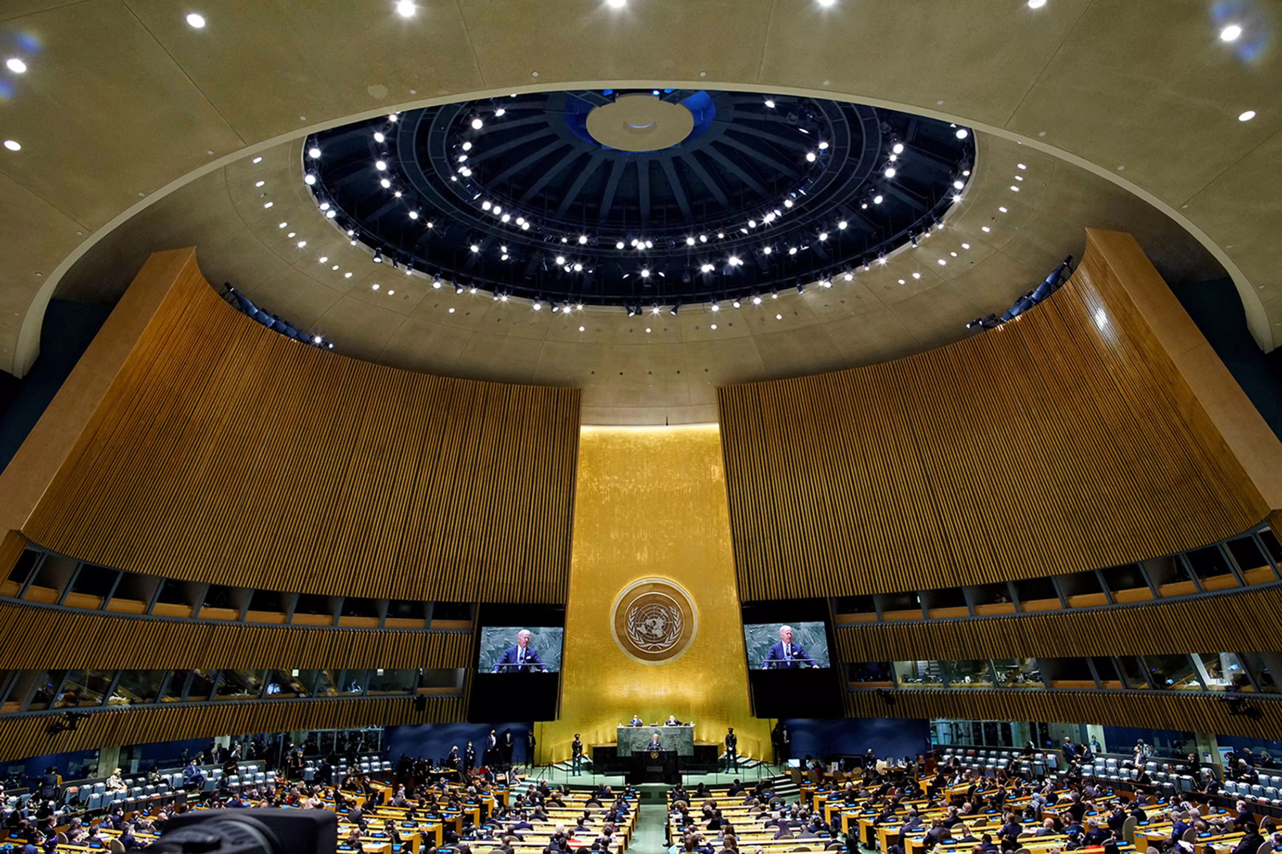
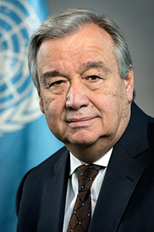
United Nations: Structure
Secretariat
Secretary-General + staff members
departments with different areas of responsibility
General Assembly
main policymaking and representative organ
purely deliberative - a forum for multilateral discussion
universal representations - equal vote
appoints Secretary-General, elects non-permanent members of the SC (2/3 majority)

Slide 12
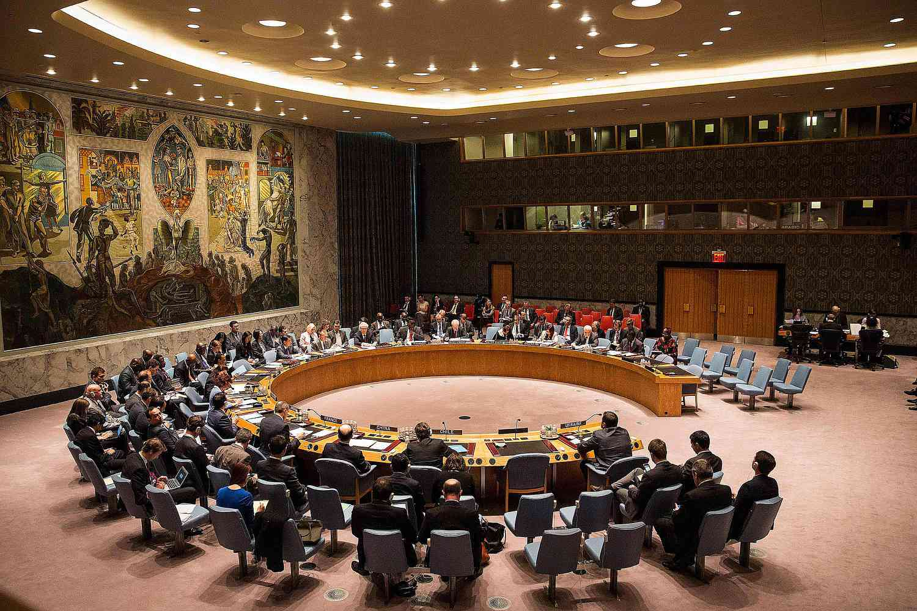
United Nations: Structure
Security Council
5 permanent + 10 non-permanent members (2-year term),
each member = 1 vote
decisions - vote of 9 members, including permanent members
primary responsibility - maintenance of international peace and
security (Chapters VI, VII)
may establish subsidiary bodies (Counter-Terrorism Committee, Non-Proliferation Committee, Military Staff Committee, Sanctions Committee…)

Slide 13
United Nations: International Peace and Security
Chapter VI: Pacific Settlement of Disputes
parties to any dispute - shall seek a solution by peaceful means
SC can call upon the parties to settle the dispute by peaceful means
SC investigates a dispute → to determine a risk to international peace and security
Chapter VII: Action with Respect to Threats to the Peace, Breaches of the Peace, and Acts of Aggression
SC determines the existence of threat to peace / breach of the peace / act of aggression
SC decides on the use of non-military measures
SC can take military action to maintain or restore international peace and security
undertake to make available to SC armed forces, assistance, and facilities

Slide 14
UN Charter, Article 51
“Nothing in the present Charter shall impair the inherent right of individual or collective self-defence if an armed attack occurs against a Member of the United Nations, until the Security Council has taken measures necessary to maintain international peace and security. Measures taken by Members in the exercise of this right of self-defence shall be immediately reported to the Security Council and shall not in any way affect the authority and responsibility of the Security Council under the present Charter to take at any time such action as it deems necessary in order to maintain or restore international peace and security.“

Slide 15
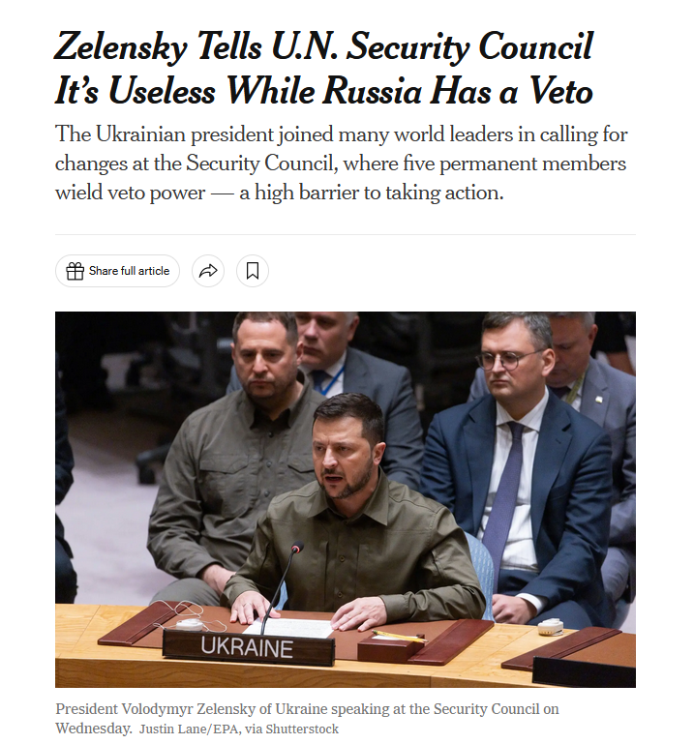
VIDEO

Slide 16

United Nations: Structure
Economic and Social Council - principal body for economic, social and environmental issues (54 members)
Trusteeship Council - international supervision for 11 Trust Territories
International Court of Justice - (1) settlement of legal disputes among states, (2) advisory role on legal questions (15 judges)
International Courts and Tribunals
  International Criminal Tribunal for the former Yugoslavia (ICTY, 1993)
  International Criminal Tribunal for Rwanda (ICTR, 1994)

Slide 17
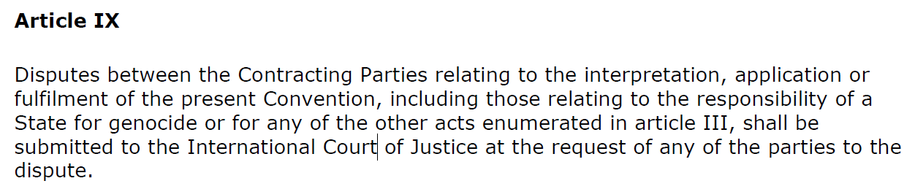
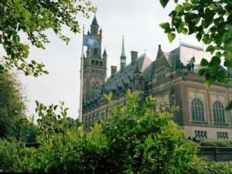
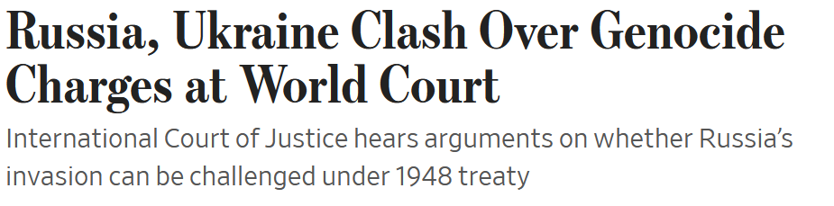
Convention on the Prevention and Punishment of the Crime of Genocide
ICJ cases

Slide 18
United Nations: Activities
Core tasks
maintenance of international peace and security [Preventive diplomacy and mediation, Peacekeeping, Peacebuilding, Disarmament, Countering Terrorism]
human rights protection [Universal Declaration of Human Rights/UDHR]
sustainable development (SDG) and climate action
humanitarian aid delivery
upholding int. law [ICJ, Courts and Tribunals]
Specific issues:
hate speech, rule of law, refugees and migrants, children and armed conflict, violence against children, sexual violence in conflict, countering disinformation…
Ad hoc activities and initiatives
(Black Sea Grain Initiative… )

Slide 19
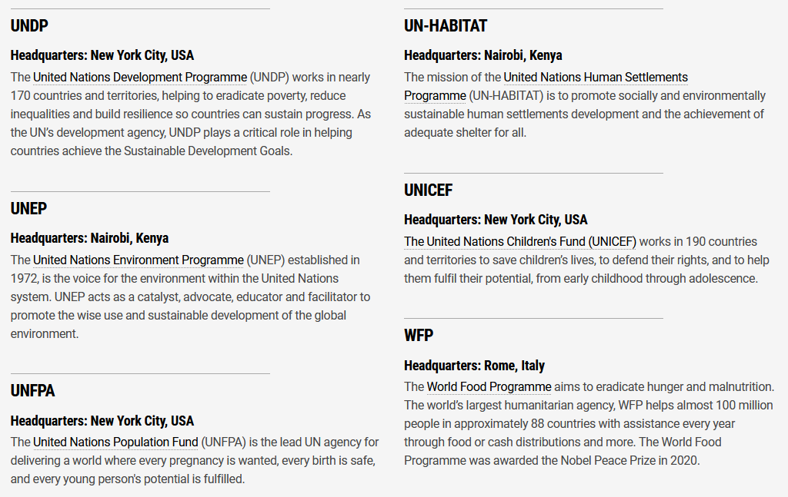
United Nations: Funds and programmes

Slide 20
United Nations: Specialised agencies
Food and Agriculture Organization of the United Nations
International Atomic Energy Agency
International Criminal Court
International Fund for Agricultural Development
International Labour Organization
International Monetary Fund
International Organization for Migration
International Seabed Authority
International Telecommunication Union
International Tribunal for the Law of the Sea
Preparatory Commission for the Compre-hensive Nuclear Test-Ban Treaty Organization
United Nations Educational, Scientific and Cultural Organization
United Nations Industrial Development Organization
World Bank
World Health Organization
World Intellectual Property Organization
World Meteorological Organization
https://www.un.org/en/about-us/specialized-agencies

Slide 21
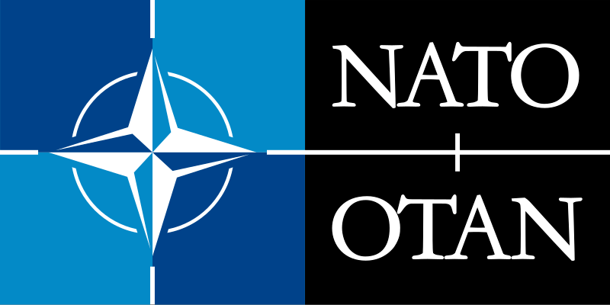
NATO: Key facts
political and military alliance - established in 1949 (April 4)
- based on the Western European Alliance (UK, France, Belgium, Netherlands, Luxembourg) + US, Canada, Denmark, Iceland, Italy, Norway, Portugal
founding document: North Atlantic Treaty (signed in Washington DC)
principle: a collective defence organization (Art. 5 of the Washington Treaty)
31 members + security partners in around 40 countries
2 official languages (English + French)
France left the NATO military command in 1966, rejoined in 2009
one member does not have a standing army (Iceland)

Slide 22
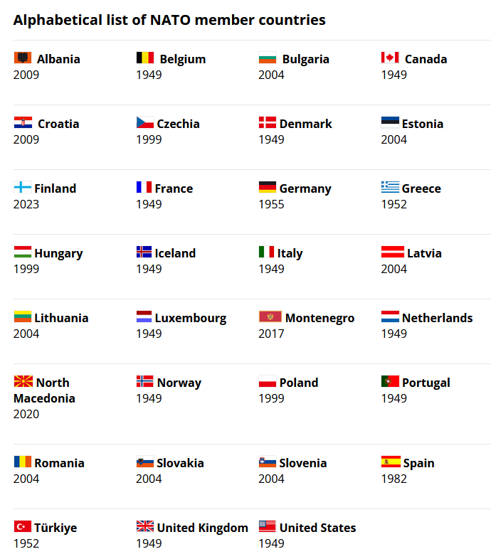
NATO: Membership
31 member countries

Slide 23
NATO Enlargement
a functioning democratic political system based on a market economy
the fair treatment of minority populations
a commitment to the peaceful resolution of conflicts
the ability and willingness to make a military contribution to NATO operations
a commitment to democratic civil-military relations and institutional structures
Art. 10 - "open door policy"
1995 Study on Enlargement - requirements to be fulfiled by potential members
How does a country join NATO?
  Accession talks with a NATO team
  Invitees send letters of intent to NATO (timetables for completion of reforms)
  Accession protocols are signed by NATO countries
  Accession protocols are ratified by NATO countries
  The Secretary General invites them to accede to the North Atlantic Treaty
  Invitees accede to the North Atlantic Treaty (national procedures)
  Deposition of their instruments of accession with the US State Department VIDEO

Slide 24
NATO: Purpose
Safeguard the freedom and security of all its members by political and military means (collective defence)
Secure a lasting peace in Europe, based on common values of individual liberty, democracy, human rights and the rule of law
Contribute to peace and stability through crisis prevention and management, partnerships

Slide 25
NATO: Washington Treaty
Article 5 and Collective defence
  The Parties agree that an armed attack against one or more of them in Europe or North America shall be considered an attack against them all and consequently they agree that, if such an armed attack occurs, each of them, in exercise of the right of individual or collective self-defence recognised by Article 51 of the Charter of the United Nations, will assist the Party or Parties so attacked by taking forthwith, individually and in concert with the other Parties, such action as it deems necessary, including the use of armed force, to restore and maintain the security of the North Atlantic area.
invoked only once after the 9/11 terrorist attacks

Slide 26
NATO: Washington Treaty
Article 3 - Resilience
  In order more effectively to achieve the objectives of this Treaty, the Parties, separately and jointly, by means of continuous and effective self-help and mutual aid, will maintain and develop their individual and collective capacity to resist armed attack.
Article 4 - Consultation
  The Parties will consult together whenever, in the opinion of any of them, the territorial integrity, political independence or security of any of the Parties is threatened.

Slide 27
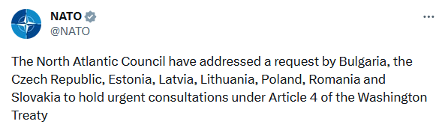
NATO: Decison-making process and consultations
Article 4 of the Washington Treaty
  any member can bring any issue of concern for discussion within the NAC by invoking Art. 4
  invoked 7 times (last time - February 24, 2022)
principle of consensus decision-making
  all decisions are made by consensus after consultation and discussion
  applied at every committee level
  SecGen faciliates the process

Slide 28
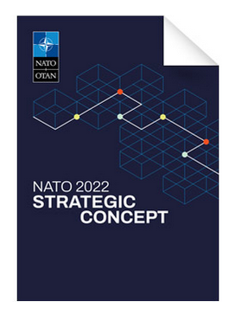
NATO: Core tasks
enshrined in Strategic Concept (2022)
Deterrence and defence
Crisis prevention and management
Cooperative security
Resilience - enshrined in Art. 3
both civili preparedness + military capacity
7 baseline requirements for national resilience
assured continuity of government and critical government services
resilient energy supplies
ability to deal effectively with uncontrolled movement of people
resilient food and water resources
ability to deal with mass casualties
resilient civil communications systems
resilient civil transportation systems

Slide 29
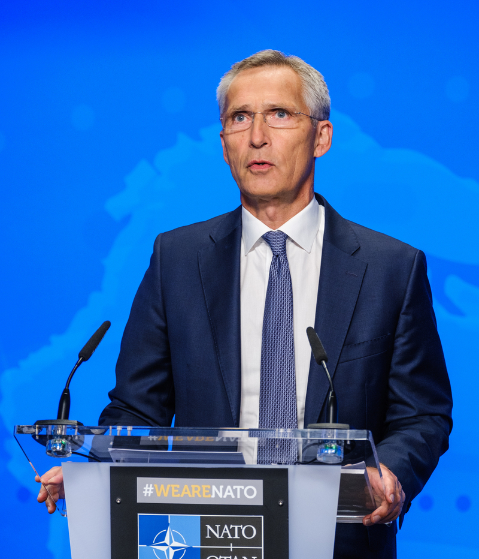
NATO: Structure
North Atlantic Council (the Council / NAC)
principal political decision-making body within NATO
oversees a wide network of committees and working groups
member states represented at different levels (Permanent Representatives, foreign or defence ministers, heads of state and government)
Secretary General
chairs the NAC + all major committees; head of IS; principal spokesperson
facilitates consultations and decision-making and implementation of decisions

Slide 30
NATO: Structure
Nuclear Planning Group (NPG)
senior body on nuclear matters in the Alliance
reviews the NATO nuclear policy
discusses specific policy issues (nuclear arms control and nuclear proliferation)
all Allies members of the NPG, except for France
NATO Organization - overview
Organizations and agencies - see the list here

Slide 31
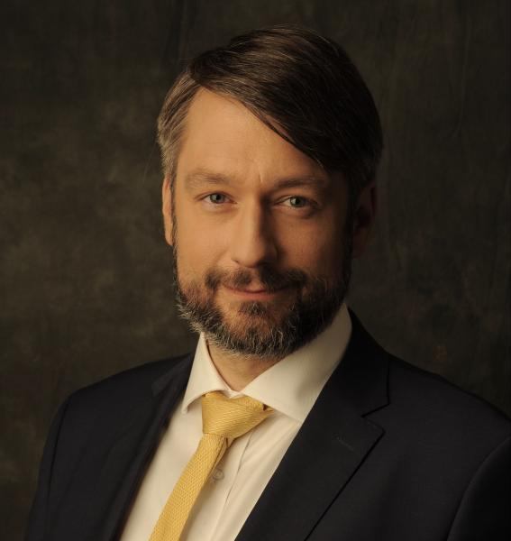
NATO: Civilian structure
NATO Headquarters (Brussels)
home to NAC, national delegations, offices/missions of partner countries = a venue for dialogue and cooperation
National delegations to NATO
represent member states, contribute to the consultation process
each headed by an ambassador/permanent representative
International Staff
supports the NAC and national delegations at NATO HQ, helps implement
decisions
headed by the NATO SecGen
includes the Office of the SecGen, 8 divisions, independent offices

Slide 32
NATO: Military structure
Military Committee (MC) - the senior military authority in NATO
composed of the Chiefs of Defence of member countries / military representatives (Milrep) of the Chiefs of Defence; headed by its Chair
provides the NAC and the NPG with consensus-based military advice
provides the Strategic Commanders with guidance (mil matters)
International Military Staff
executive body of the MC and the mil. command structure, several divisions and offices
provides strategic and military advice for the MC, ensures decisions/policies‘ implementation

Slide 33
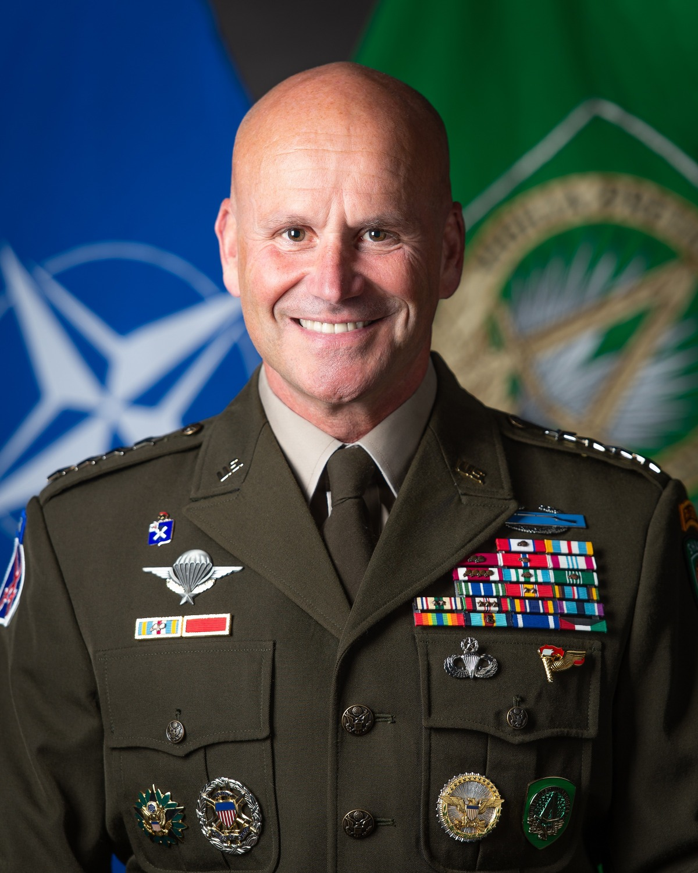
NATO: Structure
NATO Command Structure (NCS) - composed of ACO and ACT
(= 2 strategic commands)
A. Allied Command Operations (ACO)
planning and execution of Alliance operations, consists of several permanent HQs - strategic, operational and tactical levels
Strategic: Supreme Headquarters Allied Powers Europe (SHAPE) - headed by SACEUR (Supreme Allied Commander Europe)
Operational: Joint Force Commands (JFCs) in Brunssum, Naples and Norfolk
Tactical: Single Service Commands (SSCs) - Izmir (Land), Northwood (Maritime) and Ramstein (Air)

Slide 34

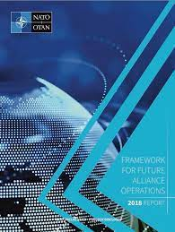
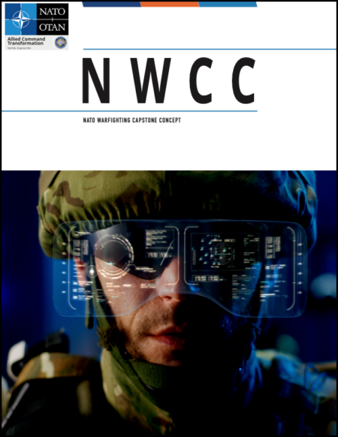
NATO: Structure
B. Allied Command Transformation (ACT, Norfolk)
leads the military adaptation of the Alliance (developing concepts, analysing security environment, defence planning, educating and training… )
headed by the Supreme Allied Commander Transformation (SACT)
Norfolk HQ + 3 subordinate entities: Joint Warfare Centre, the Joint Force Training Centre and the Joint Analysis & Lessons Learned Centre
educational and training facilities
Centres of Excellence and Partner Training and Education Centres

