Slide 1
Strengthening European defense cooperation
THE EUROPEAN DEFENCE AGENCY (EDA)
Elisa Antei, 545553
21.11.2023
International Security Policy
Masaryk University, Brno

Slide 2
OUTLINE
History and Background
Mission and Objectives
Membership
Organigram
Achievements and Initiatives
Challenges and Future Prospects
Q&A (2 + ?)
Conclusions

Slide 3
HISTORY AND BACKGROUND
- Emerging idea of a European Defence Agency (EDA) in the early 2000s
- Treaty of Nice (2001): laying the groundwork for the establishment of EDA -> Need for improved defense capabilities and increased cooperation among EU MS
- Establishment of EDA (2004). LEGAL BASIS: creation formalized by a Joint Action of the Council of the EU, reflecting the political will of MS to collaborate more closely in the defense domain
- Founding Principles: collective defense, mutual assistance, and shared security

Slide 4
EDA’S MISSIONS AND OBJECTIVES
Joint Action replaced by a Council Decision of 2011, revised by Council Decision 2015/1835 on the statute, seat, and operational rules of EDA:
Three main missions:
Supporting the development of defence capabilities and military cooperation among the European Union Member States;
Stimulating defence Research and Technology (R &T) and strengthening the European defence industry;
Acting as a military interface to EU policies.
EDA as a catalyst, promotes collaborations, launches new initiatives, and introduces solutions to improve defense capabilities.

Slide 5
MEMBERSHIP
Initially, membership limited to 15 states (2004):
Finland
Sweden
United Kingdom
France
Belgium
Luxembourg
The Netherlands
Austria
Germany
Greece
Italy
Portugal
Spain
Slovenia
Czech Republic
Membership growth (Evolution + Expansion):
Over the years, EDA witnessed significant growth in its membership.
At these days, EDA supports its 27 Member States – all EU countries.

Slide 6
ORGANIGRAM
The EDA has a unique structure that brings together each aspect of the defense process.
Led by Jiří Šedivý, EDA Chief Executive, and Deputy Chief Executive André Erich Denk under the authority of Josep Borrell, the High Representative of the Union for Foreign Affaires and Security Policy, the Agency’s organisational structure comprises of three operational directorates :
Industry, Synergies & Enablers Directorate (ISE)
supports a range of activities critical to collaborative defence capability development in Europe.
Capability, Armament & Planning Directorate (CAP)
supports the coherent development of the European defence landscape by integrating EDA’s involvement in the Capability Development Plan (CDP), the Coordinated Annual Review on Defence (CARD) and the Permanent Structured Cooperation (PESCO).
Research, Technology & Innovation Directorate (RTI)
promotes and supports defence research at EU level. Based on the Overarching Strategic Research Agenda (OSRA), developed together with the Member States, the Directorate coordinates and plans

Slide 8
ACHIEVEMENTS & INITIATIVES
- Pooling and sharing initiatives
- Defence Innovation Prize
- providing expertise in supporting Common Security Defence Policy (CSDP) missions
- Cooperation with non-Euc ountries for a broader defense collaboration (Engagement Beyond EU Borders)
The Eda is busy across a great many programmes and projects. Some of the recent include:
Helicopter Training Programme
European Satellite Communication (SATCOM) Procurement Cell (ESCPC)
Maritime Surveillance Networking (MARSUR)
Airworthiness
Effective Procurement Methods
Counter- Improvised Explosive Devices (IED) Theatre Exploitation Laboratory
A pratical contribution of EDA regarding airworthiness:
About military airworthiness, European armonization can only be achieved at an individual programme level;
Delays and additional costs;
Deliver a strategy striving to armonise the airworthiness requirements

Slide 9
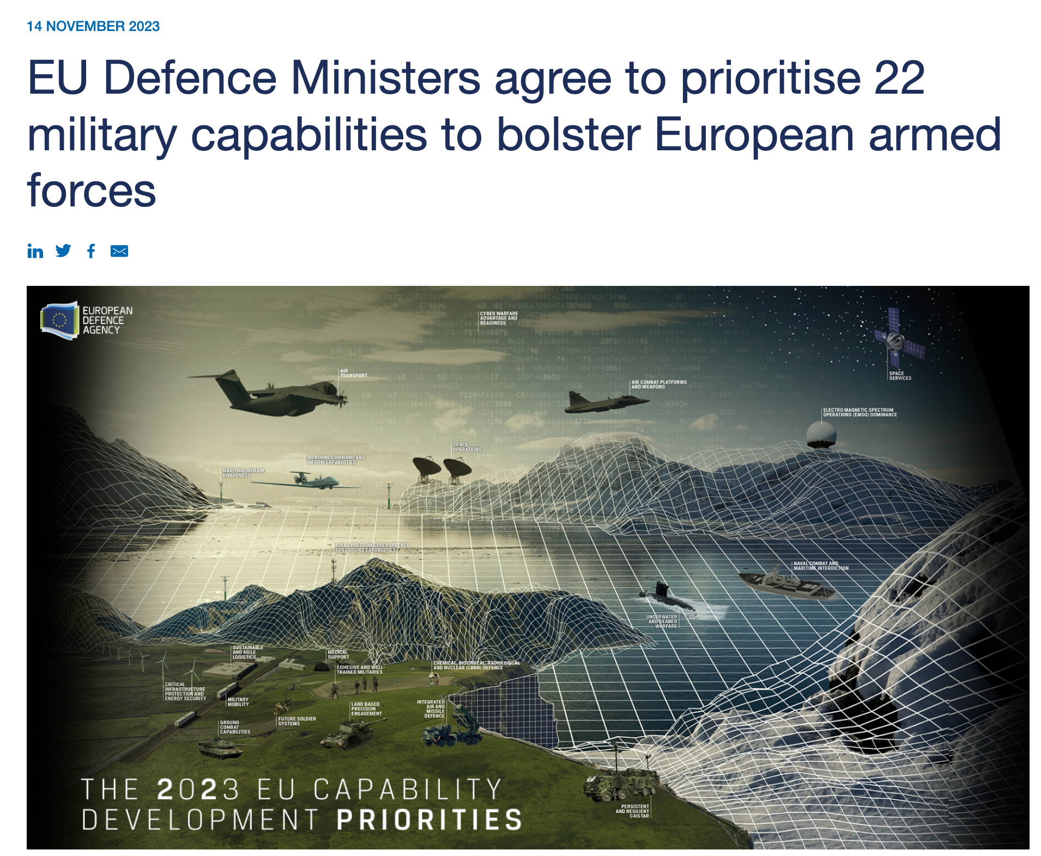
CURRENT CHALLENGES & FUTURE PROSPECTS
Underinvestment and insufficient European cooperation -> substantial defence capability gaps;
The 22 prioritises address the need for full-spectrum defence capabilities;
Over the last 18 monts, EU MS worked with EDA and EU Military Staff to assess the military capability requirements;
EDA will steer collaborative activities aimed at implementing priorities to strenthen the EU’s capabilities
https://www.youtube.com/watch?v=FId3AGo7eJs

Slide 10
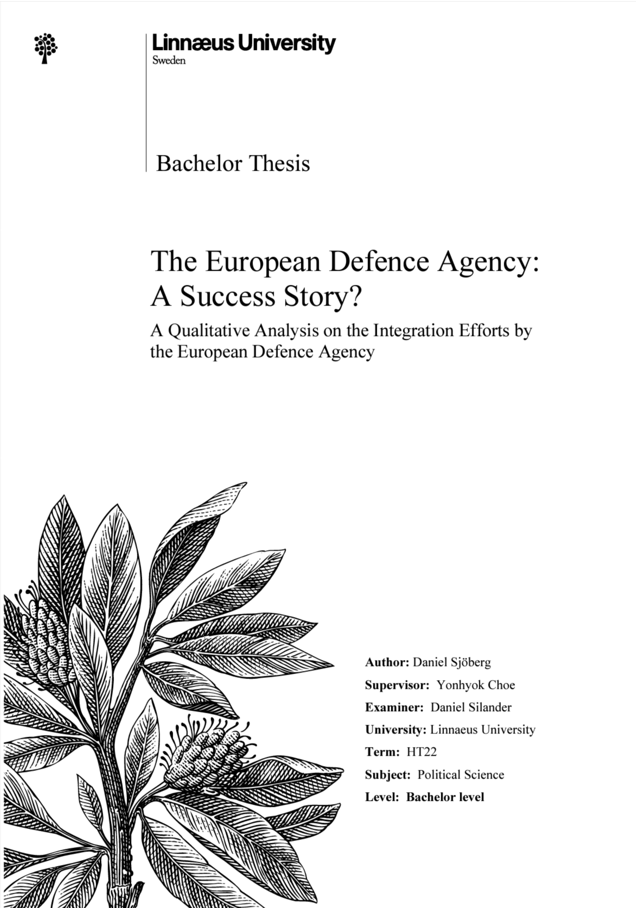
Q&A
Is NATO enough for defense or is the European Defence Agency necessary?
NATO and the EDA serve different yet complementary roles in the realm of the European defense. While NATO is a military alliance aimed at providing security and defense for its members (primarily against external threats), the European Defence Agency (EDA) is an agency aimed at defense collaboration within the EU, complementing NATO’s efforts. Therefore, NATO and the EDA can complement each other, both playing important roles in European defense.
2. The European Defence Agency (EDA): A Success Story?
The result of a study was that integration has come a long way within the EDA, as the Member States are cooperating within EDA through its many collaborative projects and intiatives (efaidnbmnnnibpcajpcglclefindmkaj/https://www.diva-portal.org/smash/get/diva2:1731816/FULLTEXT02)

Slide 11
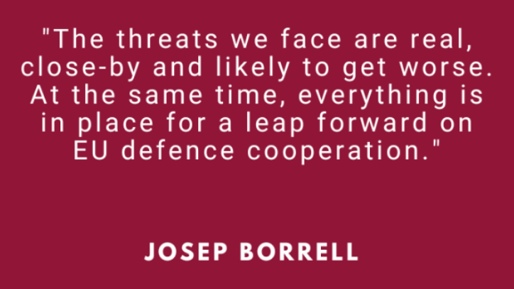
CONCLUSIONS
- Reiterating the importance of the EDA’s role in fostering cooperation, enhancing capabilities, and contributing to a more secure and united Europe;
- The EDA is more than just words (!): it is an organization actively engaged in various initiatives and projects, involving policy discussions and coordination.

Slide 12
REFERENCES
Council of the EU, https://www.consilium.europa.eu/en/meetings/fac/2023/11/14/
European Defence Agency (EDA), https://eda.europa.eu/our-history/our-history.html
chrome-extension://efaidnbmnnnibpcajpcglclefindmkaj/https://www.amo.cz/wp-content/uploads/2015/11/The-European-Defence-Agency.pdf
EU Official Website, https://european-union.europa.eu/institutions-law-budget/institutions-and-bodies/search-all-eu-institutions-and-bodies/european-defence-agency-eda_en
chrome-extension://efaidnbmnnnibpcajpcglclefindmkaj/https://www.diva-portal.org/smash/get/diva2:1731816/FULLTEXT02

Slide 13
Thank you so much for your attention!

