Slide 1
Cybersecurity
Part 2: Non-state actors
Jakub Drmola

Slide 2
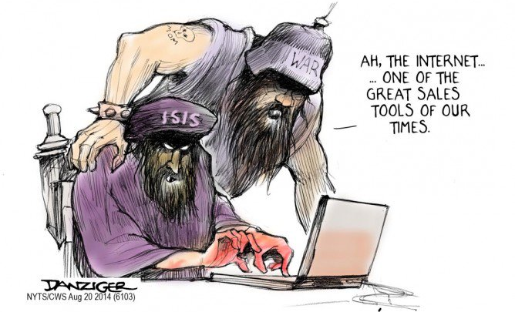
Cybeterrorism

Slide 3
What is terrorism?
extortion?
using threats and fear to get stuff?
logic of terrorism

Slide 4
victims
violence
fear
demands
attackers
audience

Slide 5
Typical features
violence, damage, fear
goal and representation
publicity
repeatability, campaign
symbolism, spectacle

Slide 6
Challenges
poor understanding among media and politicians
getting better only very slowly
rare overlap of politics and IT

Slide 7
Cyberterrorism is…
massive differences of opinion:
  “terrorists on the internet”
  recruitment, guides, propaganda, communication, planning
  physical attacks on data infrastructure
  defined by:
    preparation/means/target?

Slide 8
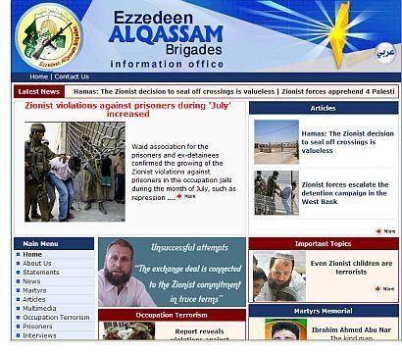

Slide 9
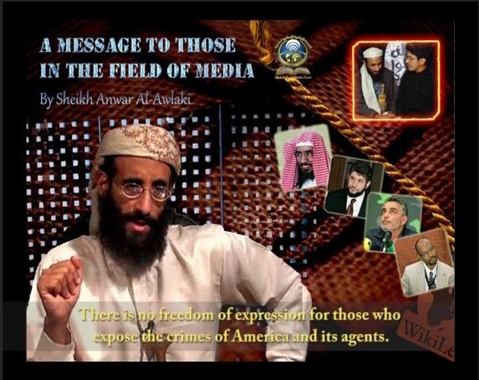

Slide 10
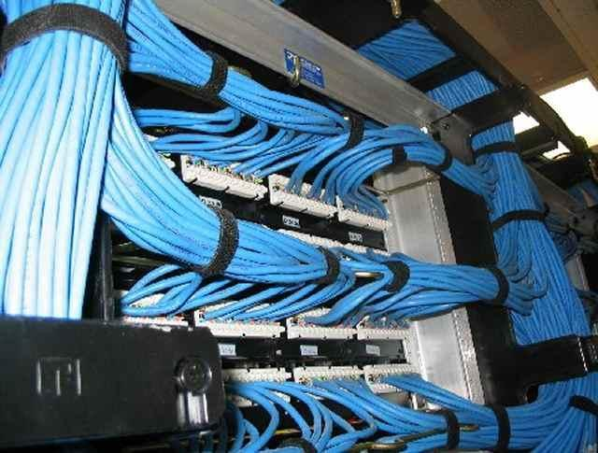

Slide 11
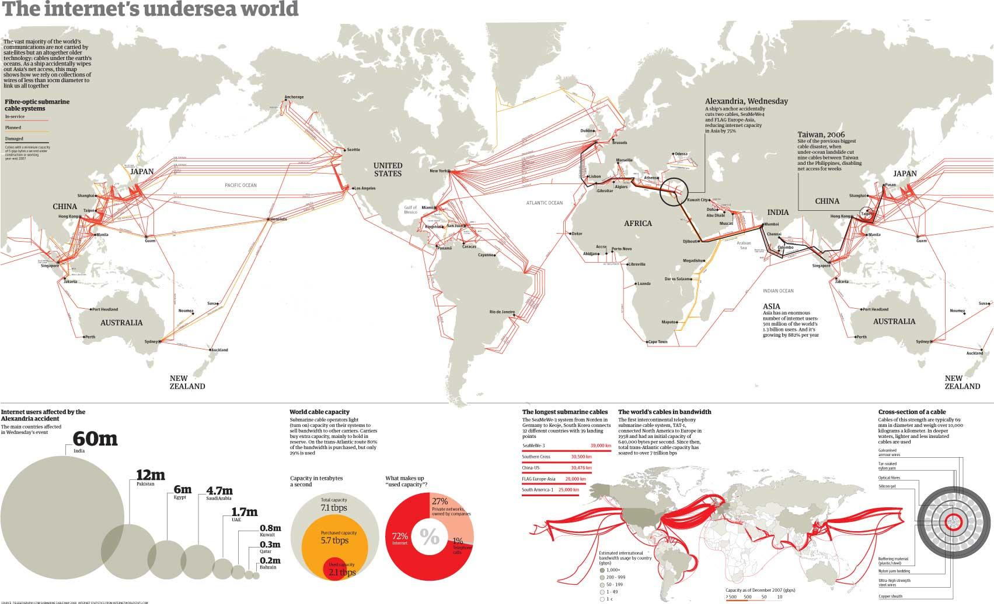

Slide 12
History
first ideas towards the end of the Cold War
quick growth in 90s (+ Y2K)
explosion (figurative) after 9/11

Slide 13
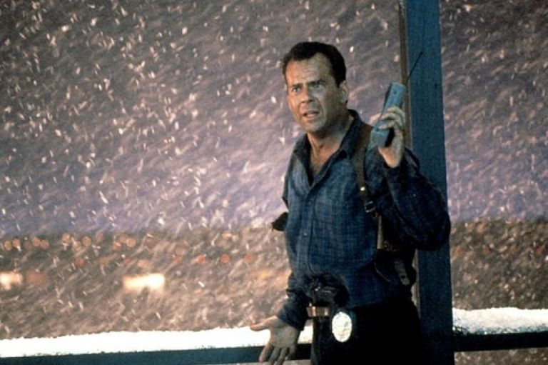

Slide 14


Slide 15
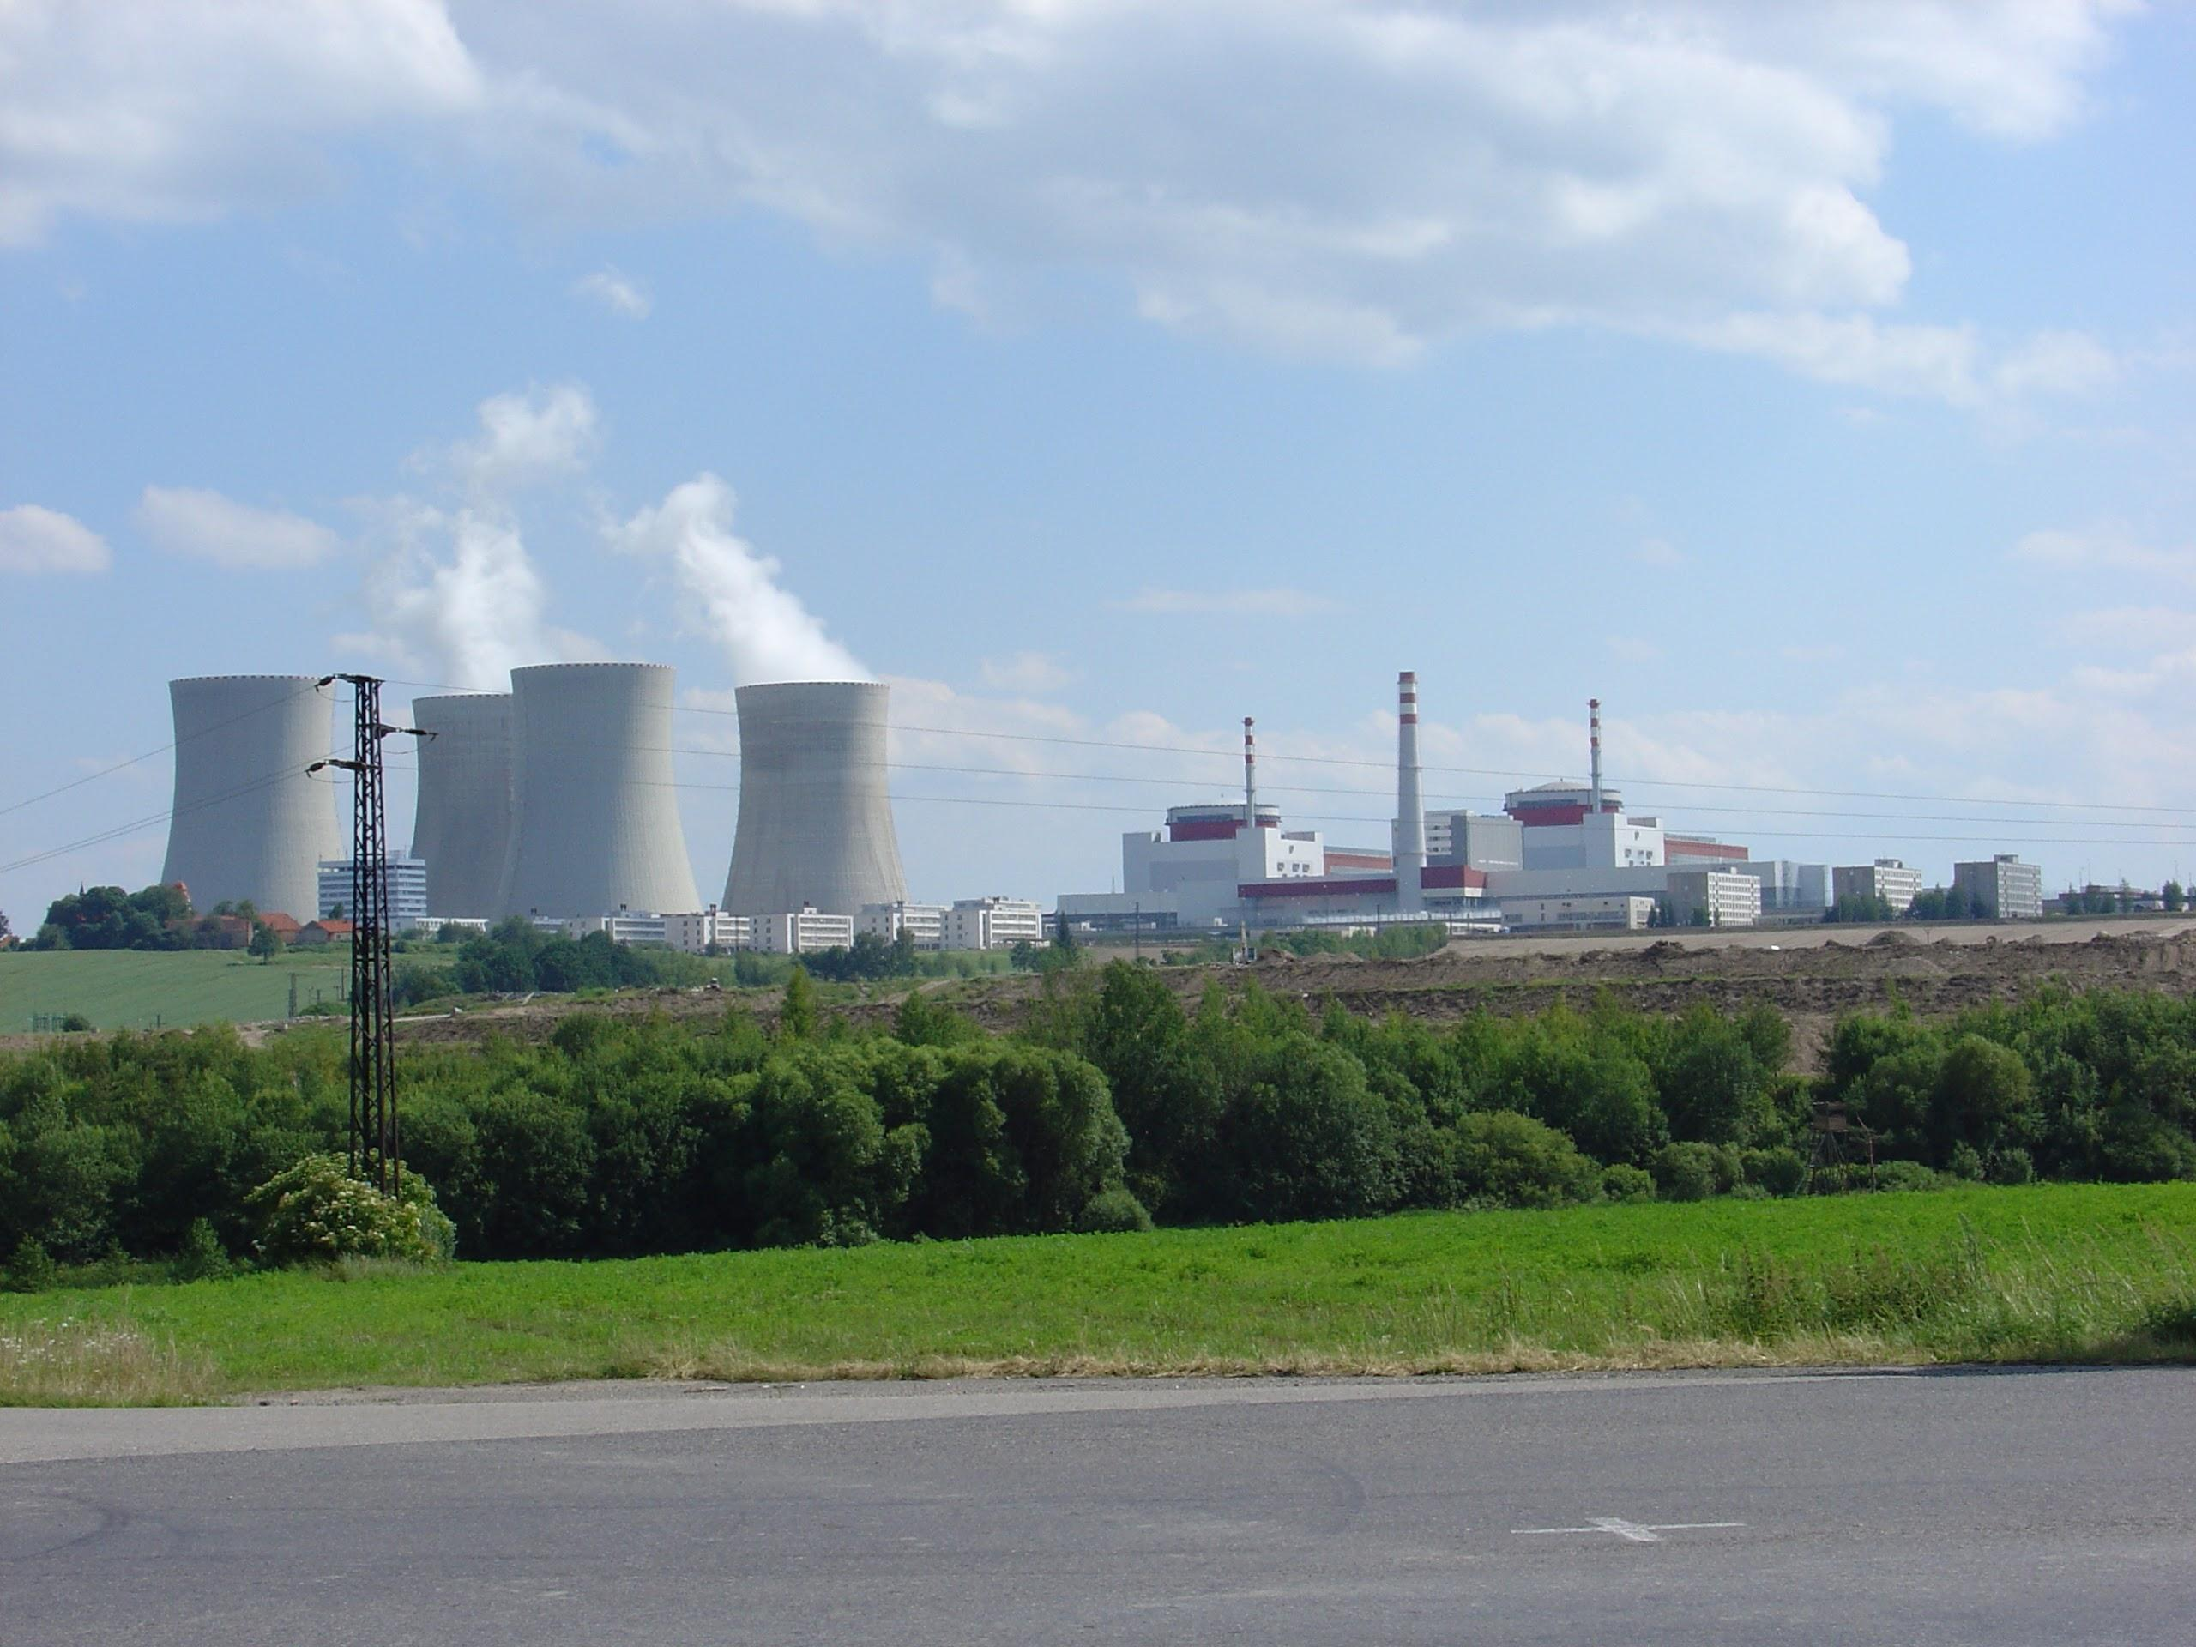

Slide 16
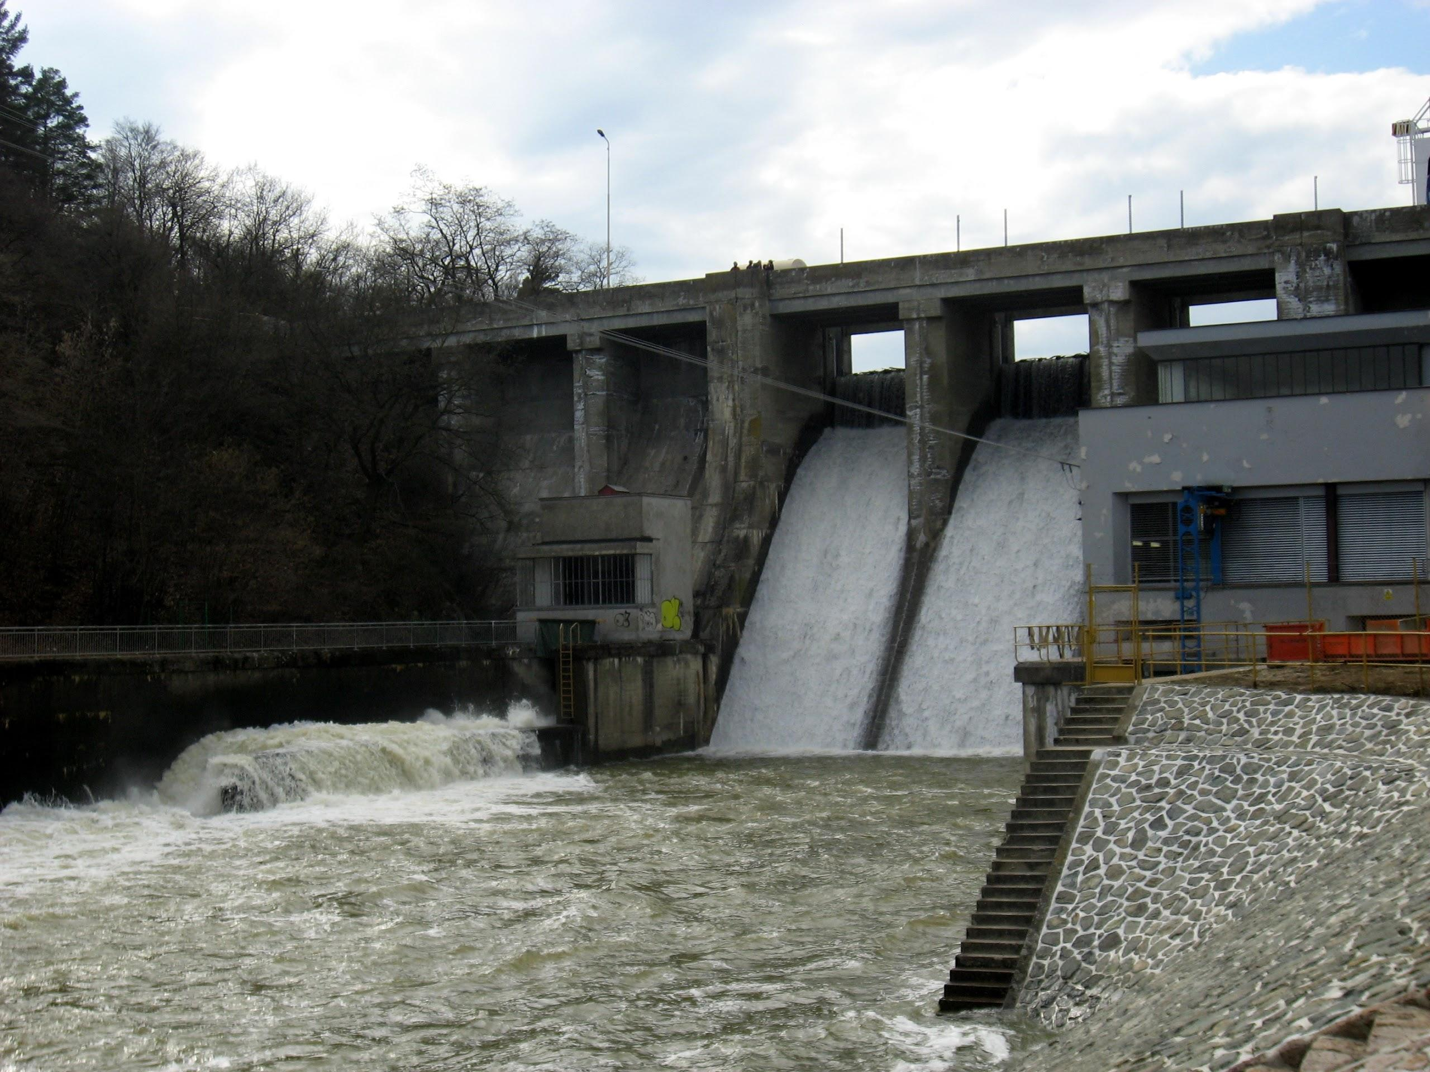

Slide 17


Slide 18


Slide 19
Cases?
Queensland “cyberterror”, 2000
StuxNet, 2010
Lodz, 2008
Anonymous and LulzSec?
Estonia 2007 and Georgia 2008?

Slide 20
Reality
imagined and unfulfilled concept
“nothing is happening”
    not really true, things are happening all the time, but it is not cyberterrorism
why?
required combination of skills, motivation, resources
  its too hard to match effectiveness of real terrorism

Slide 21
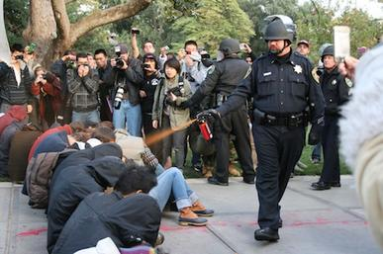

Slide 22
Future of cyberterrorism
Would we recognize it? What should it look like?

Slide 23


Slide 24
Hacktivism

Slide 25
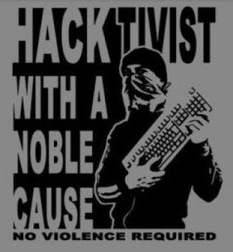

Slide 26
Hacktivism
disrupting networks, misusing systems
support ideology, political goal, etc.
political activism adapted to the internet in 21st century

Slide 27
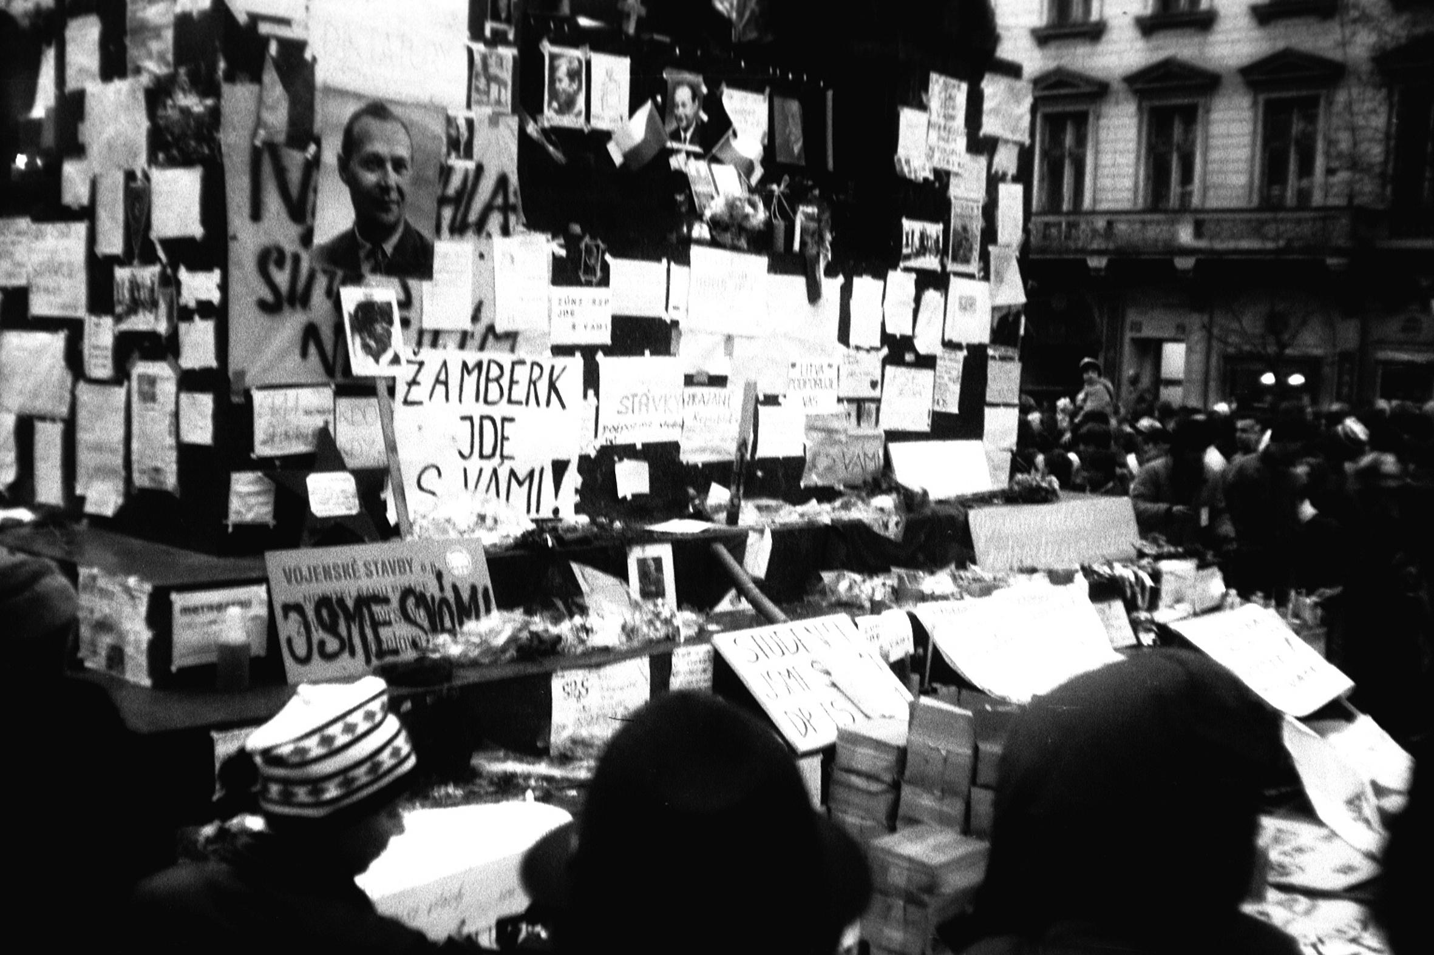

Slide 28
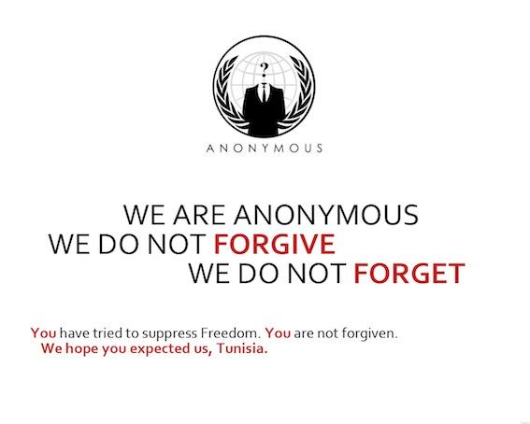

Slide 29
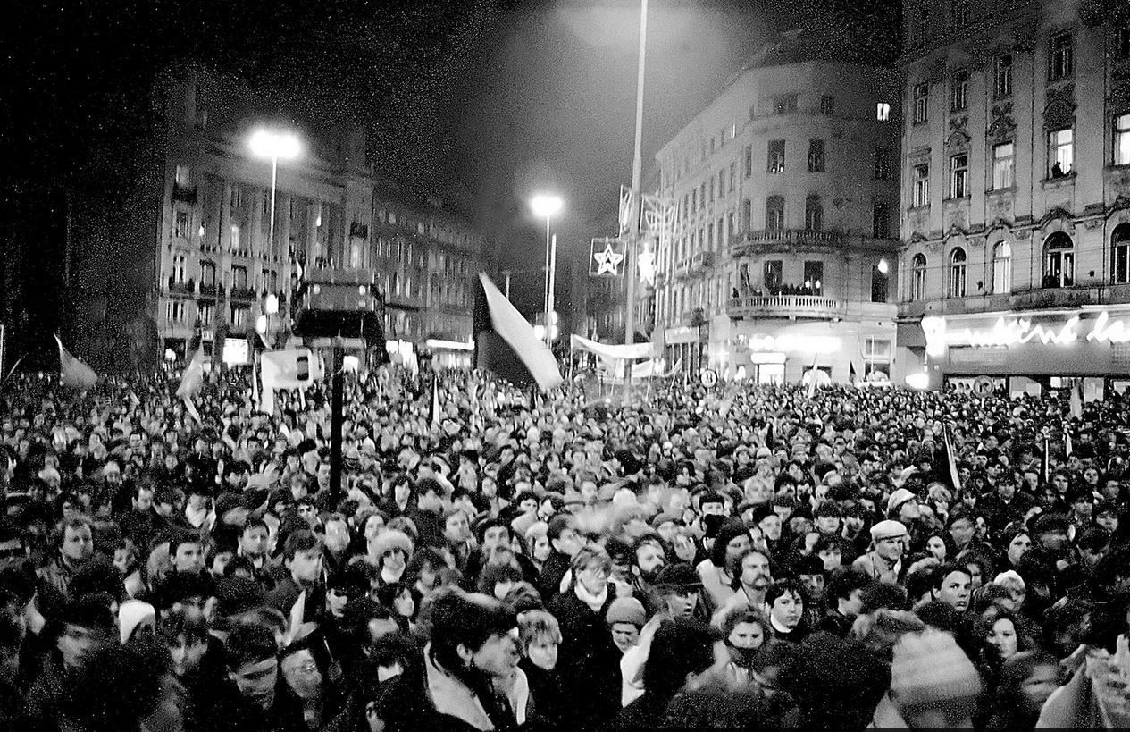

Slide 30
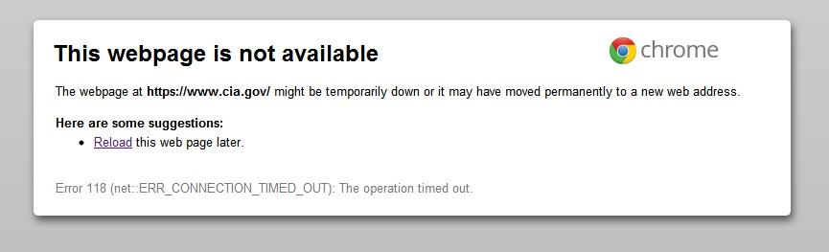

Slide 31
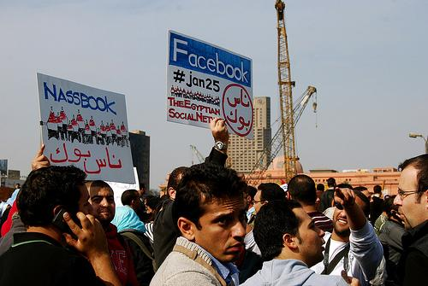

Slide 32
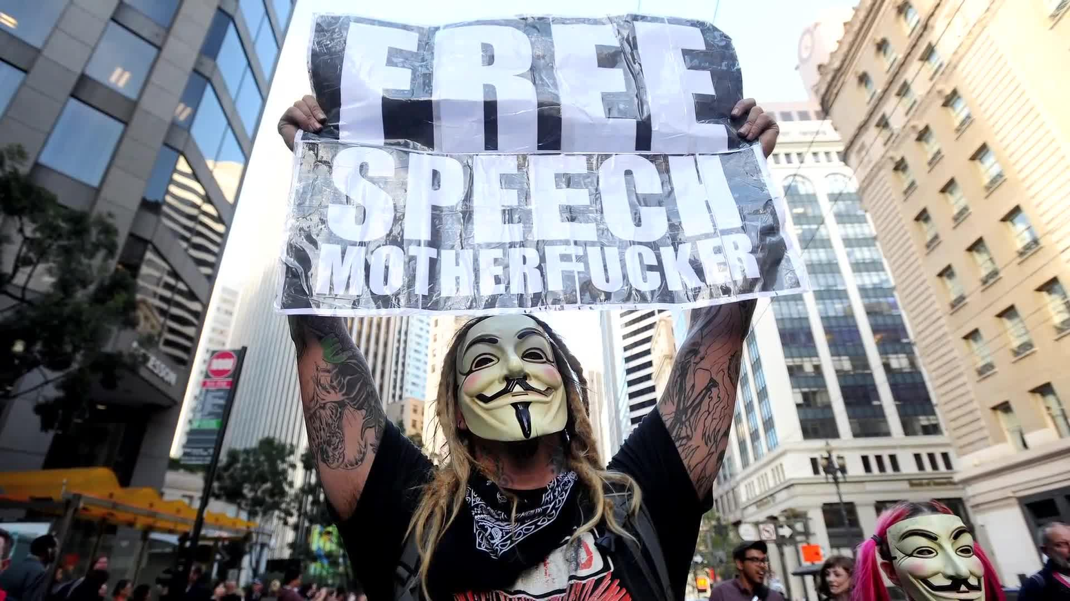

Slide 33
Brief history
roots towards the end of Cold War
hacktivism started from hackers
  not from political activism
going all the way back to the counterculture
universities, corporations

Slide 34


Slide 35
Present?
rise since 2008
major force since 2010
covers all strains of politics and ideologies
Anonymous iconic
  reality is much muddier

Slide 36


Slide 37





Slide 38
Anonymous
who are they?
where they came from?
why?
what do they want?
why the mask?

Slide 39
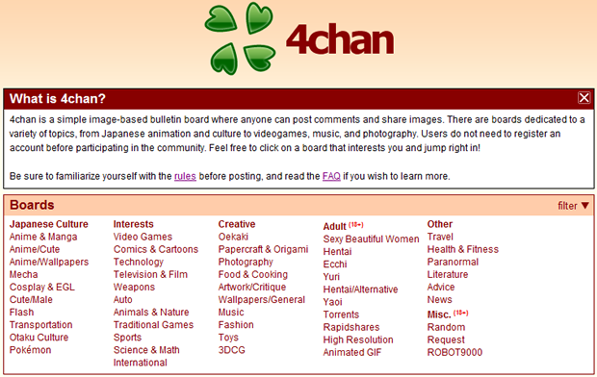

Slide 40
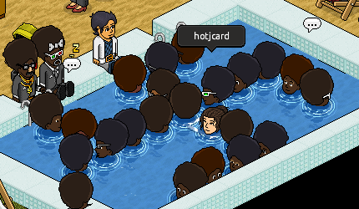

Slide 41
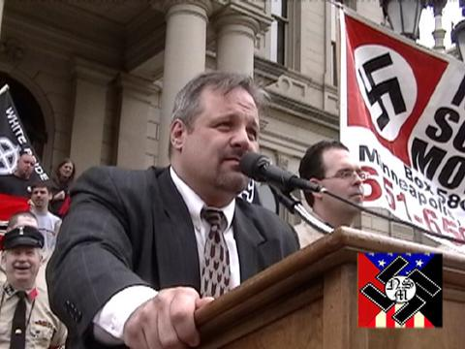
https://youtu.be/ZHl0WI32XkY?t=1384

Slide 42
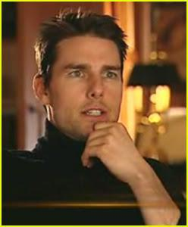
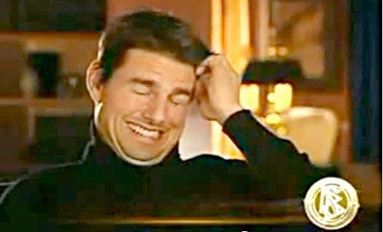

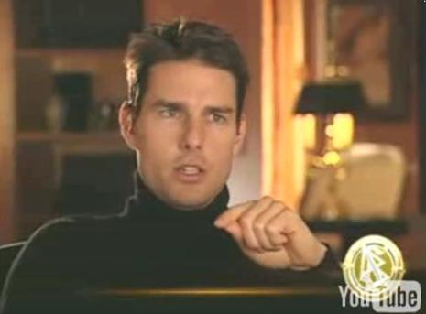

Slide 43
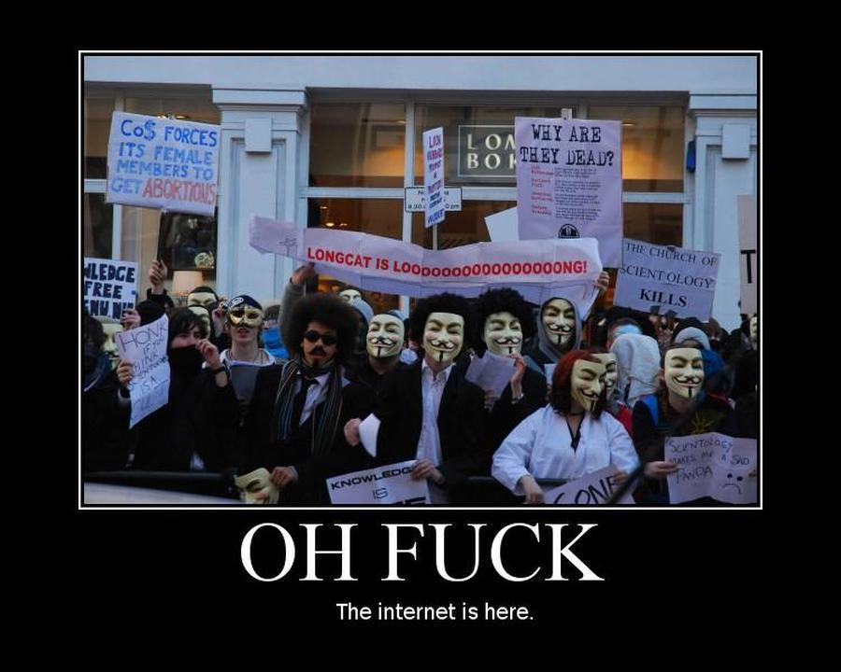

Slide 44
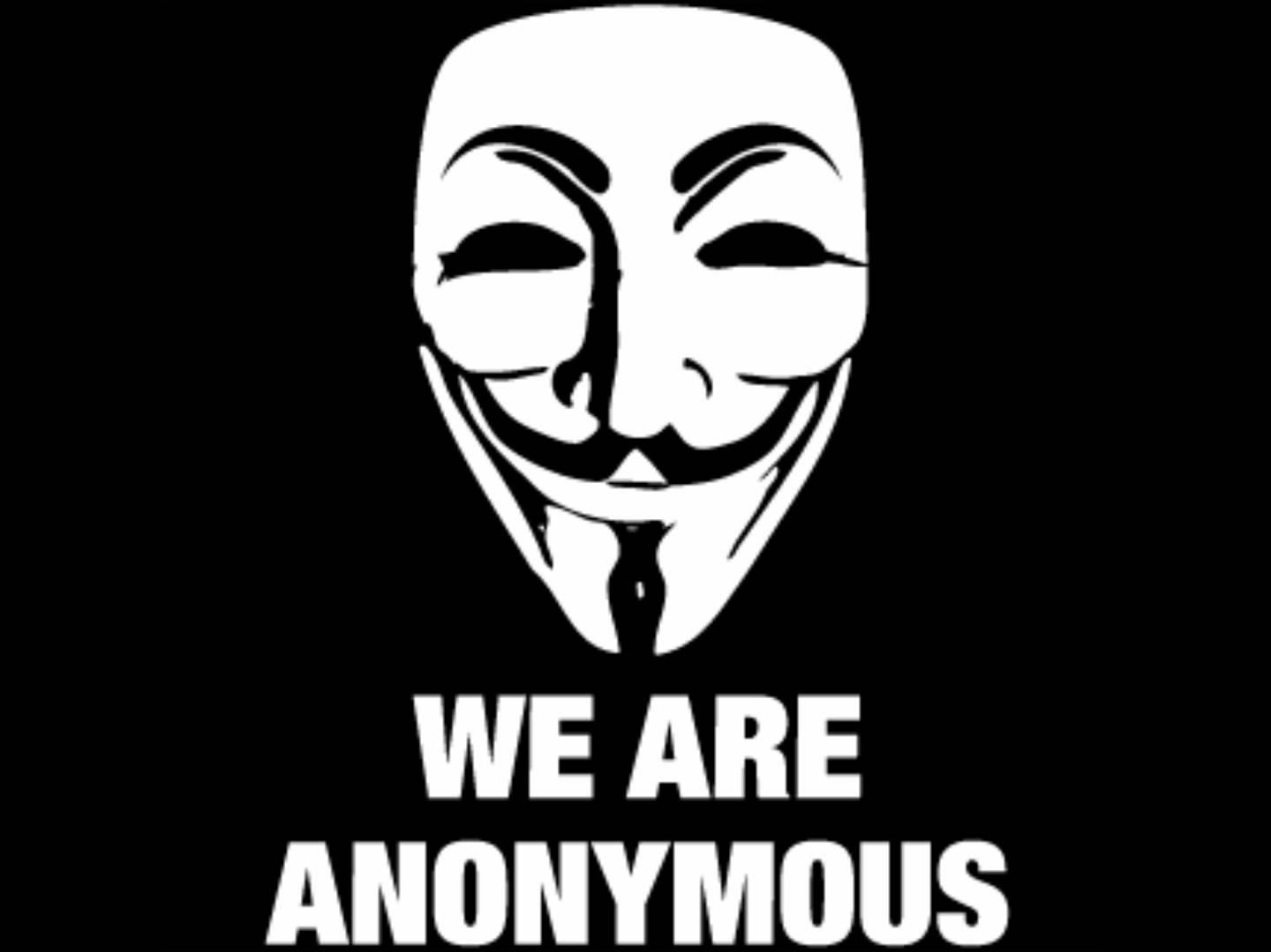

Slide 45
Videos
Scientology Tom Cruise video
https://www.youtube.com/watch?v=UFBZ_uAbxS0
Chanology declaration
http://www.youtube.com/watch?v=JCbKv9yiLiQ
We are Legion
http://www.youtube.com/watch?v=gn9-80ObGA8

Slide 46
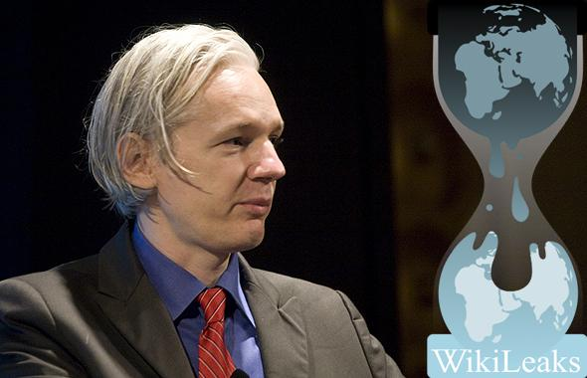

Slide 47
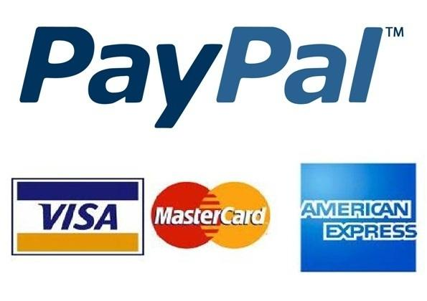

Slide 48
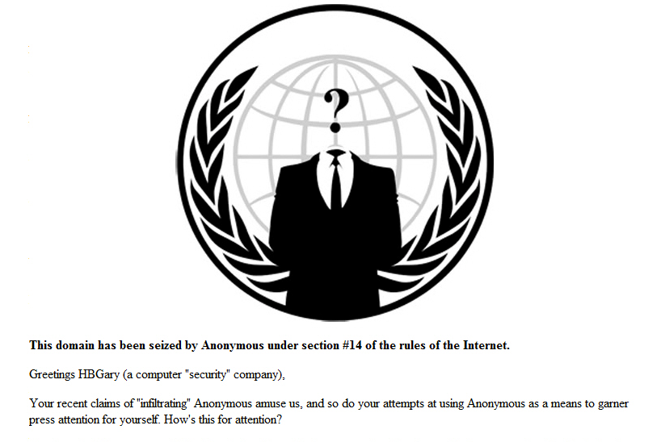

Slide 49
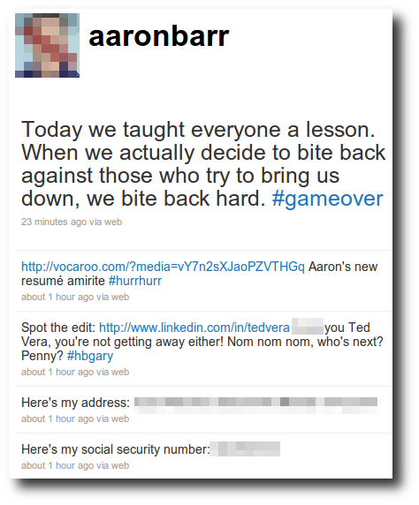



Slide 50

http://pastebin.com/HZtH523f

Slide 51
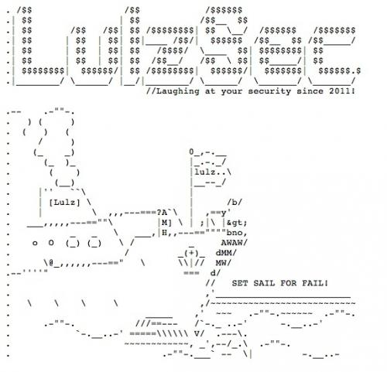

Slide 52
There’s more
Sony
Arab spring
AntiSec
Vigilantism
  against ultra-right, children porn
Stratfor
MegaUpload, ACTA
arrests
Syria, DPRK, Ukraine

Slide 53
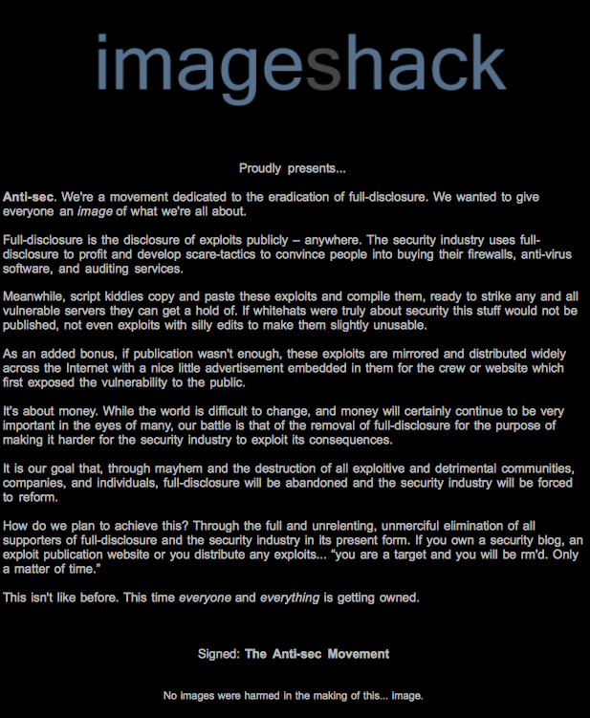

Slide 54
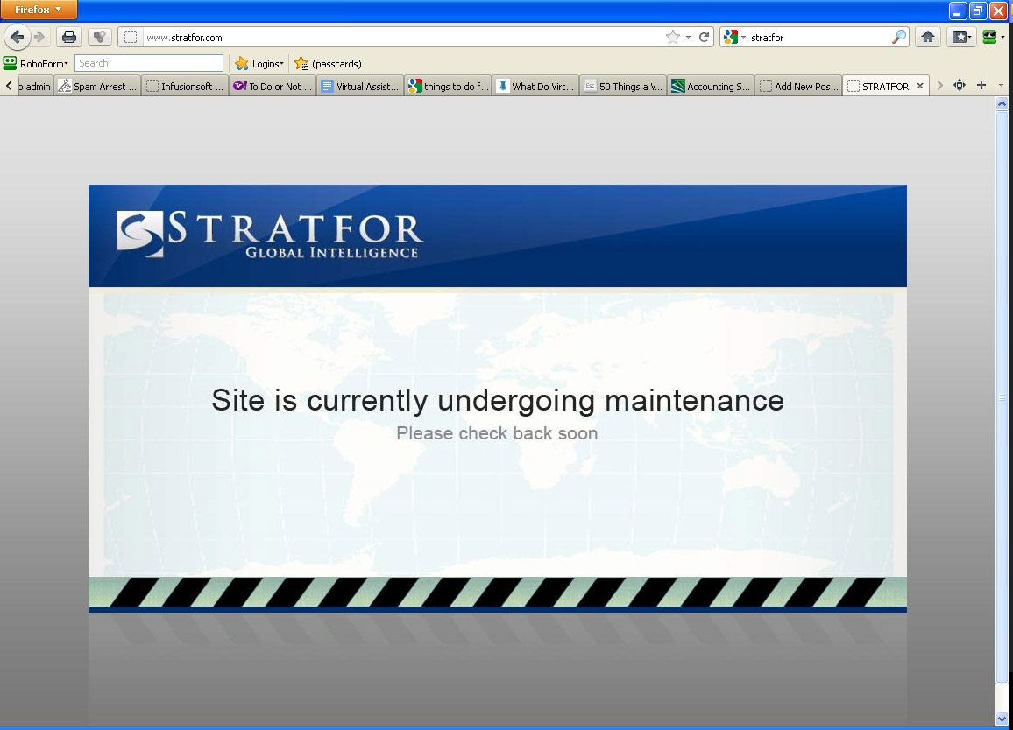

Slide 55
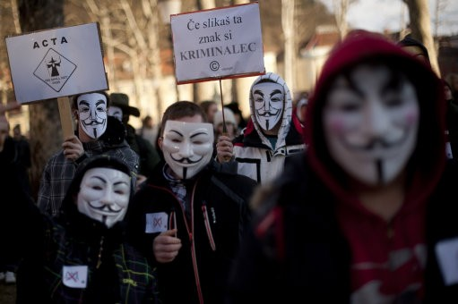

Slide 56
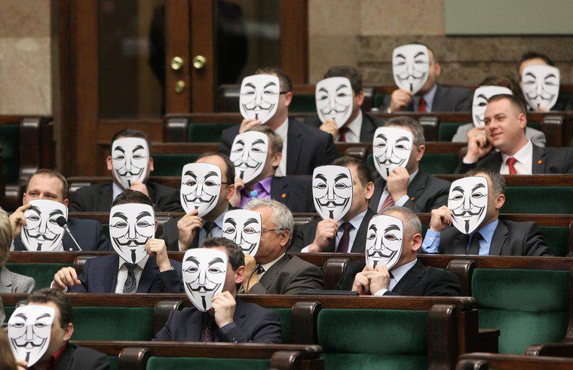

Slide 57
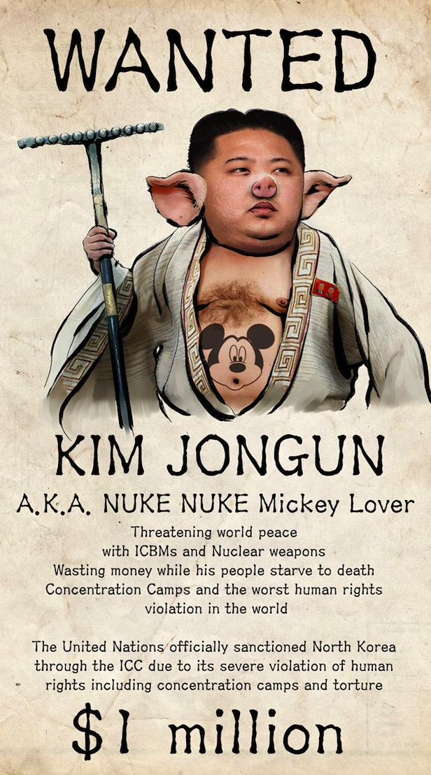

Slide 58
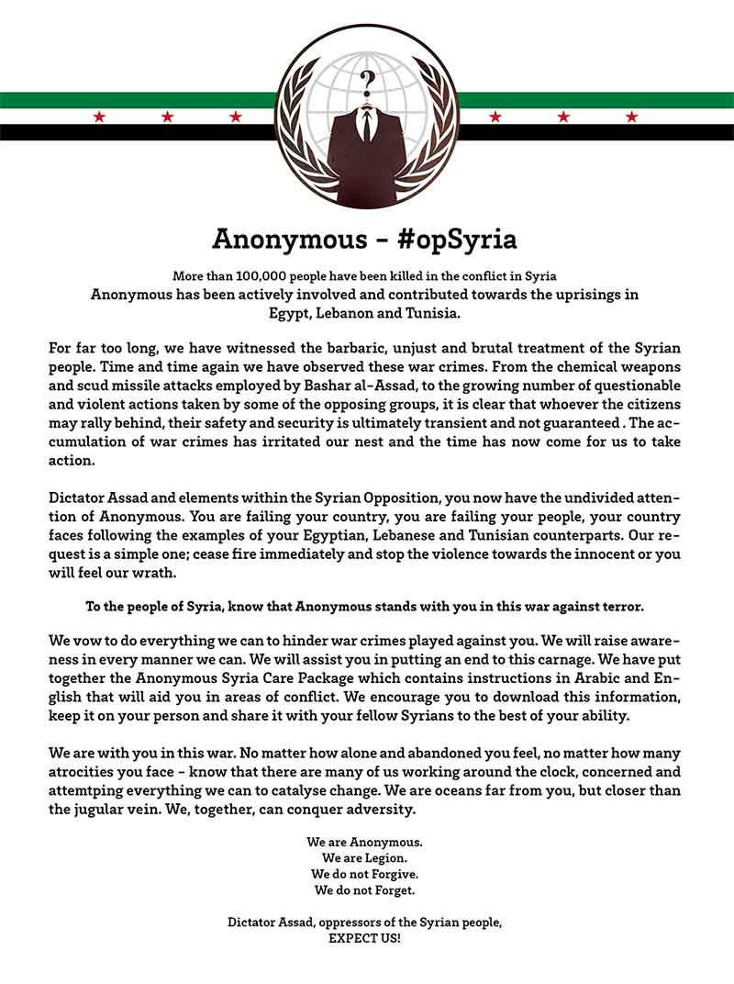

Slide 59
The spectrum of hacktivism
can be for anything
  nationalistic
  anarchistic
  religious
  vigilantism
  ecological
dominant form is a vague leftwing anarchism (Anonymous)

Slide 60
How dangerous is it?
compared to other threats, hacktivism is not especially dangerous
  attacks are usually short
  and more importantly – public!
hacktivism can also act as „immunization“

Slide 61
Structure and organization
not hierarchical
„adhocracy“
loose network structure
often even individual or separate groups in conflict with one another (see th3j35t3r)

Slide 62
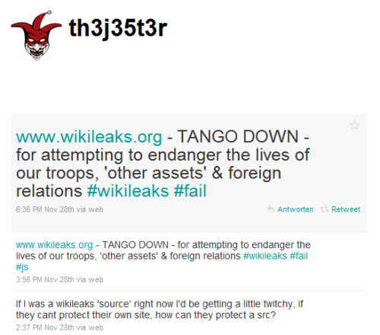

Slide 63
Targets
concept of „ops“
target selection is based on reactions and opportunities
  therefore at least partially predictable

Slide 64
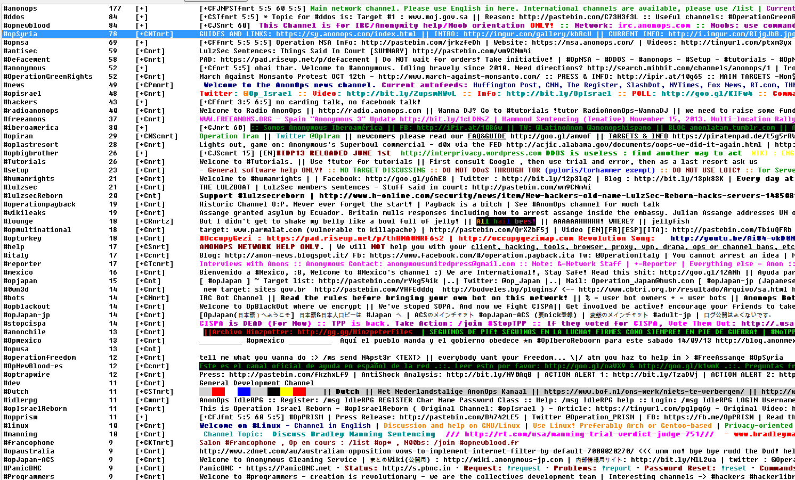

Slide 65
Tools and Methods
DDoS
  botnets or LOIC and its derivatives (deniable?)
defacement
dox
communication and propaganda
  twitter, youtube, facebook, blogs, IRC

Slide 66
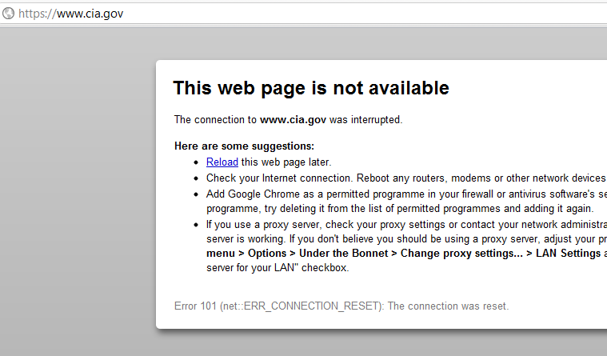

Slide 67


Slide 68
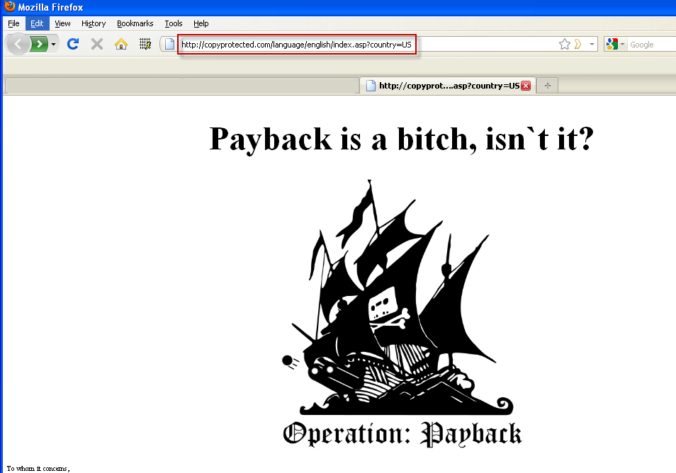

Slide 69
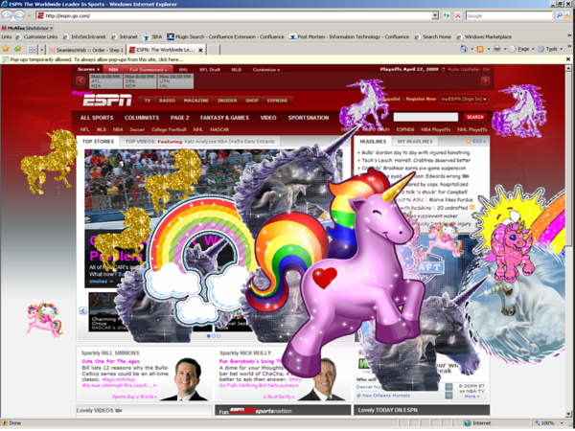

Slide 70
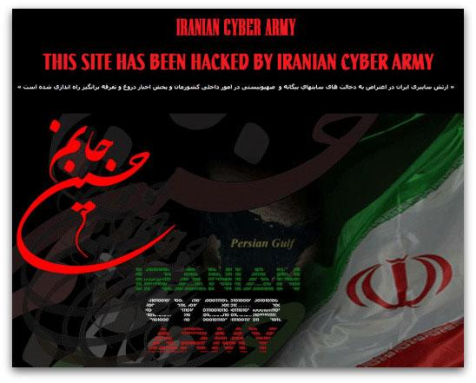

Slide 71
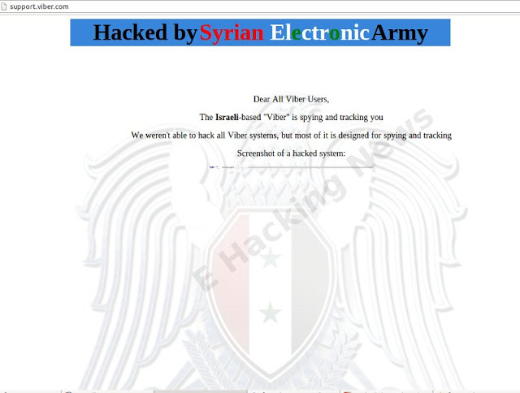

Slide 72
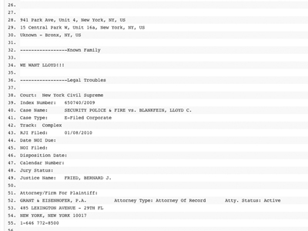

Slide 73
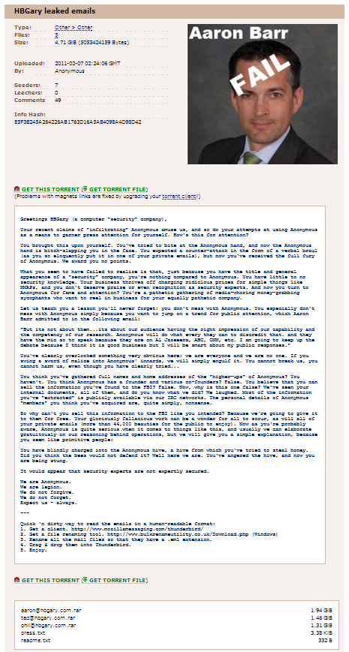

Slide 74
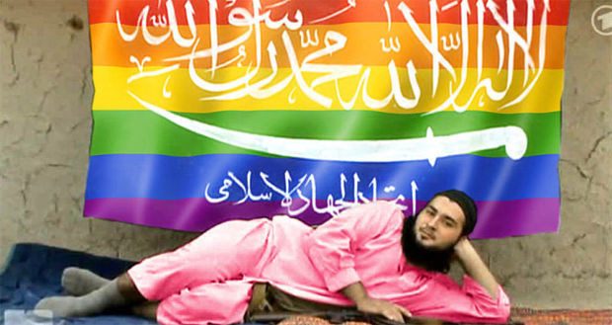

Slide 75
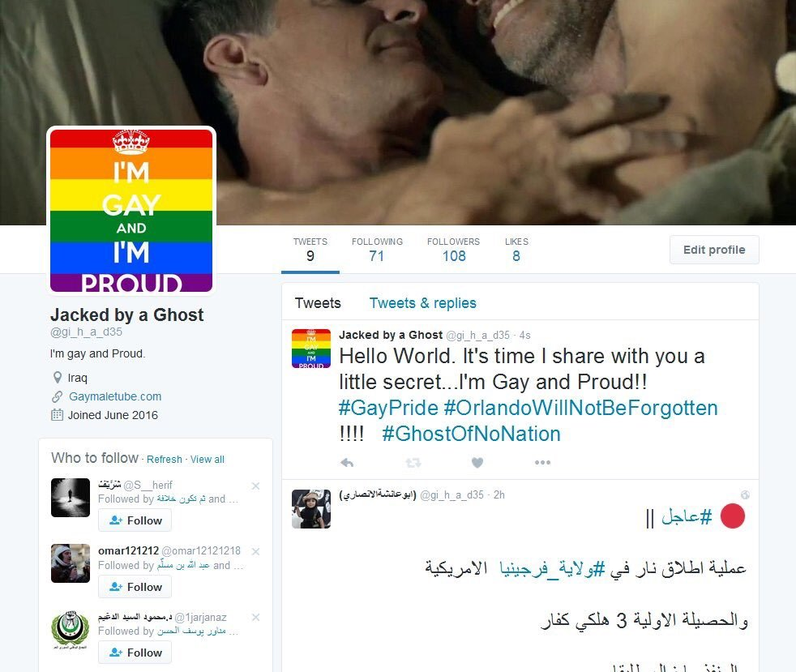

Slide 76
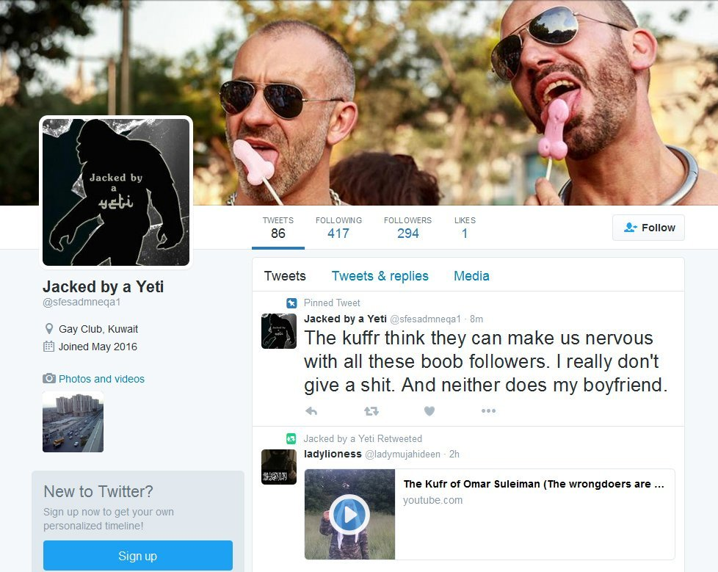

Slide 77
Future?
depends on three main pillars
people
  who perform the attacks
tools
  to perform the attacks with
causes
  what are the attacks for
new cybermilitias and patriotic hackers?

Slide 78



Slide 79
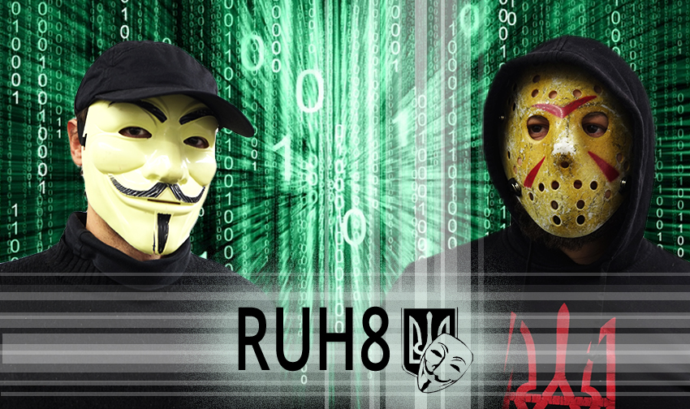

Slide 80
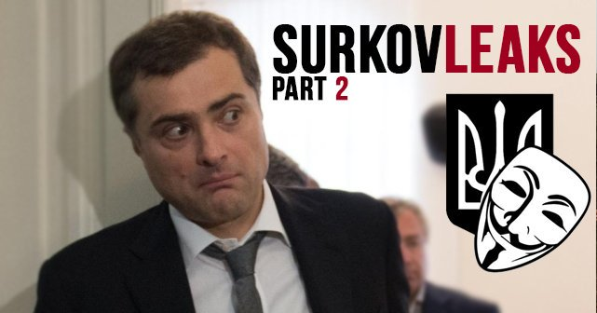

Slide 81
