Slide 1
History of asymmetric warfare
Jakub Drmola

Slide 2
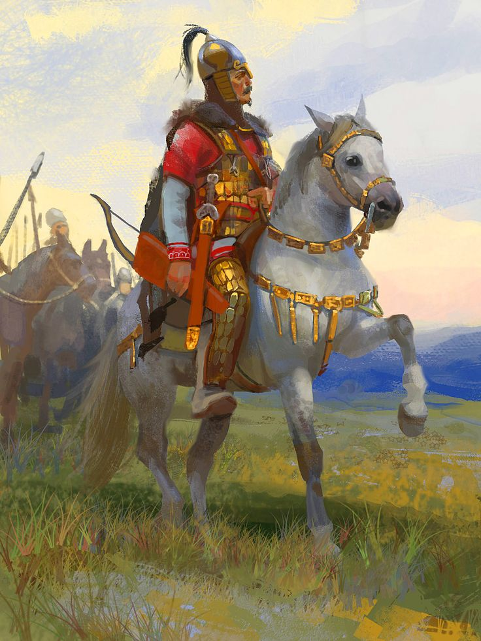
When was asymmetric warfare invented?
“They are very quick in their operations of exceeding speed and fond of surprising their enemies. They suddenly disperse and then reunite and again after having inflicted vast loss upon the enemy, scatter themselves over the whole plane in irregular formations, always avoiding a fort or an entrenchment.”

Slide 3
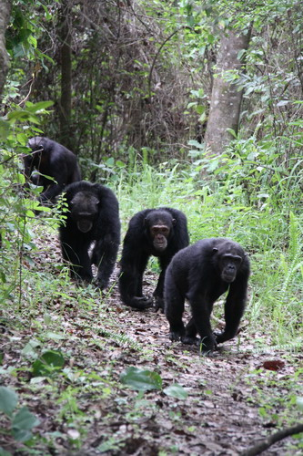
“These calls announce the start of a raid into land controlled by their neighbors. As they leave their core zone, the patrol goes silent, occasionally stopping to listen. Signs of the enemy are detected and examined closely. The militia is now at the very edge of their territory. All need to be on maximum alert. Then it's waiting and listens. An unfamiliar call raises the tension. It's an uncertain time. The size of the rival group is as yet unknown.
Not far away the neighbors are eating, oblivious to the approaching dangers. The patrol moves off with a sense of purpose. They must remain silent until they close in on their rivals. The attack is on. To intimidate their opponents, the aggressors scream and drum. It's a ferocious attack …”
https://www.youtube.com/watch?v=a7XuXi3mqYM

Slide 4
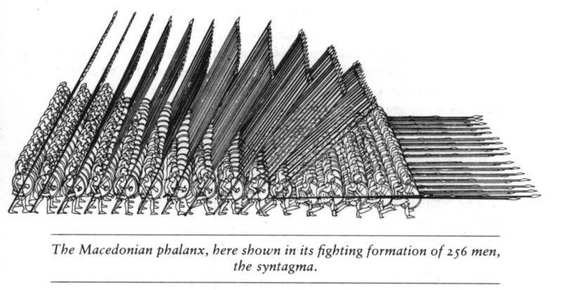
Long term perspective
asymmetric/irregular warfare is actually the original, “normal” warfare
characteristic for tribal conflicts and so is “counterinsurgency”
it is referenced in the oldest records
conventional/regular warfare is comparatively recent invention
  it requires “civilization”
historically more visible and attractive

Slide 5
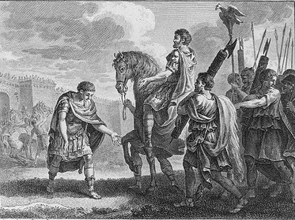
Oldest period
Sun Tzu (6th century B.C.)
  “An army may be likened to water, for just as flowing water avoids the heights and hastens to the lowlands, so an army avoids strength and strikes weakness.”
  “The supreme art of war is to subdue the enemy without fighting.”
Quintus Fabius Maximus Verrucosus (3rd century B.C.)
  adopted “Fabian strategy” after initial Hannibal’s victories
  avoiding direct battle, attacking supply routes, war of attrition
  time must be on the side of defender
  military success, political disaster
Zealots and Sicarii in Judea (1st century A.D.)
  guerrilla warfare against Roman Empire
  Sicarii were actually a bit more terroristy

Slide 6
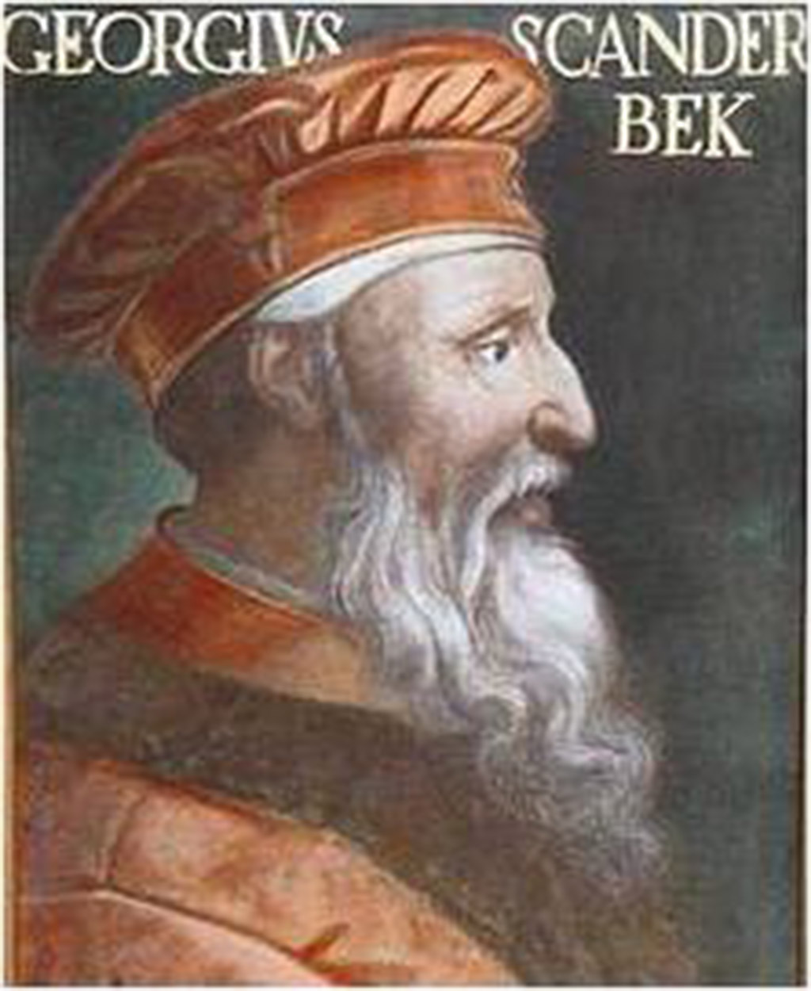
Middle ages
some bits of asymmetric warfare can be seen during the Hundred Years’ (1337-1453) and Thirty Years’ (1618-1648) wars
  for example Bertrand du Guesclin
anti-Ottoman resistance in the Balkans
  for example Skandenberg of Albania (15th cent.)
colonial wars
Robin Hood as guerrilla fighter?
  social rebellion and local resistance
Irish resistance 1594-1603

Slide 7
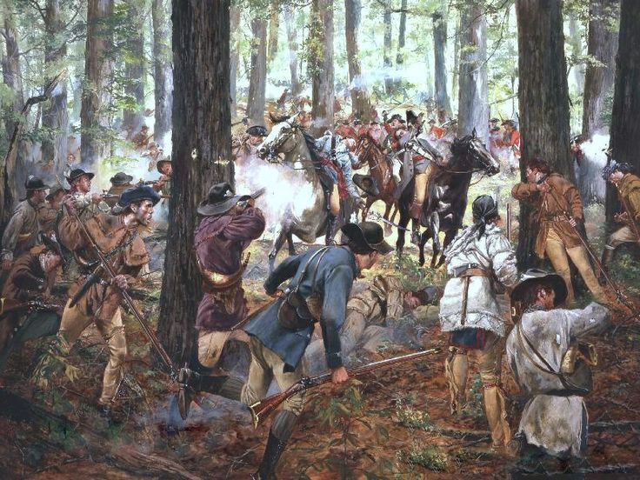
American War of Independence (1775–1783)
almost perfect conditions for asymmetric warfare
attacks on supply routes, officers, etc.
war was eventually decided back in London due to lack of support

Slide 8
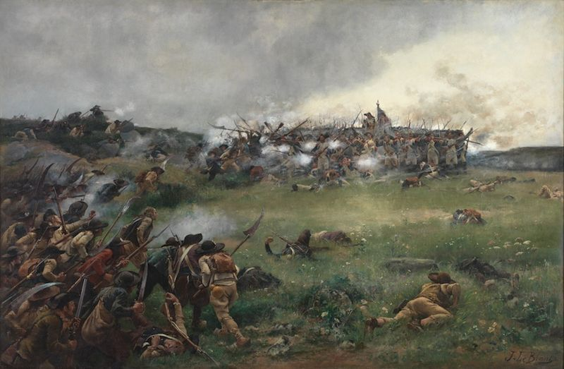
War in the Vendee (1793)
- a counter-revolutionary insurgency
- caused primarily by new conscription laws
- poorly equipped guerillas
- great role of local terrain
- local support

Slide 9
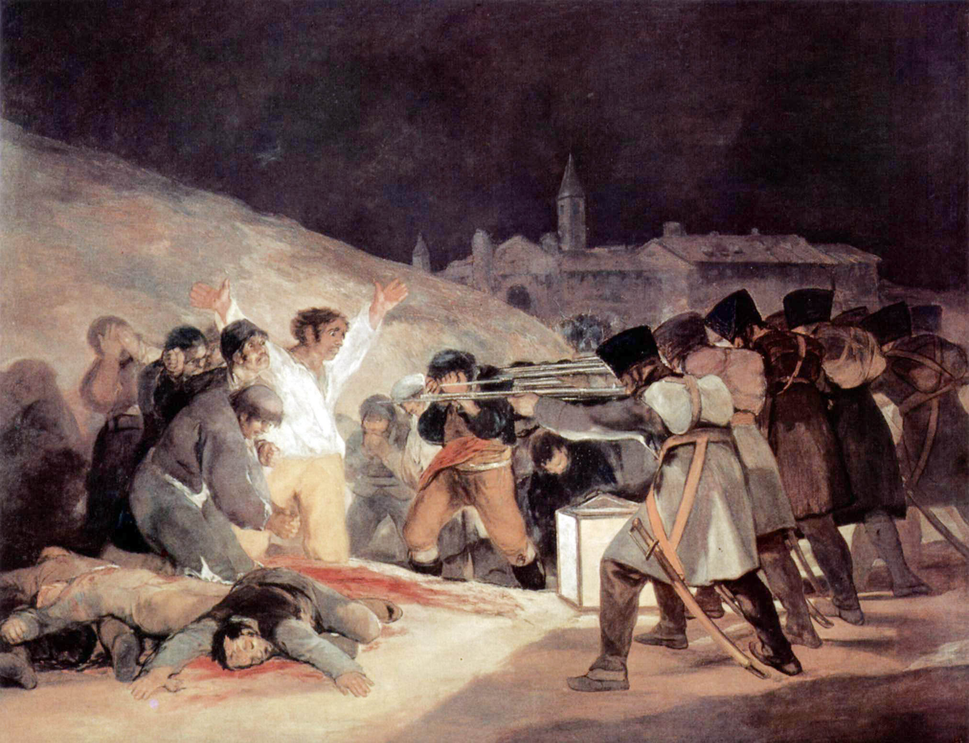
Napoleon’s Spanish “ulcer”, that he wanted to “liberate” and it might had cost him the war (1807-1814)
"It is manifest that, though a great army may easily defeat or disperse another army, less or greater, yet it is not in a like degree formidable to a determined people, nor efficient in a like degree to subdue them, or to keep them in subjugation–much less if this people, like those of Spain in the present instance, be numerous, and, like them, inhabit a territory extensive and strong by nature. For a great army, and even several great armies, cannot accomplish this by marching about the country, unbroken, but each must split itself into many portions, and the several detachments become weak accordingly, not merely as they are small in size, but because the soldiery, acting thus, necessarily relinquish much of that part of their superiority, which lies in what may be called the engineer of war; and far more, because they lose, in proportion as they are broken, the power of profiting by the military skill of the Commanders, or by their own military habits. The experienced soldier is thus brought down nearer to the plain ground of the inexperienced, man to the level of man: and it is then, that the truly brave man rises, the man of good hopes and purposes; and superiority in moral brings with it superiority in physical power."
- William Wordsworth

Slide 10
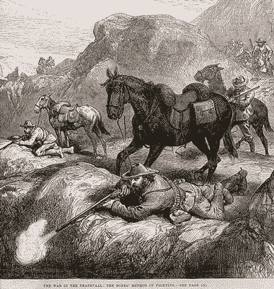
Modern Era
American Civil War (1861-1865)
  both sides legitimized local guerillas
  option to prolong the war
Franco-Prussian War (1870-1871)
  “francs-tireurs” – French anti-Prussian guerrillas in captured territory
Boer Wars (1880-1881, 1899-1902)
  both wars highly asymmetrical
  Boers very effective “mobile snipers”
  British army adapted well (camouflage, fortifications, protected supply routes, razing enemy supplies, concentration camps, pursuit units, armoured trains)
  decent conditions of surrender

Slide 11
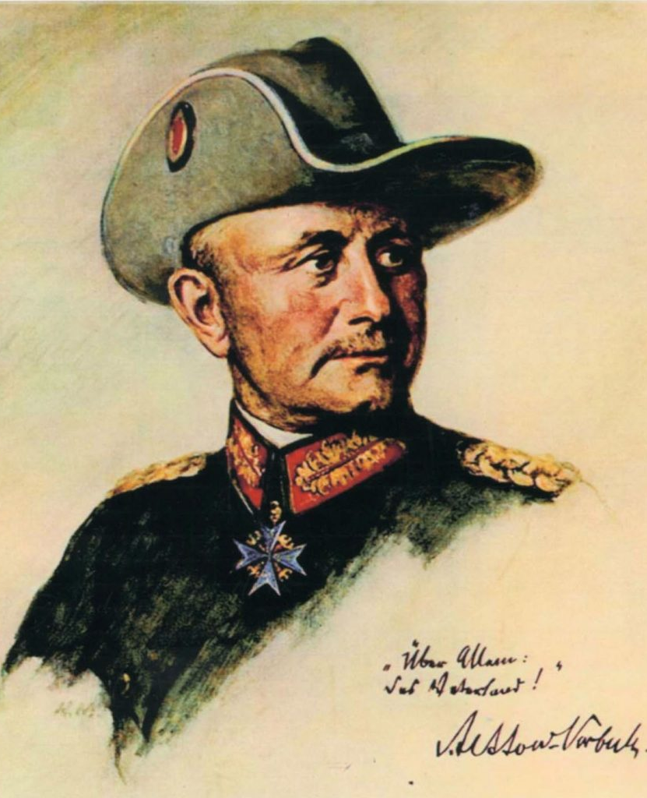
The Great War
T.E. Lawrence (and Gertrude Bell)
  tried to create anti-Ottoman Arab revolt
  “successful”, consequences still felt today (Sykes-Picot line)
  Germany tried the same thing against India (Niedermayer expedition)
Paul von Letow-Vorbeck
  undefeated German colonel in Tanzania
  waged asymmetric war against much larger British army in Africa
  goal was to force Entente to keep forces in Africa
  no supplies, lived off the land
https://youtu.be/4iKHwHPpIKQ?t=2280

Slide 12
Further conflicts
partisans and occupation resistance movements during WW2
  France, Poland, Yugoslavia, and many others
Chinese revolution and Mao’s Long March
de-colonization wars
  Africa and Asia
Vietnam War
Afghan War

Slide 13
Videos
Algiers - /p00txp61/
Paris - /p00txp44/ (4:00)
Bin Hao - /p00txnyc/
Vietnam 1 - /p00txp2s/
Vietnam 2 - /p00txnwv/
Iraq - /p00txqjt/ (2:00)

