Slide 1
Hybrid Warfare
Jakub Drmola

Slide 2
What is hybrid warfare?
- is it conventional or irregular warfare?
- is it warfare in cyberspace or on the ground?
- is it warfare with weapons or information?
- is it new or old?
- there is no agreed definition

Slide 3

“… hybrid threat refers to an action conducted by state or non-state actors, whose goal is to undermine or harm a target by influencing its decision-making at the local, regional, state or institutional level. Such actions are coordinated and synchronized and deliberately target democratic states’ and institutions’ vulnerabilities. Activities can take place, for example, in the political, economic, military, civil or information domains. They are conducted using a wide range of means and designed to remain below the threshold of detection and attribution.”

Slide 4
Evolution of the concept
- first appearance in 1990s
  western concept of parallel conventional and irregular operations
  the concept gradually grew more and more vague and pointless
- resurgence in 2014
  “hybrid warfare” became synonymous with the war in Ukraine
  completely different understanding of the concept by RF – “nonlinear warfare”

Slide 5
Some traits
- hybrid war?…. just using any and all possible means to prevail
- but different from “total war”
- blurs the line between war and peace
- aims to be economical and efficient
- does not always seek immediate victory
- population-centric a political
- flexible and adaptive

Slide 6
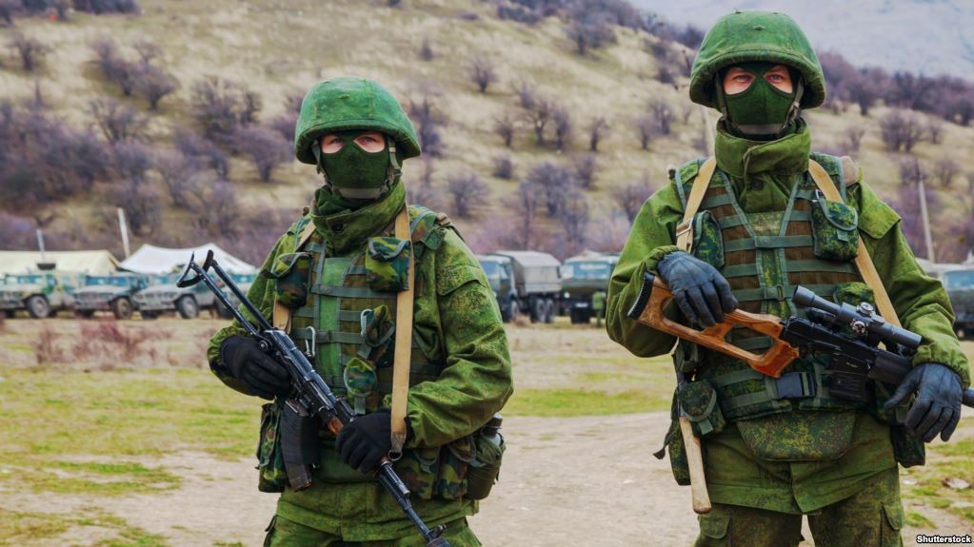

Slide 7
Tools used
- mobilizing sympathetic population
- arming and supporting proxy groups
- limited and clandestine deployment of regular forces
- “deregularization” of units
- cyber-attacks against the enemy and his infrastructure
- information warfare at both local and international level

Slide 8
So what is it again?
- it is just warfare in the broadest sense
- i.e. not limited to single type
- including non-military means
- avoiding escalation and full confrontation
- fluid, dynamic, adaptive

Slide 9
The recipe for “hybrid” warfare
Mix together: conventional warfare + irregular warfare + information warfare + political warfare + economic warfare + cyber warfare
- specific ratios of ingredients will differ case by case
- season to taste, shake and stir, and be ready modify
- also called “non-linear warfare” (RF, 2017) or “unrestricted warfare” (PRC, 1999)

Slide 10
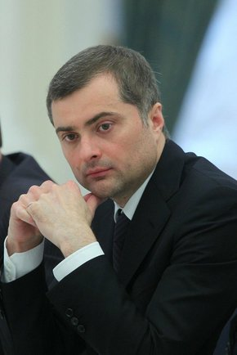
“Non-linear war”
concept by Vladislav Surkov (allegedly)
  Putin’s advisor
shifting state of confusion
leveraging media
https://www.youtube.com/watch?v=tyop0d30UqQ

Slide 11
Irregular warfare
- or asymmetric warfare
- or guerilla warfare
- or insurgency
- or partisans

Slide 12
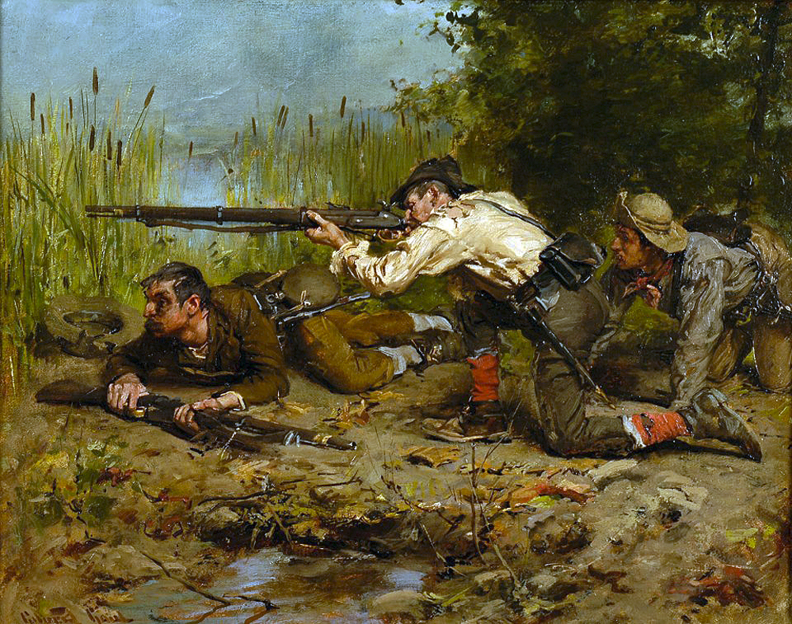

Slide 13
Features of irregular warfare
Compared to conventional (regular, symmetrical) warfare:
  mobility and flexibility, there is no front
  avoiding direct and open battle
  poorly armed and equipped, dependent on external support and spoils
  political, telluric
Compared to terrorism:
  control of territory and population
  targets enemy military and government
  imitated military structure
  willing to engage when advantegous

Slide 14


Role of terrain
geography and climate
  mountains, forests, swamps?
  or deserts, islands, plains?
international borders
  where? how long? with whom?
  what about coastline?
population centers
cities as a specific type of terrain
type of economy
  industrial/agrarian
  concentrated/dispersed
  modern/developing country

Slide 15
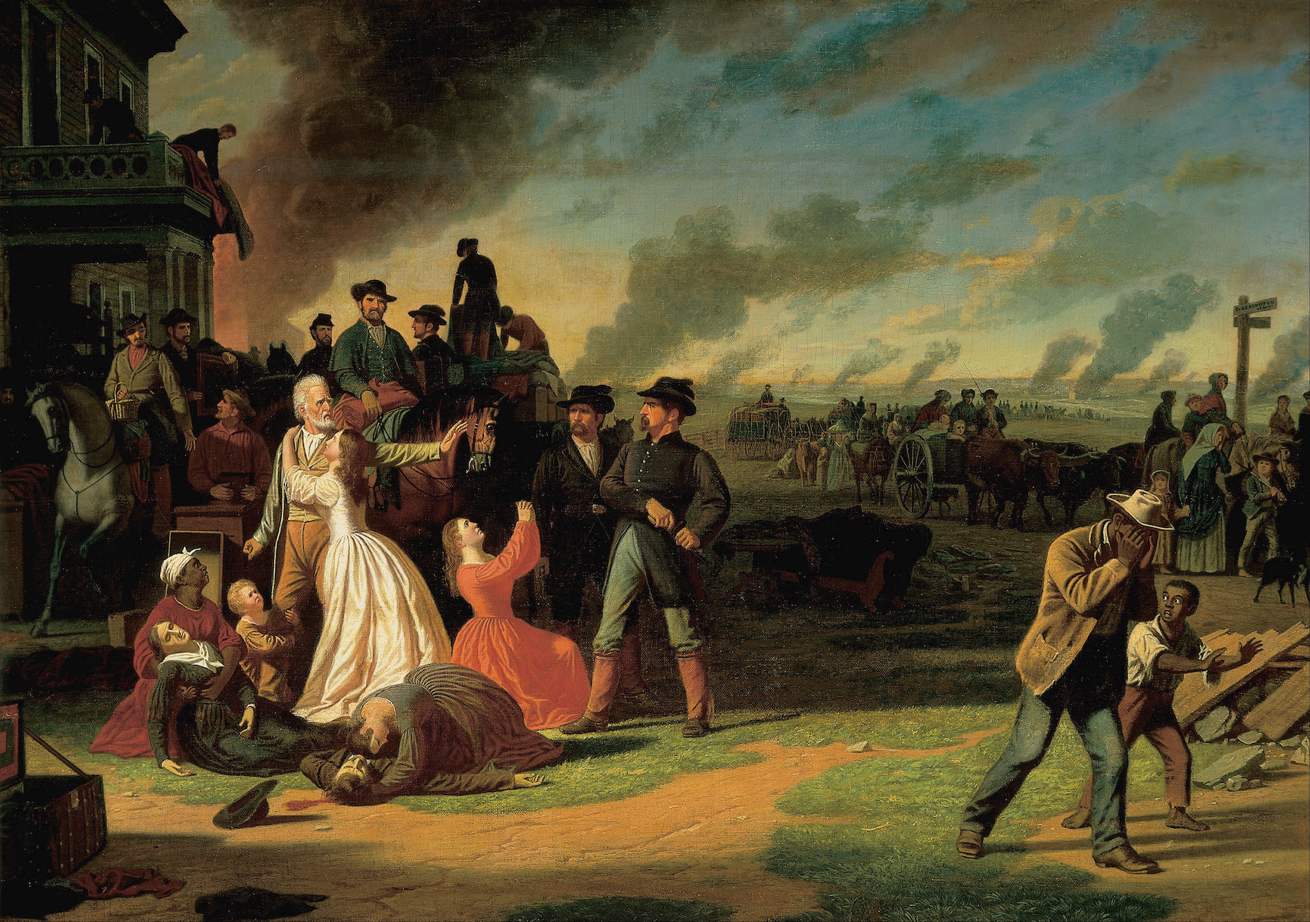
Role of population
control of population is more important than control of territory
it is source of money, information, fighters, and any other kind of support
goal of the guerilla is to take control over the population at the detriment of government

Slide 16
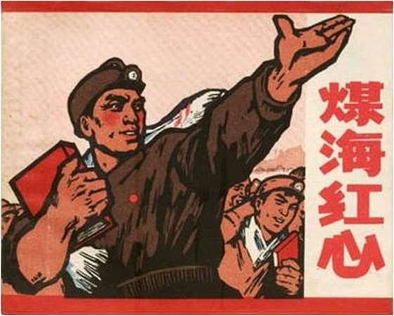
Role of cause
what are they fighting for or against
decisive factor regarding:
  control of population
  external support
  internal resistance
best cause is one that brings you maximum number of supporters and also weakens the enemy as much as possible
it will differ case by case
its importance declines with duration and escalation

Slide 17
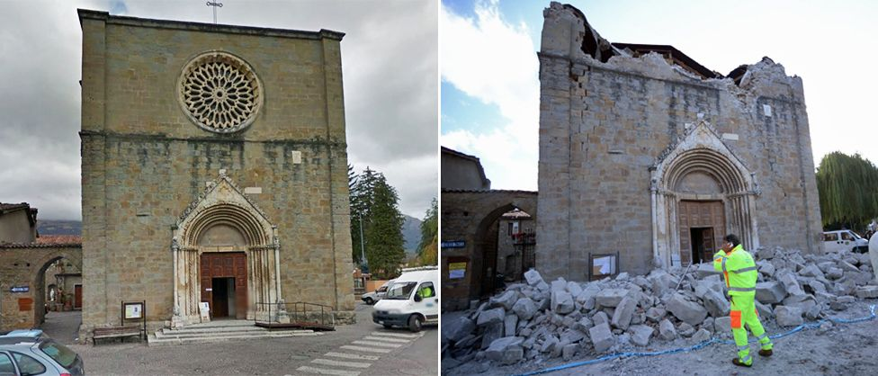
Role of entropy
laws of nature are helping the irregulars
all systems and strucutres naturally tend towards decline and disorder (entropy increases over time, second law of thermodynamics)
maintenance takes effort, resources and time
therefore destroying things is cheaper and easier than building them or protecting them
this makes war relatively easier for guerillas
the aim is to bleed out the government
H. Kissinger: „The conventional army loses if it does not win. The guerrilla wins if it does not lose.“

Slide 18
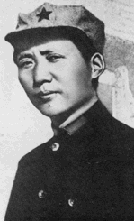
Thinkers and theoreticians
- T. E. Lawrence (1888-1935)
  “War upon rebellion is messy and slow, like eating soup with a knife.”
  “We were an influence, an idea, a thing invulnerable, intangible, without front or back, drifting about like a gas? Armies were like plants, immobile as a whole, firm-rooted, nourished through long stems to the head, we might be a vapor, blowing where we listed.”
- Mao Zedong (1893-1976)
  “The people are the sea that the revolutionary swims in”
  “The enemy advances, we retreat; the enemy camps, we harass; the enemy tires, we attack; the enemy retreats, we pursue.”
  3 steps of revolutionary war
- Ernesto ‘Che’ Guevara (1928-1967)
  “Guerrilla warfare is used by the side which is supported by a majority but which possesses a much smaller number of arms for use in defense against oppression.”

Slide 19
How to fight against it?
in general, countermeasures are more effective in the beginning but also harder to justify
once they can be justified, it might be too late
cannot do much with the terrain, but try to control key points
chasing guerillas across forests and mountains with regular forces rarely works
  special operations can work, but depend on: intelligence, terrain and surprise, cooperation of local population
control population
    good<---> bad, build schools or execute people
    isolate it from the guerillas, or even move it
    it’s a competition for their support
    mobilize your supporters

Slide 20
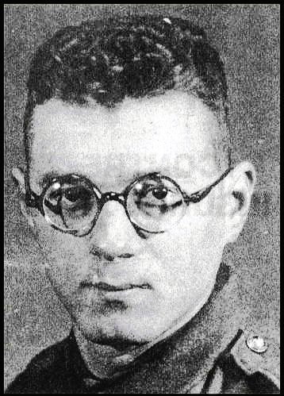
Steps by Galula
1. Assume military control of the area
2. Soldiers live with the people
3. Control movement of population (census)
4. Eliminate local supporters of the rebels
5. Elect new, loyal local leaders
6. Test their loyalty, organize home defence militias
7. Educate and politicize locals
8. Destroy rest of the guerillas
it is order-sensitive and dependent on chosen area

Slide 21
Other things to note
people’s actions align with their interests, but are not always rational
most will not openly support what they percieve to be the losing side
if guerillas cannot lay down their arms and get amnesty, they will just keep fighting
population control can easily turn into counterproductive brutality
there is huge difference between local and expeditionary counterinsurgency
history lessons are always forgotten, mistakes are always repeated
  because armies hate to fight like this
  they prefer conventional, symmetrical war
some “rebels” are not political but just profit-driven (warlords)

