Slide 1
Digital Skills
Current Issues in Research of Media and Audiences
Mgr. et Mgr. Natálie Terčová
Interdisciplinary Research Team on Internet and Society (IRTIS)
Mgr. Štěpán Žádník
Department of Media Studies and Journalism, FSS MU

Slide 2
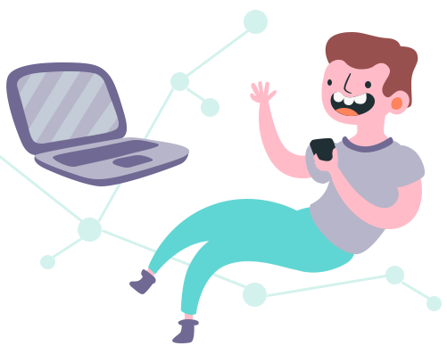
Who are these people?
Štěpán
PhD student
Convergent audiences and the distribution
of audiovisual content
Research specialist
Department of Media Studies and Journalism
Project manager/ Account Manager
MEDIAN, s.r.o.

Slide 3
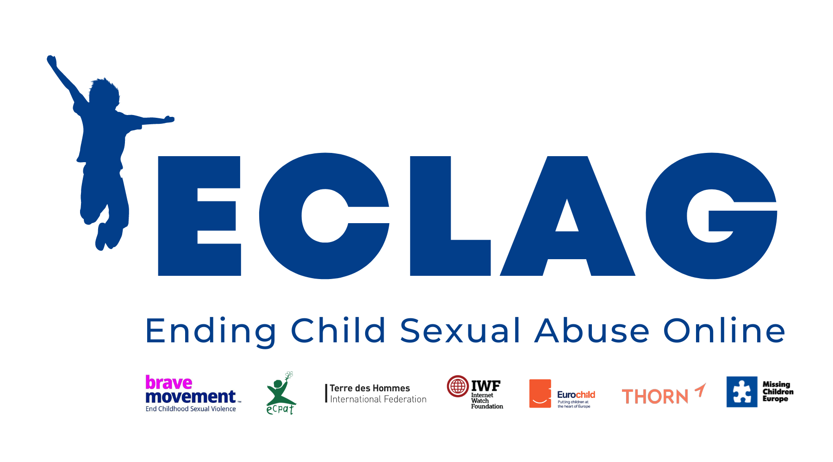

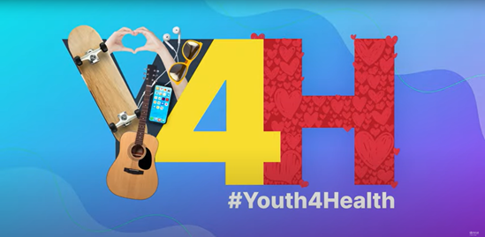



Who are these people?
Natálie
Research specialist
Interdisciplinary Research Team on Internet and Society (IRTIS)
PhD student
Digital skills of children and adolescents
Founder
Internet Governance Forum (IGF) Czech Republic
Youth Envoy
International Telecommunication Union, United Nation
+ Ambassador for Brave Movement (ECLAG); ICANN Fellow & EURALO,
ISOC and WHO member

Slide 4
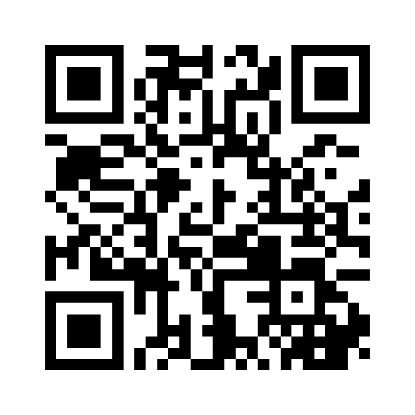
Join us online!

Slide 5

ICT penetration policy
1977 - Apple II
1981 - IBM PC
1993 - WWW goes public
Haves vs. have-nots (NTIA, 1995)
Demographic predictors
Access!
Notes:
Al Gore: vice-president in Clinton’s administrative, in Congress (1977-1993), ICT spread supporter since late 70s, ICT as democratization tool, brought government, military, federal agencies, or courts online
NetDays: since 1995, volunteers, technology donations by tech companies, connections of schools, libraries, and clinics
National Telecommunications and Information Administration
Telecommunications and Information Assistance Program (since 1993): several grants in 90s on public ICT infrasturture

Slide 6
The digital divide

Slide 7
Digital divide
I. level
01
Access to digital technology

Slide 8
World perspective
2.9 billion people remain offline
-> 96% of whom live in developing countries
Those who remain unconnected face multiple barriers, including a lack of access:
approx 390 million people are not even covered by a mobile broadband signal
Notes:
Nějaká data ke skills ve světě
NUTNO DOPLNIT

Slide 9
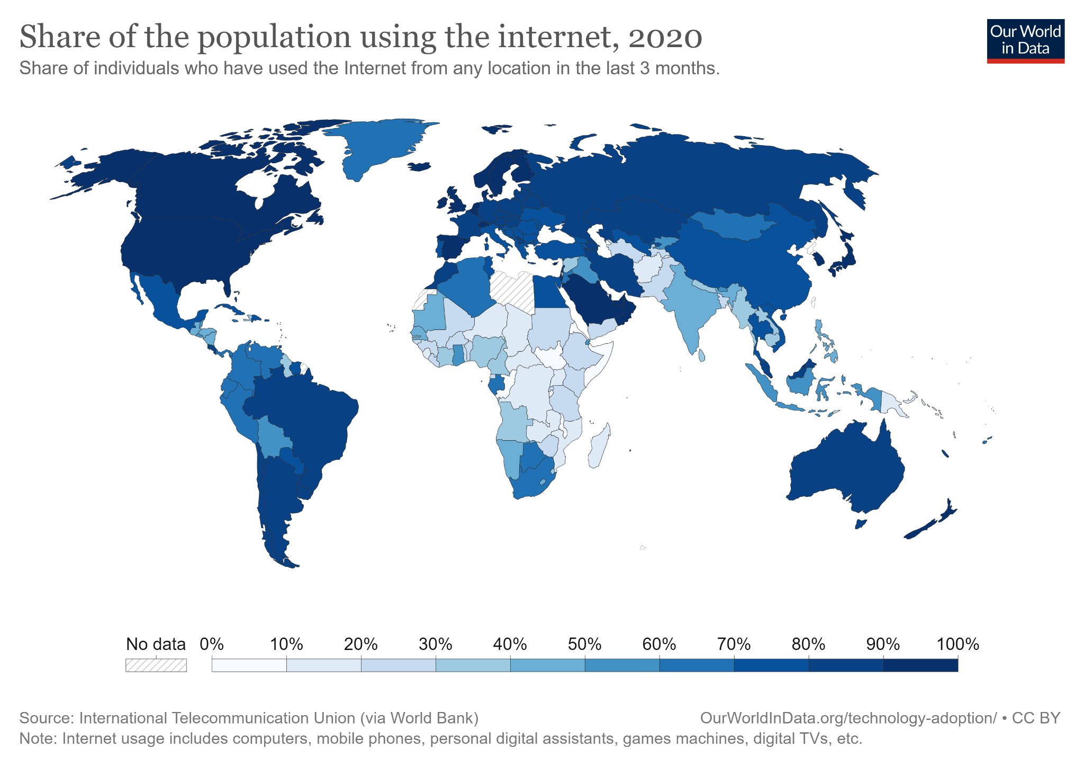

Slide 10
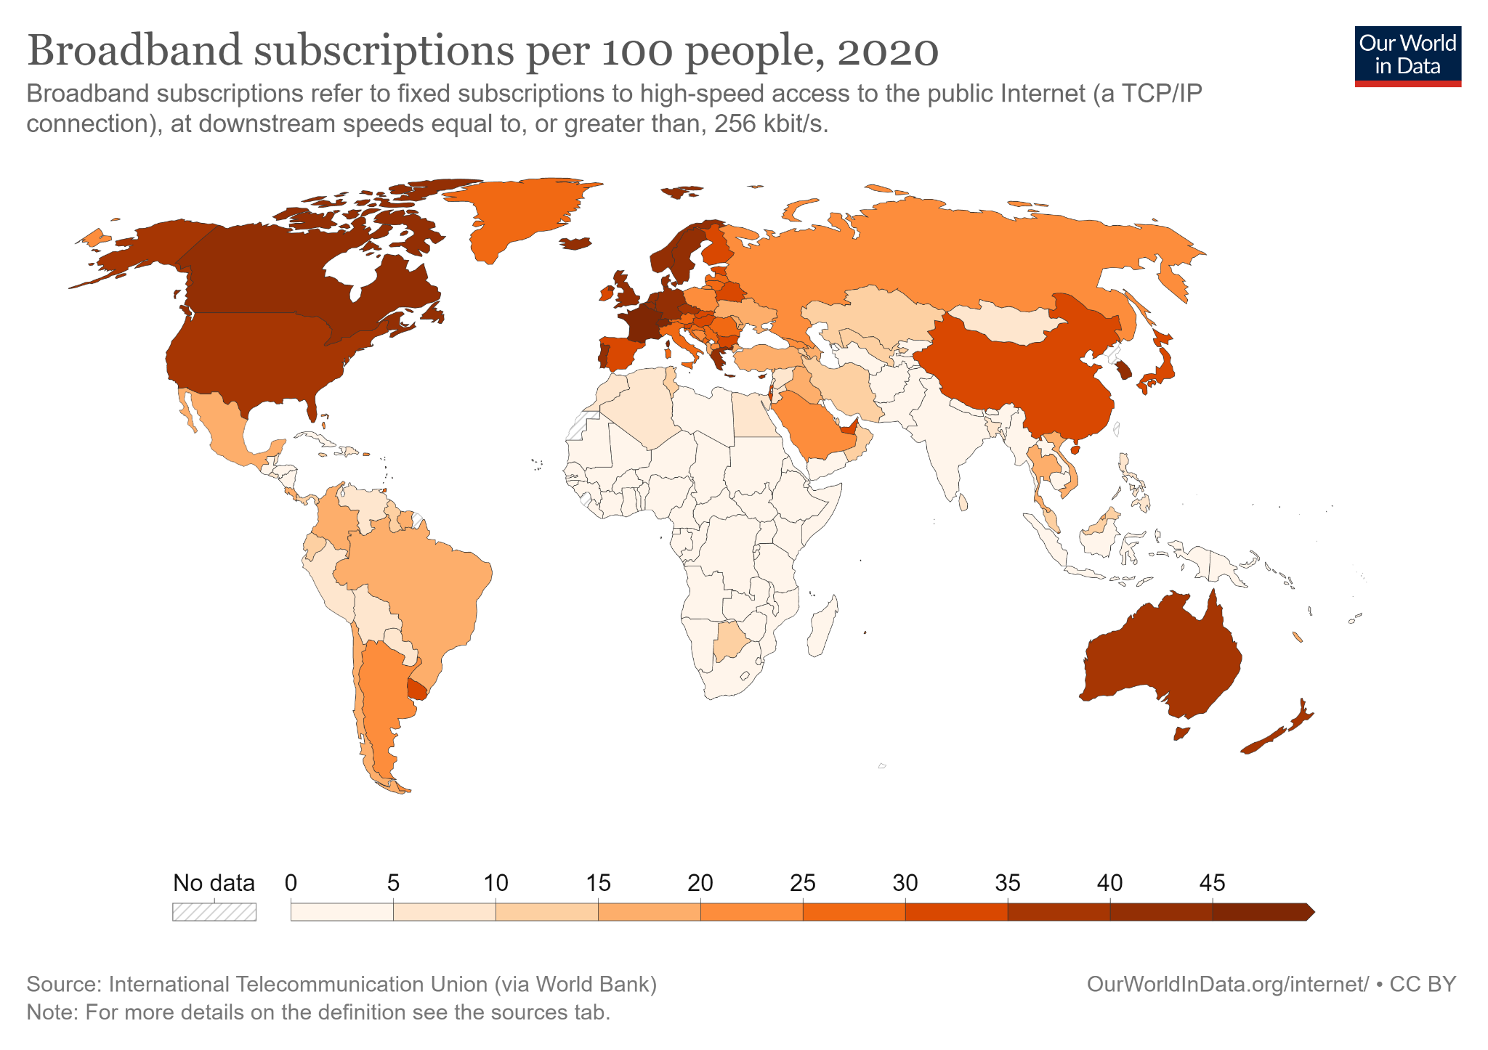
Notes:
Recommended internet download speeds for Netflix:
HD: 3 Mbps
FHD: 5 Mbps
4K/UHD: 15 Mbps

Slide 11
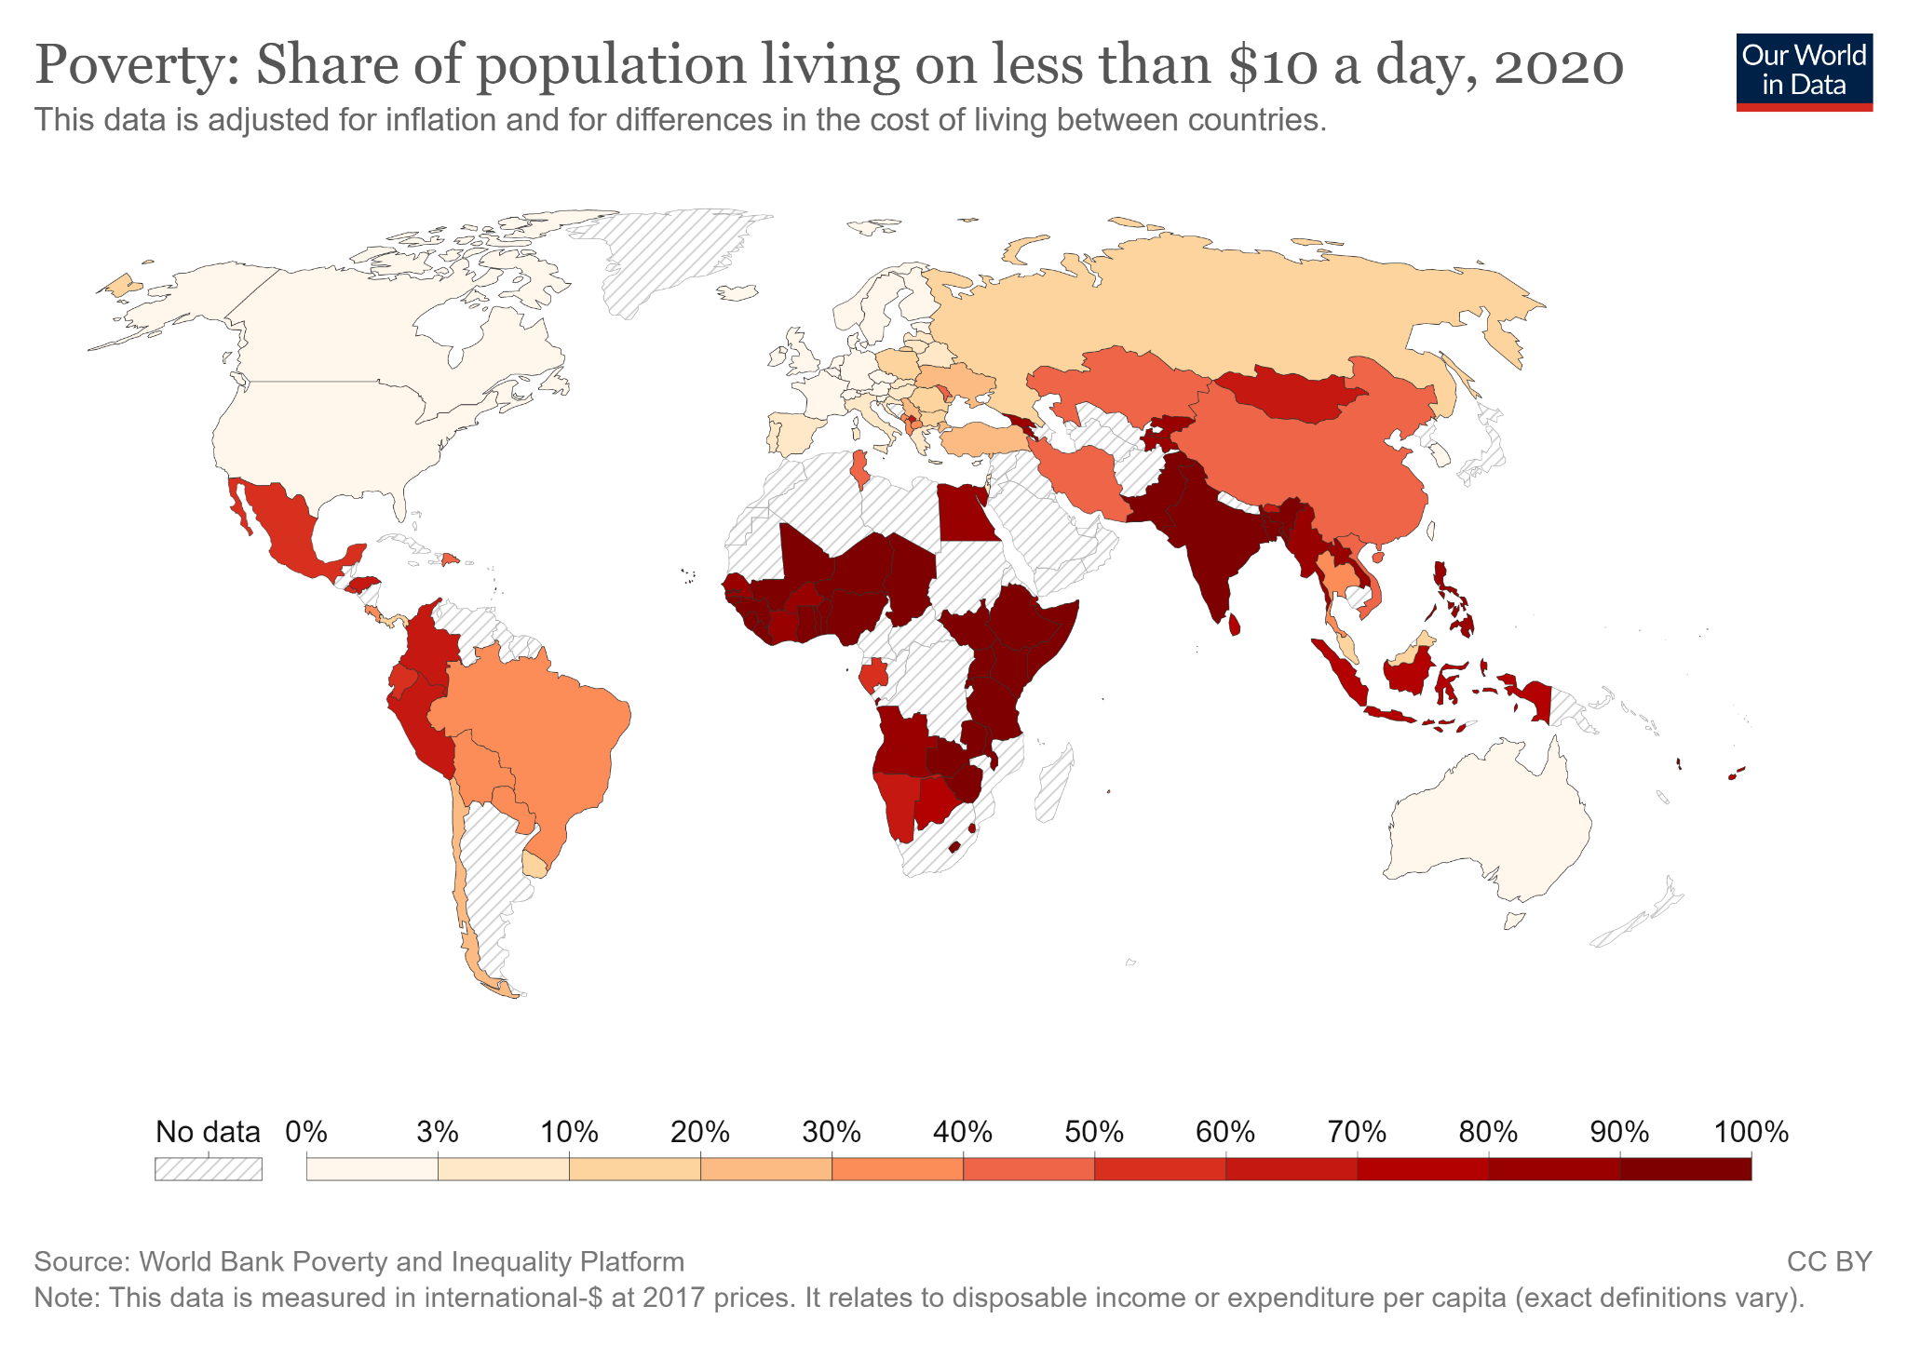

Slide 12

For everyone?
Working from anywhere is not a technical problem anymore, thanks to digitally enabled remote work, but it remains an economic-institutional one.
(Braesemann et al. 2022)
Local infrastructure
Job types
Urban / rural

Slide 13
Gender
Gender digital divide
globally, 62% of men are using the Internet compared with 57% of women
women remain digitally marginalized
in many of the world’s poorest countries
(ITU, 2021)
62%
57%

Slide 14
Age
=> generational gap
71 % of the world’s population aged 15-24 is using the Internet, compared with 57 % of all other age groups
On the global scale, in 2020, young people were 1.24 times more likely to connect than the rest of the population
57 %
71 %
(ITU, 2021)
Notes:
There is also a generational gap – 71 % of the world’s population aged 15-24 is using the Internet, compared with 57 % of all other age groups.
In 2020, 71 % of the world’s youth (aged between 15 and 24 years) were using the Internet, compared with 57 per cent of the other age groups. On the global scale, young people were thus 1.24 times more likely to connect than the rest of the population.

Slide 15
Digital divide(s)
I. level
01
Access to digital technology
II. level
02
Gaps in skills and usage
III. level
03
Differences in outcomes

Slide 16
What are digital skills?

Slide 17
Digital Skills
The ability to use information and communication technologies in
a way that helps achieve useful and quality results in everyday life
increase the benefits of using ICTs
reduce the potential risks of using ICTs
(Helsper et al., 2020; ITU, 2018)

Slide 18
How do we use them?

Slide 19
Communication
Content Creation
Leisure
Work/Education

Slide 20
Digital skills in our lives
Changes - in education, shopping, leisure…
Often necessary for performing basic tasks
Would it be possible to study at Masaryk University without having basic digital skills?

Slide 21
Digital Immigrants
Digital Natives
born before the widespread adoption of digital technology
born after the widespread adoption of digital technology
Not all children born today are digital natives by default!
Notes:
HOWEVER
Not all children born today are digital natives by default. Interacting regularly with technology at a young age is the deciding factor. (So it depends also on countries, SES…)
That said, children today are more likely to be familiar with the terminology of the digital world. This isn’t to say they will intuitively understand computer programming or how a network transmits data. They will, however, be better placed to understand these technologies as they will have seen them in action many times.

Slide 22
…and what about Covid?
Notes:
Můžeme a nemusíme nechávat

Slide 23
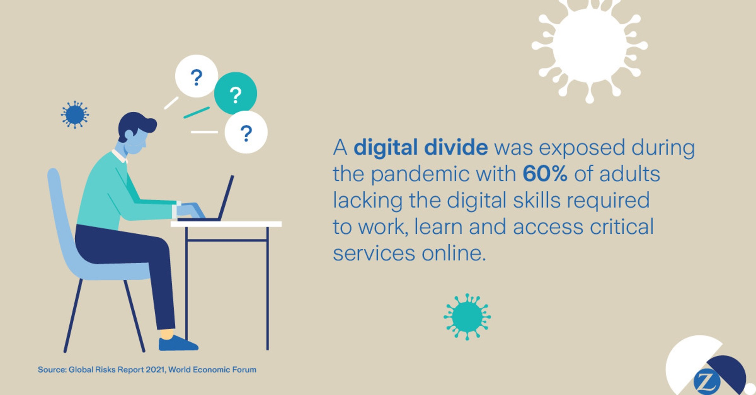
Notes:
Můžeme a nemusíme nechávat

Slide 24
What can we do about this?
Notes:
(Š)

Slide 25
The role of significant others in establishing user practices
Notes:
(Š)

Slide 26
Networked individualism
Easing of traditional formal ties
Internet, mobile devices
Notes:
(Š)

Slide 27

Social capital
Bridging vs. bonding ties
Social homophily
The consequence of the unequal distribution of skills and of the different use of support sources is an unequal distribution of the benefits the Internet has to offer.
(van Deursen, Courtois, and van Dijk 2014)
Notes:
(Š)

Slide 28
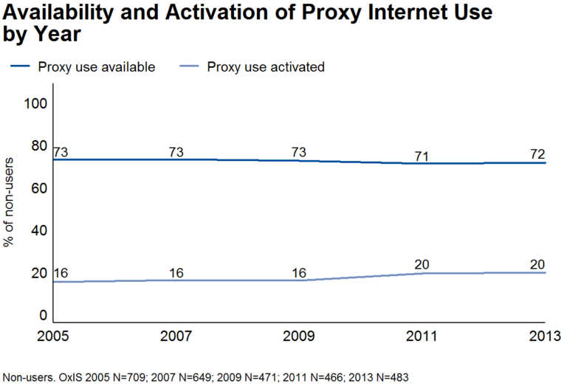

Slide 29
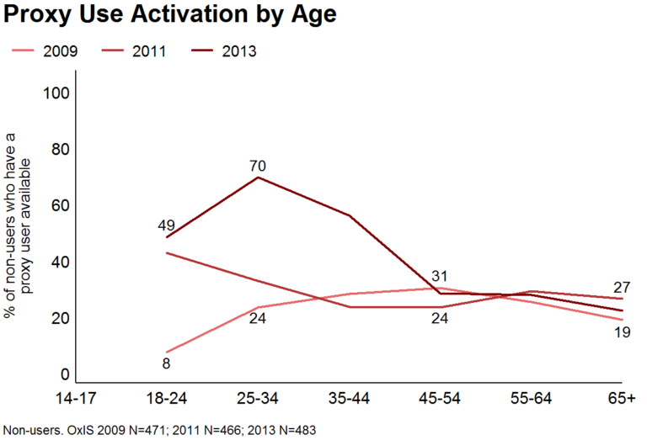

Slide 30
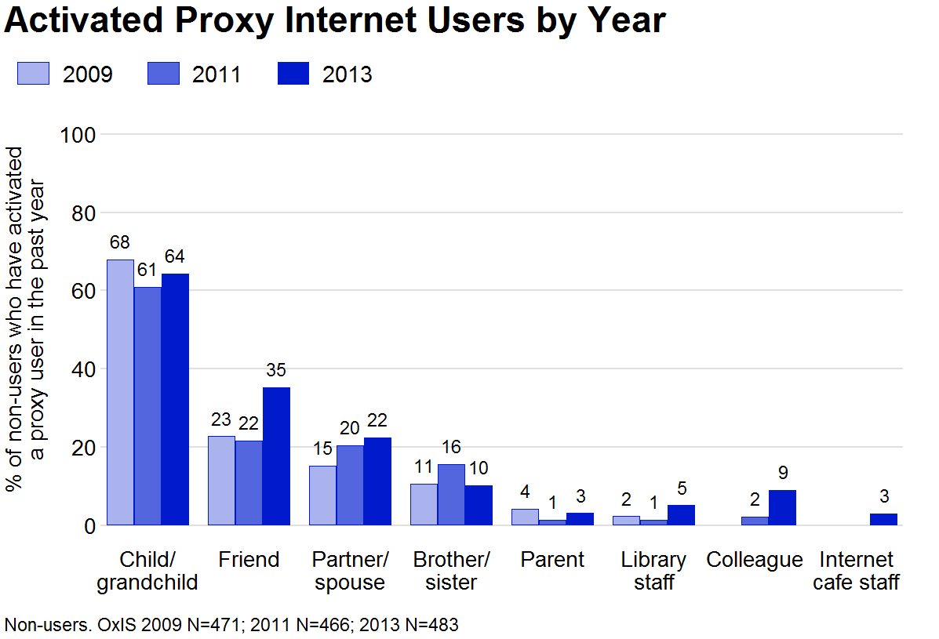

Slide 31

Forms of help
Warm experts
Proxy users
Notes:
(Š)

Slide 32
Are digital skills always beneficial?
Notes:
Having digital skills, based on what was said, seems like a great thing – you may interact with friends, find jobs, learn, …
(Do you agree?)

Slide 33
Double-edged weapon?
CATFISHING
JOB OFFERS
MUSIC
ANONYMITY
COMMUNICATION
NEWS
LEAKED INFO
PORN
MOVIES
CAT VIDEOS
E-SHOPS
CYBERBULLYING
DARK WEB
BETTING
WEATHER FORECAST
Notes:
Being able to dive deeper into the online world may also uncover vast content that may potentially be negative …

Slide 34
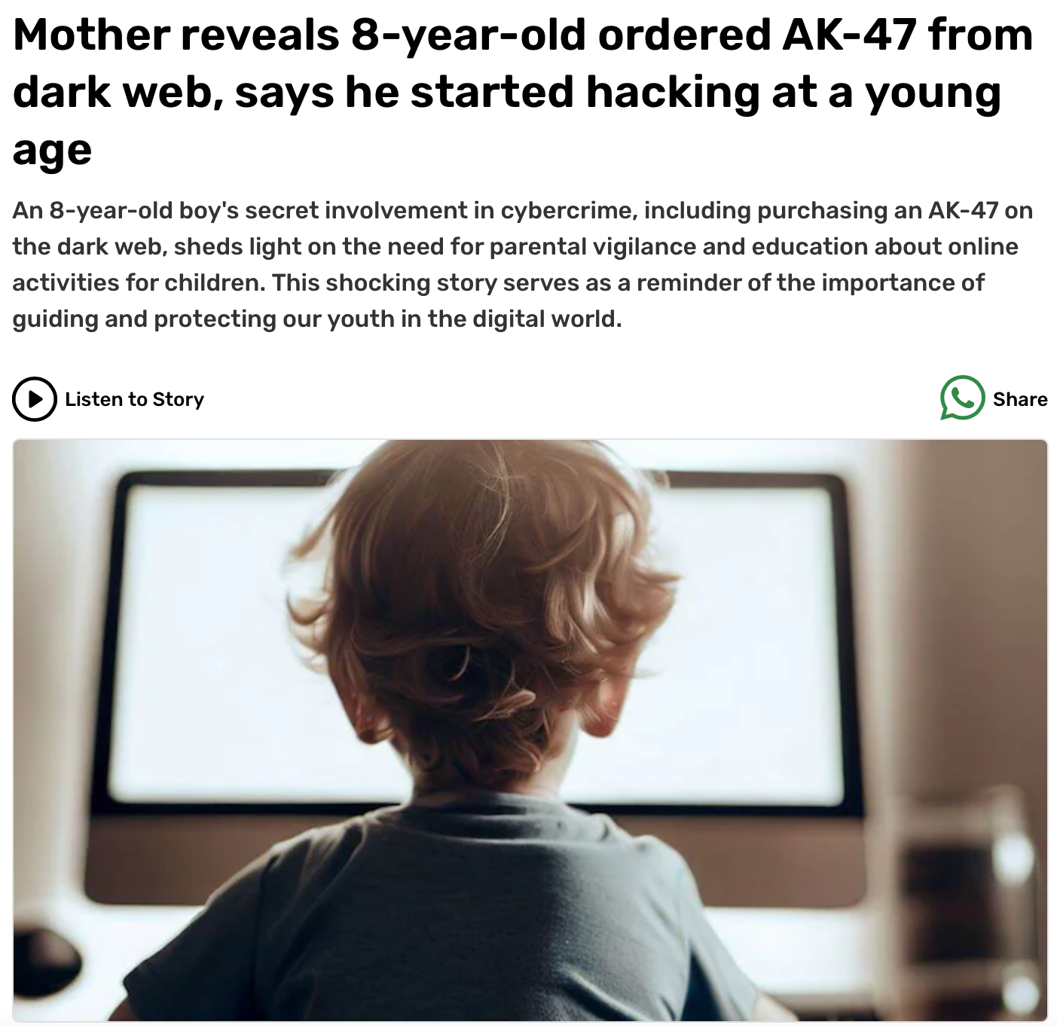
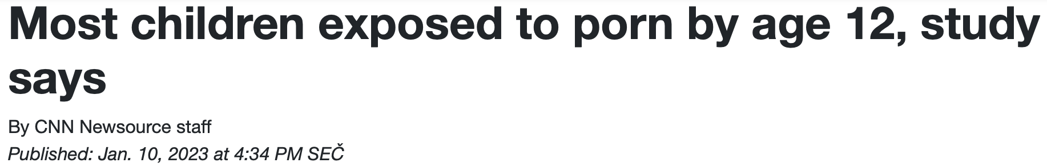
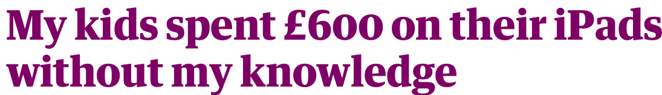
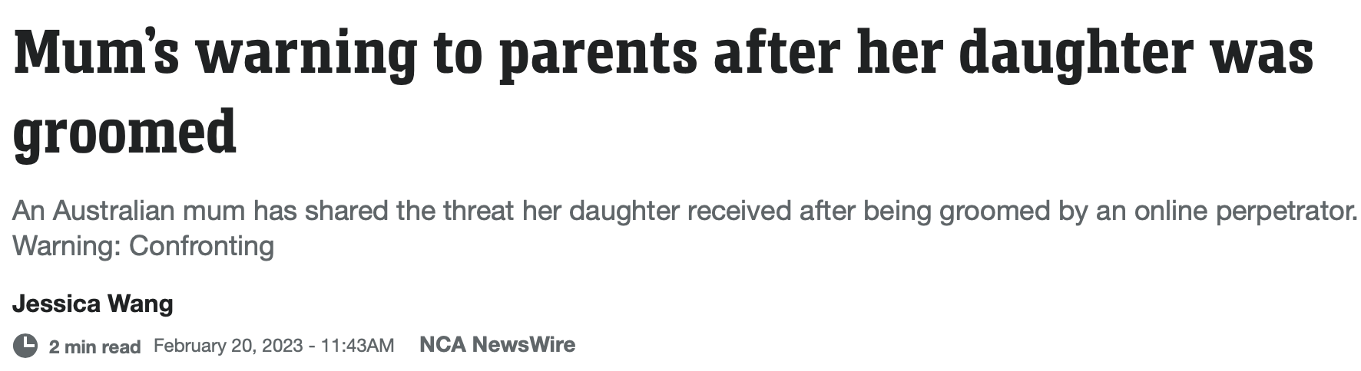
Double-edged weapon?
CATFISHING
ANONYMITY
LEAKED INFO
MOVIES
E-SHOPS
WEATHER FORECAST
Notes:
Being able to dive deeper into the online world may also uncover vast content that may potentially be negative …

Slide 35
More skilled people use more online opportunities
Notes:
Based on current research, we know that mode digitally skilled people use more online opportunities, i.e. they spend logically more time online

Slide 36
More skilled people use more online opportunities
Those who spend more time online, encounter more risks
Notes:
However, as they are online longer, there are more occasions in which they may encounter risks

Slide 37
More skilled people use more online opportunities
Those who spend more time online, encounter more risks
More skilled people are more at risk
Notes:
Based on that, we may conclude that more skilled people are more at risk

Slide 38
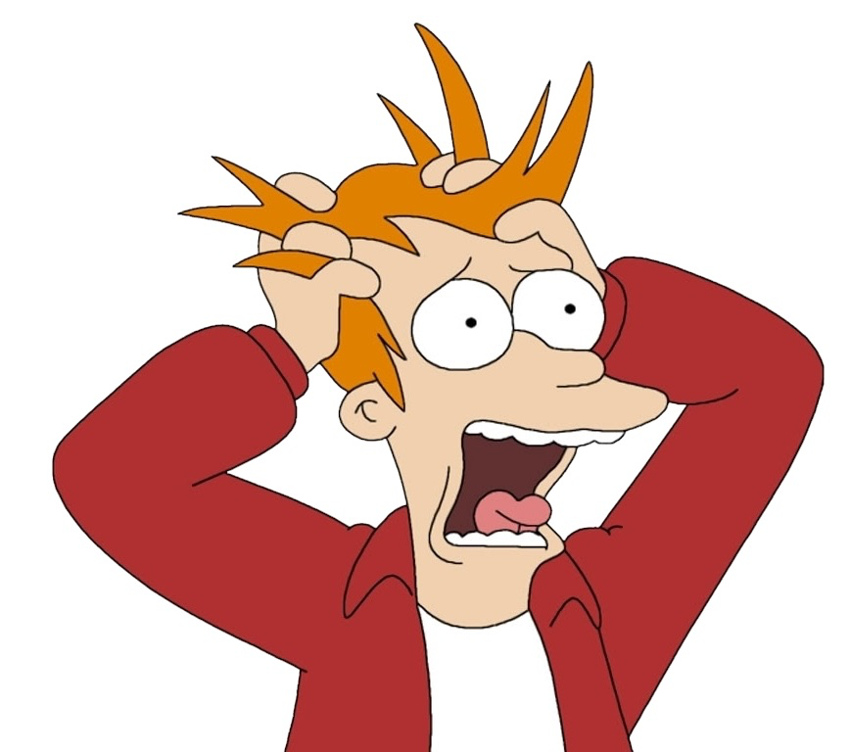
More skilled people use more online opportunities
Those who spend more time online, encounter more risks
More skilled people are more at risk
Notes:
So what should we do about it?

Slide 39

higher levels of digital skills are associated with more exposure to risky and potentially harmful online content
(Donoso et al., 2020)
Notes:
Even thought higher levels of digital skills are associated with more exposure to risks and potentially harmful online content …

Slide 40

higher levels of digital skills are associated with more exposure to risky and potentially harmful online content
(Donoso et al., 2020)
specific digital skills might in turn act as protective factors against risks
(van Deursen, 2020;
van Deursen & Helsper, 2017)
Notes:
It is also assumed that specific digital skills might in turn act as protective factors against risks
(Do you have any ideas what type of digital skills those might be?)

Slide 41

Content filtering
Firewall and Antivirus
Password Management
Secure Communication
Phishing Awareness
Software Updates
…. and many more

Slide 42
Harm or not?
Exposure to risky content ≠ harm will follow
Notes:
However, it is important to keep it mind that even though one is exposed to, for instance, a potentially harmful content (video of someone abusing drugs, …) it does not automatically mean that harm will follow.
Some people may more easily cope with such exposures, so we are unable to give generalizing conclusions such as – all the pornography will harm and traumatize our kids!

Slide 43

Harm or not?
Notes:
If someone will or will not experience harm is based on multiple factors, raging from age, education… to the fact if, for example in case of children, their parents or caregivers do so called „mediation“ and talk with them about online dangers.
Current research is now trying to disantangle what are the common factors between the most vulnerable groups.

Slide 44
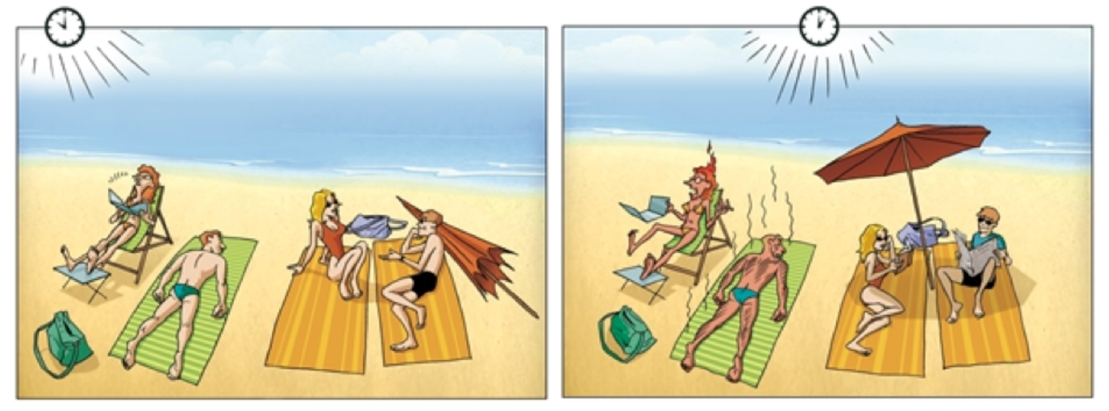
Harm or not?
Notes:
ON THE LEFT: risky situation -> you may get (sun)burned. But there are multiple factors included -> you may be exposed to sun but if you wear a sunscreen or other protection, you may be ok (without harm). Or, coming back to the case of kids, if they are aware of such threat from the sun, they may soon seek shadow. Maybe their parents or friends talked to them about the possibilities of getting sunburned.. So they will be more careful / will be aware how to act.
So => not everyone who enters the beach on a sunny day will experience harm in form of a sunburn

Slide 45
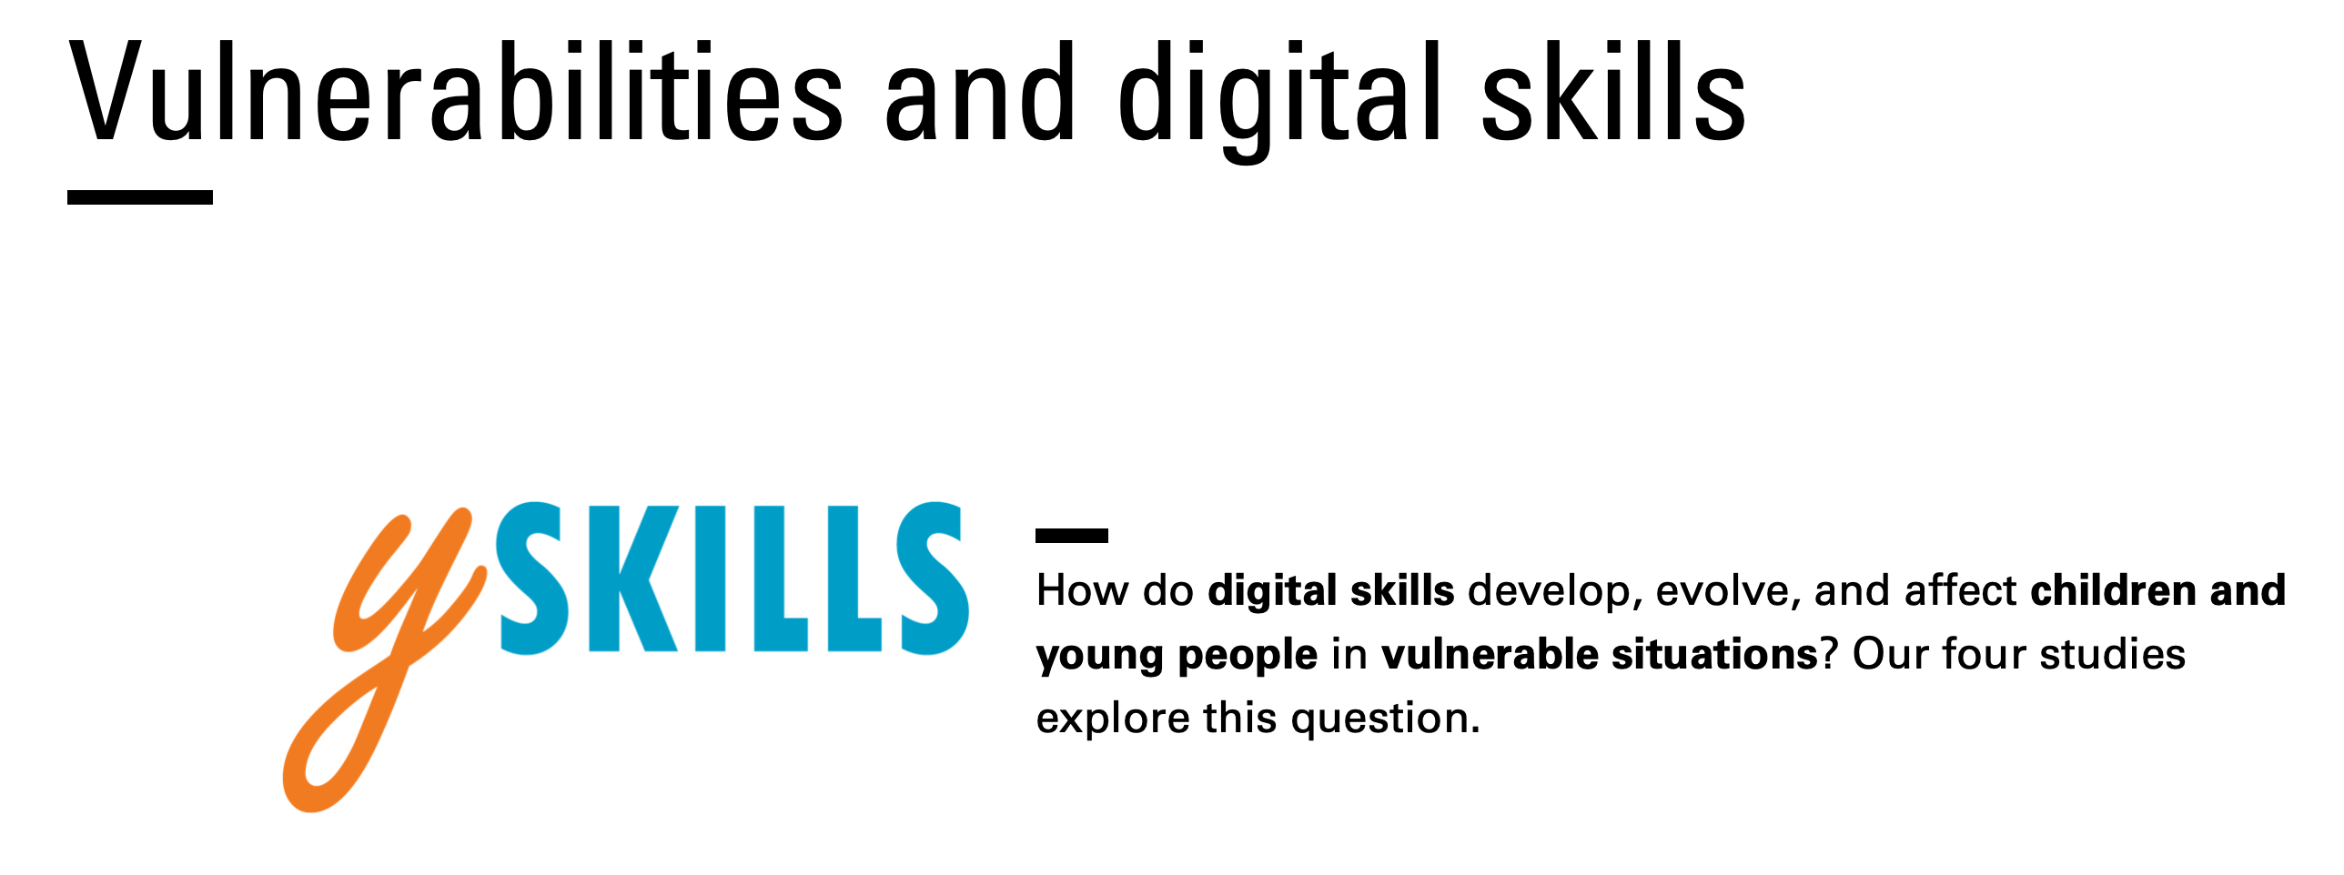
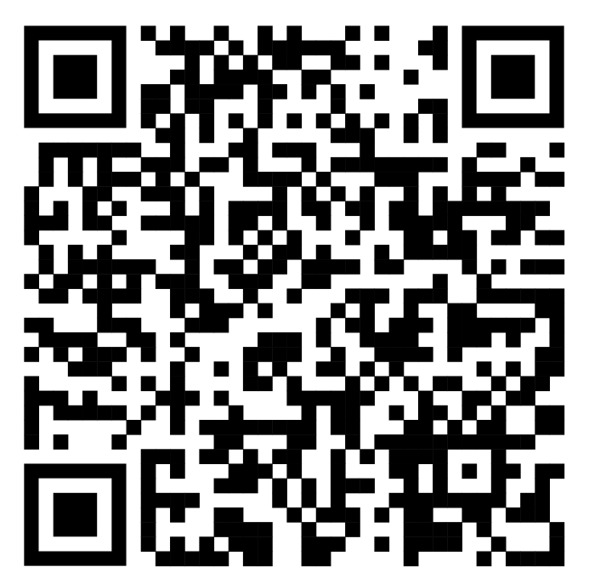
https://sway.office.com/un18yna6R9XlPEuV?ref=Link
Notes:
Natalie is currently participating on a project called ySKILLS, where they, among other things, focus on digital skills of children and its relation to risks and opportunities.
If you wan to earn more, you may check the ySKILLS website or, use the link below (you will have the ppt in your interactive sylaby) or scan the QR code
to check this interactive report focusing mainly on vulnerabilities.

Slide 46
Digital divide(s)
I. level
01
Access to digital technology
II. level
02
Gaps in skills and usage
III. level
03
Differences in outcomes
IV. level
04
Differences in treatment

Slide 47
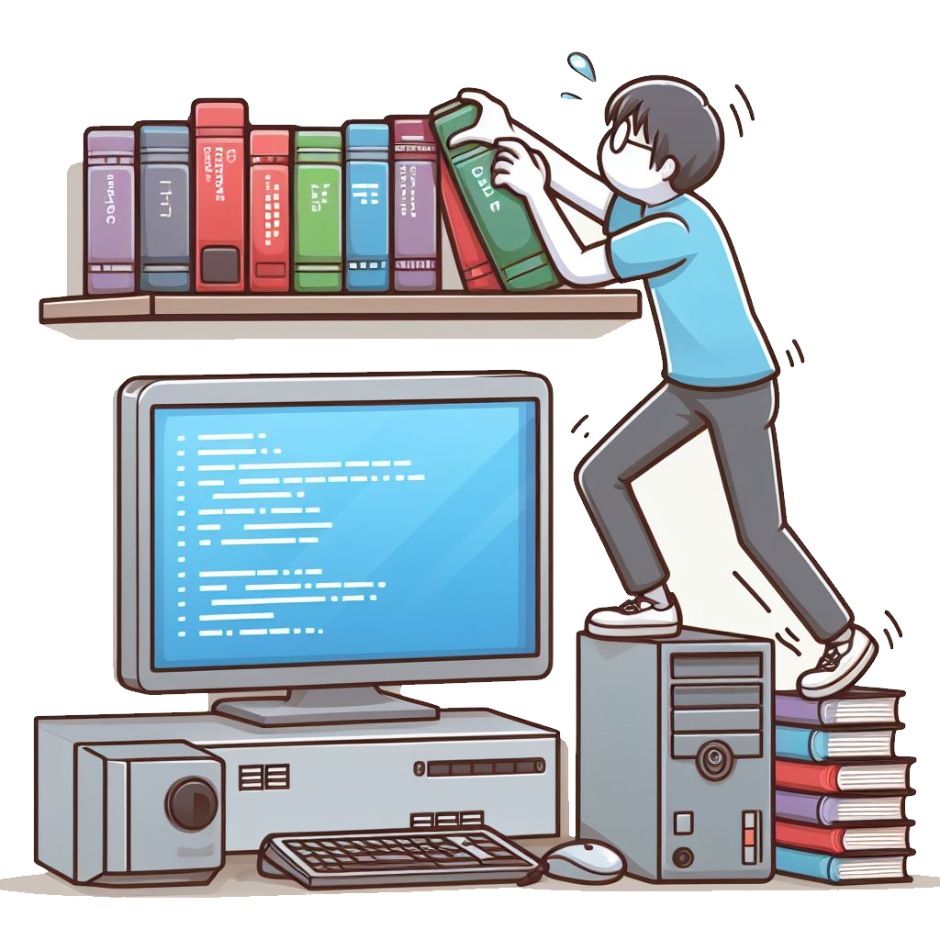
Bias in, bias out
Design, affordances
Algorithm as an objective impartial fact
Knowledge – database – treatment

Slide 48
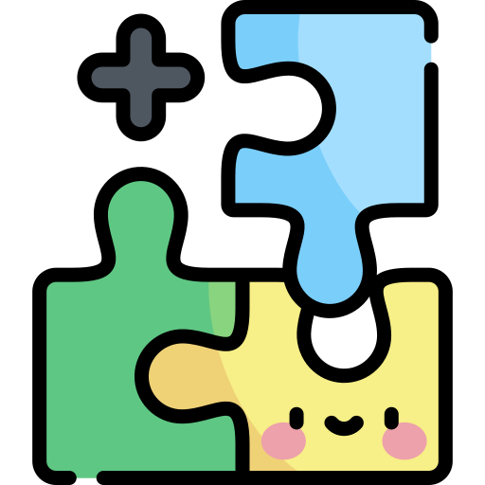
Take-home message(s)
Digital skills are important for efficient functioning in today's society
Not all digital natives are digital-savvy!
There are several forms of digital inequality, at several levels
(age, gender, country, …)
To overcome the digital divide, others can help us (...but!)
Digital skills are not solely helpful - they can also lead us to risks
Inequalities should be addressed on both individual and societal levels

Slide 49

Thank you for your attention!

Slide 50



Let’s stay in touch!
Mgr. et Mgr. Natálie Terčová
Interdisciplinary Research Team on Internet
and Society (IRTIS)
natalieterc@mail.muni.cz
Mgr. Štěpán Žádník
Department of Media Studies and Journalism,
FSS MU
stepan.zadnik@muni.cz

Slide 51
Sources
Braesemann, F., Stephany, F., Teutloff, O., Kässi, O., Graham, M., & Lehdonvirta, V. (2022). The global polarisation of remote work. PLOS ONE, 17(10), e0274630. https://doi.org/10.1371/journal.pone.0274630
Donoso, V., Retzmann, N., Joris, W., & d’Haenens, L. (2020). Digital Skills: An Inventory of Actors and Factors. KU Leuven, Leuven: ySKILLS.
Dutton, W. H., & Blank, G. (2013). Oxford Internet Survey 2013 Report: Cultures of the Internet (p. 64). http://oxis.oii.ox.ac.uk/wp-content/uploads/2014/11/OxIS-2013.pdf
Helsper, E.J., Schneider, L.S., van Deursen, A.J.A.M., & van Laar, E. (2020). The youth Digital Skills Indicator: Report on the conceptualisation and development of the ySKILLS digital skills measure. KU Leuven, Leuven: ySKILLS.
International Telecommunication Union (ITU) (2021). Measuring digital development: Facts and figures. Geneva, Switzerland: ITU Publications.
International Telecommunication Union (ITU) (2018). Measuring the Information Society report, Volume 1. Geneva, Switzerland: ITU Publications.
Keipi, T., Näsi, M., Oksanen, A., & Räsänen, P. (2017). Online Hate and Harmful Content: Cross-national perspectives. Routledge.
Livingstone, S., & Stoilova, M. (2021). The 4Cs: Classifying Online Risk to Children. (CO:RE Short Report Series on Key Topics). Hamburg: Leibniz-Institut für Medienforschung | Hans-Bredow-Institut (HBI); CO:RE - Children Online: Research and Evidence.
van Deursen, A. J. A. M. (2020). Digital inequality during a pandemic: Quantitative study of differences in COVID-19-related internet uses and outcomes among the general population. Journal of Medical Internet Research, 22(8). doi:10.2196/20073.
van Deursen, A. J. A. M., & Helsper, E. J. (2017). Collateral benefits of internet use: Explaining the diverse outcomes of engaging with the Internet. New Media & Society, 20(7), 2333–51. doi:10.1177/1461444817715282.
van Deursen, A. J. A. M., Courtois, C., & van Dijk, J. A. G. M. (2014). Internet Skills, Sources of Support, and Benefiting From Internet Use. International Journal of Human-Computer Interaction, 30(4), Article 4. https://doi.org/10.1080/10447318.2013.858458
Icons retrieved from Flaticon
Infographics by Slidesgo
Image generated by Image Creator from Microsoft Designer

