Slide 1

Political participation and discussions on social media
Karolína Bieliková
Martina Novotná
CMA17: Current Issues in Research of Media and Audiences

Slide 2
Today‘s lesson
01
02
03
What is political participation?
Types of participation
Dark
participation
Traditional vs. news forms of political participation
New opportunities?
Ideal model
Expressive vs. passive
Online political discussions
Mis/disinformation
Conspiracy thoeries
Incivility and intolerance

Slide 3
01
What is political participation?
Notes:
Using slido creating wordcloud what kinf of activities they imagine under political participation

Slide 4
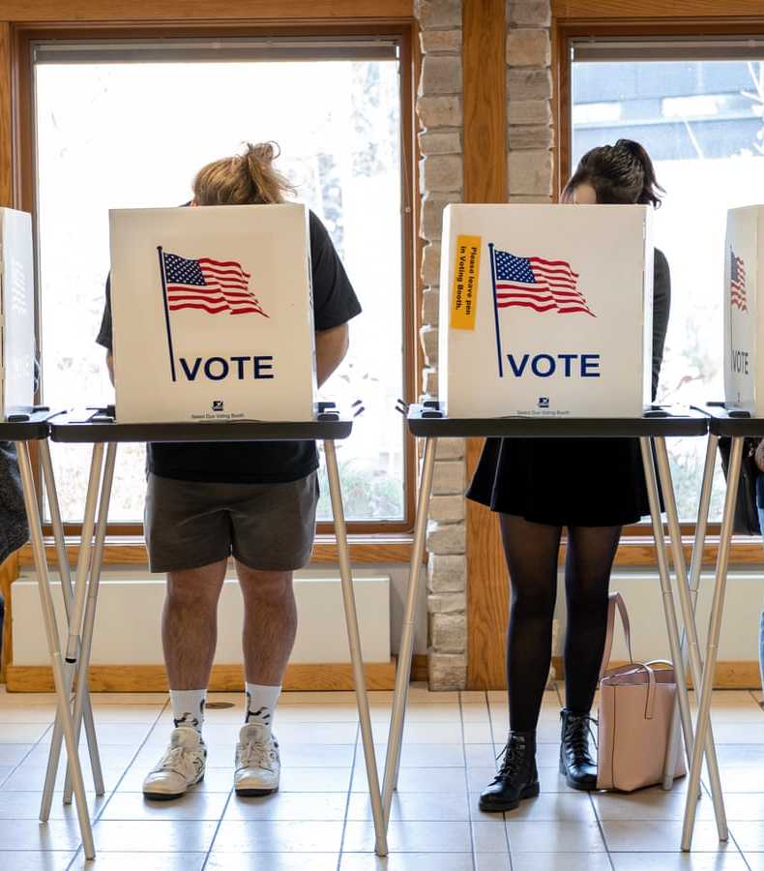
Political participation
‘those activities by private citizens that are more or less directly aimed at inﬂuencing the selection of governmental personnel and/or the actions they take’ (Verba & Nie, 1972)
Reflects activities not attitudes
Spectrum of what activities are political participation is getting wider with the use of internet and growing number of social media (Waeterloos, Walrave, & Ponnet, 2021; Lee & Kim, 2021)

Slide 5
Traditional political participation
(Verba & Nie, 1972)
Verba and Nie’s seminal deﬁnition cited above, political participation has four minimal deﬁnitional features:
  (i) participation is an activity,
  (ii) it is voluntary and not ordered by a ruling class or obliged under some law,
  (iii) it refers to people in their role as non-professionals or amateurs,
  (iv) it concerns government, politics, or the state
Voting
Cooperative activity
Campaign activity
Citizen- initiated contact

Slide 6
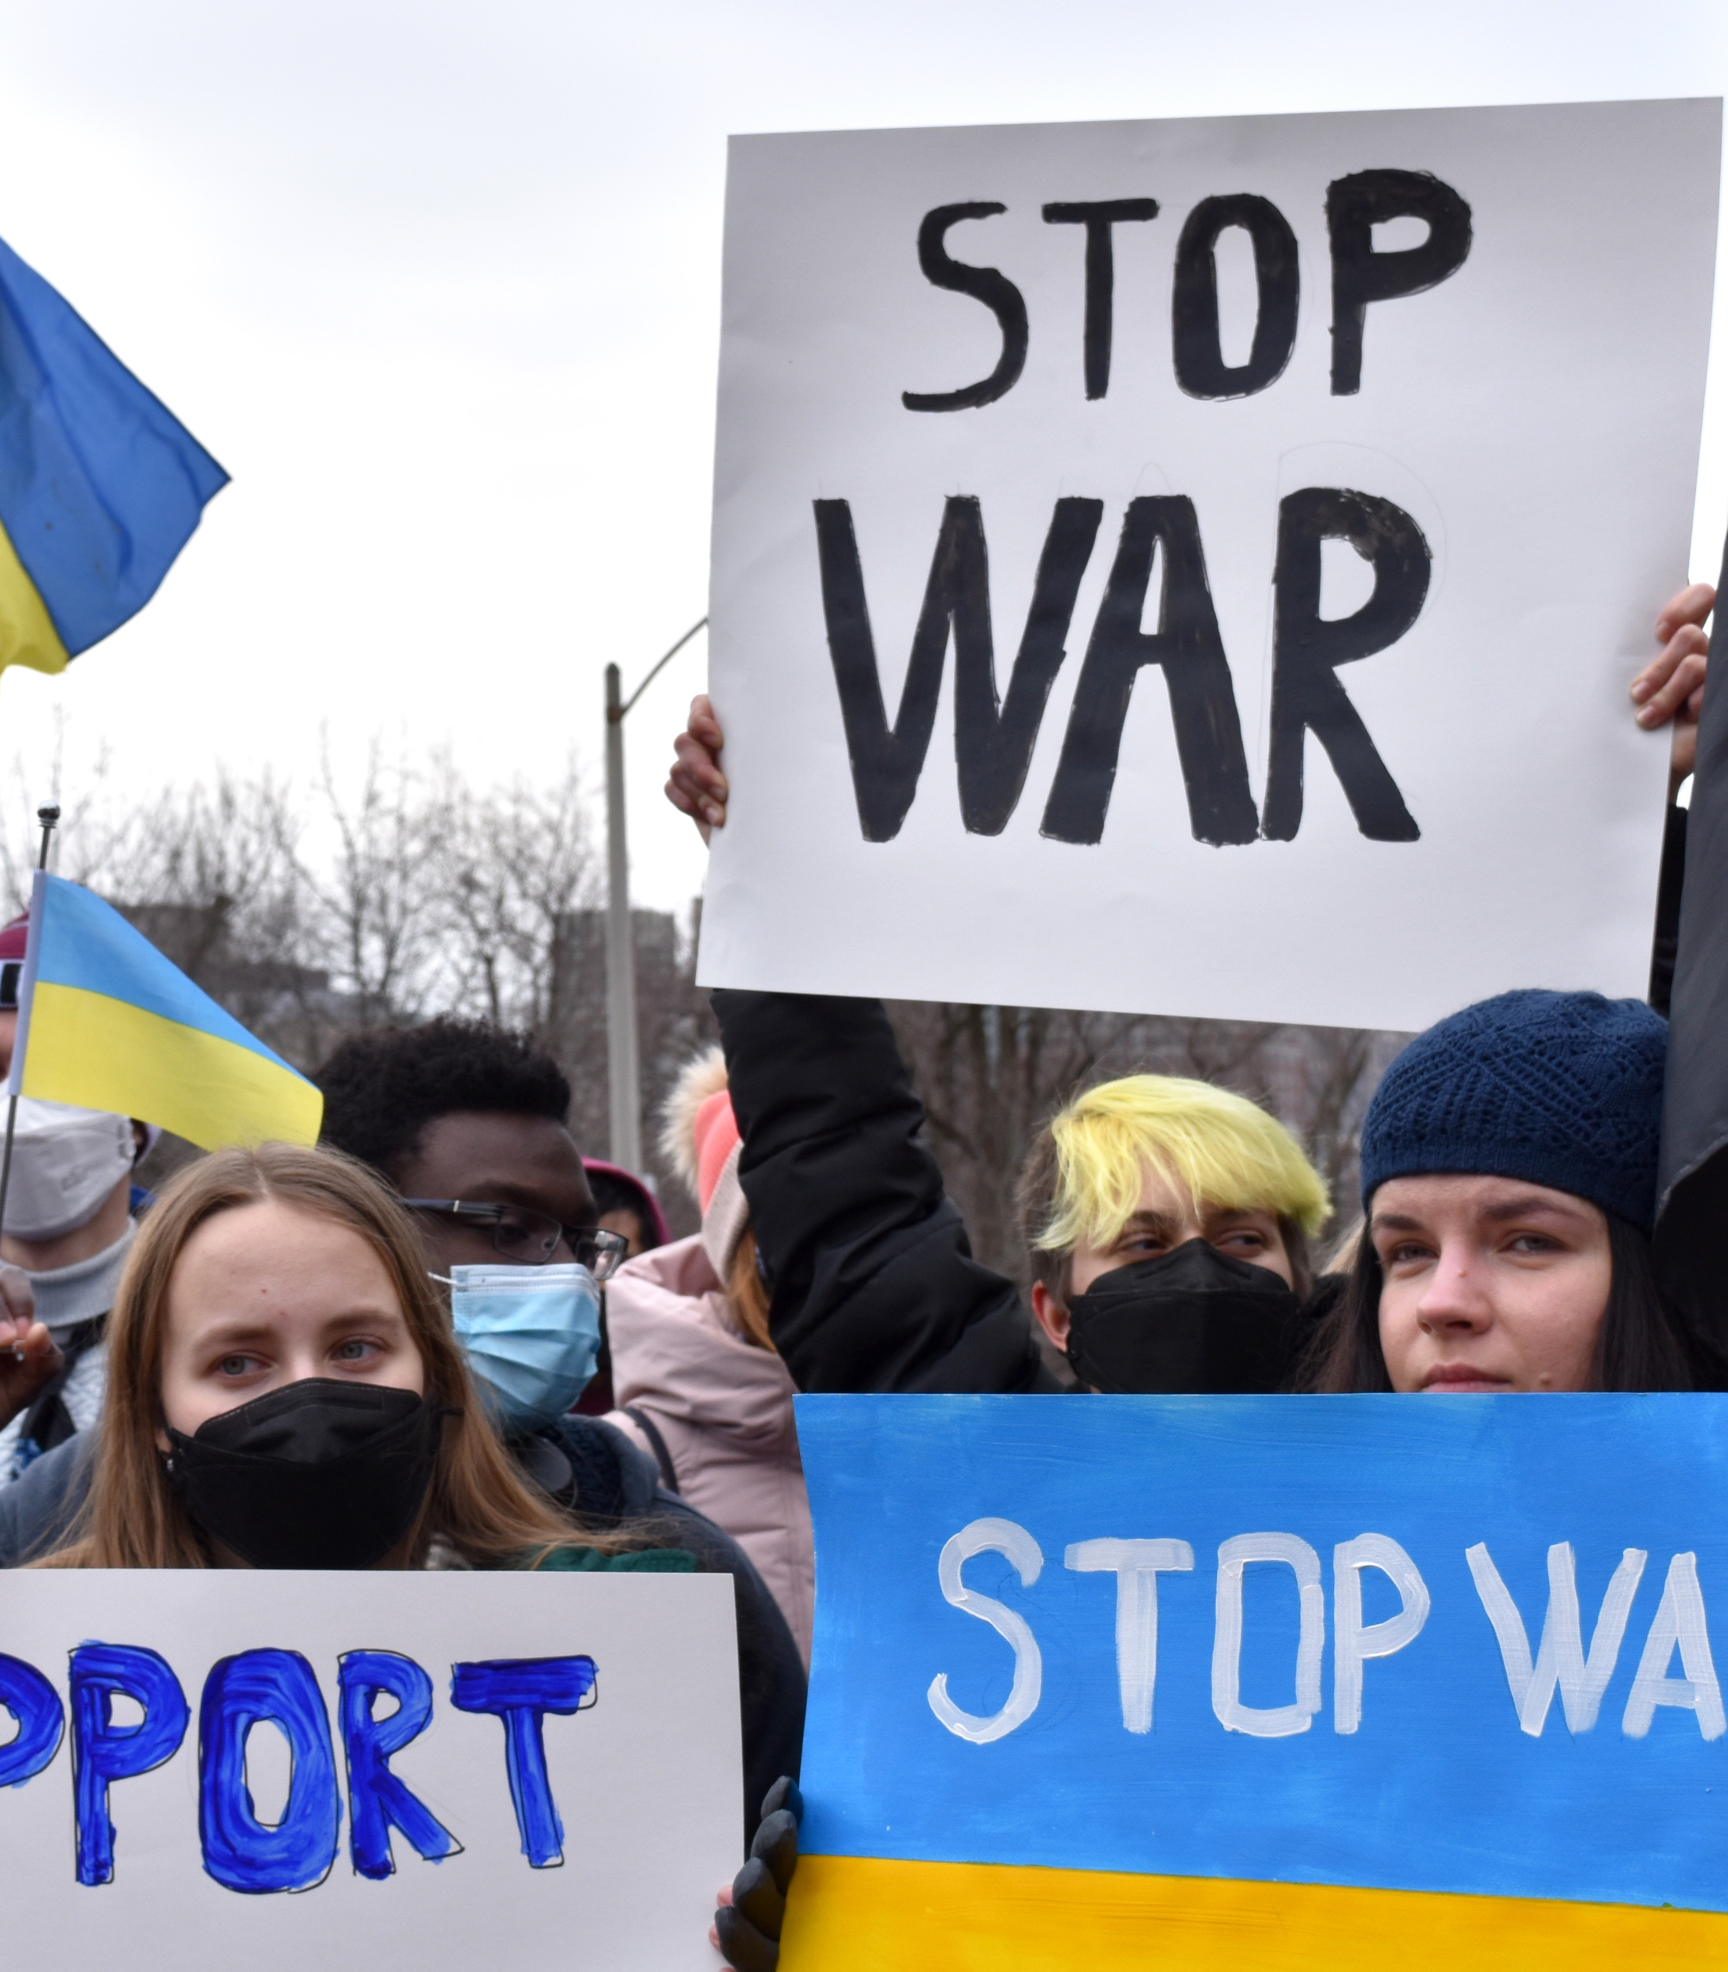
New forms of participation
Opening up the definition of participation: ‘any dimensions of social activity that are either designed directly to inﬂuence government agencies and the policy process, or indirectly to impact civil society, or which attempt to alter systematic patterns of social behavior’ (Norris, 2002: 16)
Blurring the boundaries between political and civic participation
Additional forms of participation such as joining boycotting or attending demonstrations

Slide 7
What can change with internet?
Do you see any new possibilities?
What are new types of participation people can use now?

Slide 8
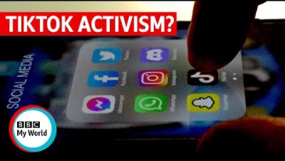

Slide 9
What does the internet change?
More voices/perspective
Direct communication
Blog, vlogs or social media account as a space for voicing own opinions
More opportunities for marginalized voices than through traditional communication channels
Citizens can more directly communicate with politcal actors
Political actors have more actors mointoring their behaviour
Open place for discussion
Bottom-up engagement
Opportunities to discuss current topics with more people
Supporting democracy and further participation
Citizen engagement can more easily be noticed and lead to change
Raising issues overlooked by traditional media/political actors

Slide 10
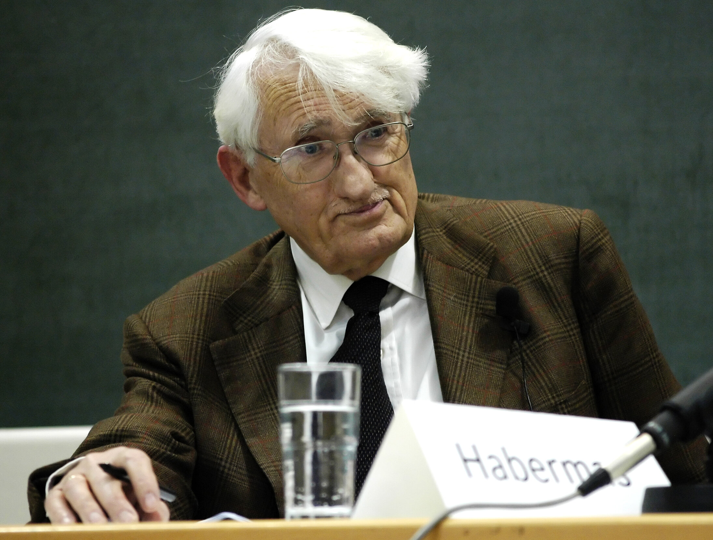
Ideal model of political participation
Habermas: Public sphere (1989)
  “a domain for of our social life in which such as a thing as public opinion can be formed“
A place where people openly discuss current topics/events and matters of concern
Mediated between state and society
In theory it is open to everyone and free from coercion or intimidation by state
A space where common good can be discussed and decided upon

Slide 11
02
Types of participation
Notes:
Using slido creating wordcloud what kinf of activities they imagine under political participation

Slide 12
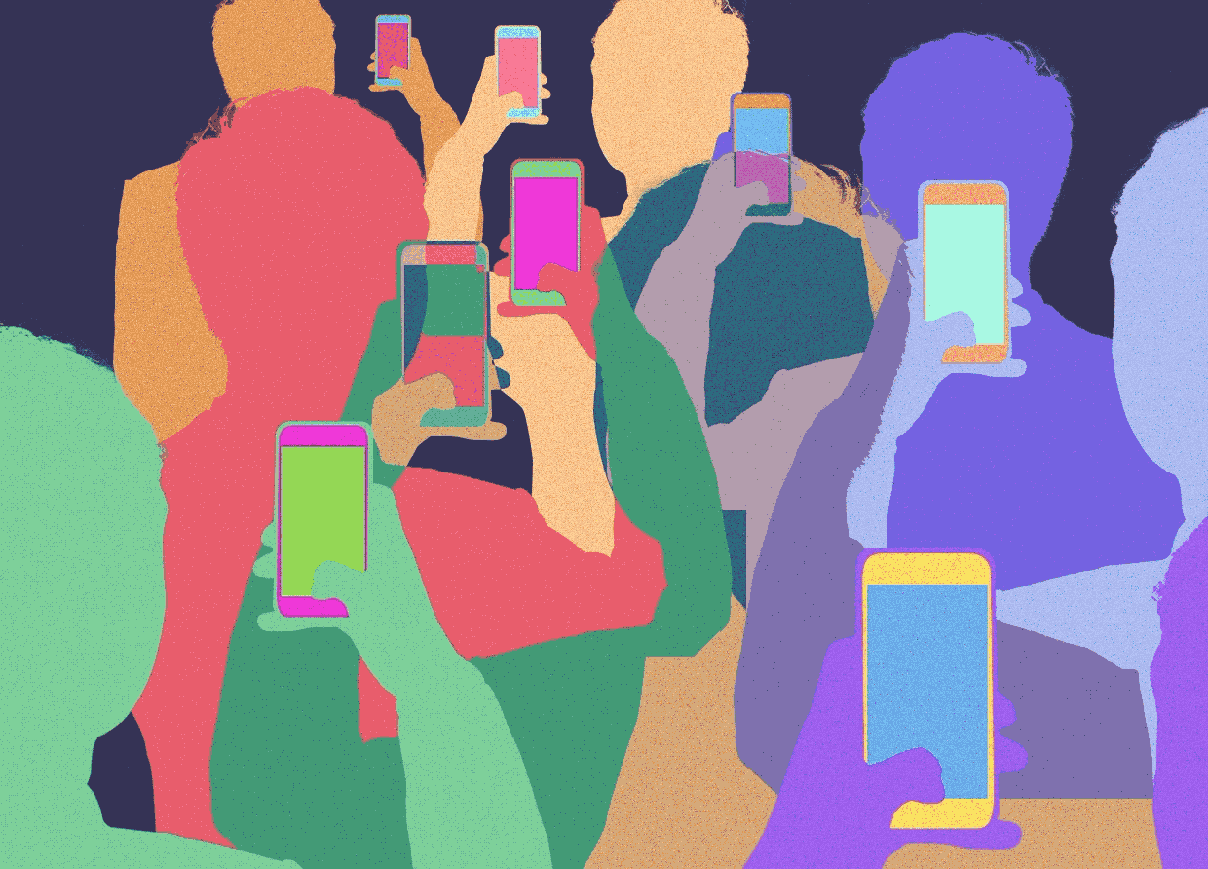
How can online participation look like?
Expressing one‘s opinion online
BUT growing number of social media leads to grosing numbers of activities that can be considered political participation
What can we still consider as political participation?

Slide 13
SOCIAL MEDIA STRATEGIES
Expressive participation
Passive participation
Main attribute is that is more visible
Sharing, writing posts, posting images, creating events etc.
By some users considered more effective than passive participation
Takes more effort
Not as visible
Reading posts, comments, events, etc.
Often seen as less effective
Is like expressive or passive?

Slide 14
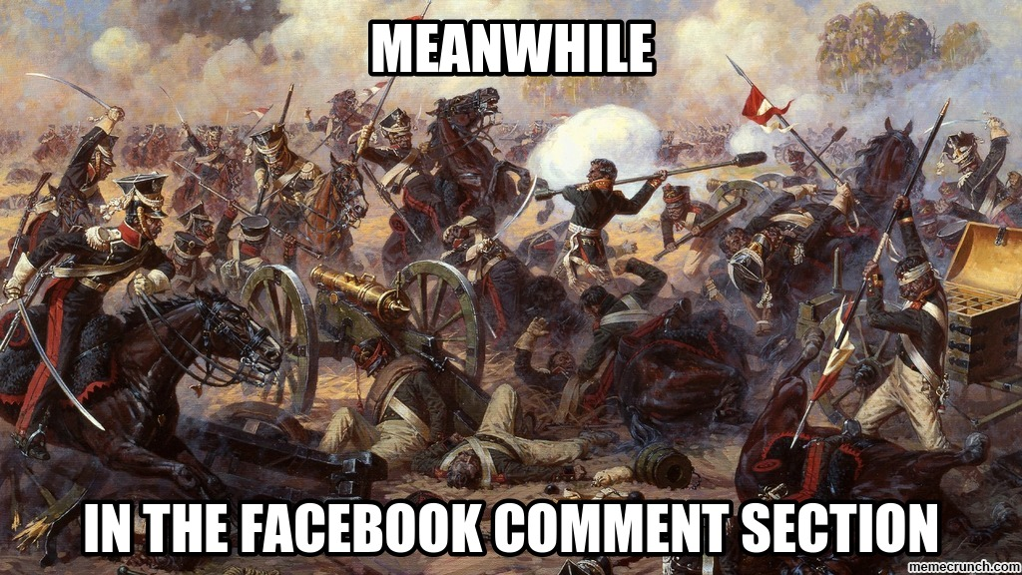
Passive participation – does it do anything?
Users often do not consider activities of passive participation as an act of political participation (f.e. reading posts, comment section)
This type of participation can be perceived as less important because it is not visible to the public
BUT passive participation can lead to expressive participation
Influence on attitudes and opinions

Slide 15
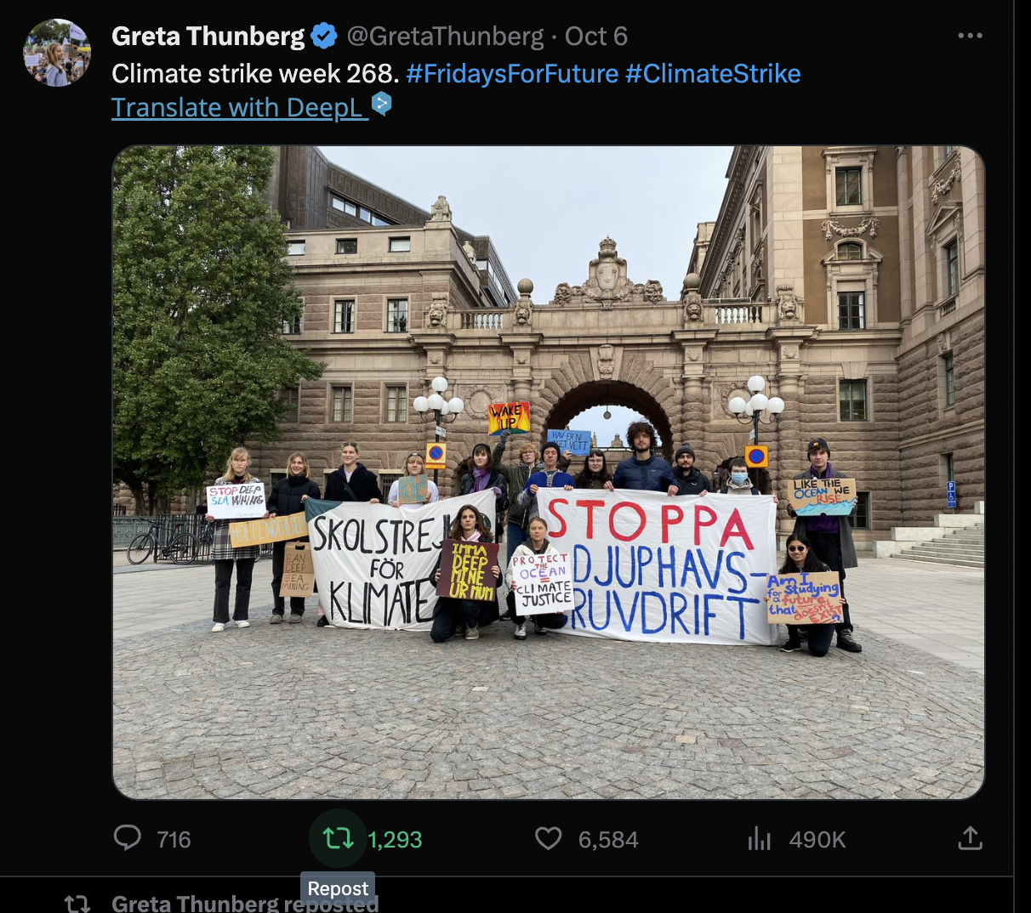
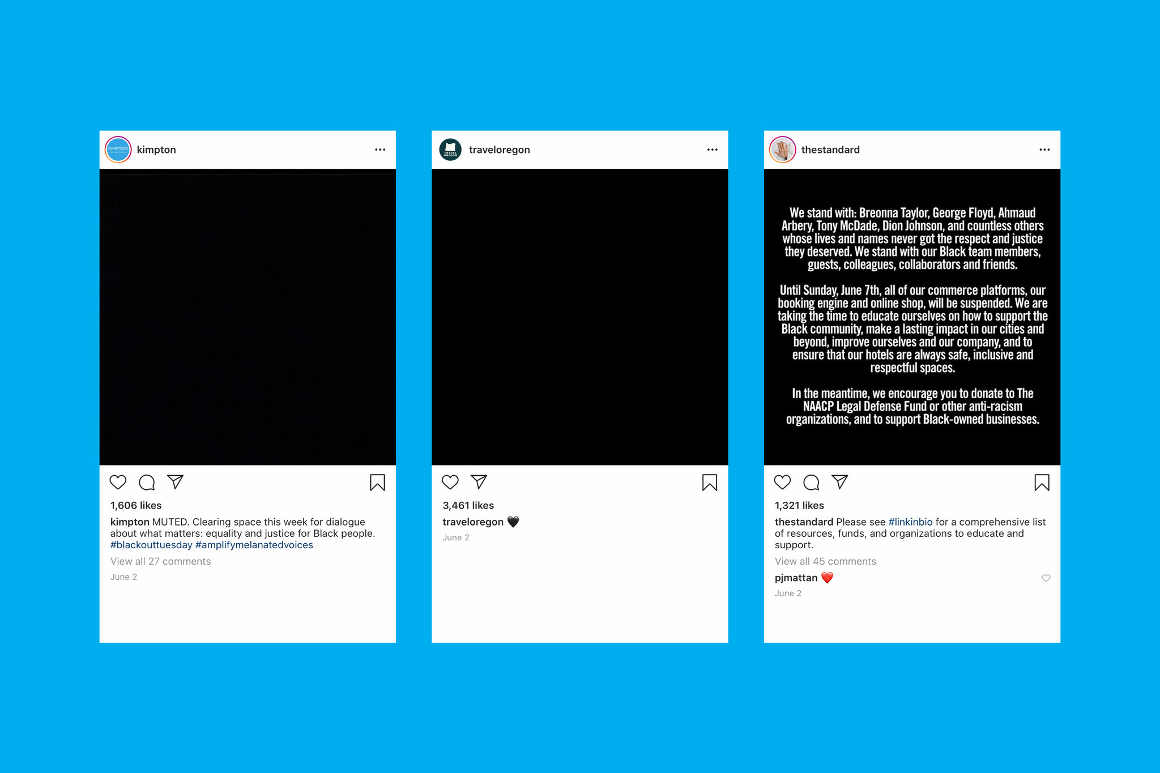
Expressive participation
Creating
Sharing
Participation that take the most effort
often perceived as the “most valuable”
Voicing opinions, providing information or preferences etc.
Expressing opinions or narrative without creating the content

Slide 16
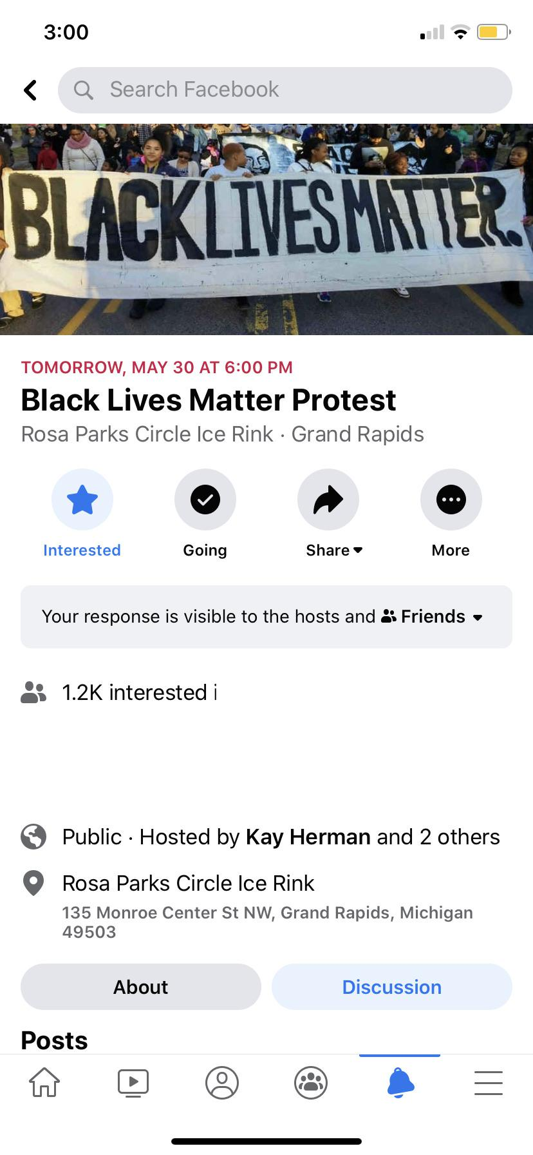
Question of slacktivism/clicktivism
(...) which refers to the trend of fulfilling only the desire for instant self-satisfaction and having little impact on actual political processes (Halupka, 2014; Lim, 2013; Morozov, 2011).
Criticism that there is a disconnect between online activities and the real impact in everyday life (Štětka & Mazák, 2015)
Fear that opportunities in the online space may lead to less political activity offline (real participation in the demonstration)

Slide 17
Political Conversation & Democracy
Political discussion as a requirement for a “strong democracy”
Online political discussions are perceived as a valuable form of political participation (Ohme, 2019)
Since the early 20th century, scholars such as Gabriel Tarde and John Dewey emphasized the role of political discussion in democratic life.
Jurgen Habermas’ influential work emphasized the role of public spheres to enable citizens to influence the political sphere.

Slide 18
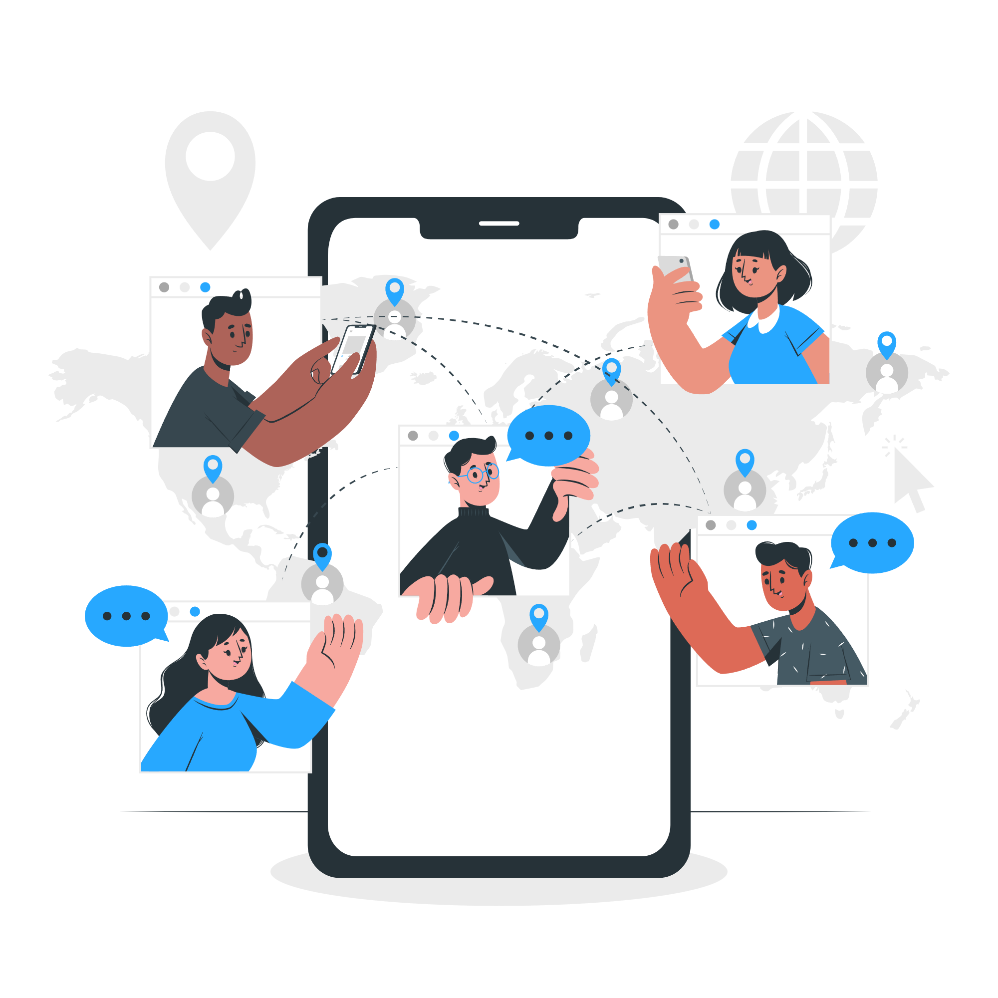
Online Political Talk: Expectations vs Reality
The ‘online public sphere’ would create the conditions for democratic deliberation.
E-participation and e-deliberation initiatives could allow the public to engage in formal decision-making processes actively.
Political discussion is often judged based on its deliberative potential
Scholars have raised concerns about access and new barriers to the online public sphere (Habermas, 2022; Kennedy et al., 2021; Vochocová et al., 2016).

Slide 19
03
Dark participation

Slide 20
What is dark participation?
Quandt, 2018 : “(..) characterized by negative, selfish or even deeply sinister contributions (..)”
Participation that does not helps but threatens democracy
Includes: trolling, cyberbullying, dissemination of mis/disinformation, uncontrolled news environment, incivility, hateful comments, etc.
this type of participation seems to be growing parallel to the recent wave of populism in Western democracies

Slide 21
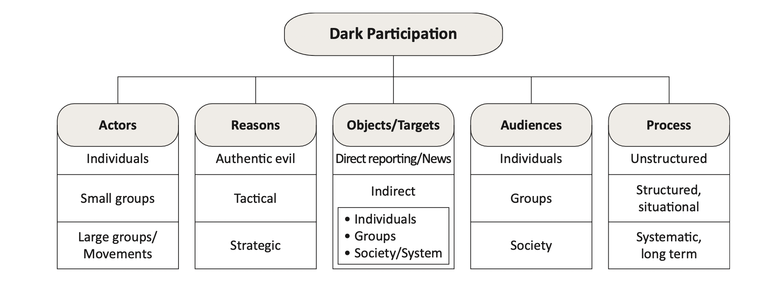
Variants of dark participation

Slide 22
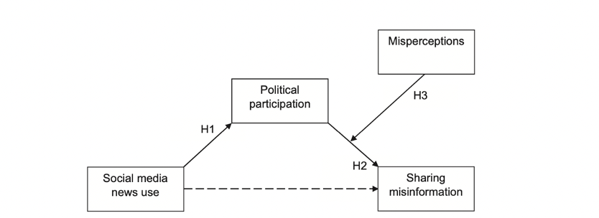
Misinformation
The difference between sharing misinformation led by deception (i.e., disinformation campaigns) or cognitive bias
The problem of sharing without controlling information/sources
Relationship with the amount of news on SNS and motivation to use (Valenzuela et al, 2019)

Slide 23
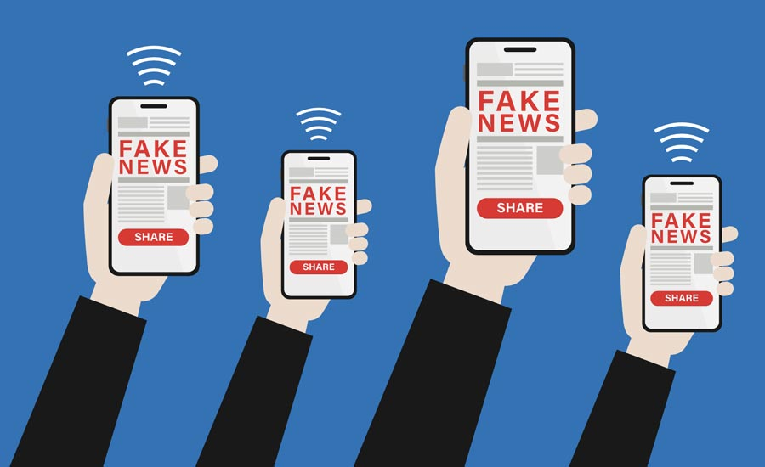
Disinformation
Sharing disinformation as an act of political participation
Motivated by speaking the truth to public
The goal is to put the correct information out there
Situation Czech republic (STEM, 2020)
  72% of citizens believe that the major media in the Czech Republic deliberately distort or withhold important information
  41% then find this allegedly withheld information on their own from other sources
  6% said that at least once a week they received information that was not reported or withheld by the major media

Slide 24
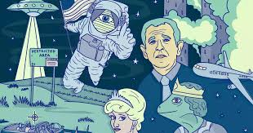
Conspiracy theories
Conspiracy thinking can lead to higher participation online
Distrust towards systemativ traditional forms of participation (voting)
Finding alternative ways to particpate (counter)
Connected to antisystematic thinking
Motivation is to be heard if they think their voices are silenced in traditional cannals

Slide 25
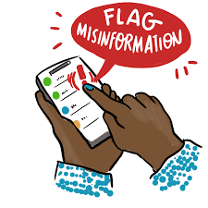
Fact-checking as participation
Some users may by motivated to provide correct information and stop the dissemination of disinformation
Motivated by
  Need to help other
  Normative idea to do what is right
BUT problem is whith lasting motivation and growing frustration
  Can lead to less expressive types of participation (blocking, reporting)
  Ignoring all together
  Or trolling and using sarcasm and humour
Sarcasting fact-checking can still be as effective the one using serious language
Influence of who is providing the correct information (person vs. social media)

Slide 26
Influence on relationships (Duffy, Tandoc & Ling, 2020)
Sharing news and information to build relationships (gaining social recognition; trying to entertain, inform others)
BUT pressure to share can lead to sharing fake news
Subsequent negative reactions to shared information may cause fear of further sharing → social exclusion
Differences across age
  Older people - sharing threats as warnings or advice (especially to family, friends)
  Young people - more caution before sharing information

Slide 27
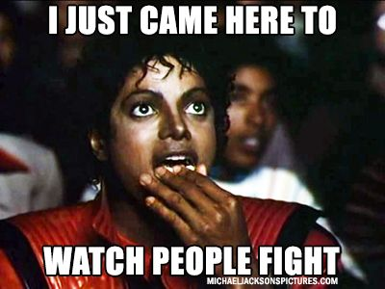
Incivility Online
Studies have shown that online discussions frequently involve hostility, vulgar language, and verbal fighting (Coe et al., 2014, Rossini, 2022).
Many scholars argue that incivility undermines the democratic potential of discussions.
Online incivility often seen as “toxic”, a signal of “low quality”, and incompatible with democratically relevant political talk.

Slide 28
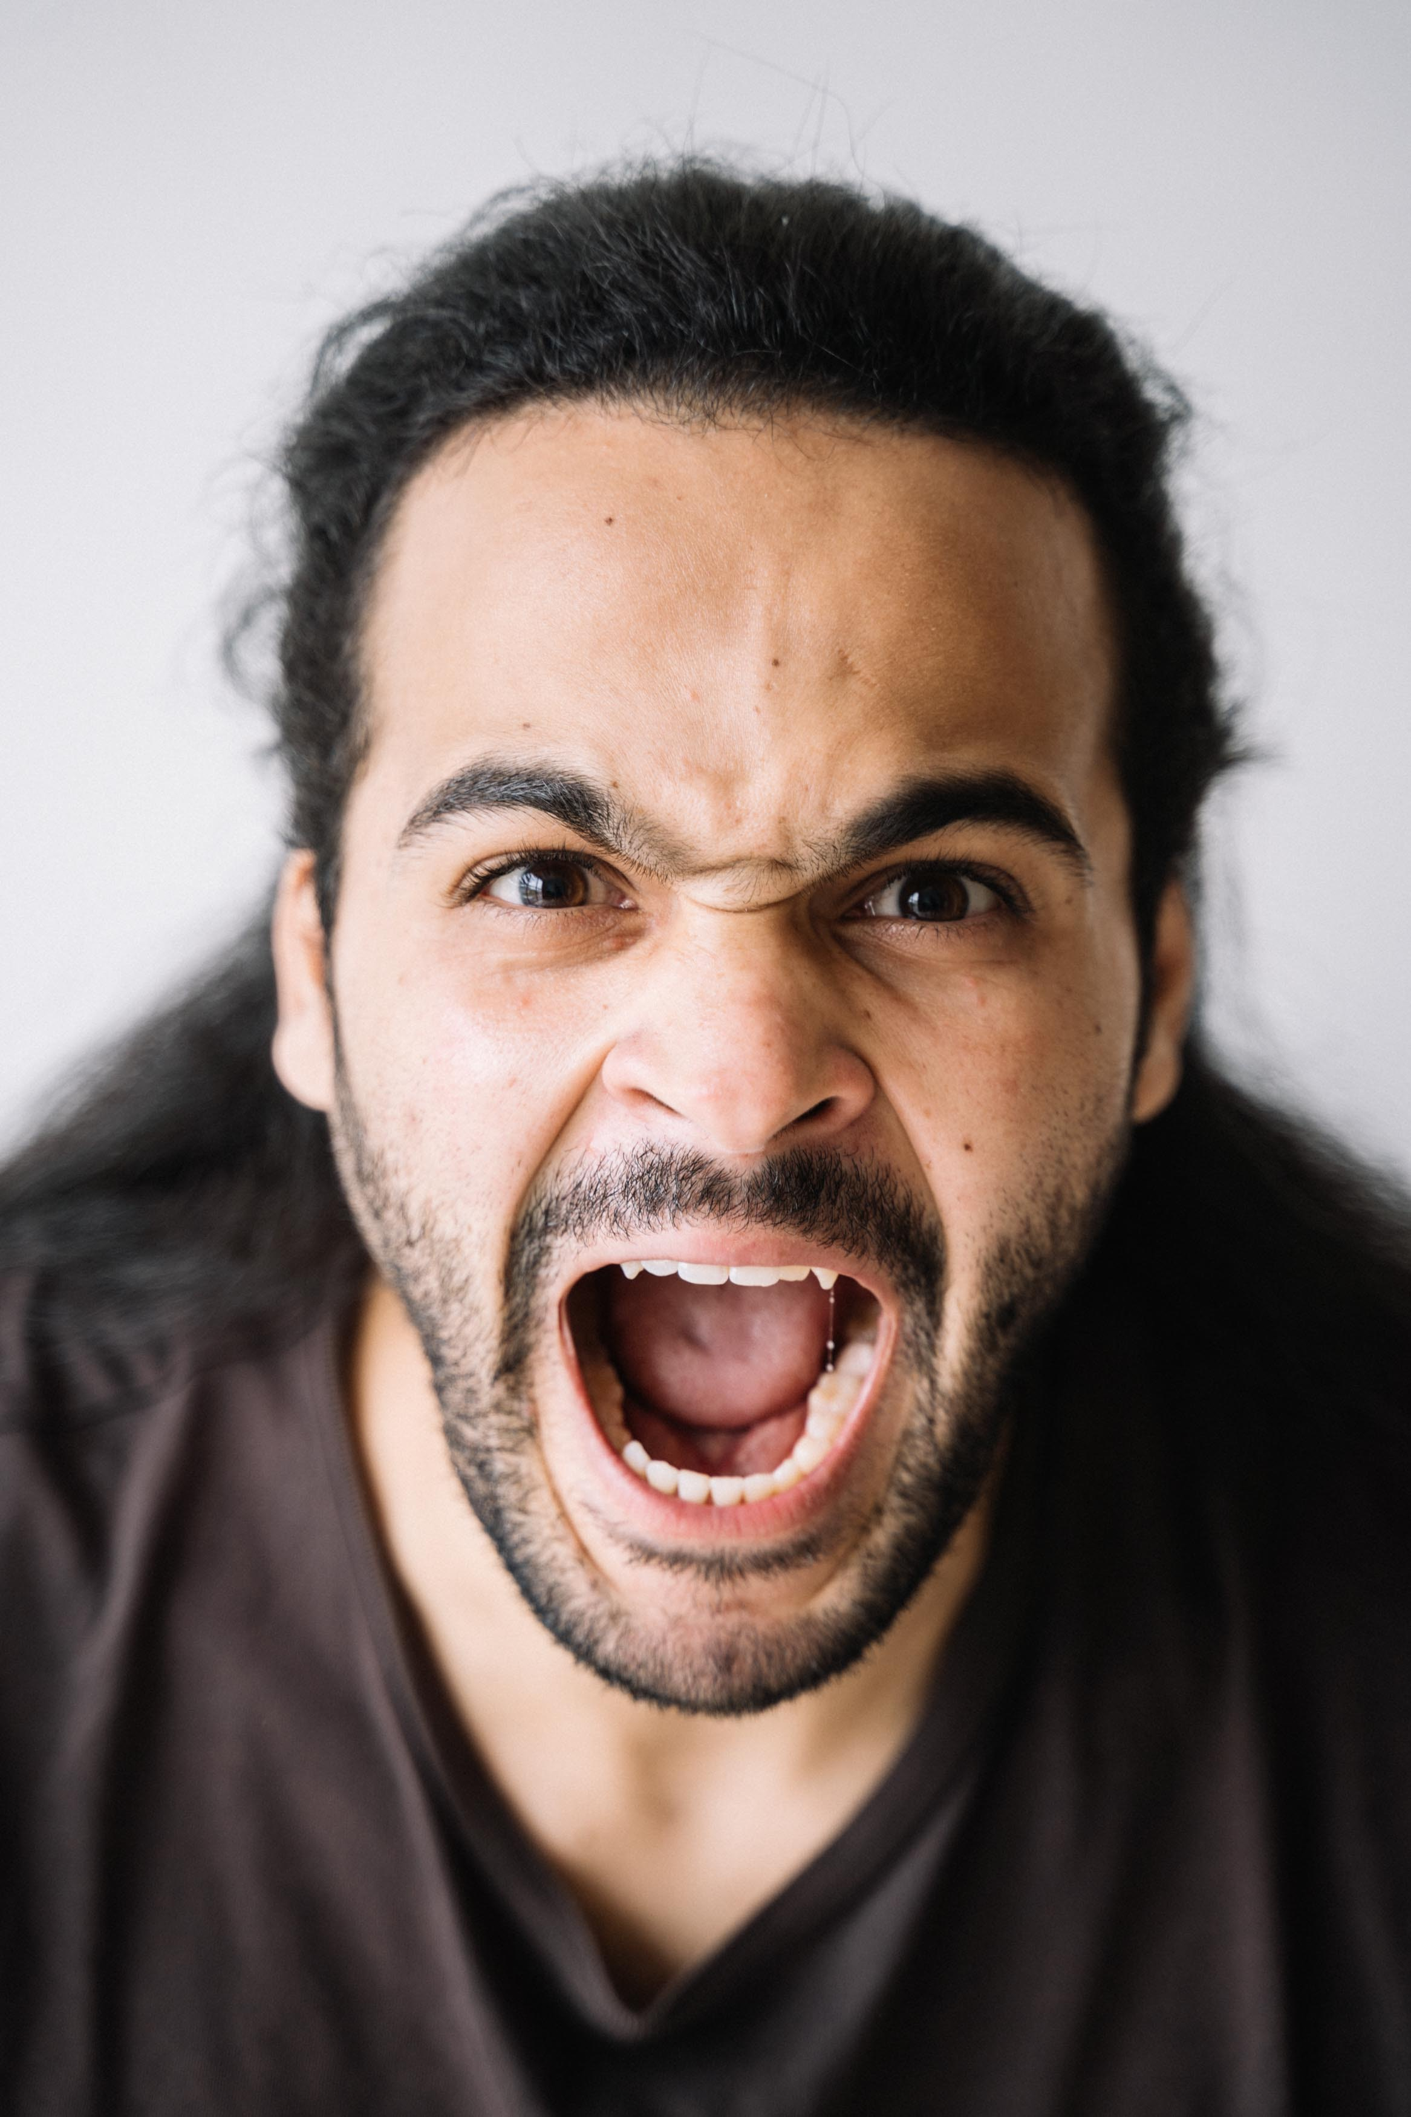
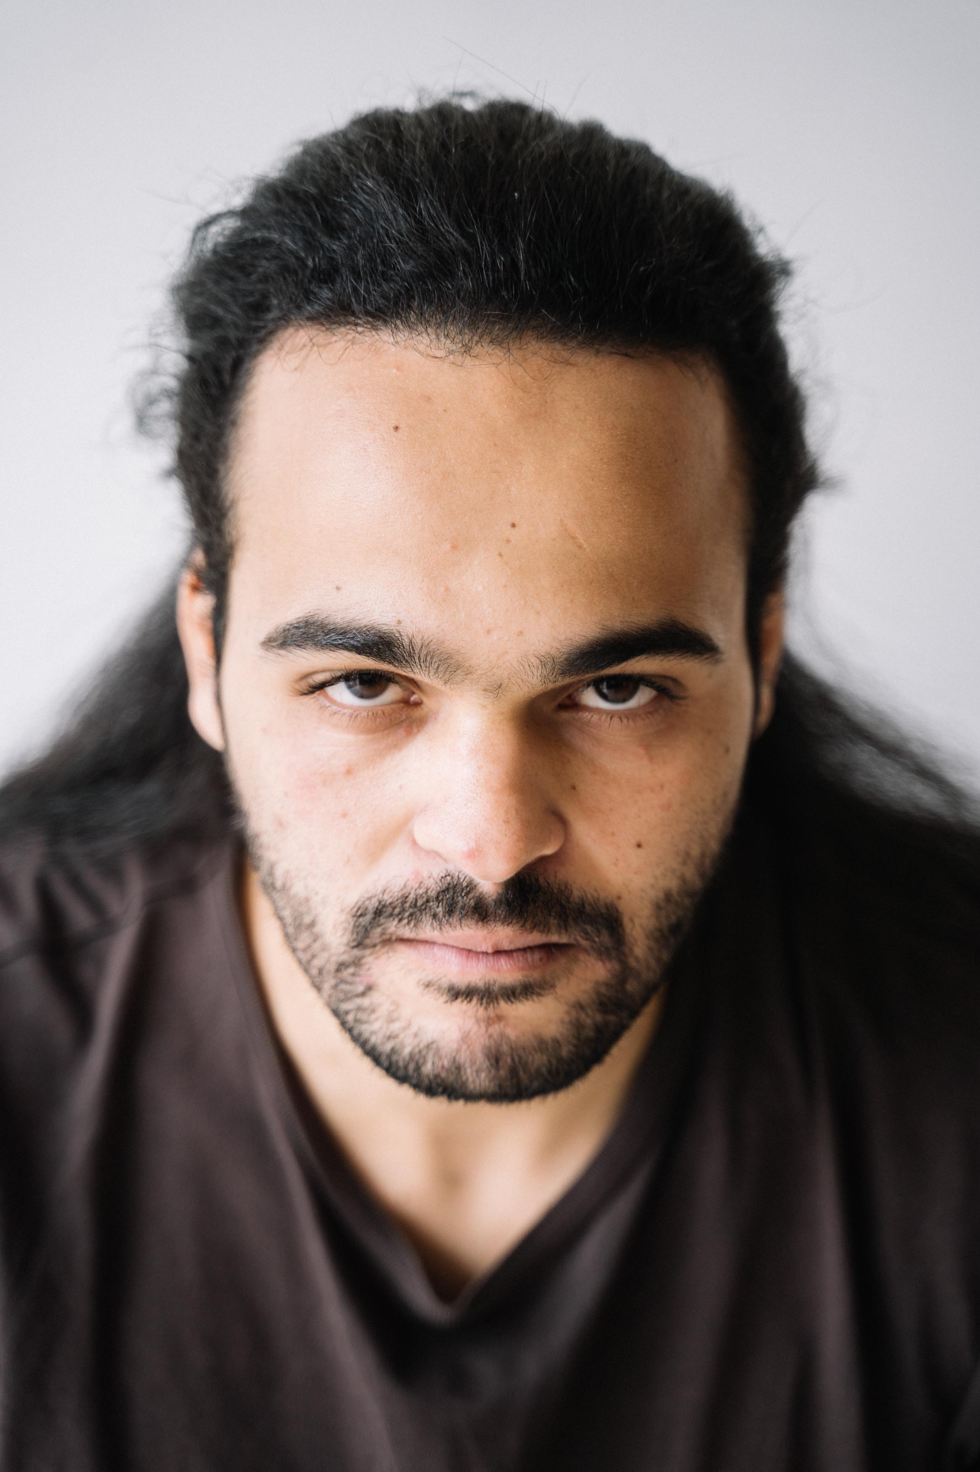
Incivility vs intolerance
„uncivil discourse can be understood as expressions that feature a rude, disrespectful or dismissive tone towards other participants in a discussion, the story, or the discussion topic, as well as opinions expressed with antinormative intensity.“
„Intolerance is operationalized in this study as set of behaviors that are threatening to democracy and pluralism - such as prejudice, segregation, hateful or violent speech, and the use of stereotyping in order to disqualify others and groups.“
(Rossini, 2022)

Slide 29
SUBCATEGORIES
Incivility & intolerance
Vulgar words
Personal attacks
Aspersions towards policy, institutions
Attacks towards arguments or perspectives
Threats toward individual rights
Intolerance toward political positions and personal opinions
Racism
Social or economic intolerance
Attacks toward gender and sexual freedom
Religious freedom
Offensive stereotypes
Violent threats

Slide 30
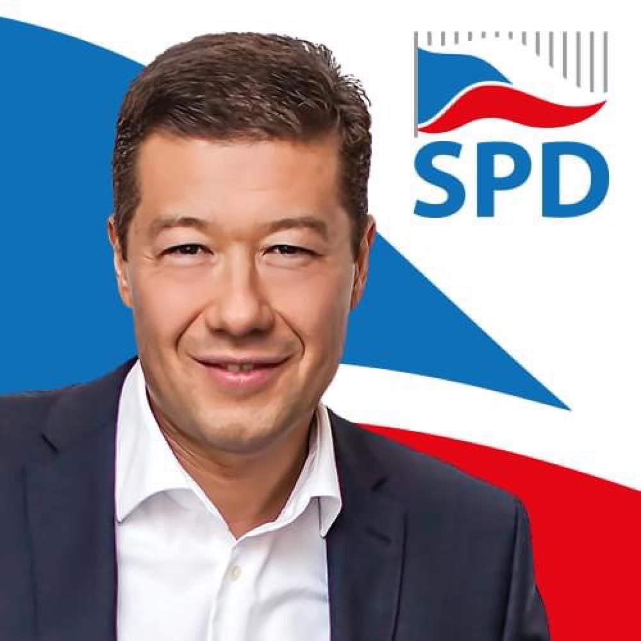

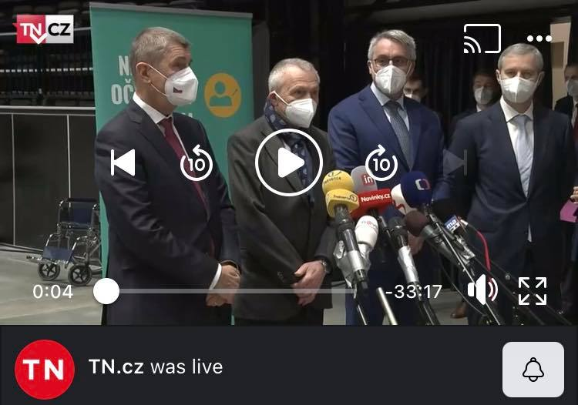

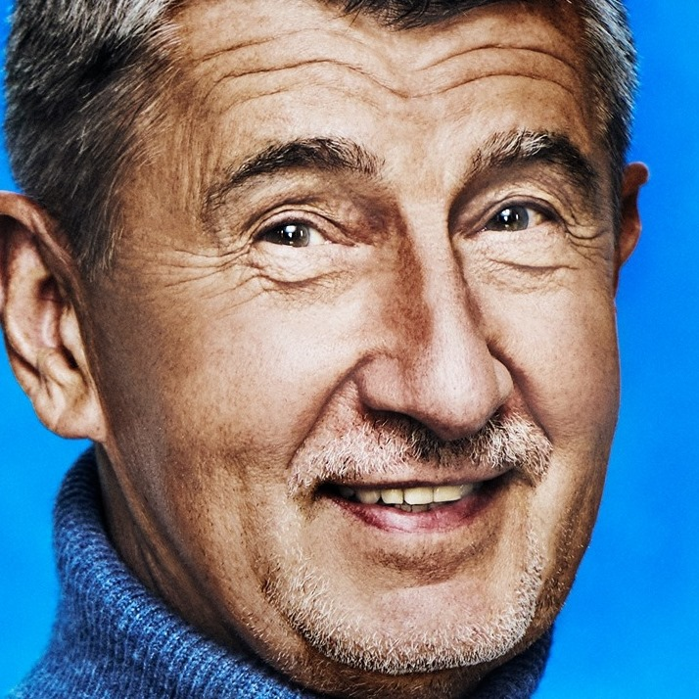
Examples of Incivility and intolerance
1
3
You are lying again... based on the news from the previous week there are no free beds left in the hospitals by now, and yet you are saying that 12 % of the beds are still free.
Okamura, the person who is lying, also steal... Which virus??
As a punishment, you will go to do cleaning to Fukushima..or just stop lying, bastard
2
Dr. Mengele and his team!
You should excuse murders! No one wants your vaccine, and you have already killed so many people
5
You do not even know grammar. Awful mistakes
4

Slide 31
How do incivility and intolerance influence active engagement in online discussions?
„Discussions of people from the other side, when I say it politely, so I just provoke, and then I don't look at those discussions anymore. Because it is just bunch of vulgar words and shits, so I do not follow discussions anymore.“ – Vendelín
„Things about Hitler and so on, so this is 100% beyond the border, and I directly report it.“ – Samuel
„(…) so, for instance, they comment post, and I am writing with him a bit, but in most of the cases it ended up with aggression, and I do not want to be part of this (…).“ – Martin

Slide 32
Perceptions of Incivility: What Matters
Types of attacks
Age matters
Gender matters
Space
Personal attacks seen as more uncivil than attacks towards political arguments (Muddiman, 2017)
Middle-aged adults perceive name-calling as highly uncivil, while college students rate vulgarity as more uncivil (Kenski et al., 2017)
Women are more likely to perceive incivility (Kenski et al., 2017; Vochocová, 2020)
Data shows that in the case of news media outlets, some trigger more hostility than others (Humprecht et al., 2020).

Slide 33
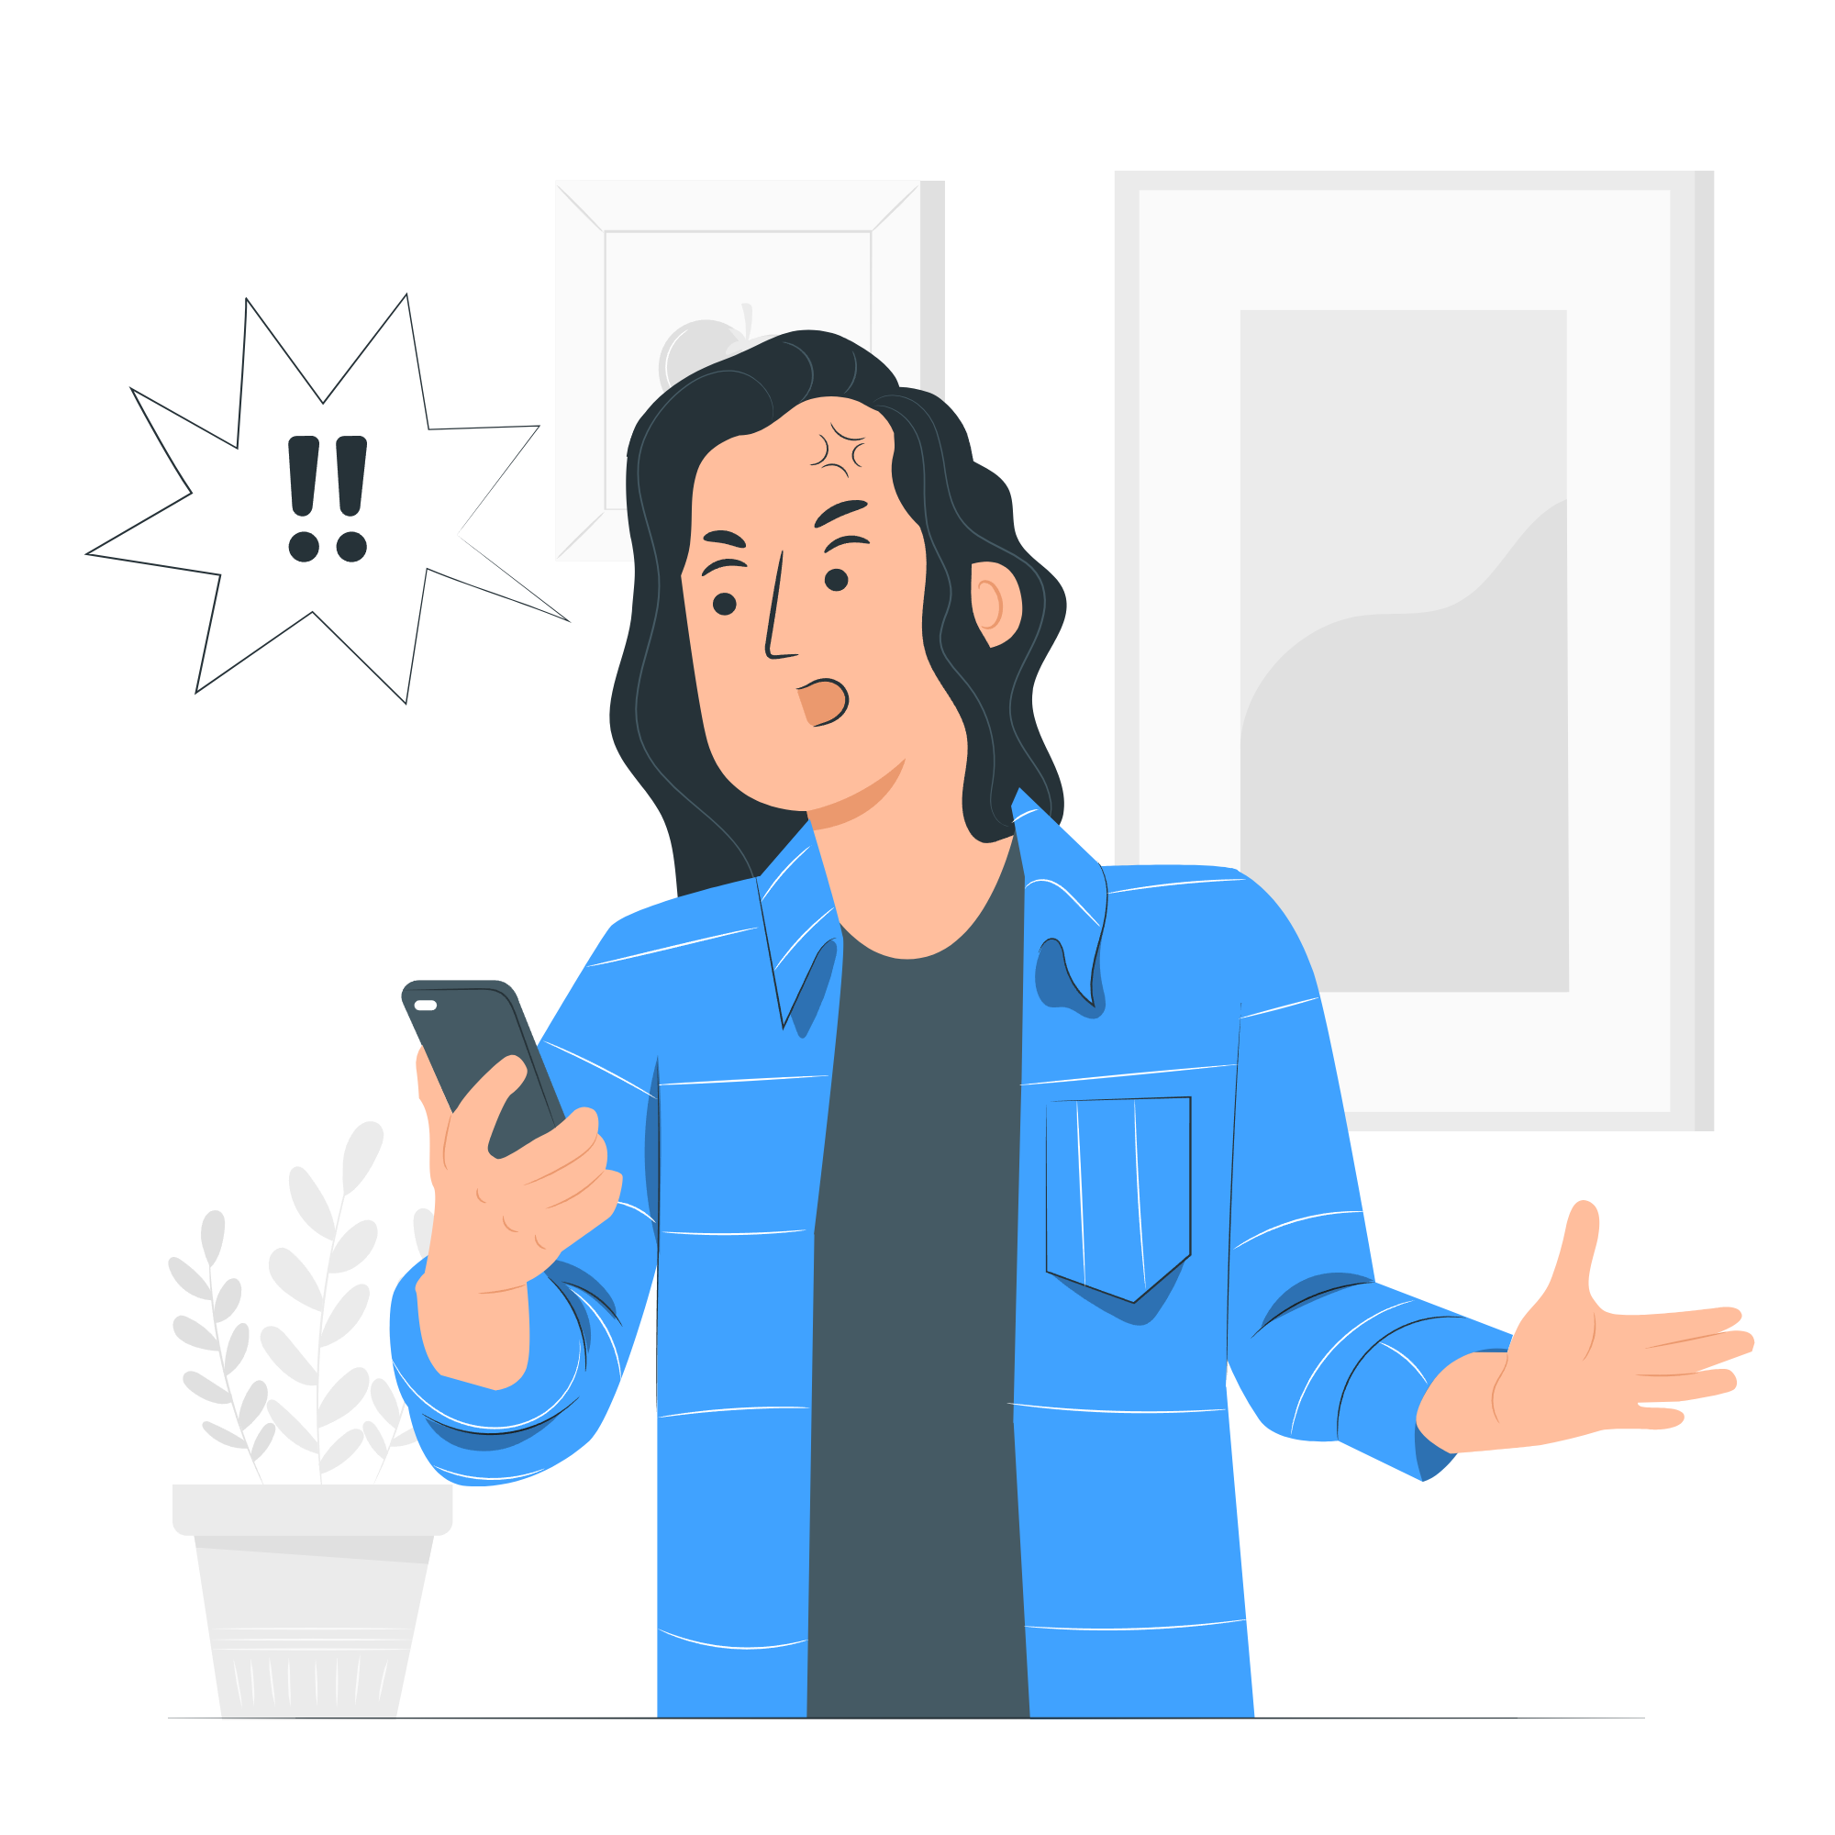
Other Factors When it Comes to Incivility
Partisanship matters: people perceive those aligned with them politically as less uncivil (Muddiman, 2017) as well as incivility may increase cross-cutting attention (see Lee et al., 2021)
Conflict-orientation matters: people who like debates are entertained and energized by incivility (Sydnor, 2017)
“Extreme” behaviors (e.g. racial slurs, violence) consistently seen as highly “uncivil” (Stryker et al., 2016)

Slide 34
Negative & Positive Effects of Incivility
… may influence polarization (Anderson et al., 2014; Borah, 2014)
… trigger incivility by those on the same side (Gervais, 2015)
Risk of reinforcement of uncivil behaviour or its acceptance (Hmielowski et al., 2014)
… Incivility can raise attention, awareness, and recall of arguments (Mutz, 2016)
… boost engagement and participation in online comments (Borah, 2014; Coe et al., 2014)
On social media, uncivil discussions can be seen as entertaining (Sydnor, 2019)

Slide 35

GROUP ACTIVITY
Split into groups
10 minutes of brainstorming
10 minutes of discussion
(1) Fighting for the opinion that incivility is a regular pattern of online discussions and is okay.
(2) Find arguments for a statement that incivility is harmful – why and for which reasons we should worry about it.

Slide 36
TAKE AWAYS
Internet provides new options for political participation (more accessible, less effort)
Dissemination of false information in online environment disrupts the idea of new ideal public sphere
Online political discussions are important, but some voices may be excluded due to new online barriers.
Incivility is evaluated as a problematic pattern, but some participants in online discussions are resilient.
Optimistic scenario: there are not many people who frequently spread intolerance in comparison to incivility.

Slide 37
THANK YOU!
DOES ANYONE HAVE ANY QUESTIONS?
k.bielikova@mail.muni.cz
mnovotna@fss.muni.cz
Please keep this slide for attribution

Slide 38
SOURCES
, Anderson, A. A., Brossard, D., Scheufele, D. A., Xenos, M. A., & Ladwig, P. (2014). The “nasty effect”: Online incivility and risk perceptions of emerging technologies. Journal of Computer-Mediated Communication, 19(3), 373–387. https://doi.org/10.1111/jcc4.12009
Borah, P. (2014). Does it matter where you read the news story? Interaction of incivility and news frames in the political blogosphere. Communication Research, 41(6), 809–827. https://doi.org/10.1177/0093650212449353
Coe, K., Kenski, K., & Rains, S. A. (2014). Online and uncivil? Patterns and determinants of incivility in newspaper website comments. Journal of Communication, 64(4), 658–679.
Gervais, B. T. (2015). Incivility online: Affective and behavioral reactions to uncivil politi- cal posts in a web-based experiment. Journal of Information Technology & Politics, 12, 167–185. https://doi.org/10.1080/19331681.2014.997416
Habermas, J. (1989). The structural transformation of the public sphere: An inquiry into a category of bourgeois society. The MIT Press.
Habermas, J. (2022). Reflections and hypotheses on a further structural transformation of the political public sphere. Theory, Culture & Society, 39(4), 145–171.
Hmielowski, J. D., Hutchens, M. J., & Cicchirillo, V. J. (2014). Living in an age of online incivility: examining the conditional indirect effects of online discussion on political flaming. Information, Communication & Society, 17(10), 1196–1211.
Humprecht, E., Hellmueller, L., & Lischka, J. A. (2020). Hostile Emotions in News Comments: A Cross-National Analysis of Facebook Discussions. Social Media + society, 6(1), 205630512091248. https://doi.org/10.1177/2056305120912481.
Kennedy, R. D., Sokhey, A. E., Abernathy, C., Esterling, K. M., Lazer, D., Lee, A. S., Minozzi, W., & Neblo, M. A. (2021). Demographics and (equal?) voice: Assessing participation in online deliberative sessions. Political Studies, 69(1), 66–88.

Slide 39
Kenski, K., Coe, K., & Rains, S. A. (2017). Perceptions of Uncivil Discourse Online: An Examination of Types and Predictors. Communication Research, 47(6), 795–814. https://doi.org/10.1177/0093650217699933
Lee, J., Choi, J., & Kim, J. (2021). Effects of online incivility and emotions toward in-groups on cross-cutting attention and political participation. Behaviour & Information Technology, 1–15. https://doi.org/10.1080/0144929x.2021.1969429
Muddiman, A. (2017). Personal and Public Levels of Political Incivility. International Journal of Communication 11, 3182–3202.
Mutz, D. C. (2016). In-your-face politics: The consequences of uncivil media. Princeton University Press
Norris, P. (2002), Democratic Phoenix: Reinventing Political Activism, Cambridge: Cambridge University Press.
Quandt, T. (2018). Dark Participation. Media and Communication, 6(4), 36-48.. Retrieved from https://doi.org/10.17645/mac.v6i4.1519
Rossini, P. (2022). Beyond Incivility: Understanding Patterns of Uncivil and Intolerant Discourse in Online Political Talk. Communication Research, 1-27. https://doi.org/10.1177/0093650220921314.
Stoll, A., Ziegele, M., & Quiring, O. (2020). Detecting Impoliteness and Incivility in Online Discussions. Computational Communication Research, 2(1), 109–134. https://doi.org/10.5117/ccr2020.1.005.kath
Stryker, R., & Conway, B. A. & Danielson, J. T. (2016): What is political incivility? Communication Monographs. https://doi.org/10.1080/03637751.2016.1201207
Sydnor, E. (2018). Platforms for Incivility: Examining Perceptions Across Different Media Formats. Political Communication, 35(1), 97–116. https://doi.org/10.1080/10584609.2017.1355857
Sydnor, E. (2019). Disrespectful democracy: The psychology of political incivility. Columbia University Press.
Theocharis, Y., & Van Deth, J. (2018). The continuous expansion of citizen participation: A new taxonomy. European Political Science Review, 10(1), 139-163. doi:10.1017/S1755773916000230

Slide 40
Verba, S. and N.H. Nie (1972), Participation in America: Political Democracy and Social Equality, Chicago, IL: University of Chicago Press.
Vochocová, L. (2020). ‘Frustrated women invite the immigrants to Europe’: Intersection of (xeno-) racism and sexism in online discussions on gender aspects of immigration. European Journal of Cultural Studies, 24(1), 333–349.
Valenzuela, S., Halpern, D., Katz, J. E., & Miranda, J. P. (2019). The Paradox of Participation Versus Misinformation: Social Media, Political Engagement, and the Spread of Misinformation. Digital Journalism, 7(6), 802-823.
Waeterloos, C., Walrave, M., & Pennet, K. (2021). Designing and validating the Social Media Political Participation Scale: An instrument to measure political participation on social media. Technology in Society, 64.. Retrieved from https://doi.org/10.1016/j.techsoc.2020.101493

