Slide 1
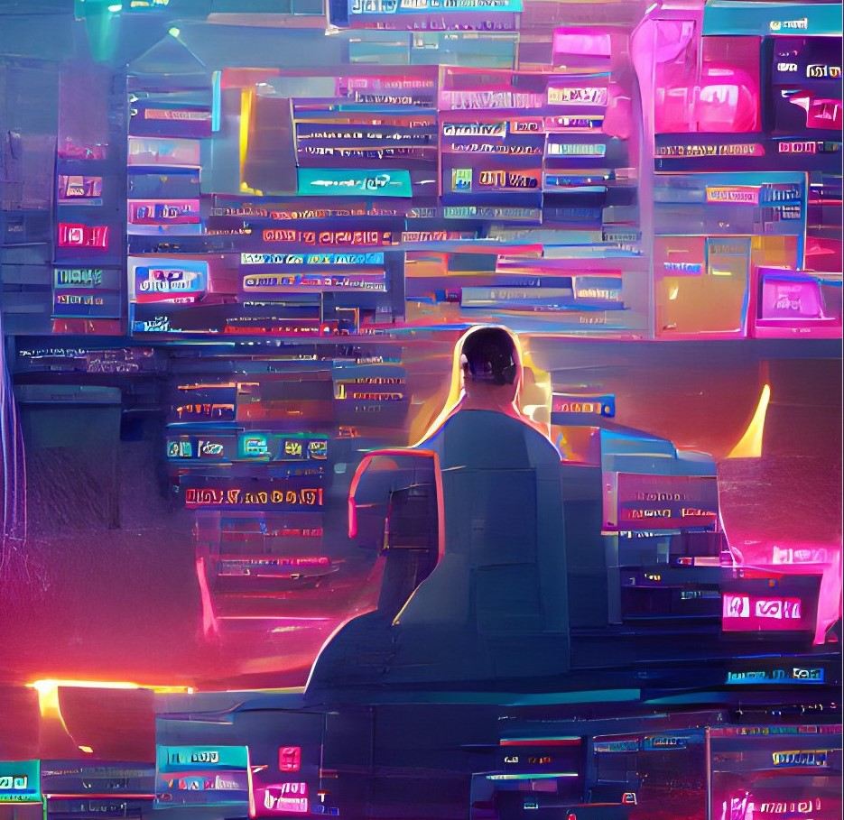

ZURb1614 / CMA17
Current issues in research of media and audiences
Introduction and course organisation
Marie Jaroň Bedrošová
marie.bedrosova@mail.muni.cz

Slide 2

What is the course about?
Series of lectures and discussions about selected topics in the current research of media and media audiences
Department of Media Studies and Journalism
Interdisciplinary Research Team on Internet and Society (IRTIS)

Slide 3

September 20 | Introduction and course organisation Marie Jaroň Bedrošová
September 27 | Experimental research in cyberaggression and media aggression Marie Jaroň Bedrošová
October 4 | Problematic smartphone use and attention economy Jana Blahošová
October 11 | (Social) media and political polarization Alena Kluknavská
October 18 | Sexual expression on social media: From Instagram to Reddit Michaela Lebedíková
October 25 | Political participation and discussions on SNS Karolína Bieliková, Martina Novotná
November 1 | Online safety: Children in the digital space Natálie Terčová
November 8 | Fans and the allure of dismantling heteronormative hegemony Iveta Jansová
November 15 | Mobile media and homelessness Vojtěch Dvořák
November 22 | Exploring the impact of media multitasking on cognitive abilities and well-being Shanu Shukla
November 29 | Digital skills Natálie Terčová, Štěpán Žádník
December 6 | Media audiences in fragmented media environment and how to handle them Klára Smejkal
December 13 | Closing session, feedback Marie Jaroň Bedrošová, Iveta Jansová

Slide 4

September 20 | Introduction and course organisation Marie Jaroň Bedrošová
September 27 | Experimental research in cyberaggression and media aggression Marie Jaroň Bedrošová
October 4 | Problematic smartphone use and attention economy Jana Blahošová
October 11 | (Social) media and political polarization Alena Kluknavská
October 18 | Sexual expression on social media: From Instagram to Reddit Michaela Lebedíková
October 25 | Political participation and discussions on SNS Karolína Bieliková, Martina Novotná
November 1 | Online safety: Children in the digital space Natálie Terčová
November 8 | Fans and the allure of dismantling heteronormative hegemony Iveta Jansová
November 15 | Mobile media and homelessness Vojtěch Dvořák
November 22 | Exploring the impact of media multitasking on cognitive abilities and well-being Shanu Shukla
November 29 | Digital skills Natálie Terčová, Štěpán Žádník
December 6 | Media audiences in fragmented media environment and how to handle them Klára Smejkal
December 13 | Closing session, feedback Marie Jaroň Bedrošová, Iveta Jansová
Reading week at Faculty of Arts,
attendance voluntary

Slide 5

Course organisation
Wednesday 12:00 – 13.40; AVC
Course guarantor: Iveta Jansová
Course organisation and contact:
Marie Jaroň Bedrošová
marie.bedrosova@mail.muni.cz
General questions about the course or the assignement – write to Marie Jaroň Bedrošová
Questions about selected course/assignement topics – write to the teacher of the relevant lecture

Slide 6

Course requirements
Read weekly reading assignments before the lecture (interactive syllabus)
Attendance at all lectures is not compulsory but recommended

Slide 7


Credit requirements
Writing a popularisation text
    Topic taught in the course selected by the student (limited amount of students per topic)
    Topic registration (Topic list in IS)
    Deadline: December 10, 2023
    3 standard pages (1 standard page = 1,800 characters), including references
    Deadline: January 4, 2023
  Returned assignements need to be revised and submitted in a week
If you need to finish the course earlier, write to Marie Jaroň Bedrošová

Slide 8
What is popularisation text?
Popularisation text

Slide 9
What is popularisation text?
What is the purpose?
Popularisation text

Slide 10
What is popularisation text?
What is the purpose?
Communicating science to the public
E.g., article about a scientific problem in the media; blog post for the public about new research findings; …
Popularisation text

Slide 11
Topic
The topic of the popularisation text must be related to some topic taught in the course
But it must not just copy something that has already been presented in the course (i.e., find new academic texts about the topic)
If you are unsure about the suitability of the topic, please consult it with the teacher of the relevant lecture or with Marie Jaroň Bedrošová
Popularisation text

Slide 12
What sources to use?
Academic sources
Popularisation text

Slide 13
What sources to use?
Academic sources
    Peer reviewed journal papers
    Academic books and chapters
Popularisation text

Slide 14
What sources to use?
Academic sources
    Peer reviewed journal papers
    Academic books and chapters
Where to find them?
Popularisation text

Slide 15
What sources to use?
Academic sources
    Peer reviewed journal papers
    Academic books and chapters
Where to find them?
    Databases of scientific articles:
    Google Scholar https://scholar.google.com/
    MUNI electronic sources https://ezdroje.muni.cz/prehled/index.php?lang=en&type=abecedne
    E.g., EBSCO (database with social scientific articles and chapters)
Popularisation text

Slide 16
What sources to use?
Academic sources
    Peer reviewed journal papers
    Academic books and chapters
Where to find them?
    Databases of scientific articles:
    Google Scholar https://scholar.google.com/
    MUNI electronic sources https://ezdroje.muni.cz/prehled/index.php?lang=en&type=abecedne
    E.g., EBSCO (database with social scientific articles and chapters)
Use at least 2 academic sources
Popularisation text

Slide 17
What is not a good source?
Non-academic sources
    Not peer-reviewed articles and chapters
    Bachelor and master theses
    Blogs, comments, news articles, …
You can use such sources as illustrative examples but they should not make the core of your text
Popularisation text

Slide 18
How to write a popularisation text?
Choose a topic that is relevant and interesting to the public
Think about where you would like to publish your popularisation and for which audience (e.g., wide public, parents of young children) – keep them in mind when writing your text
Popularisation text

Slide 19
How to write a popularisation text?
Lay-understandable language
    Explain and decribe all terminology and concepts in an understandable language
    Do not unnecessarily use academic and technical terms
But do not „sensationalise“ or „tabloidise“ the topic – keep to the scientific facts, be clear and do not exaggerate or create media panic out of nothing
Popularisation text

Slide 20

How to write a popularisation text?
Even in popularisation texts, use references!
Be aware of plagiarism (and self-plagiarism)
„How to avoid plagiarism: Student handbook“ (Foltýnek et al., 2020)
More about citing and plagiarism during the closing session
Popularisation text

Slide 21
Tips
Make the topic interesting for the reader
Interview an expert about the topic (e.g., MUNI teacher or another scientist) and ask them questions about your topic
    Use quotations or comments from the expert in your popularisation
Use visuals
    Pictures
    Infographics, boxes with definitions, illustrations
    Use figures from your sources (properly cite them!) or create your own
Popularisation text

Slide 22
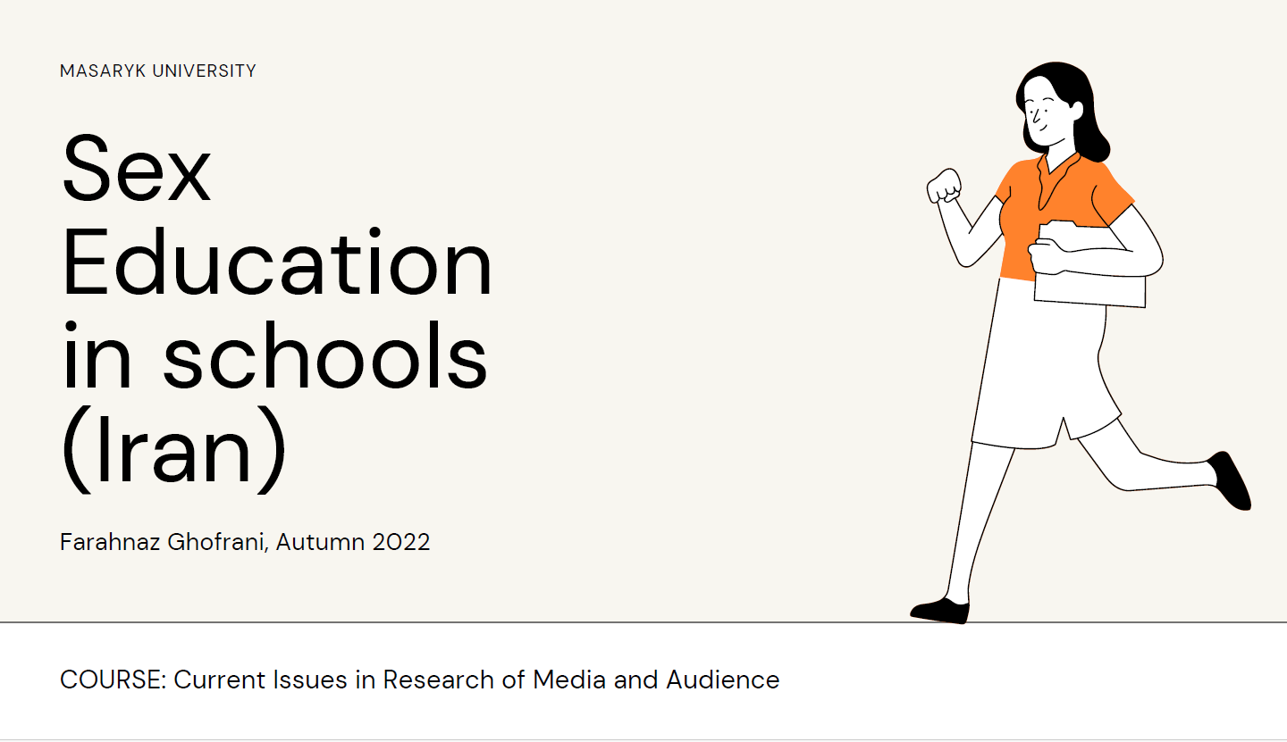
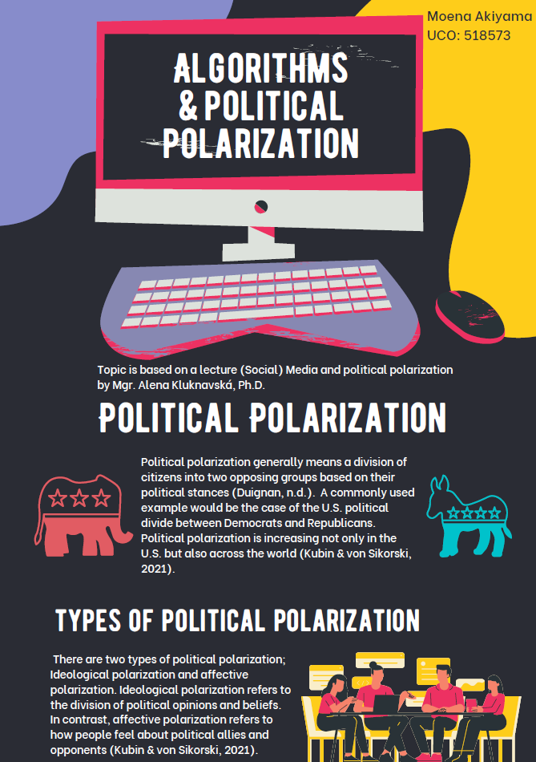
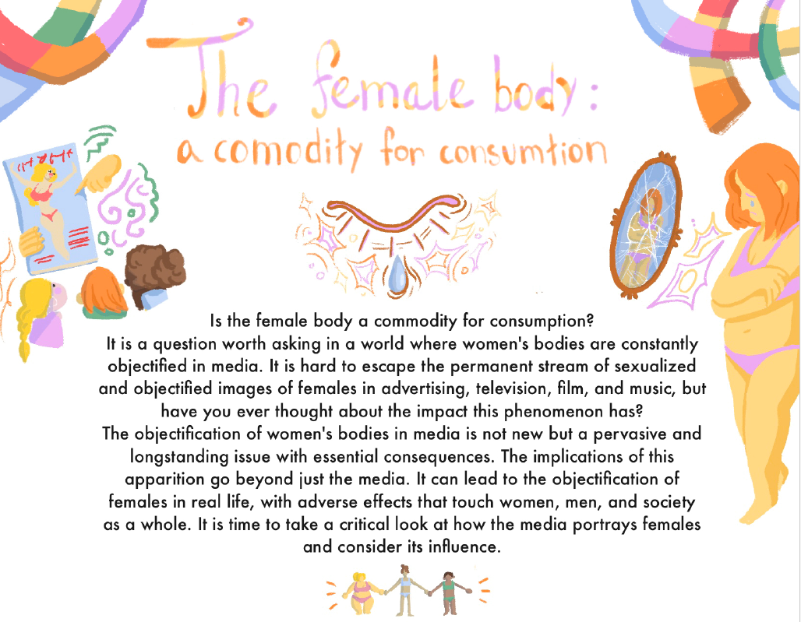
Iunna Titova, Autumn 2022

Slide 23
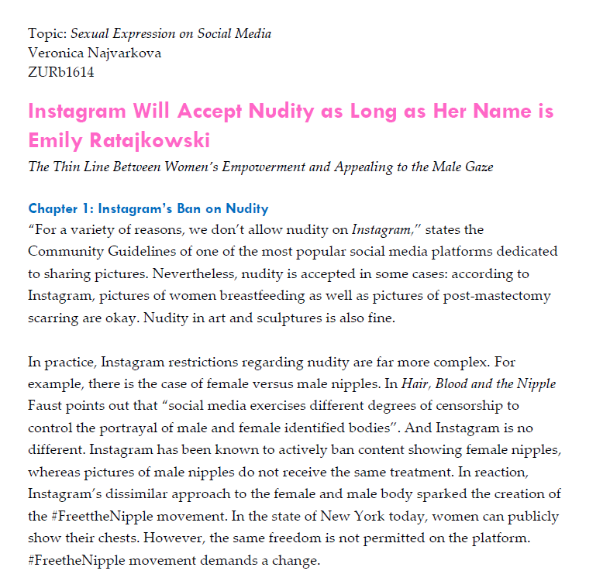
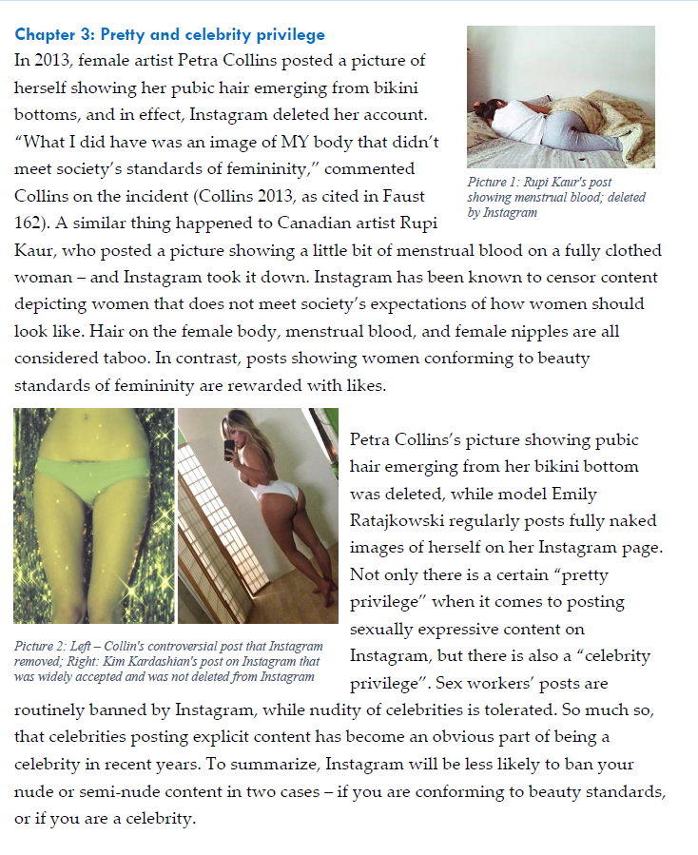

Slide 24

Do you have any questions?
Marie Jaroň Bedrošová
marie.bedrosova@mail.muni.cz

