Slide 1
Sexual expressions on social media: from Instagram to Reddit
Michaela Lebedíková
ZURb1614

Slide 2
Rules for nice lecture
This is a safe space. Everyone is welcome. We value different opinions but respect each other. I invite you to use inclusive language.
We will discuss sexual themes, but nothing graphic will be shown.
Be considerate when sharing experiences with the class.
Resources available at the end of lecture.

Slide 3
Table of contents
1
3
5
2
4
Constructing sexual identity via social media
Finding your niche: Reddit communities
Introduction: slippery slope of nudity online
Sex work, sex education and shadowbanning
Conclusion!

Slide 4
01
Introduction: the slippery slope of nudity online
If Kim K can do it, I can too, right?

Slide 5
Sexuality went digital
„The accessibility and relative anonymity afforded by digital media have also created a unique environment in which adolescents can explore their emerging sexualities, including consuming sexual media and constructing their own online sexual experiences.“ (Widman et al., 2021)
„Sexualities are expressed, constructed, and negotiated in digital contexts,“ (…)
The current research focuses „on three recurring strands: (a) sexual selfhood projects; (b) intimacy and online dating; and (c) sexual communities.“ (Adams-Santos, 2020)

Slide 6
Social media
a set of mobile and web-based platforms built on Web 2.0 technologies, and allowing users at the micro-, meso- and macro-levels to share and geo-tag user-generated content (images, text, audio, video and games), to collaborate, and to build networks and communities, with the possibility of reaching and involving large audiences
(Ouirdi et al., 2014)

Slide 7
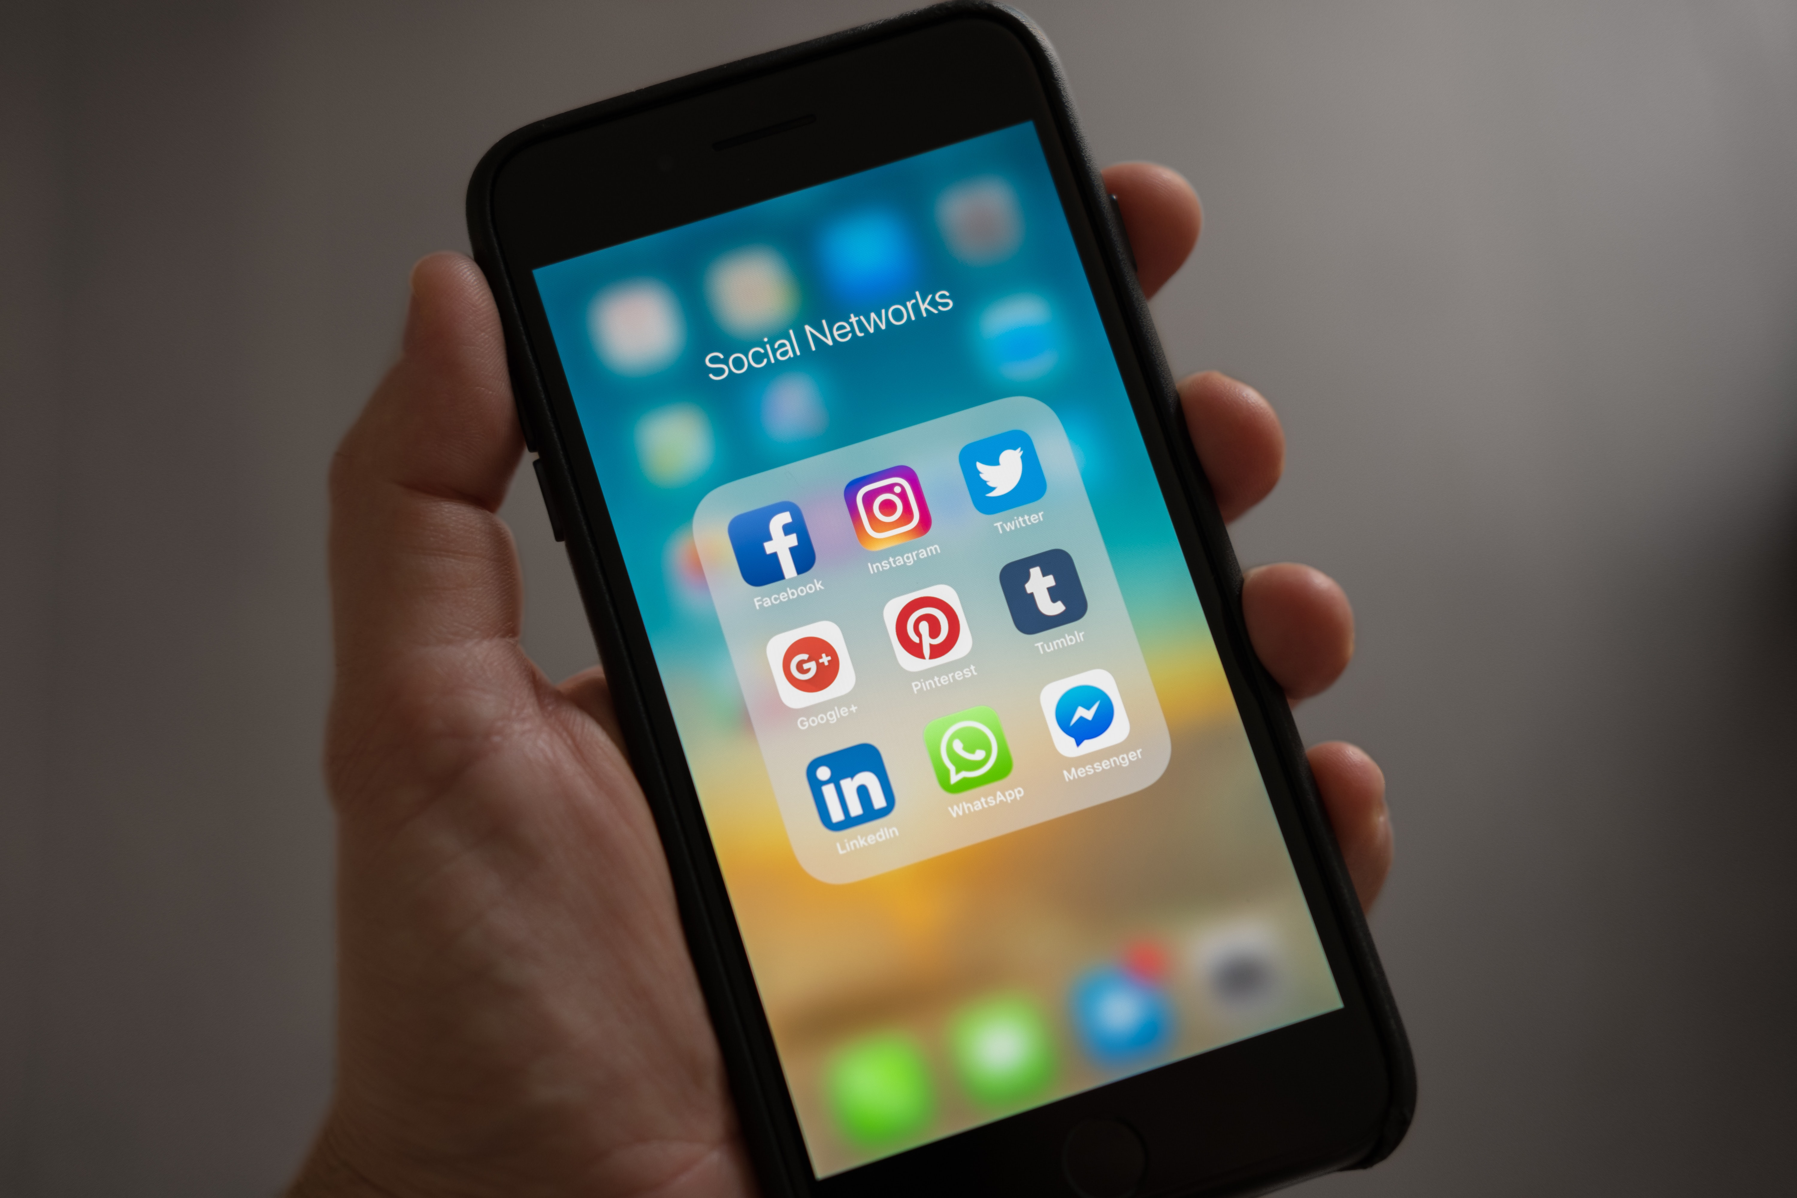
Ok, so what about sex and social media?

Slide 8
Social media
We know that there are times when people might want to share nude images that are artistic or creative in nature, but for a variety of reasons, we don't allow nudity on Instagram. We don’t allow nudity on Instagram, with some exceptions, like photos of post-mastectomy scarring and women actively breastfeeding. Nudity in photos of paintings and sculptures is OK, too.

Slide 9



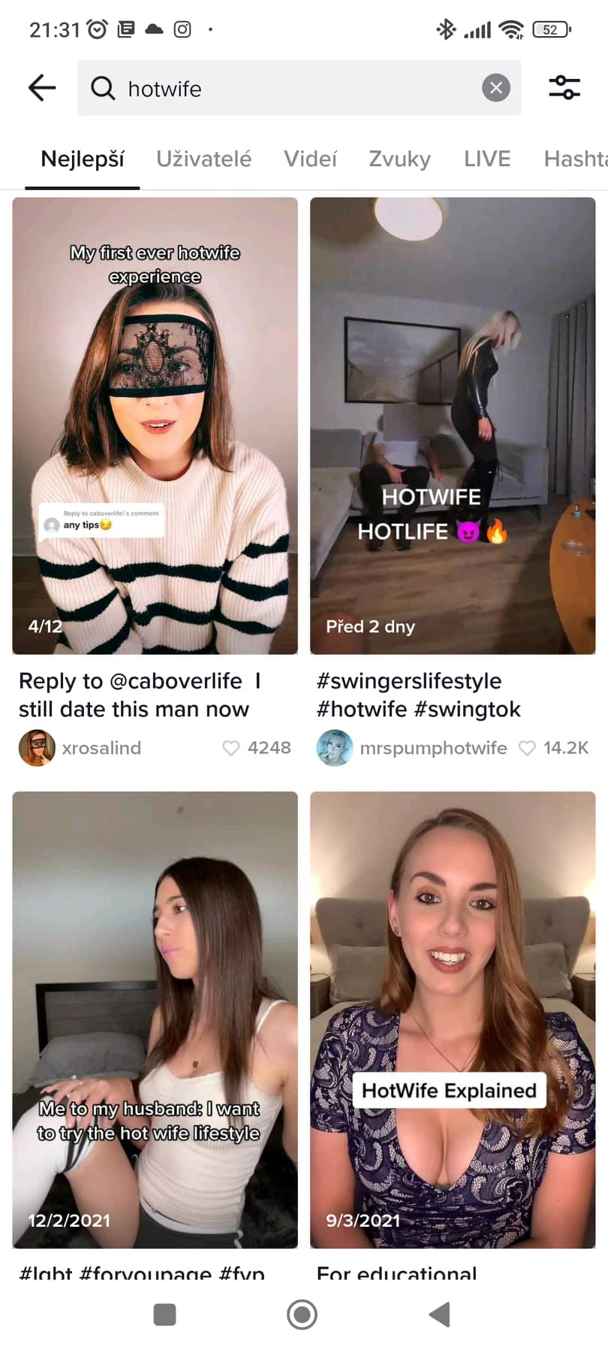
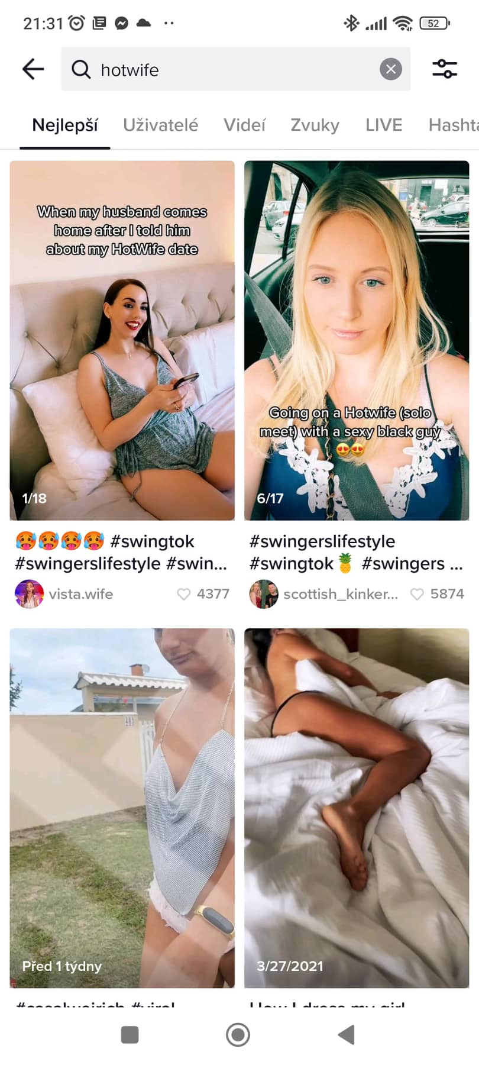
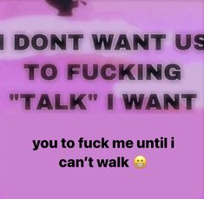
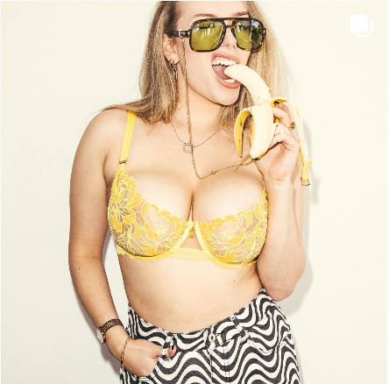
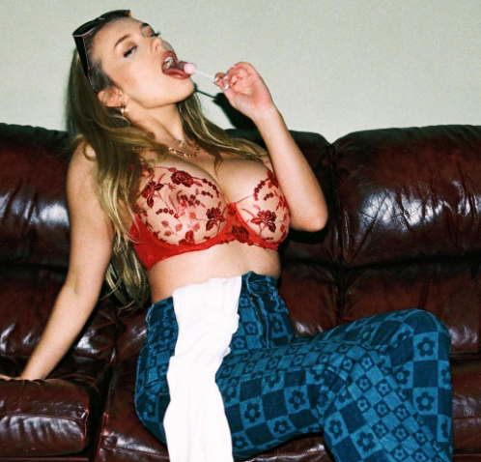
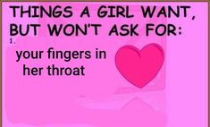
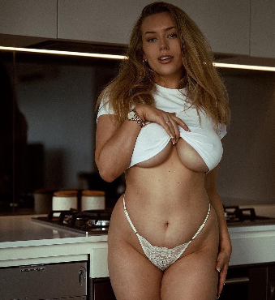
What can we see on different social media?
@avalonhopeofficial

Slide 10
OK what? How do the algorithms work?

Slide 11
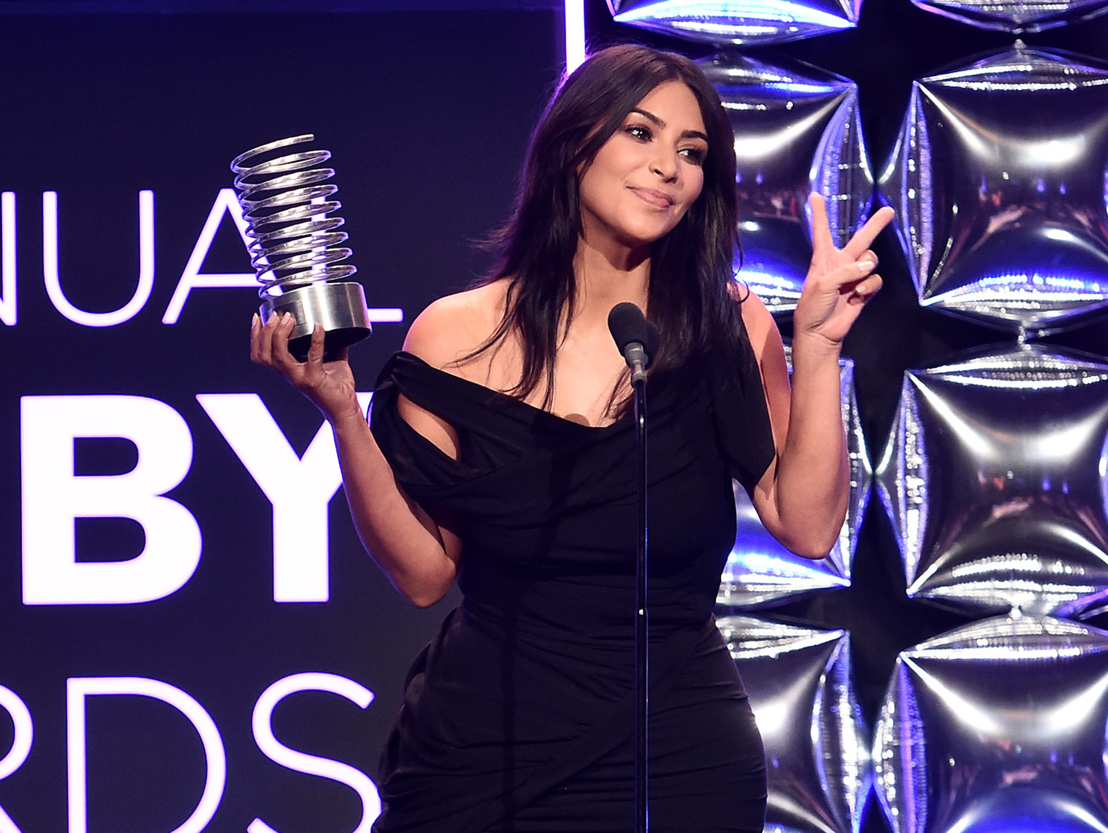
„Nude selfies
`til I die!“
- Kim Kardashian in a speech at Webby awards 2016 after she received the Break the Internet award

Slide 12
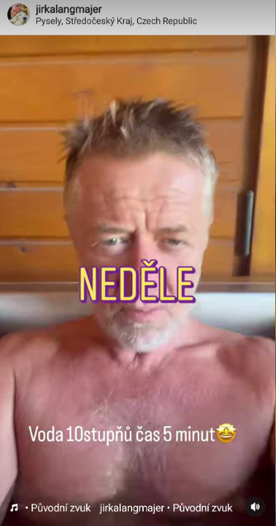
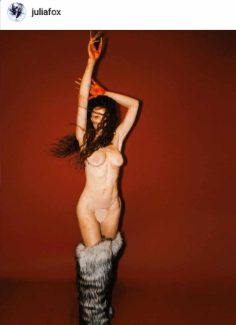
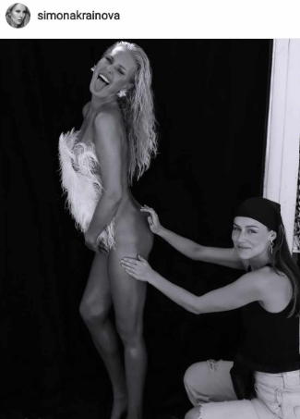
But really?

Slide 13
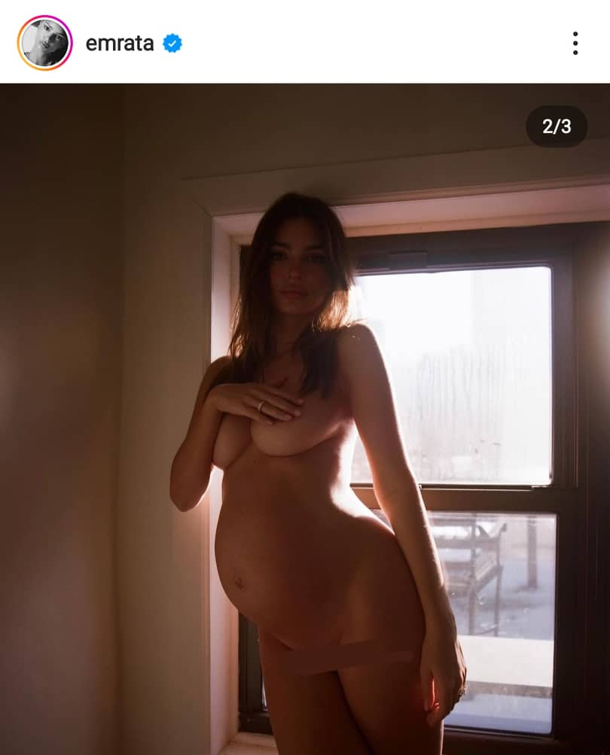
But really?
#freethenipple
According to Instagram, apparently not all nipples are equal
celebrities vs. ‚regular people‘
It may seem that regulations are enforced equally – but nope.
Emily Ratajkowski, 2. 3. 2021

Slide 14
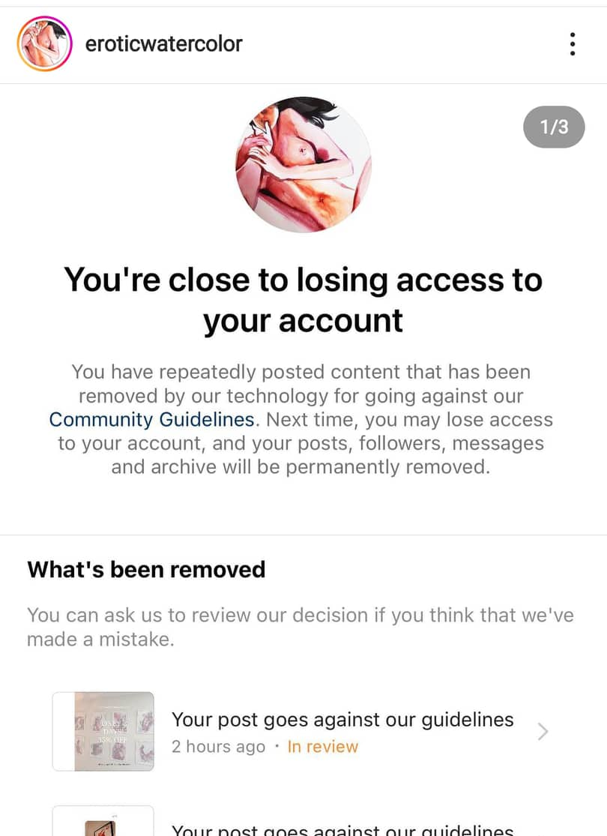
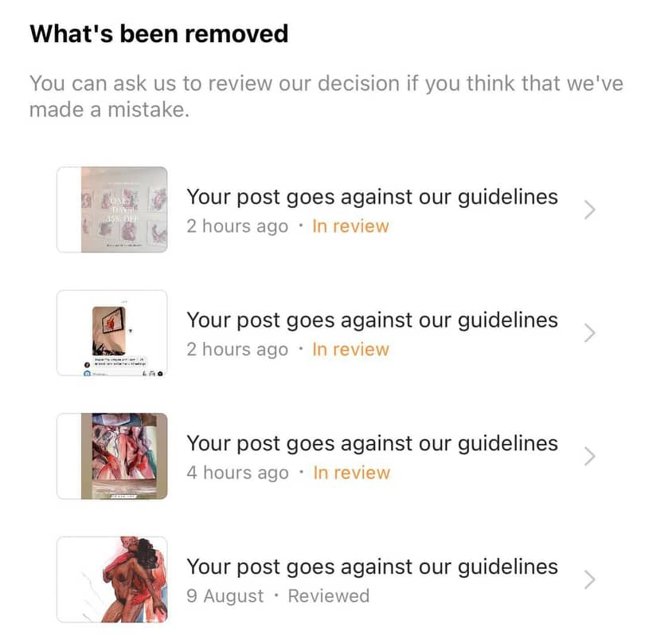
But really?
But really?
Emily Ratajkowski, 2. 3. 2021

Slide 15

Will/should Instagram ever Free the Nipple?
Try to come up with pro/cons!

Slide 16
Real research
Tukachinsky, R., Inaba, H., Kraus, K., Stewart, D., & Williams, M. (2019). Sex, likes and Instagram: Celebrity self-presentation on Instagram images. In C. Madere, Star power: The media effects created by celebrities, (pp. 165-179). Rowman & Littlefield.
Main findings
Social media platforms have revolutionized the relationship between celebrities and their fanbase
Self-sexualization on social media has been assumed to be driven by attempts to gain attention and approval from followers.
In the case of celebrities, women are not only exposed to media-generated sexual standards, but they are actively participating in creating and maintaining them, and thus are even more likely to conform to these sexual norms.

Slide 17
02
Identity
Constructing sexual identity on social media: how we build our presence?

Slide 18
Sexual identity
Identity consists of a stable sense of one’s goals, beliefs, values, and life roles (Erikson, 1950; Marcia, 1987).
Sexual identity refers to dimensions attributed to sexual orientation identity (i. e. sexual behavior and emotional attachment to other genders), and dimensions of human sexuality (e.g., sexual needs, sexual values, modes of sexual expression, preferred characteristics of sexual partners, preferred sexual activities and behaviors) as well as group membership identity (e.g., a sexual orientation identity, or considering oneself as a member of sexuality-related social groups) and attitudes toward sexual minority individuals. (Dillon et al., 2011)

Slide 19
How social media contribute to our identities?
Identity work
Sexual exploration
Facilitating conversation
Identity construction and realization, challenging stereotypes
Finding what is possible, available, exploring it and dicussing it
Finding other people, sharing content, images, selfies, nudes, etc.
Safe space
Sexual education
???
A space to talk about sex while staying (pseudo)anonymous
Finding valuable information about sexual health and sexuality
People find new ways how to do „sex“ and „sexuality“ on social media every day!

Slide 20

Male and female gaze
Some platforms allow for sharing one‘s nude body – such as Reddit (not talking about OnlyFans here – imagine „regular“ people)
Male gaze = depicting women as sexual object (sexual objectification) for the pleasure of heterosexual male viewer (c. f. Laura Mulvey!)
Female/feminine gaze = depicting women from the point of other women (e. g. Fleabag or The Devil Wears Prada)
Men are not exempt from sexual objectification!
Different feminist standpoints: free sexuality vs. catering to male gaze -> similar to arguments of feminist „Sex Wars“
Going beyond heterosexuality: queering the gaze
  Body (dis)satisfaction among gay men > gay male gaze

Slide 21
Is sharing your nude body emancipatory?
Why yes/why not?

Slide 22
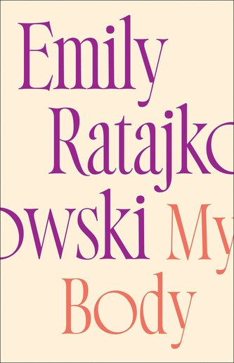
Rocketing to world fame at age twenty-one, Ratajkowski sparked both praise and furor with the provocative display of her body as an unapologetic statement of feminist empowerment. The subsequent evolution in her thinking about our culture's commodification of women is the subject of this book. My Body is a profoundly personal exploration of feminism, sexuality, and power, of men's treatment of women and women's rationalizations for accepting that treatment. These essays chronicle moments from Ratajkowski's life while investigating the culture's fetishization of girls and female beauty, its obsession with and contempt for women's sexuality, the perverse dynamics of the fashion and film industries, and the grey area between consent and abuse.

Slide 23
Real research
Duguay, S. (2016). Lesbian, Gay, Bisexual, Trans, and Queer Visibility Through Selfies: Comparing Platform Mediators Across Ruby Rose’s Instagram and Vine Presence. Social Media + Society, 2(2), 205630511664197. https://doi.org/10.1177/2056305116641975
Main points
Visibility of non-normative identities in mixed spaces of public discourse can give rise to “queer publics” (Berlant & Warner, 1995, p. 344) that open possibilities for new understandings around sexuality and gender.
Beyond sexual conversations, LGBTQ people have employed staged self-reflections on social media to engage in identity development and circulate new understandings across publics.
+ the importance of TikTok! ☺

Slide 24
03
Sex work, sex education and the war with Instagram
Shadowbanning & „S€GGS“

Slide 25
It is increasingly hard for sex educational platforms and sex workers to promote their work online

Slide 26
What are the stakes?
Shadowban
Demonetization
Permanent ban
the account exists, but becomes unsearchable / not favored by algorithm
e. g. YouTube – you can still upload, but not earn money
a.k.a. losing account forever

Slide 27
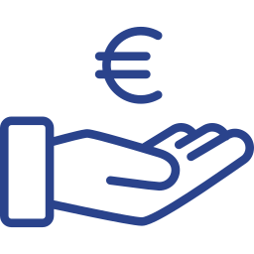
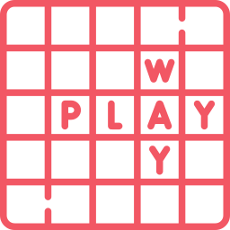


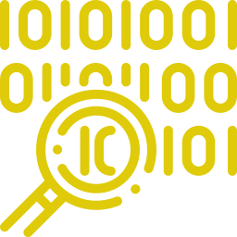
Techniques to prevent shadowbans
special characters
word play
emojis
pronunciation
„leetspeak“
S€ggs, S€X
Lonely Clams
🔥🍑🍆🌶️💦
.🐝DSM
L1NK 1N B10
and other variations that are meant to fool the algorithm
stands for „Only Fans,“ site for selling content
generally understood as erotic emojis
stands for „BDSM“
…and usually, there is more in the link

Slide 28
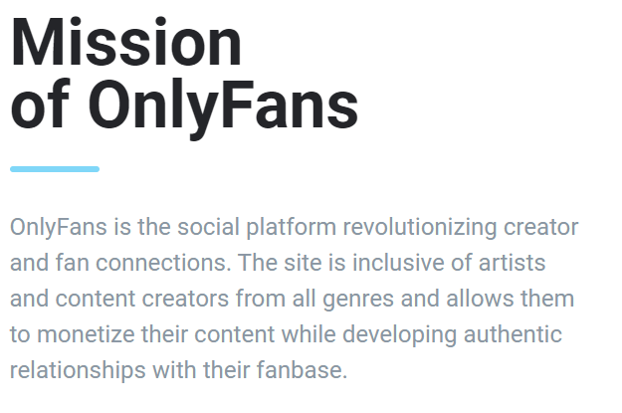
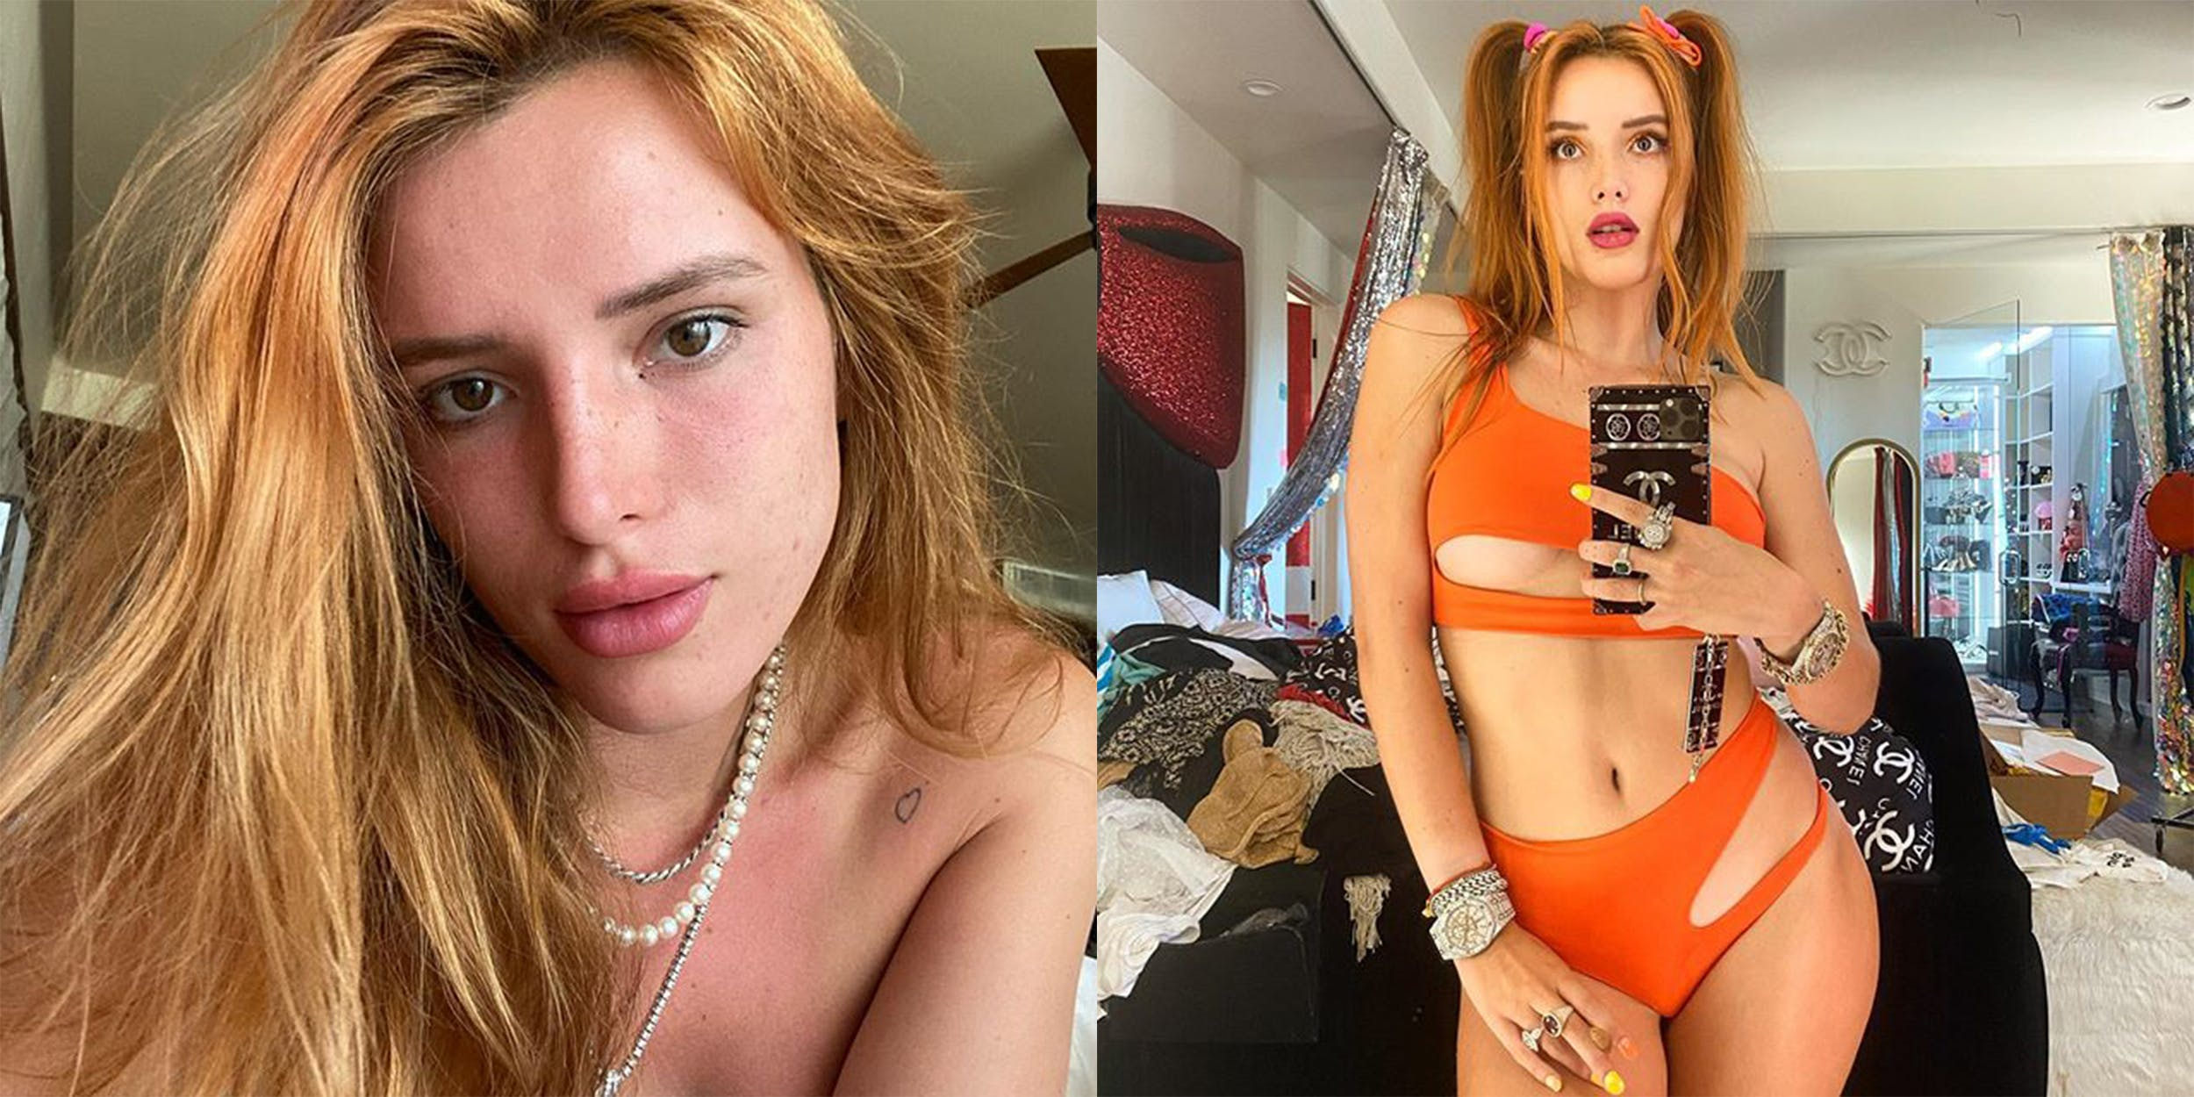
OnlyFans controversy
OnlyFans is a website for creators to share and monetize their content. In reality, most of these „creators“ are sex workers.
Bella Thorne: good (?) intentions and consequences
In 2020, Thorne joined OF and promoted widely her site
She made 2m USD in a week by charging 200 USD for nudes – that turned out to be pics in lingerie
People demanded refund -> OF changed payments – capped tips at 100 USD, exlusive content to 50 USD and people now get paid monthly instead of weekly

Slide 29
Real research
Are, C., & Paasonen, S. (2021). Sex in the shadows of celebrity. Porn Studies, 8(4), 411–419. https://doi.org/10.1080/23268743.2021.1974311
Main findings
Since the 2010s, sexually suggestive, semi-nude and nude photographs shared on social media have become standard in the making and maintenance of celebrity image
Bodily displays on social media are nevertheless not moderated equally. Sex workers and pole dancers in particular are often affected by account deletions and/or shadowbanning, with platforms demoting, instead of promoting, the visibility and accessibility of their content

Slide 30
Real research
Are, C., & Paasonen, S. (2021). Sex in the shadows of celebrity. Porn Studies, 8(4), 411–419. https://doi.org/10.1080/23268743.2021.1974311
The shadowbanning of sex is partly an effect of the Allow States and Victims to Fight Online Sex Trafficking Act and the Stop Enabling Sex Traffickers Act (FOSTA/SESTA). (…) Reversing the principle with regards to content related to sex work, FOSTA/SESTA has effectively rendered platforms liable for the content posted on them (Constine 2019; Tripp 2020). In order to comply with FOSTA/SESTA, social media platforms have been censoring an increasing amount of content to avoid being seen as facilitating sex work, while also reworking their community standards to ban sexual communication and depictions of nudity and sexual activity.
However, naked celebrities are lucrative, and draw traffic! $$$

Slide 31

04
Reddit
Finding your niche with Reddit communities
Reddit

Slide 32
What is Reddit?
Social media to create communities, share content, discuss and message with others
7th most popular in the US
More than 52 million daily users across 100 000+ communities
Social media to create communities, share content, discuss and message with others
7th most popular in the US
More than 52 million daily users across 100 000+ communities
Miller, 2022

Slide 33
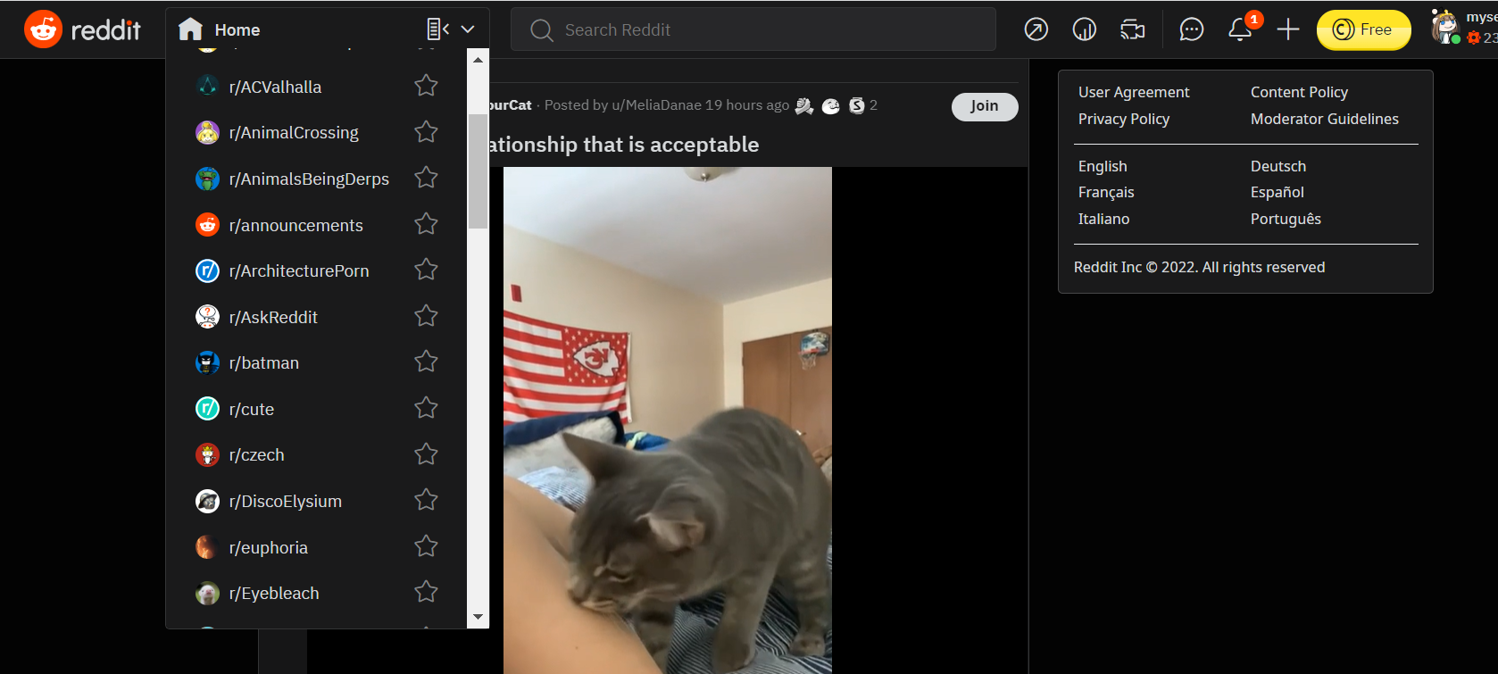

Slide 34
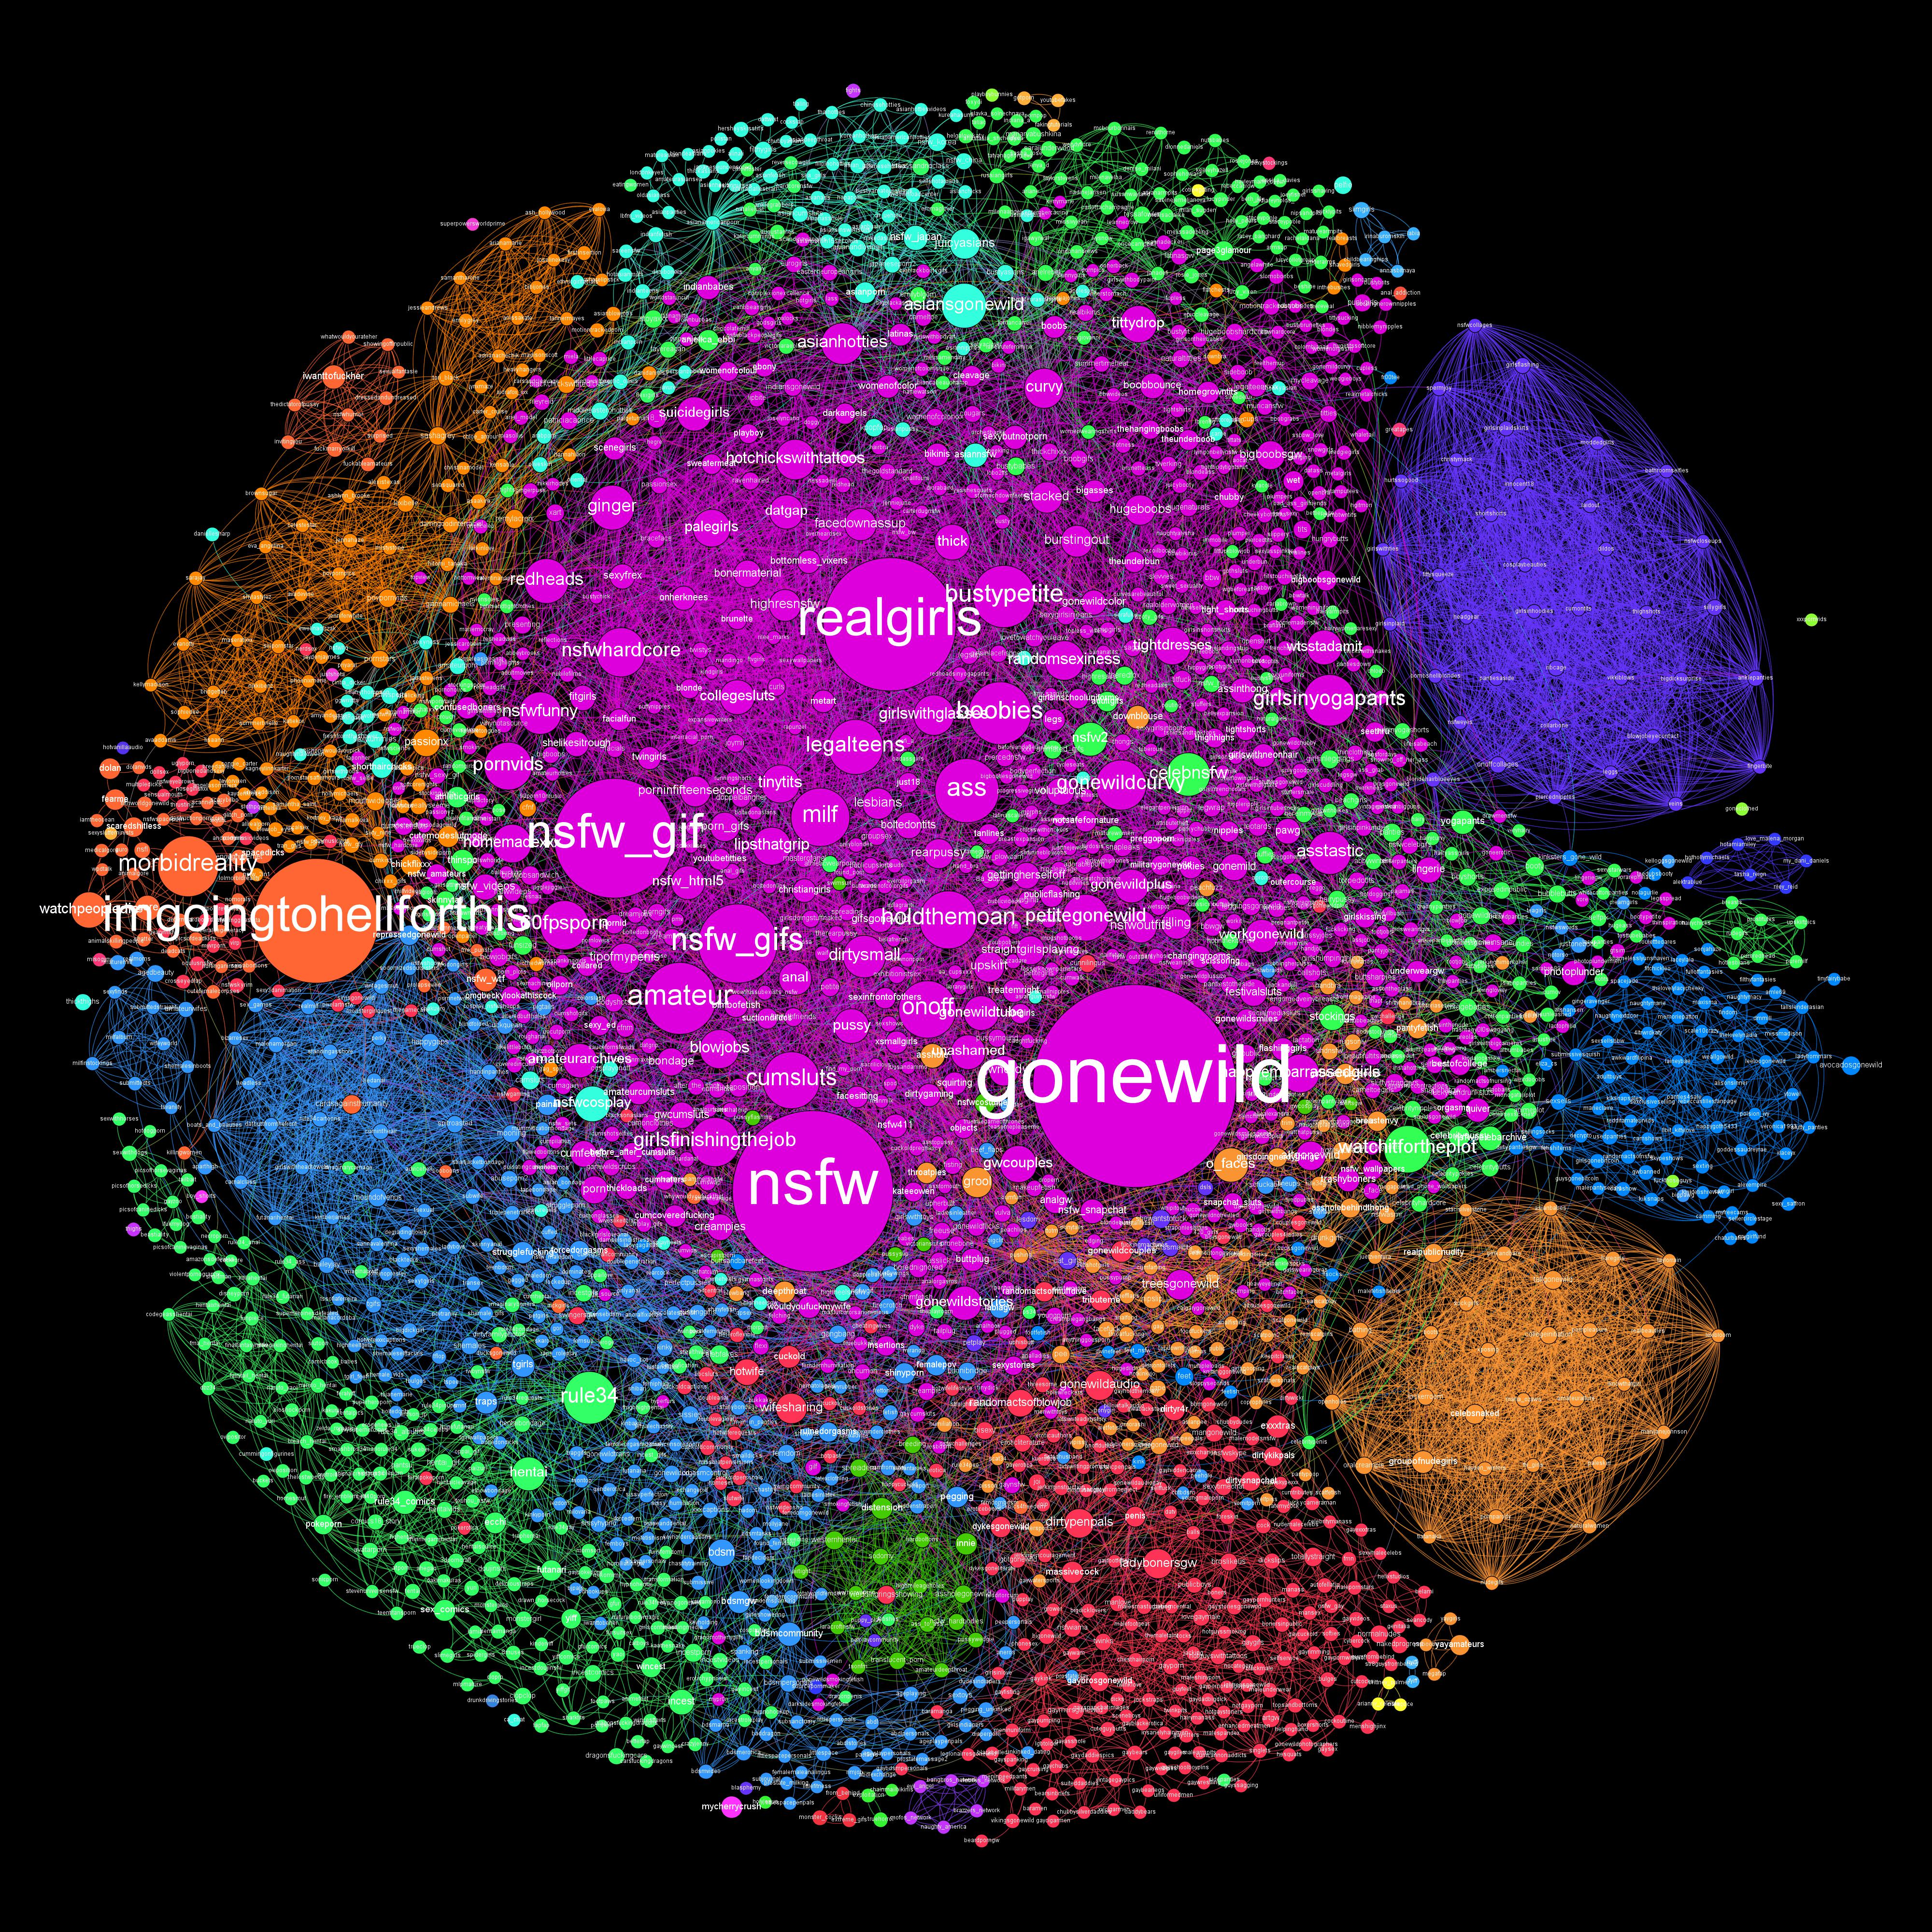
Safe exploration of sex / kinks
Finding body assurance
  r/ratemy…
Anonymity, pseudonymity and battling non-consensual posting
  Embodied verification (van der Nagel, 2020)
Controversial subreddits
  Devoted to violent, explicit or illegal content
  i. e. photos of underaged girls, non-consensual photos, etc.
r/dataisbeautiful u/flashman

Slide 36
Real research
Tiidenberg, K., & van der Nagel, E. (2020). WHAT’S AT STAKE WHEN SEX IS DEPLATFORMED?. AoIR Selected Papers of Internet Research, 2020. https://doi.org/10.5210/spir.v2020i0.11348
Main points
Sex is also worried about, moralized over, and increasingly regulated by social media platforms through a combination of human and automated means.
Taking away platform for sex means: loss of support and self-actualization for queer people; less diverse content and lack of spaces to discuss sex as an everyday part of life; loss of safe spaces; inability to construct sexual self online

Slide 37
Conclusion
05
Now… a task!
Please take 5 minutes to write down things that surprised you / got you thinking / found inspirational. Use your phone, computer, paper, whatever.
Let‘s share them!

Slide 38
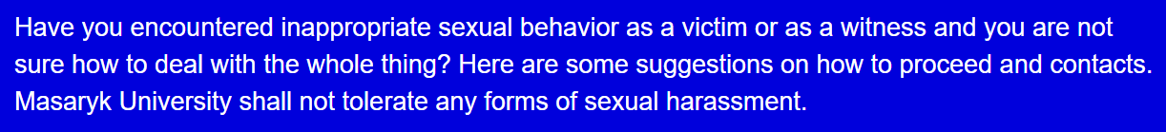
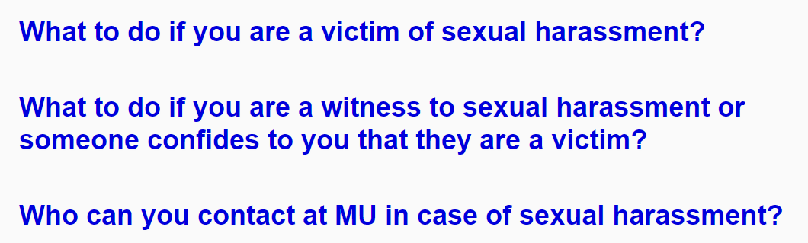
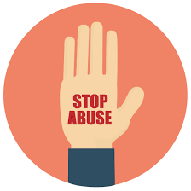
Resources
https://www.muni.cz/en/students/sexual-harassment

Slide 39

Thank you!
Liked my lecture? Let me know and let‘s stay in touch!
@mlebedikova
m.lebedikova@mail.muni.cz

Slide 40
Bibliography
Miller, B. (2022). Exploring the Posting of Nude Photographs on Reddit in Relation to Self-Esteem, Perceived Attractiveness, Narcissism, and Sensation Seeking. Archives of Sexual Behavior, 51(6), 3083–3092. https://doi.org/10.1007/s10508-022-02301-y
van der Nagel, Emily. 2020. ‘Embodied Verification: Linking Identities and Bodies on NSFW Reddit.’ In Mediated Interfaces: The Body on Social Media, edited by Carolina Cambre, Crystal Abidin and Katie Warfield. New York: Bloomsbury
Widman, L., Javidi, H., Maheux, A. J., Evans, R., Nesi, J., & Choukas-Bradley, S. (2021). Sexual Communication in the Digital Age: Adolescent Sexual Communication with Parents and Friends About Sexting, Pornography, and Starting Relationships Online. Sexuality and Culture, 0123456789. https://doi.org/10.1007/s12119-021-09866-1
Adams-Santos, D. (2020). Sexuality and digital Space. Sociology Compass, 14(8). https://doi.org/10.1111/soc4.12818
Ouirdi, M. el, el Ouirdi, A., Segers, J., & Henderickx, E. (2014). Social Media Conceptualization and Taxonomy: A Lasswellian Framework. Http://Dx.Doi.Org/10.1177/0973258614528608, 9(2), 107–126. https://doi.org/10.1177/0973258614528608
Erikson, E. H. (1950). Childhood and society. New York: Norton
Marcia, J. E. (1987). Identity in adolescence. In J. Adelson (Ed.), Handbook of adolescent psychology. New York: Wiley.
Dillon, F. R., Worthington, R. L., & Moradi, B. (2011). Sexual Identity as a Universal Process. In Handbook of Identity Theory and Research (pp. 649–670). Springer New York. https://doi.org/10.1007/978-1-4419-7988-9_27

