Slide 1
Global Perspectives on AI Regulation
3.10.2023
GLCb2028 Artificial Intelligence in Political Science and Security Studies
Jan KLEINER
jkleiner@mail.muni.cz

Slide 2
Presentation outline
General approaches to regulation and their problems.
Case studies (EU, China, USA).
Activity – discussion.

Slide 3
The race to AI regulation (Smuha, 2021)
The increased visibility of the risks associated with AI has led to calls for appropriate regulation to ensure trustworthy AI. This has resulted in a "race to AI regulation" alongside the "race to AI" itself.
Multitude of AI applications and their distinct challenges require tailored policies and a holistic regulatory approach.
Recognition that trading off trust for economic benefits hampers AI's long-term benefits → cautious optimism.
Regulators rushing to adopt requirements for Trustworthy AI – BUT: currently primarily based on voluntary guidelines and not enforceable when harm occurs.
The need for enforceable safeguards for human rights, democracy, and the rule of law.

Slide 4
Regulatory toolbox (Smuha, 2021)
Modalities of regulation:
Regulation by law (traditionally seen as the main regulatory modality).
Social norms, which can influence and constrain behaviour through societal expectations and values.
The market, which can shape behaviour through economic incentives and competition.
The architecture or design of technological applications, which can incorporate safeguards and constraints into the technology itself.
Carrots, sticks, and sermons (governance/policy tools) (Bemelmans-Videc et al., 1998).
Notes:
Modalities of regulation can be used by governments to intentionally influence and constrain the behaviour of individuals, groups, or legal entities such as companies

Slide 5
The problems of AI regulation (Smuha, 2021)
Various jurisdictions.
The absence of a commonly agreed definition of AI → cannot effectively assess AI investment levels, research advancements, and adoption across different countries.
Regulators face complex and multidisciplinary field and have to assess consequences of their intervention and non-intervention.
Synoptic delusion?
Hard to keep up with the rapid advancement in AI tech.
AI regulation´s potential impact on other technologies and stakeholders.

Slide 6
A detour: Two normative theories
The Social Contract Theory (SCT) and The Stakeholder Theory (ST).
SCT – an individual has rational reasons to form a contract (e.g., Hobbes: the brutal state of nature → security or Kant: universal moral norms) (Lessnoff, 1990).
ST – weighing multiple stakeholder´s interests within a societal arrangement → SITL (society-in-the-loop) developed from HITL (human-in-the-loop) (Rahwan, 2018).

Slide 7
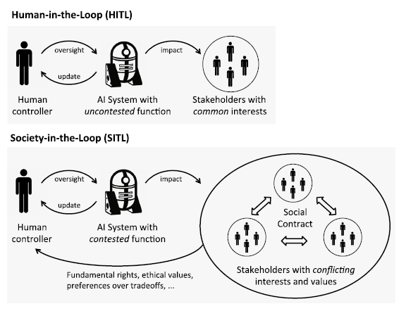
Source: Rahwan, 2018: 9

Slide 8
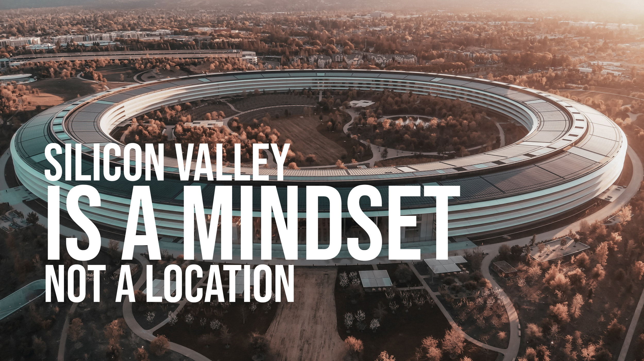
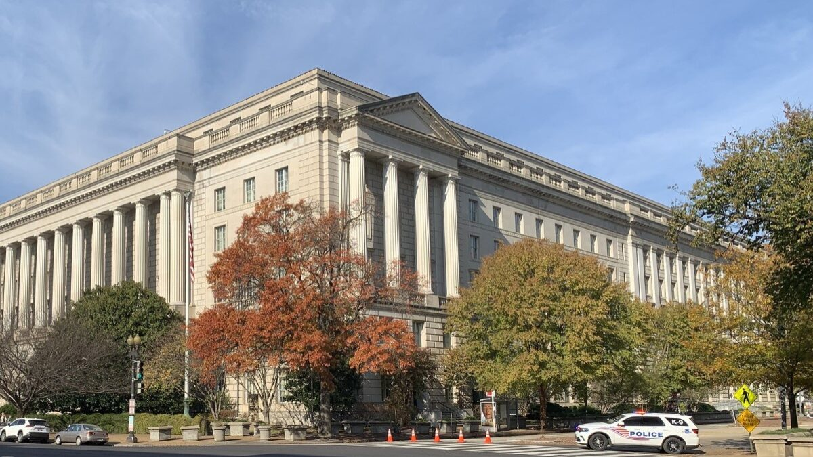
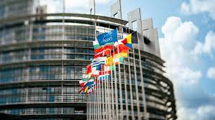
Case studies on regulation: Four Internets (O'Hara and Hall, 2021)
Internet governance models:
Silicon Valley's open,
Brussels' bourgeois,
Beijing's authoritarian,
and DC's commercial internet,
plus, Moscow's spoiler model.
Source: The Federalist
Source: Nordic Innovation House
Source: HN
Source: China Briefing
Source: The Denver Post

Slide 9
The EU case I: setting rules of the game (Smuha, 2021)
(EU) is acknowledged as the regulatory standard-setter in data protection – aims for the same in AI (but not unsontested).
Has established the High-Level Expert Group on AI (AI HLEG).
GDPR – EU´s flagship data-protection tool.
A competitive disadvantage -> falling behind the U.S. and China.
EU AI Act – the first comprehensive AI regulation (European Parliament, 2023).

Slide 10
The EU case II: Individuals and their rights (European Parliament, 2023)
EU AI Act:
Part of the EU´s digital strategy.
Passed July 2023 (potentially 2025-2026 in effect).
Different risk levels → different rules:
Unacceptable – cognitive behavioural manipulation, social scoring, real-time biometric identification systems, democratic process medling (e.g., facial recognition) etc. → banned
High – toys, aviation, medical, biometric ident. sys., critical infrastr. ops, law enforcement etc. → assessed before and throughout their lifecycle.
Generative AI – transparency
Limited – minimal transparency compliance
More on EU´s websites.

Slide 11
The Chinese case I: Competition and social control (Roberts et al., 2021)
China aims to become a world leader in AI by 2030 incl. shaping of the ethical boundaries (seeting the rules of the game).
Set by 2017 New Generation Artificial Intelligence Development Plan‘.
Focus on international competitiveness, economic growth, and social governance.
Government-affiliated bodies and private companies in China have also developed their own AI ethics principles ('Beijing AI Principles‘, Tencent, or Chinese Association for Artificial Intelligence).

Slide 12
The Chinese case II: Now (Sheehan, 2023)
One of the „world´s earliest and detailed regulations governing AI“.
West often sees Chinese AI reg. only geopolitically and as a competition – but worth the study.
Three most impactful regulations:
2021 regulation on recommendation algorithms
.Bar excessive price discrimination and protects the rights of workers…“
2022 rules for deep synthesis (synthetically generated content)
„Requires conspicuous labels be placed on synthetically generated content.“
2023 draft rules on generative AI
„Requires both the training data and model outputs to be “true and accurate”.“ (an obsatcle for LLMs).

Slide 13
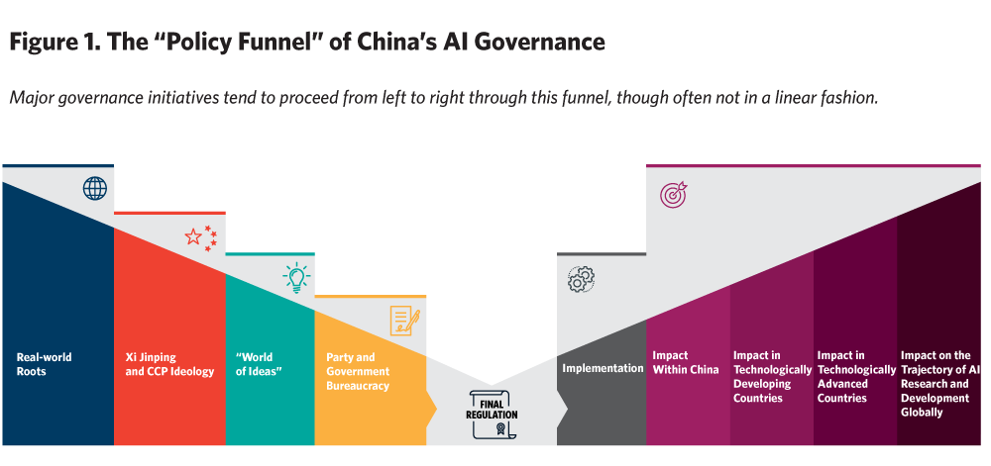
How China makes AI regulation, a conceptual model (Sheehan, 2023):

Slide 14
The U.S. case: Regulation in Its „Early Days“ (Kang, 2023)
No concrete law text (U.S. falling behind EU and China – is it a new/bad phenomenon?). BUT: suits many tech companies.
Despite the hype, only blueprint (The White House, 2023):
„You should be protected from unsafe or ineffective systems“.
„You should not face discrimination by algorithms and systems should be used and designed in an equitable way.“
„You should be protected from abusive data practices via built-in protections and you should have agency over how data about you is used.“
„You should know that an automated system is being used and understand how and why it contributes to outcomes that impact you.“
„You should be able to opt out, where appropriate, and have access to a person who can quickly consider and remedy problems you encounter.“

Slide 15
Activity: Team Discussions
Divide yourselves into teams.
Choose a position on AI regulation (2 mins).
Look up credible information about that position (5-10 mins).
Tip: Use SciSpace for effective pdf-info extraction.
Moderated discussion with other teams.

Slide 16
References I
Bemelmans-Videc, M.-L., Rist, R. C., & Vedung, E. (1998). Carrots, Sticks & Sermons: Policy Instruments and Their Evaluation. In Carrots, Sticks and Sermons: Policy Instruments and Their Evaluation. Transaction Publishers.
European Parliament. (2023). EU AI Act: first regulation on artificial intelligence. European Union. https://www.europarl.europa.eu/news/en/headlines/society/20230601STO93804/eu-ai-act-first-regulation-on-artificial-intelligence?at_campaign=20226-Digital&at_medium=Google_Ads&at_platform=Search&at_creation=Sitelink&at_goal=TR_G&at_advertiser=Webcomm&at_audience=ai%20legislation&at_topic=Artificial_intelligence_Act&gclid=Cj0KCQjw1OmoBhDXARIsAAAYGSHYcgbTP0Q9lD-o_Fqan-XgXTEFr1FRUMGO6VvFvZvoxzHLEGiAhZsaAoW8EALw_wcB
Kang, C. (2023). In U.S., Regulating A.I. Is in Its ‘Early Days’. The New York Times. https://www.nytimes.com/2023/07/21/technology/ai-united-states-regulation.html
Lessnoff, M. (1990). Social Contract Theory. New York University Press.
O’Hara, K., & Hall, W. (2021). Four Internets. Oxford University Press. https://doi.org/10.1093/oso/9780197523681.001.0001

Slide 17
References II
Rahwan, I. (2018). Society-in-the-loop: programming the algorithmic social contract. Ethics and Information Technology, 20(1), 5–14. https://doi.org/10.1007/s10676-017-9430-8
Roberts, H., Cowls, J., Morley, J. et al. (2021). The Chinese approach to artificial intelligence: an analysis of policy, ethics, and regulation. AI & Society, 36, 59–77. https://doi.org/10.1007/s00146-020-00992-2
Sheehan, M. (2023). China’s AI Regulations and How They Get Made. Carnegie Endowment for International Peace. https://carnegieendowment.org/2023/07/10/china-s-ai-regulations-and-how-they-get-made-pub-90117
Smuha, N. A. (2021). From a ‘race to AI’ to a ‘race to AI regulation’: regulatory competition for artificial intelligence, Law, Innovation and Technology, 13(1), 57-84, DOI: 10.1080/17579961.2021.1898300

Slide 18
Thank you for your attention.
Questions?
Jan KLEINER
jkleiner@mail.muni.cz

