Slide 1


Science and AI: Building a Toolbox
17.10.2023
GLCb2028 Artificial Intelligence in Political Science and Security Studies
Jan KLEINER
jkleiner@mail.muni.cz

Slide 2
Lecture outline
Presence check + pre-class tasks.
Part 1: How science works and academic ethics → the basis for ethical AI use.
Part 2: Toolbox and practical examples.
Part 3: Practicing.

Slide 3
Part 1: Science

Slide 4
What is Science?
Common basis for all disciplines (Gauch, 2003):
  Evidence-based.
  Use of inductive (qualitative) and deductive logic (hypotheses testing).
  Probability.
  Parsimony.
Principles of science:
  Empirically testable.
  Replicable.
  Objective/non-personal.
  Transparent/controlable (by other scientists).
  Falsifiable/confirmable (inferences must relate to observed evidence).
  Logical Consistency.
  Broader context.

Slide 5
Important criteria
Validity and reliability – favours quantitative.
What about qualitative?
Mason (1996): rigour, quality and potential for generalizability.
Le Compte and Goetz (1982): external reliability (replicability) and validity (generalizability), internal reliability (among observers) and validity (aligning data and theory).
Guba and Lincoln (1981): Trustworthiness set: credibility (via triangulation), transferability (to different case), dependability (due dilligence? + audit trail), confirmability (on whose side are we? We cannot do impartial research; transparencyt).

Slide 6
Ethics – why?
Keeping the trust in science.
Citations – author contribution acknowledgement.
Effective system of vast knowledge management.
Transparency -> auditability.
Can you think of any other reasons?

Slide 7
Academic hell
Sloppy science – archiving, collecting, storing etc.
Fabrication of data and conclusions.
Wrong use of scientific methods.
Big ego.
Not upholding scientific principles.
Plagiarism.

Slide 8
How to cite ChatGPT? APA
“When prompted with “Is the left-brain right brain divide real or a metaphor?” the ChatGPT-generated text indicated that although the two brain hemispheres are somewhat specialized, “the notation that people can be characterized as ‘left-brained’ or ‘right-brained’ is considered to be an oversimplification and a popular myth” (OpenAI, 2023).“ (McAdoo, 2023)
Reference
  OpenAI. (2023). ChatGPT (Mar 14 version) [Large language model]. https://chat.openai.com/chat

Slide 9
Student-centered principles (UTS, 2023)
Students understand the significance of GenAI for society, careers, and studies.
Students understand legitimate use of GenAI in their studies.
Students are equipped to engage critically and ethically with GenAI.
Students experience GenAI’s strengths and limitations as aids to learning.
Students are assessed on what they need to know in an AI world.

Slide 10
Open Universities Australia (2023)
DO:
ask for research guidance before writing an essay
use it when brainstorming
ask questions about study material you don’t understand
use it to proofread your work
cite any AI assistance in your reference list
DONT:
ask AI software to write essays for you
blindly trust AI-generated information
do anything that violates your university’s academic integrity policy

Slide 11
Discussion
How does LLM usage cope with scientific principles?
How to ethically use AI tools?
Do I need to disclose ChatGPT-brainstormed ideas?
Have you encountered any particular issues?

Slide 12
Part 2: Toolbox

Slide 13
Generative AI and study companions
Claude – LLM like ChatGPT, but higher limit (only in USA and UK).
  + ChatGPT and Bard.
  + ChatGPT cheat sheets.
Revision.ai – Flashcards from pdf notes.
Easy-Peasy AI – GPT-4 model based AI + image gen.
Quillbot – paraphraser, MS Word plugin.
Forefront.ai – GPT-3.5, Claude, input tokens, internet search, file uploads
PromptGPT – web with prompts and jailbreaks.
Prompt-genie – 14 days free trial.
Scholarcy – summary cards of small/medium documents.
MAXQDA – Open AI plugin – text analysis client-based SW.
Penseum – study companion, temporary halt on new accounts.
Perplexity.ai – ChatGPT + Google

Slide 14
Literature review
Elicit – summarizing, comparing studies free (5k credits) -> paid.
Scispace – pdf TLDR, summaries, chat.
Research Rabbit – vizualisation.
Connected Papers – vizualisation.
Open Knowledge Maps – visualisation.
Consensus – outputs based on a research question.
VOSViewer – client-based SW, visualisation, text mining capabilities.
Sourcerly – find sources.
Jenni AI – writing co-pilot using papers.
Litmaps – lit finder and vis.

Slide 15
Data visualisation and analysis
Flourish.
Datawrapper.
BioRender – life sciences visualisations.
Bard – „write a Python/R code for data visualisation“ → paste data sample → export code → use the code in R studio
Text analysis (Claude/ChatGPT – Grounded Theory coding) → sensitizing concepts + Leximancer (free trial) → analysis.
GPT Excel – MS Excel formulas generator and companion.
There is an AI for that – find Ais using AI.

Slide 16
Part 3: Practice makes perfect

Slide 17
Literature review – a little bit of theory (Jesson, Matheson and Lacey, 2011)
Systematic (structured) vs. traditional (unstructured) → continuum!
Cannot be ever complete – esp. with the problem of GRAY LITERATURE.
Traditional | Systematic
Random process guided by researcher (bias) | Rigorous, structured process driven by scientific principles and methods.
Implicitly/explicitly subjective. | Objective, balanced, less biased.
Lack of scientific method(s). | Method is focused, explicit and transparent.
Identification of topic, topic recon, support for arguments, introduction. | Systematic overview of every relevant piece of knowledge – available.

Slide 18
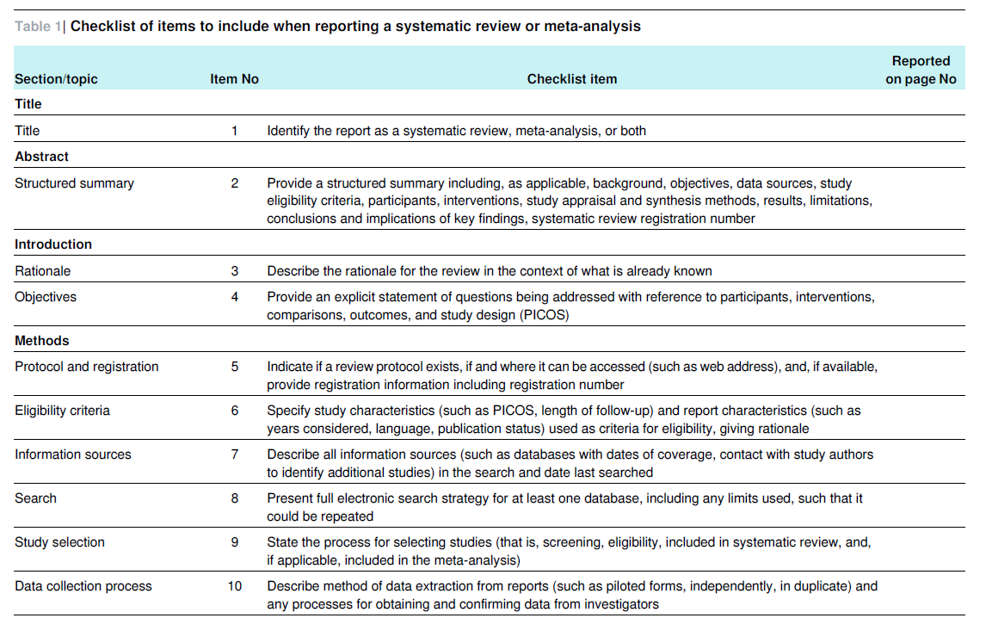
Source: Moher et al., 2009, p. 5-6

Slide 19
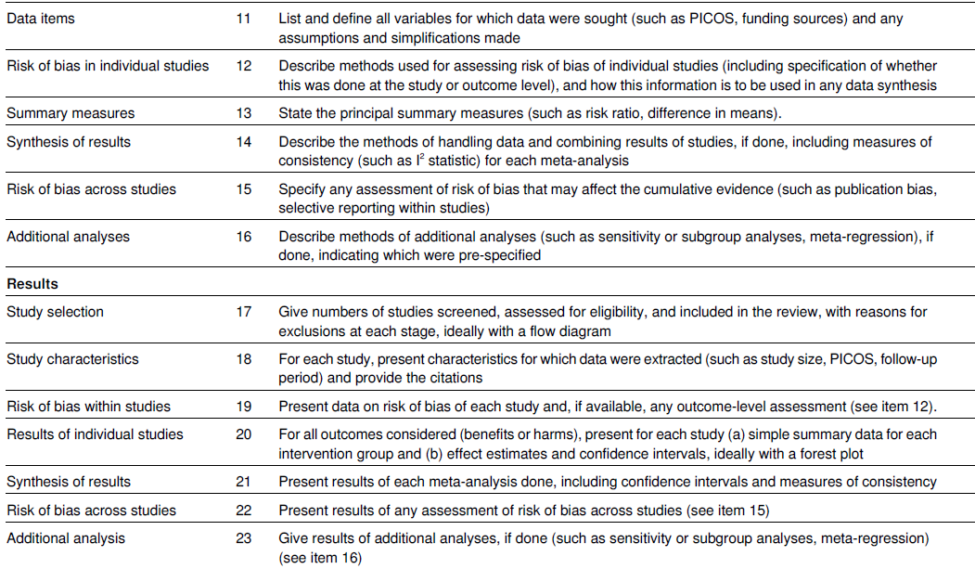
Source: Moher et al., 2009, p. 5-6

Slide 20
Practice time!
Explore the tools.
Form author teams.
Think about the topic you want to explore in the final project/your own research/other courses.
Perform an unstructured literature review – exploration of relevant papers in this area and make it a first step of your research report → but you will strive for structured literature review in it!

Slide 21
References
Gauch, Hugh G. Jr. (2003). Scientific Method in Practice. Cambridge University Press.
Guba, E. G., and Lincoln, Y. S. 1981. Effective evaluation: Improving the usefulness of evaluation results through responsive and naturalistic approaches. San Francisco, CA: Jossey-Bass.
Jesson, J., Matheson, L. and Lacey, F. (2011). Doing Your Literature Review: Traditional and Systematic Techniques. Londýn: SAGE.
LeCompte, M. D., and Goetz, J. P. 1982. Problems of Reliability and Validity in Ethnographic Research. Review of Educational Research, 52, 31-60.
https://doi.org/10.3102/00346543052001031
Mason, J. (1996). Qualitative researching. Sage Publications, Inc.
McAdoo, T. (2023). APA Style. Available from: https://apastyle.apa.org/blog/how-to-cite-chatgpt.
Moher, D., Liberati, A., Tetzlaff, J., Altman, D. G., & PRISMA Group (2009). Preferred reporting items for systematic reviews and meta-analyses: the PRISMA statement. PLoS medicine, 6(7), e1000097. https://doi.org/10.1371/journal.pmed.1000097
Open Universities Australia. (2023). How you should—and shouldn’t—use ChatGPT as a student. Available from: https://www.open.edu.au/advice/insights/ethical-way-to-use-chatgpt-as-a-student
UTS. (2023). Five principles for the effective ethical use of generative AI. Available from: https://lx.uts.edu.au/collections/artificial-intelligence-in-learning-and-teaching/resources/five-principles-for-effective-ethical-use-generative-ai/

Slide 22
Thank you for your attention!
Questions?
Jan KLEINER
jkleiner@mail.muni.cz

