Slide 1


Wargame
14.11.2023
GLCb2028 Artificial Intelligence in Political Science and Security Studies
Jan KLEINER
jkleiner@mail.muni.cz

Slide 2
AI and Wargames (Knack and Powell, 2023)
Red Teaming in general (political/security/other simulations, table-tops -> identification of gaps in a strategy, SWOT analyses, policy analyses etc.).
  Narrow (safe) usage: Repetitive tasks within sims and wargames (background info creation, automatic translation/transcription, textual data analysis, visuals etc.).
  High-risk usage: Red team, game manager etc.
Low cost/questionable reliability.
Better on tactical/operational level than on the strategic one.

Slide 3
Wargame theory – introduction I (Appleget et. al, 2020)
Usually a sponsor – sets goals and timeframe.
Sole purpose of the analytic wargame is to collect analytic data to answer sponsor´s (research) questions – data determine wargame´s success → well tought-out data collection plan is needed!
Roadmap = data collection and management plan (DCMP).
Not just for combat/conflict scenarios, but for Analysis of alternatives (AoA) – e.g., M1A2 Abrams and its replacement options.
+ pedagogic, research tool.

Slide 4
Wargame theory – introduction II (Appleget et. al, 2020)
Course of action wargaming.
BOGGSAT = "bunch of guys and gals sitting around a table„.
Vs.
Seminar wargames - designed around the DCMP (Decision-Centric Methodology Process) and have a structured approach.
Quantitative/qualitative/hybrid models.
Strong role of probability and chance (dice rolls) + conditioned probability (e.g., missile interception of Iron Dome AA system – informed by statistics).

Slide 5
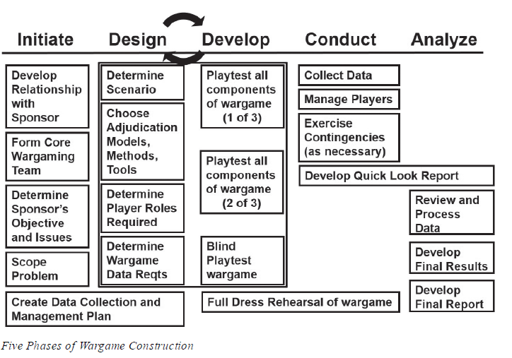
Source: Appleget et al. (2020, p. 73).

Slide 6
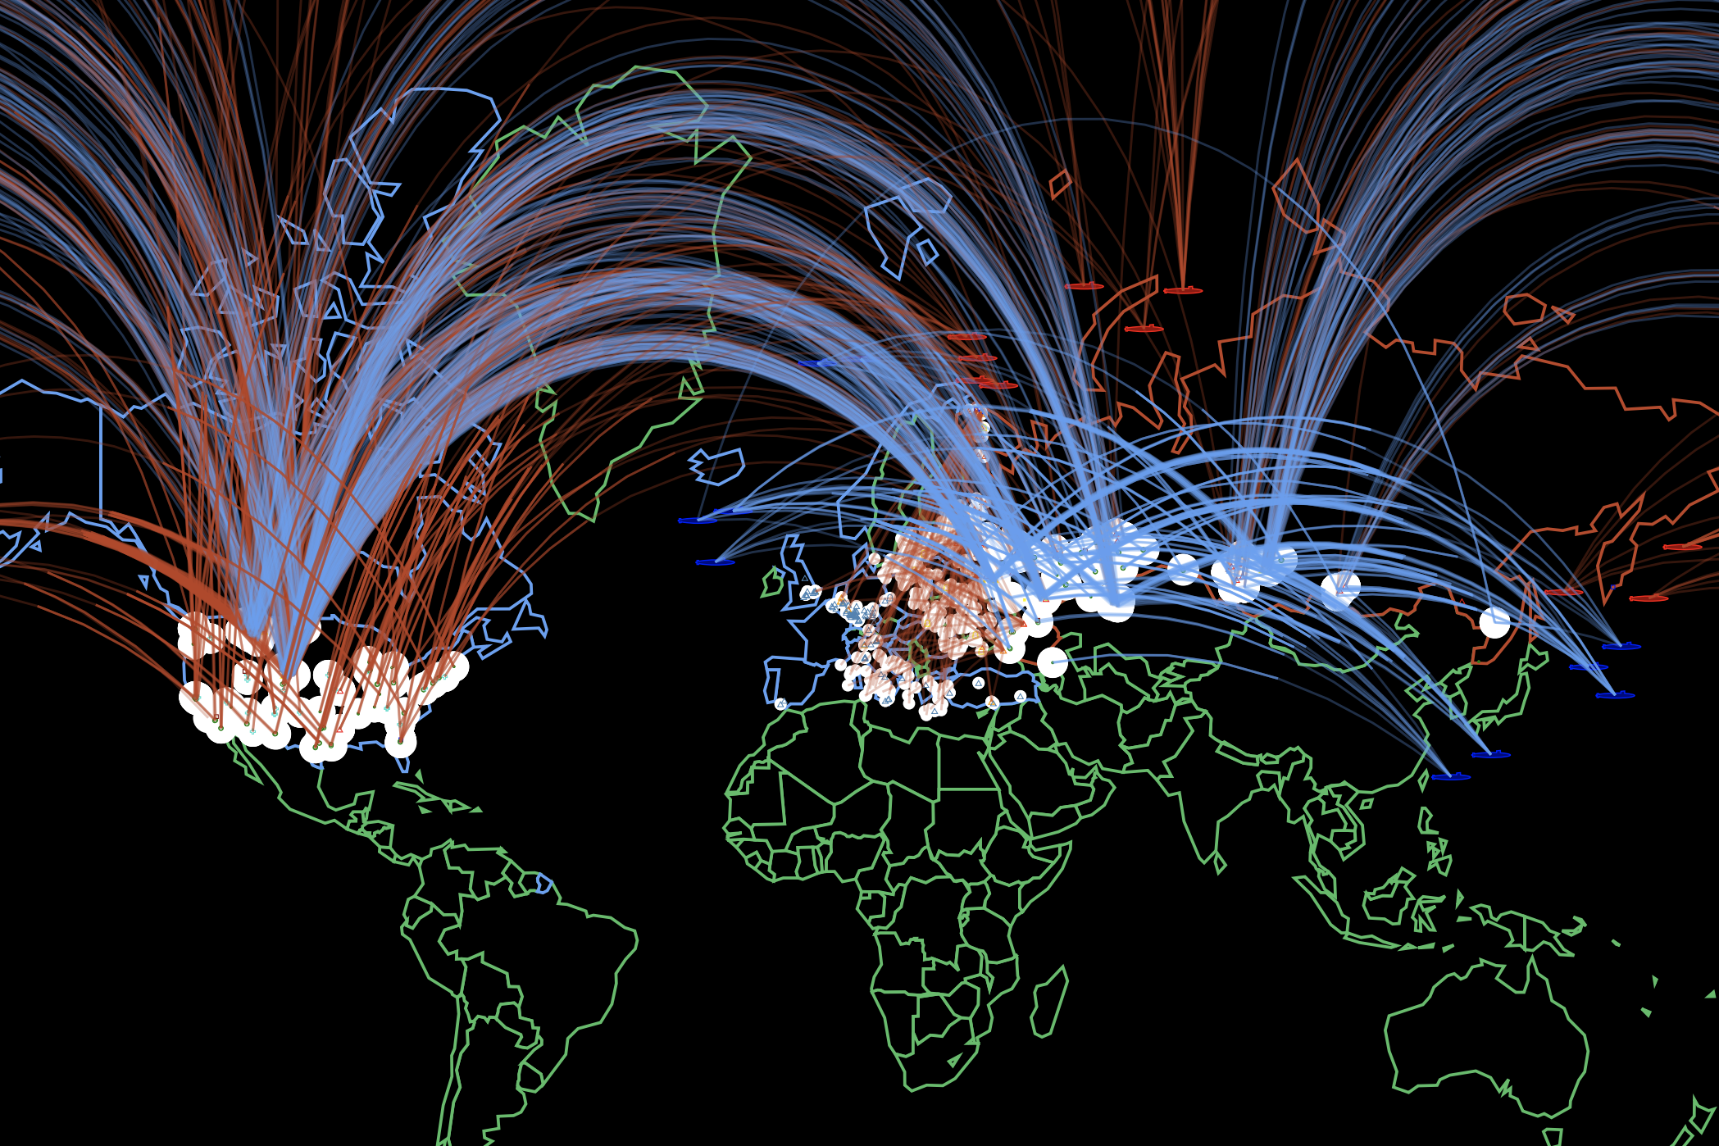
Process:
Choose the arena of the simulation – wargame/strategic table-top/policy analysis/COA etc.
  Why? – justification, purpose -> litreview
Choose the specifics of the simulation framework – actors, setting, dividing into teams, roles etc.
Proceed while adhering to the literature.

Slide 7
AI and Wargame (Appleget et al., 2020)
Will it be an analytic wargame? If so, how will we collect data? → Data Collection and Management Plan (DCMP).
BOGGSAT vs. seminar wargame (designed around the DCMP)? Do not choose only because it is easy!
Who will be the fascilitator?
Establish a wargame plan – every task that needs to be accomplished for preparation, execution, analysis, and reporting.
Incorporate AI tools into the wargame – adere to literature!

Slide 8
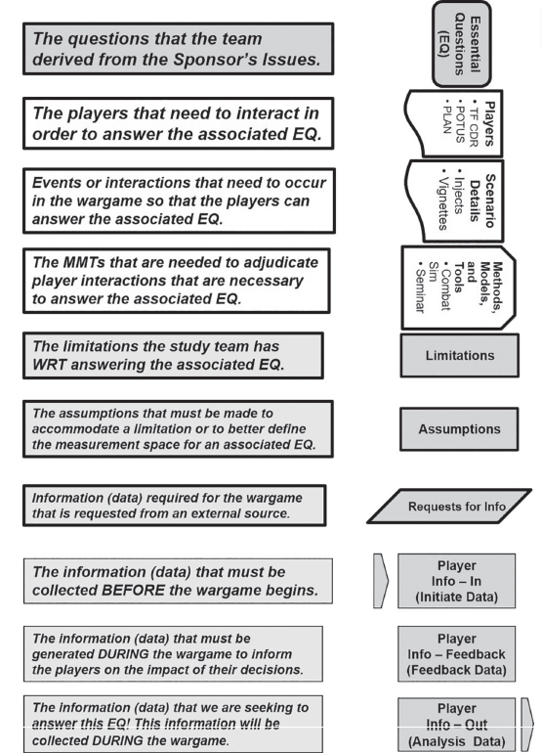
DCMP (Appleget et al., 2020, p. 104)

Slide 9
Design (Appleget et al., 2020)
Measurement space (if analytical) – quantitative/qualitative?; conceptualisation and operationalisation; function of the scenario – e.g., TTDs of MBTs).
Scenario – sets scene + narrative for players; must be plausible (we do not want players to „fight the scenario“).
Data – initiate (data we need before the wargame begins), feedback data (needed to keep players playing – injects, responses etc.), analysis data.
Methods, models, and tools.
Players.
Assumptions – all scenarios set in future need assumptions! → time setting needs to be decided as well (past, present, future).
→ Practical exercise (p. 128).

Slide 10
References I
Appleget, J. Burks, R. & Cameron, F. (2020). The Craft of Wargaming – A Detailed Planning Guide for Defense Planners and Analysts. Annapolis: Naval Institute Press. ISBN 9781682473771
Knack, A. & Powell, R. (2023). Artificial Intelligence in Wargaming An evidence-based assessment of AI applications. The Alan Turing Institute.

Slide 11
Thank you for your attention.
Questions?
Jan KLEINER
jkleiner@mail.muni.cz

