Slide 1
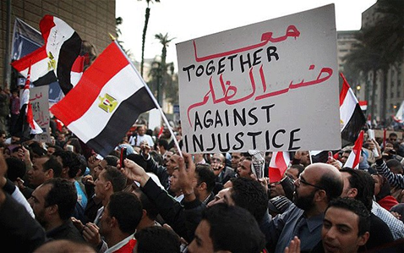
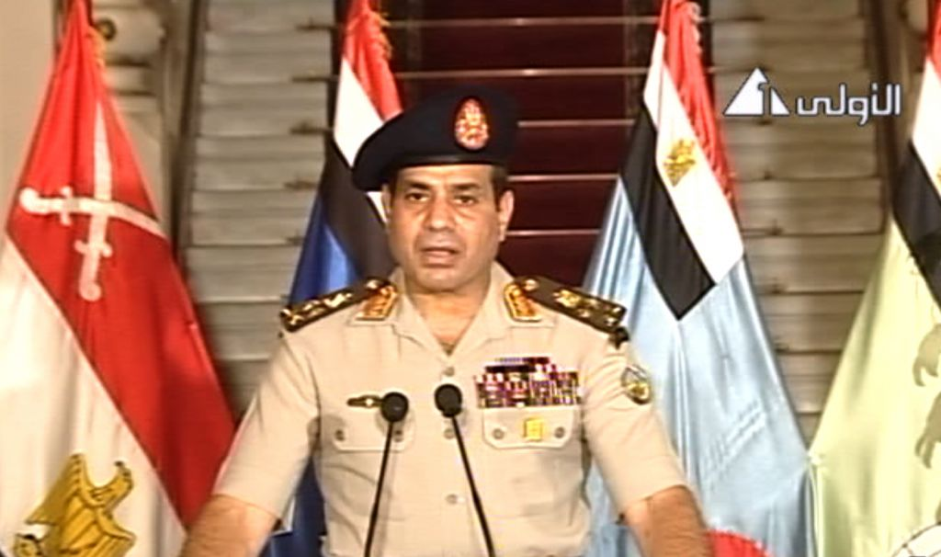
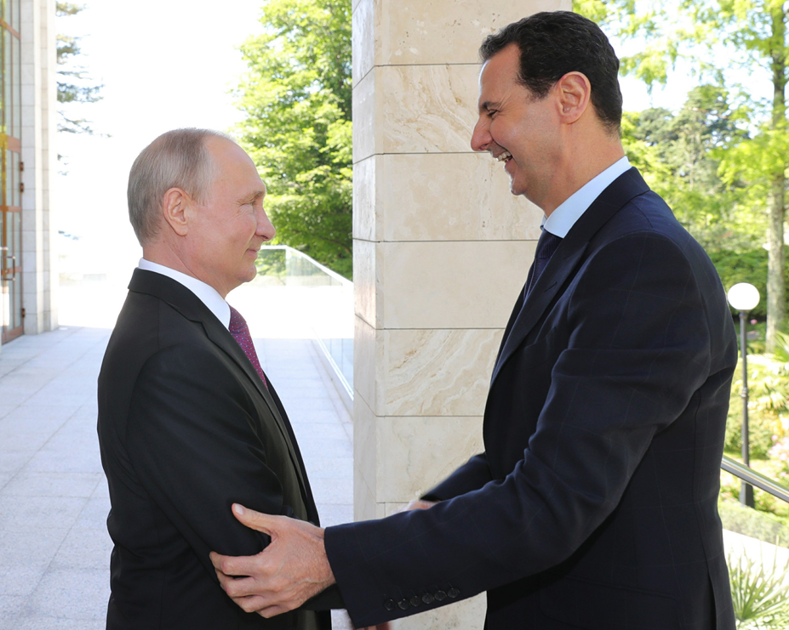
ARAB SPRING AND WAR IN SYRIA
Mgr. Eva Taterova, M.A., Ph.D.
Faculty of Social Studies
Masaryk University

Slide 2
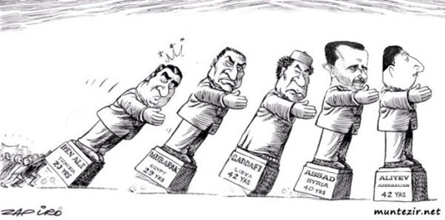
ARAB SPRING
December 2010: Mohamed Bouazizi‘s self-immolation in Tunisia → protest against president Bin Ali‘s government → spread to almost all other Arab countries (a significant surprise for the whole world).
Various reasons for the protests: economic troubles, difficult social situation, corruption, limited human and political right.
Role of the new media and social networks such as Facebook and Twitter.

Slide 3
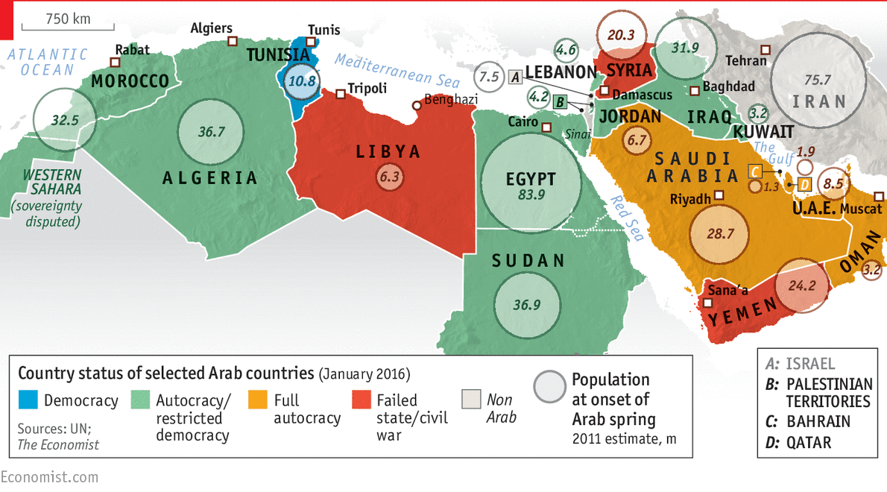
SITUATION AFTER ARAB SPRING

Slide 4

Ambiguous (and still open) consequences of the Arab Spring
A stable but often very brutal autocracy sinks into chaos (Syria, Yemen, Libya) or the resurgence of autocracy (Egypt).
In the ongoing chaos, radicals of all kinds are strengthening - from secularists (clan warlords in Syria or Kurdish militias) to religious extremists (ISIS, An-Nusra).
Weakening US power, slightly strengthening influence of Russia (Syria), China, regional power Turkey is trying to become a local hegemon.

Slide 5
Ambiguous (and still open) consequences of the Arab Spring
Intra-Islamic religious disputes are politicized and sharpened (Saudis and their allies versus Iran and its allies), the Israeli-Arab conflict (but not the Israeli-Palestinian conflict) is de-escalating.
Giant refugee waves, humanitarian disasters, devastation or stagnation of economies, rising inequality and poverty.
Abdel Fattah el-Sisi

Slide 6
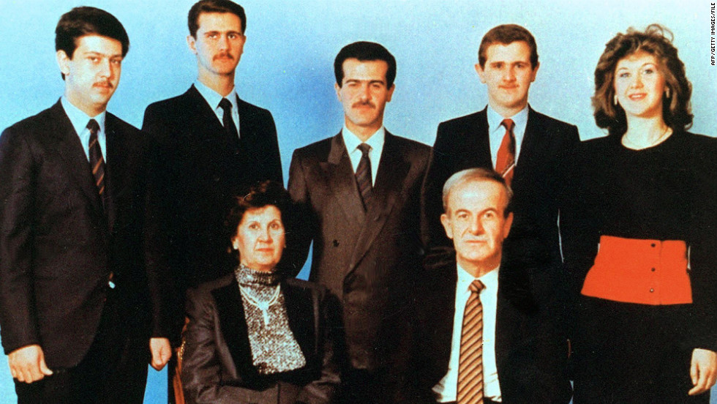
PRESIDENTAL MONARCHY IN SYRIA
The president is almighty, supported by the army.
Personal cult – “people, unity, revolution“.
March 1963: military coup lead by Ba‘ath Party (The Arab Socialist Ba'ath Party) → 1970 Hafez Assad became the president of Syria.
Three pillars of power: family, Ba‘ath Party, army.

Slide 7
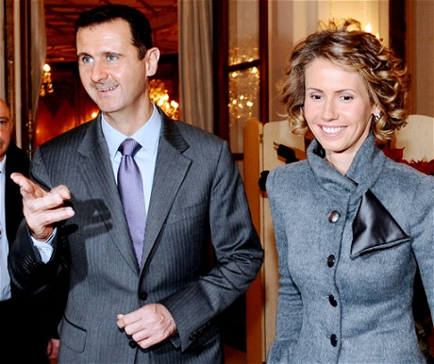
POLITICAL DEVELOPMENT IN SYRIA
1990s significant changes in international relations (failure of USSR → loss of the significant ally).
Deep social changes: social mobilization – more than 50% urbanization rate, growing literacy, 28% people had university or high school education.
Gradual change of the regime – more freedom to travel, to make business, more autonomy, release of some political prisoners.
June 2000: death of Hafez Assad → Bashar Assad.

Slide 8
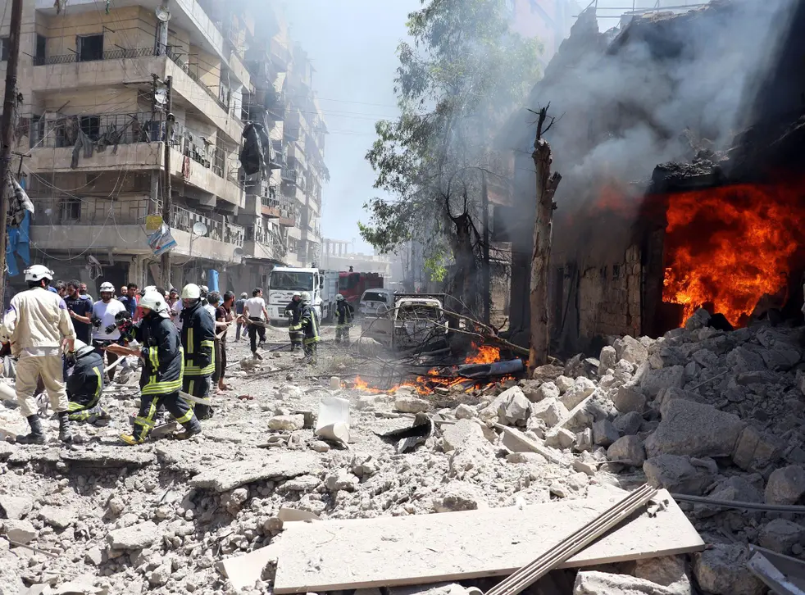
WAR IN SYRIA
March 2011 demonstrations against Bashar Assad‘s regime.
Bashar Assad decide to suppress the uprisings with the help of the army → the conflict escalated in regular civil war.
Massive damages: more than 470,000 death, more 3 millions of refugees – huge violation of the human rights (torture, political prisoners, weapons of massive destruction).
Syria has become the battlefield of the great powers such as Iran, Saudi Arabia, Russia, Turkey and others.

Slide 9
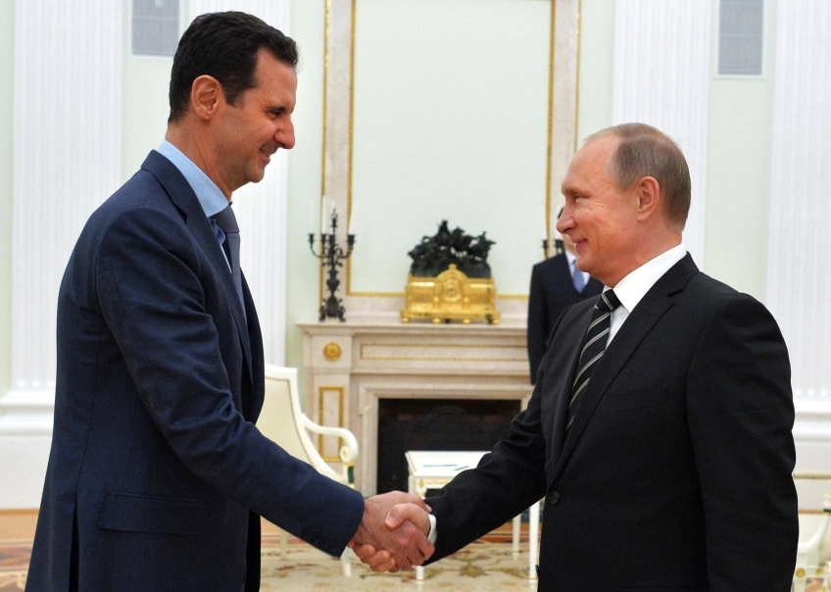
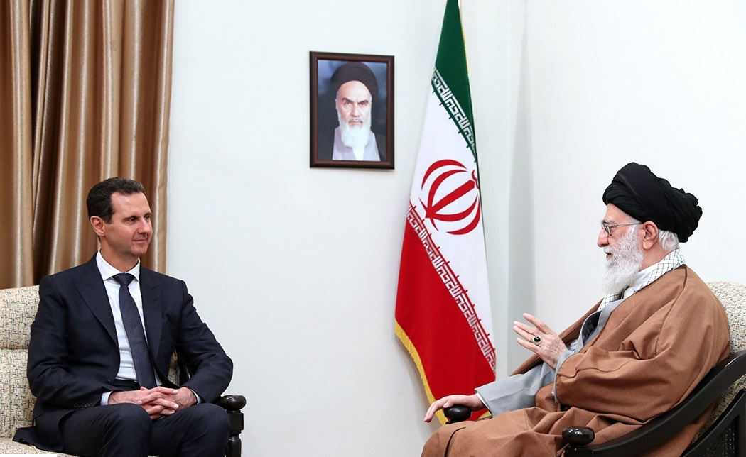
WAR IN SYRIA
Assad‘s supporters:
  Syrian government forces.
  Hizballah.
  Russia, Iraq, Iran.
Opposition:
  National Coalition for Syrian Revolutionary and Opposition Forces
  Islamic state.
  An-Nusra Fronte (close connections to al-Kaida).
  Turkey, Qatar, Saudi Arabia.

Slide 10
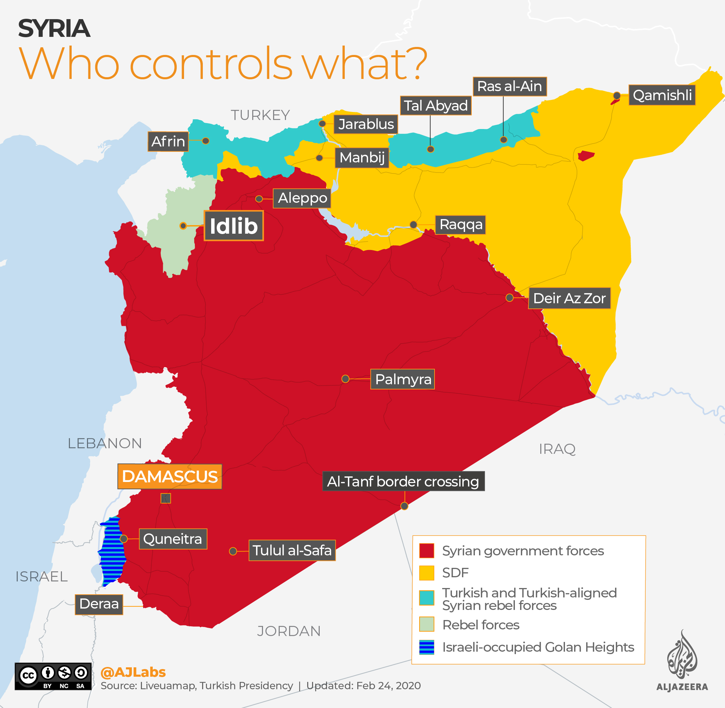

Slide 11
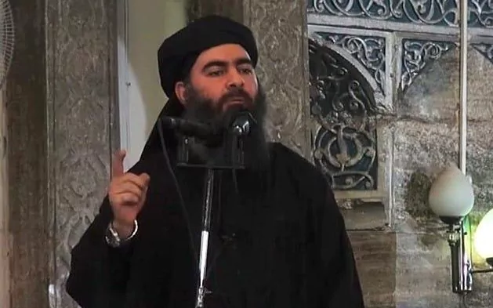
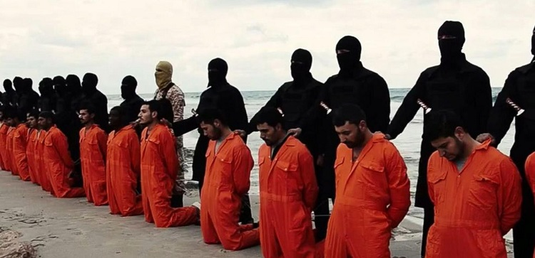
GROWTH OF ISLAMIC STATE (ISIS)
Close connection to wars in Iraq and war in Syria – al-Qaeda was a great inspiration for Abu Bakr al-Baghdadi, the leader of ISIS.
Abu Bakr al-Baghdadi has been a leader of ISIS since 2010 - in 2014 he claimed himself to be a caliph.
Increase of activities since the withdrawal of US army from Iraq in 2011, and the war in Syria.

Slide 12
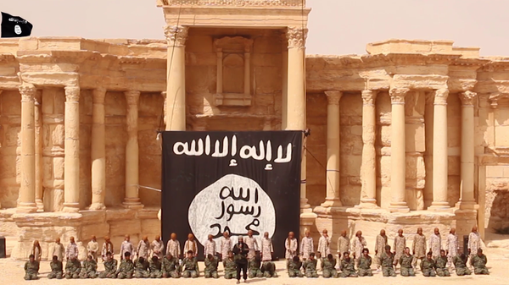
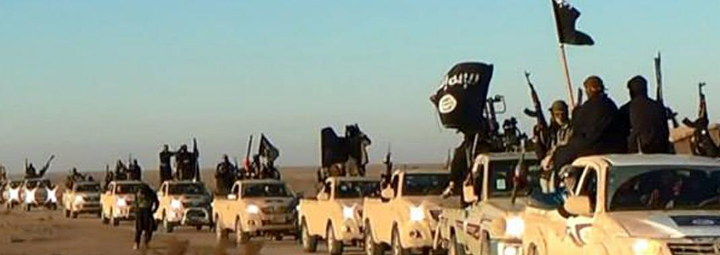
GROWTH OF ISLAMIC STATE (ISIS)
The main rival of ISIS has been especially the Kurdish forces (peshmerga).
Significant emphasis on propaganda and media campaign.
Terrorist attacks outside of the Middle East (Paris in November 2015, Istanbul in January 2016, Brussels in March 2016, Berlin in December 2016, Manchester in May 2017, Vienna in November 2020).

Slide 13
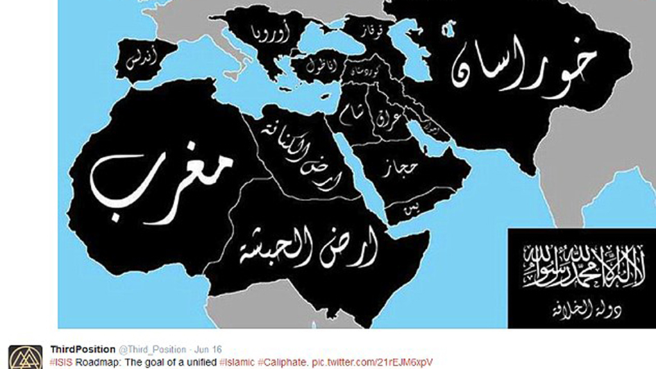
TERRITORIAL CLAIMS OF ISIS

Slide 14
THANK YOU FOR YOUR ATTENTION

