Slide 1
Export-led growth
China in the World Economy, autumn 2023

Slide 2
Repetition from last time
1) How does a country finance its imports?

Slide 3
Repetition from last time
1) How does a country finance its imports?
2) What is the role of banks in an economy?

Slide 4
Repetition from last time
1) How does a country finance its imports?
2) What is the role of banks in an economy?
3) What happened with rural land during the 1980s?

Slide 5
Repetition from last time
1) How does a country finance its imports?
2) What is the role of banks in an economy?
3) What happened with rural land during the 1980s?
4) What was the system of „dual prices“?

Slide 6
Repetition from last time
1) How does a country finance its imports?
2) What is the role of banks in an economy?
3) What happened with rural land during the 1980s?
4) What was the system of „dual prices“?
5) Where did FDI come from in the 1980s? Which areas were opened to it?

Slide 7
Repetition from last time
1) How does a country finance its imports?
2) What is the role of banks in an economy?
3) What happened with rural land during the 1980s?
4) What was the system of „dual prices“?
5) Where did FDI come from in the 1980s? Which areas were opened to it?
6) Did China‘s private sector originate is a program of privatization?

Slide 8
Repetition from last time
1) How does a country finance its imports?
2) What is the role of banks in an economy?
3) What happened with rural land during the 1980s?
4) What was the system of „dual prices“?
5) Where did FDI come from in the 1980s? Which areas were opened to it?
6) Did China‘s private sector originate is a program of privatization?
7) What was the purpose of the obligation of foreign investors to form joint ventures?

Slide 9
Today
Continuing reforms in the 1990s and 2000s – export-led growth
The fallout from the 2008 Financial crisis
The rise of Xi Jinping and China‘s technological ambitions

Slide 10
Return to reform and opening up
1992 – Deng‘s Southern Tour > push for reviving the reforms

Slide 11
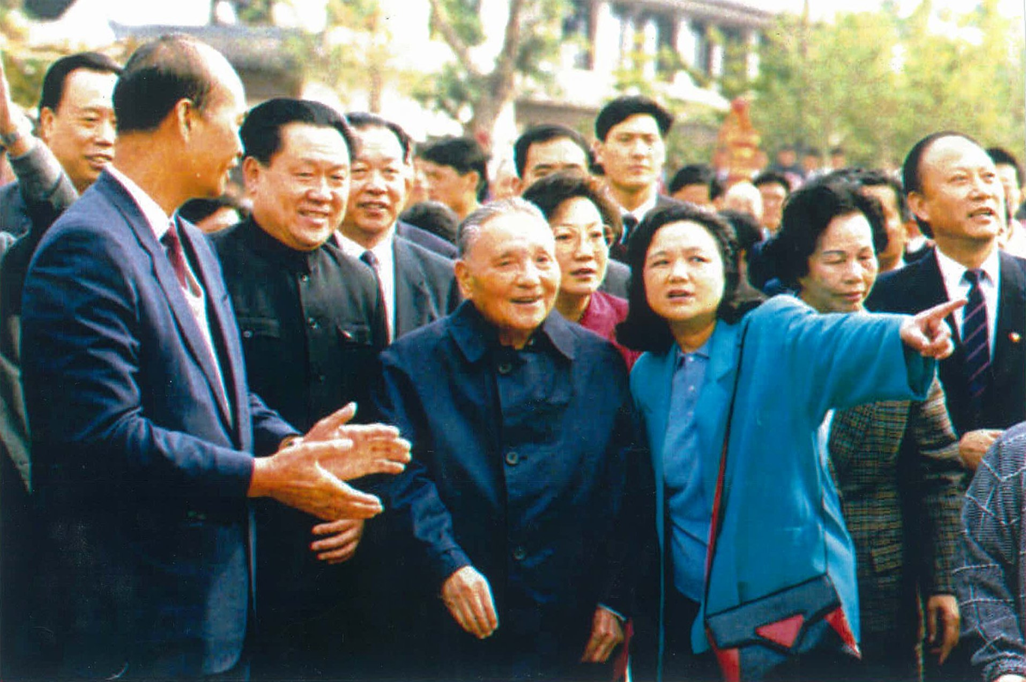

Slide 12
Return to reform and opening up
1992 – Deng‘s Southern Tour > push for reviving the reforms
New party leadership – Jiang Zenmin and Zhu Rongji – reliable party loyalists
Jiang and Zhu – from Shanghai – very conservative during the 1980s, almost no liberalization!

Slide 13
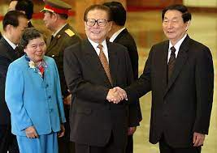

Slide 14
Return to reform and opening up
1992 – Deng‘s Southern Tour > push for reviving the reforms
New party leadership – Jiang Zenmin and Zhu Rongji – reliable party loyalists
Jiang and Zhu – from Shanghai – very conservative during the 1980s, almost no liberalization!
Return to a pro-market policy, but with more cautious approach than in the 1980s – fear of another Tiananmen

Slide 15
Return to reform and opening up
Focus on gradually reforming the urban economy – again at the expense of the countryside!

Slide 16
Return to reform and opening up
Focus on gradually reforming the urban economy – again at the expense of the countryside!
Higher taxes in for rural farmers and entrepreneurs > more inequality between cities and villages

Slide 17
Return to reform and opening up
Focus on gradually reforming the urban economy – again at the expense of the countryside!
Higher taxes in for rural farmers and entrepreneurs > more inequality between cities and villages
Increased rural illiteracy!
Resources invested in urban areas

Slide 18
Return to reform and opening up
Focus on advanced technologies + large projects + foreign investment + export

Slide 19
Return to reform and opening up
Sophisticated infrastructure – high speed trains connecting major cities

Slide 20
Return to reform and opening up
Sophisticated infrastructure – high speed trains connecting major cities
Some SOEs transformed into joint-stock companies, but the Party usually retains the controlling voting block
= hybrid ownership – difficult to interpret who makes decisions

Slide 21
Return to reform and opening up
Industrial policy

Slide 22
„Industrial policy is defined as the strategic effort by the state to encourage economic transformation, i.e. the shift from lower to higher productivity activities, between or within sectors.“

Slide 23
„Industrial policy is defined as the strategic effort by the state to encourage economic transformation, i.e. the shift from lower to higher productivity activities, between or within sectors.“
x trade policy – attempts to influence import and export

Slide 24
Industrial policy – subsidies, tax breaks, grants, guaranteed loans, public procurement of products…
Trade policy – tariffs and quotas

Slide 25
Industrial policy - takes place within a country (subsidies, tax break, grants, privileged access to loans…)
Trade policy – takes place at the border – tariffs and non-tariff barriers to trade

Slide 26
Industrial policy - takes place within a country (subsidies, tax break, grants, privileged access to loans…)
Trade policy – takes place at the border – tariffs and non-tariff barriers to trade
> China is far more active in industrial policy!

Slide 27
Return to reform and opening up
Industrial policy –– „national champions“ – support of highly advanced companies such as Huawei – attempts to push them to the global cutting edge

Slide 28
Return to reform and opening up
„Letting go of the small“ – small companies can be privatized and left to their own devices
If they go bankrupt, who cares?

Slide 29
Return to reform and opening up
The state must nurture the big ones > economies of scale, export, prestige….

Slide 30
Return to reform and opening up
The state must nurture the big ones > economies of scale, export, prestige….
Largest firms – monopolistic construction companies (housing, infrastructure, electrical grid) - remained as SOEs

Slide 31
Return to reform and opening up
The state must nurture the big ones > economies of scale, export, prestige….
Largest firms – monopolistic construction companies (housing, infrastructure, electrical grid) - remained as SOEs
Financial sector (banks) – continues to be overwhelmingly state owned

Slide 32
Return to reform and opening up
The state must nurture the big ones > economies of scale, export, prestige….
Largest firms – monopolistic construction companies (housing, infrastructure, electrical grid) - remained as SOEs
Financial sector (banks) – continues to be overwhelmingly state owned
> Chinese foreign investment is based on state-owned capital!

Slide 33
> „state capitalism“

Slide 34
Return to reform and opening up
Problems – large rate of investment, relatively small growth of consumption

Slide 35
Return to reform and opening up
Problems – large rate of investment, relatively small growth of consumption
= huge growth, but you can‘t enjoy its fruit, new wealth is immediately reinvested

Slide 36
Export-led growth
Focus on foreign direct investment (FDI) and export – integrating China into the world economy

Slide 37
Export-led growth
Focus on foreign direct investment (FDI) and export – integrating China into the world economy
x 1980s – mostly homegrown growth

Slide 38
Export-led growth
Focus on foreign direct investment (FDI) and export – integrating China into the world economy
x 1980s – mostly homegrown growth
FDI = source of foreign technologies
Push to attract investors – financial incentives, offer of access to China‘s already huge market

Slide 39
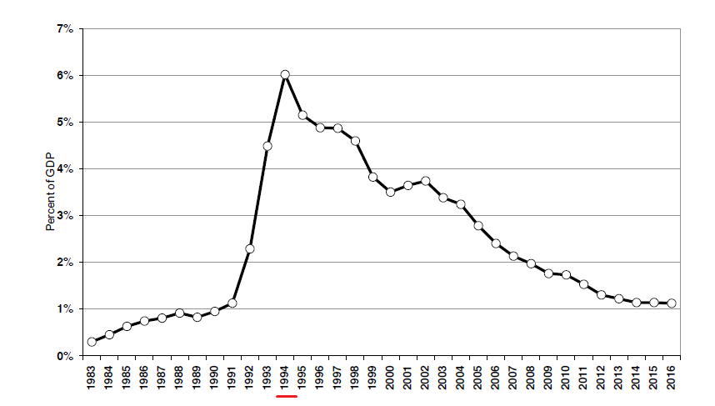
FDI as a percentage of GDP

Slide 40
Export-led growth
New special economic zone – Shanghai
> centre of economic activity moves into the Yantze delta

Slide 41
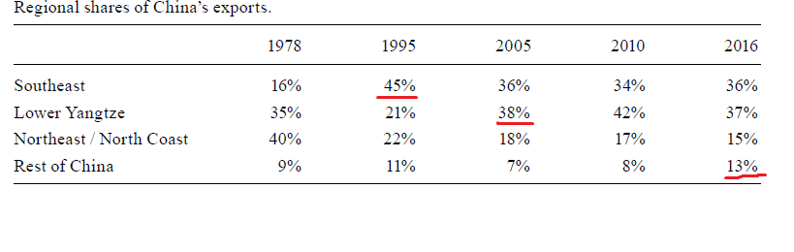

Slide 42
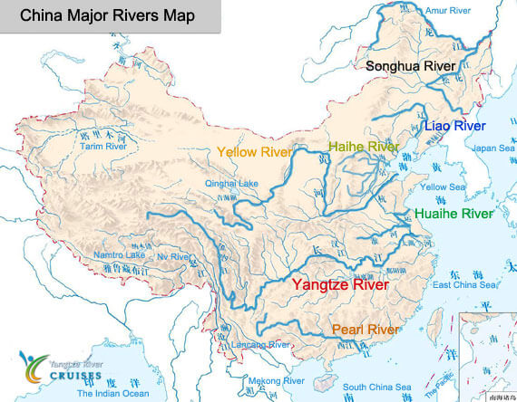

Slide 43
Return to reform and opening up
Subcontractors, joint-ventures – investors need to commit themselves to transfer their know-how to Chinese counterparts

Slide 44
Return to reform and opening up
Subcontractors, joint-ventures – investors need to commit themselves to transfer their know-how to Chinese counterparts
Sometimes outright IP theft

Slide 45
Return to reform and opening up
Support for large state or semi-state companies + foreign capital; indifference to small businesses
> best strategy for Chinese companies – get incorporated in Hong Kong, then do business in China as a foreign company

Slide 46
Reforms to the „ordinary“ foreign trade
Last time – special economic zones

Slide 47
Reforms to the „ordinary“ foreign trade
Last time – special economic zones
Now – reforms to the normal trade regime
= the rest of China
From 1980s onwards

Slide 48
Ordinary trade
Number of monopoly FTCs increased – from 12 to several thousands

Slide 49
Ordinary trade
Number of monopoly FTCs increased – from 12 to several thousands
But all of them were, at least officially, SOEs!

Slide 50
Ordinary trade
Number of monopoly FTCs increased – from 12 to several thousands
But all of them were, at least officially, SOEs!
The FTC system was only completely abolished in 2004, after entering the WTO!

Slide 51
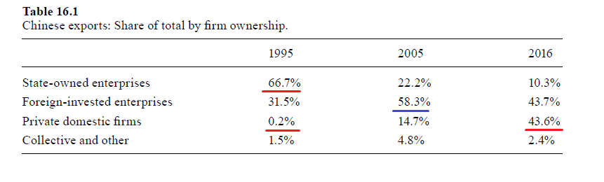

Slide 52
Ordinary trade
Liberalized prices – the foreign trade companies were encouraged to make money instead of fulfilling a plan

Slide 53
Ordinary trade
Liberalized prices – the foreign trade companies were encouraged to make money instead of fulfilling a plan
Before – artificial prices totally detached from the world market, trade guided by state direction
After reform – „export and import whatever is profitable in your business area“

Slide 54
Ordinary trade
Liberalized prices – the foreign trade companies were encouraged to make money instead of fulfilling a plan
Before – artificial prices totally detached from the world market, trade guided by state direction
After reform – „export and import whatever is profitable in your business area“
> give the central government a part of the foreign exchange, keep the rest as use it to do more business

Slide 55
Ordinary trade
„Canalization“ – if you wanted to import something and you did not have the license to do it, you had to persuade one of the monopoly SOEs to do it for you

Slide 56
Ordinary trade
„Canalization“ – if you wanted to import something and you did not have the license to do it, you had to persuade one of the monopoly SOEs to do it for you
> even TVEs and other small companies de facto could take part in trade, but a part of the profit went to the SOEs

Slide 57
Ordinary trade
„Canalization“ – if you wanted to import something and you did not have the license to do it, you had to persuade one of the monopoly SOEs to do it for you
> even TVEs and other small companies de facto could take part in trade, but a part of the profit went to the SOEs
> FTCs as middlemen

Slide 58
Ordinary trade
Gradual devaluation of the RMB

Slide 59
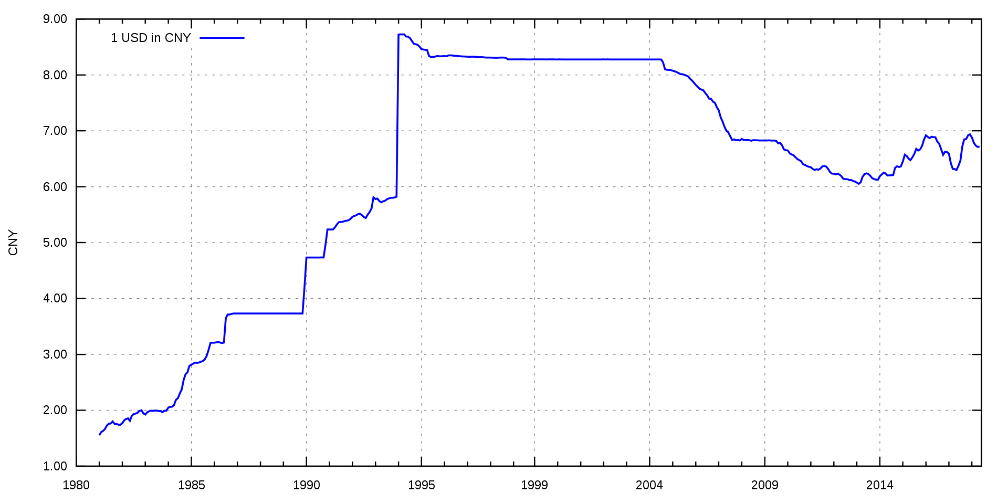
USD to RMB

Slide 60
Ordinary trade
Gradual devaluation of the RMB
Separate foreign exchange market – foreign trade companies could exchange money and ignore the official rate

Slide 61
Ordinary trade
Gradual devaluation of the RMB
Separate foreign exchange market – foreign trade companies could exchange money and ignore the official rate
> two exchange rates – the official one and the one used between the companies
Fix and floating at the same time (kind of)

Slide 62
Ordinary trade
Gradual devaluation of the RMB
Separate foreign exchange market – foreign trade companies could exchange money and ignore the official rate
> two exchange rates – the official one and the one used between the companies
Fix and floating at the same time (kind of)
Which one was lower?

Slide 63
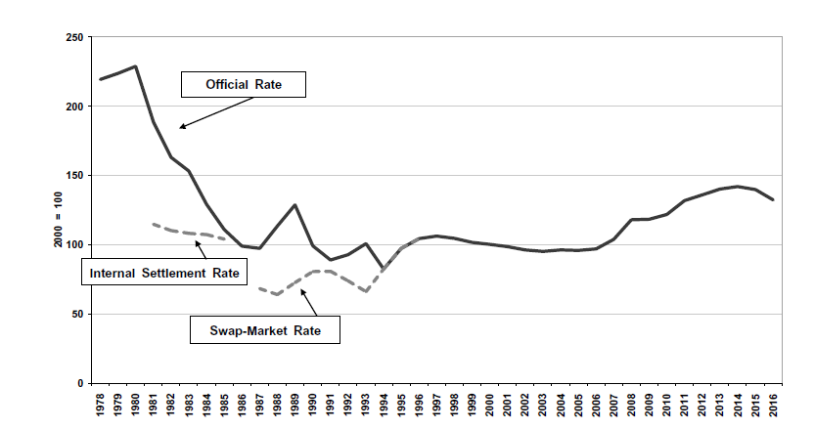
RMB to UDS

Slide 64
Ordinary trade
Main devaluation – 1994 – official rate set and fixed at the previous unofficial rate

Slide 66
USD to RMB

Slide 67
Ordinary trade
Main devaluation – 1994 – official rate set and fixed at the previous unofficial rate
= „Let‘s respect the collective wisdom of the market“

Slide 68
Ordinary trade
Main devaluation – 1994 – official rate set and fixed at the previous unofficial rate
= „Let‘s respect the collective wisdom of the market“
The rate was competitive and led to a more or less balanced trade

Slide 69
Ordinary trade
Main devaluation – 1994 – official rate set and fixed at the previous unofficial rate
= „Let‘s respect the collective wisdom of the market“
The rate was competitive and led to a more or less balanced trade
Under floating, the rate would appreciate because of growing exports
= as China became more competitive, the rate should have gone up

Slide 70
Ordinary trade
But China artificially kept the rate at the 1994 level all the way until 2005

Slide 71
USD to RMB

Slide 72
Ordinary trade
But China artificially kept the rate at the 1994 level all the way until 2005
+ „real depreciation“
The price level in China rose more slowly than in the US and most other capitalist countries

Slide 73
Ordinary trade
But China artificially kept the rate at the 1994 level all the way until 2005
+ „real depreciation“
The price level in China rose more slowly than in the US and most other capitalist countries
> Chinese goods became relatively cheaper

Slide 74
Real appreciation / depreciation
If your exchange rate is stable AND you have lower inflation than a partner country, your currency is undergoing a real depreciation

Slide 75
Real appreciation / depreciation
If your exchange rate is stable AND you have lower inflation than a partner country, your currency is undergoing a real depreciation
> your goods become more competitive > you export more
As if you devalued the currency

Slide 77
USD to RMB

Slide 78
Ordinary trade
But China artificially kept the rate at the 1994 level all the way until 2005
+ real depreciation
> undervaluation, huge trade surpluses!

Slide 79
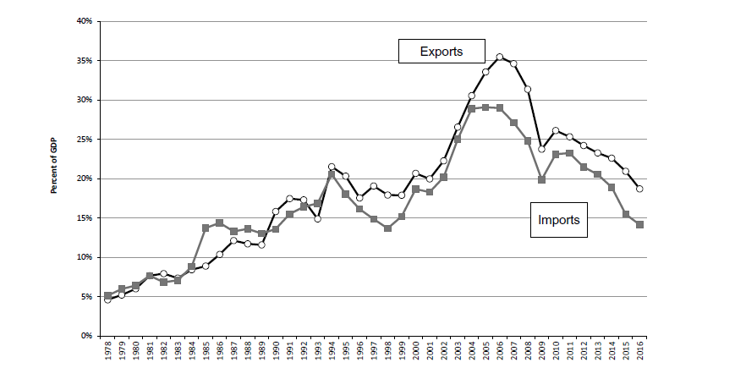

Slide 80
Ordinary trade
The 1994 reform was connected with making the RMB convertible for current account transactions

Slide 81
Ordinary trade
The 1994 reform was connected with making the RMB convertible for current account transactions
> every FTC could access foreign exchange whenever they wished, with no regulation – if it was for trade
= liberalization

Slide 82
Ordinary trade
The 1994 reform was connected with making the RMB convertible for current account transactions
> every FTC could access foreign exchange whenever they wished, with no regulation – if it was for trade
= liberalization
Plans to also abolish capital controls = to make the RMB convertible for financial account transactions

Slide 83
Ordinary trade
The 1994 reform was connected with making the RMB convertible for current account transactions
> every FTC could access foreign exchange whenever they wished, with no regulation – if it was for trade
= liberalization
Plans to also abolish capital controls = to make the RMB convertible for financial account transactions
Abandoned because of the 1997 Asian Financial crisis

Slide 84
Special economic zones
New SEZ in Shanghai
More importantly – entire coastal region opened for „export-processing“

Slide 85
Special economic zones
New SEZ in Shanghai
More importantly – entire coastal region opened for „export-processing“
Raw materials given to Chinese companies (often TVEs) for assembly and processing

Slide 86
Special economic zones
New SEZ in Shanghai
More importantly – entire coastal region opened for „export-processing“
Raw materials given to Chinese companies (often TVEs) for assembly and processing
Formally no trade, no FDI! – investment was only allowed in SEZs

Slide 87
Special economic zones
> due to proliferation of export processing + reforms to ordinary trade, SEZs gradually became less special

Slide 88
The 2000s – continuing export-led growth

Slide 89
The 2000s – export-led growth
Progress from textile exports to electronics

Slide 90
The 2000s – export-led growth
Slow, gradual liberalization continued into the new millennium

Slide 91
The 2000s – export-led growth
Slow, gradual liberalization continued into the new millennium
China‘s most capitalist moment – after entering the WTO in 2001

Slide 92
The 2000s – export-led growth
Exports and imports – 5 % of GDP each in 1978
World average is about 20 % for each

Slide 93
The 2000s – export-led growth
Exports and imports – 5 % of GDP each in 1978
World average is about 20 % for each
China reached this level by 2001, its exports continued to soar after entering the WTO

Slide 94
The 2000s – export-led growth
Exports and imports – 5 % of GDP each in 1978
World average is about 20 % for each
China reached this level by 2001, its exports continued to soar after entering the WTO
2006 – exports stood at 35 % of GDP, imports at 30 % > 65 % together

Slide 95
The 2000s – export-led growth
Exports and imports – 5 % of GDP each in 1978
World average is about 20 % for each
China reached this level by 2001, its exports continued to soar after entering the WTO
2006 – exports stood at 35 % of GDP, imports at 30 % > 65 % together
In the United States, the sum is around 20 %!
= China was already far more opened than the world average or comparably large countries!

Slide 96
The 2000s – export-led growth
2009 – largest exporter in the world
2011 – largest manufacturer
2012 – largest GDP by purchasing power parity

Slide 97
The 2000s – export-led growth
Huge growth of export, current account surplus (5 % of GDP in 2006)

Slide 98
The 2000s – export-led growth
Huge growth of export, current account surplus (5 % of GDP in 2006) = China finally overcame its problem of financing imports

Slide 99
The 2000s – export-led growth
Huge growth of export, current account surplus (5 % of GDP in 2006) = China finally overcame its problem of financing imports
> accumulation of foreign exchange (mostly dollars)

Slide 100
The 2000s – export-led growth
What is China going to do with all this foreign exchange?

Slide 101
The 2000s – export-led growth
What is China going to do with all this foreign exchange?
Keep it as a reserve – a precaution against a monetary crisis

Slide 102
The 2000s – export-led growth
What is China going to do with all this foreign exchange?
Keep it as a reserve – a precaution against a monetary crisis
Anxiety after the Asian monetary crisis of 1997

Slide 103
How a monetary crisis works
A country has a fixed exchange rate

Slide 104
How a monetary crisis works
A country has a fixed exchange rate
- China does have a fixed exchange rate – the yuan was first tied to the US dollar, since 2005, it is pegged to a basket of currencies

Slide 105
USD to RMB

Slide 106
How a monetary crisis works
A country has a fixed exchange rate
Markets (banks etc.) think that the rate is overvalued and unsustainable > they start to sell the currency

Slide 107
How a monetary crisis works
A country has a fixed exchange rate
Markets (banks etc.) think that the rate is overvalued and unsustainable > they start to sell the currency
> pressure for devaluation

Slide 108
How a monetary crisis works
A country has a fixed exchange rate
Markets (banks etc.) think that the rate is overvalued and unsustainable > they start to sell the currency
> pressure for devaluation
The central bank needs to start buying the currency to keep the same rate – they need foreign currencies to do this!

Slide 109
How a monetary crisis works
A country has a fixed exchange rate
Markets (banks etc.) think that the rate is overvalued and unsustainable > they start to sell the currency
> pressure for devaluation
The central bank needs to start buying the currency to keep the same rate – they need foreign currencies to do this!
If they fail > increased interest rates to stop the capital flight > drop of domestic credit > domestic recession

Slide 110
How a monetary crisis works
= in the end, the Central bank usually freezes the creation of money, which stops capital flight, but creates recession

Slide 111
How a monetary crisis works
= in the end, the Central bank usually freezes the creation of money, which stops capital flight, but creates recession
Did anything like this ever happen in Czechia?

Slide 112
How a monetary crisis works
= in the end, the Central bank usually freezes the creation of money, which stops capital flight, but creates recession
Did anything like this ever happen in Czechia?
Yes, in 1997!

Slide 113
How a monetary crisis works
China fears this scenario, so it keeps large reserves of foreign currency
> if you sit upon a huge pile of dollars, you can defeat a speculative attack
Actually, you can deter it

Slide 114
The 2000s – export-led growth
What else can you do with foreign exchange?
= you don‘t use it to buy imports, you don‘t want to keep it as reserves

Slide 115
The 2000s – export-led growth
What else can you do with foreign exchange?
= you don‘t use it to buy imports, you don‘t want to keep it as reserves
Foreign investment – purchases of Western companies; Belt and Road Initiative

Slide 116
The 2000s – export-led growth
Major exporter of advanced technology products already by 2005!
= laptops, mobile phones, scanners, cameras, medical equipment

Slide 117
The 2000s – export-led growth
2002 – change in Party leadership – Hu Jintao and Wen Jiabao
Only transfer of power without a purge in PRC‘s history!

Slide 118
The 2000s – export-led growth
2002 – change in Party leadership – Hu Jintao and Wen Jiabao
Only transfer of power without a purge in PRC‘s history!
Theoretically – generations of party leadership – change every 10 years (1992-2002-2012-2022)

Slide 119
The 2000s – export-led growth
2002 – change in Party leadership – Hu Jintao and Wen Jiabao
Only transfer of power without a purge in PRC‘s history!
Theoretically – generations of party leadership – change every 10 years (1992-2002-2012-2022)
Hu leadership – continuation of previous policies
More resources devoted to social spending – healthcare, education, alleviation of rural poverty

Slide 120
The 2000s – export-led growth
Major exporter of advanced technology products already by 2005!
= laptops, mobile phones, scanners, cameras, medical equipment
Growth continued at breakneck speed – over 10 % a year – even though the base was already quite large

Slide 121
The 2000s – export-led growth
Major exporter of advanced technology products already by 2005!
= laptops, mobile phones, scanners, cameras, medical equipment
Growth continued at breakneck speed – over 10 % a year – even though the base was already quite large
= biggest story of the decade; the West overlooked it

Slide 122
Next time:
The return of industrial policy
The fallout of the 2008 Financial crisis
The rise of Xi Jinping and the US-Chinese trade war

