Slide 1
The Belt and Road Initiative
China in the World Economy, 2023

Slide 2
Questions from last time
Which transactions are captured by the current account of balance of payments?

Slide 3
Questions from last time
Which transactions are captured by the current account of balance of payments?
Which go under the financial account?

Slide 4
Questions from last time
Which transactions are captured by the current account of balance of payments?
Which go under the financial account?
Which are more volatile (=prone to sudden change?)

Slide 5
Questions from last time
Which transactions are captured by the current account of balance of payments?
Which go under the financial account?
Which are more volatile (=prone to sudden change?)
Why is this a problem for a fixed exchange rate?

Slide 6
Questions from last time
Which transactions are captured by the current account of balance of payments?
Which go under the financial account?
Which are more volatile (=prone to sudden change?)
Why is this a problem for a fixed exchange rate?
For what purposes can you use an international currency?

Slide 7
Questions from last time
6. What are the advantages of issuing an international currency?

Slide 8
Questions from last time
6. What are the advantages of issuing an international currency?
7. How does China strive to expand the international use of the renminbi?

Slide 9
Questions from last time
6. What are the advantages of issuing an international currency?
7. How does China strive to expand the international use of the renminbi?
8. What is the purpose of the IMF?

Slide 10
Questions from last time
6. What are the advantages of issuing an international currency?
7. How does China strive to expand the international use of the renminbi?
8. What is the purpose of the IMF?
> Global reserve of international currencies > balance of payments, debt and monetary crises

Slide 11
Questions from last time
6. What are the advantages of issuing an international currency?
7. How does China strive to expand the international use of the renminbi?
8. What is the purpose of the IMF?
> Global reserve of international currencies > balance of payments, debt and monetary crises
9. What is the purpose of the World Bank?

Slide 12
Questions from last time
6. What are the advantages of issuing an international currency?
7. How does China strive to expand the international use of the renminbi?
8. What is the purpose of the IMF?
> Global reserve of international currencies > balance of payments, debt and monetary crises
9. What is the purpose of the World Bank?
> Provide low-interest investment to poor countries that are unable to attract private investors

Slide 13
Questions from last time
11) What is the purpose of IMF‘s quotas?

Slide 14
Questions from last time
11) What is the purpose of IMF‘s quotas?
12) Why is China underrepresented in these quotas?

Slide 15
Questions from last time
11) What is the purpose of IMF‘s quotas?
12) Why is China underrepresented in these quotas?
13) What other criticisms of the international financial institutions does China have?

Slide 16
Today
The Belt and Road Initiative
> as a reaction and logical outcome of economic processes inside of China
> as China‘s ideological answer to Western liberal approaches to development aid

Slide 17
The World Bank and BRI
> Since 1970s – shift from „hard“ investment towards policy advice and institutional reforms

Slide 18
The World Bank and BRI
> Since 1970s – shift from „hard“ investment towards policy advice and institutional reforms
Focus on alleviating poverty and illiteracy and mortality instead of GDP growth per se

Slide 19
The World Bank and BRI
> Since 1970s – shift from „hard“ investment towards policy advice and institutional reforms
Focus on alleviating poverty and illiteracy and mortality instead of GDP growth per se
Liberal approach – let markets lead the economy, while the public sector provides basic welfare

Slide 20
The World Bank and BRI
> Since 1970s – shift from „hard“ investment towards policy advice and institutional reforms
Focus on alleviating poverty and illiteracy and mortality instead of GDP growth per se
Liberal approach – let markets lead the economy, while the public sector provides basic welfare
Large scale infrastructural investment plays a much smaller role

Slide 21
The World Bank and BRI
Foreign aid is miniscule compared to private investment

Slide 22
The World Bank and BRI
Foreign aid is miniscule compared to private investment
Conditional - high standards for environment, human rights etc. > bureaucracy

Slide 23
The World Bank and BRI
Foreign aid is miniscule compared to private investment
Conditional - high standards for environment, human rights etc. > bureaucracy
Highly concessional – presented as gifts from donors > economically fine, but can feel patronizing

Slide 24
The World Bank and BRI
Private investors – wary of investing in poor countries – they are only going to lend money for a very high interest

Slide 25
The World Bank and BRI
Private investors – wary of investing in poor countries – they are only going to lend money for a very high interest
Also usually unwilling to bankroll large (and uncertain) projects

Slide 26
The World Bank and BRI
China sees all of this as a problem

Slide 27
The World Bank and BRI
China sees all of this as a problem
„The West is forcing poor countries to accept its neoliberal ideology and has no respect for their cultures“

Slide 28
The World Bank and BRI
China sees all of this as a problem
„The West is forcing poor countries to accept its neoliberal ideology and has no respect for their cultures“
„It neglects their real needs – investment into physical infrastructure“

Slide 29
The World Bank and BRI
China sees all of this as a problem
„The West is forcing poor countries to accept its neoliberal ideology and has no respect for their cultures“
„It neglects their real needs – investment into physical infrastructure“
Donor – recipient relation – colonial mindset – it is better to have a cooperation among equals

Slide 30
The World Bank and BRI
China sees all of this as a problem
„The West is forcing poor countries to accept its neoliberal ideology and has no respect for their cultures“
„It neglects their real needs – investment into physical infrastructure“
Donor – recipient relation – colonial mindset – it is better to have a cooperation among equals
„As a successful developing country, China has a better understanding of what poor countries need“

Slide 31
The World Bank and BRI
China sees all of this as a problem
„The West is forcing poor countries to accept its neoliberal ideology and has no respect for their cultures“
„It neglects their real needs – investment into physical infrastructure“
Donor – recipient relation – colonial mindset – it is better to have a cooperation among equals
„As a successful developing country, China has a better understanding of what poor countries need“
„It is not greedy or imperialist, it respects everybody“

Slide 32
The World Bank and BRI
The AIIB and the Belt and Road Initiative – China‘s answer to what they don‘t like about the World Bank and other Western-led development efforts

Slide 33
The World Bank and BRI
The AIIB and the Belt and Road Initiative – China‘s answer to what they don‘t like about the World Bank and other Western-led development efforts
> focus on tangible progress and especially infrastructure

Slide 34
The World Bank and BRI
The AIIB and the Belt and Road Initiative – China‘s answer to what they don‘t like about the World Bank and other Western-led development efforts
> focus on tangible progress and especially infrastructure
= transport and energy

Slide 35
The World Bank and BRI
The AIIB and the Belt and Road Initiative – China‘s answer to what they don‘t like about the World Bank and other Western-led development efforts
> focus on tangible progress and especially infrastructure
= transport and energy
Cooperation rather than aid (> equal relationship between developing countries)

Slide 36
The World Bank and BRI
The AIIB and the Belt and Road Initiative – China‘s answer to what they don‘t like about the World Bank and other Western-led development efforts
> focus on tangible progress and especially infrastructure
= transport and energy
Cooperation rather than aid (> equal relationship between developing countries)
No connection to political values

Slide 37
The World Bank and BRI
The AIIB and the Belt and Road Initiative – China‘s answer to what they don‘t like about the World Bank and other Western-led development efforts
> focus on tangible progress and especially infrastructure
= transport and energy
Cooperation rather than aid (> equal relationship between developing countries)
No connection to political values
Few requirements > less bureaucracy

Slide 38
The World Bank and BRI
- this is how China presents the BRI

Slide 39
The Belt and Road Initiative
A vaguely defined project

Slide 40
The Belt and Road Initiative
A vaguely defined project
Umbrella term for China‘s outward investment

Slide 41
The Belt and Road Initiative
A vaguely defined project
Umbrella term for China‘s outward investment – including projects launched many years before BRI was even unveiled

Slide 42
The Belt and Road Initiative
A vaguely defined project
Umbrella term for China‘s outward investment – including projects launched many years before BRI was even unveiled
The BRI has predominantly domestic goals presented as a grand global vision

Slide 43
BRI‘s evolution
„Silk road Economic Belt“
„21st Century Maritime Silk road“

Slide 44
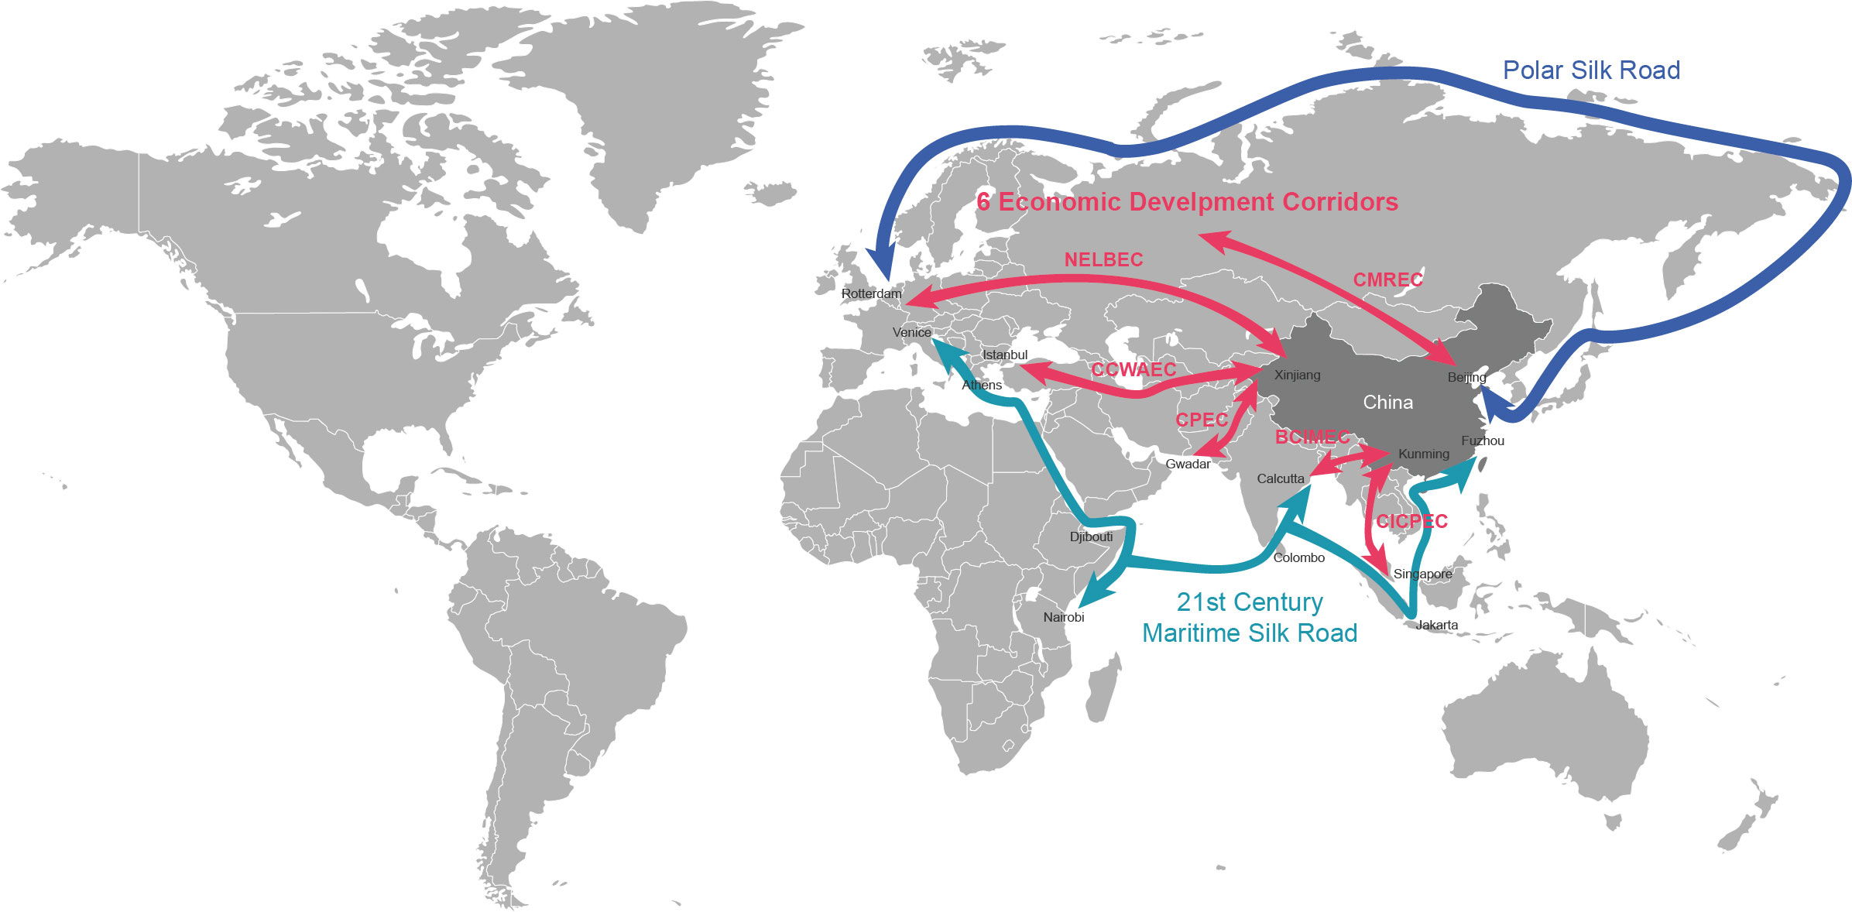

Slide 45
BRI‘s evolution
„Silk road Economic Belt“
„21st Century Maritime Silk road“
„One Belt, One Road“

Slide 46
BRI‘s evolution
„Silk road Economic Belt“
„21st Century Maritime Silk road“
„One Belt, One Road“
„Belt and Road Initiative“

Slide 47
BRI‘s evolution
„Silk road Economic Belt“
„21st Century Maritime Silk road“
„One Belt, One Road“
„Belt and Road Initiative“
„Digital Silk road“, „Health Silk road“, etc.

Slide 48
BRI‘s evolution
Confusing and constantly changed names reflect how little defined the project is

Slide 49
Goals of the BRI

Slide 50
Goals of the BRI
1) Find new outlets for construction SOEs

Slide 51


Slide 52
Goals of the BRI
1) Find new outlets for construction SOEs
For years, these companies built China‘s infrastructure and real estate

Slide 53
Goals of the BRI
1) Find new outlets for construction SOEs
For years, these companies built China‘s infrastructure and real estate
Now China has enough

Slide 54
Goals of the BRI
1) Find new outlets for construction SOEs
For years, these companies built China‘s infrastructure and real estate
Now China has enough
Overcapacity

Slide 55
Goals of the BRI
1) Find new outlets for construction SOEs
For years, these companies built China‘s infrastructure and real estate
Now China has enough
Overcapacity
> „let‘s build the same things elsewhere!“

Slide 56
Goals of the BRI
1) Find new outlets for construction SOEs
For years, these companies built China‘s infrastructure and real estate
Now China has enough
Overcapacity
> „let‘s build the same things elsewhere!“
> focus on railways, highways, bridges, tunnels, pipelines, power stations and grid

Slide 57
Goals of the BRI
1) Find new outlets for construction SOEs
For years, these companies built China‘s infrastructure and real estate
Now China has enough
Overcapacity
> „let‘s build the same things elsewhere!“
> focus on railways, highways, bridges, tunnels, pipelines, power stations and grid
– things in which China is excellent + are built by SOEs

Slide 58
Goals of the BRI
2) Develop the poor and overlooked regions in the west of China

Slide 59
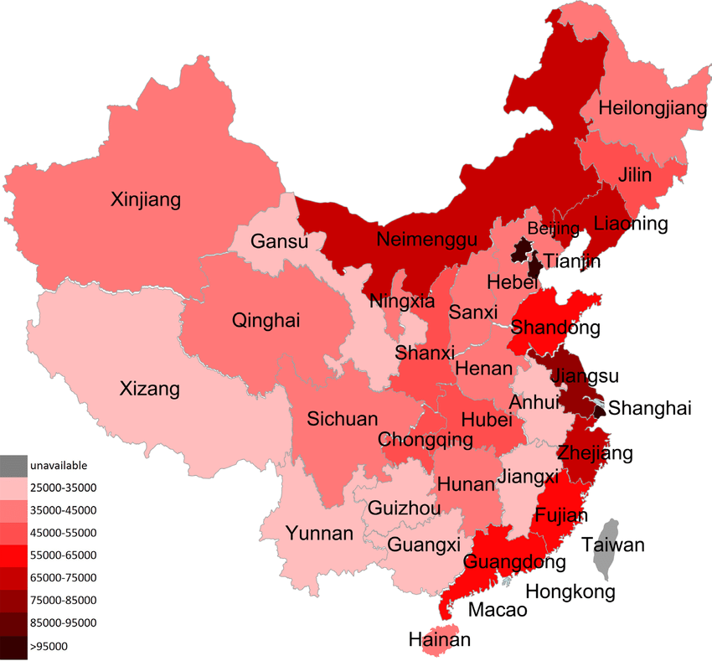

Slide 60
Goals of the BRI
2) Develop the poor and overlooked regions in the west of China
- ignored by foreign investment, unsuitable for overseas export

Slide 61
Goals of the BRI
2) Develop the poor and overlooked regions in the west of China
- ignored by foreign investment, unsuitable for overseas export
> predominantly agricultural, with few opportunities for industrial development

Slide 62
Goals of the BRI
2) Develop the poor and overlooked regions in the west of China
- ignored by foreign investment, unsuitable for overseas export
> predominantly agricultural, with few opportunities for industrial development
Connectivity and trade with Europe will create opportunities and jobs

Slide 63
Goals of the BRI
2) Develop the poor and overlooked regions in the west of China
- ignored by foreign investment, unsuitable for overseas export
> predominantly agricultural, with few opportunities for industrial development
Connectivity and trade with Europe will create opportunities and jobs
Bring in natural resources from Central Asia

Slide 64
Goals of the BRI
2) Develop the poor and overlooked regions in the west of China
- ignored by foreign investment, unsuitable for overseas export
> predominantly agricultural, with few opportunities for industrial development
Connectivity and trade with Europe will create opportunities and jobs
Bring in natural resources from Central Asia
After 2013 – the BRI concept was taken up by party leaders in western provinces

Slide 65
Goals of the BRI
3) Find new outlets for investment

Slide 66
Goals of the BRI
3) Find new outlets for investment
Previously – export earnings reinvested into US bonds
Now – necessity to diversify foreign assets

Slide 67
Goals of the BRI
4) Find new outlets for subpar products

Slide 68
Goals of the BRI
4) Find new outlets for subpar products
Developing countries can buy products that would be hard to sell in the West
Lifeline for trailing edge industries in the hinterland

Slide 69
Goals of the BRI
5) Internationalize the renminbi
– through loans (AIIB) + China‘s domestic state-owned banks

Slide 70
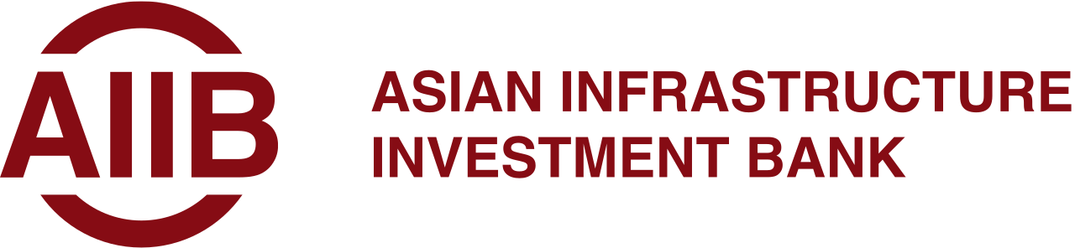

Slide 71
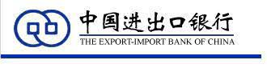

Slide 72


Slide 73
Goals of the BRI
6) Tie Xinjiang and Tibet and other far-flung provinces closer to the rest of the country

Slide 74
Goals of the BRI
7) Geopolitical expansion

Slide 75
Goals of the BRI
7) Geopolitical expansion
Spread Chinese influence

Slide 76
Goals of the BRI
7) Geopolitical expansion
Spread Chinese influence
Secure naval trade routes

Slide 77
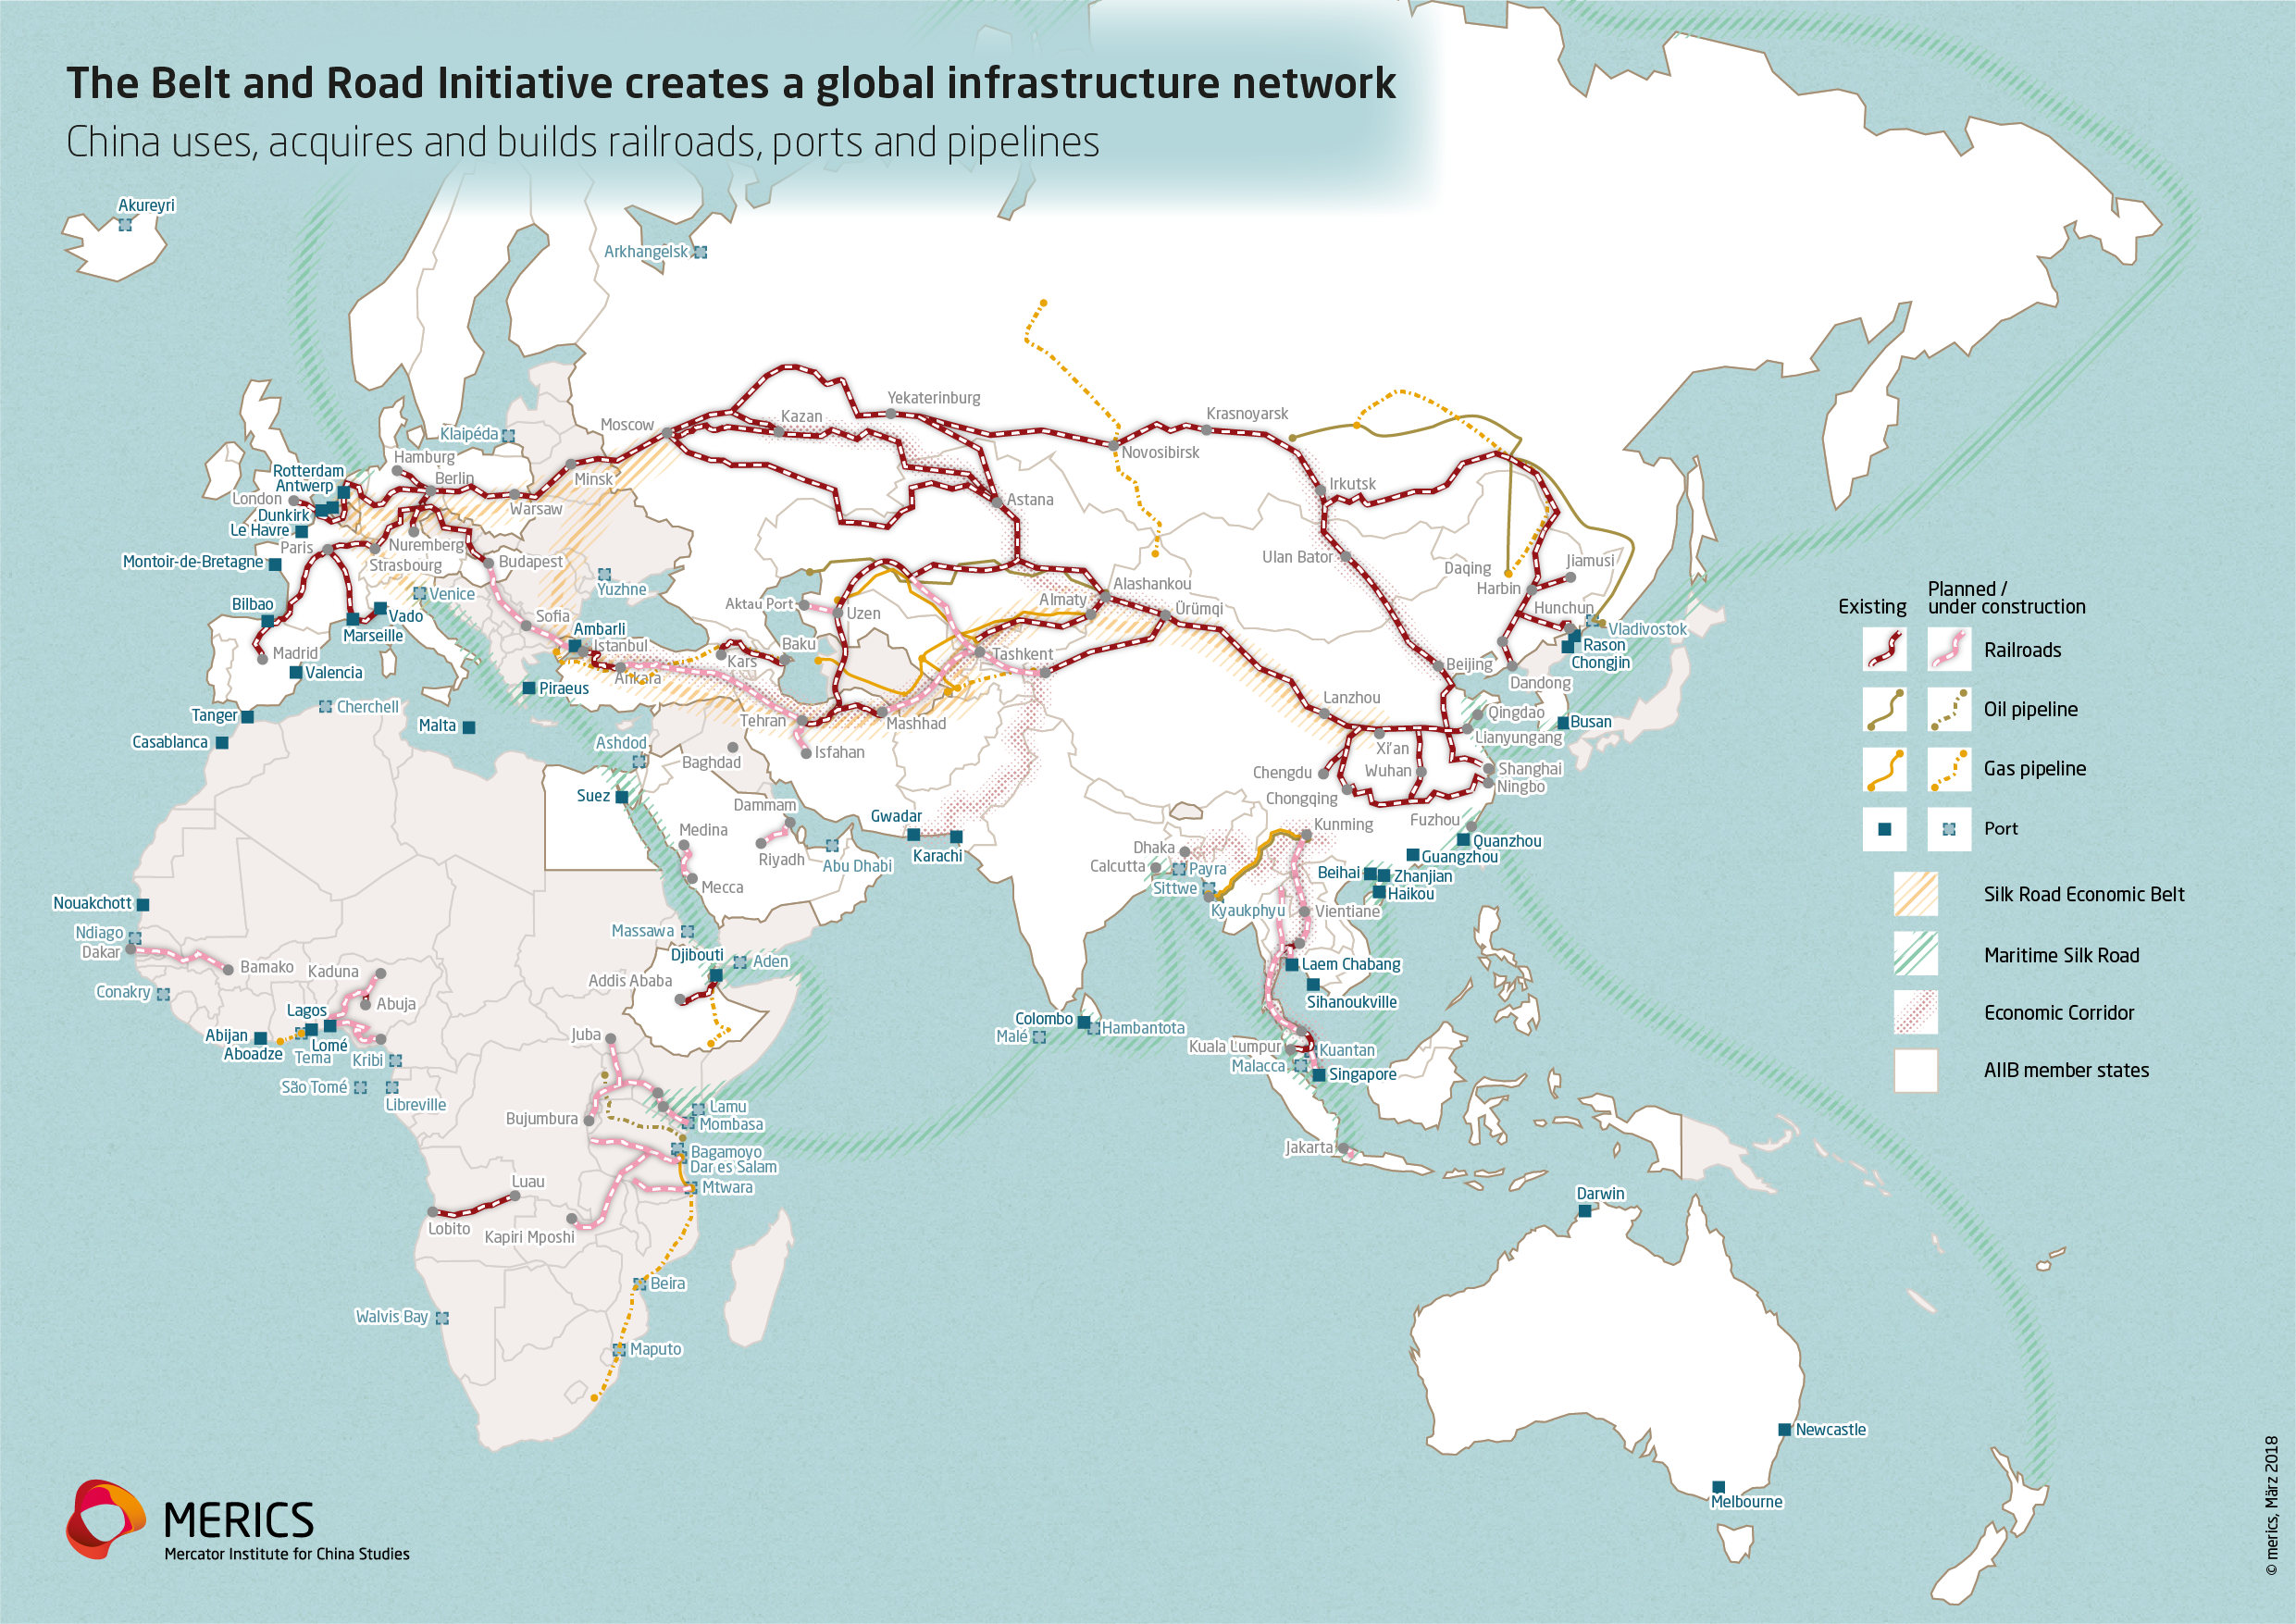

Slide 78
Goals of the BRI
7) Geopolitical expansion
Spread Chinese influence
Secure naval trade routes
Isolate India

Slide 79
Goals of the BRI
7) Geopolitical expansion
Spread Chinese influence
Secure naval trade routes
Isolate India
Lure away US allies

Slide 80
Historical Silk road

Slide 81
Historical Silk road
…had almost nothing in common with the BRI!

Slide 82
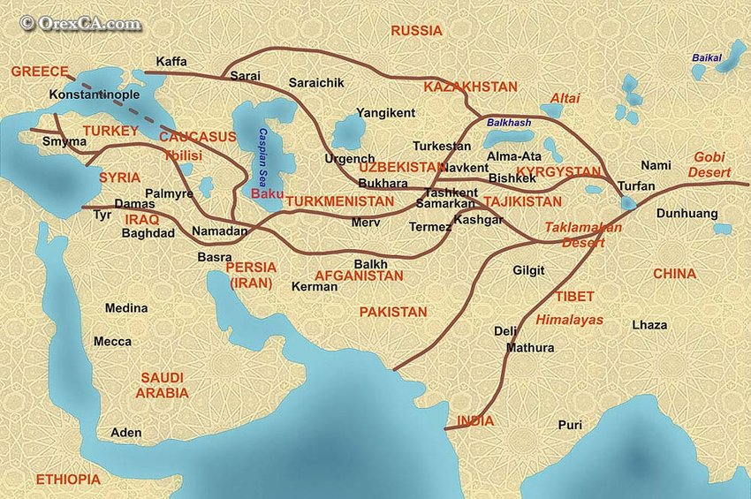

Slide 83
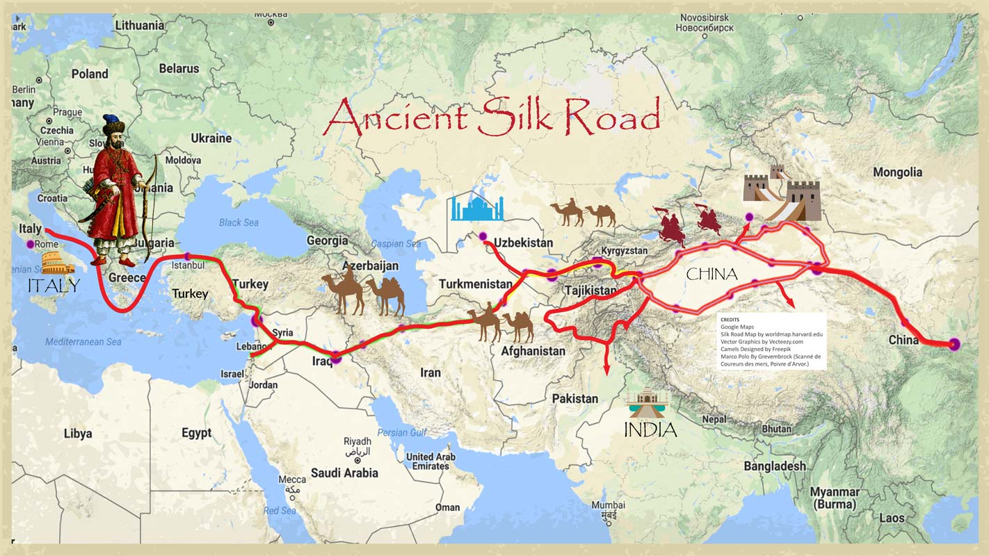

Slide 84
Historical Silk road
…had almost nothing in common with the BRI
Overland trade – carried out by independent foreign merchants – usually Arabs and Persians

Slide 85
Historical Silk road
…had almost nothing in common with the BRI
Overland trade – carried out by independent foreign merchants – usually Arabs and Persians
Supported by some Muslim dynasties and city states in Central Asia

Slide 86
Historical Silk road
…had almost nothing in common with the BRI
Overland trade – carried out by independent foreign merchants – usually Arabs and Persians
Supported by some Muslim dynasties and city states in Central Asia
The Chinese rarely travelled along the route themselves

Slide 87
Historical Silk road
…had almost nothing in common with the BRI
Overland trade – carried out by independent foreign merchants – usually Arabs and Persians
Supported by some Muslim dynasties and city states in Central Asia
The Chinese rarely travelled along the route themselves
Cultural prejudice – trade is not worthy of the Confucian elite

Slide 88
Historical Silk road
…had almost nothing in common with the BRI
Overland trade – carried out by independent foreign merchants – usually Arabs and Persians
Supported by some Muslim dynasties and city states in Central Asia
The Chinese rarely travelled along the route themselves
Cultural prejudice – trade is not worthy of the Confucian elite
The Chinese state never intentionally supported the trade route

Slide 89
Historical Silk road
…had almost nothing in common with the BRI
Overland trade – carried out by independent foreign merchants – usually Arabs and Persians
Supported by some Muslim dynasties and city states in Central Asia
The Chinese rarely travelled along the route themselves
Cultural prejudice – trade is not worthy of the Confucian elite
The Chinese state never intentionally supported the trade route
Conquest of the western regions helped to make the Silk road safe – but that was not the intention!

Slide 90
Historical Silk road
Overland trade was tolerable – only a small trickle of extremely valuable luxury products for the elite

Slide 91
Historical Silk road
Maritime trade with Southeast Asia and India – far more dangerous - less expensive products accessible to the wider population

Slide 92
Historical Silk road
Maritime trade with Southeast Asia and India – far more dangerous - less expensive products accessible to the wider population
> Fear of foreign ideas (Islam, Christianity, Hinduism…)

Slide 93
Historical Silk road
Maritime trade with Southeast Asia and India – far more dangerous - less expensive products accessible to the wider population
> Fear of foreign ideas (Islam, Christianity, Hinduism…)
Harsh crackdowns on overseas trade

Slide 94
Historical Silk road
Maritime trade with Southeast Asia and India – far more dangerous - less expensive products accessible to the wider population
> Fear of foreign ideas (Islam, Christianity, Hinduism…)
Harsh crackdowns on overseas trade
„Chinese treasure voyages“ – brief attempt to show off and create new tributary relations

Slide 95
Historical Silk road
Re-interpreted by propaganda as China‘s gift to the world – trade, cultural understanding, China‘s innovations

Slide 96
Historical Silk road
Re-interpreted by propaganda as China‘s gift to the world – trade, cultural understanding, China‘s innovations
Desire to frame new policies as rediscovered ancient wisdom, find old precedents

Slide 97
Historical Silk road
Re-interpreted by propaganda as China‘s gift to the world – trade, cultural understanding, China‘s innovations
Desire to frame new policies as rediscovered ancient wisdom, find old precedents
This makes the program even more vague

Slide 98
How the BRI works – legal aspects

Slide 99
How the BRI works – legal aspects
China signs a „cooperation agreement“ or „memorandum of understanding“ with the host country government

Slide 100
How the BRI works – legal aspects
China signs a „cooperation agreement“ or „memorandum of understanding“ with the host country government
Soft-law – it is not legally binding!

Slide 101
How the BRI works – legal aspects
China signs a „cooperation agreement“ or „memorandum of understanding“ with the host country government
Soft-law – it is not legally binding!
Memorandums – more detailed – signed with important partners
- bilateral

Slide 102
How the BRI works – legal aspects
China signs a „cooperation agreement“ or „memorandum of understanding“ with the host country government
Soft-law – it is not legally binding!
Memorandums – more detailed – signed with important partners
- bilateral
The BRI is not an international organization, but a network of bilateral relationships

Slide 103
How the BRI works – legal aspects
China signs a „cooperation agreement“ or „memorandum of understanding“ with the host country government
Soft-law – it is not legally binding!
Memorandums – more detailed – signed with important partners
- bilateral
The BRI is not an international organization, but a network of bilateral relationships
Forums – don‘t have any formal decision-making power

Slide 104
How the BRI works – legal aspects
Followed by deals made between host states and Chinese banks and SOE

Slide 105
How the BRI works – legal aspects
Banks – Import-Export Bank, AIIB, New Development Bank – intended for foreign investment
SOEs – construction companies

Slide 106
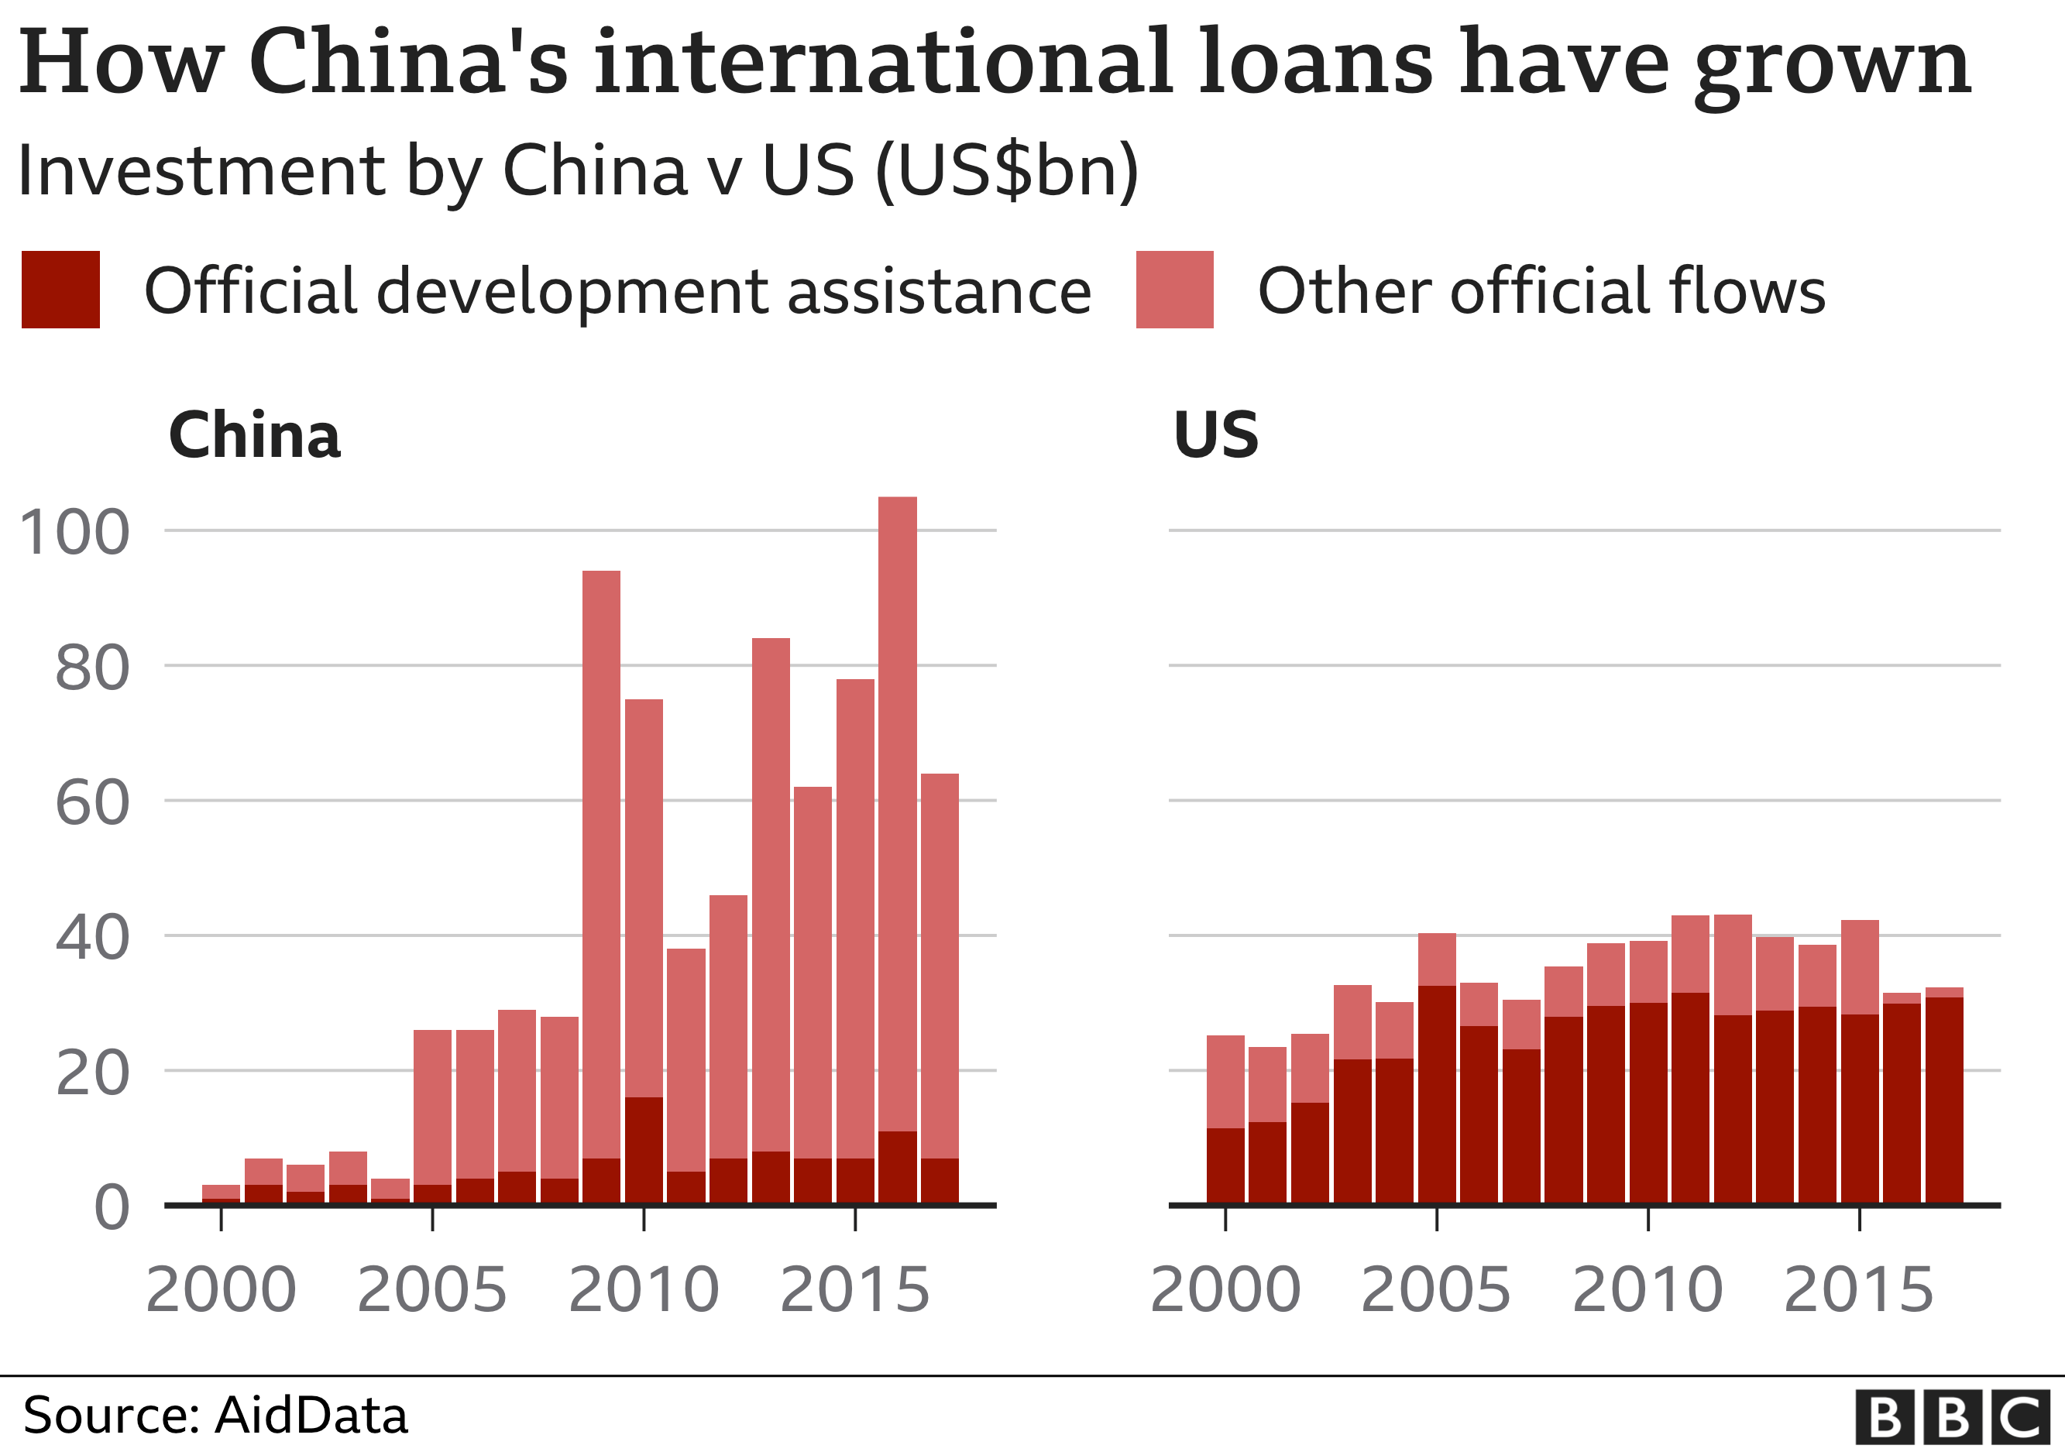

Slide 107
How the BRI works – legal aspects
Followed by deals made between host states and Chinese banks and SOE
> these entities sign commercial contracts with the partner country – loans, construction contracts

Slide 108
How the BRI works – legal aspects
Followed by deals made between host states and Chinese banks and SOE
> these entities sign commercial contracts with the partner country – loans, construction contracts
These are not international law and usually are not published > lack of transparency

Slide 109
How the BRI works – legal aspects
Followed by deals made between host states and Chinese banks and SOE
> these entities sign commercial contracts with the partner country – loans, construction contracts
These are not international law and usually are not published > lack of transparency
Problematic clauses – collaterals, debt-for-equity swaps, arbitration

Slide 110
How the BRI works – legal aspects
Contrast this with the WTO – multilateral institution, all agreements are international public law, private companies have no direct access to it

Slide 111
How the BRI works – legal aspects
Contrast this with the WTO – multilateral institution, all agreements are international public law, private companies have no direct access to it
The West – sharp division between the public and private sector – the WTO exists in the public sphere

Slide 112
How the BRI works – legal aspects
Contrast this with the WTO – multilateral institution, all agreements are international public law, private companies have no direct access to it
The West – sharp division between the public and private sector – the WTO exists in the public sphere
But aims to create rules that liberalize trade for the private sector

Slide 113
How the BRI works – legal aspects
China – state and business are interconnected
Preference for government-to-government deals and reliance on SOEs, which do not have to act in a commercially profitable way

Slide 114
How the BRI works – legal aspects
China‘s preferred way of conduct – state to state on a flexible bilateral basis
> no legal commitments for China, possibility to change the deal later on, supremacy of the state over the market

Slide 115
How the BRI works – legal aspects
Only small oversight by the Chinese government itself!

Slide 116
How the BRI works – legal aspects
Only small oversight by the Chinese government itself!
“Office of the Leading Group on Promoting the Implementation of Belt and Road Initiatives” which is under the National Development and Reform Commission (NDRC)
Only created after the fact, struggles to control all the projects

Slide 117
How the BRI works – legal aspects
The BRI label can be slapped on almost any project by a Chinese company in a third country

Slide 118
How the BRI works – legal aspects
The BRI label can be slapped on almost any project by a Chinese company in a third country
As a way to legitimize it, get Party support, ensure the locals etc.

Slide 119
How the BRI works – legal aspects
The BRI label can be slapped on almost any project by a Chinese company in a third country
As a way to legitimize it, get Party support, ensure the locals etc.
> framing of decentralized activities of China‘s vast SOEs and banks as parts of a great plan of the General Secretary

Slide 120
How the BRI works – legal aspects
„Unofficial BRI“ – large infrastructural projects are accompanies by an influx of Chinese entrepreneurs who claim they are a part of it

Slide 121
How the BRI works – legal aspects
„Unofficial BRI“ – large infrastructural projects are accompanies by an influx of Chinese entrepreneurs who claim they are a part of it
Often highly unscrupulous, legally dubious, business models – casinos, financial speculation etc.

Slide 122
How the BRI works – legal aspects
„Unofficial BRI“ – large infrastructural projects are accompanies by an influx of Chinese entrepreneurs who claim they are a part of it
Often highly unscrupulous, legally dubious, business models – casinos, financial speculation etc.
> Wild West vibe

Slide 123
How the BRI works – legal aspects
„Unofficial BRI“ – large infrastructural projects are accompanies by an influx of Chinese entrepreneurs who claim they are a part of it
Often highly unscrupulous, legally dubious, business models – casinos, financial speculation etc.
> Wild West vibe
A problem and a source of problems mainly in Southeast Asia – Malaysia, Cambodia

Slide 124
How the BRI works – economic aspects

Slide 125
How the BRI works – economic aspects
Banks – give a loan to the host state or local enterprise

Slide 126
How the BRI works – economic aspects
Banks – give a loan to the host state or local enterprise
Terms – mainly the interest rate
> more beneficial than commercial loans
> less beneficial than concessional loans from Western donors and development banks

Slide 127
How the BRI works – economic aspects
The money must be used to hire a specific SOE to carry out the project

Slide 128
How the BRI works – economic aspects
The money must be used to hire a specific SOE to carry out the project
If the loan is not repaid – collaterals, debt-for-equity swaps – some assets, like the infrastructure itself, must be handed over to the Chinese bank

Slide 129
How the BRI works – economic aspects
State guarantees – if the recipient of the loan is a private entity, the host state must nevertheless give the Chinese banks a guarantee that the loan is going to be repaid

Slide 130
How the BRI works – economic aspects
State guarantees – if the recipient of the loan is a private entity, the host state must nevertheless give the Chinese banks a guarantee that the loan is going to be repaid
For example – if a Chinese banks lends money to a power station or local construction company, the government must guarantee the loan will be repaid

Slide 131
How the BRI works – economic aspects
Renegotiation pledge - if the economic situation changes, the Chinese can change the conditions and renegotiate prices

Slide 132
How the BRI works – economic aspects
Renegotiation pledge - if the economic situation changes, the Chinese can change the conditions and renegotiate prices
The recipient must bound itself to accept this

Slide 133
How the BRI works – economic aspects
The Chinese are insuring themselves against risk

Slide 134
How the BRI works – economic aspects
The Chinese are insuring themselves against risk
Risks are objectively high in Third World countries
Because of political instability, unpredictable inflation, poor institutions, natural disasters etc.

Slide 135
How the BRI works – economic aspects
Western private capital – demands high interest rates

Slide 136
How the BRI works – economic aspects
Western private capital – demands high interest rates
Chinese state-owned capital is OK with low interests – but they want to insure their investment in other ways
> there are many conditions and strings attached

Slide 137
How the BRI works – economic aspects
Debt
- can mushroom because of the renegotiated prices and guarantees

Slide 138
How the BRI works – economic aspects
Debt
- can mushroom because of the renegotiated prices and guarantees
> when they are activated, the debt can instantly increase multiple-fold, for example from 10 % of GDP to 50 % of GDP
> it is difficult to say how much do countries in fact owe to China
= lack of transparency

Slide 139

?

Slide 140
East India Company vibe?

Slide 141
How the BRI works – economic aspects
Debt
Covid > dropping exports > inability of many developing countries to repay BRI loans

Slide 142
How the BRI works – economic aspects
Debt
Covid > dropping exports > inability of many developing countries to repay BRI loans
China participated in a 2020 debt moratorium

Slide 143
How the BRI works – economic aspects
Debt
Covid > dropping exports > inability of many developing countries to repay BRI loans
China participated in a 2020 debt moratorium
2022 – debts of 17 African countries forgiven

Slide 144
How the BRI works – economic aspects
China is not a member of the Paris and London clubs, which usually negotiate with debtors

Slide 145
How the BRI works – economic aspects
China is not a member of the Paris and London clubs, which usually negotiate with debtors
IMF – usually lends to debtors conditional on them making a deal with the Paris club

Slide 146
How the BRI works – economic aspects
China is not a member of the Paris and London clubs, which usually negotiate with debtors
IMF – usually lends to debtors conditional on them making a deal with the Paris club
Hesitation whether to lend to countries with BRI debts

Slide 147
How the BRI works – economic aspects
China is also not a member of the Development Assistance Committee, which sets standards for transparency in development lending

Slide 148
How the BRI works – economic aspects
Maintenance – once a company builds a piece of infrastructure, there is always a requirement, or even practical necessity, to use their products for future repairs

Slide 149
How the BRI works – economic aspects
Maintenance – once a company builds a piece of infrastructure, there is always a requirement, or even practical necessity, to use their products for future repairs > China is gaining a long-term economic foothold

Slide 150
Why would somebody accept a deal like this?

Slide 151
How the BRI works – economic aspects
Developing countries:
– desperate need for capital

Slide 152
How the BRI works – economic aspects
Developing countries:
– desperate need for capital
- often high levels of corruption

Slide 153
How the BRI works – economic aspects
Developing countries:
– desperate need for capital
- often high levels of corruption
> disregard for the environment etc.

Slide 154
How the BRI works – economic aspects
BRI is often associated with worsening quality of institutions and increasing corruption > local elites might embezzle the money and use them to entrench themselves in power

Slide 155
Geography of the BRI

Slide 157
Geography of the BRI
Main corridor – through Central Asia, Russia, Poland and all the way to London

Slide 158
Geography of the BRI
Main corridor – through Central Asia, Russia, Poland and all the way to London
Reality – mostly old Soviet railways

Slide 159
Geography of the BRI
Main corridor – through Central Asia, Russia, Poland and all the way to London
Reality – mostly old Soviet railways
Necessity to change trains in terminals – because of different gauge

Slide 160
Geography of the BRI
Main corridor – through Central Asia, Russia, Poland and all the way to London
Reality – mostly old Soviet railways
Necessity to change trains in terminals – because of different gauge
First change on China-Kazakhstan border, another at Belarus-Poland border

Slide 161
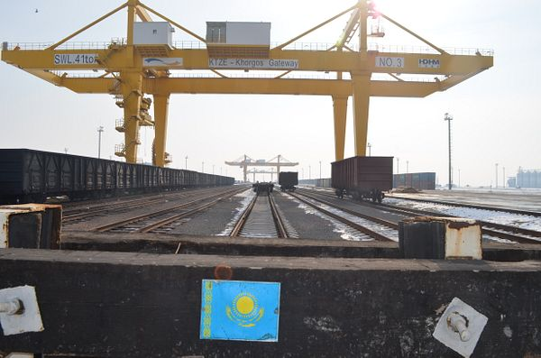

Slide 162
Geography of the BRI
Main corridor – through Central Asia, Russia, Poland and all the way to London
Reality – mostly old Soviet railways
Necessity to change trains in terminals – because of different gauge
First change on China-Kazakhstan border, another at Belarus-Poland border
> increases cost
5 times more expansive than shipment!

Slide 163
Geography of the BRI
Main corridor – through Central Asia, Russia, Poland and all the way to London
Reality – mostly old Soviet railways
Necessity to change trains in terminals – because of different gauge
First change on China-Kazakhstan border, another at Belarus-Poland border
> increases cost
5 times more expansive than shipment!
Faster, but is that useful?

Slide 164
Geography of the BRI
Only profitable when subsidized

Slide 165
Geography of the BRI
Only profitable when subsidized
What about the way back?
Europe does not export anything the other way around

Slide 166
Geography of the BRI
Only profitable when subsidized
What about the way back?
Europe does not export anything the other way around
> either China will subsidize the return of empty wagons, or containers will accumulate in Europe

Slide 167
How the BRI works – economic aspects
China does not care all that much whether the project will pay for itself

Slide 168
How the BRI works – economic aspects
China does not care all that much whether the project will pay for itself
Even in China, this is not the point – the Party decides that a bridge is going to be built, and so it will be built, no matter the costs
Non-market, statist mindset

Slide 169
How the BRI works – economic aspects
China does not care all that much whether the project will pay for itself
Even in China, this is not the point – the Party decides that a bridge is going to be built, and so it will be built, no matter the costs
Non-market, statist mindset
This becomes a problem when a developing country needs the project to be profitable to pay back the loan…

Slide 170
Geography of the BRI
Southeast Asia and Indian Ocean
– desire to avoid chokepoints, isolate India, secure maritime route to Europe

Slide 172
Geography of the BRI
Southeast Asia and Indian Ocean
– desire to avoid chokepoints, isolate India, secure naval route to Europe
Plans – canal through Malayan peninsula (in Thai territory), railway passage in Malaysia

Slide 173
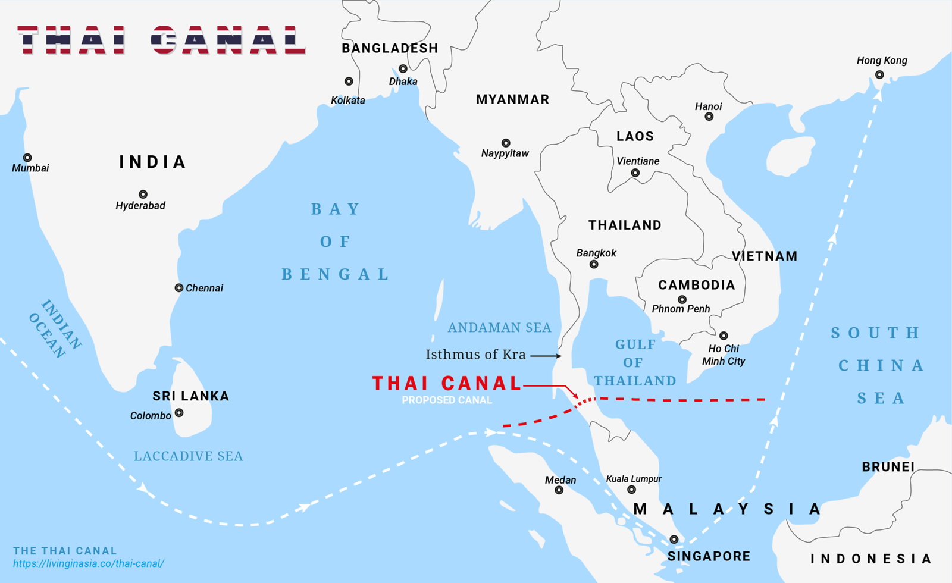

Slide 174
Geography of the BRI
Southeast Asia and Indian Ocean
– desire to avoid chokepoints, isolate India, secure naval route to Europe
Plans – canal through Malaysian peninsula (in Thai territory), railway passage in Malaysia
Malacca gate port

Slide 175
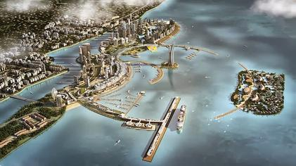

Slide 176
Geography of the BRI
Southeast Asia and Indian Ocean
– desire to avoid chokepoints, isolate India, secure naval route to Europe
Plans – canal through Malaysian peninsula (in Thai territory), railway passage in Malaysia
Malacca gate port
Sihanoukville port
Sri Lanka – main port leased to a Chinese company for 99 years

Slide 178
Geography of the BRI
Pakistan

Slide 180
Geography of the BRI
Pakistan
Most important project, largest amount of investment!

Slide 181
Geography of the BRI
Pakistan
Most important project, largest amount of investment!
Only truly new BRI project, flagship of the whole Initiative

Slide 182
Geography of the BRI
Pakistan
Most important project, largest amount of investment!
Only truly new BRI project, flagship of the whole Initiative
Railway and road connection from Tibet through Kashmir to Karachi and Gwadar – a new port

Slide 183
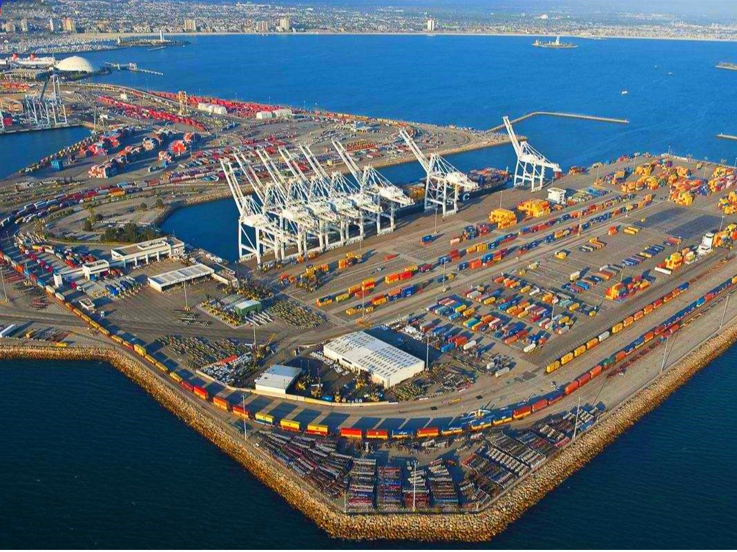

Slide 184
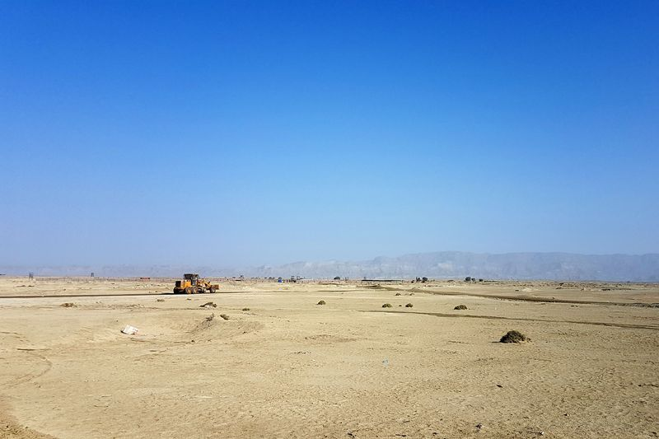

Slide 185
Geography of the BRI
Pakistan
Most important project, largest amount of investment!
Only truly new BRI project, flagship of the whole Initiative
Railway and road connection from Tibet through Kashmir to Karachi and Gwadar – a new port
Connects the Belt and the Road – the western regions and the Indian ocean sea lanes

Slide 188
Problems
Most countries which began as enthusiastic supporters of the BRI are becoming more lukewarm, or outright sceptic

Slide 189
Problems
Most countries which began as enthusiastic supporters of the BRI are becoming more lukewarm, or outright sceptic
A large percentage of projects have been canceled, or scaled down, or delayed, etc.

Slide 190
Problems
Economic problems become mixed with geopolitical anxieties and xenophobia

Slide 191
Problems
Economic problems become mixed with geopolitical anxieties and xenophobia
Almost every country in Southeast Asia has a history of anti-Chinese racism and even violent pogroms aimed at local Chinese minorities

Slide 192
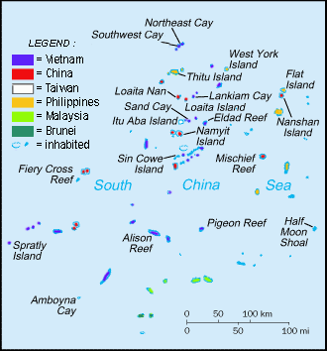

Slide 193
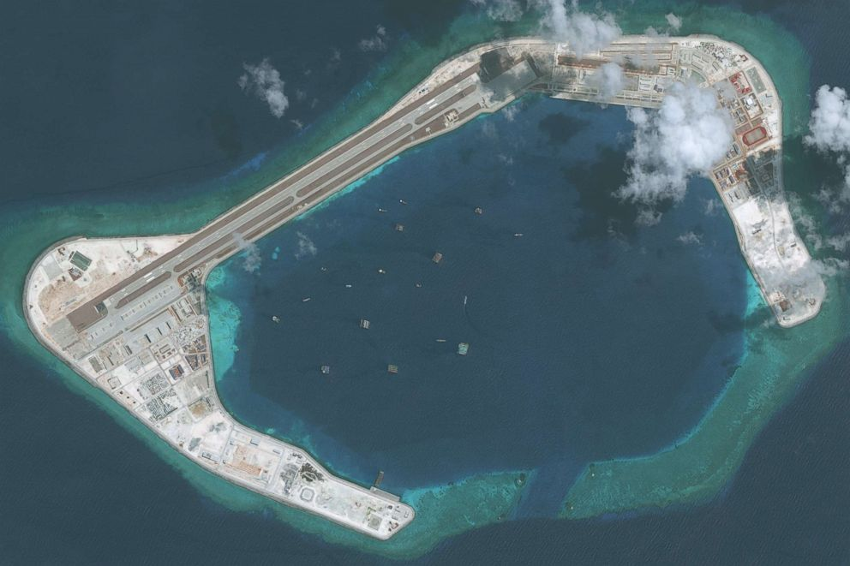

Slide 194
Problems
Malaysia, Maldives – opposition to BRI as an election topic
Cambodia, Myanmar – fear of Chinese encroachment, xenophobia between Han Chinese and locals
Kazakhstan – protests over debt + Uighurs
Pakistan – decreasing ambitions
Balkan nations – belated realization that BRI will make it hard for them to enter the EU

Slide 196
Problems
Peak of investment – 2016!

Slide 197
Problems
Perhaps the result of a naive approach?

Slide 198
Problems
Perhaps the result of a naive approach?
Will China pivot towards a softer strategy like the West did…?

Slide 199
Is BRI a form of imperialism?

Slide 200
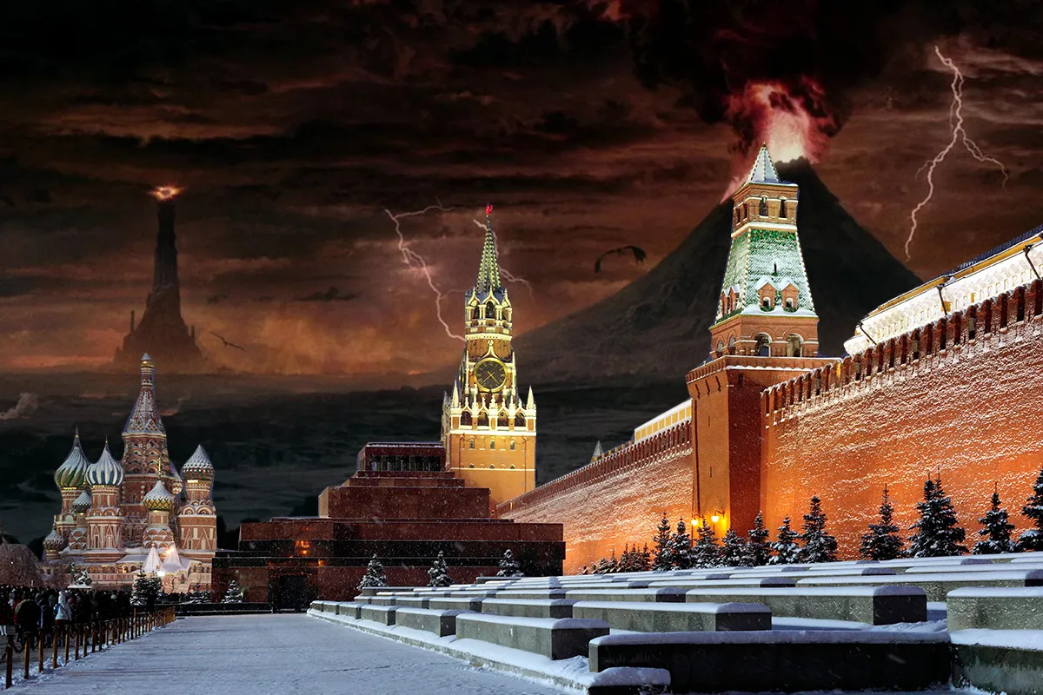
Is BRI a form of imperialism?
Not from a perspective of a centralized empire with a single will (Mordor, USSR etc.)

Slide 201
Is BRI a form of imperialism?
Not from a perspective of a centralized empire with a single will (Mordor, USSR etc.)
But many cases of modern imperialism are far more decentralized, spontaneous, gradual, organic

Slide 202
Is BRI a form of imperialism?
Not from a perspective of a centralized empire with a single will (Mordor, USSR etc.)
But many cases of modern imperialism are far more decentralized, spontaneous, gradual, organic
= led by many small actors rather than one master plan

Slide 203
Is BRI a form of imperialism?
Not from a perspective of a centralized empire with a single will (Mordor, USSR etc.)
But many cases of modern imperialism are far more decentralized, spontaneous, gradual, organic
= led by many small actors rather than one master plan
= caused by huge gaps in economic and technological and military capability rather than a political decision

Slide 204
Is BRI a form of imperialism?
Example: British imperialism in Asia
1) Individual and corporate ambition and greed

Slide 205
Is BRI a form of imperialism?
Example: British imperialism in Asia
1) Individual and corporate ambition and greed
2) Collaboration of local elites

Slide 206
Is BRI a form of imperialism?
Example: British imperialism in Asia
Official policy – small entrepots and economic privileges

Slide 207
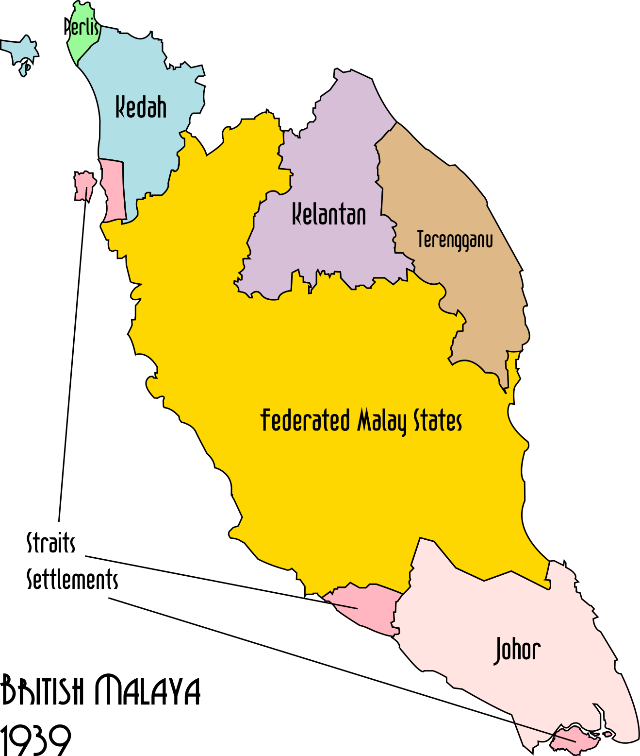

Slide 208
Is BRI a form of imperialism?
Example: British imperialism in Asia
Official policy – small entrepots and economic privileges
-> Often not full annexation, but rather gradual economic and political penetration, leading to hegemony supported by coopted local elites

Slide 209
The main idea
China is not a truly unitary actor

Slide 210
The main idea
China is not a truly unitary actor
Both good and bad outcomes sometimes come from decentralized processes

Slide 211
The main idea
Overall, the Belt and Road Initiative is a best understood as an umbrella term for all of China‘s foreign ventures

Slide 212
The main idea
Overall, the Belt and Road Initiative is a best understood as an umbrella term for all of China‘s foreign ventures
Likely driven by China‘s own economic needs
Beijing‘s strategic oversight and malicious intentions are probably overrated by Western observers
Which does not mean the BRI cannot be harmful!

Slide 213
See you in seminar next week ☺

Slide 214
The Belt and Road Initiative
A vaguely defined project
Umbrella term for China‘s outward investment – including projects launched many years before BRI was even unveiled
US and other Western countries – exaggerated perception of the BRI as a diabolical master plan to take over the world
„Debt trap diplomacy“ – describes the results and assumes them to be the original goals

Slide 215
Thank youuuu ☺ ❤️

