Slide 1
The US-China rivalry
China in the World Economy, 2023

Slide 2


Slide 3
Questions from last time
What is industrial policy?

Slide 4
Questions from last time
What is industrial policy?
When did China start to re-establish industrial policy after abandoning it in the late 1990s?

Slide 5
Questions from last time
What is industrial policy?
When did China start to re-establish industrial policy after abandoning it in the late 1990s?
How did the Financial crisis influence Chinese thinking about government intervention in the economy?

Slide 6
Questions from last time
What is industrial policy?
When did China start to re-establish industrial policy after abandoning it in the late 1990s?
How did the Financial crisis influence Chinese thinking about government intervention in the economy?
How are newer Chinese industrial policy programs, such as Made in China 2025, distinct from „normal“ industrial policy?

Slide 7
Questions from last time
Why are Chinese leaders disatisfied with China‘s position in global value chains despite exporting so many advanced products?

Slide 8
Questions from last time
Why are Chinese leaders disatisfied with China‘s position in global value chains despite exporting so many advanced products?
Why are semiconductors so important for China?

Slide 9
Questions from last time
Why are Chinese leaders disatisfied with China‘s position in global value chains despite exporting so many advanced products?
Why are semiconductors so important for China?
What is China‘s position in the global semiconductor value chain?

Slide 10
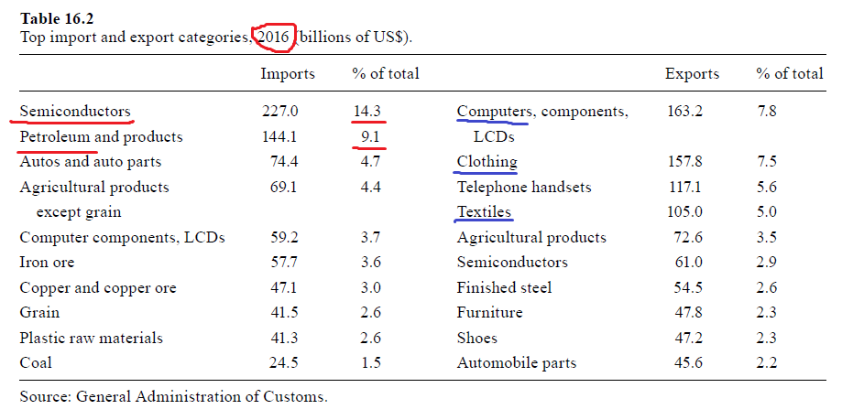
Chips

Slide 11
Chips
Semiconductors lay at the very heart of China‘s technological ambitions

Slide 12
Chips
Semiconductors lay at the very heart of China‘s technological ambitions
Desire for:
> a technological upgrade
> moving up into higher value added production
> self-reliance, limiting of imports

Slide 13
Chips
Basic unit – a transistor – either allows electric current to pass through, or it does not

Slide 14
Chips
Basic unit – a transistor – either allows electric current to pass through, or it does not
> coding of 0s and 1s

Slide 15
Chips
Basic unit – a transistor – either allows electric current to pass through, or it does not
> coding of 0s and 1s
Semiconductor materials must be used to do this - silicon

Slide 16
Chips
Basic unit – a transistor – either allows electric current to pass through, or it does not
> coding of 0s and 1s
Semiconductor materials must be used to do this - silicon
Chip – lots of transistors on a silicon wafer

Slide 17
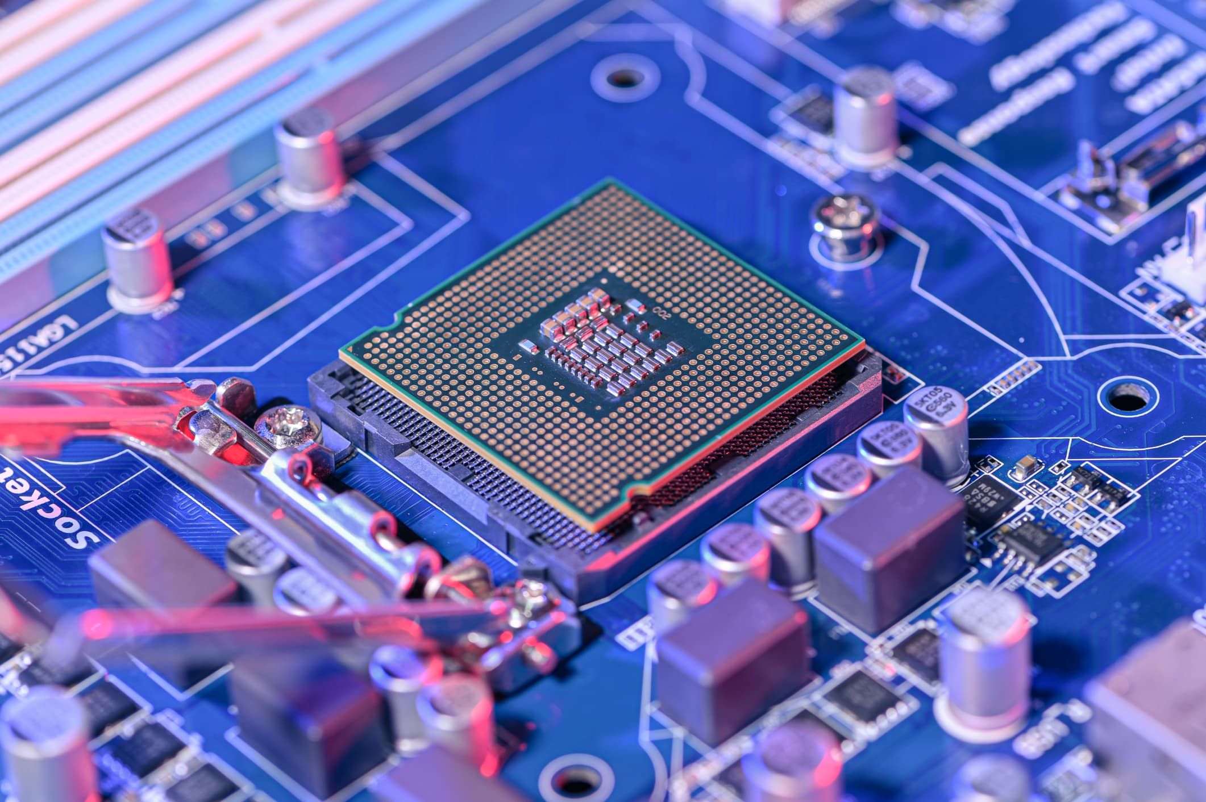

Slide 18
Chips
Basic unit – a transistor – either allows electric current to pass through, or it does not
> coding of 0s and 1s
Semiconductor materials must be used to do this - silicon
Chip – lots of transistors on a silicon wafer
Invented – Bell labs, late 1950s

Slide 19
Chips
Since 1970s – Moore‘s Law

Slide 20
Chips
Since 1970s – Moore‘s Law
Every two years, the number of transistors in a chip of equal size doubles

Slide 21
Chips
Since 1970s – Moore‘s Law
Every two years, the number of transistors in a chip of equal size doubles
> double brute computing force

Slide 22
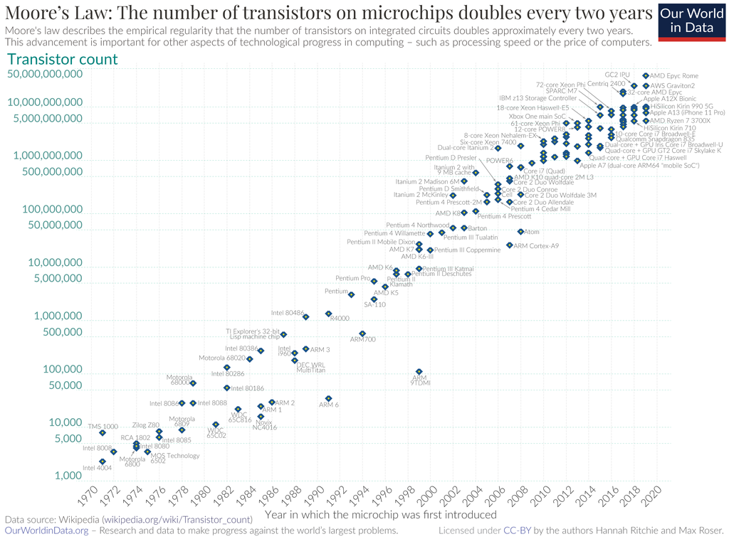

Slide 23
Chips
Since 1970s – Moore‘s Law
Every two years, the number of transistors in a chip of equal size doubles
> double brute computing force
Self-fulfilling prophecy – if you want to stay in business, you must keep up with the Law

Slide 24
Chips
Since 1970s – Moore‘s Law
Every two years, the number of transistors in a chip of equal size doubles
> double brute computing force
Self-fulfilling prophecy – if you want to stay in business, you must keep up with the Law
Or focus on specific types of rudimentary, trailing edge chips – Europe!

Slide 25
Chips
China imports the vast majority of its chips

Slide 26
Chips
China imports the vast majority of its chips
Its national chip maker- SMIC – Semiconductor Manufacturing International Corporation

Slide 27
Chips
China imports the vast majority of its chips
Its national chip maker- SMIC – Semiconductor Manufacturing International Corporation
Quintessential national champion on part with Huawei!

Slide 28
Chips
China imports the vast majority of its chips
Its national chip maker- SMIC – Semiconductor Manufacturing International Corporation
Quintessential national champion on part with Huawei!
Extremely high support - 50% of its revenue comes from state subsidies

Slide 29
Chips
China imports the vast majority of its chips
Its national chip maker- SMIC – Semiconductor Manufacturing International Corporation
Quintessential national champion on part with Huawei!
Extremely high support - 50% of its revenue comes from state subsidies
But it is still far behind industry leaders and only has a small global market share

Slide 30
Chips
SMIC‘s smallest transistors are 7 nm in size
The smallest produced on a large scale are 5nm, TSMC is planning to start 2nm production next year
Most of SMIC‘s production is even further from the frontier!

Slide 31
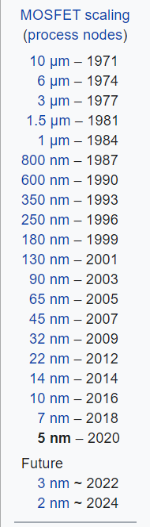

Slide 32
Chips
China imports some 70 % of chips produced worldwide, half is then re-exported
It only produces 16 % of world production, only 6 % comes from domestically owned firms

Slide 33
The semiconductor value chain
Perhaps the most sophisticated value chain in the world

Slide 34
The semiconductor value chain
No country or company in the world is able to produce cutting edge chips on its own

Slide 35
The semiconductor value chain
Dominated by USA + Taiwan, Korea, Japan; Netherlands

Slide 36
The semiconductor value chain
EDA – software (US firms)

Slide 37
The semiconductor value chain
EDA – software (US firms)
Design – smartphone manufacturers etc.

Slide 38
The semiconductor value chain
EDA – software (US firms)
Design – smartphone manufacturers etc.
SME – equipment – US + Japan + Netherlands (ASML)

Slide 39
The semiconductor value chain
EDA – software (US firms)
Design – smartphone manufacturers etc.
SME – equipment – US + Japan + Netherlands (ASML)
- extreme-ultraviolet lithography

Slide 40
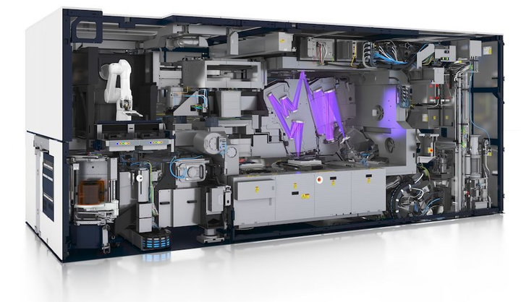

Slide 41
The semiconductor value chain
EDA – software (US firms)
Design – smartphone manufacturers etc.
SME – equipment – US + Japan + Netherlands (ASML)
- extreme-ultraviolet lithography – largest bumps on their mirrors are smaller than one atom!

Slide 42


Slide 43
The semiconductor value chain
Together – „fabs“ – most expensive factories in the world – circa 20 billion dollars to create a production link

Slide 44
The semiconductor value chain
Together – „fabs“ – most expensive factories in the world – circa 20 billion dollars to create a production link
Non-monetary inputs – need for engineers with experience, which is extremely rare

Slide 45
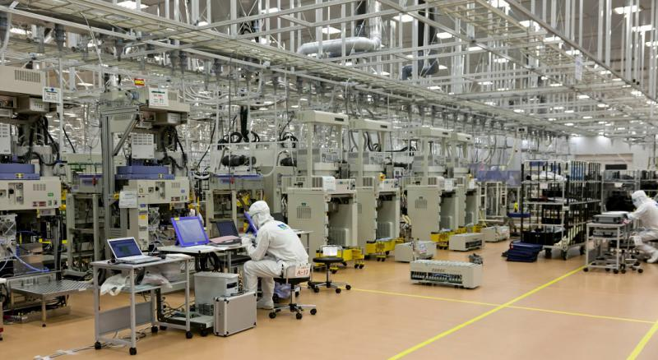

Slide 46
The semiconductor value chain
Most important producer of chips in the world – TSMC – Taiwan Semiconductor Manufacturing Company

Slide 47
The semiconductor value chain
Most important producer of chips in the world – TSMC – Taiwan Semiconductor Manufacturing Company
- 50% of global production or so, even stronger on the cutting edge

Slide 48
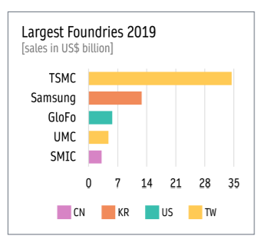

Slide 49
The semiconductor value chain
China – no EDA or SME, few experiences engineers

Slide 50
The semiconductor value chain
China‘s Achilles‘ heel!

Slide 51
The semiconductor value chain
China‘s Achilles‘ heel!
> huge resources are being invested into redressing it

Slide 52
The semiconductor value chain
China‘s Achilles‘ heel!
> huge resources are being invested into redressing it
> US steps agains China are concentrated in this area!

Slide 53
US – Chinese technological rivalry
Khan and Flynn: Maintaining China s Dependence on Democracies for Advanced Computer Chips

Slide 54
US – Chinese technological rivalry
Khan and Flynn: Maintaining China s Dependence on Democracies for Advanced Computer Chips
The goal should be to prevent China from gaining a capacity to produce cutting edge chips

Slide 55
US – Chinese technological rivalry
Khan and Flynn: Maintaining China s Dependence on Democracies for Advanced Computer Chips
The goal should be to prevent China from gaining a capacity to produce cutting edge chips
> China must be prevented from importing SME (equipment) or licensing EDA software

Slide 56
Export controls
A complicated type of sanctions-like legislation
Reserved for geopolitical rivals

Slide 57
Export controls
A complicated type of sanctions-like legislation
Reserved for geopolitical rivals
Export Controls Act of 1940 – against Japan

Slide 58
Export controls
A complicated type of sanctions-like legislation
Reserved for geopolitical rivals
Export Controls Act of 1940 – against Japan
Later used against the USSR, in cooperation with US allies
Later for „rouge states“ (North Korea, Iraq…), now for China!

Slide 59
Export controls
Basic principle
– some goods are proclaimed strategic
– some countries are proclaimed to pose a strategic risks for US national security

Slide 60
Export controls
Basic principle
– some goods are proclaimed strategic
– some countries are proclaimed to pose a strategic risks for US national security
> if you want to export the product in question to the country in question, you need a licence from the US government
Violating these rules is a criminal offense! (vs. tariffs and other economic policies)

Slide 61
US – Chinese technological rivalry
Khan and Flynn: Maintaining China s Dependence on Democracies for Advanced Computer Chips
The goal should be to prevent China from gaining a capacity to produce cutting edge chips
> China must be prevented from importing SME (equipment) or licensing EDA software

Slide 62
US – Chinese technological rivalry
Khan and Flynn: Maintaining China s Dependence on Democracies for Advanced Computer Chips
The goal should be to prevent China from gaining a capacity to produce cutting edge chips
> China must be prevented from importing SME (equipment) or licensing EDA software
This embargo must include US allies (Korea, Japan, Taiwan, Netherlands)

Slide 63
US – Chinese technological rivalry
The goal is not to prevent China from importing chips!

Slide 64
US – Chinese technological rivalry
The goal is not to prevent China from importing chips! > that would give them an even greater motivation to develop an indigenous production capacity!

Slide 65
US – Chinese technological rivalry
The goal is not to prevent China from importing chips! > that would give them an even greater motivation to develop an indigenous production capacity!
When China is dependent, the US and its allies can impose conditions for usage – so that chips are not used for military purposes, surveillance of Uighurs, etc.

Slide 66
US – Chinese technological rivalry
The goal is not to prevent China from importing chips! > that would give them an even greater motivation to develop an indigenous production capacity!
When China is dependent, the US and its allies can impose conditions for usage – so that chips are not used for military purposes, surveillance of Uighurs, etc.
Biden‘s strategy - in line with this approach

Slide 67
Biden‘s export controls on China
Wide ban on SME exports to China – mostly ASML – achieved because ASML uses US technologies
Ban on US engineers working for Chinese semiconductor companies
Ban on exporting specific advanced chips to China – AI chips
More drastic bans on specific companies

Slide 68
Trump only targeted Huawei and SMIC!

Slide 69
Export controls
Exterritorial – falls on foreign companies using US inputs or IP

Slide 70
Export controls
Other nations and the EU have similar legislation in place

Slide 71
Investment screenings
Since circa 2014, China ramped up strategic purchases of foreign technological companies

Slide 72
Investment screenings
Screening – a process that allows the government to stop a foreign investment from being carried out
- if it poses a threat for national security

Slide 73
Investment screenings
Screening – a process that allows the government to stop a foreign investment from being carried out
- if it poses a threat for national security
2018 – a new and more restrictive legislation („FIRRMA“)
CFIUS – Committe charged with screening

Slide 74
Investment screenings
A tighter regime of export controls and investment screenings is being created in the EU as well!
– two new EU regulations in 2021!

Slide 75
Investment screenings
A tighter regime of export controls and investment screenings is being created in the EU as well!
– two new EU regulations in 2021!
They explicitly allow member states to establish their own screening laws + call for cooperation

Slide 76
Investment screenings
A tighter regime of export controls and investment screenings is being created in the EU as well!
– two new EU regulations in 2021!
They explicitly allow member states to establish their own screening laws + call for cooperation
But is there political will and administrative capacity to enforce this…?

Slide 77
The US-China trade war

Slide 78
The US-China trade war
„China shock“ – contrary to expectations of economists, the post-2000 surge of imports had negative impacts on many parts of US society

Slide 79
The US-China trade war
„China shock“ – contrary to expectations of economists, the post-2000 surge of imports had negative impacts on many parts of US society
> de-industrialization, followed by permanently decreased wages and employment

Slide 80
The US-China trade war
Political conflict – winners vs. losers of globalization

Slide 81
The US-China trade war
Political conflict – winners vs. losers of globalization
Branko Milanovic - paradoxically – rich urban American are on the same side as the poor from the Global South – in favor of (US) free trade

Slide 82
The US-China trade war
Political conflict – winners vs. losers of globalization
Branko Milanovic - paradoxically – rich urban American are on the same side as the poor from the Global South – in favor of (US) free trade
> Donald Trump

Slide 83
The US-China trade war
2018-2019 – 4 waves of tariffs on Chinese goods

Slide 84
The US-China trade war
2018-2019 – 4 waves of tariffs on Chinese goods
Tariffs on Chinese products increased from circa 3 % to circa 20 %

Slide 85
The US-China trade war
2018-2019 – 4 waves of tariffs on Chinese goods
Tariffs on Chinese products increased from circa 3 % to circa 20 %
Usually, tariffs were increased by 25 percentage points, some goods were given exceptions

Slide 86
The US-China trade war
2018-2019 – 4 waves of tariffs on Chinese goods
Tariffs on Chinese products increased from circa 3 % to circa 20 %
Usually, tariffs were increased by 25 percentage points, some goods were given exceptions
Chinese retaliation

Slide 87
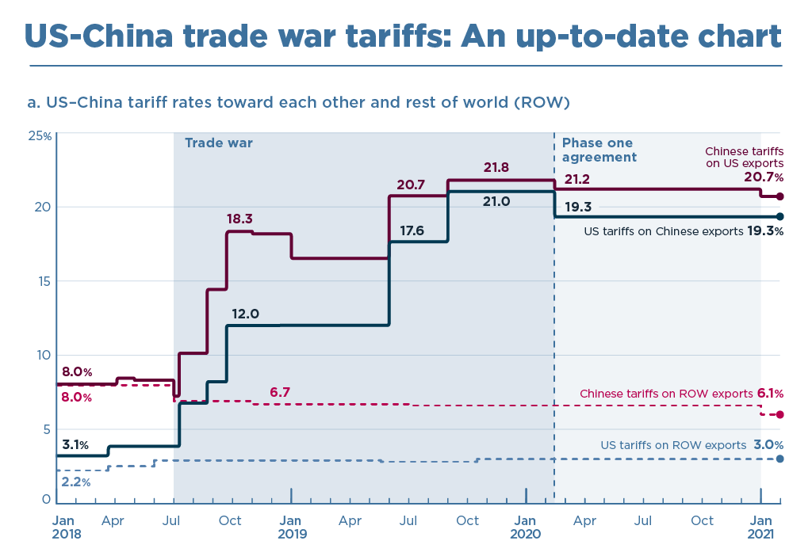

Slide 88
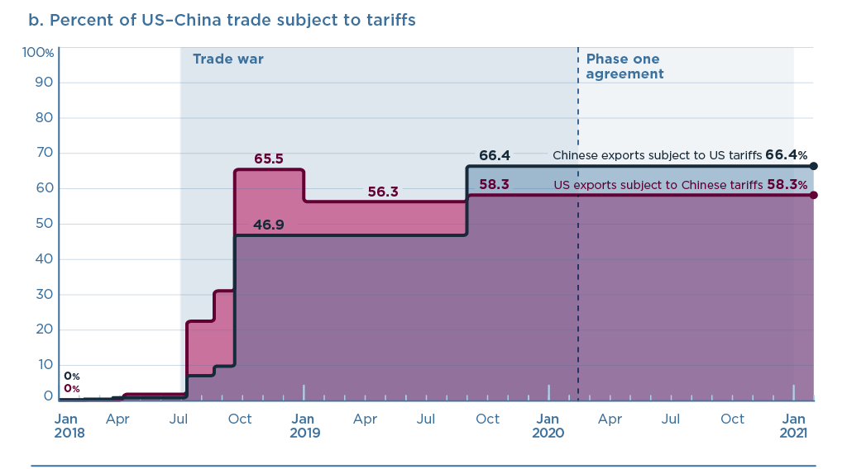

Slide 89
The US-China trade war
Much worse for China – far more dependent on exports, has more to loose

Slide 90
The US-China trade war
Much worse for China – far more dependent on exports, has more to loose
Also not great for US customers

Slide 91
The US-China trade war
Much worse for China – far more dependent on exports, has more to loose
Also not great for US customers
Winners – US workers in import-competing industries; third countries – EU!

Slide 92
The US-China trade war
Much worse for China – far more dependent on exports, has more to loose
Also not great for US customers
Winners – US workers in import-competing industries; third countries – EU!
Popular in the US – Biden continues the same policy

Slide 93
Mattoo and Staiger
The tariffs serve as leverage to force China to carry out reforms that the US demands

Slide 94
The US-China trade war
By the beginning of Covid, US imports from China returned to 2011 levels

Slide 95
The US-China trade war
By the beginning of Covid, US imports from China returned to 2011 levels
China‘s share of US imports dropped to 2008 levels

Slide 96
The US-China trade war
By the beginning of Covid, US imports from China returned to 2011 levels
China‘s share of US imports dropped to 2008 levels
= decoupling?

Slide 97
The US-China trade war
Goal – „onshoring“ – forcing companies to return home, or at least to relocate from China into another country

Slide 98
The US-China trade war
Goal – „onshoring“ – forcing companies to return home, or at least to relocate from China into another country
Far less successful – China remains paramount for large multinational companies

Slide 99
The US-China trade war
Goal – „onshoring“ – forcing companies to return home, or at least to relocate from China into another country
Far less successful – China remains paramount for large multinational companies
- a giant market
Returns on investment in China are higher than anywhere else in the world

Slide 100
The US-China trade war
Goal – „onshoring“ – forcing companies to return home, or at least to relocate from China into another country
Far less successful – China remains paramount for large multinational companies
- a giant market
Returns on investment in China are higher than anywhere else in the world
Sometimes – feigned moves abroad – products are completed in another country, so they avoid US tariffs etc.

Slide 101
The US-China trade war
How has China‘s role changed from the perspective of a multinational corporation between 2000 to 2020?

Slide 102
The US-China trade war
How has China‘s role changed from the perspective of a multinational corporation between 2000 to 2020?
From a source of cheap labor to a market – the Chinese are rich enough to consume

Slide 103
The US-China trade war
How has China‘s role changed from the perspective of a multinational corporation between 2000 to 2020?
From a source of cheap labor to a market – the Chinese are rich enough to consume
This goes hand in hand with China‘s drive to decrease its dependence on exports – promotion of domestic consumption

Slide 104
The US-China trade war
How has China‘s role changed from the perspective of a multinational corporation between 2000 to 2020?
From a source of cheap labor to a market – the Chinese are rich enough to consume
This goes hand in hand with China‘s drive to decrease its dependence on exports – promotion of domestic consumption
Trade war = another incentive to make China less dependent on exports

Slide 105
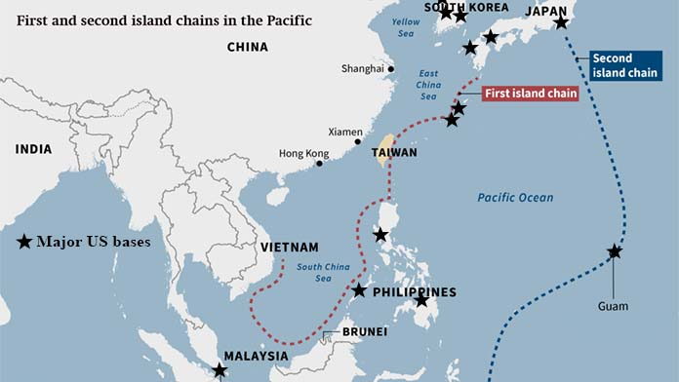
The geopolitics

Slide 106
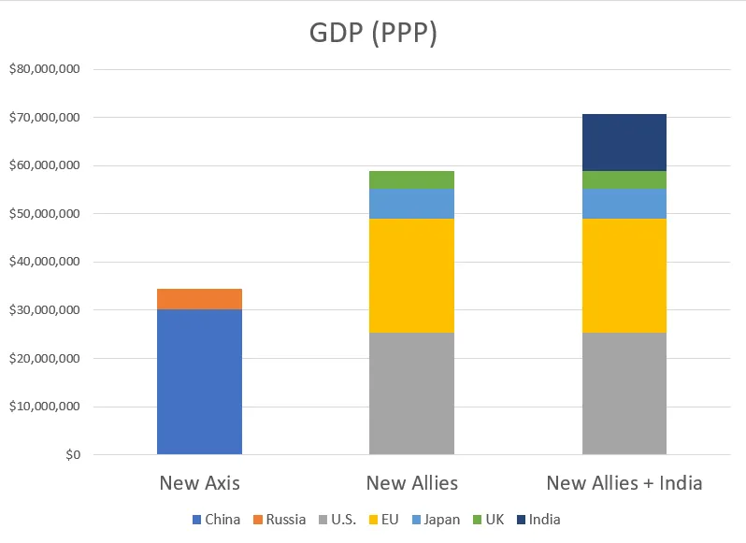
The geopolitics

Slide 107
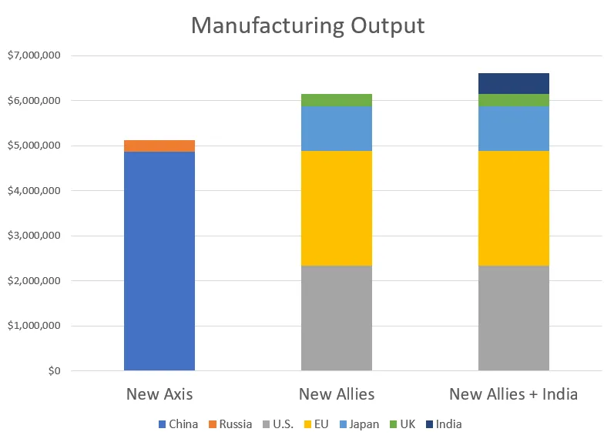
The geopolitics

Slide 108
Next time
China in the World Trade Organization

