Slide 1
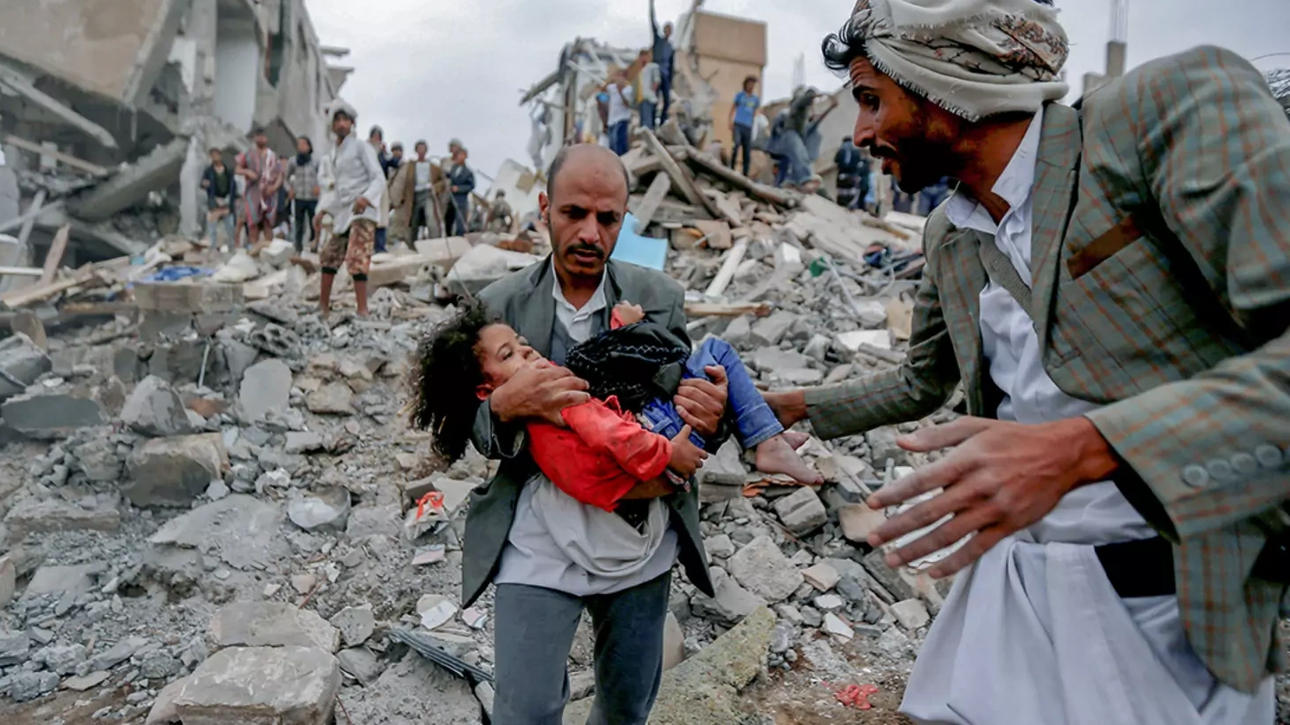
Yemen vs. KSA and the non-state actors
Goboňová Sarah, učo 548936; Goldrat Elisa, učo 545698; Kantorová Anastázie, učo 549051;
Martonová Natália, učo 548725; Vališová Klára, učo 548762

Slide 2
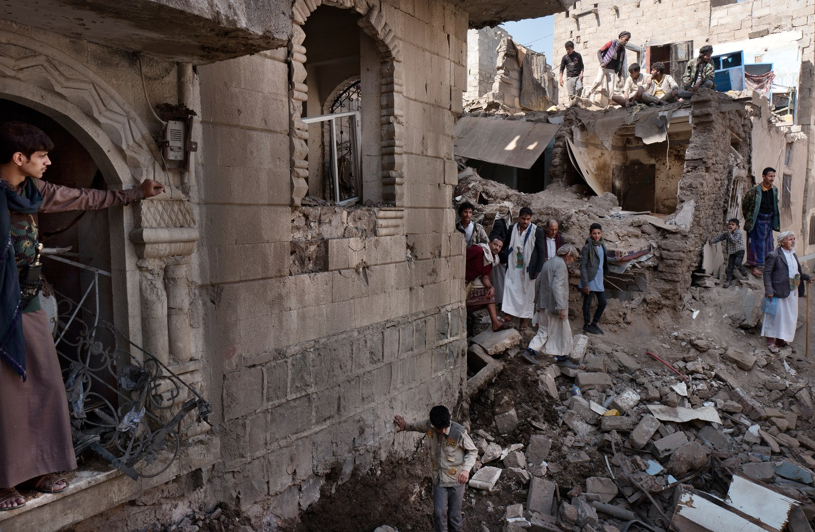
The conflict
War in Yemen started in 2014 when Houthi rebels took control of Sana'a.
A Saudi-led coalition intervened in 2015, escalating the conflict.
The war has caused a devastating humanitarian crisis with millions affected.
Infrastructure like schools and hospitals have been destroyed.
Efforts for peace have been made, but a lasting solution is yet to be achieved.

Slide 3
The Southern Transitional Council is founded
The Houthi insurgency
The present
2011
2015
2014
2017
Arab Sring in Yemen
Operation Decisive Storm begins
Ongoing humanitarian crisis

Slide 4


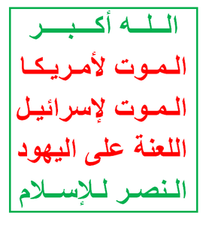

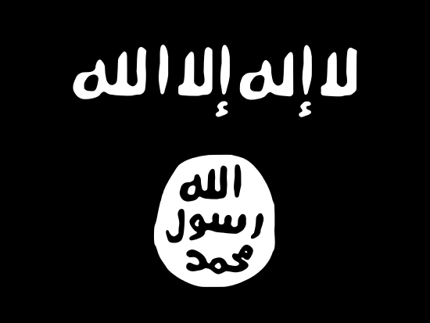
Actors of the conflict
Saudi-led coalition
The Southern Movement
The Houthis
Internationally Recognised Government
Radical groups

Slide 5
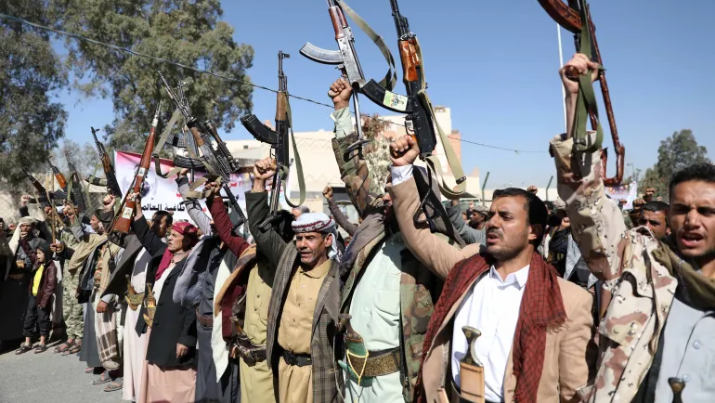
The Houthis
The Houthis, also known as Ansar Allah, are a group based in Yemen that emerged in the early 2000s.
They represent the Zaidi Shia Muslim minority and were founded by Hussein Badreddin al-Houthi.
The Houthis gained control of the capital, Sana'a, in 2014, leading to a conflict with the internationally recognized government.
A Saudi-led coalition intervened in 2015 to support the government against the Houthi rebels, escalating the conflict.
The ongoing conflict has resulted in a severe humanitarian crisis, with millions of Yemenis facing food and medical shortages

Slide 6
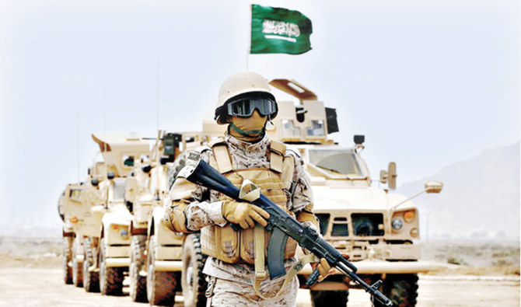
Saudi-led coalition
Coalition of some of the GCC and north Africa states with the western support.
Operation Decisive Storm, launched in 2015, led by Saudi Arabia at Yemeni President Hadi's request.
Motivation: Houthi-Iran connection, securing an independent pipeline, political ambitions.
Naval blockade, air-based campaign.
Lack of UN Security Council approval.
2021, USA withdraw from providing forces to Saudi Arabia.

Slide 7
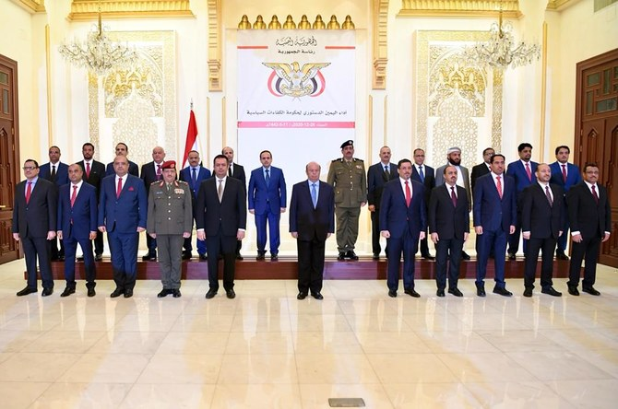
IRG
Parliamentary republic, General People's Congress dominating the political scene since 1993.
Ali Abdullah Saleh, war with the Houthis 2006-2007.
The Arab Spring, Saleh and Abdrabbuh Mansur al-Hadi and the civil war.
Saleh´s cooperation with Houthis
Hadi in exile, internationally recognised government
Rashad al-Alimi

Slide 8
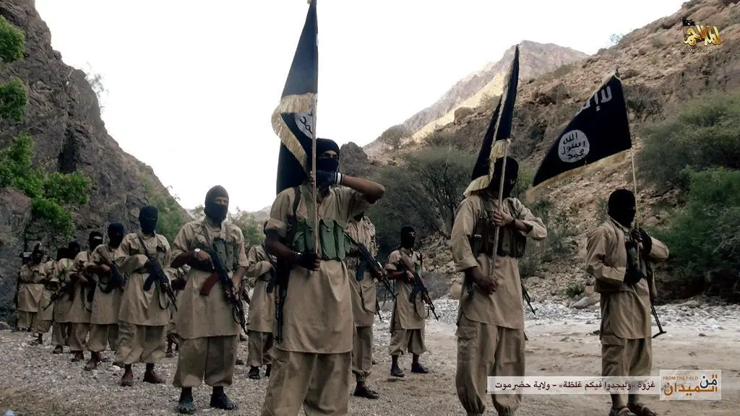
Radical groups: al-Qaeda and IS
AQAP “most dangerous al-Qaeda affiliate”.
Supports the anti-Houthi/Saleh bloc, as they are anti-Houti and view Shias as heretics.
Three goals:
  establish an Islamic state that would follow the sharia law,
  to link this state to the other Islamic countries,
  and to remove heretics from the territory while liberating Muslims.
Divided views on Al-Qaeda -> they are using the tribes to extend their ideas and it seems like they can provide more to tribal groups or to the population than the government can, but also -> Yemenis are religiously conservative and don’t have the same opinions as al-Qaeda, promoting a version of Salafism and puritanical nihilism that goes against local customs and daily survival needs.
They’ve gained significant political and territorial power in the ongoing war.

Slide 9
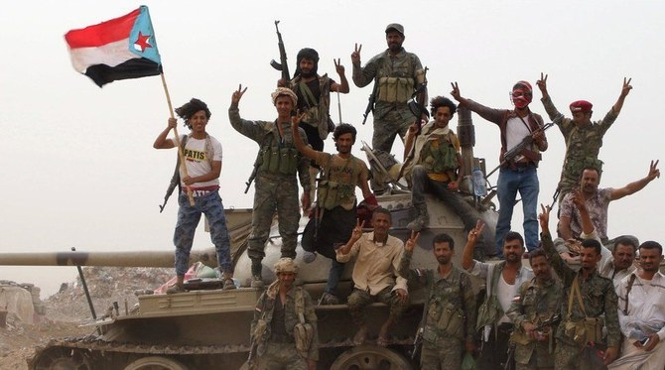
The Southern Movement
Yemeni separatist movement seeking independence for the southern regions of Yemen.
Firstly established after minor protests in 2007, but it traces its origins to the unification of Yemen, the 1994 Civil War and the ”southern grievances that followed”.
After the erruption of the 2015 war, the Southern Movement has joined the fights on the side of the anti-Houthi bloc and was greatly supported by the UAE.
Since 2017 The Southern Transitional Council, one of the many organistations that form the Southern Movement, had gained a prominent position in the organisation, declaring itself its leader.
In 2020 the Southern Transitional Council is a member of Yemen’s new executive body, the Presidential Leadership Council and it will play a pivotal role in the future development.

Slide 10
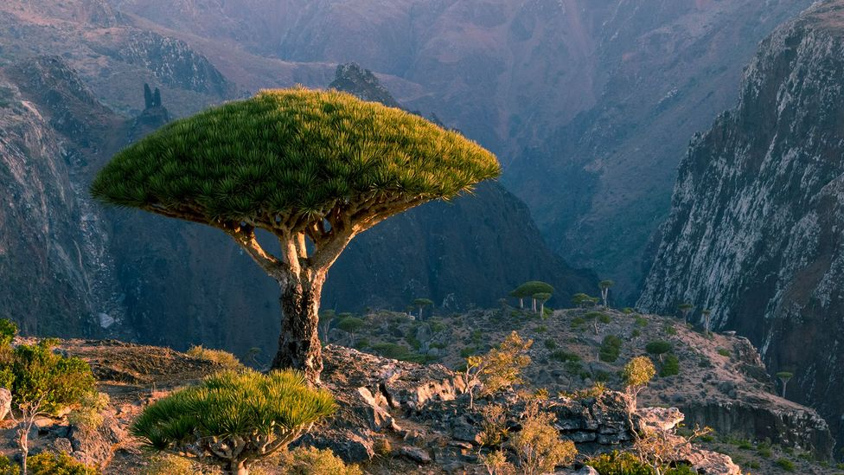
What does the future hold?

Slide 11
Thank you for your attention!

Slide 12
Attributions
Slide 1
A child is rescued from the site of an air strike in Sanaa carried out by the Saudi-led coalition, Khaled Abdullah, Reuters
Image source: https://www.cfr.org/article/saudi-arabias-war-yemen-has-failed
Slide 4
Emblem or quasi-flag of the Houthis, with Arabic text, Abdullah Sarhan
Image source: https://commons.wikimedia.org/wiki/File:Huthi-Logo_in_Jemen.png
The original emblem of the Republic of Yemen, as used by the Government & other state institutions, Rune Agerhus
Image source: https://commons.wikimedia.org/wiki/File:Emblem_of_Yemen_(2).svg
Flag of Saudi Arabia
Image source: https://en.m.wikipedia.org/wiki/File:Flag_of_Saudi_Arabia.svg
Flag of Islamic state also used by al-Qaeda in the Arabian Peninsula
Image source: https://commons.wikimedia.org/wiki/File:AQMI_Flag_asymmetric.svg
Flag of South Yemen
Image source: https://commons.wikimedia.org/wiki/File:Flag_of_South_Yemen.svg
Slide 5
Houthi supporters hold up their weapons during a demonstration outside the US embassy against the US decision to designate the Houthis a foreign terrorist organisation in Sanaa, Yemen on January 18, 2021, Khaled Abdullah
Image source: https://www.aljazeera.com/opinions/2021/1/24/why-the-us-is-wrong-to-designate-the-houthis-as-terrorists

Slide 13
Attributions
Slide 6
Arab coalition soldier patrolling the Saudi border in Yemen, AFP
Image source: https://www.arabnews.com/node/1575111/saudi-arabia
Slide 7
Yemen’s new unity government was sworn in on Saturday before President Abed Rabbo Mansour Hadi in Riyadh, Saba News Agency
Image source: https://www.arabnews.com/node/1783251/middle-east
Slide 8
Yemen’s al-Qaeda
Image source: https://www.vg.no/nyheter/utenriks/i/knEWk/yemen-s-al-qaida-entered-agreement-with-tribal-leaders-not-to-attack-the-west
Slide 9
The STC joined forces with several rival groups to combat the threat posed by Al-Qaeda, Reuters
Image source: https://www.arabnews.com/node/2170576/middle-east
Slide 10
John M Lund Photography Inc
Image source: https://www.bbc.com/travel/article/20211209-the-hermit-of-socotra-island

