Slide 1
PMCb1002 - Academic Writing
Autumn 2023, Class 4 of 6
Structure of an academic paper – part 1

Slide 2
Introduction – why is it so important?
The introduction is not a murder mystery
An opportunity to convince readers that what follows is interesting, competently written, and scientifically sound
Even lazy readers read the introduction so it should state everything they need to know to summarize your work
Frames what is to come

Slide 3
Introduction – a structure to follow
A descriptive preview
A brief exploration of the pre-existing literature/context in which you are embedding your research
A summary of how you will answer your research question and what your findings will tell us about the world in which you are writing

Slide 4
1. A descriptive preview
- You must describe some state of affairs that exists in the world, like a puzzle, unresolved question, pressing current event, conflicting arguments
- In this section, you are literally introducing the research in a compelling way

Slide 5
Example of descriptive preview
Attention on the far-right and its members has long focused on men due to the misogynistic nature of the community. However, recent years' events, such as the 2017 Unite the Right Rally, the 2021 Capitol Hill insurrection, and the ever-creeping rise of female far-right influencers, have made it impossible to ignore the role women play within this community. So far, only 20 out of the 1 000 individuals charged in relation to the Capitol Hill attack of January 6, 2021, have been women (Anderson and McMillan, 2023; CNN, 2021). While they might not have been on the frontline of this specific insurrection, far-right women, especially far-right female influencers, play a crucial role in softening the group's appearance to mainstream communities.

Slide 6
Example of descriptive preview
In parallel, far-right extremists have increased their reliance on audio content to propagate their hateful ideologies – podcasts are inexpensive to create and distribute, and there are no federal regulations compared to broadcast radio, lowering the barrier to entry (Squire and Gais, 2021). Far-right podcasts have seen great success for various reasons, yet a main one is the sheer volume at which they publish new episodes – oftentimes every weekday and even on the weekend – flooding the charts on platforms where the podcasts are available. As of 2021, 41% of Americans had listened to a podcast in the last month, up from 37% in 2020 and 9% in 2008, continuously growing the market of potential listeners (Newman et al., p.28; Pew Research Center, 2021).

Slide 7
2. A brief exploration of literature
- This section includes shortcomings or gaps in past research that your paper will address
- This section is usually where you would include a formal introduction to your research question
- Used to bridge the gap between your first paragraph and a specific literature on the topic

Slide 8
Example of Brief exploration of literature
In their 2019 work, prominent far-right researchers Julia Ebner and Jacob Davey touched upon the importance of women members as recruiters and propagandists for the far-right. Attempting to rebrand itself away from the traditional neo-Nazi movement and closer to patriotism and Identitarian rebels, women have become strong amplifiers of the far-right rhetoric. Indeed, far right groups strategically use women members to soften their image and make their regressive values seem attractive (Ebner and Davey, 2019, p.35). Eviane Leidig adds that "women in far-right extremism serve to legitimize and normalize the movement by presenting it through subtle framing and through content that is assumed to be non-political," an element that is of great use in radicalization (Leidig, 2021a). Nonetheless, although there has been increasing research on women in the far-right, their media presence remains understudied in correlation to their reach.

Slide 9
3. How you will answer your question and what it tells us
- Here, you explain what you will do, what your research will accomplish, and how it will bridge the gap in the available research (short methodology/techniques used)
- There is no mystery here: reveal exactly what you plan to do and what the readers will find.

Slide 10
Example of how you will answer your question and what it will tell us
As podcasts continue to grow in popularity and become a trusted tool for influencers to grow their audiences, this study aims to combine these topics by conducting a discourse analysis of four female podcasts' episodes published within five days of the January 6 insurrection to assess how they shaped the narrative around the riots. First, it examines how female podcasters spoke about the insurrection and determines how they aimed to shape the narrative around it. Second, it seeks to determine if the podcasts serve to legitimize, normalize, and soften the group's image to a more mainstream audience – roles often associated with women in the far-right. Finally, the research aims to determine if far-right female podcasters' can be considered far-right female influencers.
By examining these podcasts, this research seeks to provide a deeper understanding not only of women in the far-right but as thought leaders and prominent figures within their community

Slide 11
Theoretical Background
Summarize what you have learned in your literature review
Compare/contrast authors’ perspectives
Bring together authors who have similar views
Inform the reader which theory you will be following (usually, this gets the longest part of this section) as it should be very clear

Slide 12
Contextual Background
Describe the situation that you are analyzing
The short history of the issue you are tackling
The history can be much longer than the period you are analyzing – focus on what you are writing about

Slide 13
Contextual Background
On January 6, 2021, a joint session in Congress was set to take place in the American Capitol to certify Joe Biden's electoral vote win. Simultaneously, thousands of Donald Trump supporters gathered near the White House to hear him give a speech in which he called for them to "never give up [and] never concede" and for at-the-time Vice President Pence to reject Biden's win. Urging his supporters to go to the Capitol, a heavily armed mob, including members of rightwing extremist organizations such as the Proud Boys and QAnon conspiracy theorists, made their way over, eventually breaking into the building. As Trump, who was not at the Capitol but at the White House, continued to tweet about the so-called fraudulent 2020 elections, the mob aimed to enter the Senate chamber with violent intentions concerning politicians who stood in the way of them reclaiming their country after election fraud. Certain politicians, such as Pence and Pelosi, were evacuated, while other politicians and staff members hid from the rioters who brutally beat police and security officers, broke windows, and vandalized offices.

Slide 14
Contextual Background
The mob severely outnumbered the 1 400 Capitol Police officers, and the National Guard did not arrive for hours 6 after the insurrection had begun. Hours into the riot, Trump finally released a video message telling the mob to go home, without missing the chance to again reiterate that the elections were stolen and to call the rioters great patriots. Two hours after a curfew was set in Washington D.C. by the city's mayor and seven hours after the start of the riot, the U.S. Capitol Police announced that the Capitol building was secure, and the House reconvened to certify Biden's win, rejecting the Republican party's objection that the elections were fraudulent and stolen (Lonsdorf and Doring, 2022; BBC, 2022; Cohen and Lotz, 2022; Duignan, 2023; American Oversight, 2022). Unfortunately, the January 6 attack resulted in the death of at least ten individuals, including mob members as well as police officers who sustained serious injuries from the mob's attacks and two that later died of suicide (Cameron, 2022).

Slide 15
Methodology
Qualitative research methods include:
Case studies – covered in class 2
Ethnography
Content analysis
Discourse analysis
Unstructured interview
Thematic analysis
Triangulation

Slide 16
Ethnography
Related to the field of anthropology
It is the scientific description of the customs of individual peoples and cultures.
Classic example: an anthropologist travelling to an island, living within the society on said island for years, and researching its people and culture through a process of sustained observation and participation.
Netnography: the study of online communities and cultures involving the analysis of data collected from online data sources, such as online forums, social media, and blogs, to gain insights into individuals' behaviors, attitudes, and interactions within those communities.

Slide 17
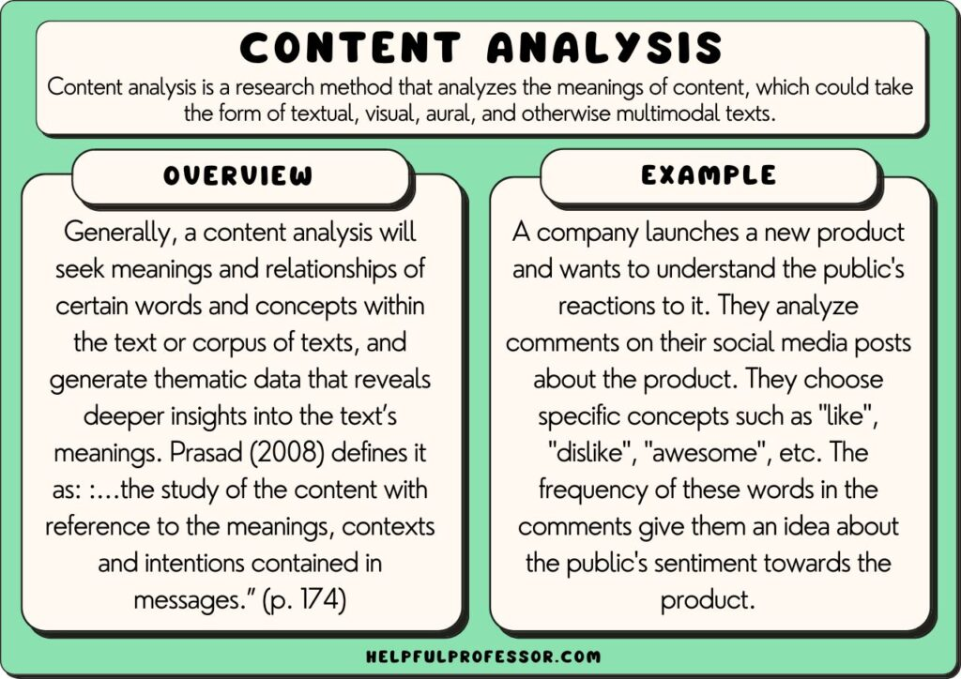
Content Analysis
A research tool used to determine the presence of certain words, themes, or concepts within some given qualitative data.
It provides insight into trends in communication. For example, you could use a discussion forum as the basis of your analysis and look at the types of things the members talk about and how they use language to express themselves.
Mostly used for written content.

Slide 18
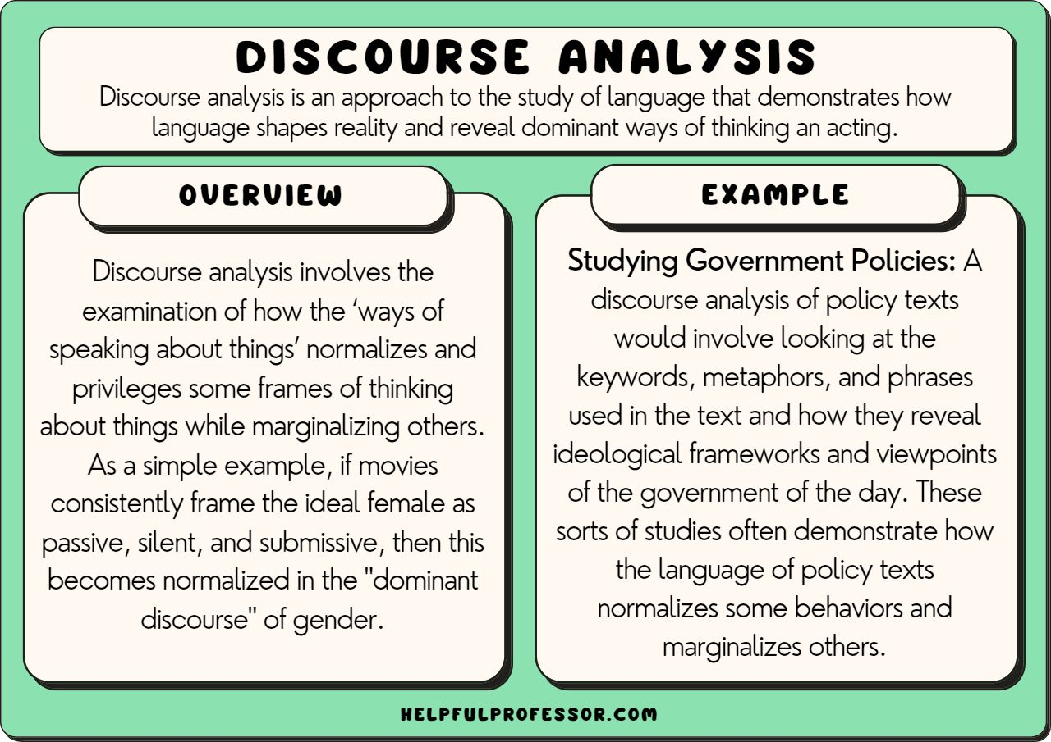
Discourse Analysis
Similar to content analysis, but it also takes into account the linguistic content and their sociolinguistic context
Useful when analyzing audio and video content, but can also be used for written content
Can also include an analysis of how the person is speaking/communicating the content: speech patterns, emphasis on words, turn talking, monologue, etc

Slide 19
Unstructured Interviews
- Unfolds like a conversation with no agreed-upon order for questions
- You obviously have a general topic to cover
- Might have a few specific questions, but you see where the interviewee takes the conversation
Advantages | Disadvantages
Interviewee feels more comfortable | More difficult to analyze
Deep-dive into the topic | Time-consuming
Discover pathways you might not have considered | Susceptible to biases

Slide 20
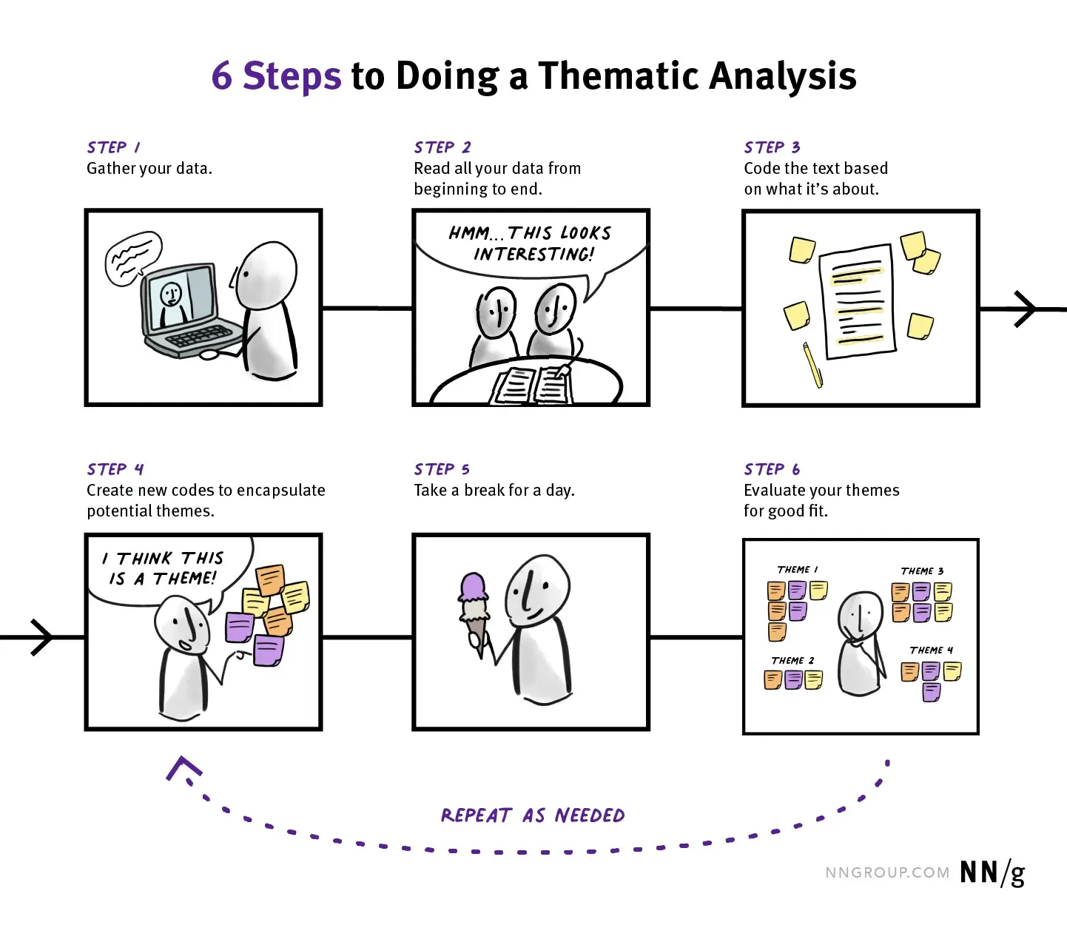
Thematic Analysis
Patterns in text, audio, or videos
Extract main themes from various data sets

Slide 21
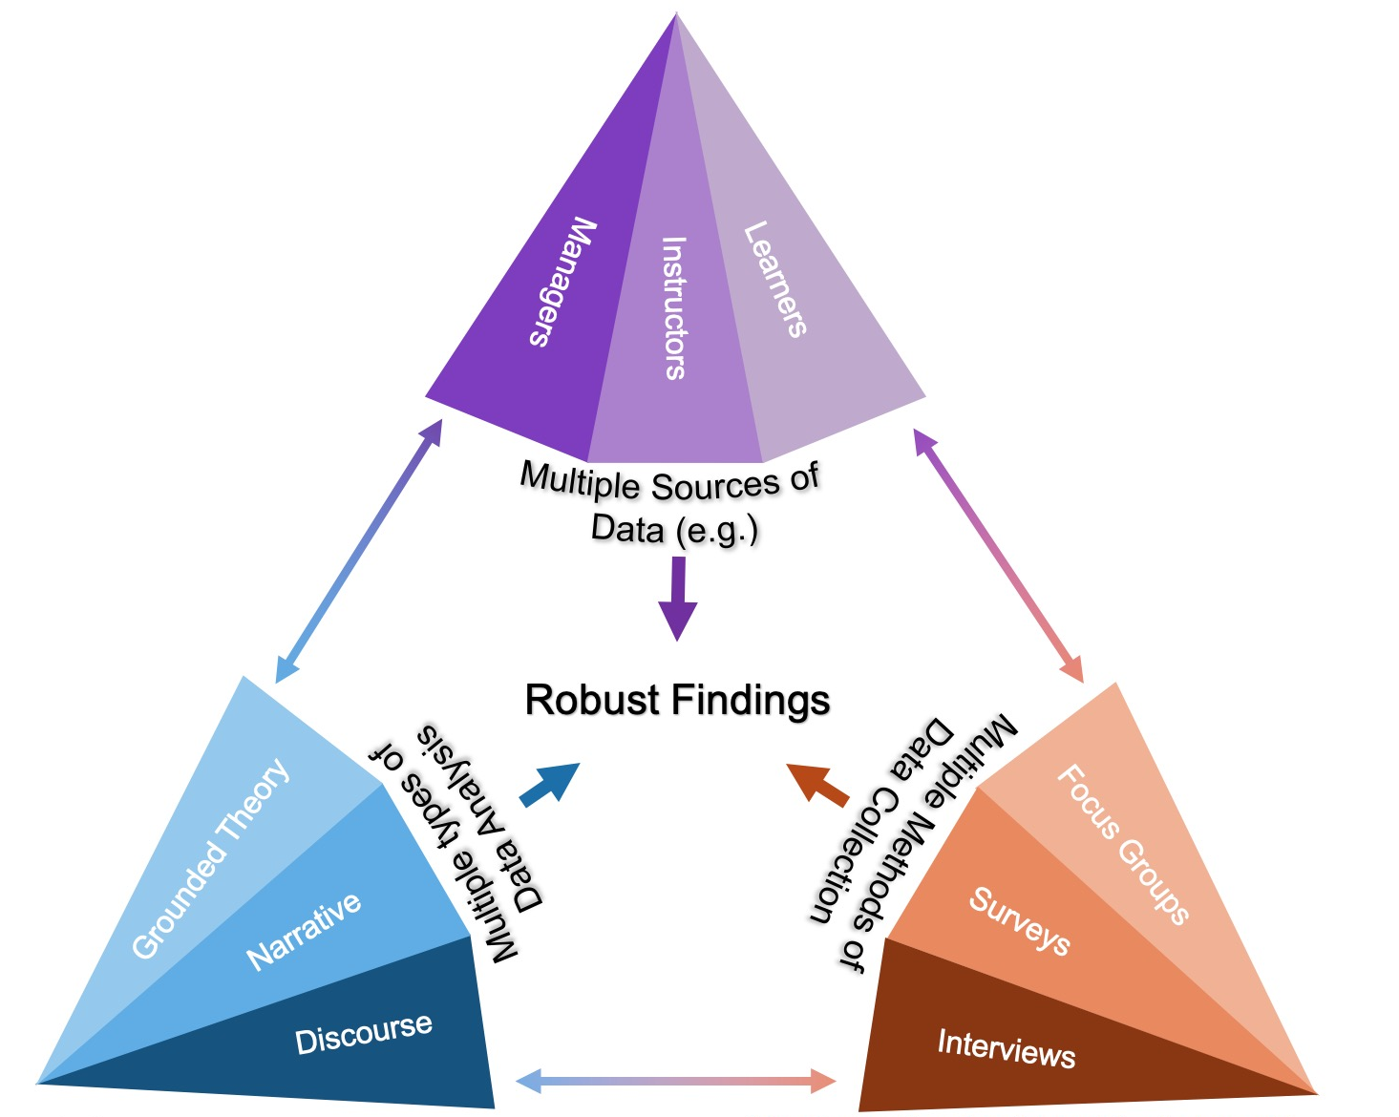
Triangulation
- The mixing of data or methods so that diverse viewpoints cast light upon a topic
- Using multiple datasets, methods, theories, and/or investigators to address a research question. It’s a research strategy that can help you enhance the validity and credibility of your findings and mitigate the presence of any research biases in your work

Slide 22
Methodology
Quantitative research methods include:
Surveys
Correlation
Data analysis
Statistical interference
Linear regression
Experiments
Sampling

Slide 23
Surveys
Collection of information from a sample of individuals
Very difficult to get a representative sample, ex: “100 Americans between the ages of 18-25 answered this online survey” – but what about those who aren’t online?
A randomized sample is also possible
Common method, easier for analysis: Likert-scale
Are people always honest?

Slide 24
Analysis
Once you have conducted your research (the process of investigating a topic in an in-depth, systematic manner), you will then have to analyze that research to examine its implications and support a defensible claim about the topic
Present the information with:
Your main point
The evidence used to support your main points
The credibility of your evidence
Potential biases?
The implications of the information
It can be divided into various sub-sections/categories

Slide 25
Analysis
For example, if you analyze the role of the mother in the ancient Egyptian family:
You could break down that topic into its parts - the mother's duties in the family, social status, and expected role in the larger society - and research those parts in order to present your general perspective and conclusion about the mother's role.

