Slide 1
PMCb1002 - Academic Writing
Autumn 2023, Class 6 of 6
Editing your work, giving and receiving feedback

Slide 2
Research Paper Structure
0. Title, Abstract, and Keywords
While this belongs at the beginning of a paper, it is done at the end
The title should be catchy and informative
The abstract tells readers everything about your paper
About 5 keywords that represent your paper

Slide 3
Research Paper Structure
1. Introduction that contains:
A descriptive preview
A brief exploration of the pre-existing literature/context in which you are embedding your research
A summary of how you will answer your research question and what your findings will tell us about the world in which you are writing

Slide 4
Research Paper Structure
2. Theoretical background:
Your papers always need to follow a theoretical framework that connects your research to existing knowledge
It gives you a basis for your hypotheses and choice of research methods
It guides your analyses by suggesting concepts and relationships to explore

Slide 5
Research Paper Structure
3. Contextual background:
Describe and give context to the situation that you are analyzing
The short history of the issue you are tackling
The history can be much longer than the period you are analyzing – focus on what you are writing about

Slide 6
Research Paper Structure
4. Methodology:
Quantitative or qualitative
Explain the approach you chose
Describe how you collected the data you used
Explain the methods you used to analyze the data you collected
Evaluate and justify the methodological choices you made
This allows readers to check whether your approach is accurate and dependable

Slide 7
Research Paper Structure
5. Analysis:
Once you have conducted your research, you will then have to analyze it to examine its implications and support a defensible claim
Provide the main points, the evidence used to support each, and the credibility of your evidence
Explain potential biases
Describe the implications of the information
It can be divided into various sub-sections/categories

Slide 8
Research Paper Structure
6. Findings:
It can be its own section, or it can be in the analysis or in the conclusion
Findings may be reported in written text, tables, graphs, and other illustrations
Include a contextual analysis of the data by tying it back to the research question(s)

Slide 9
Research Paper Structure
7. Discussion:
Not always necessary on its own. Can be part of the conclusion
This section connects your results to previous research studies, makes explicit connections back to your research question(s) and includes an explanation about how the results might be generalized
Can also include an analysis of any unexpected findings, with a description of the unexpected finding, a brief interpretation as to why you believe it appeared and, if necessary, its possible significance in relation to the overall study

Slide 10
Research Paper Structure
8. Conclusion:
Clearly states the answer to your main research question with a short summary of the research process
Counter-arguments (if available): what are the main objections to your research, and can you defend your thesis from them?
Make recommendations for future work on your thesis or dissertation topic
Show what new knowledge you have contributed to your field

Slide 11
How to edit your work
Reread the requirements and make sure you have everything requested
Print it out
Read it out loud
Give it time before you go back to it
Make yourself a checklist of necessary items
Use software like Grammarly
Fact check and ensure you have proper citations

Slide 12
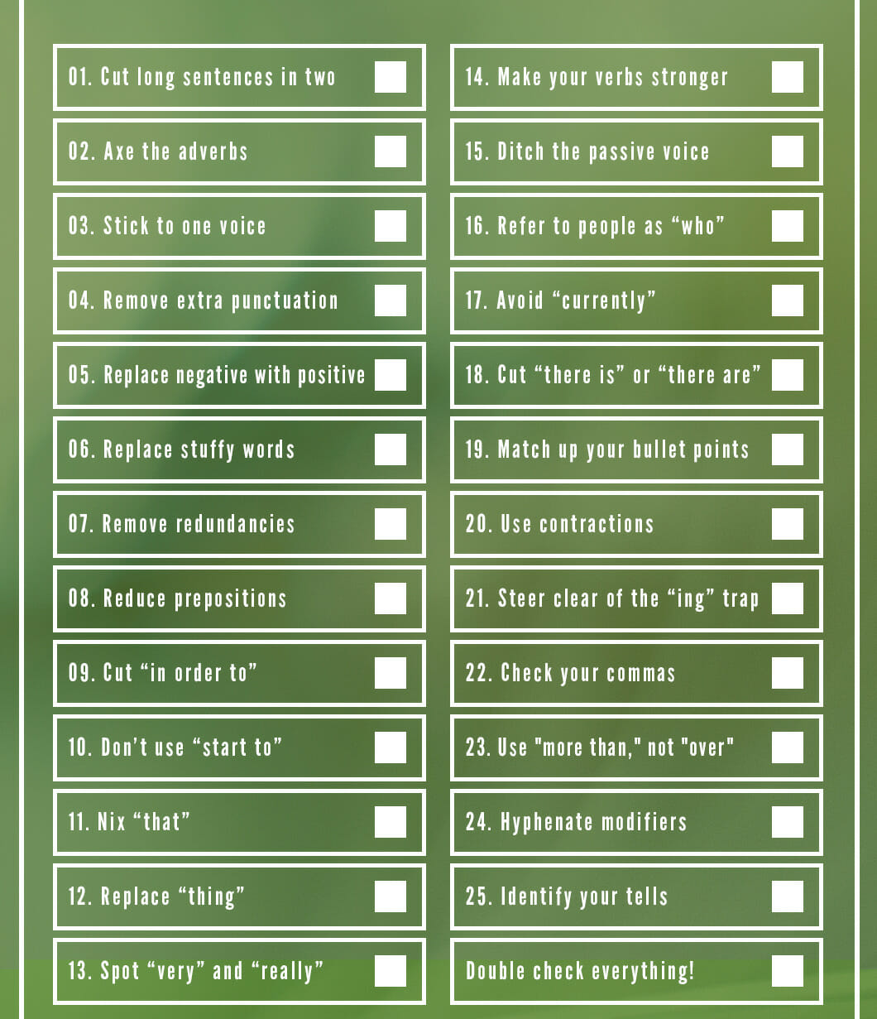
Here are a few ways to strengthen your writing
I often read from the end to the beginning so the paragraphs are stand-alone items

Slide 13
Giving Feedback
Be kind and diplomatic
Read through the whole text first
Be as specific as possible with the feedback and offer advice
Comments should be actionable
Quality > quantity
Proofreading is different from editing
Share your tips and ideas

Slide 14
Receiving Feedback
You can ask for feedback at any stage of your writing or research and specify on what you want feedback
The person providing feedback means well
The amount of feedback will vary
You do not have to follow everything the reviewer has suggested
If you do not understand some comments, ask!

Slide 15
Receiving Feedback
Use the feedback for other papers to develop better writing and research techniques
Save a copy of your original work before editing
Feedback, especially before you submit your final work, are much more important than the grade
For this class, once your final paper is submitted, you cannot resubmit ☺
Masaryk University Writing Lab

