Slide 1
Data Visualization

Slide 2
My background
Geography and Cartography
Statistical analysis
Political Science
It has serious consequences for the course
  Visualization of spatial data will be included
  The basic statistics will be neccessary
    It may seem to be a bit complicated
    Issue of „design“ will be almost neglected
    I am not familliar wit up to date journalist practices

Slide 3
Overview of course
Several blocs:
  Data preparation
  Univariate visualization
  Visualization of relationship
  Visualization of time data
  Visualization of spatial data
  Visualization of text data
  Presentation of visualizations
  ASSIGNEMENTS!!! (8 for 60 points)
  Final assignement

Slide 4
Final assignement
Goal is to provide to vizualize some (important) topic
Prefarably using somethnig from content of course
It is important for final grade
40 points (total is 100)

Slide 5
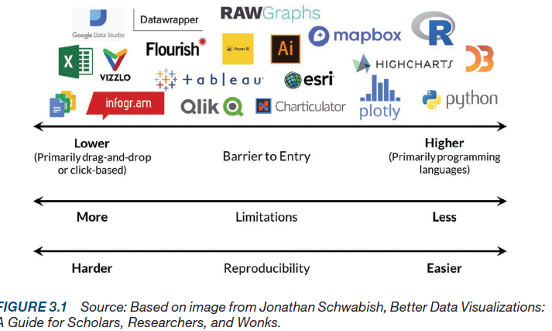
Used software

Slide 6
Introduction

Slide 7
Visualization as academic discipline
  Theories
  Methods
Visualization as daily practise
  How to make a chart from some data

Slide 8
Visualization as communication tool
Way how to communicate
  Who is talking?
  Who is listening?
  What is the message?
    Issue
    Time
    Space
    Kind of data
  What is a channel?
    Internet
      Static
      Dynamic
    Paper

Slide 9
How visualization works?
Data > „some work“ > picture
Something important is missing!
  STORY TO TELL!!!
Visual abstraction
  Selection of „telling“ characteristic of data
Comparison
  To give a meaning to certain value

Slide 10
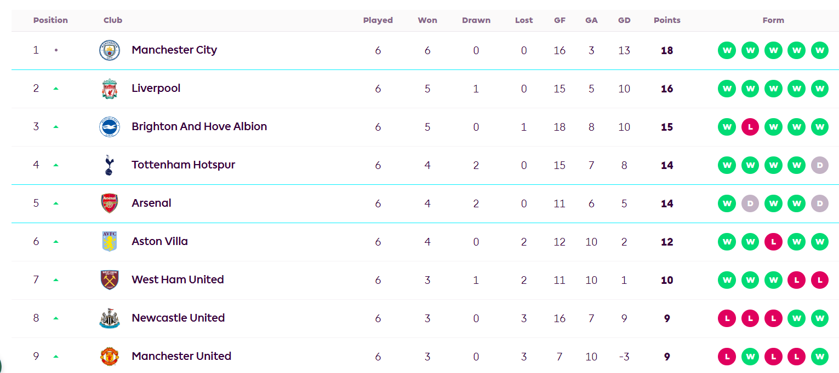
Data
Information
In form of table
Metadata: information about data
Row = case
Column =
variable
  Name
  Order
  Number

Slide 11
Data
Individual
  Data are measured on given level
  Citizens in opinion polls
  MPs
  Books, movies, …
Aggregated
  Census
  Registers
It is not characteristics of unit
    Year of establishing of municipality (individual)
    Unemployment in municipality (aggregate)

Slide 12
Most important typology
Sample
  Selection from population
  Surveys
  There is some uncertainty!
Population
  All cases are covered
  Selection is not „random“

Slide 13
Data sources
General data about world
UN: https://unstats.un.org/unsd/demographic-social/products/
UNESCO: https://uis.unesco.org/
ILO: https://ilostat.ilo.org/data/
FAO: https://www.fao.org/faostat/en/#home
WTO: https://stats.wto.org/
WB: https://databank.worldbank.org/
IMF: https://www.imf.org/en/Data
WHO: https://www.who.int/data
OECD: https://stats.oecd.org/
Useful links: ourworldindata.org, www.worldometers.info, www.statista.com

Slide 14
Politics
Freedomhouse: https://freedomhouse.org/report/freedom-world
  Democracy index
Parlgov: https://www.parlgov.org/data-info/
  Political parties – mostly Europe
Idea: https://www.idea.int/data-tools
  Various issues
CHES: https://www.chesdata.eu/
  Party positions in Europe and Latin America
Electoral manifesto: https://manifesto-project.wzb.eu/datasets

Slide 15
Electoral data
Electoral results:
  https://electiondataarchive.org/data-and-documentation/
  http://psephos.adam-carr.net/indexes/index_a.shtml
Integrity: https://www.electoralintegrityproject.com/data-1
Comparative surveys:
  https://cses.org/data-download/download-data-documentation/election-studies/
  https://u.osu.edu/cnep/surveys/surveys-through-2012/
Studies from various countries:
  https://search.gesis.org/

Slide 16
Barometer
Europe, Africa, Latin America, Asia
Comparative data
Various quality, timing and scope
Europe: https://www.gesis.org/en/eurobarometer-data-service/home
Africa: https://www.afrobarometer.org/data/data-sets/
Asia: https://www.asianbarometer.org/datar?page=d10
Latin America: https://www.latinobarometro.org/latContents.jsp

Slide 17
Comparative Projects
International Social Survey Programme
  Role of Government, Social Networks and Inequality, Family, Gender Roles, Work, Religion, Environment, National Identity, Leisure Time, Health
  https://issp.org/data-download/by-year/
World Values Survey
  Wide set of countries, various issues
  https://www.worldvaluessurvey.org/WVSContents.jsp
  + European Values Survey
European Social Study
  https://ess-search.nsd.no/

Slide 18
Public Opinion Survey Data
World
  https://ukdataservice.ac.uk/help/other-data-providers/data-archives/other-worldwide-data-archives/
  https://www.pewresearch.org/tools-and-resources/
Europe
  https://www.cessda.eu/About/Consortium
  https://datacatalogue.cessda.eu/
Czech
  http://nesstar.soc.cas.cz/webview/

Slide 19
Parliaments
IPU: https://data.ipu.org/content/parline-global-data-national-parliaments
EP: https://data.europarl.europa.eu/en/home
Czech: https://www.psp.cz/sqw/hp.sqw?k=1300

Slide 20
Media
Media monitor (only Czech) https://ezdroje.muni.cz/prehled/hledej.php?dotaz=newton+media&lang=cs

Slide 21
Searching on google
" " – exact combination of words
OR - logical or
"data about media" OR "data about culture" – pages containg first or second or both statements
And - Logical and
"data about media" OR "data about culture" – only pages containg both statements
- Minus "data about media" –culture – ony pages containing "data about media" without mentionining culture
* asteriks " data about * " – data about anything.
() – gives priority to certain word
"data about culture" 2016..2020 – two dots represents number line (2016, 2017, 2018, 2019, 2020), works in same sense as OR
filetype:xlsx (other options pdf, doc, xls, docx)
site:unstats.un.org - searching on given page site:unstats.un.org

Slide 22


