Slide 1
Visualization of relationship between variables

Slide 2
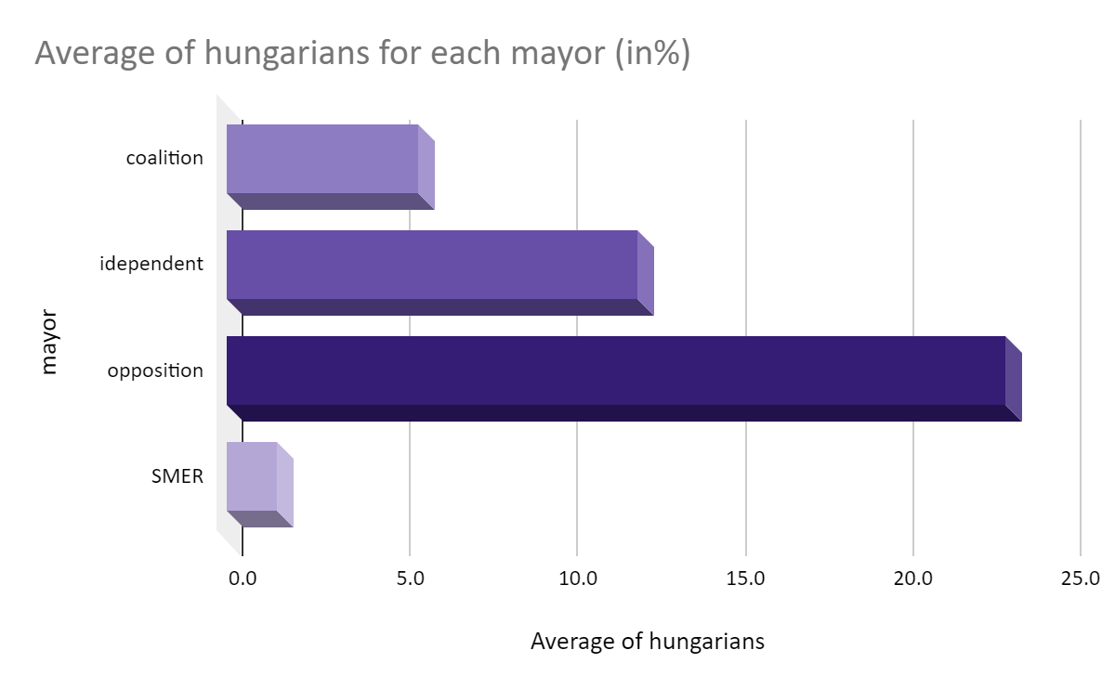

Slide 3
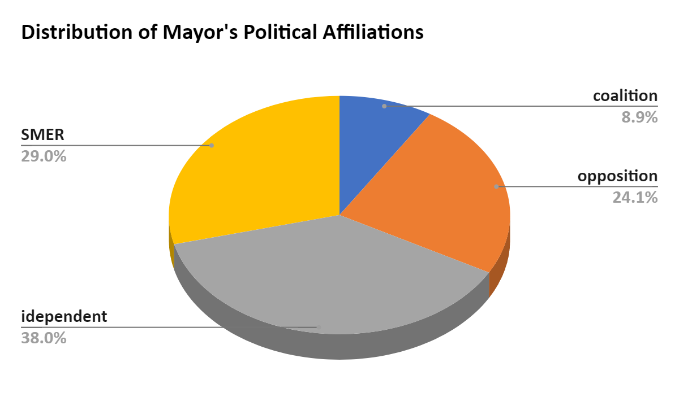

Slide 4
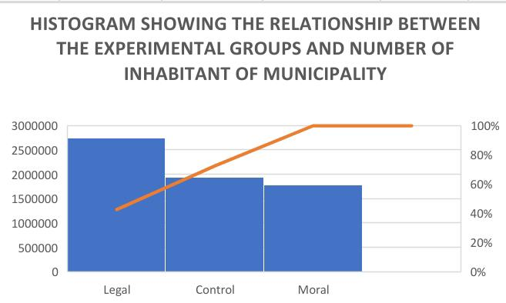
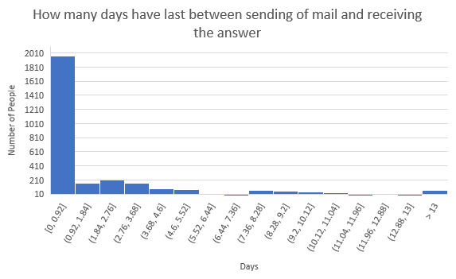
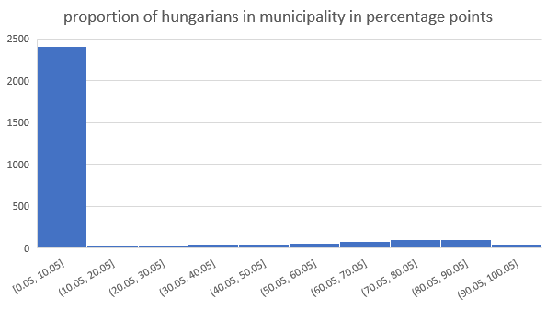
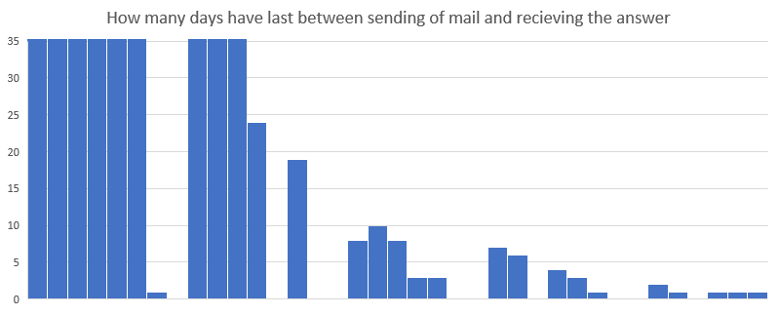

Slide 5
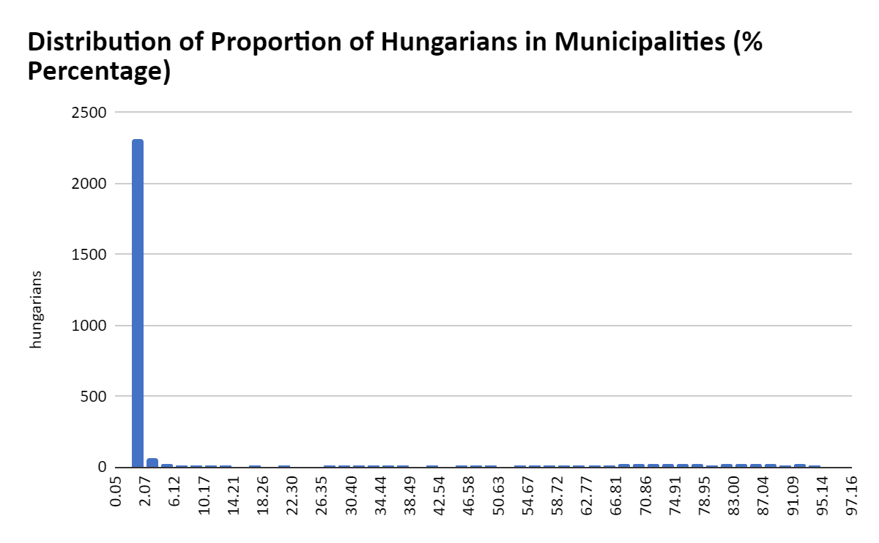

Slide 6
Two types of relationship
Correlation – two things are going together
Causation – one thing causes the second one
  Only advanced methods can reveal causation
Correlation ≠ Causation

Slide 7
Combinations of variables
Categorical x categorical – stacked bar chart, series of pie charts
Categorical x cardinal – set of boxplots
Cardinal x cardinal - scatterplot

Slide 8
How to recognize relationship
Categorical x categorical – charts are different for each category
Categorical x cardinal – charts are different for each category
Cardinal x cardinal – there is some pattern in scatterplot

Slide 9
=countif
=COUNTIFS(B:B; 1;C:C;1)
Same logic for sumif, averageif, etc
One condition ….IF
More condition …IFS
Column with variable survival
Only rows where survival = 1 are counted
Only rows where Pclass = 1 are counted
Column with variable Pclass

Slide 10
Bar chart

Slide 11
Stacked bar chart

Slide 12
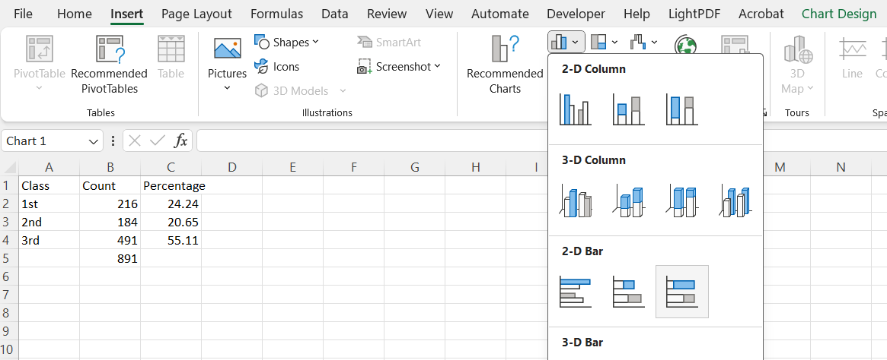
Stacked bar plot

Slide 13
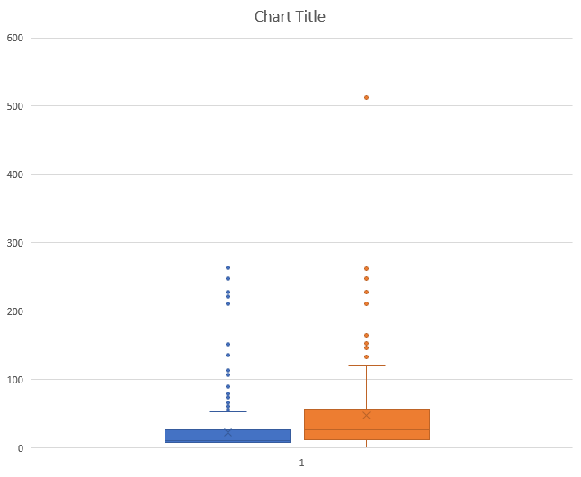
Set of boxplots

