Slide 1
Vizualization of Time Data

Slide 2
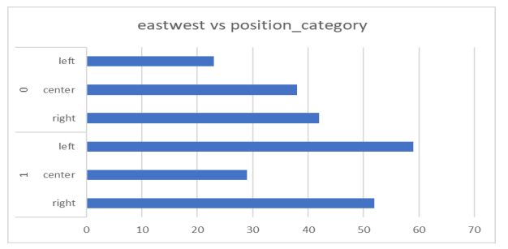
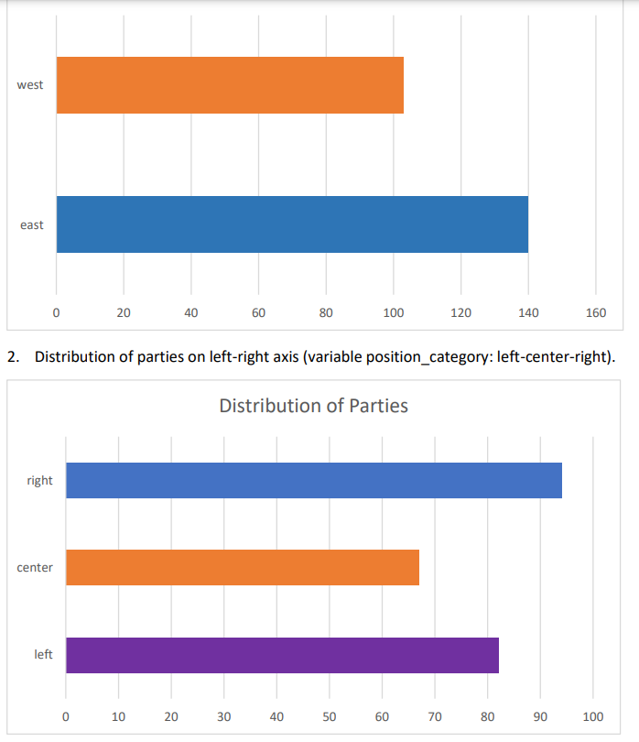
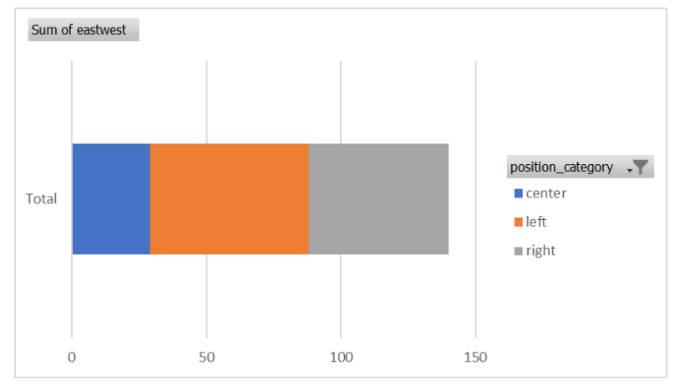
relationship between European regions (variable eastwest) and distribution of parties on left-right axis

Slide 4
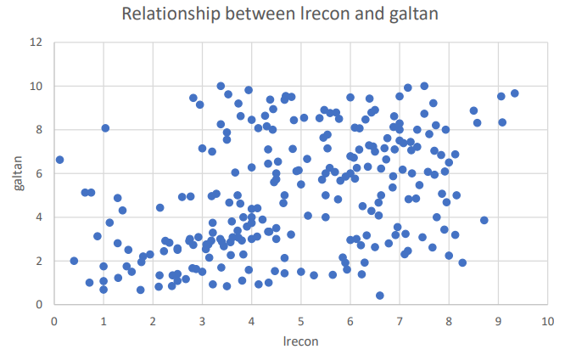
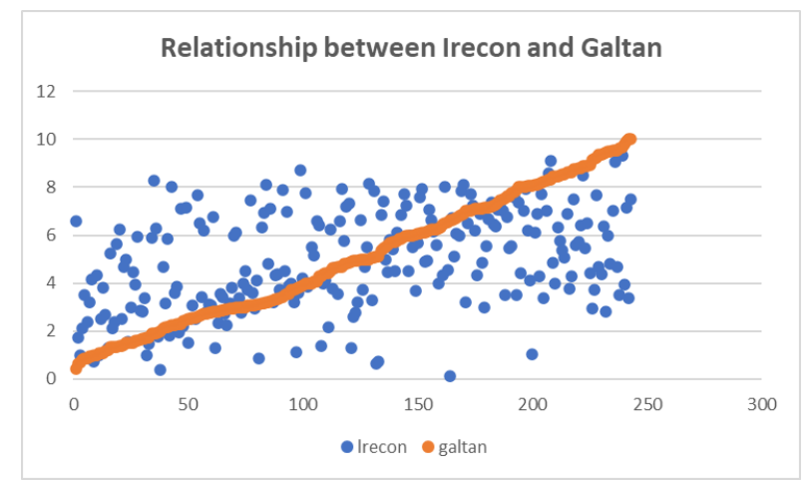
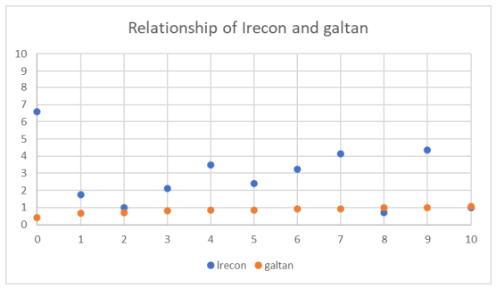
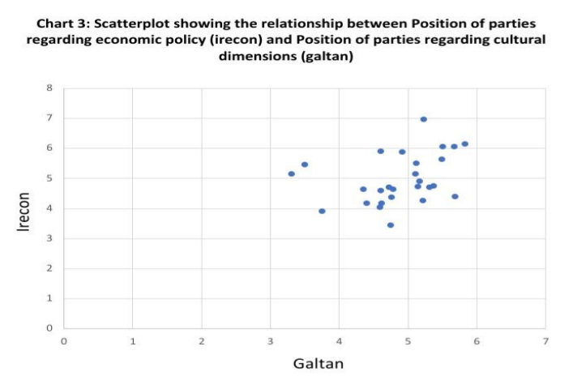
Show the relationship between lrecon and galtan

Slide 5
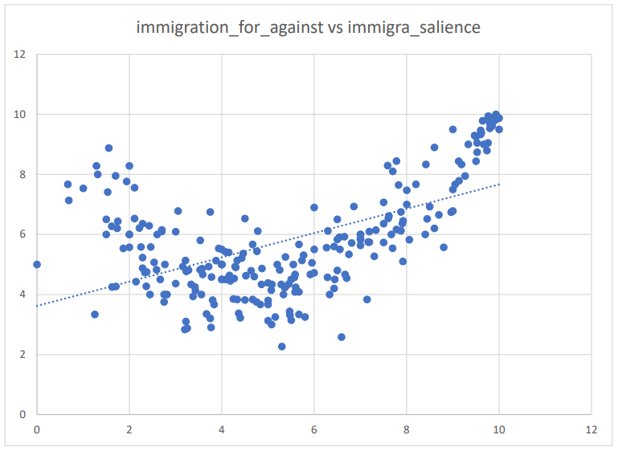

Slide 6
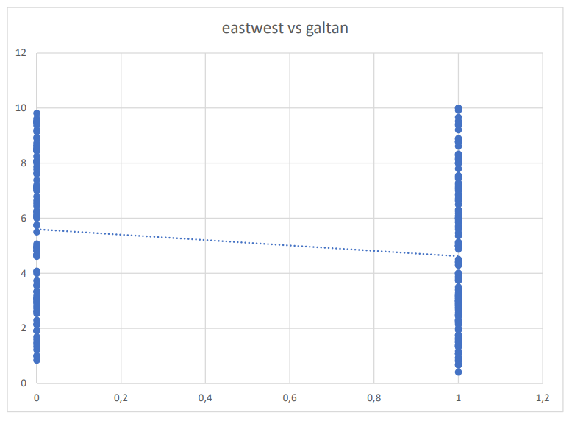
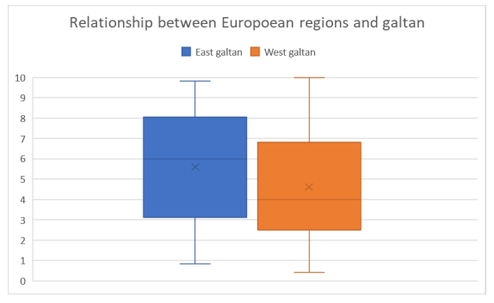

Slide 7
Continuity - temperature, party support
Discontuinity – elections
Data: Annualy, monthly, daily, (hours, minutes, seconds)
  Iregular: elections, exams, conflicts
Easy to find spurios correlation

Slide 8
Three elements of Time Data
Trend – the overal direction of evolution
  E.g. Global warming, increasing prices
Seasonality – regular changes in data
  Wheather, unemployment, activity during day
White noise

Slide 9
Trend
Usually the most important things
Allows us to say what is happening
Forecast (be cautius with that)
The main source of spurious correlation

Slide 10
Seasonality
Usually the most anoying aspect of time data
The solution is to look on the whole season
  The detail is lost in such case

Slide 11
White noise
Important when we want to see impact of some event
Make the general information hard to see
Moving average – replace current value by average of neighbouring values
  Usualy 3, 5 or 7
  Depends on data (e.g. Monthly temperature)

Slide 12
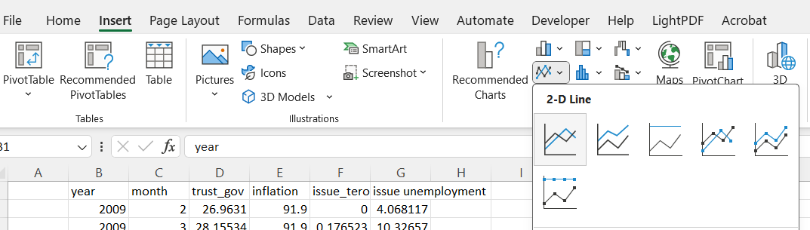

Slide 13
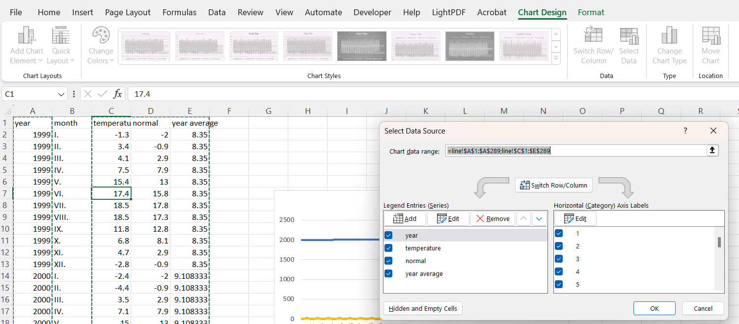

Slide 14
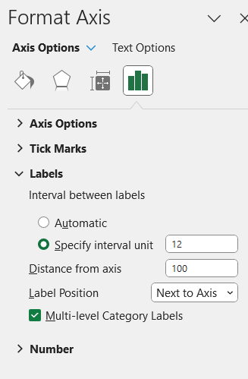

Slide 15
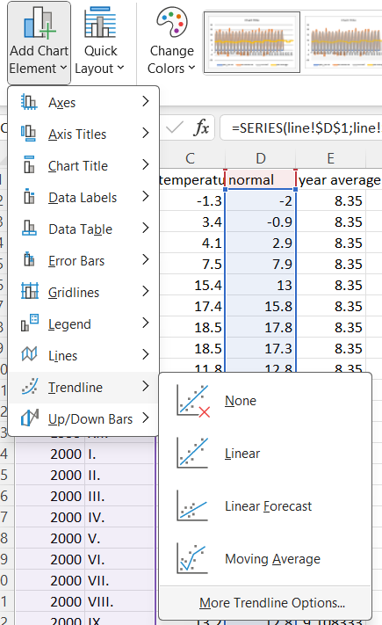
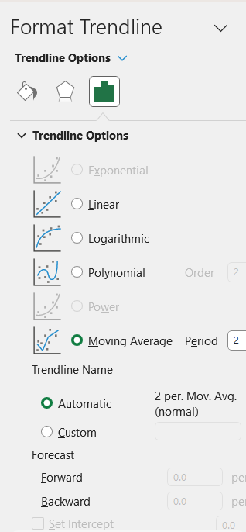

Slide 16
