Slide 1
Data Vizualization
Univariate vizualizations

Slide 2
Univariete = only one variable is visualized
Different ways of visualizations for different data types
Categorical – comparing categories (bar chart)
  Fraction – value relative to the whole (pie charts)
Cardinal – distribution = „spread of data“ (histogram, box plot)

Slide 3
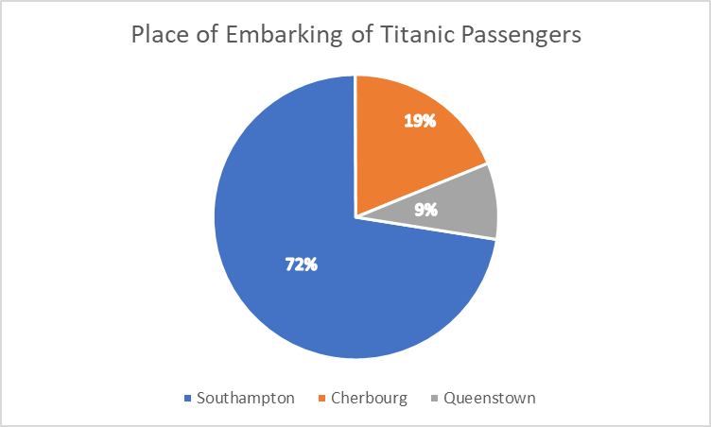
Pie chart
Only small number of categories (max about 7)
Not very informative when all slices are of similar size
Only when it is part of whole

Slide 4
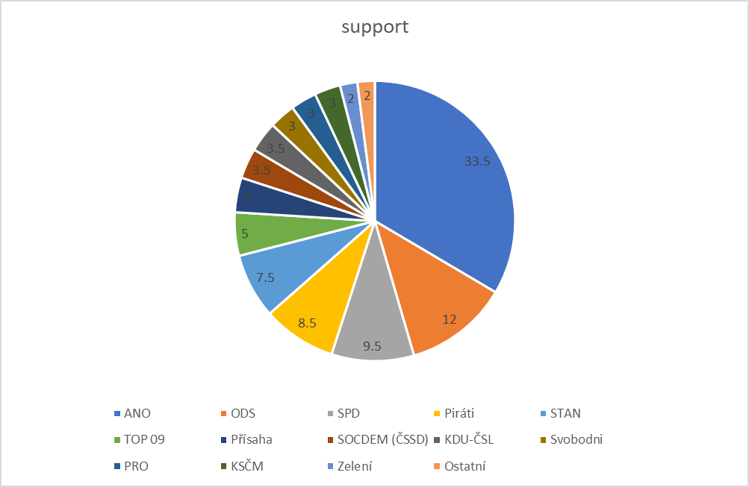
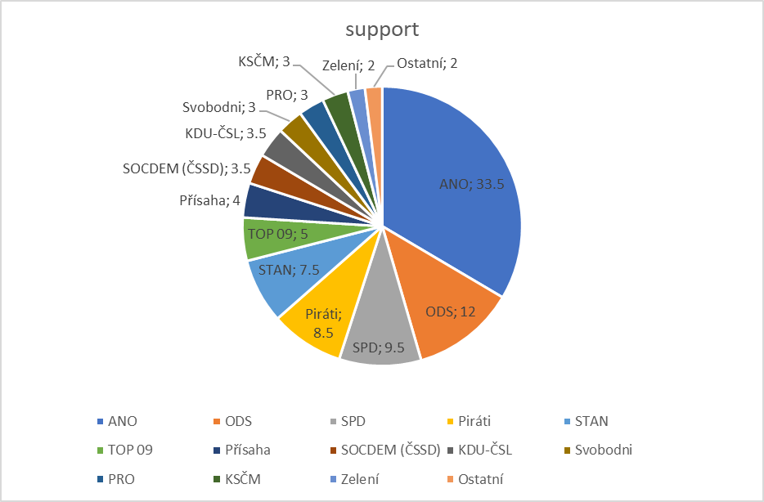

Slide 5
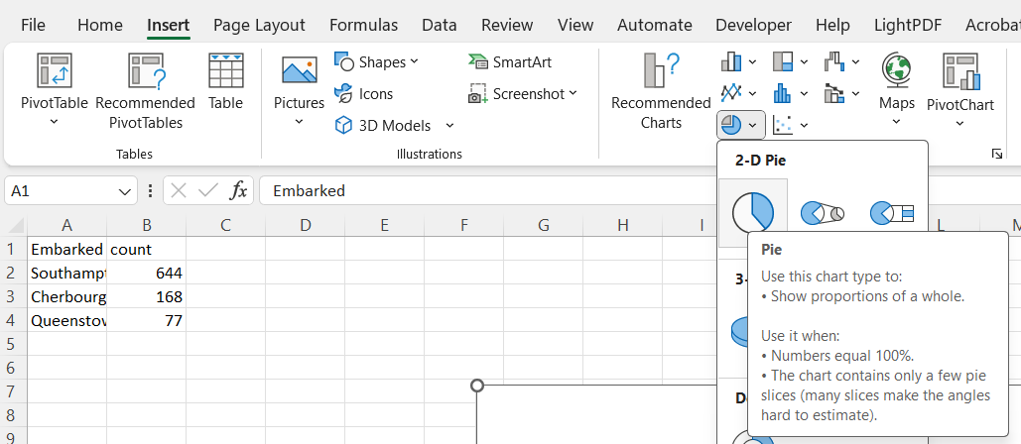
Making of pie chart
Counts for categories are needed

Slide 6
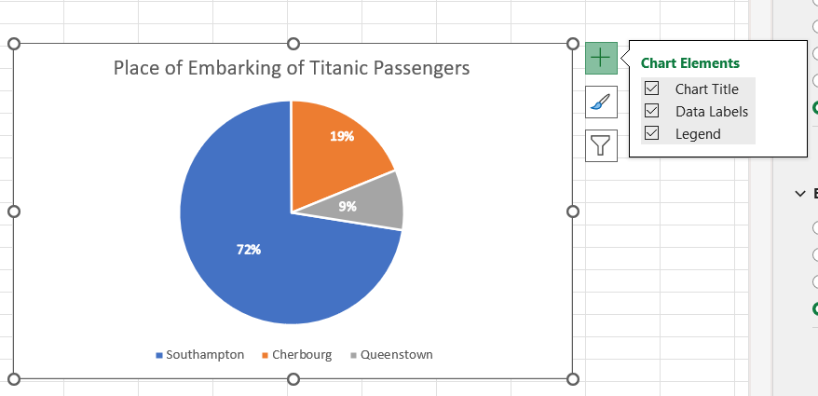

Slide 7
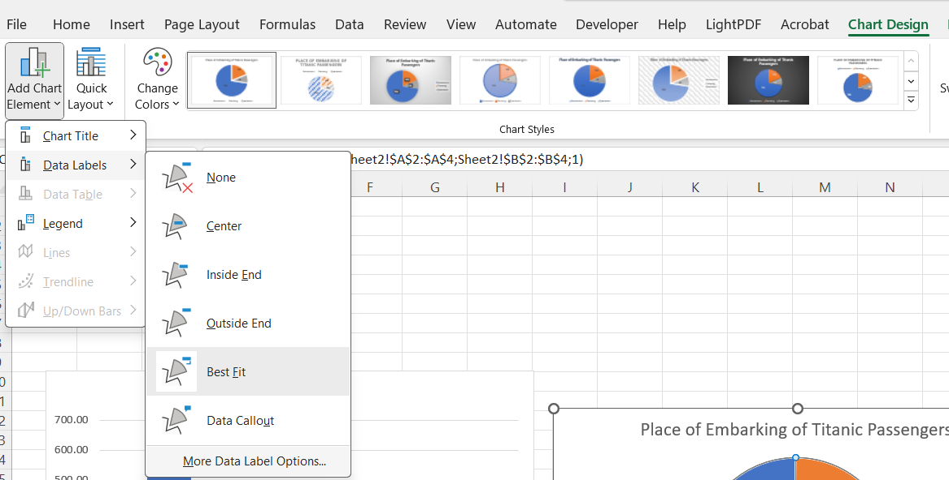
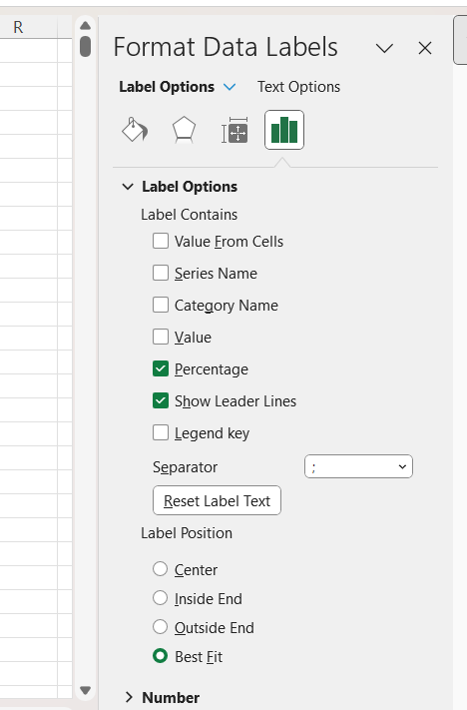

Slide 8
Bar chart
Useful for almost any situation
Base for numerous other charts
Very easy for interpretation
Unlimited number of categories
  (then it is turned into histogram)

Slide 9
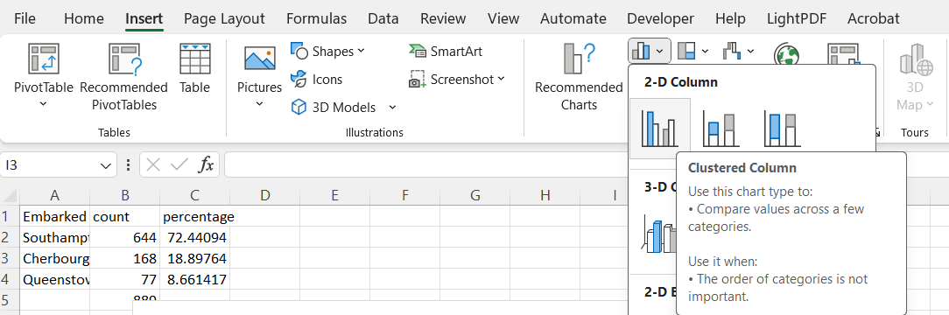

Slide 10
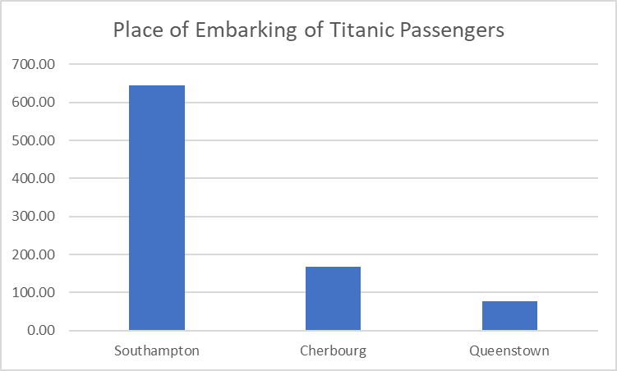
If we want percentages, we have to calculate them

Slide 11
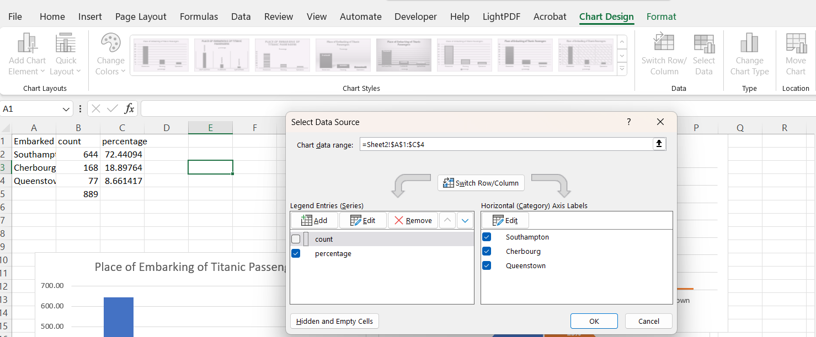

Slide 12
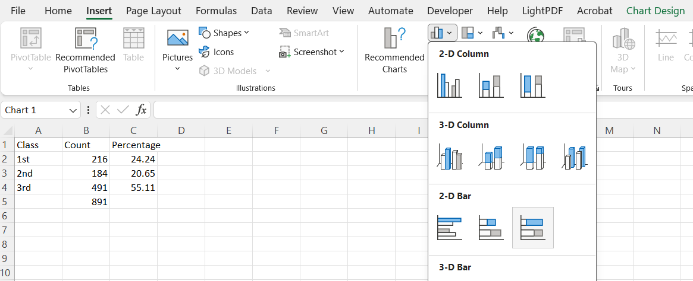
Stacked bar plot

Slide 13
Stacked bar plot

Slide 14
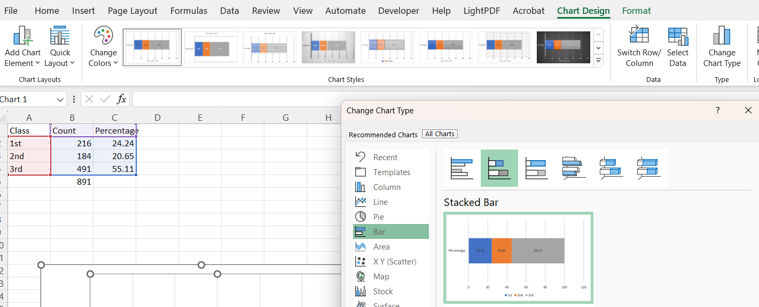

Slide 15
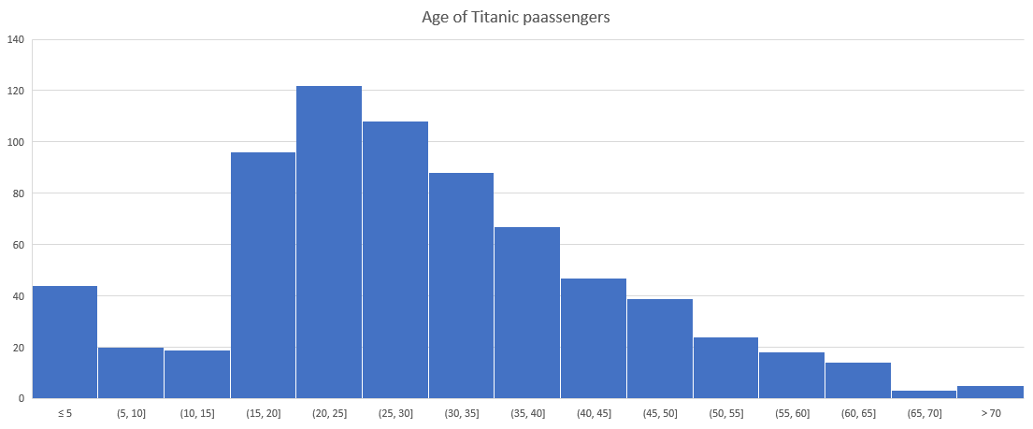
Histogram

Slide 16
Avoid the usage of 3D versions
  They can be very misleading
Always make titles, subtitles and labels as parsimonous as possible
  (parsimony means to be maximally simplistics and maximally informative simultaneously)

