Slide 1
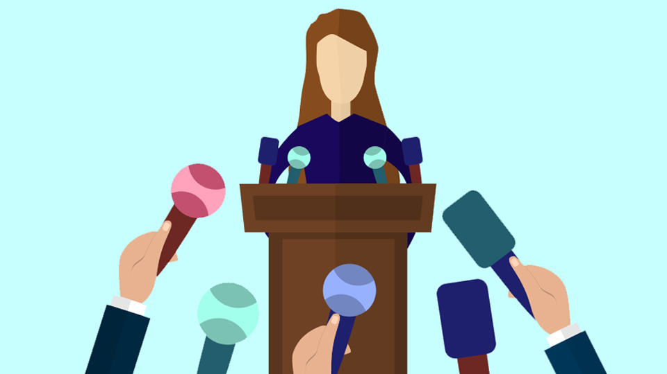
When Women Run:
Campaigns, Candidates, and Voters
Fall 2023

Slide 2
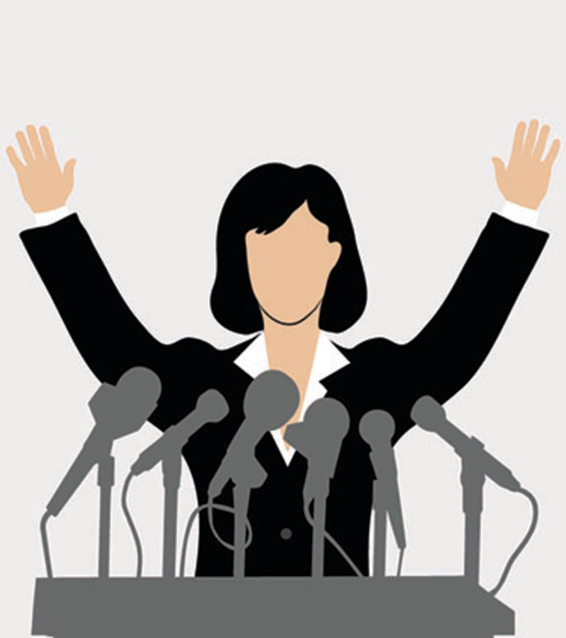
Today‘s question:
Do voters discriminate female candidates?
What is the role of gender stereotypes in campaigns?
How do candidates communicate their campaigns?

Slide 3
We spoke about
Gendered patterns in political participation
Barriers to women‘s candidacy
But what happens when women decide to run?
Do voters discriminate against women?????
Do media discriminate against women?????

Slide 4
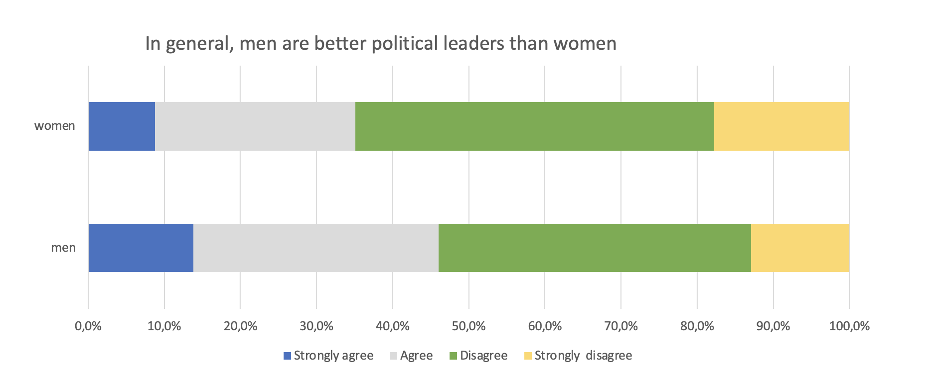
Is there an anti-woman bias in elections?
How would we measure this?
Which systems are more open to such effects?
European Value Study, Czech Republic 2017

Slide 5
Direct hostility
Public openly hostile against women in politics
Might apply for some contexts (conservative ideology or sexism)
Experimental research (CVs, applications etc.)
Hostility in different fields (even academia)
Several prominent authors suggests that this has been decreasing in politics
Sarah Fulton 2012: no bias detectable because women candidate samples in the studies suffer from selection bias

Slide 6
Direct hostility: sexism
Different types
Hostile sexims
Benevolent sexism

Slide 7
Hostile sexism scale
Many women are actually seeking special favors, such as hiring policies that favor them over men, under the guise of asking for “equality.”
Most women interpret innocent remarks or acts as being sexist.
Women are too easily offended.
Feminists are not seeking for women to have more power than men.*
Most women fail to appreciate fully all that men do for them.
Women seek to gain power by getting control over men.
Women exaggerate problems they have at work.
Once a woman gets a man to commit to her, she usually tries to put him on
When women lose to men in a fair competition, they typically complain about being discriminated against them.
There are actually very few women who get a kick out of teasing men by seeming sexually available and then refusing male advances.*
Feminists are making entirely reasonable demands of men.*

Slide 8
Benevolent sexism scale
No matter how accomplished he is, a man is not truly complete as a person unless he has the love of a woman.
In a disaster, women ought not necessarily to be rescued before men.*
People are often truly happy in life without being romantically involved with a member of the other sex.*
Many women have a quality of purity that few men possess.
Women should be cherished and protected by me.
Every man ought to have a woman whom he adores.
Men are complete without women.*
A good woman should be set on a pedestal by her man.
Women, compared to men, tend to have a superior moral sensibility.
Men should be willing to sacrifice their own well-being in order to provide.
Women, as compared to men, tend to have a more refined sense of culture

Slide 9
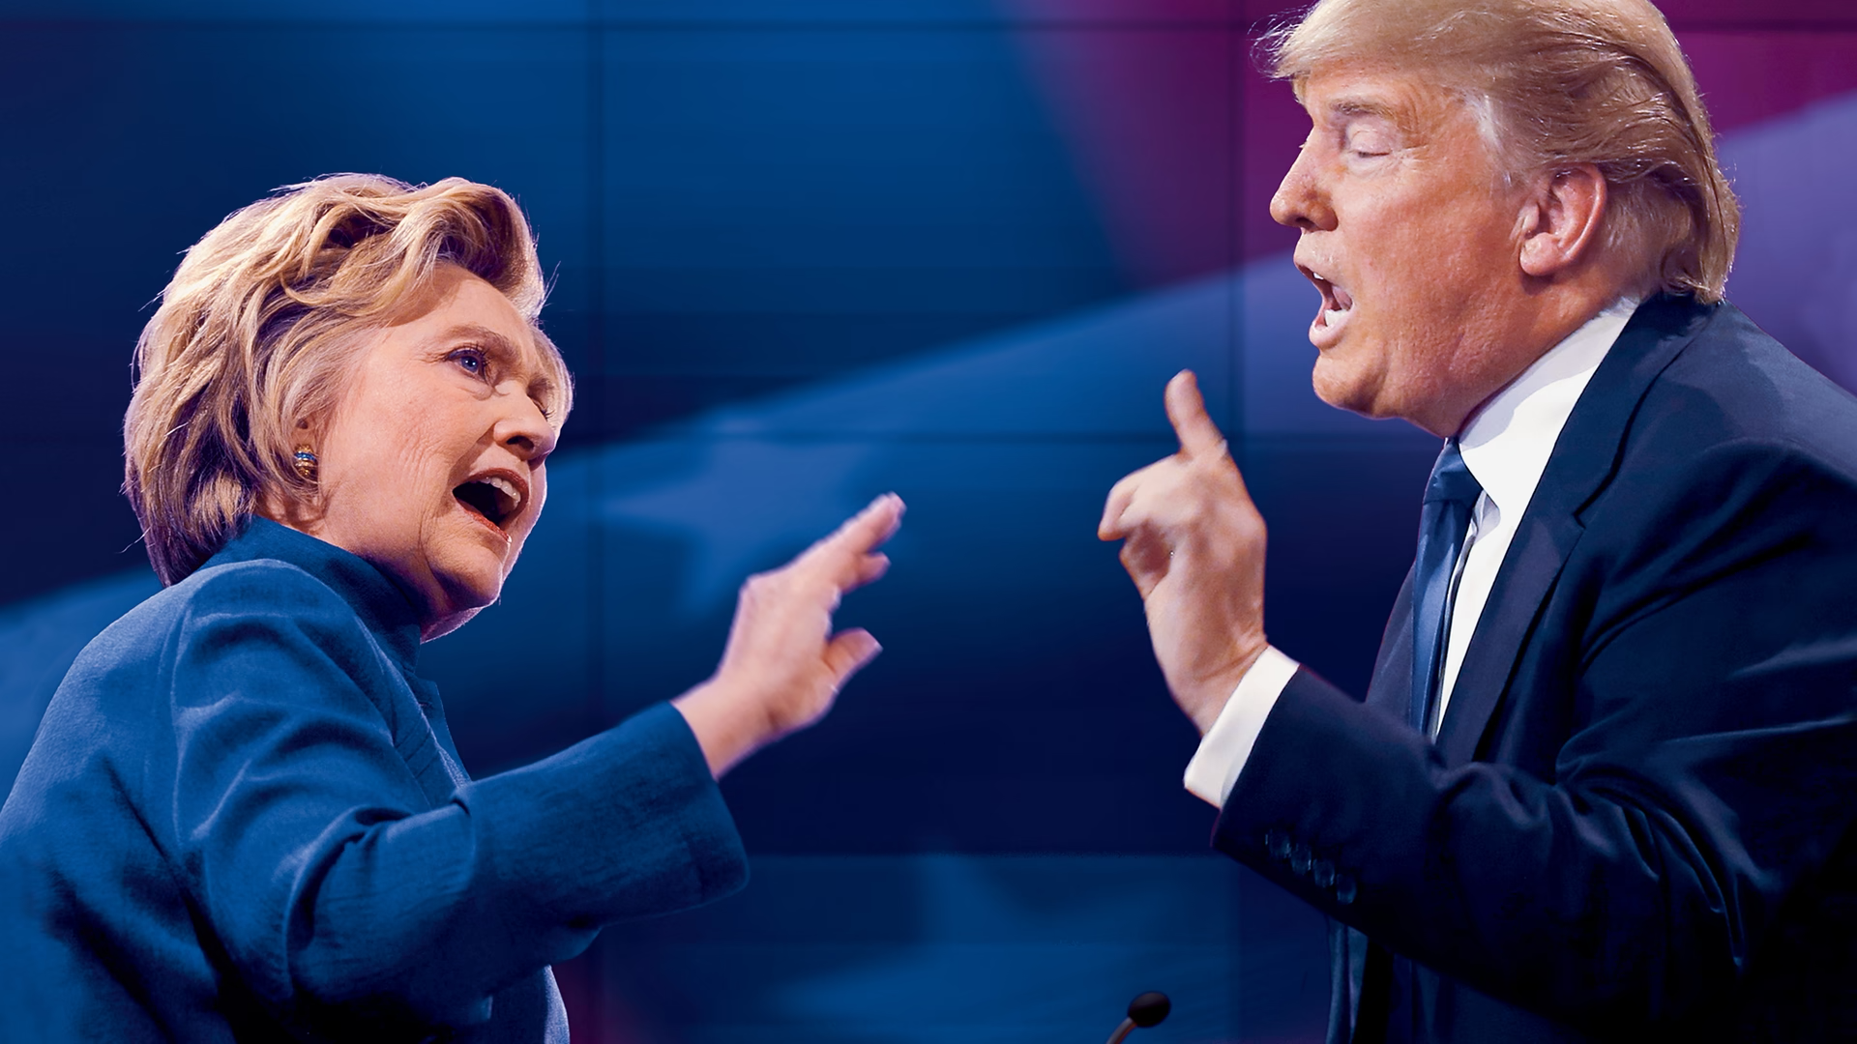
2016 US presidential election
Hostile sexism decreased turnout and campaign participation for Democrats
Hostile sexism had negative effects on discussions with family (Banda and Cassesse 2021)
Effects of the ”gender card” attack on Clinton:
  Hostile sexists exposed to attack on Clinton – decreased support for Clinton, Increased support for Trump
  Benevolent sexists – increased support for Clinton (Cassesse and Holman 2019)

Slide 10
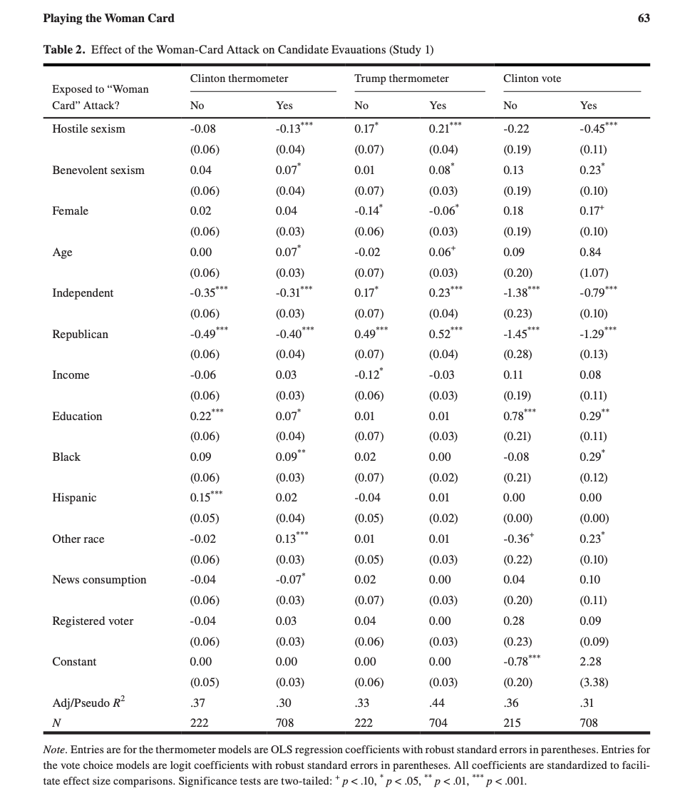
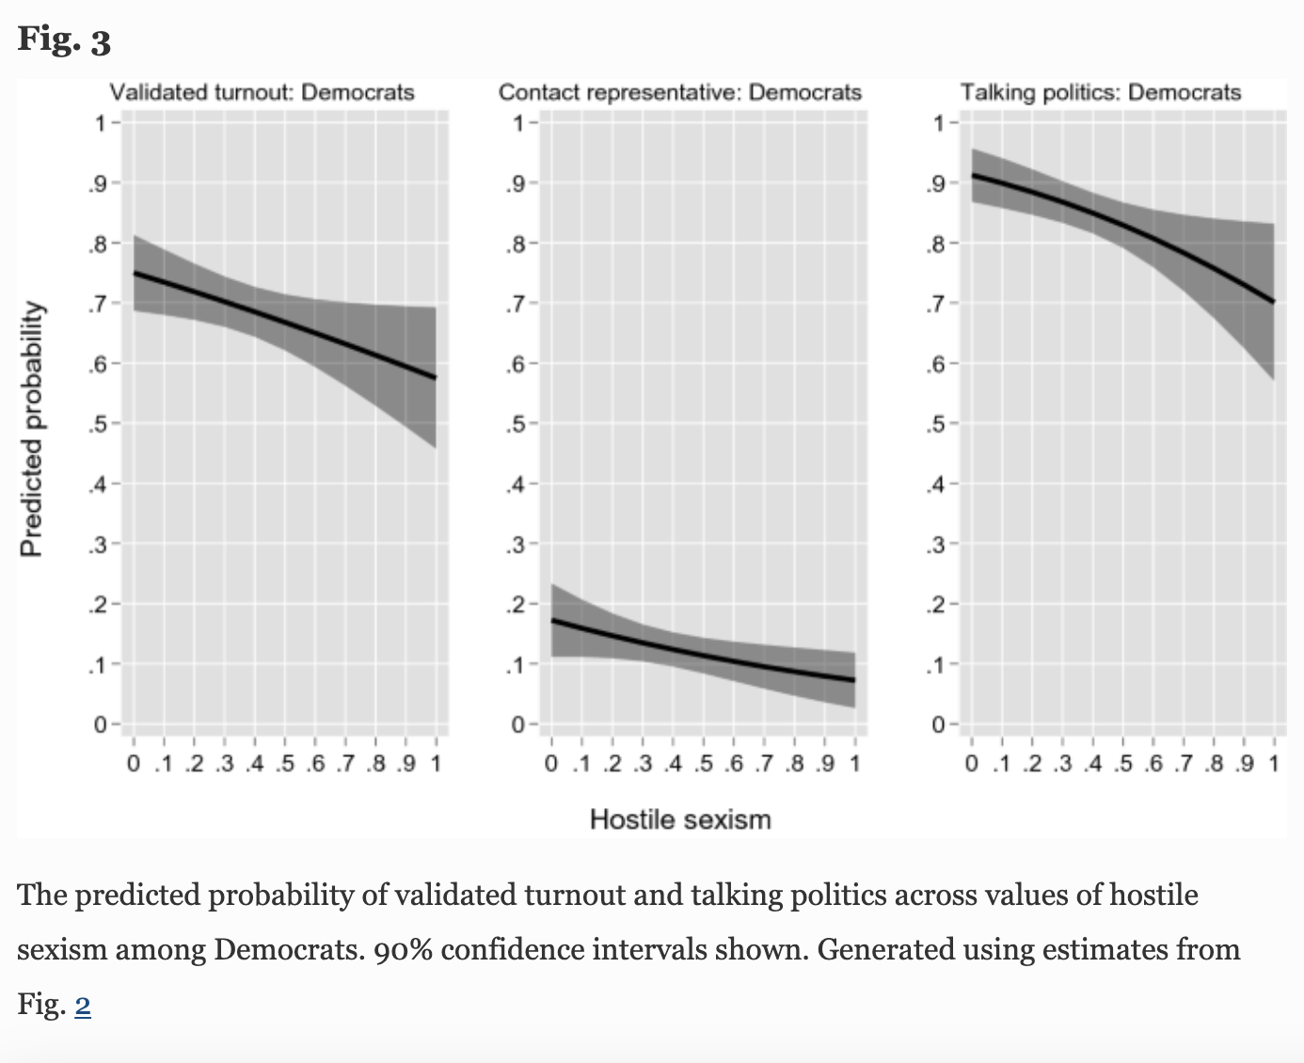
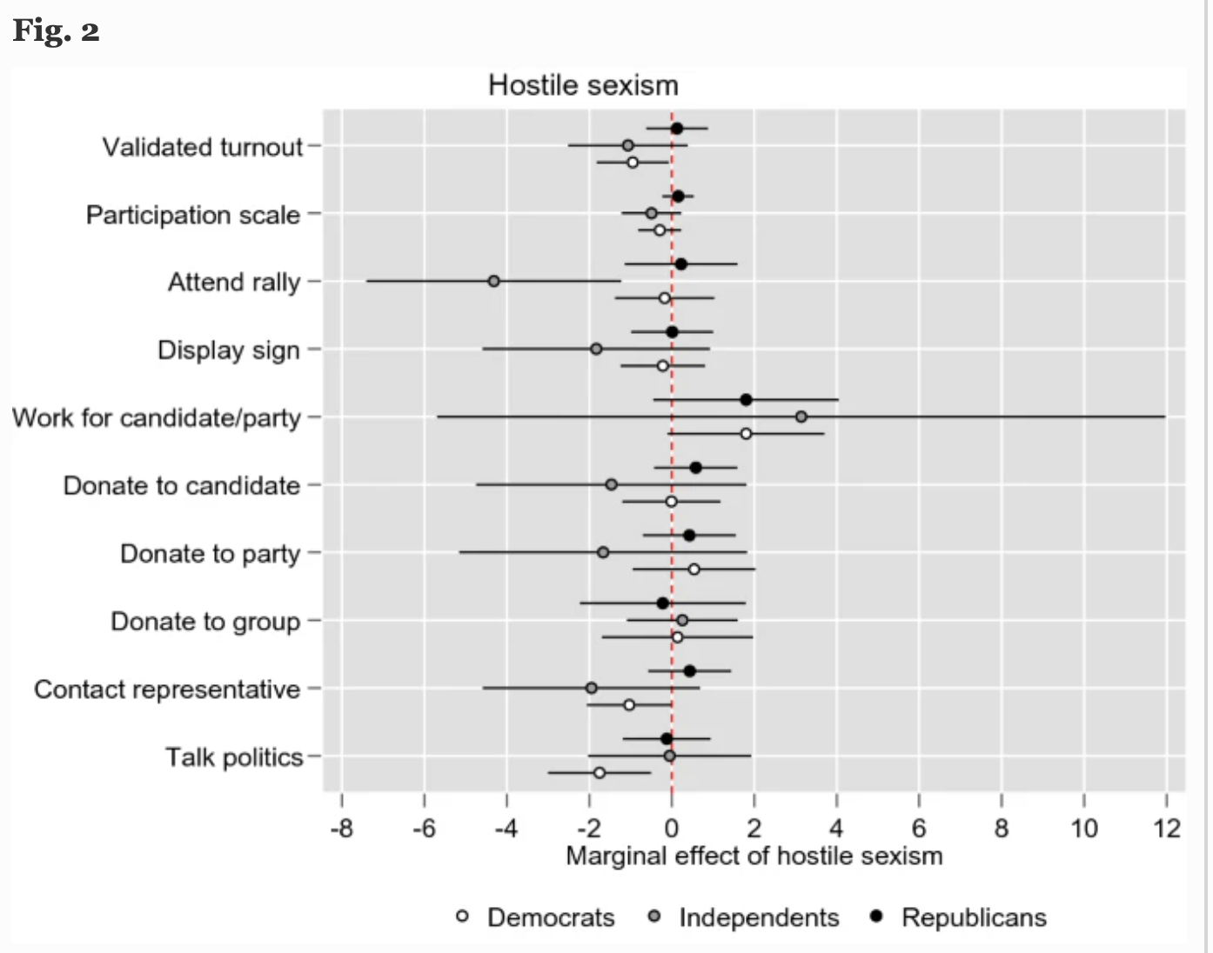

Slide 11
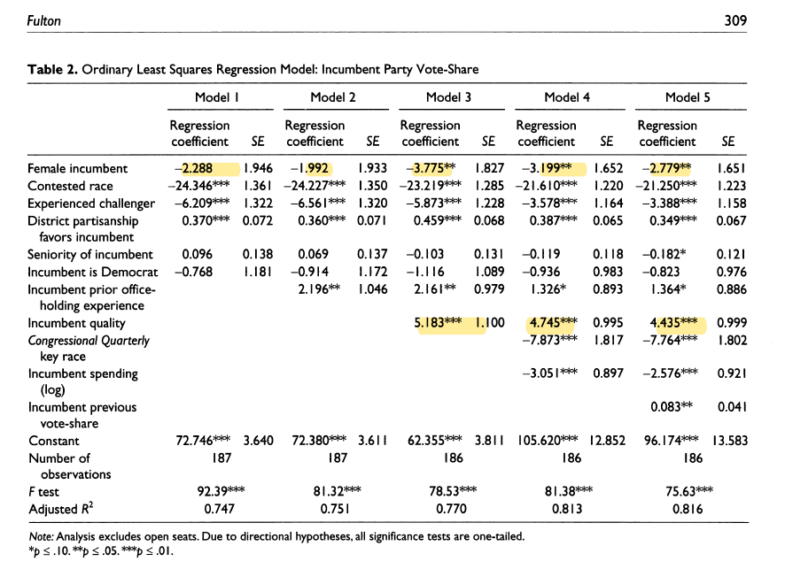
Explicit discrimination disappearing?
Studies around the world show women candidates are not discriminated against
Sarah Fulton 2012: no bias detectable because women candidate samples in the studies suffer from selection bias

Slide 12
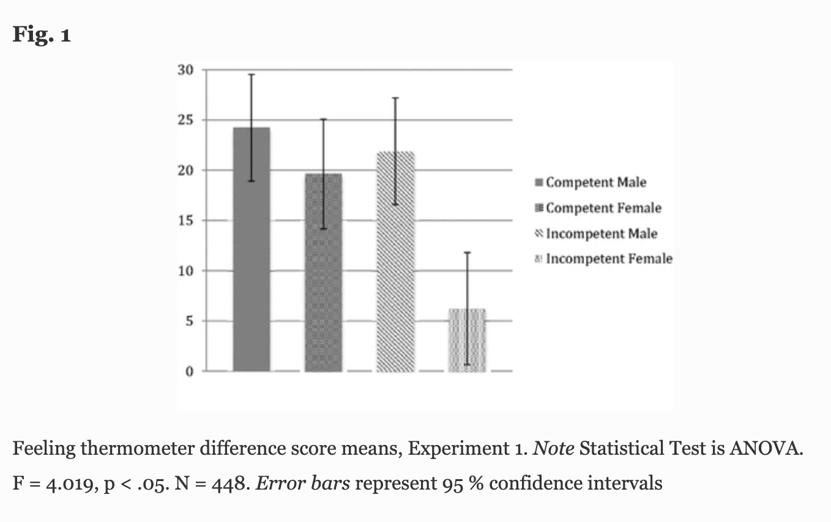
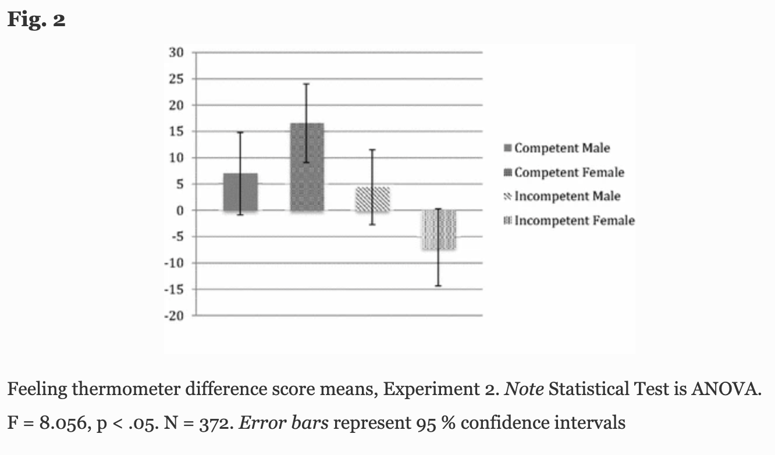
Double standards
More subtle bias
Evaluation of women candidate‘s traits stricter
Voter put mor emphasis on women candidate‘s competence. (Ditono 2014)
Women’s competence evaluated more harshly than men’s

Slide 13
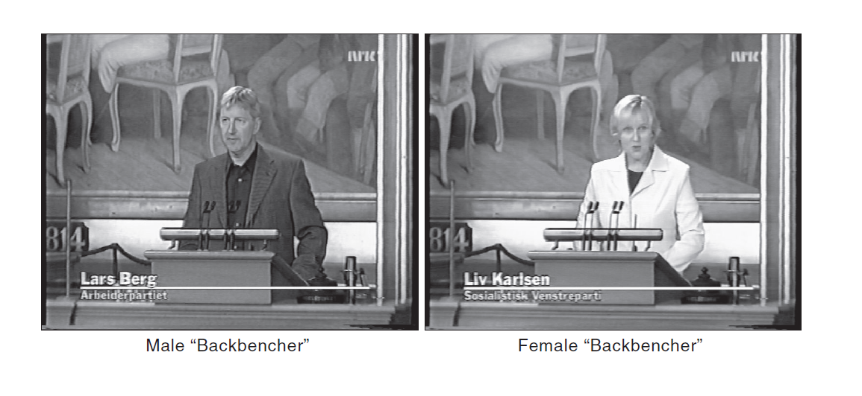
Double standards
Stereotypical evaluation also in Norway
Experimental manipulation of politician´s gender in a video recording of a parliamentary speech by a backbencher (speech held constant, politicians were actors)
First-time voters evaluated the politicians´ performances as follows:

Slide 14
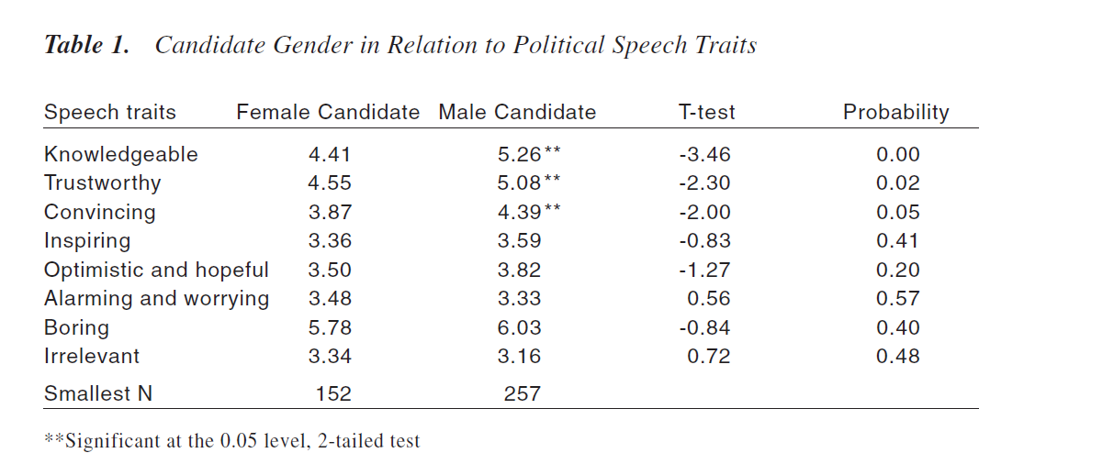
Male candidate as significantly more knowledgeable, trustworthy and convincing compared to the woman
Gender stereotypical evaluations still apply in Norway – a country with a high level of gender equality and ideology of state feminism
Hard test of the gender stereotypes and their harmfulness for women!

Slide 15
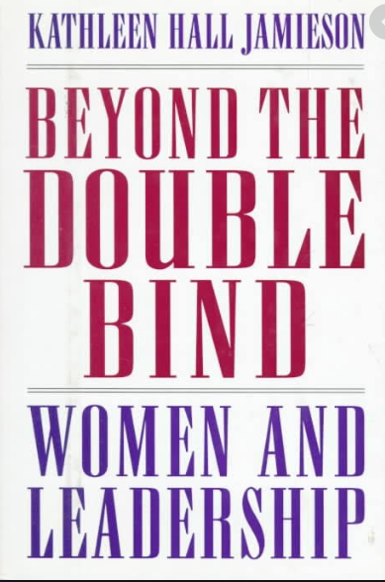
Double bind
Evaluation standards = no win situation
When people
  Require you to comply with a set of stereotypes
  But they evaluate different set of stereotypes better

Slide 16
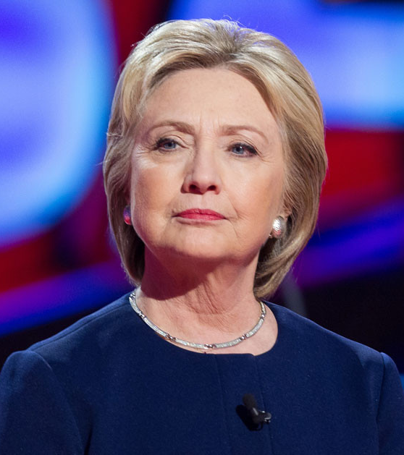
Double blind
Traditional gender roles require women to be more feminine in their trait and character
At the same time masculine traits are required from political leaders.
Not maternal, too cold, too professional, not emotional.
Various binds: Competence vs. Authenticity (Bhengazi hearings, Harp Loke, Bachmann 2016)

Slide 17
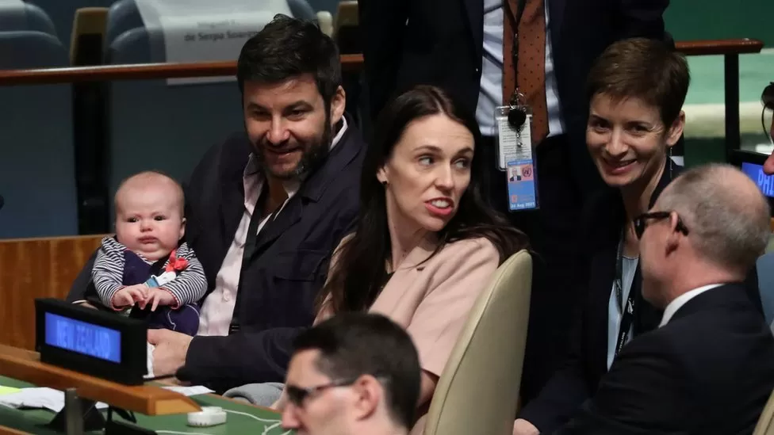
Teele et al. 2018
Are women held to dobuble standards?
No according to their experimental study.
Women candidates are more likely to be chosen
BUT!
The traits that make candidates more successful are much harder to obtain for women!

Slide 18
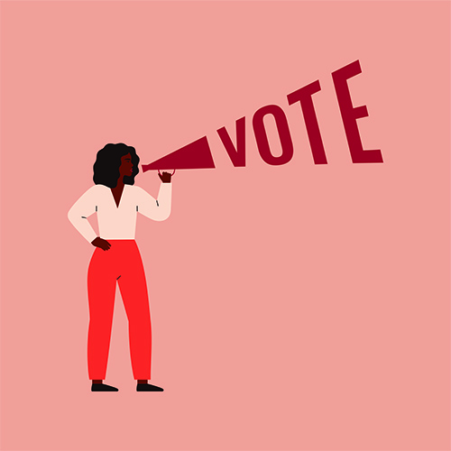
Campaigns and communication
Often no differences (mostly USA)
Gendered communication and campaign styles not supported
Campaign issues as well as communication styles
E.g. Dolan 2005:
Web campaigns of the Senate and House candidates in 2000 and 2002
Very little differences in what issues men and women candidates used

Slide 19
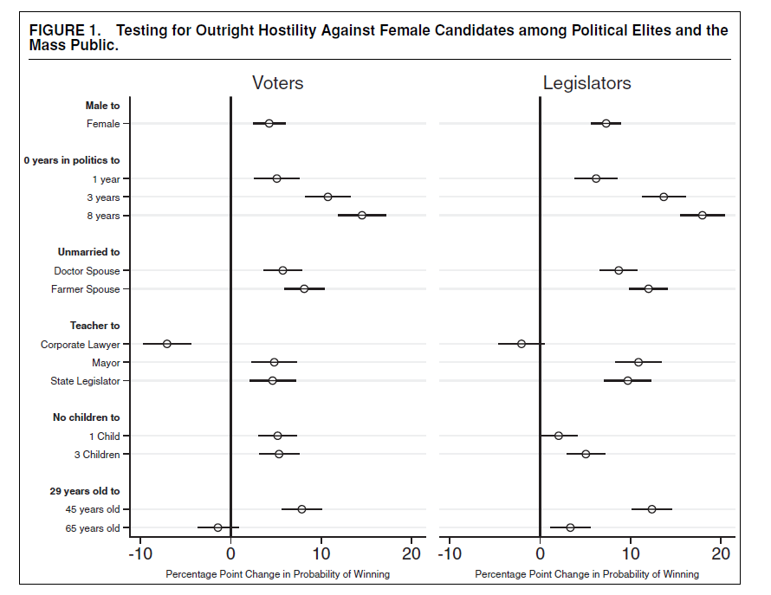
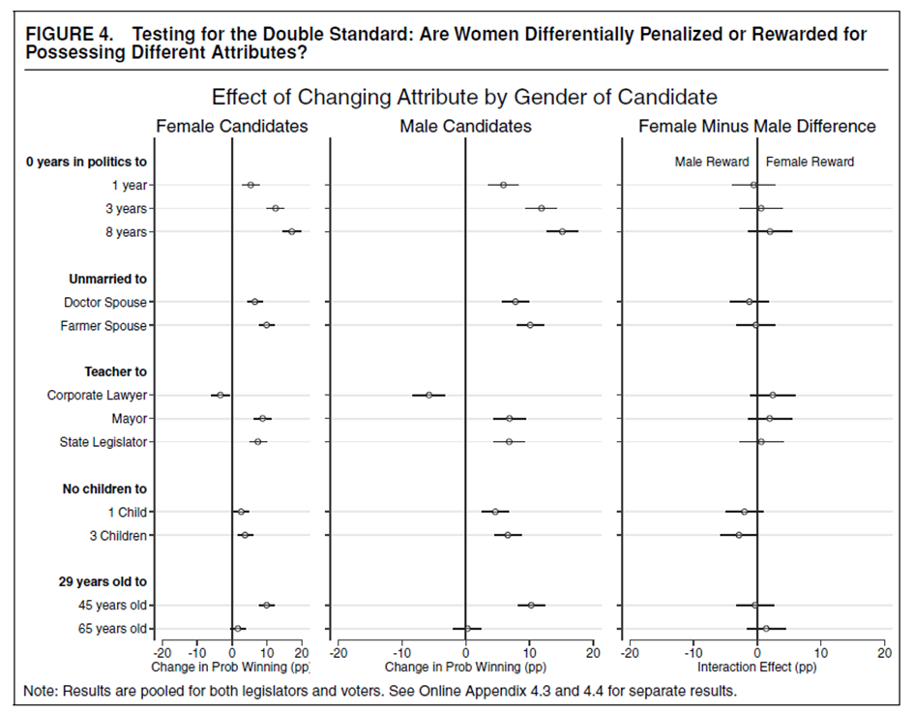

Slide 20
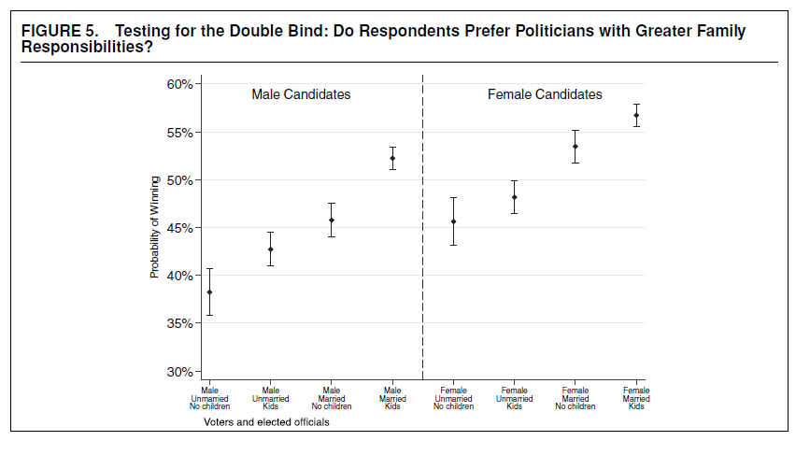

Slide 21
Clayton et al. 2020: (How) Do Voters Discriminate Against Women Candidates?
Experimental and Qualitative Evidence From Malawi
No bias against women in experiment (on the contrary)
Ceretis paribus voters prefer women candidates
BUT!
Voters prefer candidates with young children
Negative campaigns does affect evaluations of real candidates

Slide 22
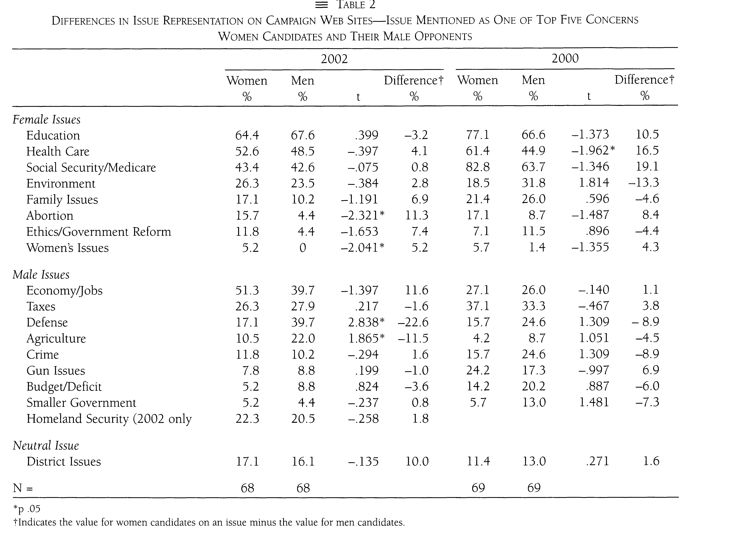
Communication styles
Often no find differences (mostly US)
Gendered communication and campaign styles not supported
Campaign issues as well as communication styles
E.g. Dolan 2005
  analysed web campaigns of the Senate and House candidates in 2000 and 2002
  Compared which issues women and men used in campaigns

Slide 23
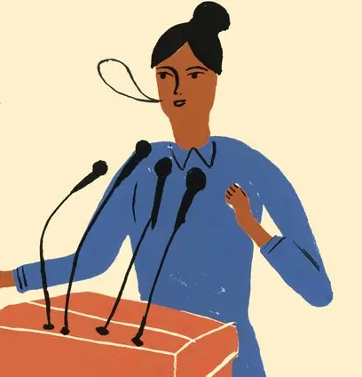
Communication styles
Gendered language (zero results)
Usual operationalization:
  Personalization (sharing private lives)
  Interactivity (interaction with other users/the public)
E.g. Sweden: Sanberg and Ohberg 2017
  candidate survey and content analysis of Twitter accounts during campaigns and after campaigns
  Women more emphasis on Twitter as a professional tool
  No difference in communication during campaign
  After campaign – women more interactive
  Assumption – campaign periods are special, candidates use it strategically

Slide 24
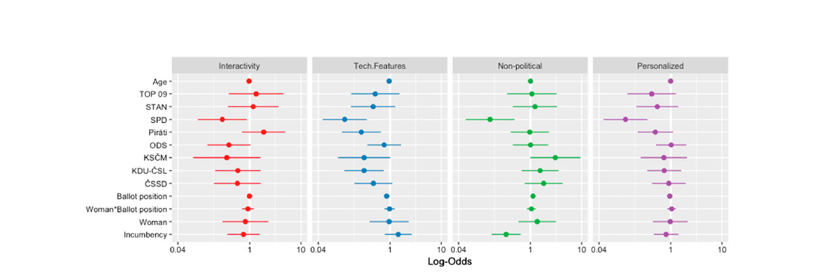
Czech Republic: Hrbková and Macková 2020

