Slide 1

Gender quota politics
Fall 2023

Slide 2
Quota?
How do you understand quota? What does it mean?
Why is this controversial?
What about quota and democracy?
What is the dominant discourse in your country?
Quota: yay or nay?

Slide 3
Quotas as a ‘fast track’ to equal representation for women (Dahlerup and Freidenvall 2005)
Incremental vs. Fast-Track route
Nordic countries: 70 years to get to 30%
Costa Rica from 19 to 35% in one election
Incremental: liberal discourse, gradual changes in social norms, education, party recruitment, get rid of barriers, quotas seen as discriminatory
Fast track: formal and informal discrimination, glass. Ceilings, active measures, quota compensation of structural barriers
What can be the downside of quota?

Slide 4
The Pros and Cons of Gender Quota Laws
Lisa Baldez 2006
Gradual change not working
Right quota provision and right context
Goal = increase in the numbers
Not more democratic or transparent process
Quota = legitimacy to alod nomination processes (Lat Am)
Parties don‘t comply (PRI in 2003 – primaries instead of quota)
How to implement qouta in decentralized systems (USA?)

Slide 5
Democracy and Adoption of Quota Worldwide. Zetterberg, Bjarnegård, Hughes, and Paxton 2022
The levels of democray matter
Adoption more likely by countries in the middle
Limited political rights = reserved seats (not threatening to elites)
More contested elections = canidate quota

Slide 6
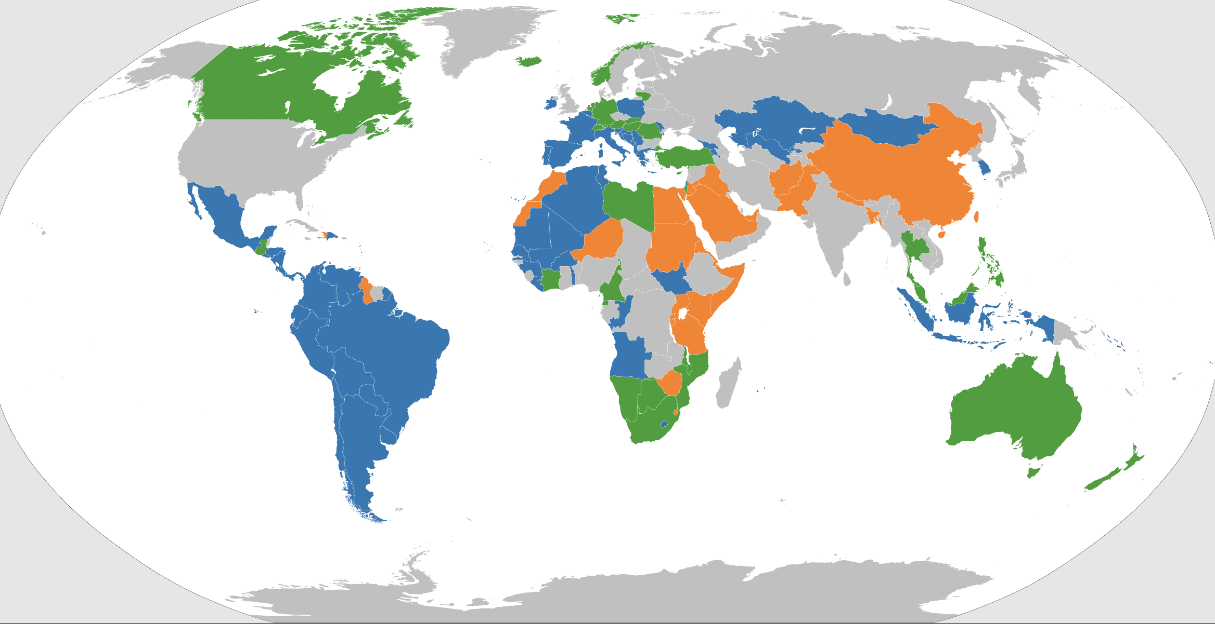
Quota worldwide

Slide 7
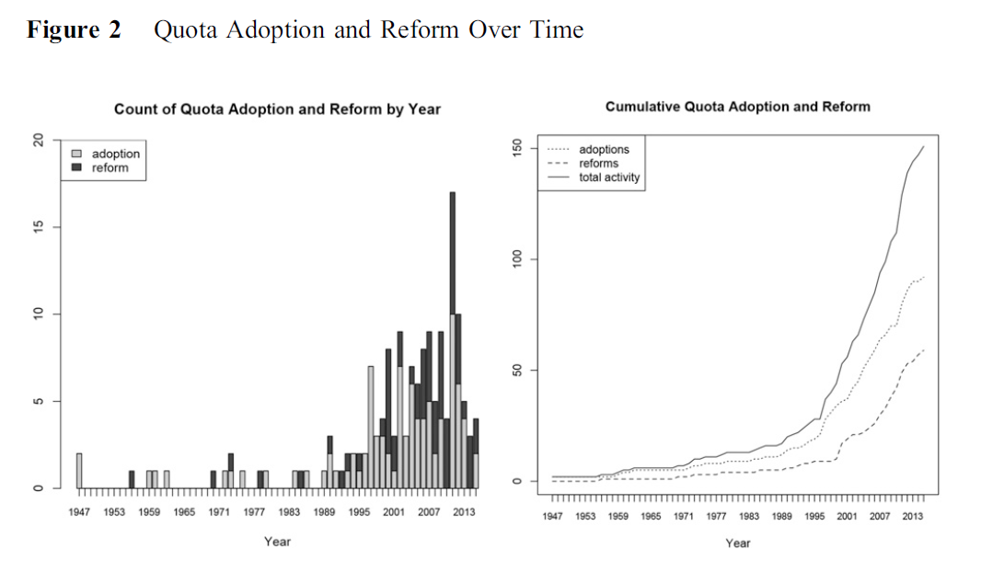
Quota worldwide
Spread after 2000
Over half of the countries apply some
Quota database: IDEA
1st wave: 1970s and 1980s Scandinavia (and Communist regimes)
2nd wave: after 1991 (Argentina) in Latin America, Beijing Action Plan 1995
3rd wave: current reforms of quota measures (to make them effective)

Slide 8
Defining quota
Affirmative action measure
No. or % of women nominated or elected
Fast-track measure
For women or gender neutral

Slide 9
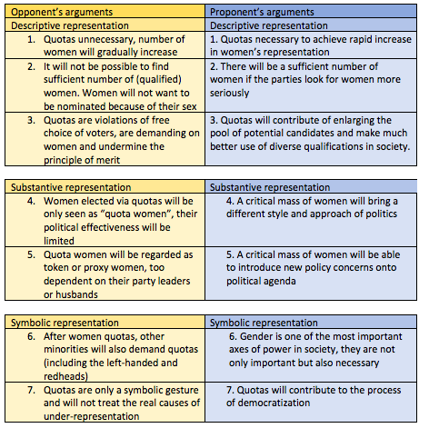
Quota arguments (Dahlerup 2017)

Slide 10
TYPES OF QUOTA
Reserved seats
Legislative quota (electoral law or constitution)
Party quota
Sometimes a combination (i.e., Rwanda: 2 reserved. Seats per province + 30% quota for candidates on the ballot)

Slide 11
Quota around the world
Reserved seats: Asia, Middle East, North Africa
Legislative quota: Latin America, Europe, Africa
Party quota: Europe, South Africa
EU countries often go from voluntary party quota to legislative quota: France, Belgium, Portugal, Slovenia, Spain, Croatia, Poland

Slide 12
Does quota work? Under what conditions?
Reserved seats (with higher thresholds)
Placement mandate (double quota),but ceiling effects
Penalties for non-compliance (must be strong)
Different effects in different contexts

Slide 13
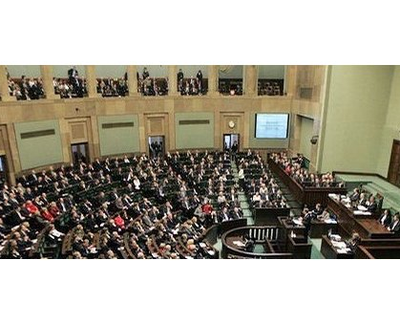
Why is quota adopted?
Social movement
International organizations, international reputation
Spillover effect
Party dynamics and rational party strategies

Slide 14
Intra and inter-party competition
Why parties adopt quota laws and not just party quota?
Political incentives
National party leaders adopt quota to get advantage over local actors
Parties adopt quota laws when losing votes to progressive challengers
Examples:
Belgium (vs. Austria)
Portugal (vs. Italy)
Weeks 2018

Slide 15
Inclusion calculation
Rational motives
When party/government loses legitimacy
Women new element (not stereotypical politicians)
Quota draw attention
Signal commitment
Can protect power of male elites
Qouta ineffective and temporary

Slide 16
Effects: legislators‘ quality?
France quota law = elected women as active and efficient lawmakers as men (no. of bills co-signed, contributions to plenary session, committee sessions, no. of repots written)(Murray 2010)
No difference in quality between women in reserved seats and contested seats in Uganda (O´Brien 2012)
In Italy, educational attainment of both female and male MPs increased after quota (Baltrunaite et al. 2014)

Slide 17
Legislator quality: Italy (Weeks and baldez 2015)
Quota women in Italy -> improvement of overall levels of qualification
Quota women no less qualified and competent than men, indicators:
  Characteristics: Previous political experience, occupation, education
  House performance: No. Of bills introduced, absenteeism, re-election
  Compare also quota women and non-quota women from 1994 one-time quota election (mixed electoral system, applied quota only to PR tier of election)
Discrimination by leaders – not low qualifications – that explain lower numbers of nominated women in 1996

Slide 18
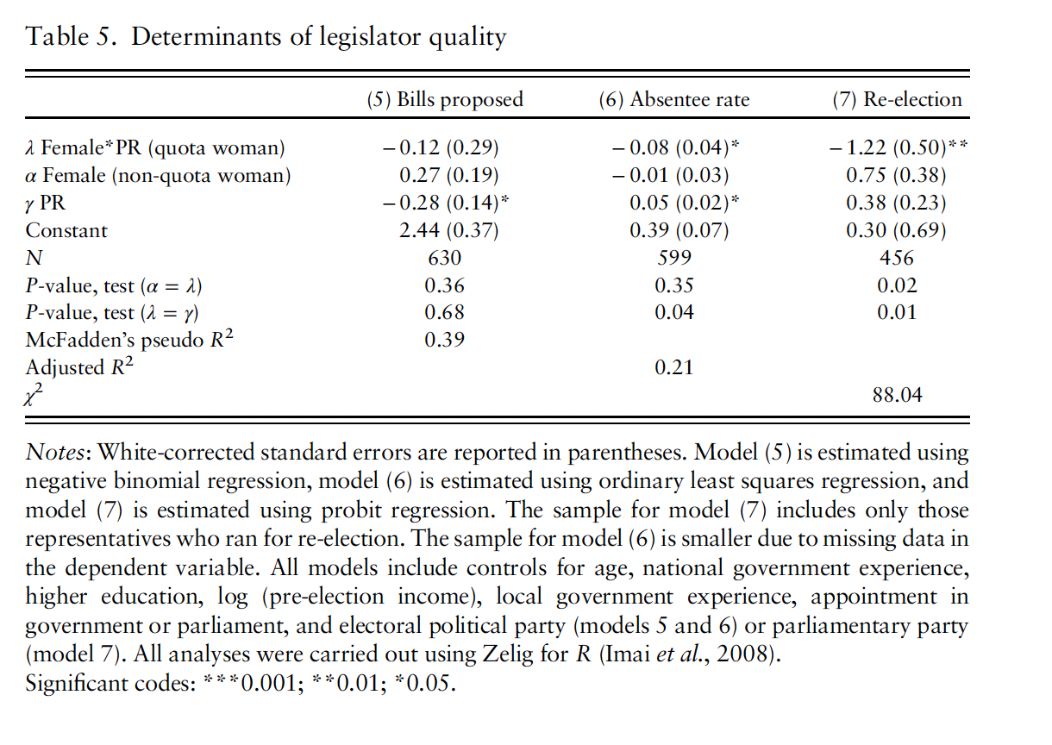
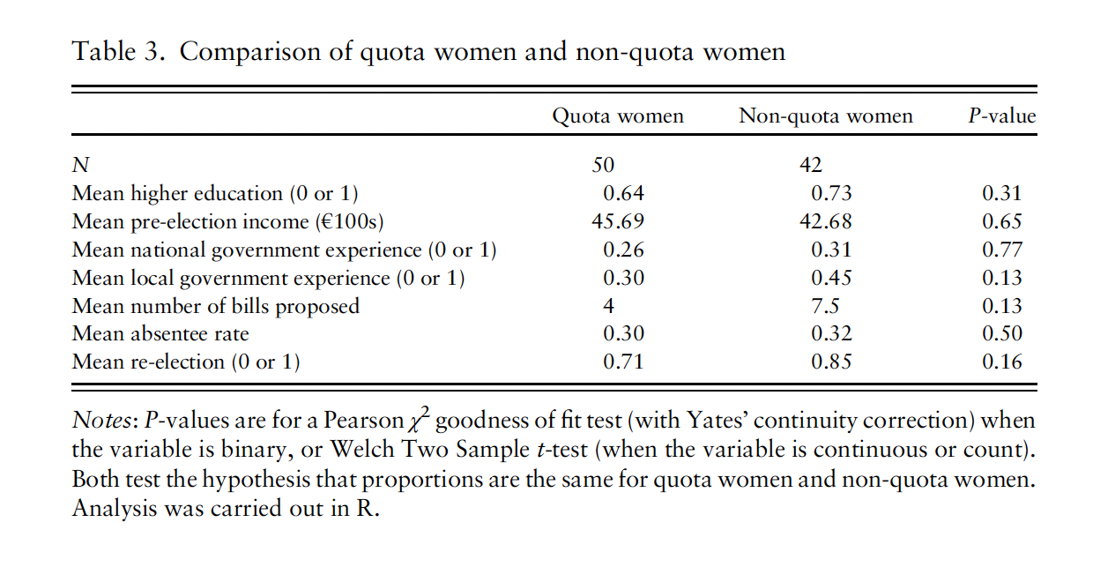

Slide 19
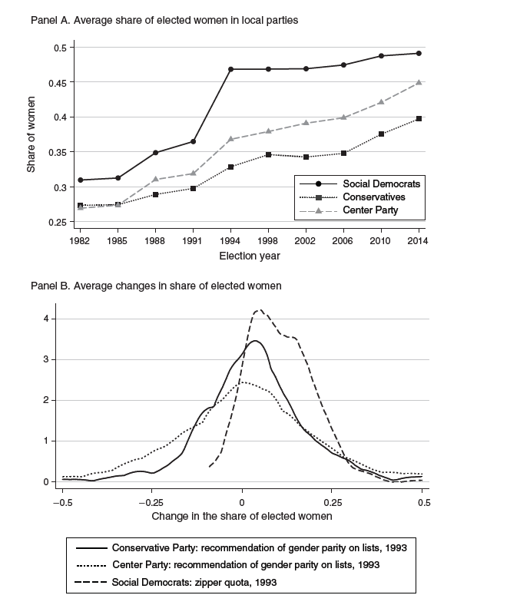
Case study: Swedish social democratic party
1994: 50:50 gender quota (zipper)
Besley et al. 2017: analysis of candidate competence prior and after the quota
Candidate earnings prior to politics (conditional on age, education, occupation)
Competence of candidates INCREASED after quota adoption
Mediocre men resigned, quality of party leaders increased, they picked more competent candidates
Rainbow Murray was probably right

Slide 20
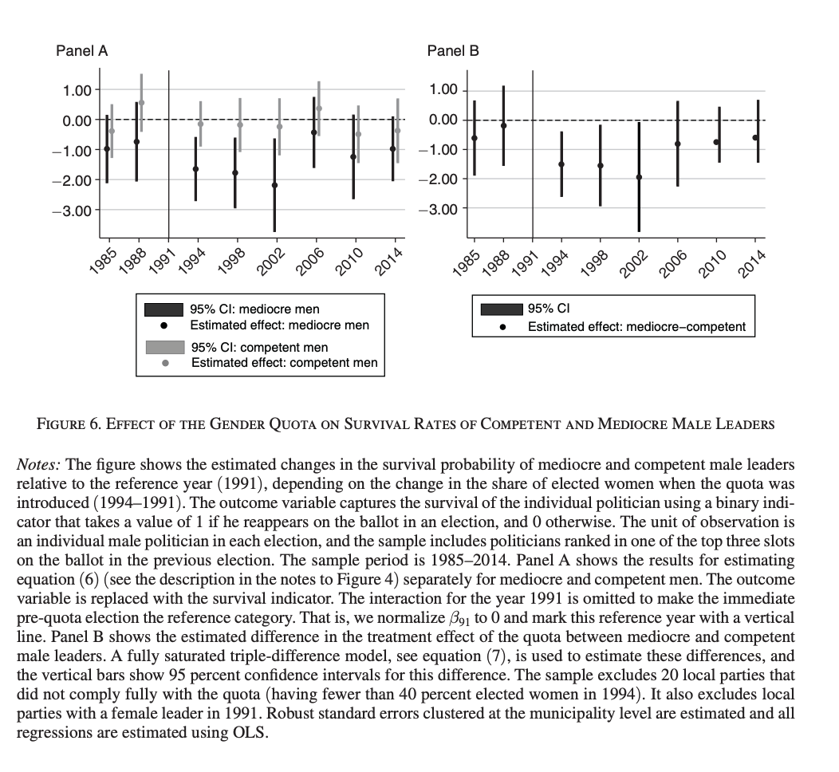

Slide 21
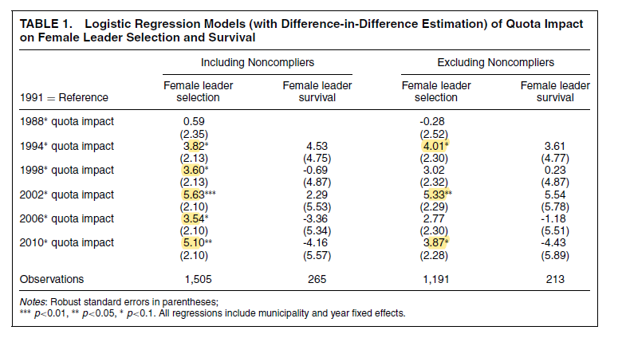
Effects: Women‘s leadership
Does quota lead to stigmatization of „quota women“?
Or does quota promote female leadership?
O‘Brien and Rickne 2016

Slide 22
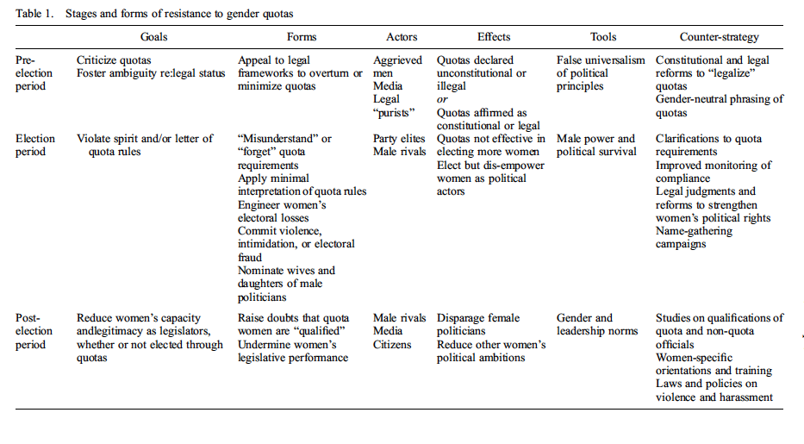
Resistance to quota (Krook 2016)

