Slide 1
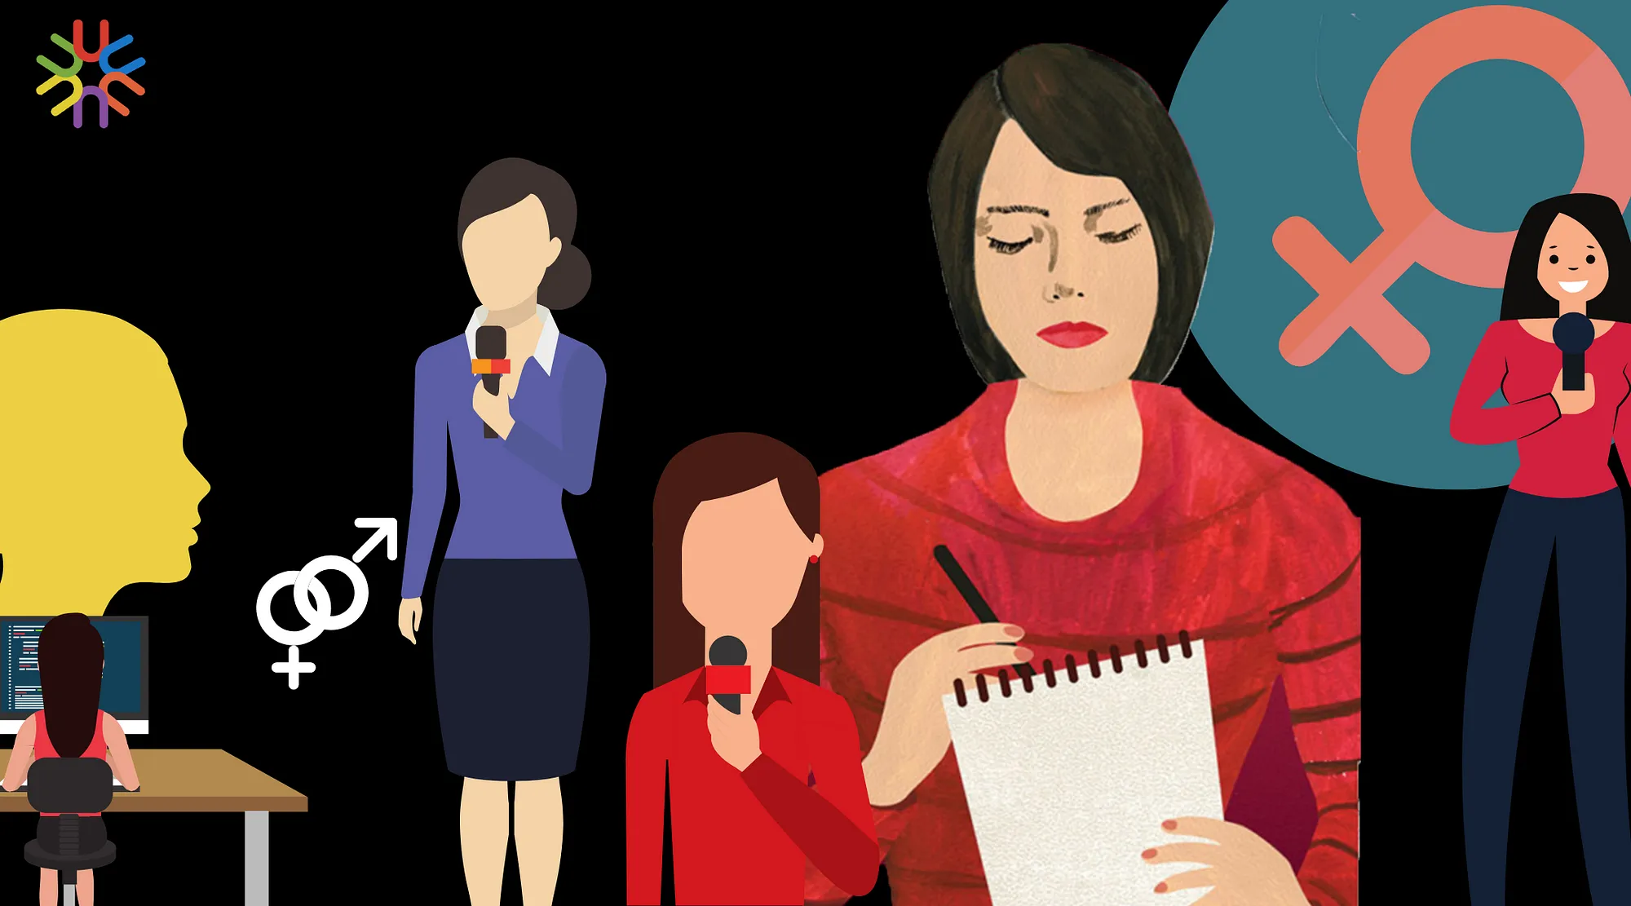
Women and media
Fall 2023

Slide 2
Journalism
Same as politics = typically masculine field
Emergence of mass media = only few women journalists
Women journalists writing about women and for women
Typically: suffrage, education, women‘s issues, hosehold, domestic life, beauty, fashion etc.
Slowly women demanded to cover typically „male“ topics (from 1960s on)
Men never demanded covering typically „female“ topics (matter of status)

Slide 3
Resistance of media outlets
Hostility and discrimination within newsrooms
Little space for women‘s advances
An internal 1973 BBC report stated: „to large numbers of listeners and viewers a female voice is considered to lack authority in news reading and reporting. According to the Head of TV presentation ‘a woman’s voice attracts too much attention. Announcing’, he thinks, ‘represents the supreme authority and a man’s voice is suited to all occasions by tradition, whereas a woman’s voice is more characteristic, but acceptable in the Open University context.“

Slide 4
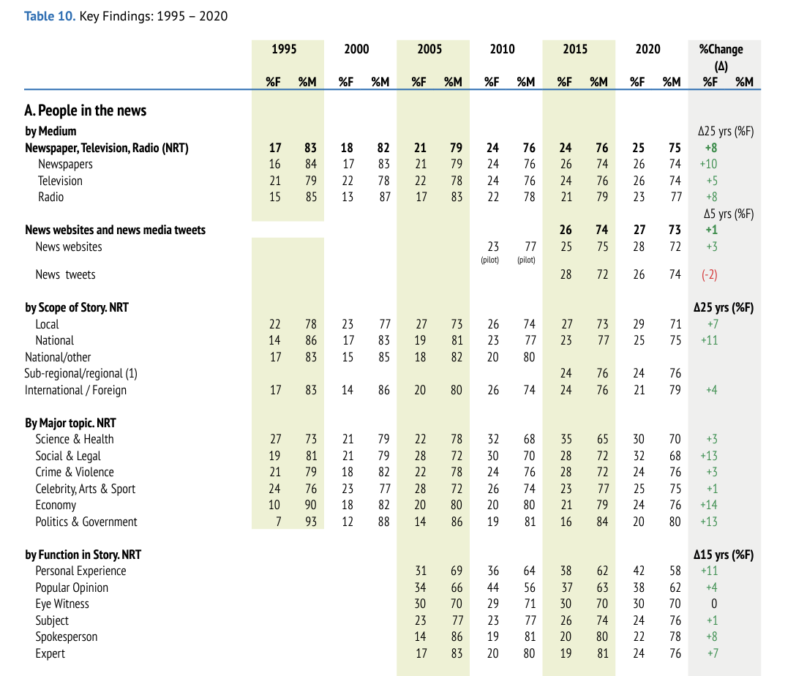
% of women journalists reporting news increasing slowly
Numbers by: Global Media Monitoring Project
https://whomakesthenews.org/
More women reporting on politics and economy, but still minority!

Slide 5
Journalism as a gendered practice
First analysis of the gendered nature of journalism in 1980s
Catherine Covern (1981):
Journalism valued independence, individual autonomy
Writing emphasizing conflict, competition, controversy
Omitting communal values and language (e.g. harmony, community, affiliation)
Inclusion of more women would bring more feminine values
More women in newsroom = transforming journalism

Slide 6
Gendered nature of journalism
Van Zoonen (1998)
  Selection of topics (men report more on news, women on soft news = horizontal segregation)
  Story angles (men focus more on facts and sensations; women focus on background, context, effects)
  Use of sources (men use more men; women use more women)
  Ethics (masculine journalism is more detached from audience and the subject women more concered iwtu audience needs)

Slide 7
Gendered nature of journalism
Very often the differences between men and women not confirmed in survey studies
Men and women very similar their values and goals)
Some differences hold though
For example Hanitzsch and Hanusch 2012
  Study gender differences across 18 countries
  Women and men do not differ in how they understand their roles

Slide 8
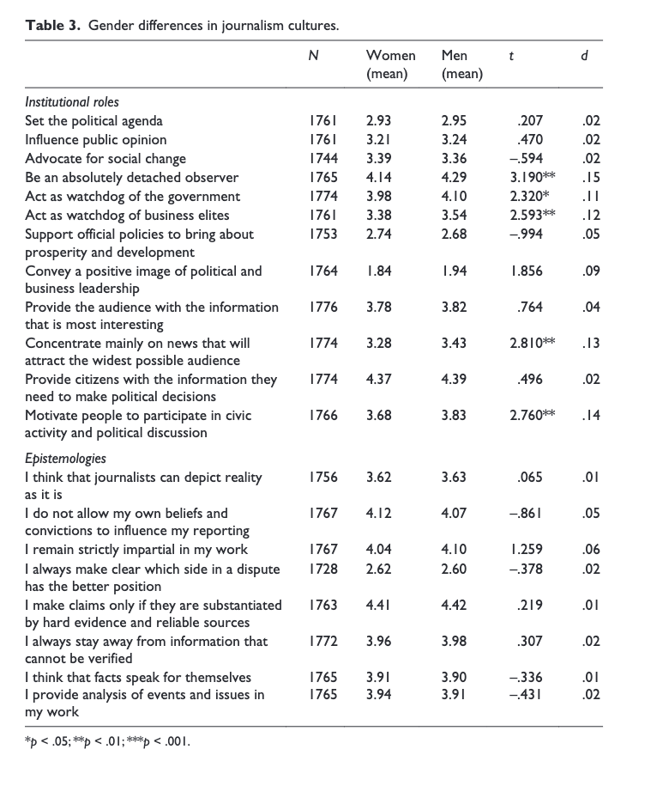
Entries are mean values of scales:
Institutional roles = from not important to extremely important
Epistemologies = from strongly disagree to strongly agree
Stars indicate that the differences between men and women are statistically significant
Women and men do not differ in most items
Men more as detached observers, as watchdog of democracy, more concerned about attracting big audience, want to motivate civic engagement

Slide 9
Gendered nature of journalism
Ross 2001: surveyed and interviewed female journalists (UK)
Identified journalism as male-dominated culture:
  Impossible work-life balance (worst for mothers)
  Macho culture
  Women often adapt and adopt the boy‘s rule of the game
  Or find other strategies (freelancing, work with other excluded proffesionals)
Significant disagreements among women journalists (see the following slide)
Conclusion: increasing the number of women is not sufficient to transform journalism

Slide 10
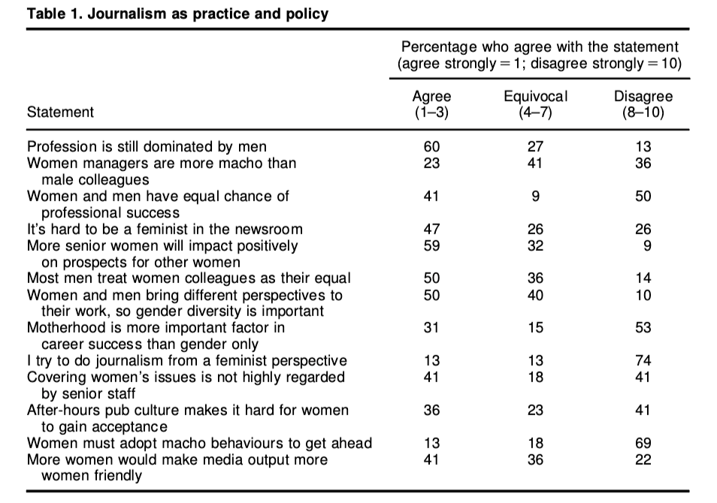
Inconsistent attitudes among women journalists
Journalists need to be aware of the dominant newsroom culture
Dissenting voices are important
Challenging the culture requires both individual and collective effort
Note that the analysis is from late 1990s

Slide 11
Individual and collective effort to challenge the culture
Various intiatives of women in media
E.g. Ženy v médiích (Czech Republic)
https://www.instagram.com/zeny_v_mediich/

Slide 12
Stereotypes about topics covered by journalists
Commonly assumed that politics, economy, technology and other „hard news“ topics are more extensively covered by men
Women more in soft news, features, even historically (fashion, beauty, lifestyles…)
Example: North 2016
  Survey and qualitative interviews with women journalists in Australia
  More women cover hard news
  But majority covers soft news
  Women pigeon-holed in these topics

Slide 13
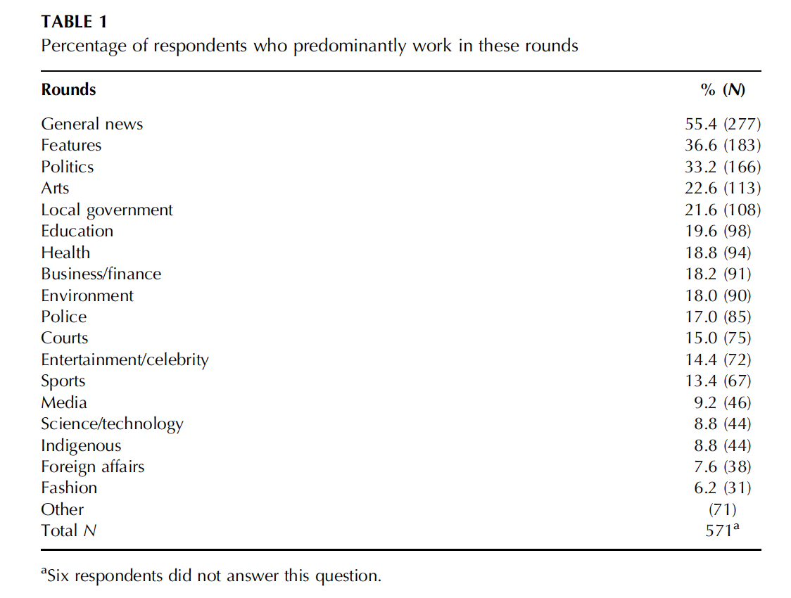
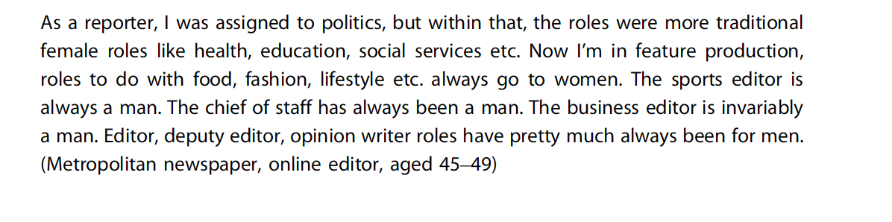
North 2016

Slide 14
Are men perceived as more credible?
Historically distrust in women‘s capacity to perform
As in the case of the BBC report
First woman anchor in major US new broadcast network: Katie Couric in 2006. Major concerns that as a woman she would not be a credible news anchor.
Are women credible enough? Especially when covering hard/stereotypically masculine news?

Slide 15
Are men perceived as more credible?
Several experimental studies of poor methodology
Usually small samples, underpowered, not worth mentioning
One (quite okay) example:
Hai and Maurus
  Experiment on a mixed sample (Swiss, German, and Austrian)
  N = 417
  Manipulated author of the news (Men vs. Woman vs. Computer)
  Manipulated the topic of the news (Masculine = footbal vs. Feminine = women‘s movies)
  Manipulated content of readers comments (Sexist vs. Non-sexist)

Slide 16
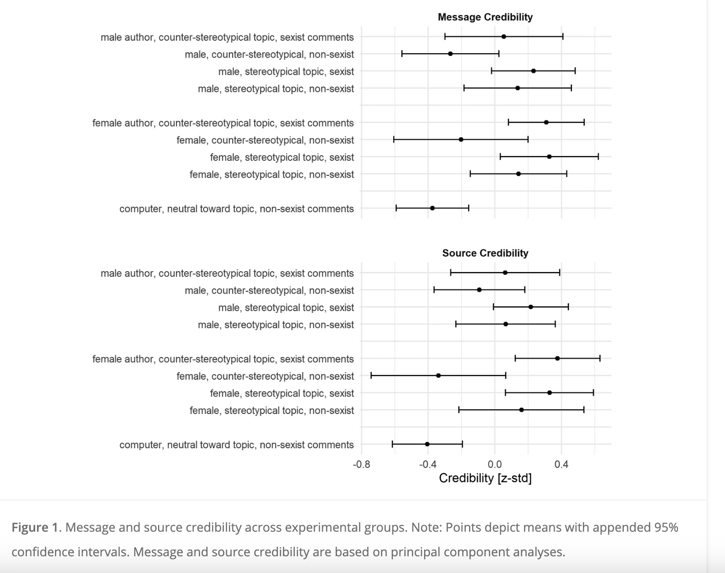
No gender effects
Computer as the author of the news decreased credibility
Sexist comments (under both men and women authored article) increased credibility of the message
Seeing sexist comments might have made the respondents process the text more carefully (is the assumed explanation)
Results consistent with another study in the US and Denmark (the Danish study was focused on gender of experts in media)

Slide 17
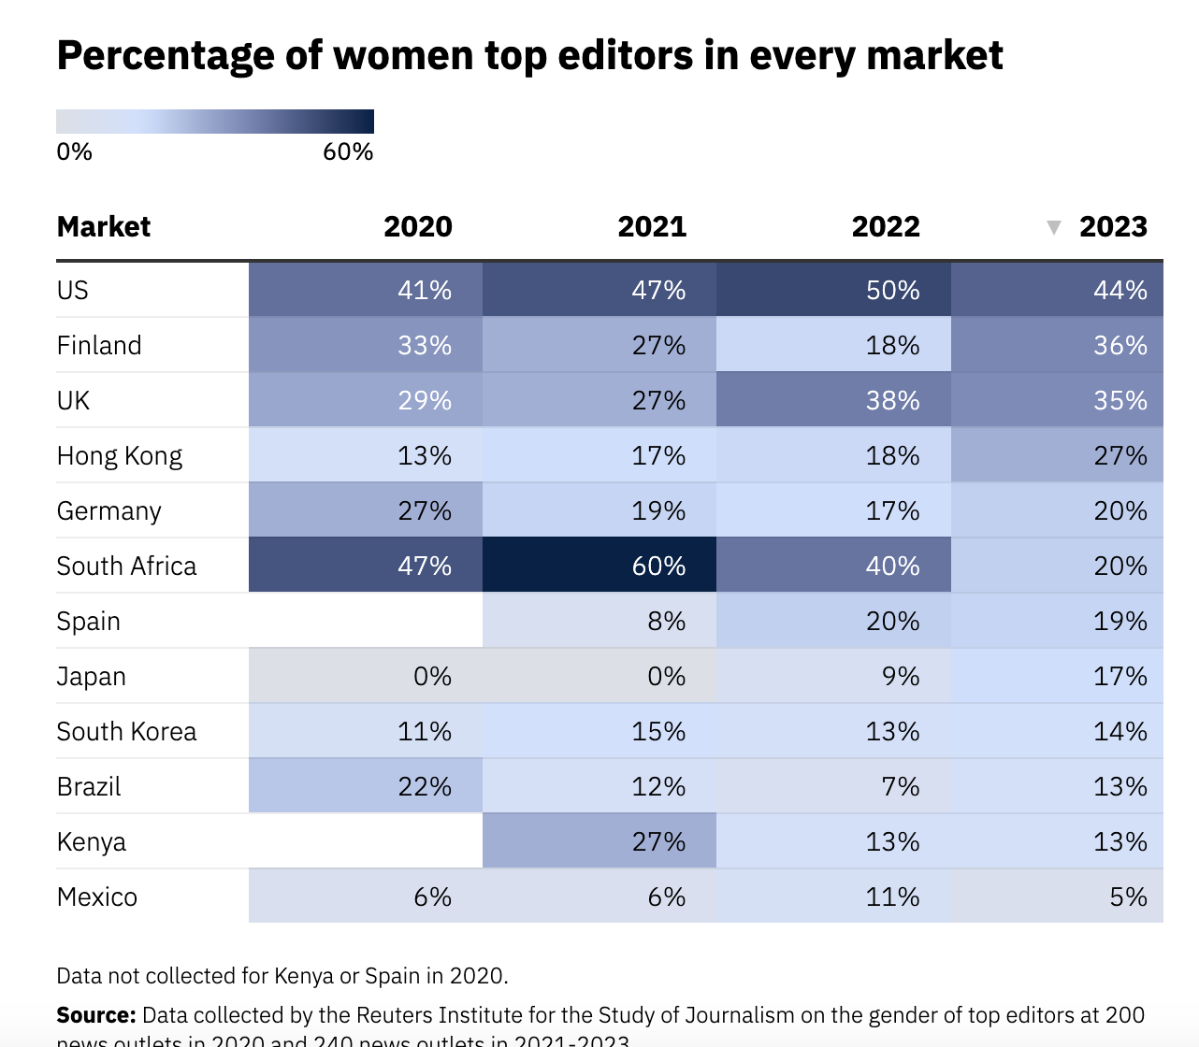
Vertical segregation of women in media
They key factor is the male-dominated nature of top management (therefore vertical)
Lack of women editors, managers, publishers
Reuters Institute analysis of 240 news outlets in 12 markets (2023)
In all markets: majority of top editors are men, women only 22%
Uncorrelated to % of women journalist in the country
Very weak correlation with gender inequality index (= even women with overall high levels of equality have low numbers of female editors)
Diversity may be increasing only at lower levels of the hierarchy (the newsroom)but not in the top leadership positions

Slide 18
Challenge the dominant concept of journalism?
The final strategy of women to transform media (Melin-Higgins 2008)
  The first is „tamend feminism“ – building female only spaces within newsrooms, magazines etc.
  The second one is women act within mainstream journalism not questioning hierarchies
Some media employ „gender equality manager/editor“ responsible for ensuring that the content complies with gender equality
Example: Spain has at leas 8 media who employ Gender/equality editor
Study among these people (Iranzo-Cabrera, Figueras-Maz, Muri-Ríos 2023) indicates that:
  There is no consensus on the definition of such a position
  Time consuming
  Resistance from colleagues, negative reactions
  Lack of support by the management and editors
  Mostly they do not have control over content

Slide 19
How media cover politics and politicians?

Slide 20
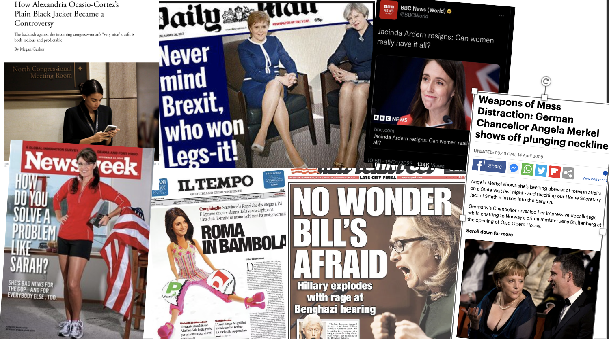

Slide 21
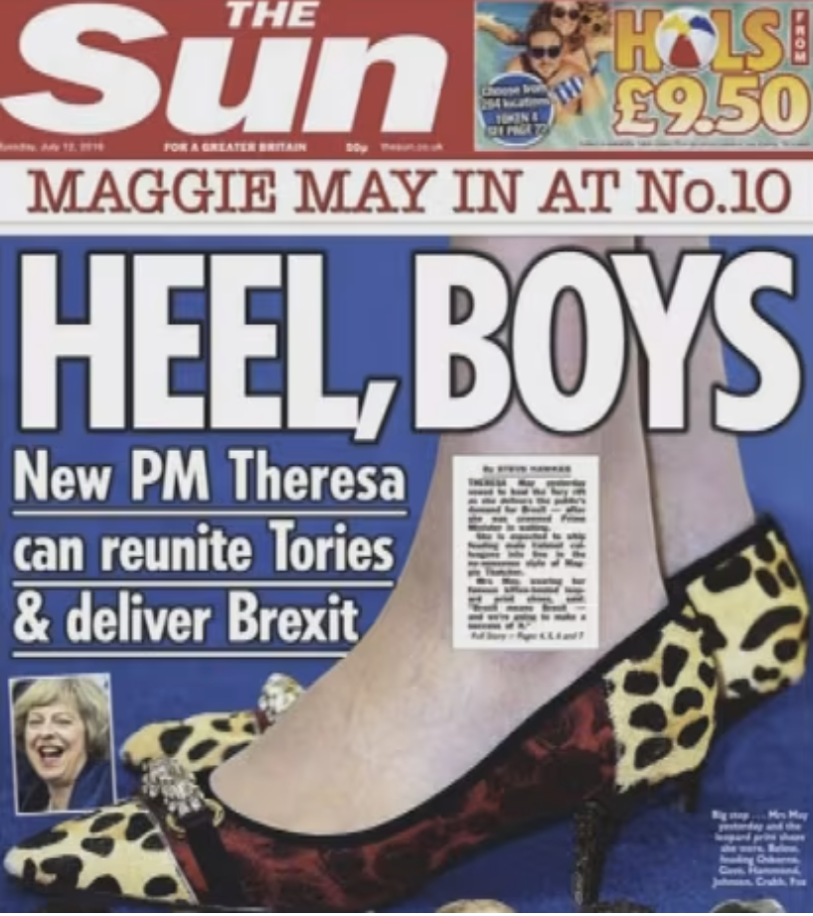
Appearance, sexism, and objectification
Women described more then men in terms of their sex, martial status and children
More focus on appearance and clothing
Objectification harmful for women in politics
Reducing people to their physical selves
Experiment (Funk and Coker 2016) manipulated politicians gender and presence/absence of objectifying comments in a mock-up Facebook thread. Findings: men tend to rate objectified politicians as less suitable for political office, less reliable and less honest.
Framing women politicians as attractive = more negative evaluation (compared to men labeled as attractive and both men and women not labeled as attractive) (Lizotte and Meggers-Wright 2019)

Slide 22
News media effects on politician‘s evaluations
Meta-analysis of available experiments about how media coverage affects the way voters evaluate men and women candidates
Rohrbach, Aaldering, Van der Pas 2023
50 studies, 670 evaluations, 23,000 participants
Results:
Most types of media practices do not have different effects on men and women with exceptions:
  Media tonality: negative coverage decreases voters‘ likelihood of voting for women (no effect for men)
  Coverage of communal (feminine) personality traits worsens evaluation of women's’ viability (ability to win)
  Coverage of appearance diminishes preferences for women candidates
  But negative evaluation of candidate's appearances. Impacts men and women in the same way
  Coverage of candidate’s. family diminishes women’s viability
  Coverage of emotionality impacts men and women similarly for evaluation of issue competence, viability and voting preferences
  Emotionality coverage makes people evaluate women politicians more strongly on communal (feminine) traits)

Slide 23
Constructing image of women politicians in the press
Mediated representation of women in politics
Reproduction of dominant discourses
Portrayal of women politicians through gender-specific frames
Sometimes reinforcing stereotypes, ideas that women belong to private sphere not politics
Analysis of media discourses about women politicians in French, Spanish, Italian, and UK media (Garcia-Blanco and Wahl-Jorgensen 2012) at the time of the first female majority Spanish cabinet appointment:
  Personalization
  Appearance and sartorial choices (more in some countries (UK) than others
  Attention to the Spanish Minister of Defence pregnancy: 1) framed as great and symbolic achievement, normalization of pregnant women in politics; 2) negatively framed as problematic and unsuitable for the office
  Framing the government gender composition as media-oriented strategic choice to attract positive attention or controversy
  Women as „extensions“ of PM Zapatero rather than full-fledged ministers with skills and intentions of their own (women politicians as puppets)
  Some text were counterarguing this by emphasizing the ministers education, achievement, skills (emphasizing gender bias, because men ministers' competences were not discussed at all)
  The cabinet also framed as PM Zapatero‘s achievement, undervaluing the long term efforts of civic society, interest groups, politicians, parties (collective dimension of the situation).

Slide 24
Coverage of women candidates
Women typically covered less intensively then male candidates
There are lots of studies which bring evidence to this
E.g., study of the 2009 European Parliament election by Lühiste and Banducci (2016):
  Women candidates received less media coverage
  Effects dependent on electoral system. Closed-list systems had positive effects on women candidate‘s coverage
  Party viability a key factor. Women candidates‘ covered more when they and also their parties were more viable (grater chances of being elected).

Slide 25
Representation of women in the media matters
In line with poststructuralist feminist theory (i.e. Butler, Mouffe etc.)
Role of hegemonic production of gender attributes and media are part of this production (produces and reproduces gendered structures in societies)
Gender is not a fixed condition which individuals are
Gender is something that individuals do
Gender articulated through practices (what we do and how we behave, even what we think) which reveals (and is also deeply rooted) in the structure of power relations (women of lower status and power, this structure is kept by the hegemonic reproduction of the structure – media part of this, they accept, normalize, legitimize certain images of men and women ).
Read some work by feminist theorists if interested ;)

Slide 26
BTW the GMMP 2020 report:
Even though the numbers of women in media are growing
Very low % of representation of minorities
Media content not challnehíing gender stereotypes
Read the report here: https://whomakesthenews.org/wp-content/uploads/2021/08/GMMP-2020.Highlights_FINAL.pdf

Slide 27
More resources (will not be in the exam)
https://www.youtube.com/watch?v=IaBJFSAxVgY&ab_channel=TED-Ed
  Ted talk on representation of women in the media
https://www.youtube.com/watch?v=714d18CS9k4&t=955s&ab_channel=AndreaSanchez
    Classical documentary Miss Representation. It is already a little dated (you might probably not get some of the cultural references such as Britney Spears in her prime years) the standards might have sifted since then. But still some interesting moments, especially speakers not easily seen in context of gender (like Condoleeza Rice).
https://www.writingwithfire.in/
  Inspirative Oscar nominated documentary about women journalists in India. Available through Apple TV or Amazon Prime.

