Slide 1

Political parties and women in politics
Fall 2023

Slide 2
Why are parties essential?

Slide 3
Central role of political parties
Nomination for elected offices
Nomination for executive offices
Representation of interests (policies)

Slide 4
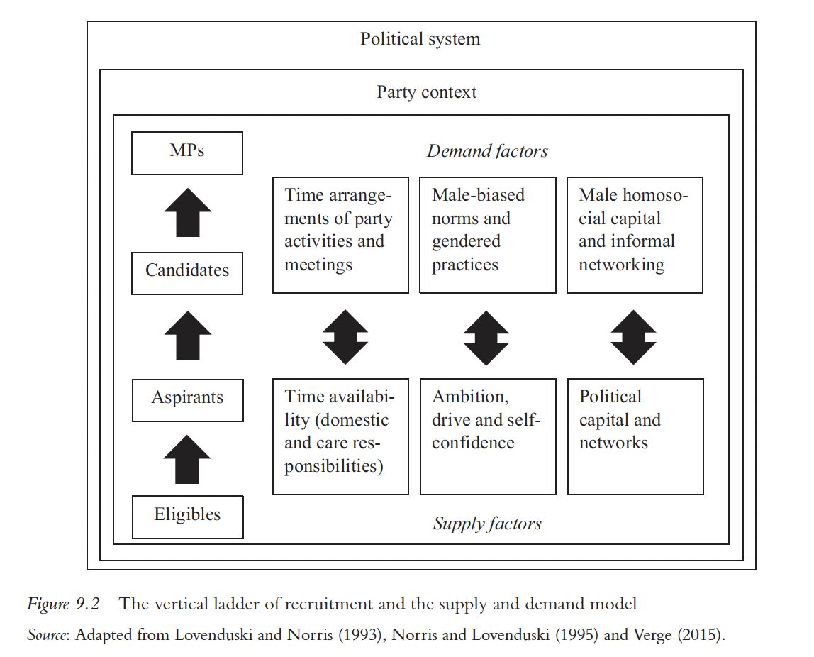
Supply-demand side of candidate recruitment
Political parties are difficult to place in this model
Demand
But can prompt supply too

Slide 5
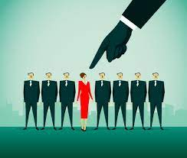
How to win a party nomination?
Party gatekeepers more likely to promote people like themselves
Female gatekeepers support women also informally
Case study: Canada (2004 and 2006 elections)
Each party nominates one candidate per district, if more candidates – primaries at local level

Slide 6
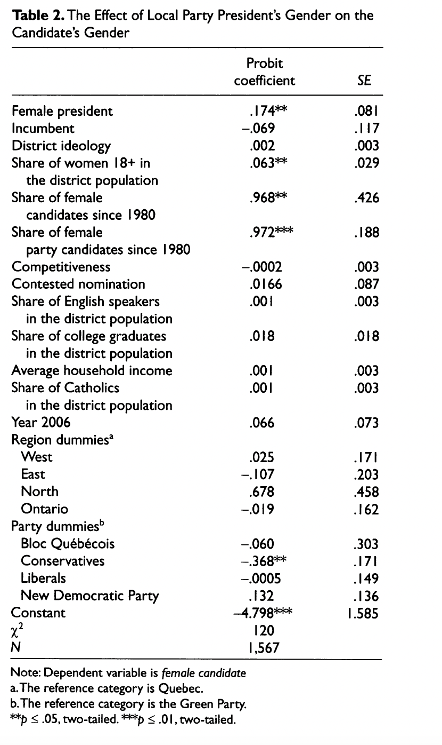
Canada 2004 and 2006
Local party leaders can influence slection processes on local level
Even if not directly responsible for selection

Slide 7
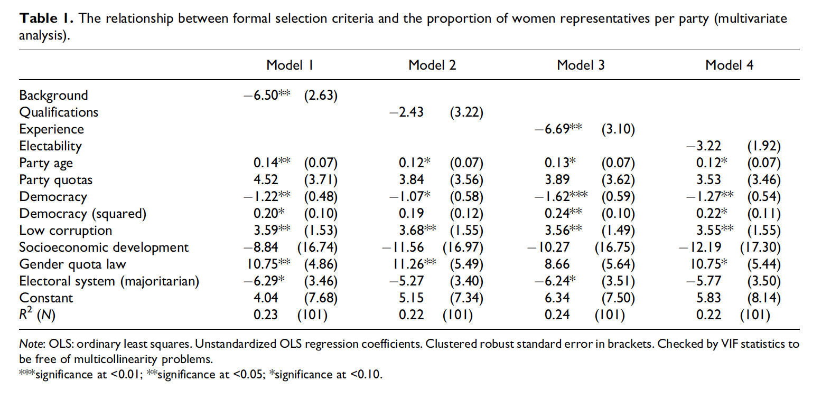
Selection criteria in parties
Party statuses
Gender neutral rules
Candidate background
Candidate qualifications
Candidate experience
Candidate electability
32 countries (Africa, Asia, CEE), 101 parties
Bjarnegard and Zetterberg

Slide 8
Informal rules
Enduring rules, nnorms, prectices, shaping collective. Behavior
Collective effect
Not codified
Rewards and sanctions from within and outside institutions
Prefernce for party experience (not in fromal rules) and local political expertise
Preference for incumbents
Assumption that women do not want to run
Scouting (in favore of women – Green party, violation of informal rules that candidates should come forward themsleves) (van Dijk 2023)

Slide 9

Outsiders on the inside?
Role of social networks
Party office holding is a gendered resource!
Sitting in party‘s executive office(s) = crutial for nomination
A key predictor in political carreers
Having a position in the party = different effects on men and women
Ca 30% of female top party positions (2006)
Men insiders are often ideal candidates

Slide 10
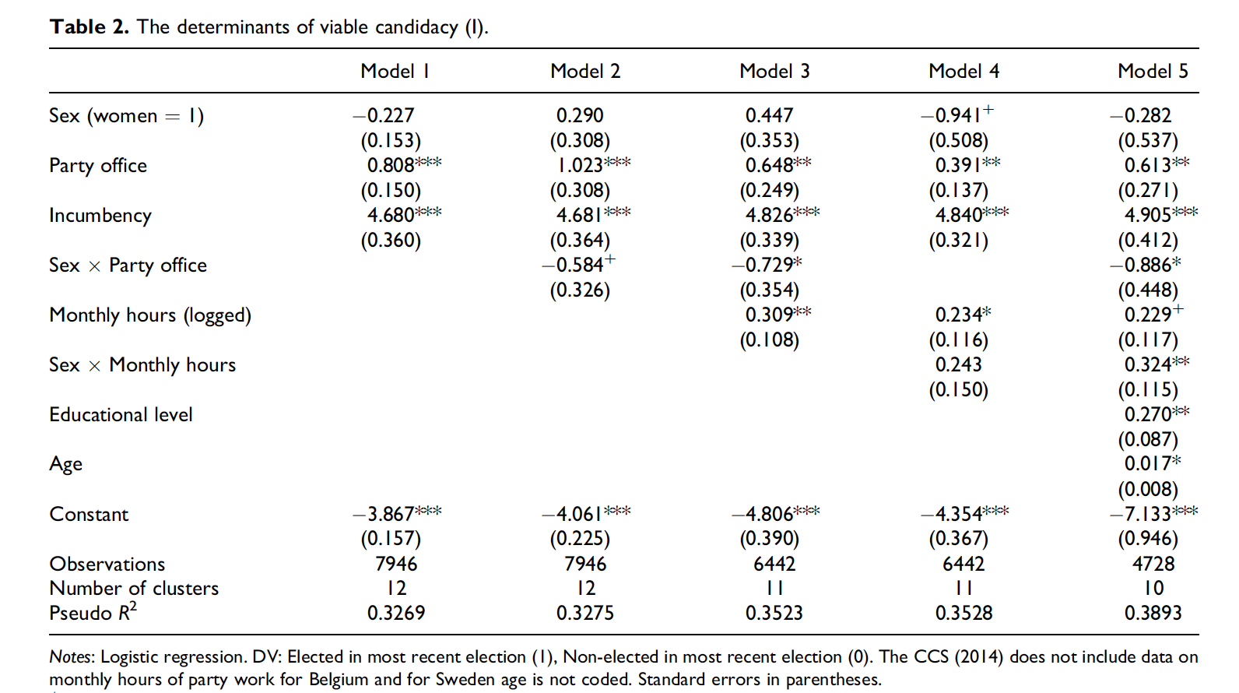
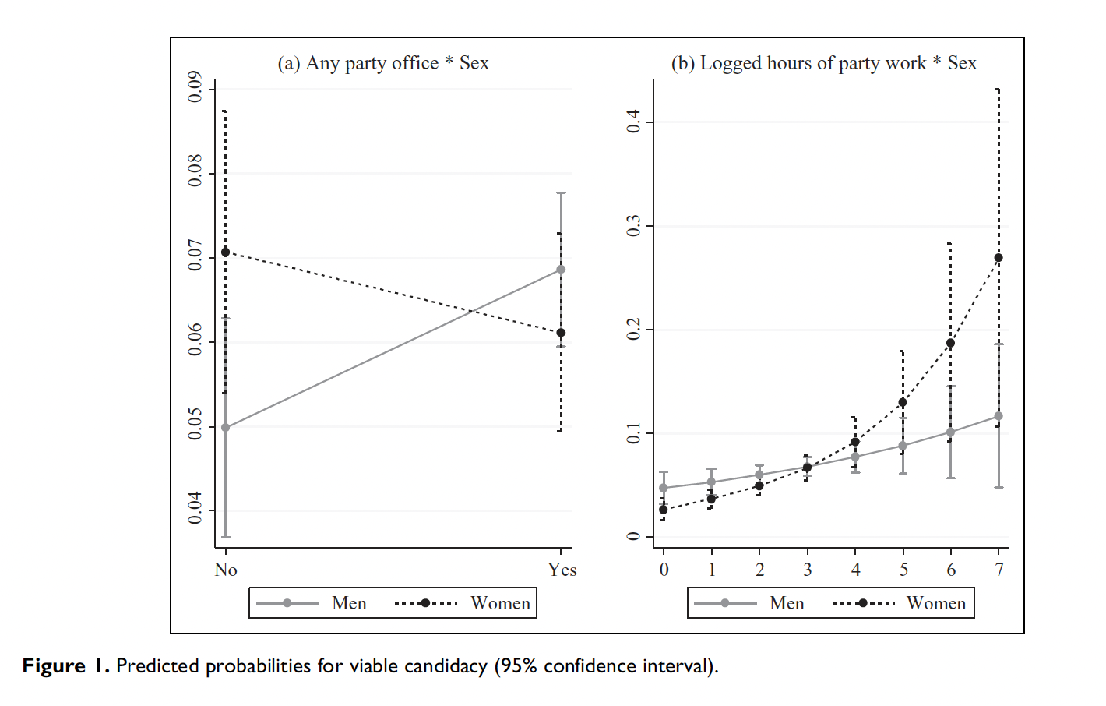
Outsiders on the inside?
Verge and Claveria 2013 (CCS 2005-12)

Slide 11
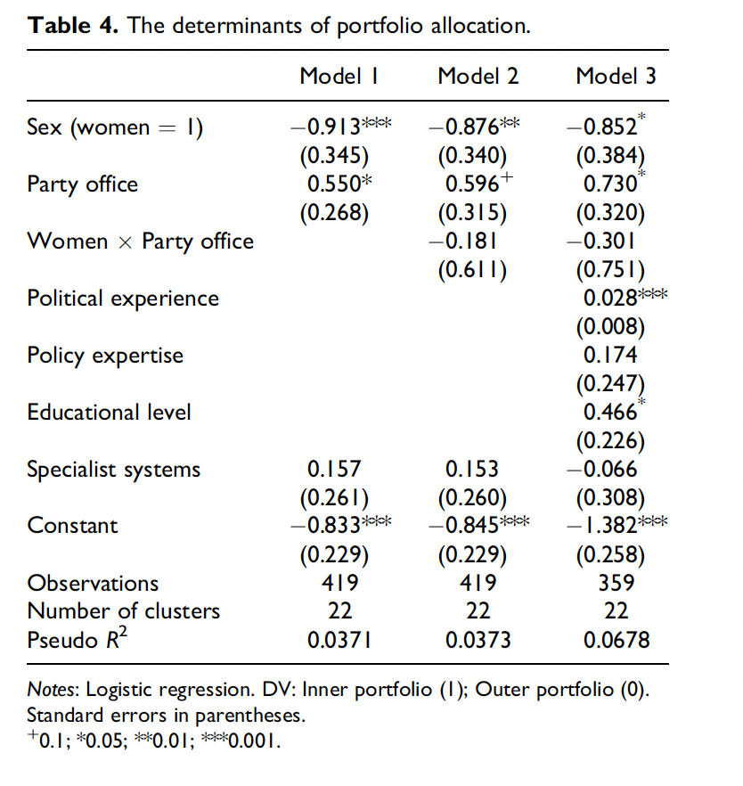
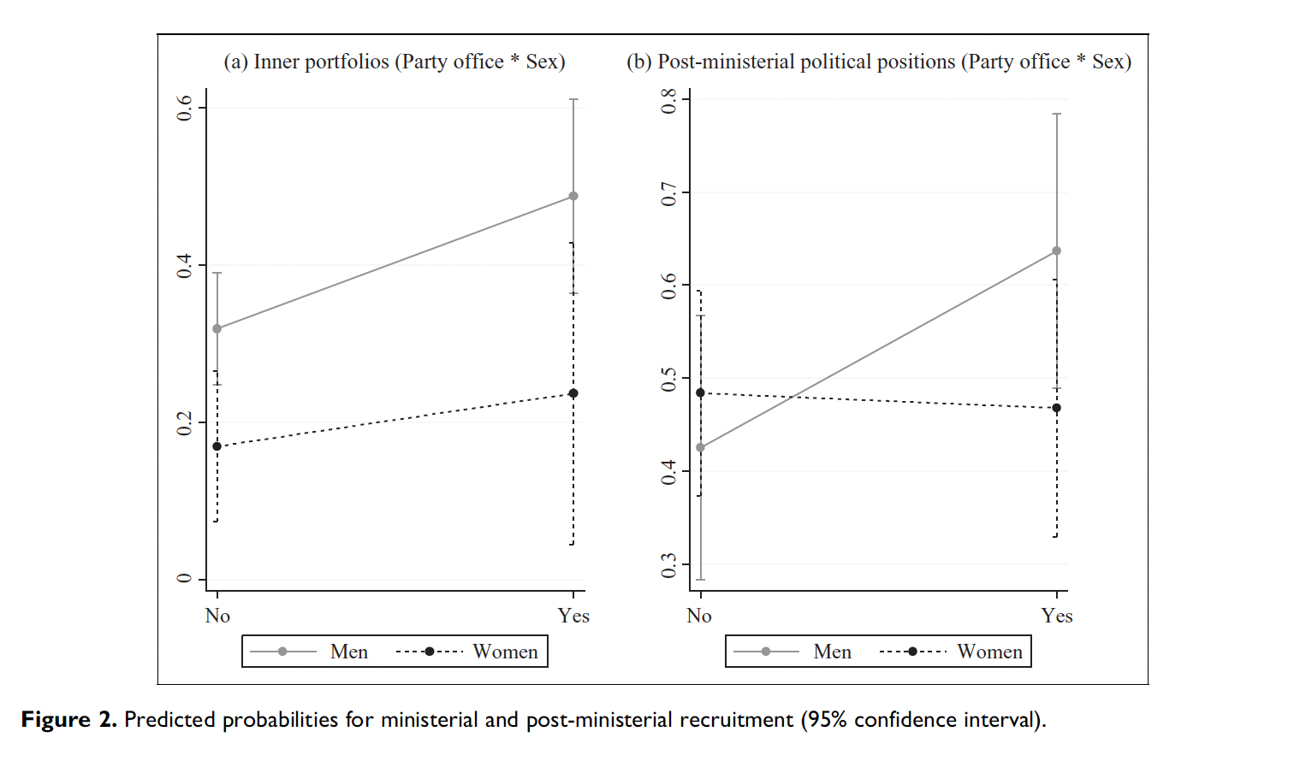

Slide 12
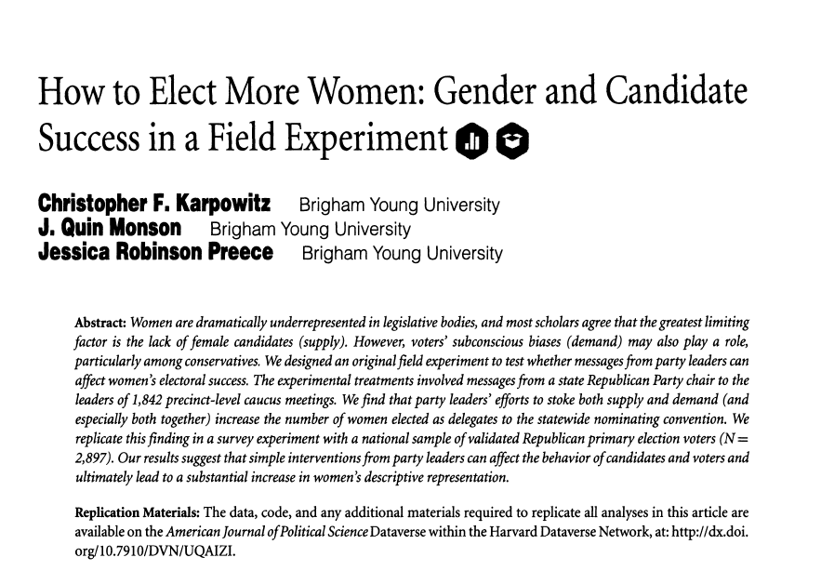
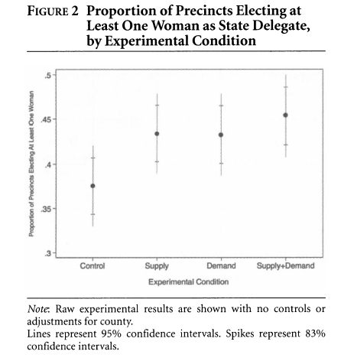
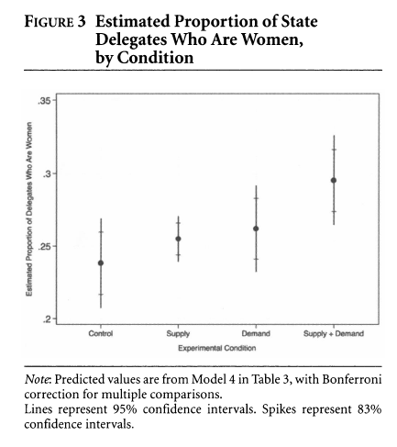
Parties need to actively recruit women
Experiment form the USA
Role of local party leaders
Subtle: manipulation of supply and demand side

Slide 13
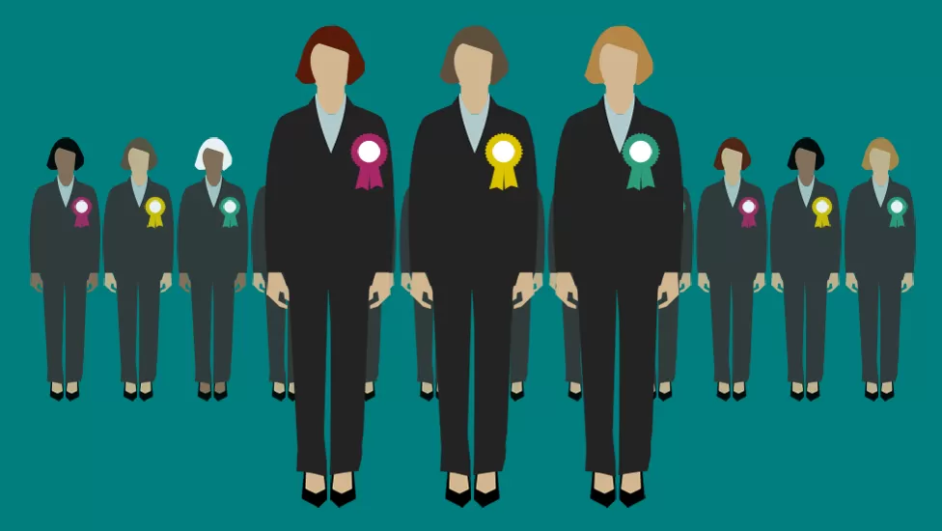
Party-level factors of women‘s representation?

Slide 14
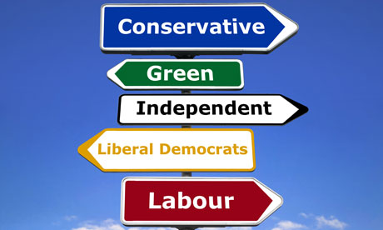
Party ideology
„How might a party's ideology directly or indirectly influence the success of women candidates?““

Slide 15
Ideology?
The main predictor of inclusion of women
Duverger 1955: Political Role of Women
Feminization of right-wing parties (sometimes: UK, LA, CDU)
Gender gap closing?
Ideology losing power?
Socio-economic vs post-materialist dimension

Slide 16
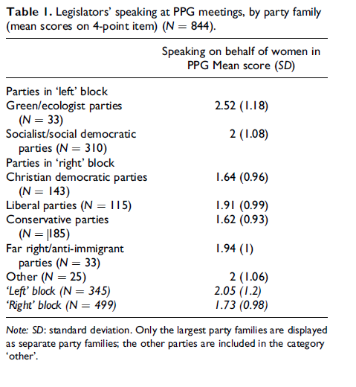
Does ideology still matter?
Better explanation when we abandon the one-dimensional measure of ideology
Two dimensions: socio-economic and post-material
Post-materialist left more connected to feminist post-materialsims
2008-2012 PARTIREP comparative survey among MPs
(AT, BE, DE, FR, HU, IT, NL, NO, PL, PT, ES, SE, UK)
Erzeel and Celis 2016

Slide 17
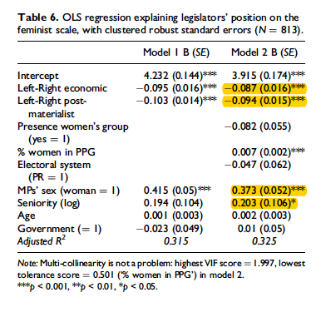
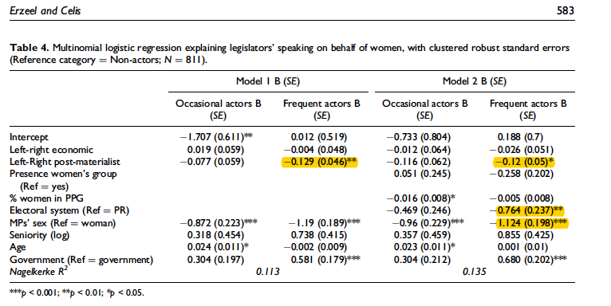

Slide 18
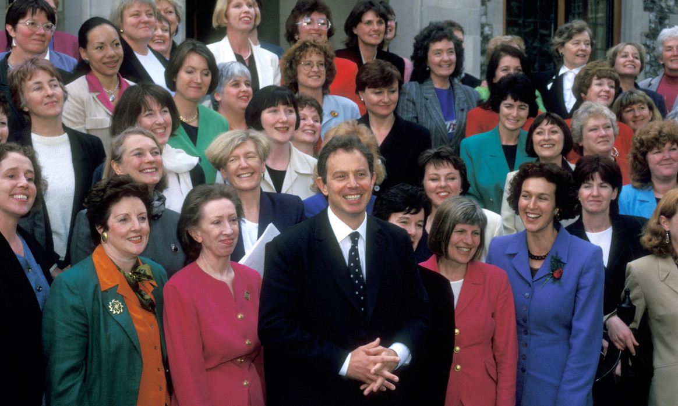
Feminization of parties: UK
Labour in UK
Change in 1997
Blair Babes (101 out of 120)
All-women shortlist
Blair, Brown focused on women electorate
“It is illustrative of how on the one hand women politicians are expected to make a difference and criticized for not transform centuries of male-designed traditions of politics. But on the other hand, they are expected to fit in with the culture of the institution an prove themselves according to the criteria developed during its long history as a male institution.” (Lovenduski

Slide 19
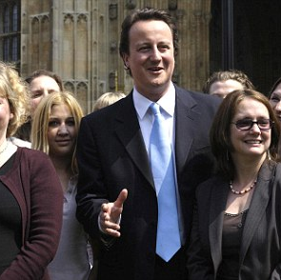
Feminization of the UK parties 2
Conservative party under D. Cameron
“scandalous under-representation of women in the party” as major problem
2010 party program
No adoption of AWS
Austerity policy and traditional conservative positions

Slide 20
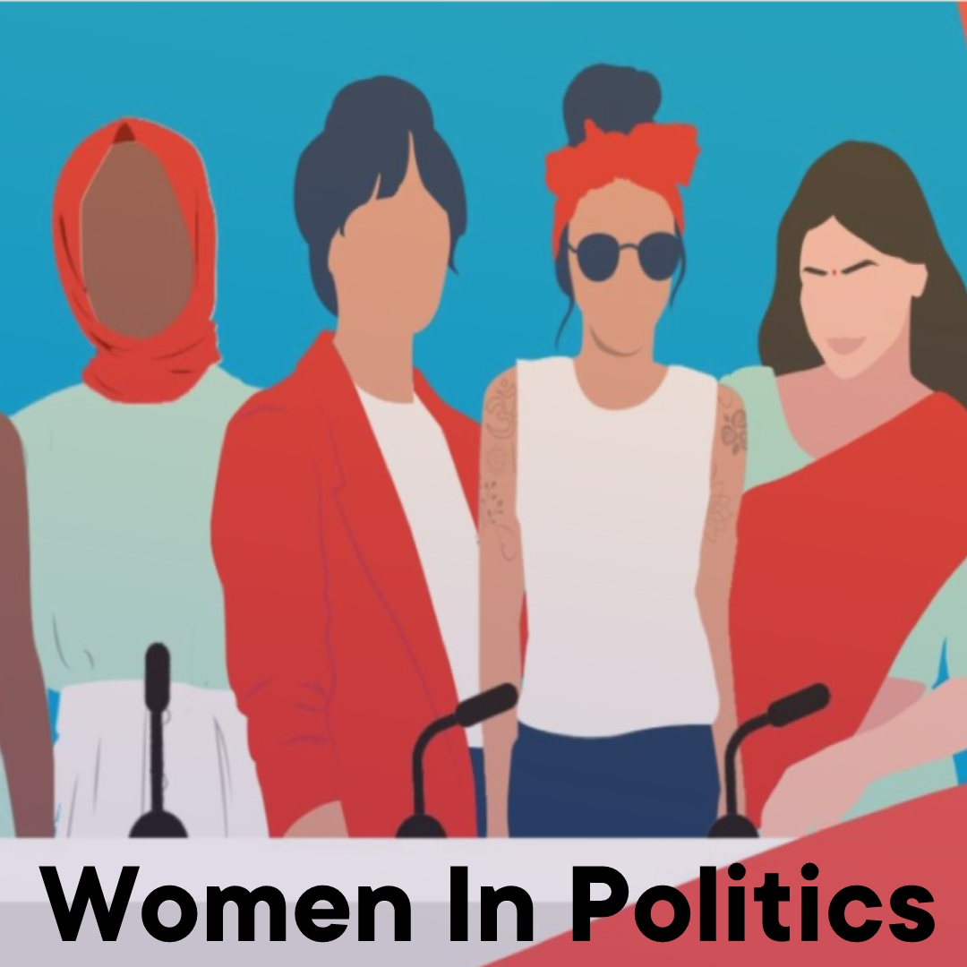
Women‘s orgainzations within parties
Women‘s section important in the past
Mobilization
Even before female suffrage
In 1980s rise of women‘s activities and demands
Dilemma: party structures or movement?
Scandinavian countries as an example
Change of the role of the sections

Slide 21
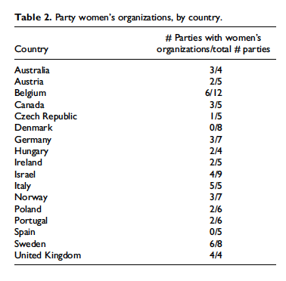
Women‘s organisations: yes or no?
Do women‘s sections prevent women from integration?
Not a modern feature
Parties abolishing these
Kittilson and Childs 2016
Data from 2011-2013

Slide 22
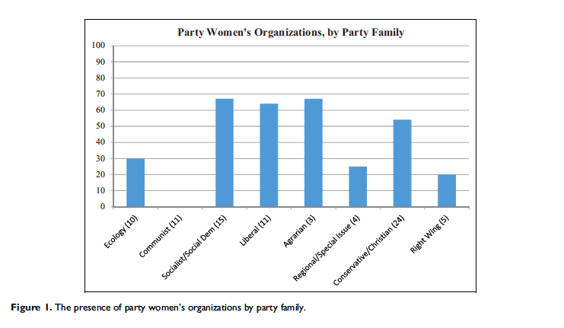

Slide 23
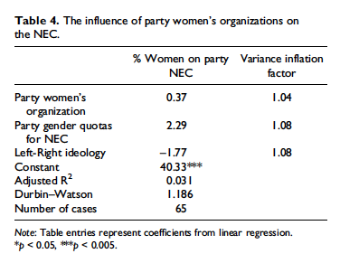
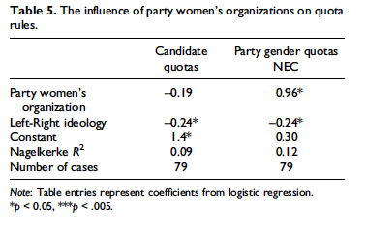

Slide 24
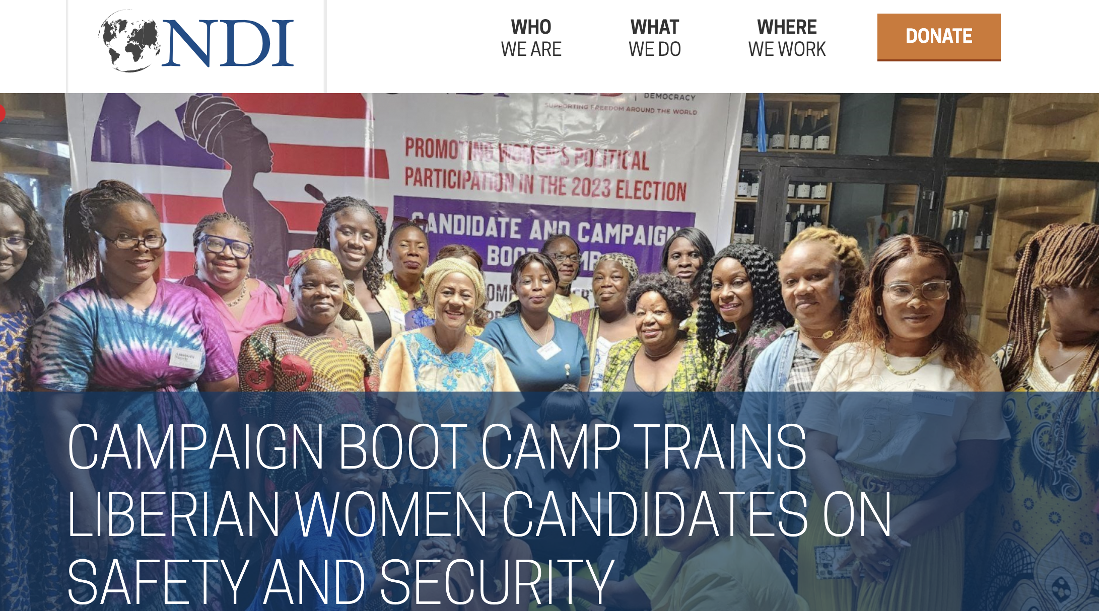

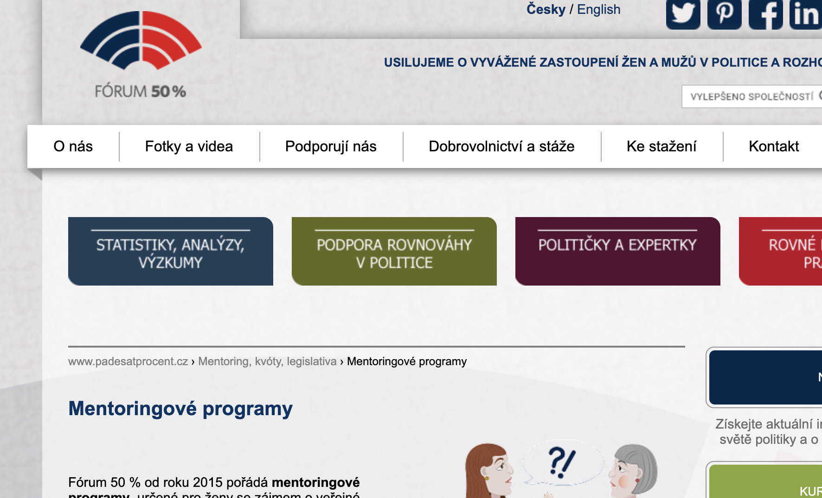
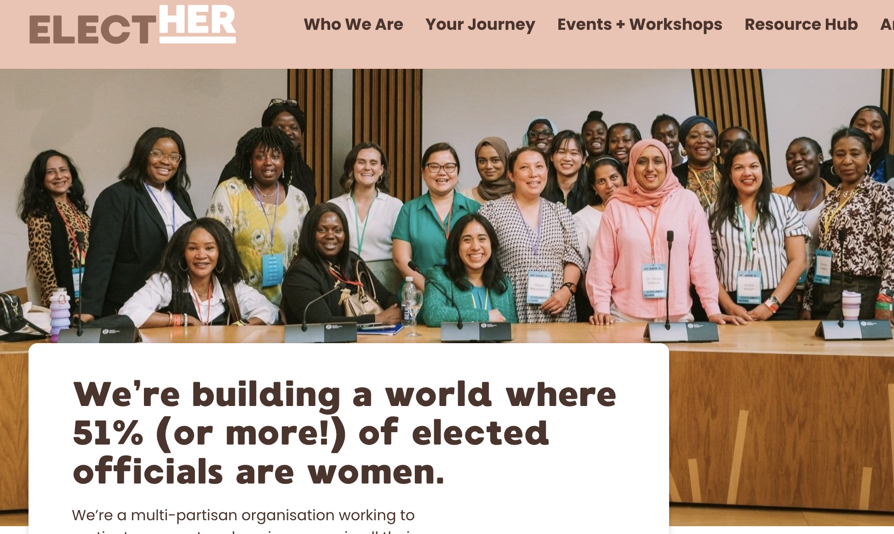

Women candidate training programs

