Slide 1
Social mobility - measurement
Social mobility indicates „societal openness“
Aggregated data and mobility tables
  Social classes
  Resources, barriers, desirability
  Mobility paths
  Macro-level of social analysis
  The first and third generation of SSR
Individual data and path analysis
  Social statuses, employment, socioeconomic indexes
  Aspirations, motivations
  Social variables influence labor market positions
  Micro-level of social analysis
  Second generation of SSR

Slide 2
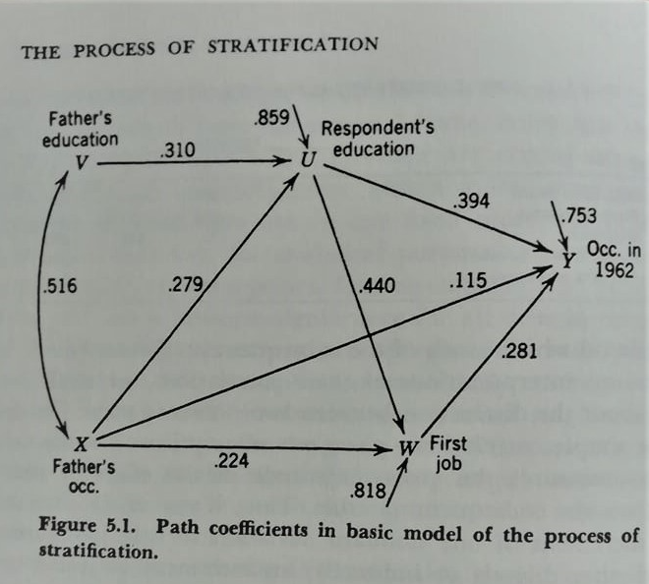

Blau and Duncan’s basic social stratification model
- Regression analysis
- Path analysis
- Structural Equation Modeling (SEM)

Slide 3
Mobility table
Intergeneration and intragenerational mobility
Social reproduction
Upward and downward social mobility
  long distance, short distance

Slide 4
Outflow mobility
calculation of percentages in rows
interpretation I: of all men originating in class Y, X% moved into class Z
interpretation II: the probability of a man born into class Y, moving into class Z, was X%

Slide 5
Inflow mobility
calculation of percentages in columns
interpretation: X% of all men in class Y came from class Z
social composition of classes, „social heterogeneity“

Slide 6
Structural and net mobility I
Social Mobility = structural mobility + net mobility
Structural (forced) mobility is given by
  economic and technological changes
  demographic changes (class difference in fertility, mortality, migration…)
Net mobility is real mobility
  how different class origins influenced destinations
  inequality in mobility chances stems from differences in:
    class resources
    class bariers
    class desirabilities
Identification structural mobility by Dissimilarity index

Slide 7
Dissimilarity index - DI, D, or Δ
DI is computed as sum of positive differences between two percent distributions divided by number 2:
Values <0;1>
Interpretation: what proportion is needed for the situation in which two distributions are identical?

Slide 8
Structural and net mobility II
Problems in identification structural mobility by DI
  two class structures are incomparable because of „career mobility“
  „age problem“ in SM research
Many efforts to empirically identify net mobility with the help of „mobility indexes“
  no proper way
Solution: change in conceptualization of intergenerational mobility
Social origin vs. social destination (SO - SD) (no intergenerational mobility)
Structural and Exchange mobility are replaced by concepts absolute and relative mobility
  It is not possible to measure structural and exchange mobility in data ex post
Contingency table: Father, Son and The Holy Ghost (the core of mobility table) (R. Erikson, J. Golthorpe: Constant Flux, 1992)

Slide 9
Absolute and relative social mobility I
  Absolute mobility is probability of ending up in a different social class from the one a person was born into.
    Usually the movements are often small: from class 2 to 1, say, or from class 5 to 6.
    Measured in percent (%)
  Relative mobility is chance, if a person started in, say, class 6 or 7, of making it to, say, class 1 or 2 compared with those who started at the top.
    It is an answer to the question: if a person starts at the bottom, how many times less likely to make it to the top than somebody born there
    Measured in odds ratios (OR)

Slide 10
Absolute and relative social mobility II
Key questions:
How strong is the relationship between where you start out (origin) and where you go to (destination)?
What is the chance of a man from class Y to end up in class Z rather than in another class?
OR (odds ratio) is the convential meassure of inequality in access to particular class destinations from different class origins.

