Slide 1
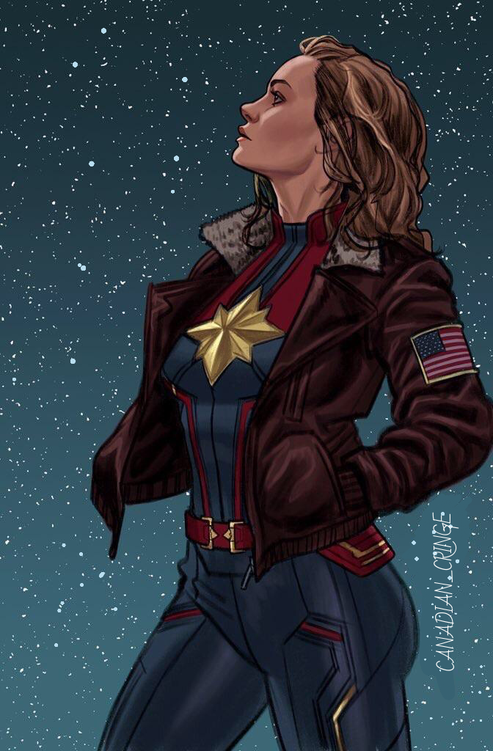
Transformative fans and the allure of dismantling heteronormative hegemony
Mgr. Iveta Jansová, Ph.D.

Slide 2
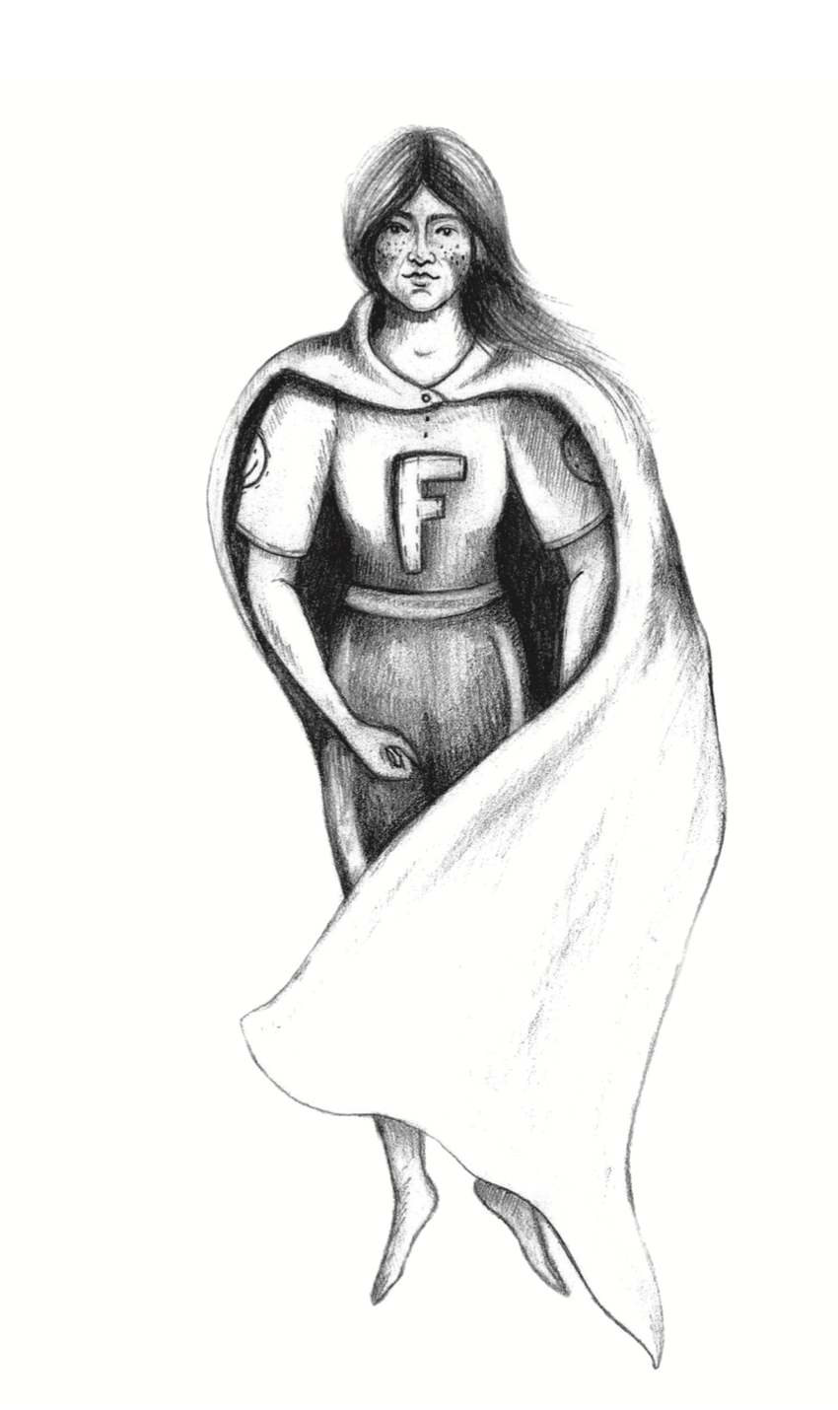
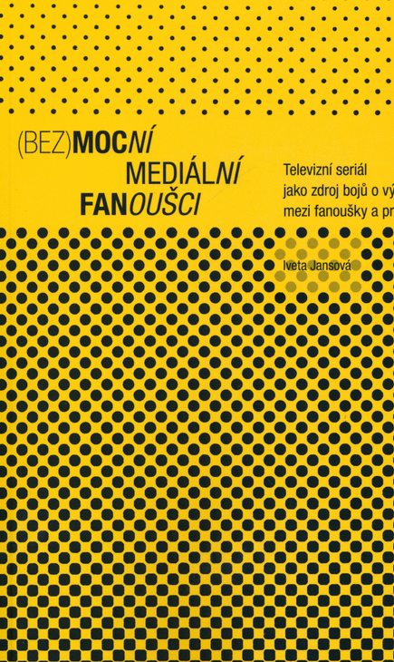
Our talk will be based on my longitudinal research into fans

Slide 3
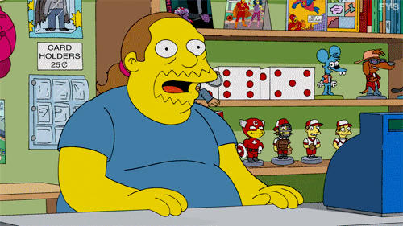

Who is a fan?
fan / fen (*fanatic)
sport fans, music fans, TV/movie fans… (fan studies, 90`s)
fans were perceived negatively in the history - stupid, asocial, misfits – powerless
we see a different picture nowadays – active, loyal, activists – powerful (Jenkins 1992, Hills 2002 etc.)
(white) men were imagined to be “default fans” (Stanfill 2019) – not really a reality
affirmational vs. transformational fans – depends on the relationship towards the original text (need to rework it or need to leave it be exactly as it was)

Slide 4

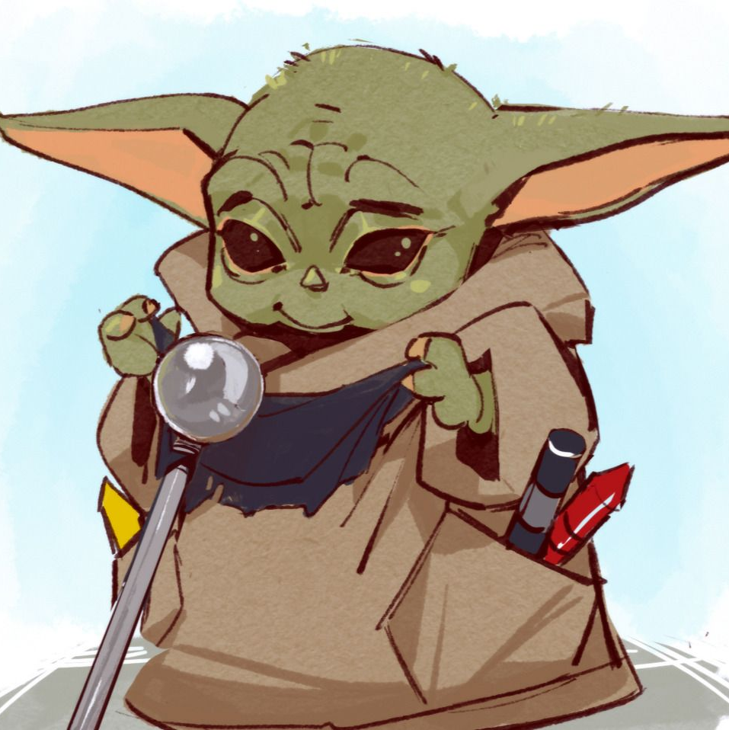
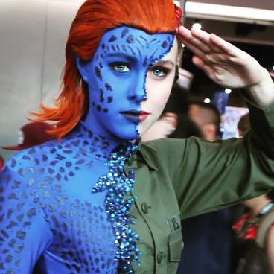
What does a fan do?
reading, writing, song writing, drawing cosplay, activism, commenting, sharing, betareading, vlogging, tumblring, comic-coning etc.
borrowing from already existing texts (TV series, comics, music etc.) and creating something new
But why:
  love for the text/author/performer, continuation, coming back to ”the place”
  righting the wrong
  overthrowing the status quo (“fighting” heteronormativity, racism, ageism)

Slide 5

How to study fans/fan practices?
Textual analysis (text of fans, text about fans…)
Observing fans and talking to them – ethnography, interviews, …
Case studies of fandoms (mix method approach)

Slide 6
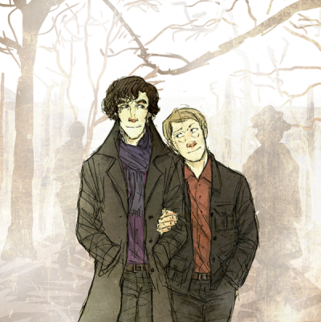
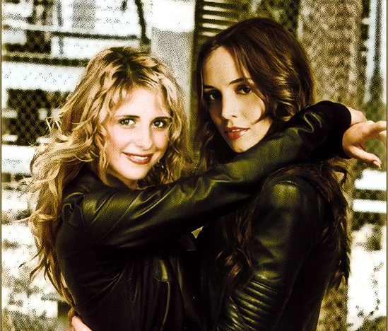
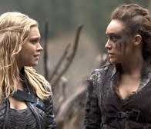
Fem/slash creativity and activism
femslash and slash – type of pairing of two female (femslash) or male (slash) characters
why – bad representation in media, not enough representation…
= simply, representation is important, we want to see OUR stories in the media, and they are not often there, especially if we are somehow marginalized (by our sexuality, handicap, race, gender, age, looks, social status etc.)

Slide 7
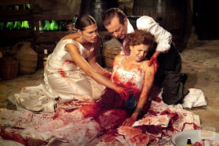
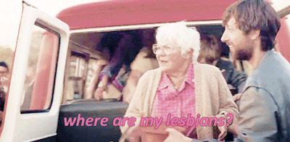
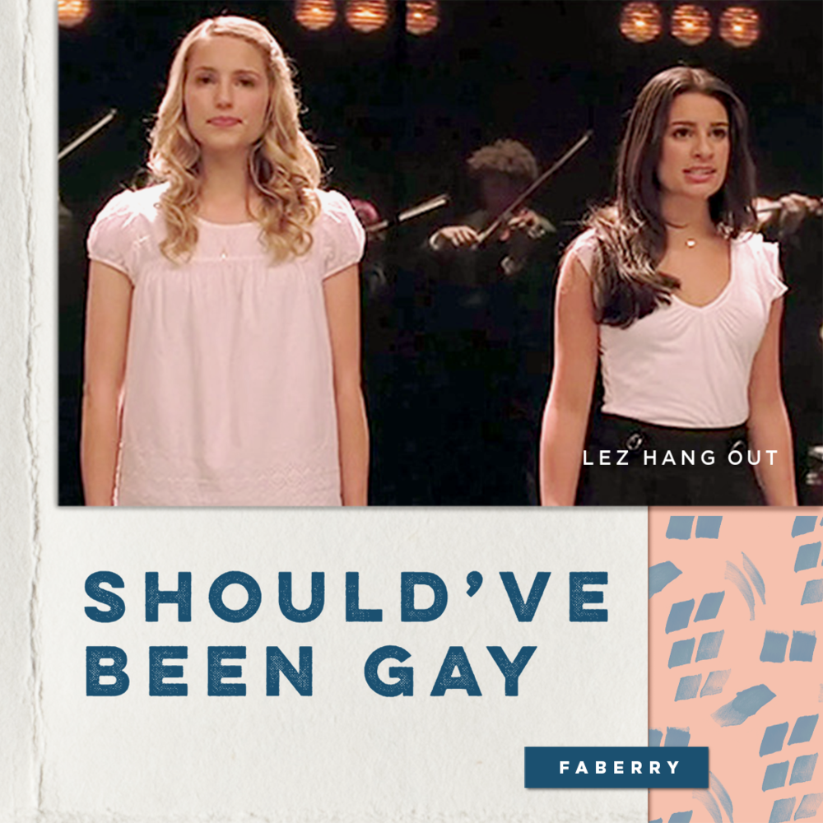
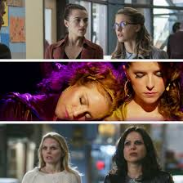
Why ”to femslash”?
Once again why:
  not enough stories,
  bad representation,
  very common deaths of LGBTQ+ characters (burry your gay trope)
  queerbaiting

Slide 8
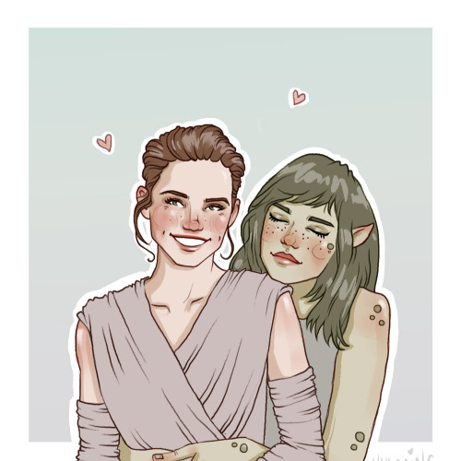
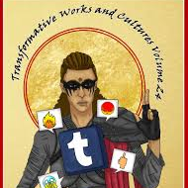
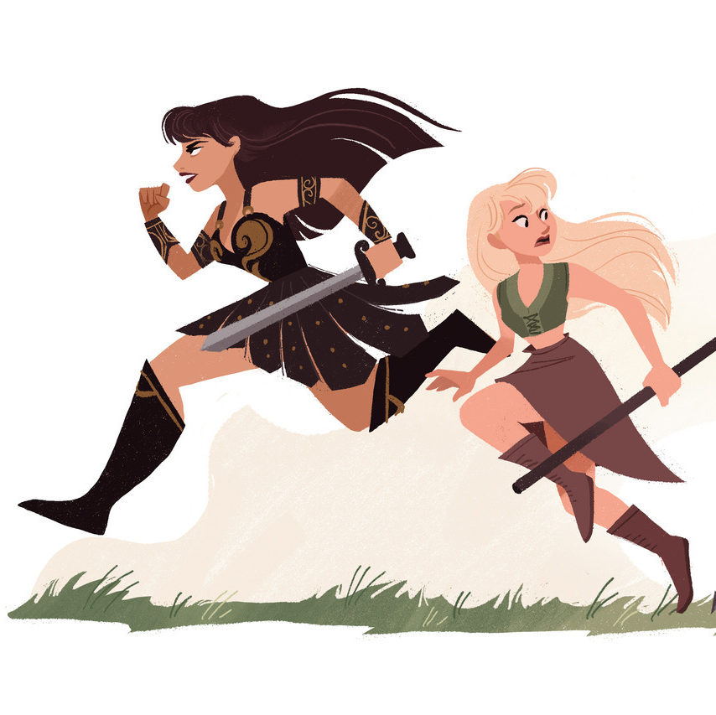
How ”to femslash”?
-
Creativity or activism
creating songs, texts, costumes, videos and many more
sharing with others, being part of the community (fandom)
doing activism – protesting bad representation, saving favorite shows (SOS campaigns), creating educational spaces (CLEXACON, documentaries etc.), crowdsourcing (web-series, movies, books etc.)…

Slide 9
