Slide 1
(Social) media and political polarization
Alena Kluknavská
#MUNI

Slide 2
Overview of the lecture
What is political polarization
The role of (social) media in polarization
Broader context which affects polarization
The current state of research on the media and political polarization

Slide 3
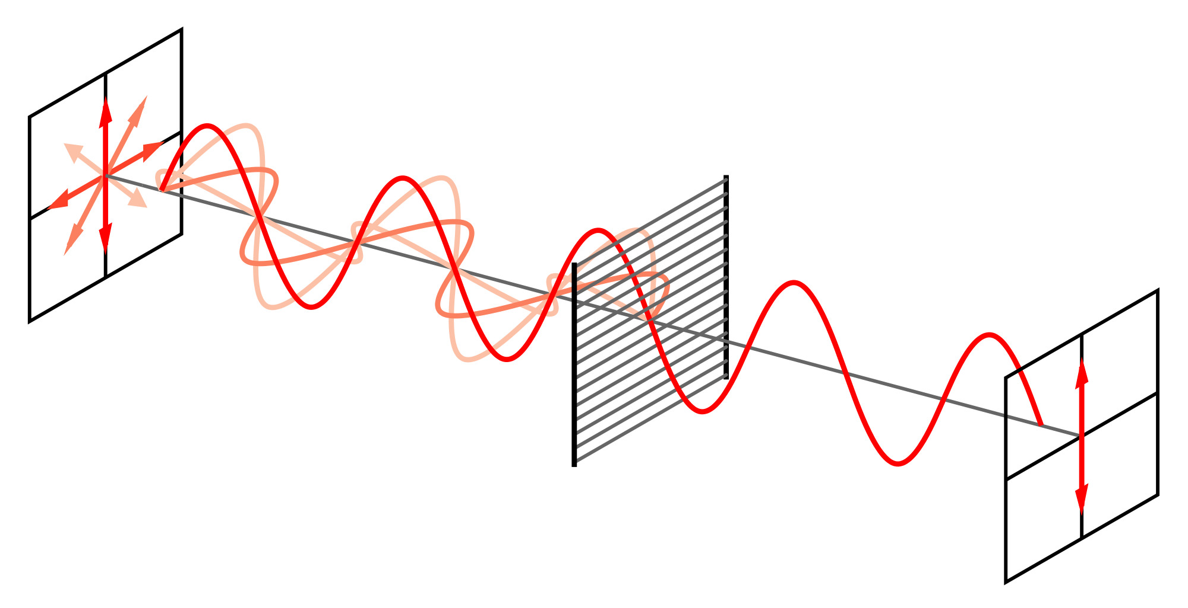
Polarization

Slide 4
Political polarization: How would you define it?

Slide 5
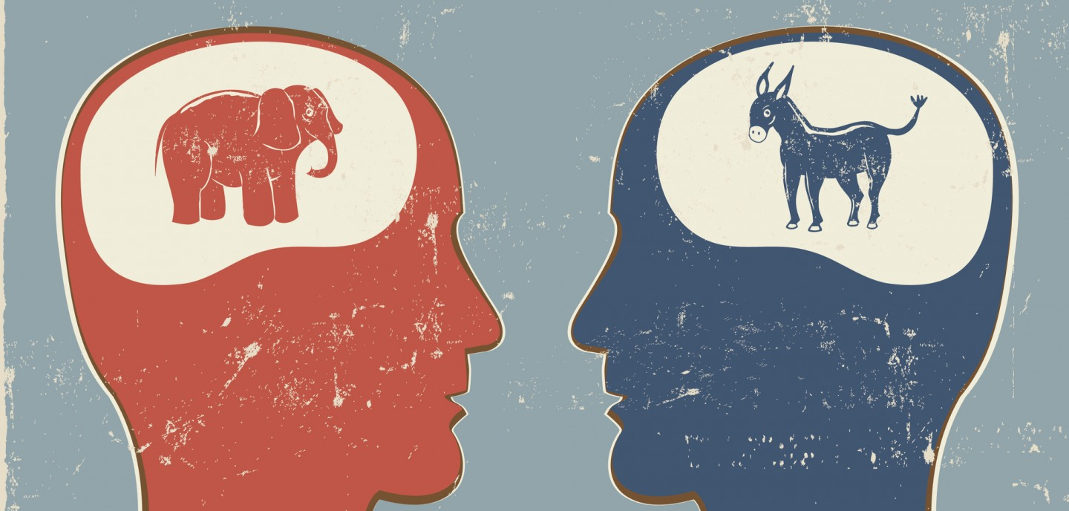

Slide 6
Political polarization: two distinct forms
Ideological polarization
Affective polarization

Slide 7
Ideological polarization
Divergence perspective:
  the divergence of political opinions, beliefs, attitudes, and stances of political adversaries
  division into two sharply contrasting groups or sets of opinions or beliefs
  more politically divided and societal groups ideologically opposed to each other
  these positions become more extreme and entrenched over time
Alignment perspective:
  the degree to which citizens’ positions on a given issue are defined by their partisan or ideological identity
  views have become increasingly connected to citizens’ political identity
  ideological constistency: the degree to which people consistently align themselves with one side or another
  often leading to a sharp divide along ideological or partisan lines
  people tend to align themselves with one of two opposing positions, such as conservative vs. liberal

Slide 8
Affective polarization
Based on work considering the role of identity in politics and how identity felt towards some groups (e.g., political parties) can worsen animosity towards other groups
It relates to interparty hostility
Assesses the extent to which people like (or feel warmth towards) their political allies and dislike (or feel lack of warmth towards) their political opponents
How warm or cold they feel toward each party

Slide 9
Implications of political polarization
Political gridlock (in bipartisan political systems especially)
Reduced cooperation of political parties
Negative campaigning
Media fragmentation
Social and societal divisions
Erosion of trust
Radicalization
Ineffective policy solutions

Slide 10
How can we measure political polarization empirically?

Slide 11
Ideological polarization
Usually surveys
  Liberal-conservative scale
  The extent to which they support/agree or do not support/agree (with) a specific political topic (e.g., climate change)

Slide 12
Affective polarization
Warmth and favorability ratings, sentiments
Examples in empirical studies:
Iyengar et al. (2012): “feeling thermometer” – warmth/favorability ratings of political allies vs. political opponents (how warm or cold they feel toward each party)
One’s own positive/negative emotional valence before and after seeing a video of a politician
Content: the positive and negative sentiment used in Tweets about political allies and opponents
Social distance: Respondents were asked whether they would be happy or unhappy if their son or daughter married a member of the other party; questions about accepting members of the opposite group as close personal friends, neighbors on the same street, coworkers in the same occupation, citizens in their country, visitors in their country, or whether they would exclude them from their country

Slide 13
The role of (social) media
Accelerated and amplified changes in media and political communication in recent years
Media becoming more fragmented and partisan = people becoming more polarized (ideologically and affectively)
Social media can shape perception of political environment
Good or bad for democracy?
Yet, mixed results: no effect on political polarization; and in certain circumstances, depolarizing effects
Prior (2013): suggests media may not significantly affect polarization of the person – but no distinction between type of polarization + focus solely on the U.S., and importantly – so much has changed since 2013

Slide 14
What do you think has changed in the last 10 years?
Political, economic, media environments…

Slide 15
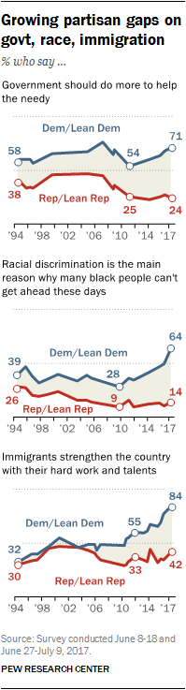
What has changed, you ask?
Notes:
Pew Research Center. (2017). The partisan divide on political values grows even wider. Retrieved March 9 2021, from https://www.people-press.org/2017/10/05/the-partisan-divide-on-political-values-grows-even-wider/.
Pew Research Center. (2019). Social Media Fact Sheet. Retrieved from https://www.pewresearch.org/internet/fact-sheet/social-media/

Slide 16
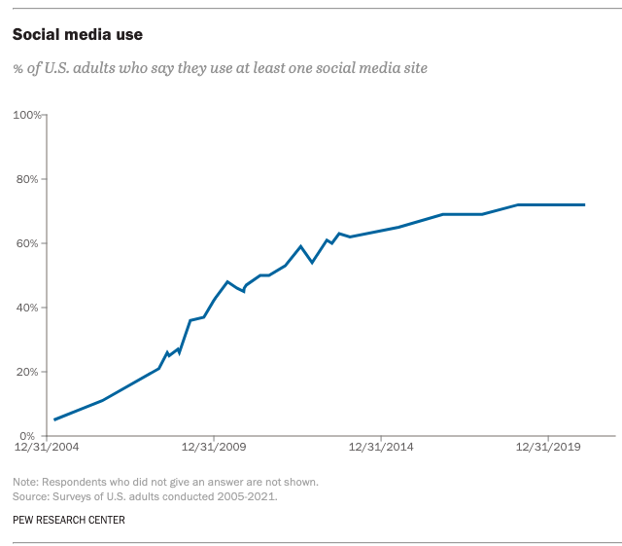
What has changed, you ask?
Notes:
Pew Research Center. (2017). The partisan divide on political values grows even wider. Retrieved March 9 2021, from https://www.people-press.org/2017/10/05/the-partisan-divide-on-political-values-grows-even-wider/.
Pew Research Center. (2019). Social Media Fact Sheet. Retrieved from https://www.pewresearch.org/internet/fact-sheet/social-media/

Slide 17
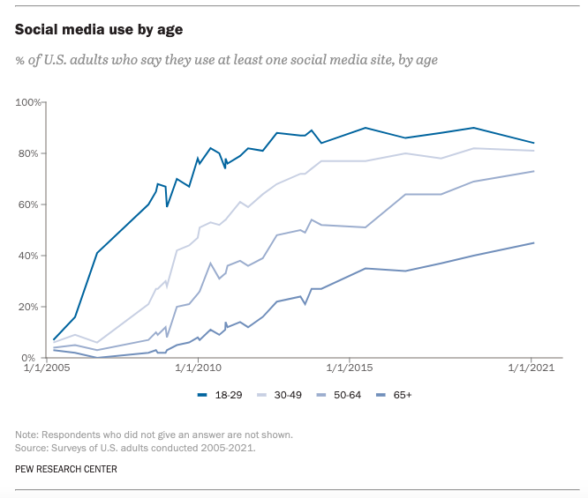
What has changed, you ask?
Notes:
Pew Research Center. (2017). The partisan divide on political values grows even wider. Retrieved from https://www.people-press.org/2017/10/05/the-partisan-divide-on-political-values-grows-even-wider/.
Pew Research Center. (2019). Social Media Fact Sheet. Retrieved from https://www.pewresearch.org/internet/fact-sheet/social-media/

Slide 18
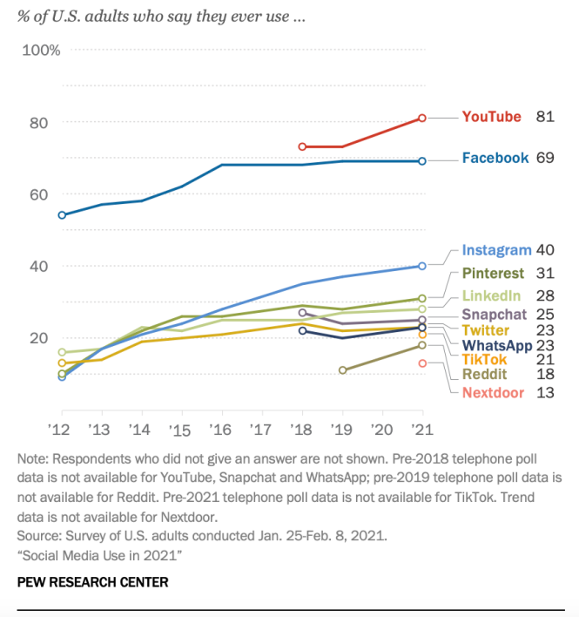
Notes:
Pew Research Center. (2021). Social Media Use in 2021. Retrieved from https://www.pewresearch.org/internet/2021/04/07/social-media-use-in-2021/

Slide 19
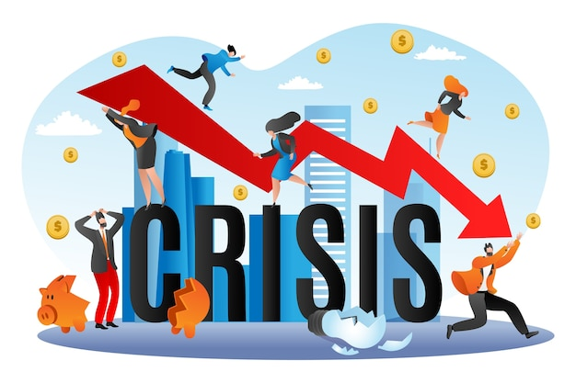
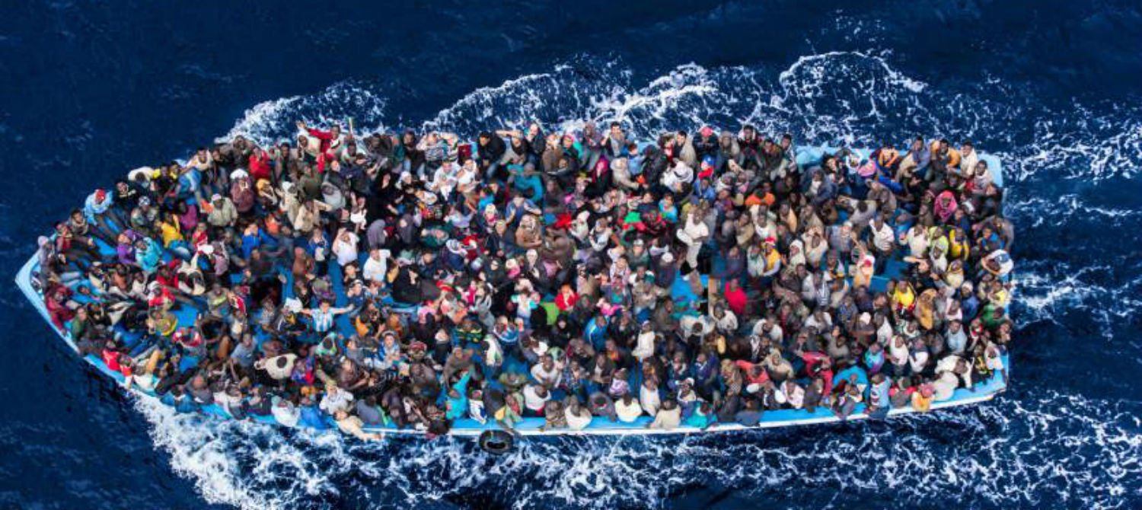


Slide 20
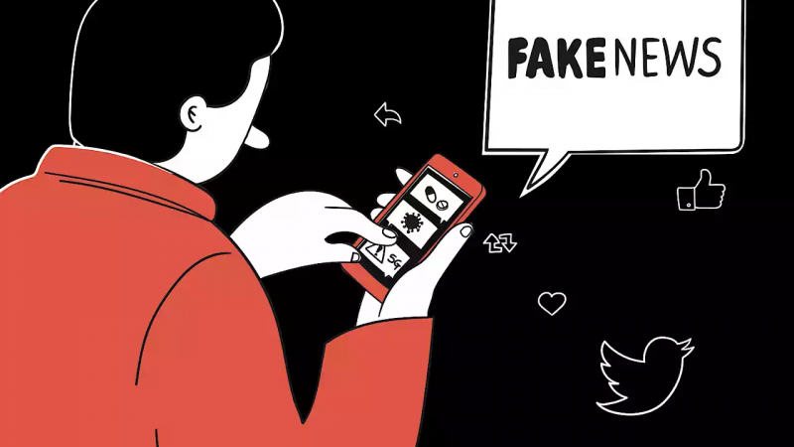
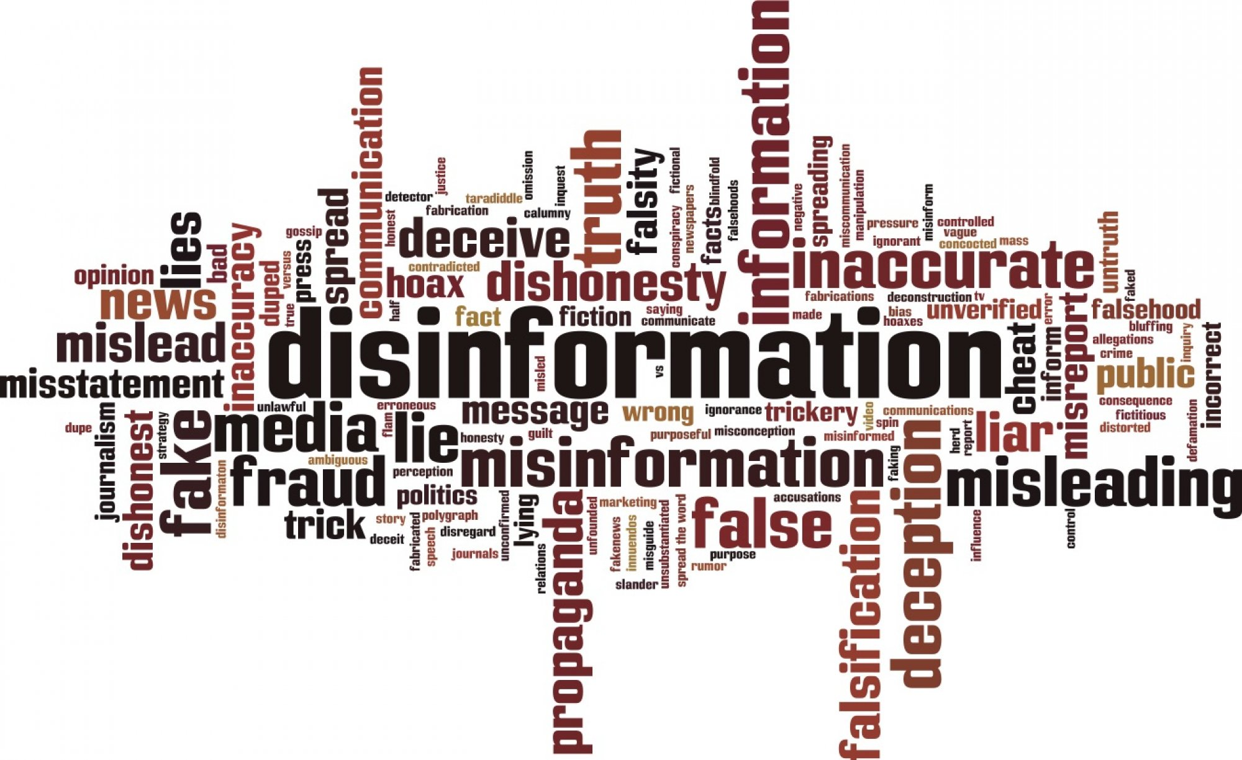

Slide 21
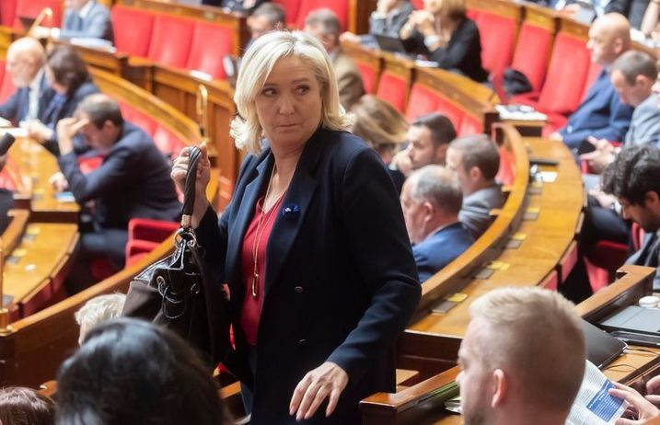
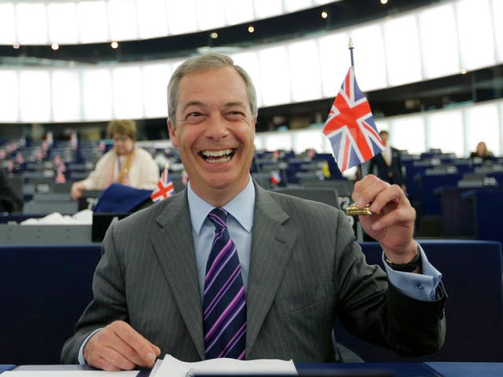
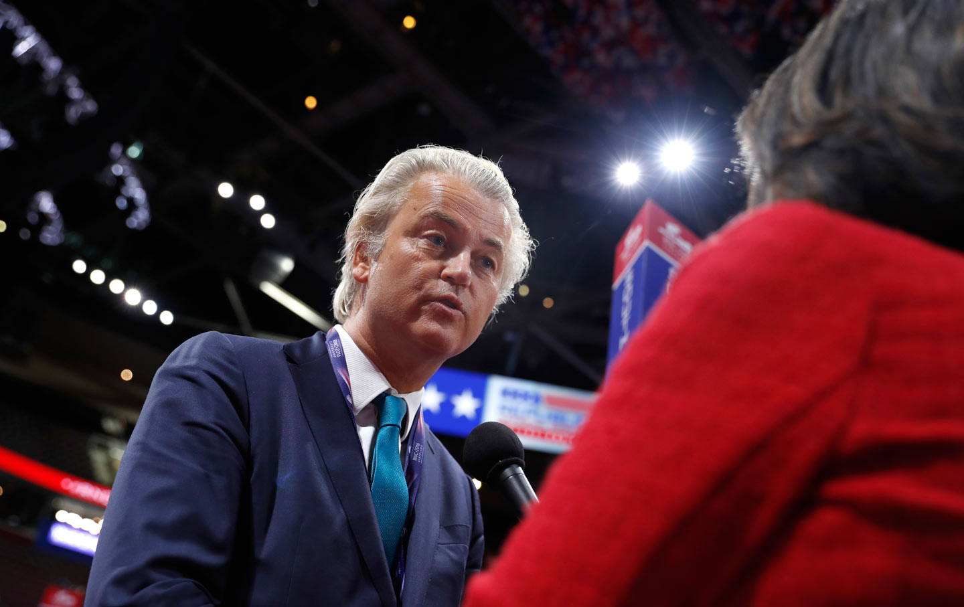
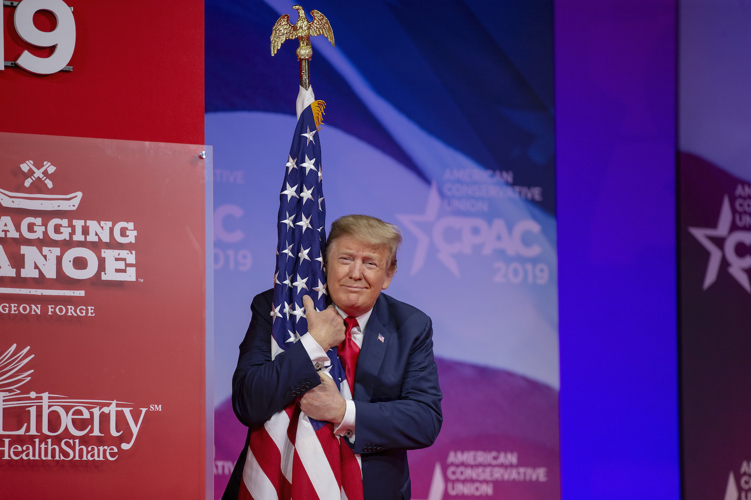

Slide 22
The current state of research on media and political polarization

Slide 23
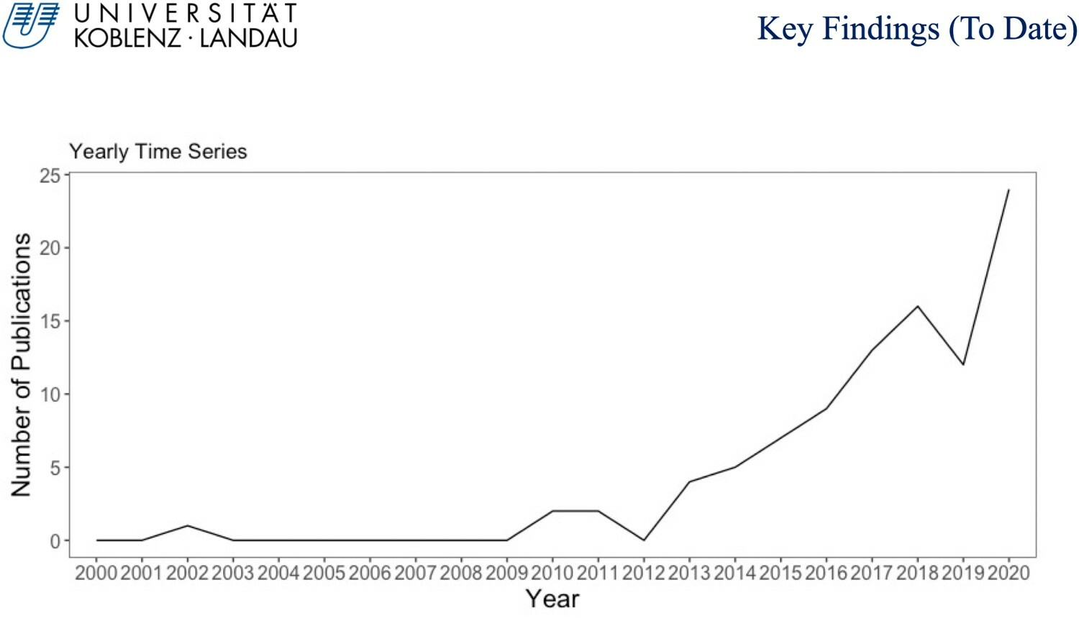
The development of the field ‘media and polarization’ over time

Slide 24
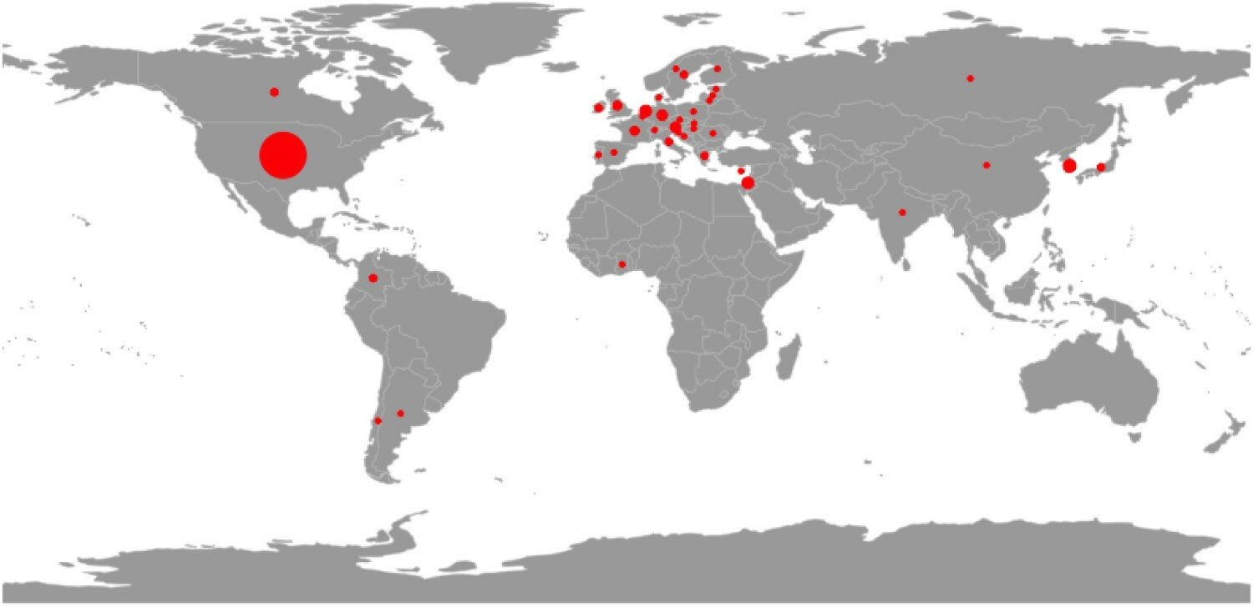
The country of samples: ‘media and polarization’

Slide 25
Areas of research: What do we know about the (social) media and polarization? (Kubin & von Sikorski, 2021)

Slide 26
Areas of research
Media content: polarization of media content
Media exposure: link between exposure to media and polarization of audiences
Media effects: link between media (use, content, features) and polarization

Slide 27
Media exposure: How does exposure to certain media content link to political polarization?
Effect of exposure to the media source on audiences
An increased use of traditional media can reduce ideological polarization
Fake news and disinformation – driving ideological polarization
Pre-selective exposure: decisions made outside of the viewers discretion (e.g., algorithms)
Selective exposure: decisions made by the viewer, selection on pre-existing beliefs
The effects of selectively consuming certain media content on polarization
  Tends to increase both ideological and affective polarization
  Partisan media especially polarizing
  Like-minded media makes people more ideologically and affectively polarized
  Less clear whether exposure to counter-attitudinal media increases polarization

Slide 28
Media content: Has media coverage been increasingly polarized?
Exploring the content of media sources (different media)
Conducting content analyses of social media posts and news content
Focus: the extent to which media content is politically polarized
Social media (often Twitter) + traditional media
Evidence of increasingly polarized content
Empirical study: Tweets by U.S. politicians - Republican politicians used more polarizing language and rhetoric than Democratic counterparts

Slide 29
Media effects: How do (can certain types of) media affect political polarization?
Effects of social media:
  Can further ideologically polarize people - negative Tweets about candidates, uncivil FB comments, counter-attitudinal Twitter posts – make people more ideologically polarized
  Can also affectively polarize people: social media comments that derogate political adversaries increase affective polarization
Effects of traditional media:
  Ideological talk shows tend to increase ideological polarization
  Fact-checkers reduce ideological polarization
  Reading a news article about an in-party scandal, being exposed to likeminded news media, incivility on news media from out-party sources (e.g., Fox News for Democrats) – associated with increased affective polarization

Slide 30
Thank you for participating!

Slide 31
Literature
Emily Kubin & Christian von Sikorski (2021) The role of (social) media in political polarization: a systematic review, Annals of the International Communication Association, 45:3, 188-206, DOI: 10.1080/23808985.2021.1976070
Pew Research Center. (2017). The partisan divide on political values grows even wider. Retrieved from https://www.people-press.org/2017/10/05/the-partisan-divide-on-political-values-grows-even-wider/.
Pew Research Center. (2019). Social Media Fact Sheet. Retrieved from https://www.pewresearch.org/internet/fact-sheet/social-media/
Pew Research Center. (2021). Social Media Use in 2021. Retrieved from https://www.pewresearch.org/internet/2021/04/07/social-media-use-in-2021/

