Slide 1
Problematic smartphone use & Attention economy
Jana Blahošová
Autumn 2023 Current issues in research of media and audiences

Slide 2
01
PROBLEMATIC SMARTPHONE USE (PSU)

Slide 3
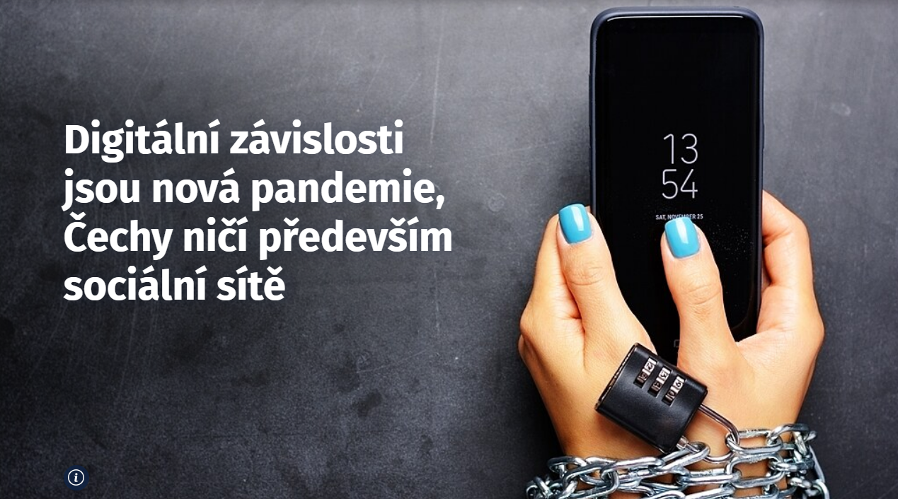
Translation:
Digital addictions are the new pandemic, Czechs are destroyed mainly by social media

Slide 4
QUIZ

Slide 5
QUESTION 1
What percentage of the world's total population uses a mobile phone?

Slide 6
KEY NUMBERS ABOUT PHONES
68% of the global population
64.4% of the global population
3 hours 46 minutes
Use mobile phone (5.44 billion of people)
Use internet (5.16 billion of people)
Average daily time spent using the internet on mobile phones
Kemp (2023)

Slide 7
QUESTION 2
How much time do you spend on your mobile phone daily (in hours)?

Slide 8
WHY IT IS SO HARD?
RECALL BIAS
Innacurate or incomplete recollection of events by study participants
SOCIAL DESIRABILITY
Respondents give answers to questions that they believe will make them look good to others
Studies on sensitive topics (e.g., drug use, sexual behavior)
RAPID & FRAGMENTED USAGE
Smartphones are typically used in rapid and fragmented ways throughout the day
Hard to correctly estimate

Slide 9
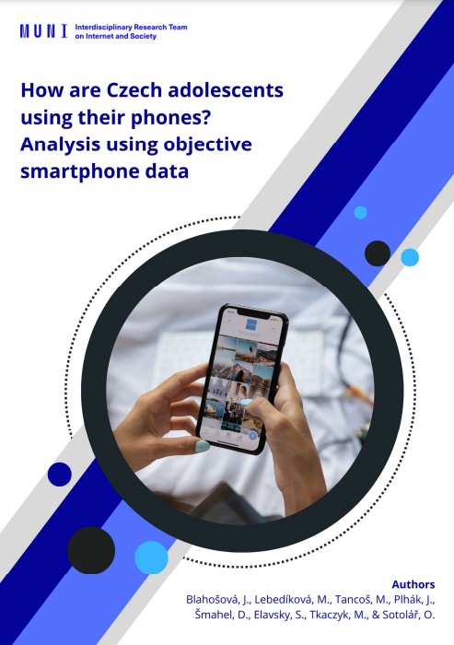
HOW ARE CZECH ADOLESCENTS USING THEIR PHONES?
12-months research, project FUTURE, WP4
201 adolescents, aged 13 to 17 years old
Special research app called IRTIS App that participants installed into their mobile phones
REPORT LINK

Slide 10
METHODS
May 2021
June 2022
1. burst
May/June
2. burst
September/
October
3. burst
January/February
4. burst
April/May
4 surveys per day
daily objective measurement of app use
14 days, 2 weekends

Slide 11
RESULTS
Comparison of the average daily time spent on the phone by adolescents (in minutes per day)
Adolescents spent more than 4 hours per day on their phones.

Slide 12
CONCLUSION
Adolescents spent 4 hours and 11 minutes per day on their smartphones (on average)
IS IT TOO MUCH? IS IT OK?

Slide 13
QUESTION 3
How much time spent on the phone daily is too much (in hours)?

Slide 14
IS TIME GOOD INDICATOR OF ADDICTION?
WHAT IS TOO MUCH? INCONSISTENT
TIME DOES NOT NECESSARILY INDICATE A PROBLEM
An individuals can be considered as problematic users if their time exceeds a predefined usage amount
the time vary across studies between 4 to 8 hours per day
Smartphone development
Increased internet access via smartphone
They are used for a variety of activities (substite of computer)
Ryding & Kuss, 2020

Slide 15
QUESTION 4
What is the best indicator to determine that someone is using the phone problematically?
Phone use negatively affects individual's overall normal functioning in life

Slide 16
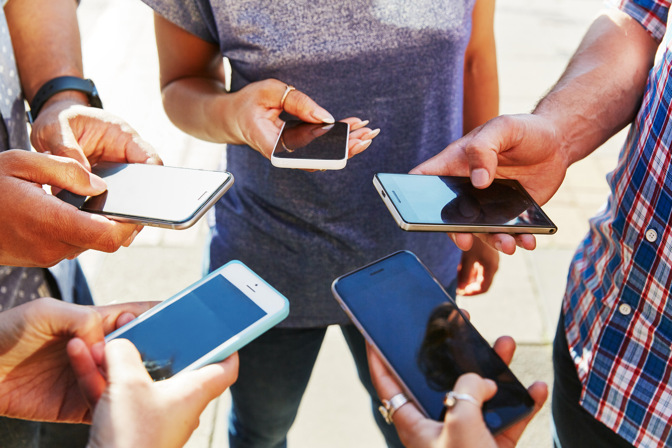
PROBLEMATIC SMARTPHONE USE
„An inability to regulate one‘s use of the smartphone, which eventually involves negative consequences in daily life.“
Billieux (2012), Billieux et al. (2015)
Terms used in literature:
Smartphone addiction
Smartphone dependence
Nomophobia

Slide 17
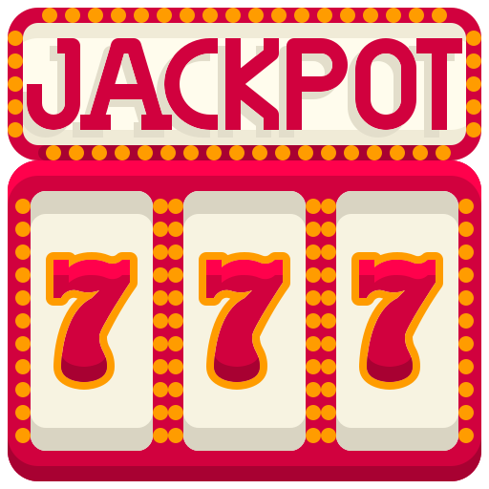
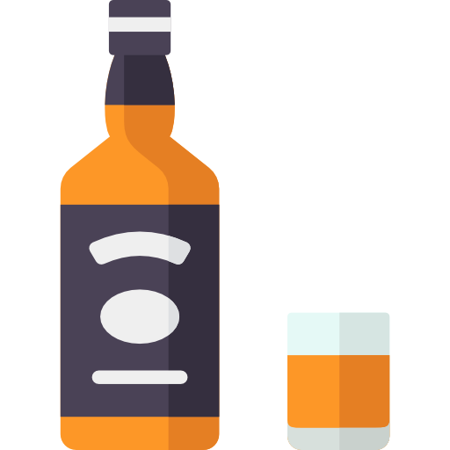
BEHAVIORAL ADDICTIONS
Problematic smartphone use is generally conceptualized as a behavioral addiction together with pathological gambling or compulsive shopping
The diagnostic manuals distinguishes two categories of addictions:
Behavioral addictions or non-substance addictions
Substance addictions
Drugs, alcohol, nicotine…
Pathological gaming

Slide 18
DIAGNOSTIC MANUALS
DSM
ICD
Diagnostic and Statistical Manual of Mental Disorders
Diagnostic tool published by American Psychiatric Association (APA)
Actual versions is DSM-5
International Classification of Diseases
Diagnostic tool published by World Health Organization (WHO)
Actual versions is ICD-11

Slide 19
BEHAVIORAL ADDICTIONS
Smartphone „addiction“ or internet „addiction“ are not officially recognized as the behavioral addictions by these diagnostic manuals
Only Internet Gaming Disorder was included into DSM-5 (2013) and ICD-11 (2019) as disorder requiring another research
2 groups of researchers:
Use the term smartphone addiction
Avoid the term smartphone addiction and even behavioral addiction and use problematic smartphone use
Behavioral addictions

Slide 20
COMPONENT MODEL OF ADDICTION
Griffiths (2005)
Behavioral addiction can be identified by the presence of six core components:
Withdrawal symptoms
Salience
Negative feeling when unable to use
Total preoccupation of smartphone use
Mood modification
Conflict
Intrapersonal and interpersonal conflicts
Mood changes experienced through the use
Tolerance
Relapse
The increase over time of daily hours spent using smartphones
Repeated use after period of abstinence

Slide 21
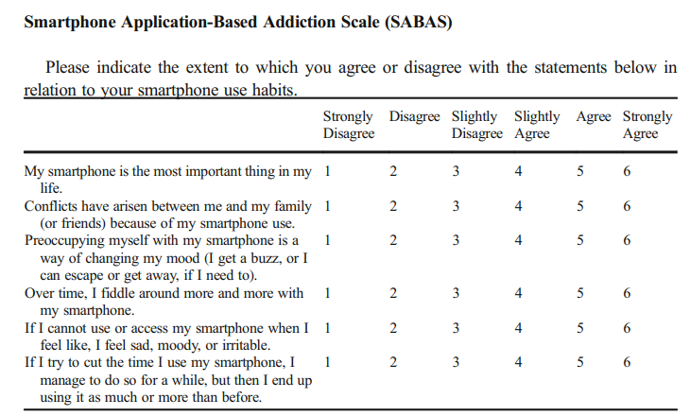
MEASUREMENT SCALE OF PSU
Csibi et al. (2021)
All symptoms have to be fullfilled to be able to say that somebody is addicted.
salience
conflict
mood
modification
tolerance
withdrawal symptoms
relapse

Slide 22
CRITIQUE OF COMPONENT MODEL
Billieux et al. (2015a)
LACK OF EVIDENCE
ORIGIN OF COMPONENTS
Evidence supporting the
identification of PSU as
behavioral addiction
Components were directly
transposed from those
diagnosing other addictions
They do not consider specifics of mobile phones
TOLERANCE CRITERIA
Substance use context: higher and higher dose of drug to receive the same reward
Smartphone use: increase in the frequency of mobile use OR still new and new devices
BUT – we can use the phone more in some situation
PATHOLOGIZATION OF
COMMON BEHAVIOR

Slide 23
CRITIQUE OF COMPONENT MODEL
Billieux et al. (2015b)
OTHER ISSUES HIDING BEHIND
„ADDICTION“ SYMPTOMS
Case study of Thalia from assigned reading
She fullfilled several smartphone „addiction“ criteria (different set) - she could be perceived as smartphone addict
E.g., she was not able to control her phone use, she constantly called and wrote messages to her boyfriend
BUT
When using different approach than addiction model:
Intensive use of mobile phone was result of other issues, e.g., higher impulsivity, reassurance behavior, bad coping strategies (regulation of emotions through smartphone use)

Slide 24
QUESTION 5
Which of the following can be connected with problematic smartphone use?
Boredom proneness
Poor sleep
Poor relationships with parents
Frequent smartphone checking
Loneliness

Slide 25
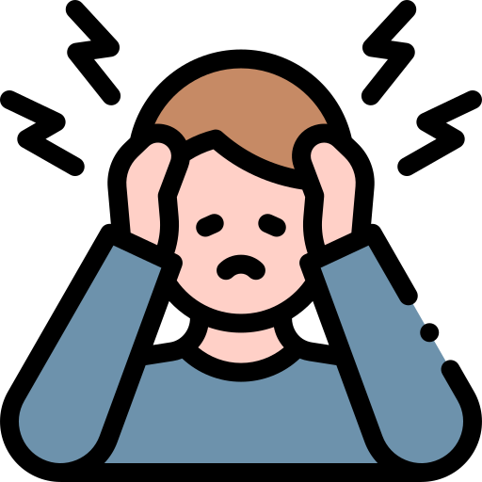
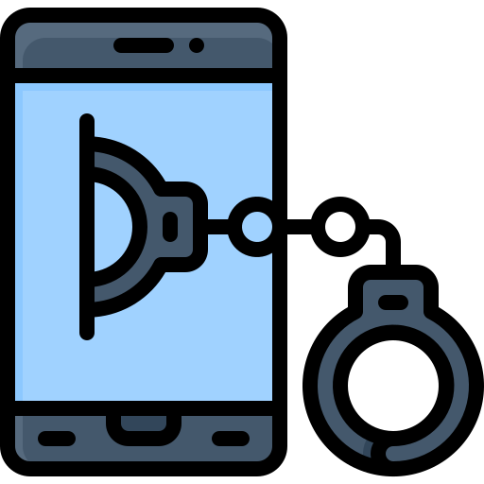
RISK FACTORS & CORRELATES OF PSU
Factors that are often present in people using their
smartphones problematically.
Cause and consequence? Directionality of the
relationship is often unknown
Loneliness and stress
Mostyn Sullivan & George (2023), Tossell et al. (2015), Billieux (2012), Pivetta et al. (2019)

Slide 26
RISK FACTORS & CORRELATES OF PSU
Sociodemographic characteristics
& environmental factors
Older adolescents & young adults
Loneliness and stress
Parents education
Monthly income
Restrictive mediation
Poor quality of relationships with parents
Parental neglect
Parental addiction (substance abuse or gambling problems)
Mostyn Sullivan & George (2023), Tossell et al. (2015), Billieux (2012), Pivetta et al. (2019)

Slide 27
RISK FACTORS & CORRELATES OF PSU
Personality traits
Mental health outcome
Neuroticism
Etraversion
Impulsivity
Low self-esteem
Sensation-seeking
Emotional instability
Insecure attachment style
Boredom proneness
Depression
Anxiety
Poor sleep
Use patterns
Smartphone checking behavior
Usage short in duration and more frequent
Proactive use – checking for notifications or messages without any trigger
Mostyn Sullivan & George (2023), Tossell et al. (2015), Billieux (2012), Pivetta et al. (2019)

Slide 28
DEVICE OR CONTENT?
„Individuals are no more addicted to the internet and smartphones than alcoholics are addicted to bottles.“
Griffiths (2021)
relative consensus that smartphone content or more specifically smartphone applications are the primary object of problematic smartphone use (Elhai et al., 2019; Griffiths, 2021)

Slide 29
TYPES OF SMARTPHONE USE/CONTENT CONNECTED WITH PSU
SOCIAL SMARTPHONE USE
PROCESS SMARTPHONE USE
Social networking sites (Facebook, Instagram, Snapchat)
Chatting, instant messaging (Messenger, WhatsApp, Telegram)
Video and phone calls
Gaming
Watching videos, movies (YouTube, Netflix)
Music, radio and podcasts
Chan, Yeo & Handayani, (2023)

Slide 30
MOTIVES ASSOCIATED WITH PSU
Mostyn Sullivan & George (2023)
Systematic review of 44 studies
Investigating motives categories that are associated with PSU
Mood regulation motives
Pass time
to reduce negative emotions, to maintain positive emotions
to avoid boredom
Social motives
Self-identity/conformity motives
to maintain relationships, to obtain social benefits
to gain approval from a social group, to avoid social disapproval
Entertainment

Slide 31
Social smartphone use (social media & instant messengers)
Social motives
Self-identity/conformity motives
Process smartphone use (gaming, watching videos, movies, etc.)
Mood regulation motives
Pass time
Entertainment

Slide 32
02
ATTENTION ECONOMY

Slide 34
ATTENTION ECONOMY
Human attention as
a commodity
Natural economy of
cyberspace
Human attention is perceived as a
scarce recource, a commodity or a
form of capital, and therefore it is
regarded as valuable.
It is a system that‘s all about
seeking, receiving and paying the
attention of other human beings
(that is limited and not replaceable)
(Goldhaber, 2006)
our time, our attention
money

Slide 35
ADDICTIVE FEATURES OF PLATFORMS
UNPREDICTABLE VARIABLE REWARDS
Rewards, mainly in form of dopamine, are random, at unknow frequencies
Rewards from usage vary
Bhargava & Velásquez (2020), Montag et al. (2019)

Slide 36
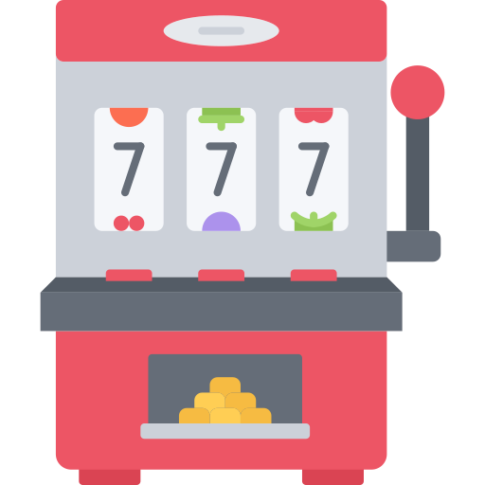
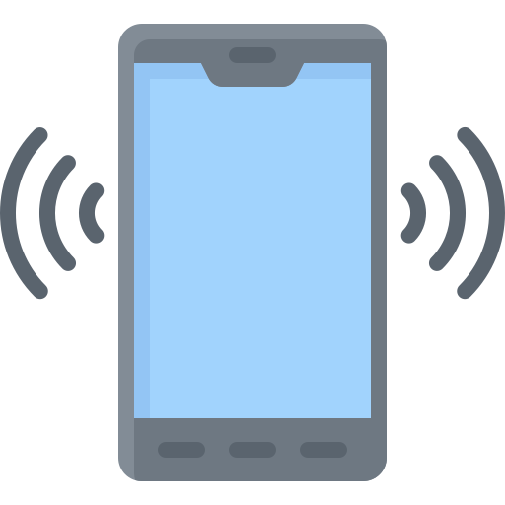
Slot machine effect
Slot machines work in similar way – you never know when you‘ll win money and you tend to repeat the behavior that can lead you to the reward
Anticipation of reward is almost as good as the reward itself at releasing dopamine
Bhargava & Velásquez (2020), Montag et al. (2019)

Slide 37
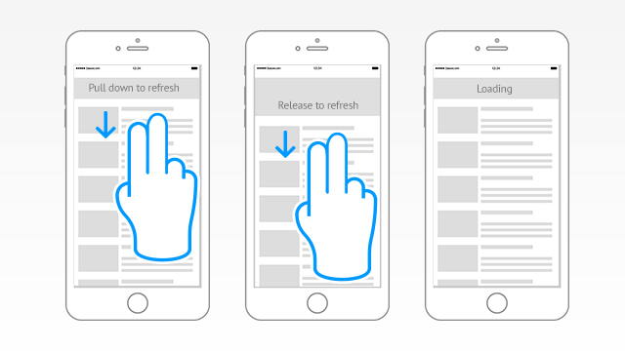
Pull-to-refresh
Seen in a number of social media platforms
It mimics the motion and variable reward schedule of a slot machines
You never know what you‘ll get (the anticipation of the reward)
Bhargava & Velásquez (2020), Montag et al. (2019)

Slide 38
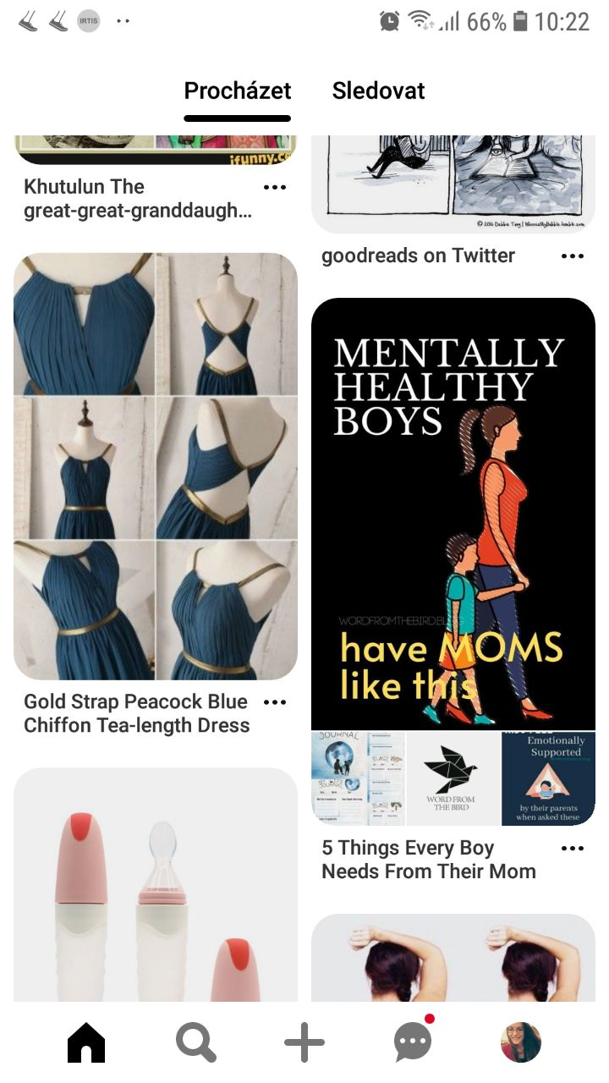
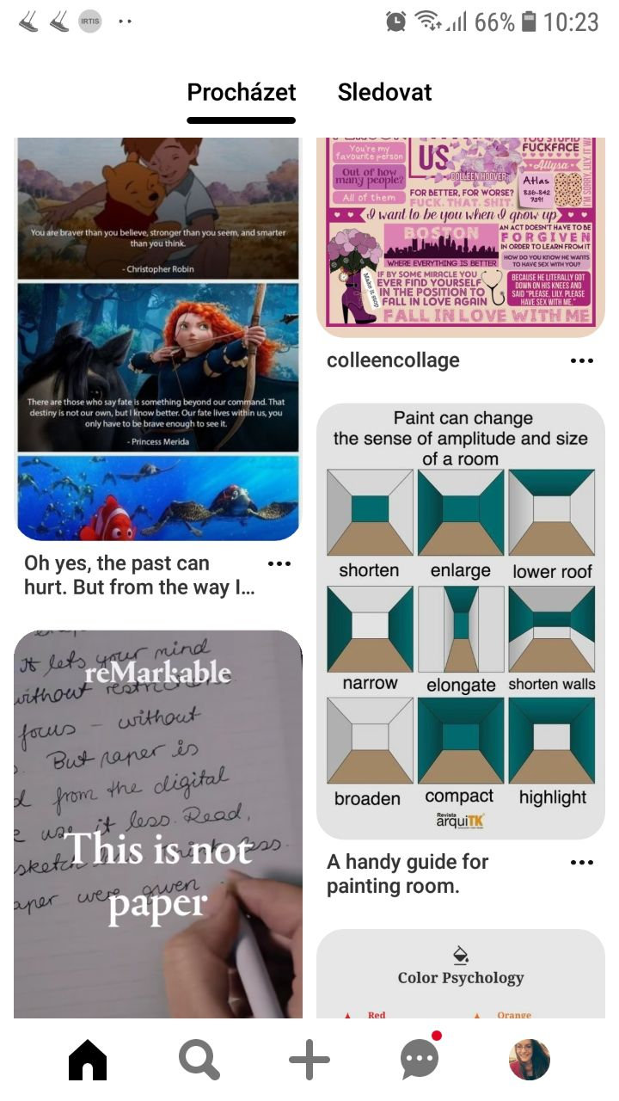
Not fully visible content
The content is arranged zigzag, some images appear to be cut off
To relieve their curiosity, the users have to scroll down to reveal the full picture
Bhargava & Velásquez (2020), Montag et al. (2019)

Slide 39
ADDICTIVE FEATURES OF PLATFORMS
DESIRE FOR SOCIAL VALIDATION & SOCIAL RECIPROCITY
To be in contact with others, to be validated by significant others – one of the main psychological needs
Craving for validation – to be part of group, consistent with group norms
Reciprocal liking – the tendency of liking those people who like us
Bhargava & Velásquez (2020), Montag et al. (2019), Eastwick & Finkle, (2009)

Slide 40
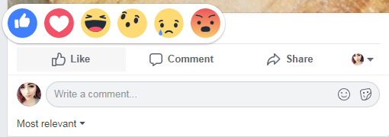
Like button, comments
It may be the reward that user is expecting while using social media
Form of social validation – we belong to other, we are consistent with a group norms
Bhargava & Velásquez (2020), Montag et al. (2019)

Slide 41
Notifications
Reciprocal liking – when a user gives a Like to someone, it is then likely that the individual will also give him a Like
Social media notify their users that these things happened – Likes, comments, shares
Bhargava & Velásquez (2020), Montag et al. (2019)

Slide 42
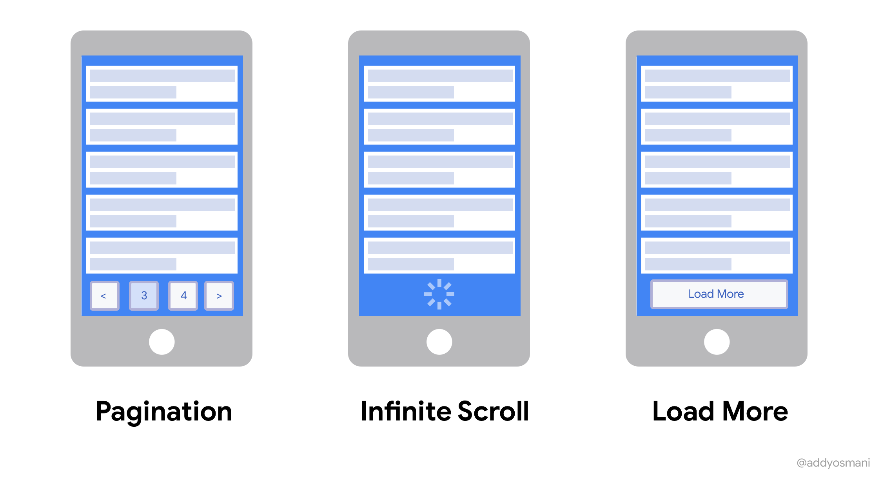
ADDICTIVE FEATURES OF PLATFORMS
REDUCTION OF NATURAL STOPPING CUES
(EXTENSION OF TIME OF USE)
Infinite scroll
Before that – at the end of the page, user have faced some decisions (to load the next page, to exit platform, and so on)
Infinite scrool removed the opportunity to make such decisions, to reflect their behavior, to decide what to do next
Bhargava & Velásquez (2020), Montag et al. (2019)

Slide 44
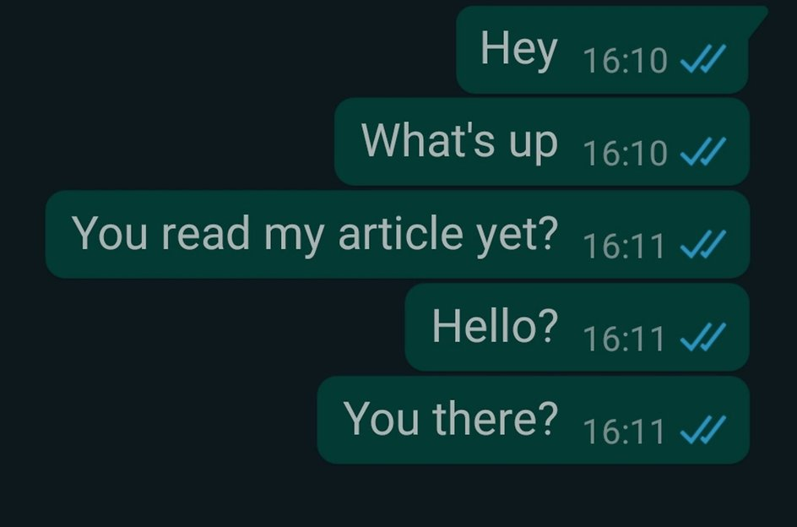
ADDICTIVE FEATURES OF PLATFORMS
SOCIAL PRESSURE
Double ticks
Marking the read messages by coloured double ticks
Both sides of the conversations know these rules
Social pressure – if the message has been read, both sides expect a fast answer
Montag et al. (2019)

Slide 45
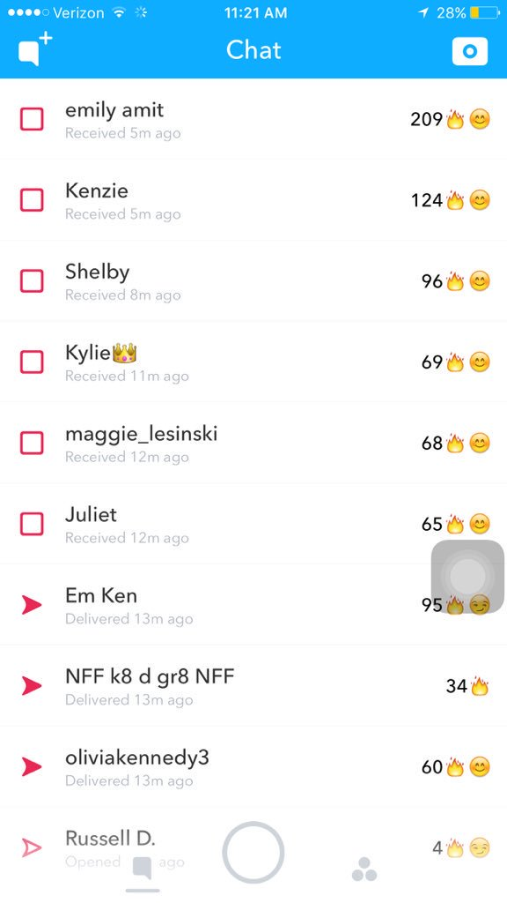
ADDICTIVE FEATURES OF PLATFORMS
PSYCHOLOGICAL INVESTMENT
Snapstreaks
Sunk cost bias – the more the individuals invest in something (time, money, effort), the more they tend to persist in the behavior
Snapstreaks – the number of consecutive days that individuals have been snapping on Snapchat
Pressure to continue with these streaks
Bhargava & Velásquez (2020), Griffiths, 2018

Slide 46
TAKE-HOME MESSAGE
What's the most interesting thing you learned today?
What will you take away from the lecture?

Slide 47
REFERENCES
Billieux, J. (2012). Problematic Use of the mobile Phone: A Literature review and a Pathways model. Current Psychiatry Reviews, 8(4), 299–307. https://doi.org/10.2174/157340012803520522
Billieux, J., Maurage, P., López-Fernández, O., Kuss, D. J., & Griffiths, M. D. (2015a). Can disordered mobile phone use be considered a behavioral addiction? An update on current evidence and a comprehensive model for future research. Current Addiction Reports, 2(2), 156–162. https://doi.org/10.1007/s40429-015-0054-y
Billieux, J., Philippot, P., Schmid, C., Maurage, P., De Mol, J., & Van Der Linden, M. (2015b). Is dysfunctional use of the mobile phone a behavioural addiction? Confronting Symptom-Based versus Process-Based approaches. Clinical Psychology & Psychotherapy, 22(5), 460–468. https://doi.org/10.1002/cpp.1910
Bhargava, V. R., & Velásquez, M. (2020). Ethics of the Attention Economy: The problem of Social Media Addiction. Business Ethics Quarterly, 31(3), 321–359. https://doi.org/10.1017/beq.2020.32
Blahošová, J., Lebedíková, M., Tancoš, M., Plhák, J., Smahel, D., Elavsky, S., Tkaczyk, M., & Sotolář, O. (2023). How are Czech adolescents using their phones? Analysis using objective smartphone data. Brno: Masaryk University
Csibi, S., Griffiths, M. D., Demetrovics, Z., & Szabo, A. (2021). Analysis of Problematic Smartphone Use Across Different Age Groups within the ‘Components Model of Addiction’. International Journal of Mental Health and Addiction, 19(3), 616–631. https://doi.org/10.1007/s11469-019-00095-0
Eastwick, P. W. & Finkel, E. J. (2009). Reciprocity of liking. In Encyclopedia of human relationships. London: Sage
Elhai, J. D., Yang, H., & Montag, C. (2019). Cognitive- and emotion-related dysfunctional coping processes: Transdiagnostic mechanisms explaining depression and anxiety’s relations with problematic smartphone use. Current Addiction Reports, 6(4), 410–417. https://doi.org/10.1007/s40429-019-00260-4
Goldhaber, M. H. (2006). The value of openness in an attention economy. First Monday. https://doi.org/10.5210/fm.v11i6.1334
Griffiths, M. D. (2005). A ‘components’ model of addiction within a biopsychosocial framework. Journal of Substance Use, 10(4), 191–197. https://doi.org/10.1080/14659890500114359
Griffiths, M. D. (2018). Adolescents social networking: How do social media operators facilitate habitual use? Education and Health, 36(3).
Griffiths, M. D. (2021). Internet use disorders: What's new and what's not? Journal of Behavioral Addictions, 9(4), 934–937. https://doi.org/10.1556/2006.2020.00072

Slide 48
REFERENCES
Chan, S. J., Yeo, K. J., & Handayani, L. (2023). Types of smartphone usage and problematic smartphone use among adolescents: A review of literature. International Journal of Evaluation and Research in Education, 12(2), 563. https://doi.org/10.11591/ijere.v12i2.22909
Kemp, S. (2023). Digital 2023: Global overview report. https://datareportal.com/reports/digital-2023-global-overview-report
Meng, S., Cheng, J., Li, Y., Yang, X., Zheng, J., Chang, X., Shi, Y., Chen, Y., Lu, L., Sun, Y., Bao, Y., & Shi, J. (2022). Global prevalence of digital addiction in general population: A systematic review and meta-analysis. Clinical Psychology Review, 92, 102128. https://doi.org/10.1016/j.cpr.2022.102128
Montag, C., Lachmann, B., Herrlich, M., & Zweig, K. A. (2019). Addictive Features of Social Media/Messenger Platforms and Freemium Games against the Background of Psychological and Economic Theories. International Journal of Environmental Research and Public Health, 16(14), 2612. https://doi.org/10.3390/ijerph16142612
Mostyn Sullivan, B., & George, A. M. (2023). The association of motives with problematic smartphone use: A systematic review. Cyberpsychology: Journal of Psychosocial Research on Cyberspace, 17(1), Article 2. https://doi.org/10.5817/CP2023-1-2
Pivetta, E., Harkin, L., Billieux, J., Kanjo, E., & Kuss, D. J. (2019). Problematic smartphone use: An empirically validated model. Computers in Human Behavior, 100, 105–117. https://doi.org/10.1016/j.chb.2019.06.013
Ryding, F. C., & Kuss, D. J. (2020). Passive objective measures in the assessment of problematic smartphone use: A systematic review. Addictive Behaviors Reports, 11, 100257. https://doi.org/10.1016/j.abrep.2020.100257
Sohn, S. Y., Rees, P., Wildridge, B., Kalk, N. J., & Carter, B. (2019). Prevalence of problematic smartphone usage and associated mental health outcomes amongst children and young people: a systematic review, meta-analysis and GRADE of the evidence. BMC Psychiatry, 19(1). https://doi.org/10.1186/s12888-019-2350-x
Tossell, C., Kortum, P., Shepard, C., Rahmati, A., & Zhong, L. (2015). Exploring smartphone addiction: Insights from long-term telemetric behavioral measures. International Journal of Interactive Mobile Technologies, 9(2), 37–43.

Slide 49
THANKS!
DO YOU HAVE ANY QUESTIONS?
Jana Blahošová
jana.blahosova@mail.muni.cz

