Slide 1
International Missions and Operations (self-study)
International Security Policy, October 28, 2024
Vendula Divišová, FSS MU, vendula.divisova@mail.muni.cz

Slide 2
Structure
UN Peace operations
NATO missions and operations
EU: CSDP military and civilian missions
OSCE: Field operations
Czech contributions to international missions and operations
Czech Armed Forces: Current operations

Slide 3
UN: Peace operations
peace operations - umbrella term = all UN missions involving military personnel
Types of operations
Peace enforcement
the application of a range of coercive measures, including the use of military force
to restore international peace and security (under Chapter VII, Art. 42)
Peacekeeping (operations under Chapter VI and ½)
support the implementation of a ceasefire or peace agreement
Peacebuilding - creating the necessary conditions for sustainable peace
peace operations - rarely limited to one type of activity!
Notes:
for slides 3-6, see the obligatory reading: United Nations (Department of Peacekeeping Operations). United Nations Peacekeeping Operations: Principles and Guidelines (2008), pp. 17-40.
Peace enforcement
Article 42, UN Charter
Should the Security Council consider that measures provided for in Article 41 would be inadequate or have proved to be inadequate, it may take such action by air, sea, or land forces as may be necessary to maintain or restore international peace and security. Such action may include demonstrations, blockade, and other operations by air, sea, or land forces of Members of the United Nations.
Nothing in the present Charter shall impair the inherent right of individual or collective self-defence if an armed attack occurs against a Member of the United Nations, until the Security Council has taken measures necessary to maintain international peace and security.
Chapter VII Missions
United Nations Mission in the Democratic Republic of Congo
United Nations Mission in Sierra Leone
United Nations Assistance Mission for Rwanda
United Nations Angola Verification Mission II
United Nations Operation in Somalia II
United Nations Stabilisation Mission in Haiti
United Nations Security Council Resolution 678 (Gulf War)
United Nations Security Council Resolution 1973 (Libya)
The boundaries between conflict prevention, peacemaking, peacekeeping, peacebuilding and peace enforcement have become increasingly blurred. Peace operations are rarely limited to one type of activity.
While UN peacekeeping operations are, in principle, deployed to support the implementation of a ceasefire or peace agreement, they are often required to play an active role in peacemaking efforts and may also be involved in early peacebuilding activities.
Today's multidimensional peacekeeping operations facilitate the political process, protect civilians, assist in the disarmament, demobilization and reintegration of former combatants; support the organization of elections, protect and promote human rights and assist in restoring the rule of law.
UN peacekeeping operations may use force to defend themselves, their mandate, and civilians, particularly in situations where the State is unable to provide security and maintain public order.

Slide 4
UN: Peace operations

Slide 5
UN: Peace operations
traditional UN peacekeeping operations
goal – to preserve peace and assist in implementation of the agreement (ceasefire / peace)
typical tasks:
observation, monitoring, reporting
supervision of cease-fire
interposition as a buffer
usually no direct role in political efforts to resolve the conflict
example - UNFICYP mission

Slide 6
UN: Peace operations
Principles of peacekeeping
Consent of the parties (to the conflict)
Impartiality - implementing mandate with no prejudice to any party (x neutrality, inactivity)
Non-use of force except in self-defence and defence of the mandate
Legitimacy - international legitimacy (mandate, broad representation, conduct of personnel… )
Credibility - mission‘s ability to achieve its mandate
Promotion of national and local ownership (trust and cooperation, long-term sustainability)

Slide 7
UN: Peace operations
recent transformations in peace operations:
protection of civilians as a central mission goal
a 'robust turn‘ in UN peacekeeping → greater preparedness to use force
move from peacekeeping to the goal of stabilization
examples - MINUSMA, MINUSCA
peacekeeping (use of force at the tactical level) x peace enforcement (operational level)
Robust peacekeeping
“the use of force by a United Nations peacekeeping ope-ration at the tactical level, with authorisation of the Security Council, to defend its mandate against spoilers whose activities pose a threat to civilians or risk undermining the peace process”
Notes:
see the obligatory reading for seminar no. 5: “Twenty-first century UN peace operations: protection, force and the changing security environment“
summary below⬇
Introduction
Today, United Nations peace operations are deployed in greater numbers to more difficult operating theatres in response to more complex conflict situations than ever before.1 More than 100,000 UN peacekeepers are deployed in missions mandated under Chapter VII
Increasingly often, UN peacekeepers are instructed to carry out this work in contexts where there is no peace to keep or where peace is fragile. As a result, UN peacekeepers are sometimes targeted by insurgent groups (Burkina Faso, South Sudan… )
a perceptible ‘robust turn’ in UN peacekeeping presents a series of dilemmas and issues that must be addressed if the long-term credibility of UN peace operations is to be retained, let alone enhanced. If these issues are not confronted, there is a risk that the gap between expectations and capacities will widen further, raising the possibility of major crises in peacekeeping such as those experienced in Rwanda (1994), Bosnia (1995) and Sierra Leone (2000).
three transformations in peace operations—the emergence of the protection of civilians as a central mission goal (with accompanying principle of due diligence); a so-called ‘robust turn’ towards greater preparedness to use force; and a subtle move away from peacekeeping as an impartial overseer of peace processes towards the goal of stabilization
Once conceived of primarily as a buffer between warring states or a tool for monitoring the implementation of ceasefire or peace agreements, UN peace operations have evolved into one of international society’s principal collective means of maintaining international peace and security. This shift has been accompanied by inflated expectations about the capacity of peacekeepers
It is now common for missions to be expected to help rebuild state institutions, promote the rule of law, facilitate the delivery of humanitarian assistance, monitor and promote human rights, support
national and local political processes, oversee ceasefires, manage the disarmament, demobilization and reintegration (DDR) of former combatants, promote security sector reform and set in motion a range of early peacebuilding programmes in collaboration with other partners, all while paying particular attention to the needs and participation of women and children.6 However, it is the protection of civilians as a whole-of-mission activity that has become the benchmark against which today’s UN peace operations are judged.7 This in turn has encouraged two other transformations: moves towards the adoption of more ‘robust’ postures in the face of persistent attacks on civilians, and a subtle shift in mandates away from the impartial overseeing of peace processes towards active support for the consolidation and extension of state authority.
Protection of civilians
civilian protection was typically not considered a core part of peacekeeping before the end of the twentieth century.8 Indeed, one of the tragic ironies of the UN’s self-named ‘Protection Force’ deployed to the former Yugoslavia in the 1990s was that it did not actually have a mandate to protect civilians within its area of operations. Following the failure of UN peacekeepers to protect vulnerable civilians in Rwanda and Srebrenica in the mid-1990s, the seminal Brahimi Report on UN peace operations recognized that ‘no failure did more to damage the standing and credibility of United Nations peacekeeping in the 1990s then its reluctance to distinguish victim from aggressor’.
Reflecting this, since 2002 the UN’s Standing Rules of Engagement for peace operations have authorized the use of force ‘to defend any civilian person who is in need of protection’
Starting in 1999 with the UN Mission in Sierra Leone (UNAMSIL), the UNSC has invoked Chapter VII of the UN Charter with increasing frequency to authorize peacekeepers to use ‘all means necessary’ to protect civilians from harm. Since then, civilian protection and the authorization of ‘all means necessary’ to that end have gradually become core aspects of UN peace operations and central to many of its new mandates, such as those for the Central African Republic (MINUSCA), Mali (MINUSMA), and South Sudan (UNMISS).
In practice, the protection of civilians by military peacekeepers has evolved to entail one or more of three types of activity.
The first and most common type involves the positioning of military forces to deter attacks on civilians. The second, less frequent, type involves measures designed to eliminate or restrict the activities of armed groups that threaten civilians. The third, least frequent of all, is the interposition of peacekeepers between civilians and their armed tormentors.
The ‘robust turn’
a robust approach to peacekeeping was defined in the 2009 ‘New Partnership Agenda’ launched by the UN’s Department of Peacekeeping Operations (DPKO)
In operational terms, the DPKO understands robust peacekeeping as entailing ‘the use of force by a United Nations peacekeeping operation at the tactical level, with authorisation of the Security Council, to defend its mandate against spoilers whose activities pose a threat to civilians or risk undermining the peace process’
can entail the use of significant force, including small arms fire, cannon and artillery fire, and the use of helicopter-launched munitions, against an armed group.
While the UN operation in the Congo (1960–64) was an antecedent, a watershed in mandating peace operations with the use of force beyond self-defence came with the UNITAF/UNOSOM II operations in Somalia in 1992–3.
Since 2011, the UNSC has authorized a number of missions that have arguably espoused this robust approach.19 Missions such as MINUSMA in Mali, MINUSCA in the Central African Republic (CAR) and the FIB under MONUSCO have adopted a more forceful posture and have deployed into places where there is active conflict and ‘no peace to keep’.
Such an approach allows for the use of force at the tactical level in self-defence and defence of the mandate—the latter invariably applied to the task of protection of civilians—while continuing to rule out the use of force at the operational level
argued that it is the level at which force is utilized that distinguishes peacekeeping (limited to tactical-level force) from peace enforcement (operational-level force). It has also become an article of faith that peace enforcement should be the exclusive domain of UNSCauthorized multinational operations and certainly not a field of action for UN peacekeeping
In April 2013, the UNSC passed Resolution 2100 mandating the United Nations Multidimensional Integrated Stabilization Mission in Mali (MINUSMA)
mandate also authorizes a French contingent of over 1,000 troops ‘to use all necessary means ... to intervene in support of elements of MINUSMA when under imminent and serious threat upon request of the Secretary-General’
Peace operations as stabilization
Traditionally, peacekeeping has been understood as the deployment of forces to support a peace process or assist in the implementation of ceasefires or peace agreements. However, a third role—stabilization, the use of military means to stabilize a country—has grown in prominence over the past decade. At the time of writing, the UN had four missions explicitly labelled as stabilization operations
Stabilization missions are distinct from more traditionally conceived UN missions—even robust, complex, multidimensional ones such as the UN/AU Mission in Darfur (UNAMID)—in at least two significant ways. First, they are self-consciously partial
Their deployment is therefore not necessarily associated with a peace process and the peacekeepers are not directed to treat all parties alike. Instead, written into their mandate is a directive to support one particular armed group (the state), if necessary to defeat spoilers.
Second, stabilization missions are intentionally directed towards countries where there is no such peace and therefore they operate in active conflict zones. Their objective is to stabilize a country, which implies that at the point of deployment it is unstable
stabilization is about using military means to stabilize a country, sometimes with all necessary means to neutralize potential “spoilers” to a conflict’
it involves a coupling of peacekeeping to broader practices of statebuilding and peacebuilding, such that the strategic objectives of these new peace operations are stretched to include these more expansive goals
= The context for and nature of UN peace operations have changed dramatically in recent years. Transformations in the type of mission environments, the primary objectives at stake and the modalities employed to achieve them raise a number of serious challenges that jeopardize the status quo and could pose existential threats for the peacekeeping endeavour in the future.

Slide 8
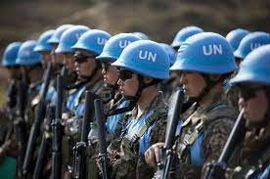
UN: Peace operations
Past peacekeeping operations - list here
Current peacekeeping operations - here
UN Organization Stabilization Mission in the Democratic Republic of the Congo (MONUSCO)
UN Interim Force in Lebanon (UNIFIL)
UN Mission in the Republic of South Sudan (UNMISS)
UN Multidimensional Integrated Stabilization Mission in the Central African Republic (MINUSCA)
UN Disengagement Observer Force (UNDOF)
UN Interim Security Force for Abyei (UNISFA)
UN Military Observer Group in India and Pakistan (UNMOGIP)
UN Multidimensional Integrated Stabilization Mission in Mali (MINUSMA)
UN Peacekeeping Force in Cyprus (UNFICYP)
UN Interim Administration Mission in Kosovo (UNMIK)
UN Truce Supervision Organization (UNTSO)
UN Mission for the Referendum in Western Sahara (MINURSO)
Notes:
2 examples of peacekeeping missions:
(1) UN Multidimensional Integrated Stabilization Mission in Mali (MINUSMA) (robust peacekeeping)
goal: Supporting political process and helping stabilize Mali
The United Nations Multidimensional Integrated Stabilization Mission in Mali (MINUSMA) was established by Security Council resolution 2100 of 25 April 2013 to support political processes in that country and carry out a number of security-related tasks. The Mission was asked to support the transitional authorities of Mali in the stabilization of the country and implementation of the transitional roadmap.
By unanimously adopting resolution 2164 of 25 June 2014, the Council further decided that the Mission should focus on duties, such as ensuring security, stabilization and protection of civilians; supporting national political dialogue and reconciliation; and assisting the reestablishment of State authority, the rebuilding of the security sector, and the promotion and protection of human rights in that country.
The Security Council today unanimously approved the creation of a 12,600 member peacekeeping force in the West African nation of Mali, strongly condemning the January offensive by armed groups towards the south and stressing that terrorism could only be defeated by a sustained and comprehensive approach to isolate the terrorist threat.
Acting under Chapter VII of the United Nations Charter, the Council decided to establish the United Nations Multidimensional Integrated Stabilization Mission in Mali (MINUSMA) by 1 July 2013, and thereby transfer the functions of the African-led International Support Mission in Mali (AFISMA) — set up by the Economic Community of West African States (ECOWAS) in September — to the new entity. The Secretary-General was requested to subsume the United Nations Office in Mali (UNOM) into its activities and to appoint a Special Representative for Mali and Head of Mission to assume overall authority for the coordination of United Nations activities.
By the terms of resolution 2100 (2013), MINUSMA would comprise up to 11,200 military personnel, including reserve battalions able to deploy rapidly within the country, as required, and 1,440 police personnel. The Council called on Member States to provide troops and police with adequate capabilities and equipment.
In terms of mandate, the Council authorized MINUSMA to use all necessary means, in support of the transitional authorities of Mali, to stabilize key population centres, especially in the north, deter threats and take active steps to prevent the return of armed elements to those areas. It would support Mali’s transitional authorities to extend and re-establish State administration throughout the country, and support both national and international efforts towards rebuilding the Malian security sector.
By other terms, French troops were authorized to use all necessary means to intervene in support of MINUSMA when under “imminent and serious threat” and upon the request of the Secretary-General, with the Council deciding to review that role within six months of its commencement.
Further by the text, the Council urged transitional authorities to hold free, fair, transparent and inclusive presidential and legislative elections “as soon as technically possible”, welcoming the commitment to organize presidential elections on 7 July 2013 and legislative polls on 21 July 2013.
Citations from the UN Resolution
“Reaffirming the basic principles of peacekeeping, including consent of the parties, impartiality, and non-use of force, except in self-defence and defence of the mandate, and recognizing that the mandate of each peacekeeping mission is specific to the need and situation of the country concerned,
“Condemning strongly the offensive launched on 10 January 2013 by terrorist, extremist and armed groups towards the south of Mali and stressing that terrorism can only be defeated by a sustained and comprehensive approach involving the active participation and collaboration of all States, and regional and international organizations to impede, impair, and isolate the terrorist threat, and reaffirming that terrorism could not and should not be associated with any religion, nationality or civilization,
“Welcoming the swift action by the French forces, at the request of the transitional authorities of Mali, to stop the offensive of terrorist, extremist and armed groups towards the south of Mali and commending the efforts to restore the territorial integrity of Mali by the Malian Defence and Security Forces, with the support of French forces and the troops of the African-led International Support Mission in Mali (AFISMA),
“Determining that the situation in Mali constitutes a threat to international peace and security,
“Acting under Chapter VII of the Charter of the United Nations
Termination of the mission: On 16 June 2023, the Foreign Minister of Mali requested that the United Nations terminate MINUSMA due to what he called its "failure" to stabilize the situation there.^{[12]} The mission was officially terminated on 30 June 2023, with all UN forces due to leave Mali by 31 December 2023.
UNFICYP (more traditional peacekeeping)
The United Nations Peacekeeping Force in Cyprus (UNFICYP) is a United Nations peacekeeping force that was established under United Nations Security Council Resolution 186 in 1964 to prevent a recurrence of fighting following intercommunal violence between the Greek Cypriots and Turkish Cypriots, to contribute to the maintenance and restoration of law and order and to facilitate a return to normal conditions.
Following the 1974 Greek Cypriot coup d'état and the Turkish invasion of Cyprus, the United Nations Security Council extended and expanded the mission to prevent the dispute turning into war, and UNFICYP was redeployed to patrol the United Nations Buffer Zone in Cyprus and assist in the maintenance of the military status quo. Since its establishment, the force has also worked in concert with the Special Representative of the Secretary-General and representatives of the two communities to seek an amicable diplomatic solution to the Cyprus dispute.
goal: Contributing to a political settlement in Cyprus
UNFICYP was originally set up by the Security Council in 1964 to prevent further fighting between the Greek Cypriot and Turkish Cypriot communities. After the hostilities of 1974, the Council has mandated the Force to perform certain additional functions.
In the absence of a political settlement to the Cyprus problem, UNFICYP has remained on the island to supervise ceasefire lines, maintain a buffer zone, undertake humanitarian activities and support the good offices mission of the Secretary-General.
Cyprus became independent in 1960 with a constitution that was intended to balance the interests of Greek Cypriot and Turkish Cypriot communities. Cyprus, Greece, Turkey, and the United Kingdom entered into a treaty to guarantee the basic provisions of the constitution and the territorial integrity and sovereignty of Cyprus.
A series of constitutional crises resulted, however, in the outbreak of intercommunal violence in December 1963. After all attempts to restore peace failed, the UN Security Council unanimously adopted resolution 186 (1964), which recommended the establishment of UNFICYP.
As given in resolution 186 (1964), UNFICYP’s mandate is to use its best efforts to:
prevent a recurrence of fighting;
contribute to the maintenance and restoration of law and order;
contribute to a return to normal conditions.
After the hostilities of 1974, the Security Council adopted a number of resolutions expanding UNFICYP’s mandate. The changes included supervising the de facto ceasefire that came into effect on 16 August 1974, and maintaining a buffer zone between the lines of the Cyprus National Guard and of the Turkish and Turkish Cypriot forces.
Following reports every June and December of the Secretary-General to the Security Council about the status of the Cyprus conflict and UNFICYP, the Council has consistently renewed the mandate.
About the buffer zone
After 1974, most of Cyprus’s Greek and Turkish Cypriots have lived separately in northern and southern regions of the island that are currently divided by a UN-controlled buffer zone.
The buffer zone - also called ‘the Green Line’ - extends approximately 180 km across the island. In some parts of old Nicosia it is only a few meters wide, while in other areas it is a few kilometres wide. Its northern and southern limits are the lines where the belligerents stood following the ceasefire of 16 August 1974, as recorded by UNFICYP.
In line with UNFICYP’s mandate to work toward a return to normal conditions, many parts of the buffer zone are farmed and/or inhabited. There are several villages or special areas (called Civil Use Areas) within the Buffer Zone, where more than 10,000 people live and/or work. Civilians may enter these areas freely. Elsewhere in the buffer zone, civilian movement or activity requires specific authorization from UNFICYP. Located in the eastern region of the buffer zone, Pyla is the only village where Greek Cypriots and Turkish Cypriots live side-by-side.
UNFICYP keeps permanent watch over the buffer zone with patrols in vehicles, on foot, on bicycles and by helicopter. Additionally, a highly mobile unit stands ready to respond to emergencies within the buffer zone.
Approximately 1,000 incidents occur within the buffer zone each year, ranging from name-calling to unauthorized use of firearms. Civilian construction is another regular issue; UNFICYP always has to consider security, ownership and operational requirements in its efforts to encourage a return to normal conditions in the buffer zone.
About the Good Offices
The Office of the Special Adviser and UNFICYP share an overall goal: supporting the comprehensive settlement of the Cyprus problem. However, the specific mandates and tasks of each, while complementary, differ considerably. The mandate of UNFICYP is, “in the interest of preserving international peace and security, to use its best efforts to prevent a recurrence of fighting and, as necessary, to contribute to the maintenance and restoration of law and order and a return to normal conditions” (Security Council resolution 186 (1964)). The mandate of the Secretary General’s Good Offices and the Office of his Special Adviser is to support the conduct of negotiations between the Greek Cypriot and Turkish Cypriot leaders.
While there is close cooperation between UNFICYP and the Office of the Special Adviser in supporting the peace negotiations, there is no overlap between the two missions. UNFICYP, with its present mandate and structure, is not equipped to provide direct support to the negotiations. It does, however, play a vital role in support of the peace process by ensuring a stable environment conducive to the negotiation process. The Office of the Special Adviser has been established specifically to provide direct support to the negotiations. Consequently, the office consists of political affairs officers and thematic experts, whose main task is to provide in-house expertise and facilitate the negotiation process, including support for the working groups and technical committees and the chairing of the meetings of the leaders and of their Representatives.

Slide 9
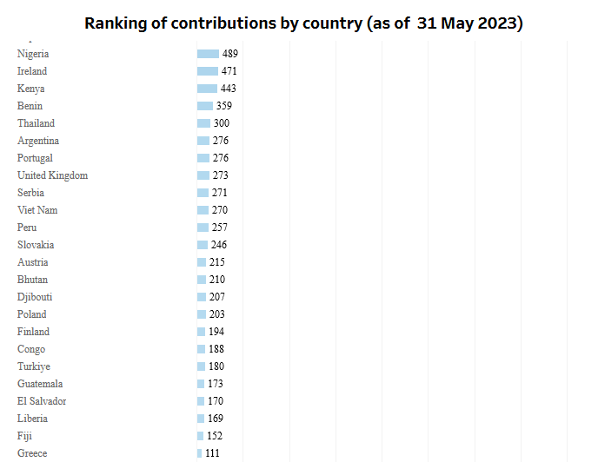
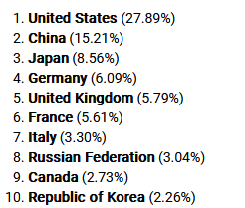
UN: Peace operations
Contributions by country - link
Contributions by country to current ► peacekeeping operations (personnel)
top 10 providers of contributions to peacekeeping operations for 2020-2021 (funding) ►
Notes:
there is a difference between countries that fund the UN peacekeeping missions and that directly contribute with personnel

Slide 10
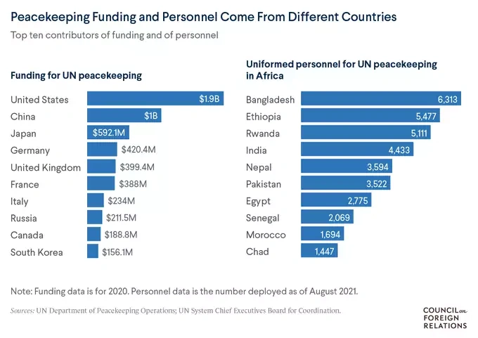
UN: Peace operations

Slide 11
NATO: Operations and missions
collective defence and crisis prevention and crisis management operations (including peace support operations)
disaster relief operations
terminated missions:
1990-91 - Turkey: Operation Anchor Guard (First Gulf War, monitoring)
1992-95 - Bosnia and Herzegovina (first combat operations)
2001-2014/2021 - Afghanistan: ISAF → The Resolute Support Mission
2001-16 - Operation Active Endeavour (a collective defence operation)
2004-11 - NATO Training Mission in Iraq (NTM-I)
2001-02 - USA: Operation Eagle Assist (counter-terrorist operation, Article 5)
Notes:
you can learn more here: https://www.nato.int/cps/en/natohq/topics_52060.htm

Slide 12
NATO: Operations and missions
terminated missions:
2001-03 - North Macedonia: Operations Essential Harvest, Amber Fox and Allied Harmony
2011 - Libya: Operation Unified Protector
2008-16 - Counter-piracy operations in the Gulf of Aden (Operation Allied Protector, Operation Ocean Shield)
relief assistance missions (earthquake in Pakistan, Hurricane Katrina… )
2004 - Operations Distinguished Games (Athens, Olympic Games)
Notes:
you can learn more here: https://www.nato.int/cps/en/natohq/topics_52060.htm

Slide 13
NATO: Operations and missions
Current missions
Kosovo: KFOR
3 operations in the maritime domain: Standing Naval Forces, Operation Sea Guardian and the Aegean Activity
NATO Mission Iraq
NATO Air Policing
African Union assistance missions
NATO support to earthquake relief efforts in Türkiye
NATO’s military presence in the east of the Alliance
Notes:
see here: https://www.nato.int/cps/en/natohq/topics_52060.htm

Slide 14
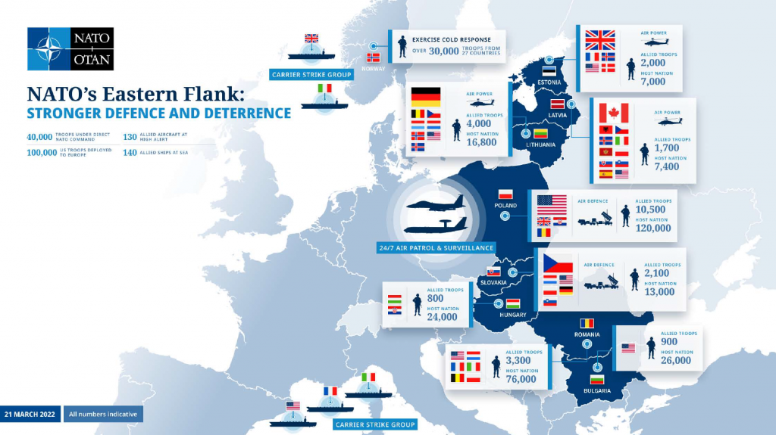
NATO: Operations and missions

Slide 15
EU: CSDP military and civilian missions
CSDP - military and civilian assets → peacekeeping operations, conflict prevention and the strengthening of international security (Art. 42, Treaty of Lisbon)
joint disarmament operations, humanitarian and rescue tasks, military advice and assistance tasks, conflict prevention and peace-keeping tasks, tasks of combat forces in crisis management, including peace-making and post-conflict stabilization
❐ all these tasks can contribute to the fight against terrorism
2 types of missions
Military operations
Civilian missions
Notes:
Art. 42 of the Lisbon Treaty
The common security and defence policy shall be an integral part of the common foreign and security policy. It shall provide the Union with an operational capacity drawing on civilian and military assets. The Union may use them on missions outside the Union for peace-keeping, conflict prevention and strengthening international security in accordance with the principles of the United Nations Charter. The performance of these tasks shall be undertaken using capabilities provided by the Member States.
Member States shall make civilian and military capabilities available to the Union for the implementation of the common security and defence policy, to contribute to the objectives defined by the Council. Those Member States which together establish multinational forces may also make them available to the common security and defence policy.
Member States shall undertake progressively to improve their military capabilities.
Decisions relating to the common security and defence policy, including those initiating a mission as referred to in this Article, shall be adopted by the Council acting unanimously on a proposal from the High Representative of the Union for Foreign Affairs and Security Policy or an initiative from a Member State. The High Representative may propose the use of both national resources and Union instruments, together with the Commission where appropriate.

Slide 16
EU: Completed missions and operations
first missions in 2003 → over 37 overseas operations
Notes:
you can learn more here: https://www.eeas.europa.eu/eeas/missions-and-operations_en

Slide 17
EU: Current missions and operations
currently - 21 CSDP missions and operations (12 civilian, 9 military)
full list of current missions and operations here
examples:
European Union Advisory Mission in support of Security Sector Reform in Iraq - Civilian Mission (EUAM IRAQ)
European Union Training Mission in Mali - Military Mission (EUTM Mali) VIDEO
European Union Capacity Building Mission in Mali - Civilian mission (EUCAP SAHEL MALI)
European Union Training Mission in Central African Republic - Military Mission (EUTM RCA)
EUFOR BOSNIA-HERZEGOVINA Military Operation ALTHEA
EUMAM Ukraine: European Union Assistance Mission Ukraine
Notes:
you can learn more here: https://www.eeas.europa.eu/eeas/missions-and-operations_en

Slide 18
OSCE: Field operations
mostly in South-Eastern Europe, Eastern Europe and Central Asia
tailor-made mandates - agreed by consensus of the participating states + agreement of the host country
assist host countries in fulfilling their OSCE commitments and enhancing local capacities (law enforcement, rule of law, non-discrimination… )
Conflict Prevention Centre (CPC) - planning and managing the field operations
closed field operations - full list here
Notes:
you can learn more here: https://www.osce.org/closed-field-operations

Slide 19
OSCE: Field operations
Current field operations:
OSCE Presence in Albania
OSCE Mission to Bosnia and Herzegovina
OSCE Mission in Kosovo
OSCE Mission to Montenegro
OSCE Mission to Serbia
OSCE Mission to Skopje
OSCE Mission to Moldova
Centres / programmes in Turkmenistan, Kazahstan, Kyrgyzstan, Tajikistan, Uzbekistan
Notes:
you can learn more here: https://www.osce.org/where-we-are

Slide 20
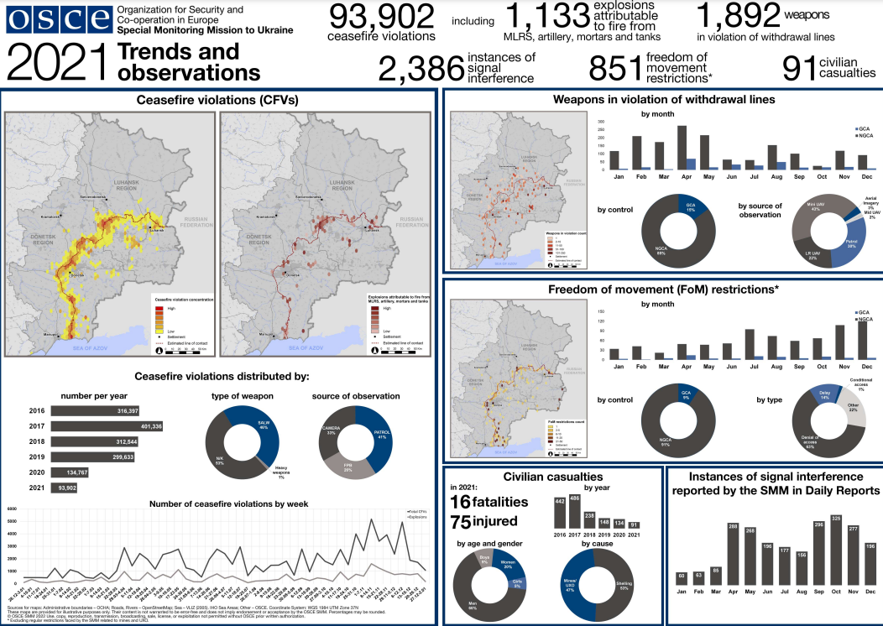
Notes:
- Special Monitoring Mission to Ukraine - illustration of the important evidence gathered as part of the monitoring mission (now closed)

Slide 21
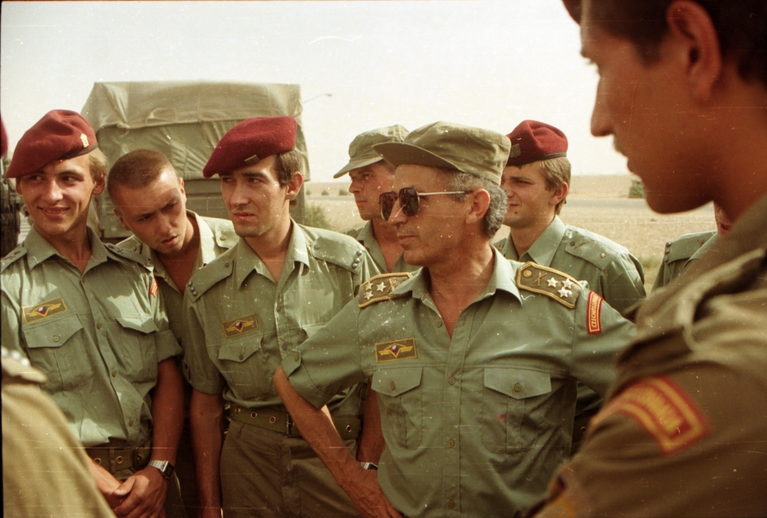
Czech contributions to international missions and operations
contribution in the Gulf War between 1990–1991
military operations led by the UN (UNPROFOR in former Yugoslavia
deployment to the NATO-led peacekeeping operations in BiH (IFOR, SFOR, and SFOR II) - probably facilitated the Czech Republic’s admission to NATO
Notes:
Czechoslovakia’s contribution to the Desert Shield and Desert Storm Operations between 1990–1991 in the Persian Gulf marks the commencement of the Czech Armed Forces’ modern era (Stehlík, 2019).2 Since that time, the Czech Armed Forces have contributed to numerous military operations abroad led by the UN (such as the peacekeeping mission UNPROFOR in former Yugoslavia) or under the Partnership for Peace arrangements (see Bureš & Dušková, 2007; Stojar, 2017). The deployment to the NATO-led peacekeeping operations in Bosnia and Herzegovina (IFOR, SFOR, and SFOR II) is believed to have facilitated the Czech Republic’s admission to NATO while the Alliance membership “would clear a path for the Czech membership in the EU” (Schmitt, 2016; see also Peterson, 2007).
On March 24, 1999, just twelve days after the Czech Republic’s accession to NATO, the country found itself in an extremely challenging situation when the Alliance decided to intervene militarily in Yugoslavia. It launched the Operation Allied Force to prevent further atrocities and to compel Serbia to accept a political settlement. From the three new Alliance members, the most heated debate on the intervention occurred in the Czech Republic with only 35% of citizens approving of the operation as the polls indicated at the time. As argued by Schmitt (2016), most of them perceived the operation “as a relapse into Cold War patterns of behavior and aggression by a military alliance against a sovereign country”. Despite the opposition that formed in the Parliament, the country authorized NATO to use its airspace and airfields at the beginning of April 1999. It also provided a concrete contribution by deploying a field hospital and transport aircraft as part of the humanitarian assistance in Albania. Later on, the Czech contribution to the KFOR peacekeeping operation in Kosovo continued in even greater numbers and tasks (Arnold, 2019; Peterson, 2007). From August 2005, the Czech Armed Forces could even take pride in becoming the leading nation of the KFOR Multinational Brigade CENTRE – a task of type, scope, and responsibility the country assumed for the very first time (Asiedu, 2005; Ministry of Defence of the Czech Republic, 2006).

Slide 22
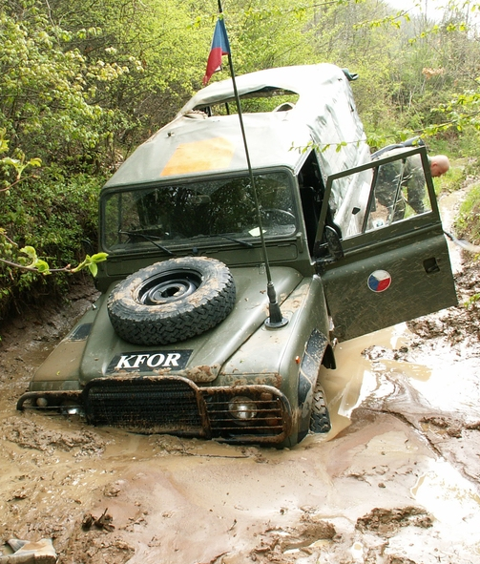
Czech contributions to international missions and operations
1999 - contribution to Operation Allied Force + KFOR (later also leadership role), vast disapproval of the Czech public
9/11 - active support (CZE signed the letter “United We Stand” and “Vilnius Ten” letter)
deployment to Iraq and Afghanistan (first combat operations)
criticism - unclear connection to immediate security interests + lack of public support
A tendency to 'over-perform'? Why?
Notes:
Another important milestone came after 9/11 with interventions in Iraq and Afghanistan. The Czech Republic was among the countries that openly expressed support for the U.S. policy by signing the letter “United We Stand” (a British-Spanish initiative embraced by eight countries) and the so-called “Vilnius Ten” letter right before the intervention (Rupnik, 2005). Since March 2002, the country was also contributing to the Operation Enduring Freedom (OEF) by deploying a contingent to the territory of Kuwait including a CBRN (Chemical, biological, radiological and nuclear) unit and later a field hospital to Basra in Iraq and military police (AMO, 2005; Ministry of Defence, 2005). In March 2004, under the OEF mission, the 601st Special Forces Group started to operate in Afghanistan as the first combat unit in the history of the Czech Armed Forces (Ministry of Defence, n.d.). In a survey from February 2004, 75% of the respondents spread across all party preferences stood against combat deployment which only 17% supported (CVVM, 2004). In May 2002, the Czechs also joined the ISAF mission in Afghanistan where they deployed a field hospital, a platoon of guards, and military police. During the long war, they contributed with numerous components including a field surgical team, field hospital, chemical detachment, military police, Special Forces, helicopter unit, OMLT unit (Operational Mentoring and Liaison Team), military advisor team or a PRT (Provincial Reconstruction Team) in the Afghan Province of Logar. Moreover, they also assumed the task of protecting the perimeter of the Dutch Camp in the southern Afghan province of Uruzgan in 2008 (Ministry of Defence, 2018).
Again, the country’s support, despite the internal opposition, is interpreted as rather externally driven since the country was among those that “were more likely to feel some obligation to ‘help out’ in the ‘coalition of the willing’ in Iraq, in light of their recently acquired NATO obligations” (Peterson, 2007, p. 477). The selection of Prague as the host city for the 2002 NATO summit was also perceived as no coincidence as it was exploited “to cement the activities of the new members” that would soon be requested for further assistance in both military operations ((Peterson, 2007)). The country was propelled to continue its contribution even under persisting doubts from its population, which in its majority expressed disagreement with the military attack. In March 2003, 72% of the Czech citizens disapproved of the intervention against the 21% that supported it (CVVM, 2005). In 2009, the Ministry of Foreign Affairs ordered a survey of public opinion on the Czech Provincial Reconstruction Team in Logar, in which 42% of respondents approved of the reconstruction, while 41% stood in opposition with an apparent division between the political right (in favor) and left (mostly against). Fifty-three per cent of the Czechs supported the statement they would appreciate such efforts would not include Czech soldiers at all. At the same time, almost 20% of respondents did not know the Czech Armed Forces contributed to the ISAF mission, while only 42% knew there was a Czech PRT (Šulc, 2009). As Czech sociologist Ivan Gabal explained, “the Czech population perceives a general need to take part in a good thing, but basically, nobody has explained them the connection between Czech national interests and activities in Afghanistan” (Šulc, 2009).
Later on, Afghanistan became the key focus of the Czech foreign and security policy based solely on the resources and energy invested. As Stejskal (2009, p. 104–105) observed, “this state – at least from the outside – occurred somehow spontaneously, inadvertently, and unplanned” and it rather resembled a snowball effect than an implementation of a clear plan. He further pointed out that the Czech deployment in Afghanistan had no basis in the country’s strategic documents. Schmitt (2016, p. 3) also raised the argument that for the new Alliance members, these operations had indeed “little connection to their immediate security and lacked broad backing from their citizens.” The primary motivation for the Czech military participation is the need to secure guarantees from the allies should the country itself ever be directly threatened and there is enough evidence that this dependency is even willfully exploited. The issue of the Czech military contributions even got to a point where it is not open to serious political discussion and neither needs to be backed by solid public support, as long as the public remains ignorant of the military missions.
At the same time, by the continuous participation in foreign operations, the country does not only build its “reputation for loyalty” within the Alliance but also a reputation for doing a good job. General (retired) Petr Pavel (2019) believes the Czech soldiers “earned the reputation of those with whom you can go to a fight” which means others will let them “cover their backs” even though no such official list of trustworthy armies exists. Such positive motivations cannot be excluded from considerations on how the Czech Armed Forces tend to “overperform” in their foreign commitments given its resources and domestic support. In a critical evaluation report on defense from 2014, the authors pointed out how the entire Czech Armed Forces have to be mobilized to sustain and rotate one deployed battalion (Mičánek et al., 2014).

Slide 23
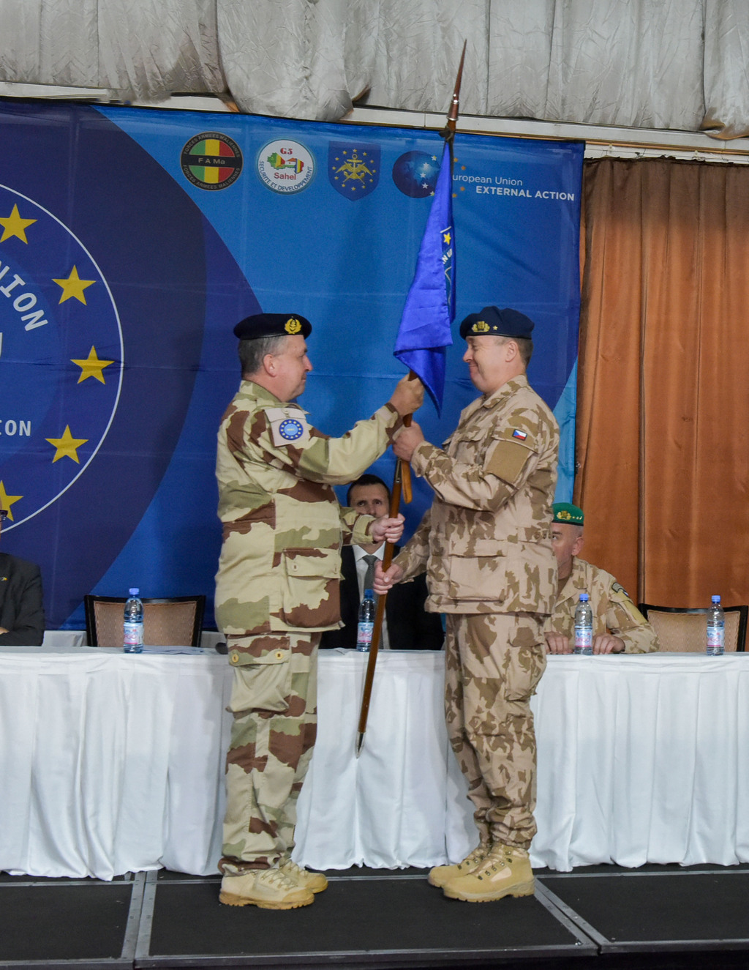
Small states contributions to international missions and operations
burden-sharing in NATO: 3C = Cash, Capability and Contribution (to NATO-led missions and operations)
“fear of abandonment” → establishing reputation for loyalty
but also positive inducements → prestige and recognition
+ other benefits (military training, interoperability… )
Notes:
3 possibilities of burden-sharing in NATO: Cash, Capability and Contribution
commentary: the main shortcoming of using defence spending as a share of GDP to compare national contributions to the Alliance is that it does not look at the “output”, i.e. what capabilities are generated with this “input” – i.e. what resources NATO ultimately has at its disposal and how member nations contribute to NATO-led missions and operations. This is, in the final analysis, what is important. What is more, if a national economy shrinks at a faster rate than inflation-adjusted defence spending, military spending as a percentage of GDP increases – but this says nothing about the military capabilities
The role of small states:
Researchers have been dealing with an important question of what incentive a small state has to deploy its soldiers to a risky and quite controversial military mission when its security interests are not directly at stake. A currently expanding body of research investigates small states’ behavior in their foreign and security policy and their specific interests in contributing to NATO- or U.S.-led coalition operations. Oma and Petersson (2019) elaborate on Snyder’s “fear of abandonment” of states that depend on their ally and try to overcome this fear by establishing its reputation for loyalty within the alliance. They supported the thesis in the cases of Norwegian and Swedish contributions to the ISAF mission. Pedersen and Reykers (2020) argue that the motivations of small states to contribute to a mission and even “over-perform” (either by providing large contributions or accepting greater risks) are not solely “negative” – stemming from their dependency (the so-called bandwagon for protection). On the contrary, countries can also be motivated by positive factors as they strive for “potential rewards in the form of prestige and recognition, which they receive from the alliance hegemon for their engagement” (p. 17). These rewards can subsequently improve their status in the alliance.

Slide 24
Czech Armed Forces: Current operations
enhanced Forward Presence (Lithuania, Latvia)
enhanced Vigilance Activity (eVA) (Slovakia) - The NATO eVA Battle Group Slovakia
KFOR (Kosovo)
VP MSU (Multinational Specialised Unit) KFOR units
Bosnia and Herzegovina (EUFOR - ALTHEA)
EUNAVFOR MED
EUMAM Ukraine (European Union Military Assistance Mission)
OIR (Operation Inherent Resolve) and NMI (NATO Mission Iraq) in Iraq and Kuwait
military observers (Multinational Force and Observers - Sinai, UNDOF, MONUSCO, UNMIK, MINUSCA)
Notes:
you can learn more here: https://mise.mo.gov.cz/aktualni-mise/default.htm (only available in Czech)

