Slide 1
International Organisations I
International Security Policy, October 7, 2024
Vendula Divišová, FSS MU, vendula.divisova@mail.muni.cz

Slide 2
Structure
International organisations and IR theory
Definitions
Types of international organisations
International security organisations (part I)
  United Nations
  NATO

Slide 3
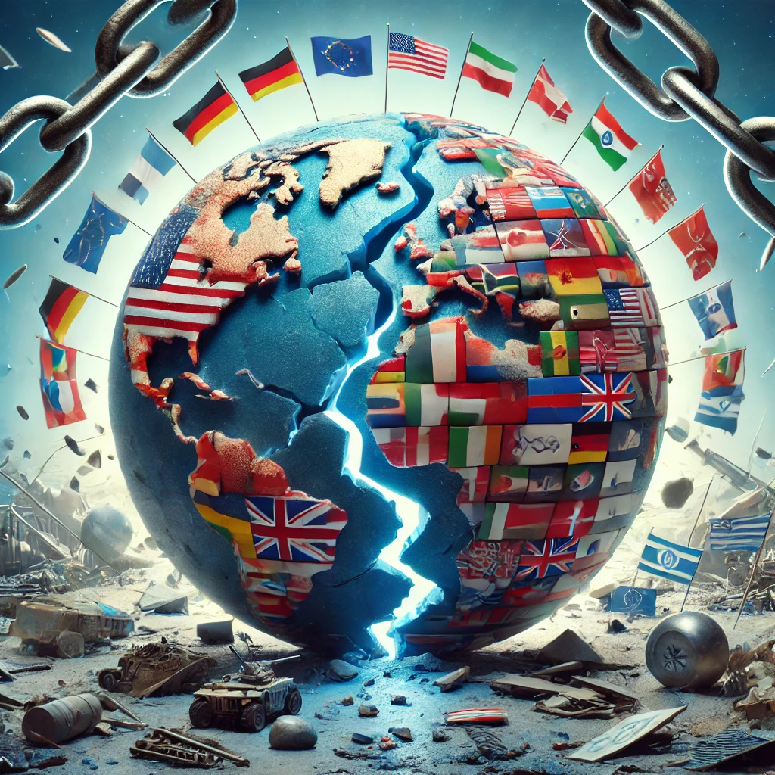
Is the international system anarchical?

Slide 4
International organisations as a way to mitigate anarchy…
INTERNATIONAL ORGANIZATIONS
„an organization established by a treaty or other instrument governed by international law and possessing its own international legal personality“
INTERNATIONAL REGIMES
“principles, norms, rules, and decision-making procedures around which actors' expectations converge in a given area of international relations“ (S. Krasner)
formal structure
less institutionalized
narrower focus

Slide 5
Types of international organisations
Collective defence organisations [NATO, ANZUS]
protection against a common enemy (a commitment to respond jointly to an external threat)
Collective security organisations [UN]
maintaining peace and security → states will not resolve common disputes by force (or threat of force)
Cooperative security organisations [OSCE]
efforts to reduce the risk of war and increase international security
limiting and regulating armed force, arms control, relationship building

Slide 6
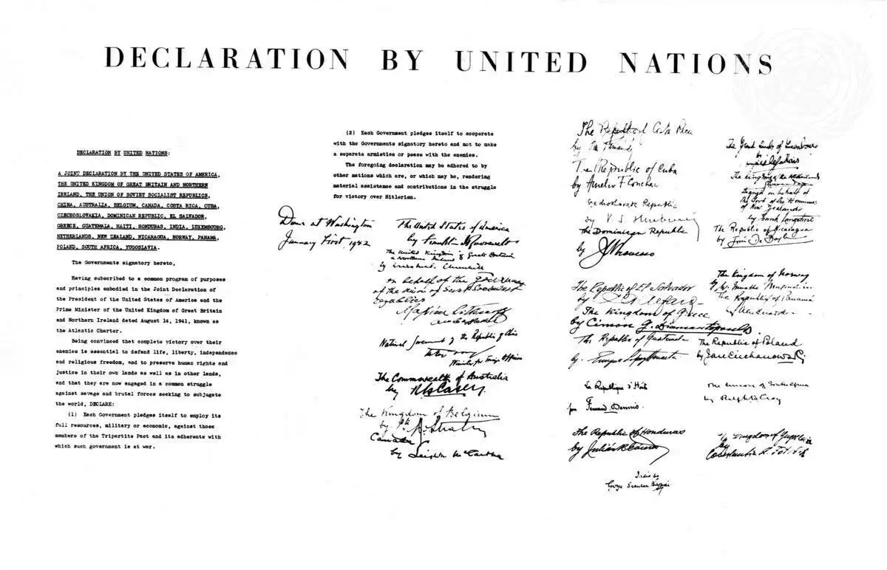

Slide 7

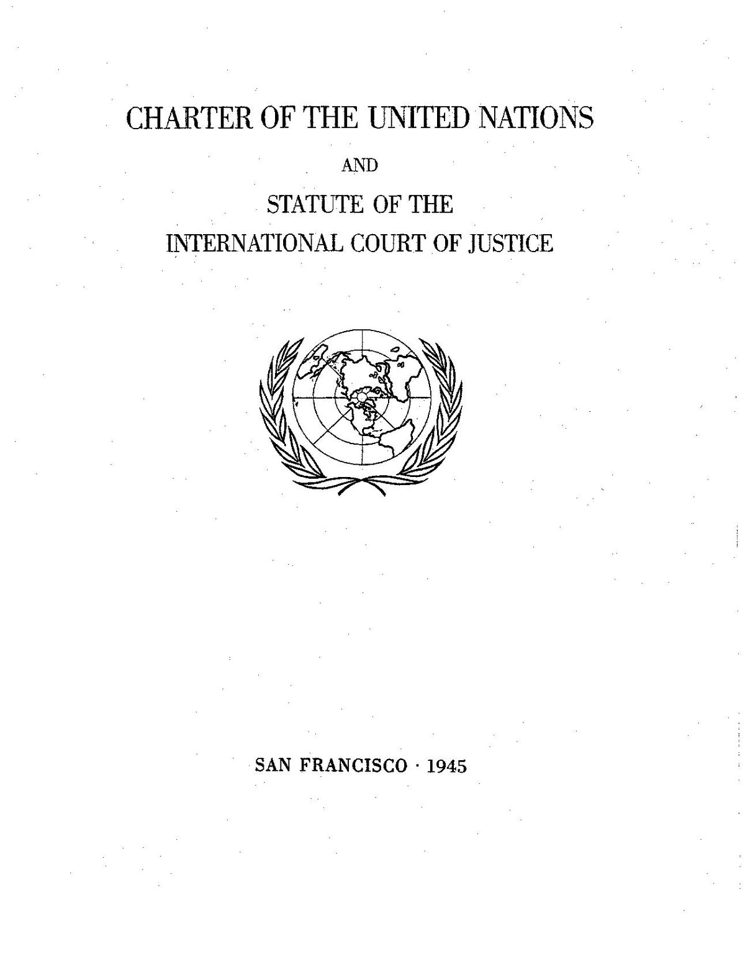
United Nations: Key facts
flag + “UN blue“ colour
main bodies:
General Assembly
Security Council
Economic and Social Council
Trusteeship Council
International Court of Justice
UN Secretariat
founded in 1945 (51 member states)
now 193 member states
founding document

Slide 8

United Nations: Purpose
UN Charter - Article 1
To maintain international peace and security
To develop friendly relations among nations based on respect for the principle of equal rights and self-determination of peoples
To achieve international co-operation in solving international problems of an economic, social, cultural, or humanitarian character, and in promoting and encouraging respect for human rights and for fundamental freedoms for all
To be a centre for harmonizing the actions of nations in the attainment of these common ends
sovereign equality for all members
settlement of international disputes by peaceful means
no threat or use of force

Slide 9
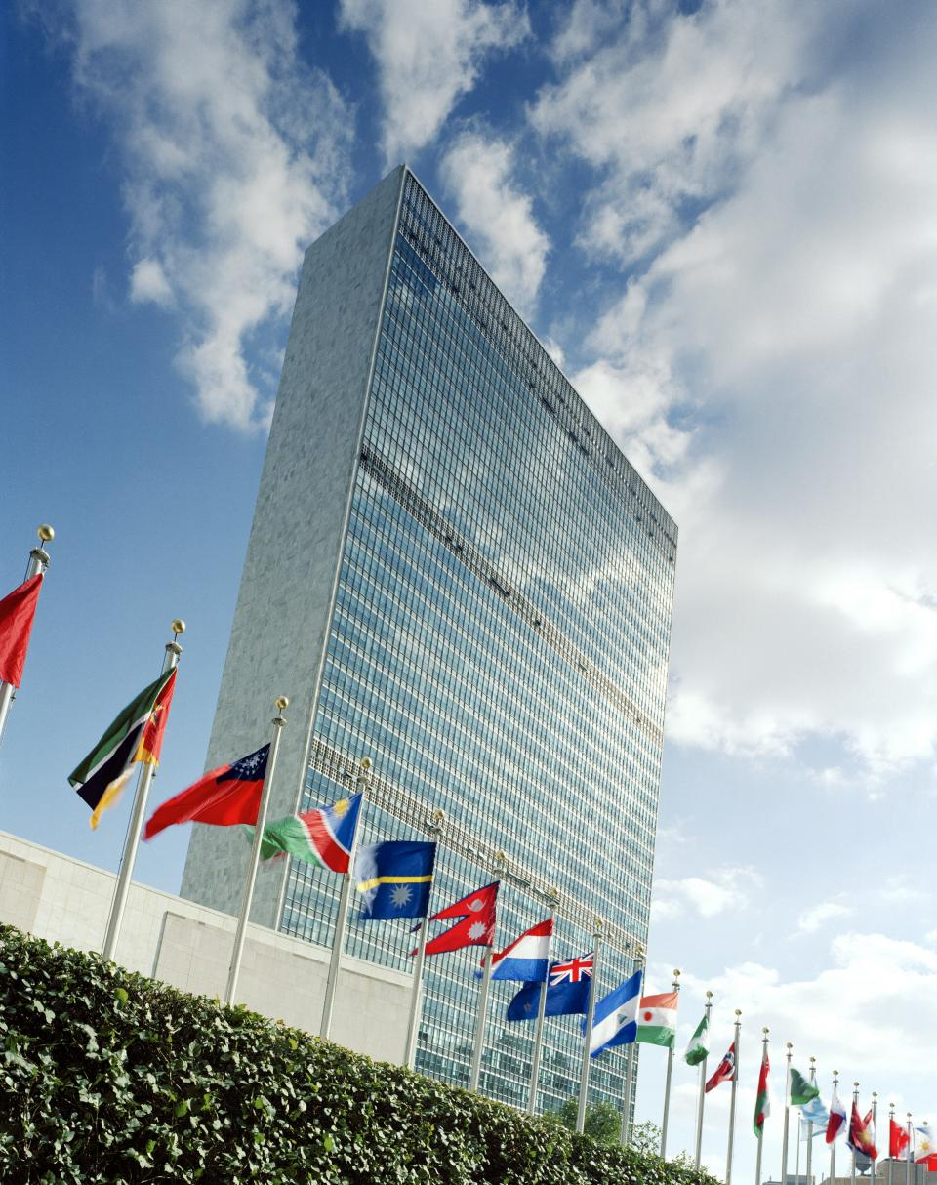
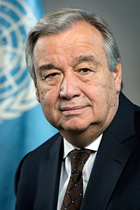
United Nations: Structure
Secretariat
Secretary-General + staff members
departments with different areas of responsibility
based in NYC
António Guterres

Slide 10

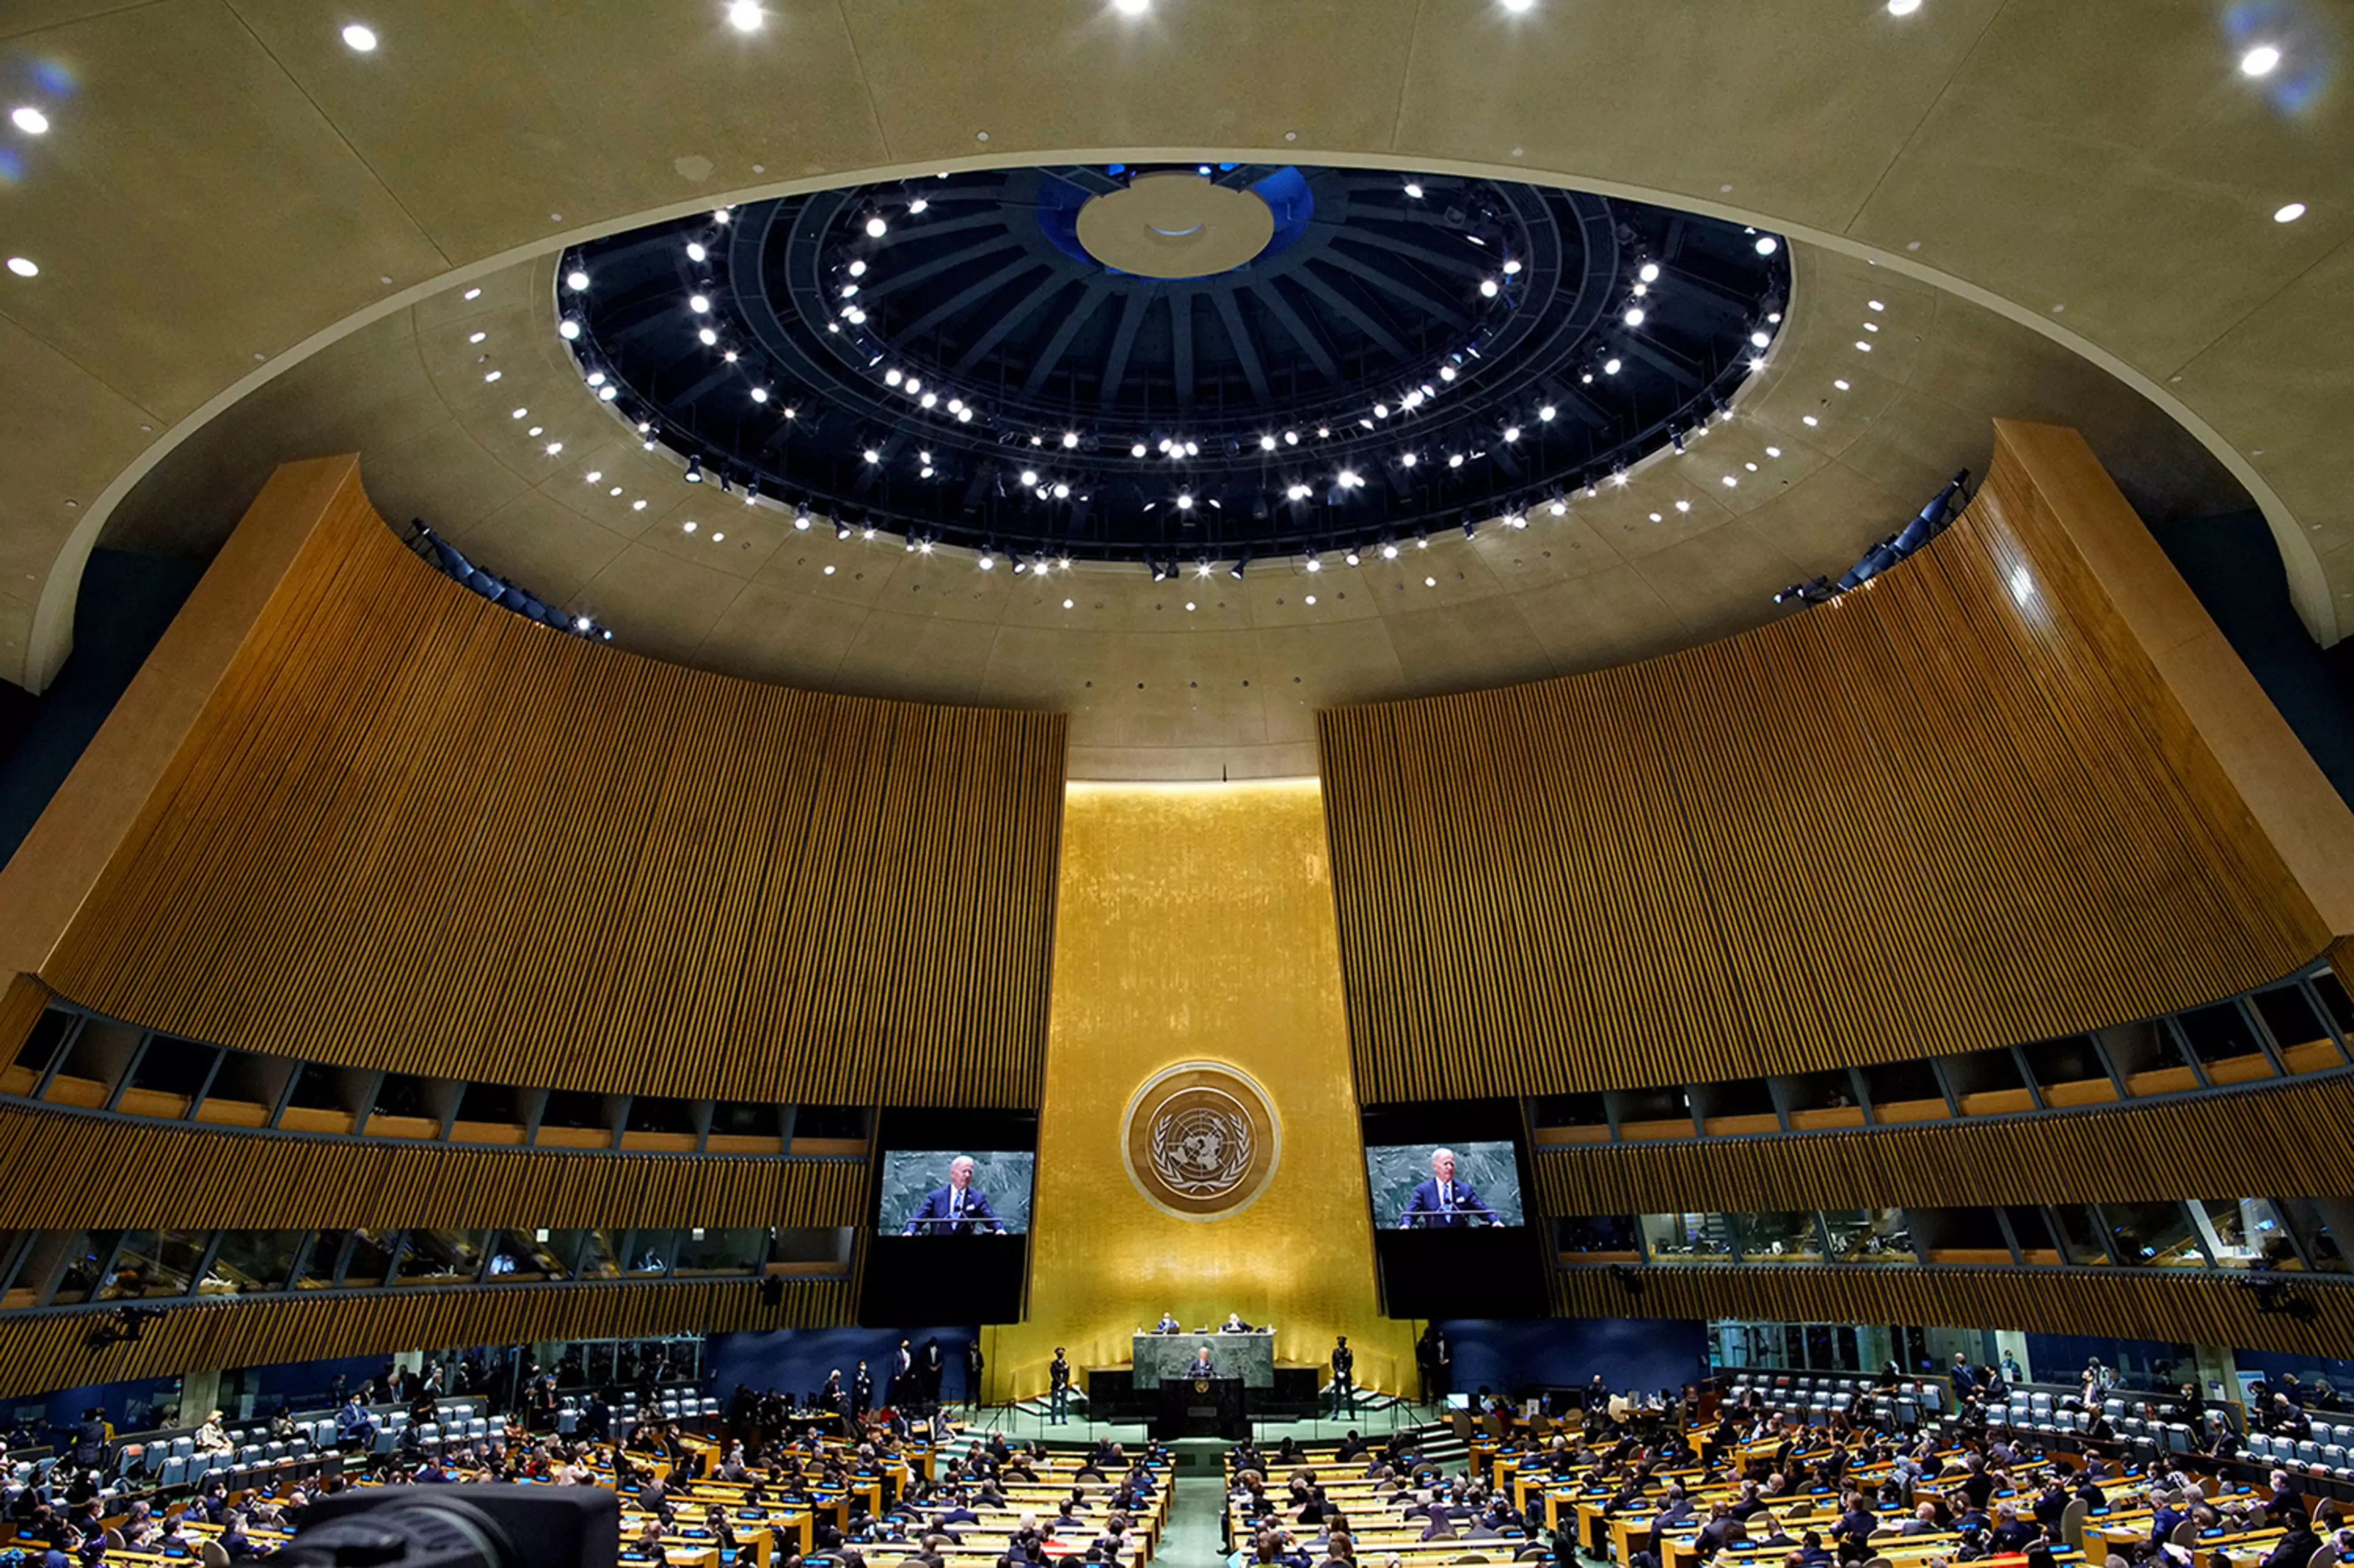
United Nations: Structure
key issue in San Francisco - how to differentiate between larger and smaller states?
General Assembly
main policymaking and representative organ
forum for multilateral discussion
universal representations = equal vote
GA appoints Secretary-General
GA elects non-permanent members of
the Security Council

Slide 11
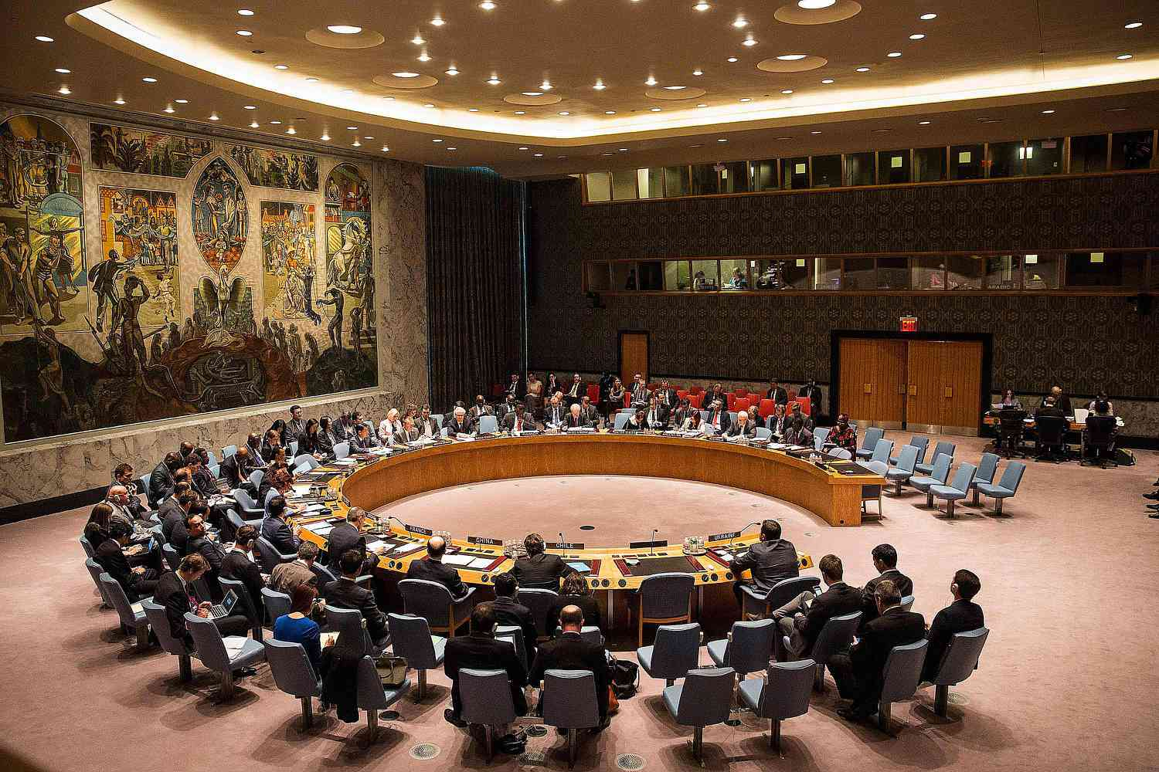

United Nations: Structure
Security Council
primary responsibility - maintenance of international peace and security (powers enshrined in Ch. VI, VII, VIII, XII)
5 permanent + 10 non-permanent members
(2-year term)
each member = 1 vote
may establish subsidiary bodies
How a decision is made? vote of 9 members (including permanent members!)
(Counter-Terrorism Committee, Non-Proliferation Committee, Military Staff Committee, Sanctions Committees…)

Slide 12
United Nations: International Peace and Security
Chapter VI: Pacific Settlement of Disputes
parties to any dispute shall seek a solution by peaceful means
Security Council can call upon the parties to settle the dispute by peaceful means
Security Council determines whether the maintenance of international peace and security could be endangered

Slide 13
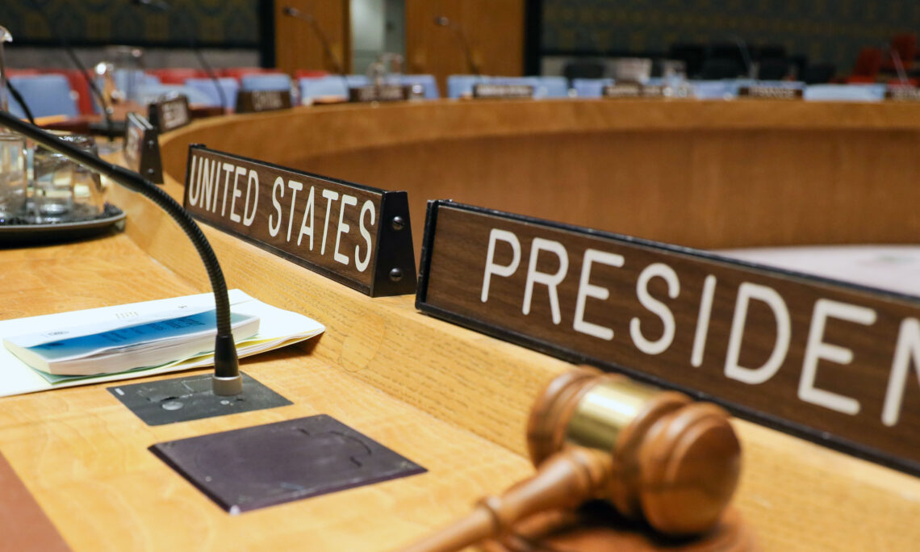
United Nations: International Peace and Security
Chapter VII: Action with Respect to Threats to the Peace, Breaches of the Peace, and Acts of Aggression
Security Council
determines the existence of threat to peace / breach of the peace / act of aggression
decides on the use of non-military measures
can take military action to maintain or restore international peace and security
undertake to make available to SC armed forces, assistance, and facilities

Slide 14
UN Charter, Article 51
“Nothing in the present Charter shall impair the inherent right of individual or collective self-defence if an armed attack occurs against a Member of the United Nations, until the Security Council has taken measures necessary to maintain international peace and security. Measures taken by Members in the exercise of this right of self-defence shall be immediately reported to the Security Council and shall not in any way affect the authority and responsibility of the Security Council under the present Charter to take at any time such action as it deems necessary in order to maintain or restore international peace and security.“
this option was not included in the original draft of the UN Charter!

Slide 15
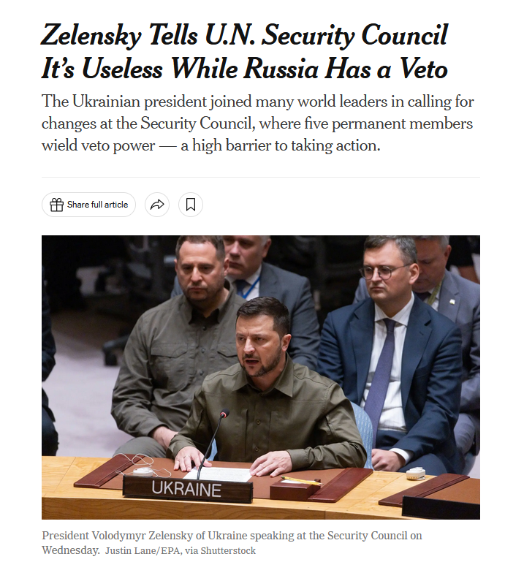
VIDEO

Slide 16

United Nations: Structure
Economic and Social Council - principal body for economic, social and environmental issues
Trusteeship Council - international supervision for 11 Trust Territories
International Court of Justice - legal disputes by states, advisory role on legal questions
International Courts and Tribunals
  International Criminal Tribunal for the former Yugoslavia (ICTY, 1993)
  International Criminal Tribunal for Rwanda (ICTR, 1994)
Peacebuilding Commission (PBC) - advisory body to SC and GA

Slide 17
United Nations: Activities
Core tasks
maintenance of international peace and security [Preventive diplomacy and mediation, Peacekeeping, Peacebuilding, Disarmament, Countering Terrorism]
human rights protection [Universal Declaration of Human Rights/UDHR]
sustainable development (SDG) and climate action
humanitarian aid delivery
upholding int. law [ICJ, Courts and Tribunals]
Specific issues:
hate speech, rule of law, refugees and migrants, children and armed conflict, violence against children, sexual violence in conflict, countering disinformation…
Ad hoc activities and initiatives
(Black Sea Grain Initiative… )

Slide 18
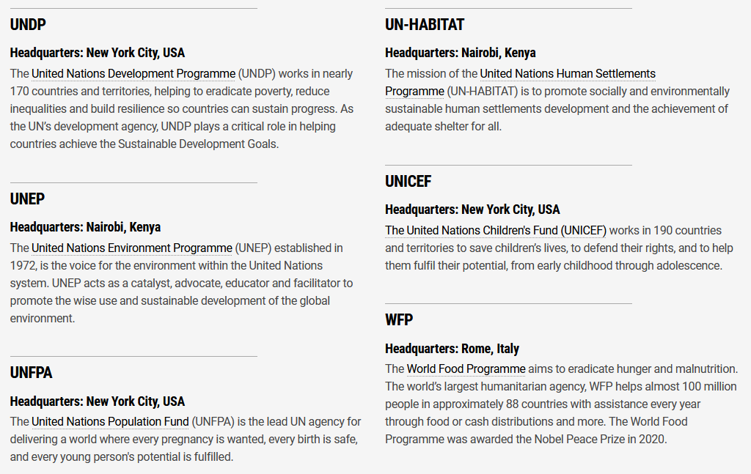
United Nations: Funds and programmes
+ specialised agencies
https://www.un.org/en/about-us/specialized-agencies

Slide 19
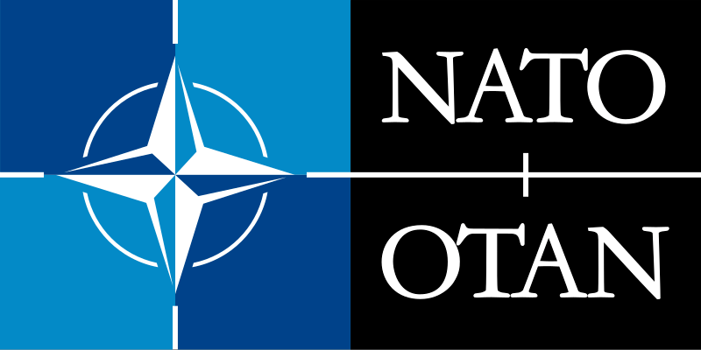
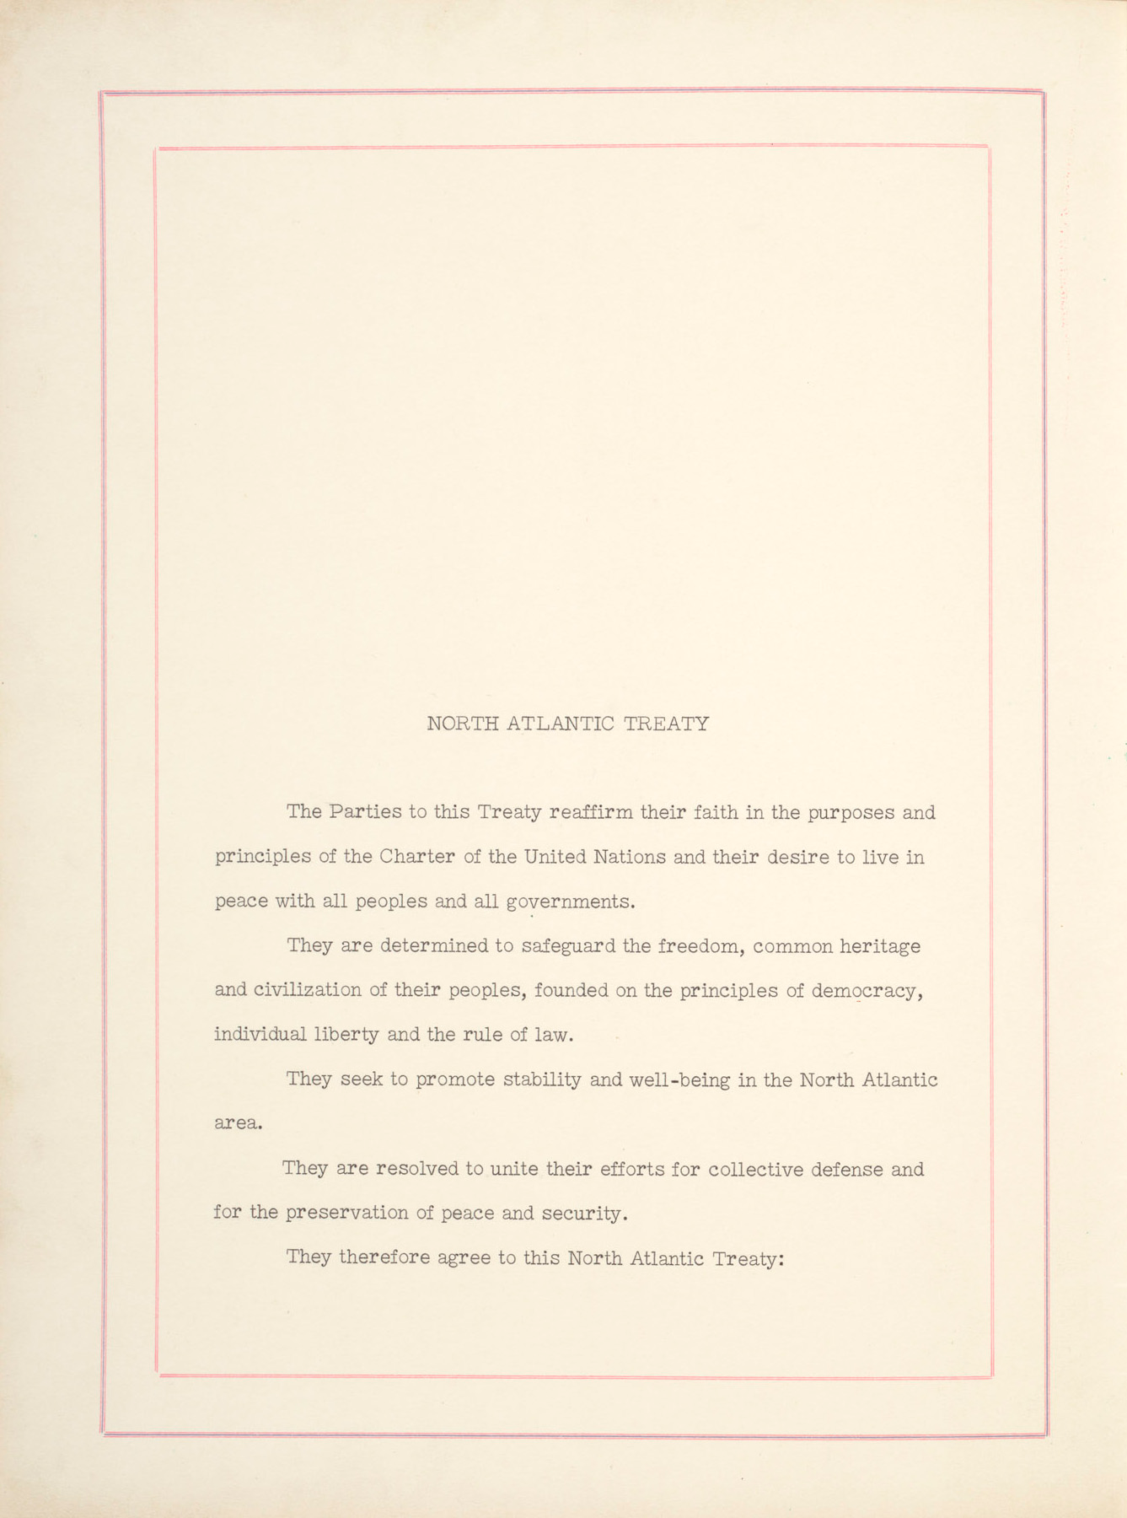
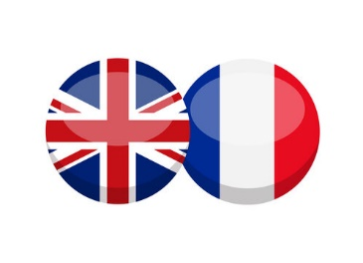
NATO: Key facts
political and military alliance
a collective defence organization (Art. 5)
established in 1949 (April 4)
founding document: North Atlantic Treaty (signed in Washington DC)
2 official languages (English + French)

Slide 20
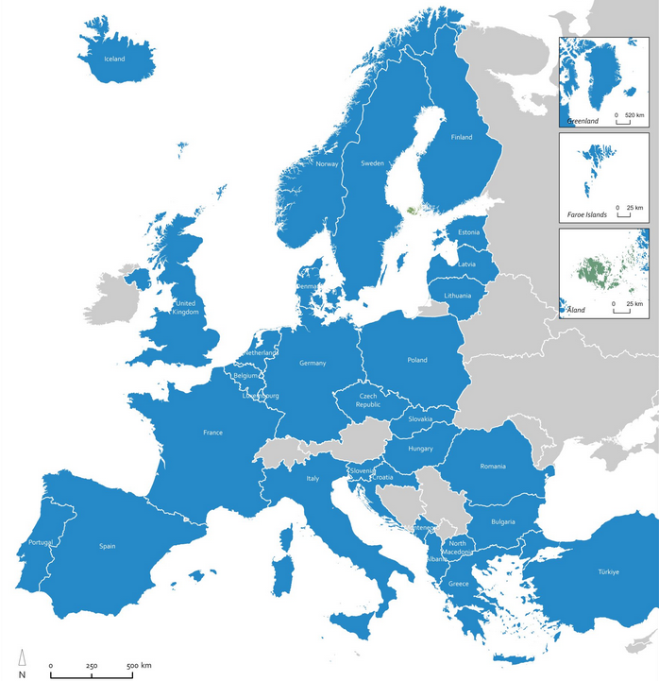
NATO: Membership
no standing army
32 member countries
+ security partners in around 40 countries
France left the NATO military command in 1966, rejoined in 2009
founding members: Belgium, Canada, Denmark, France, Iceland, Italy, Luxembourg, the Netherlands, Norway, Portugal, the United Kingdom and the United States

Slide 21
NATO: Purpose
Collective defence
Safeguard the freedom and security of all its members by political and military means
Secure a lasting peace in Europe, based on common values of individual liberty, democracy, human rights and the rule of law
Contribute to peace and stability through crisis prevention and management, partnerships
Sustainable peace in Europe
Stability outside NATO

Slide 22

Article 5 and Collective defence
The Parties agree that an armed attack against one or more of them in Europe or North America shall be considered an attack against them all and consequently they agree that, if such an armed attack occurs, each of them, in exercise of the right of individual or collective self-defence recognised by Article 51 of the Charter of the United Nations, will assist the Party or Parties so attacked by taking forthwith, individually and in concert with the other Parties, such action as it deems necessary, including the use of armed force, to restore and maintain the security of the North Atlantic area.
invoked just once - after 9/11
United States feared of being drawn into a war through treaty obligations

Slide 23
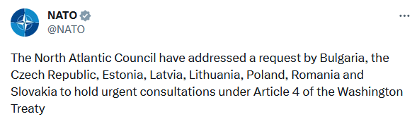
NATO: Decison-making process and consultations
principle of consensus decision-making
  all decisions are made by consensus after consulation and discussion
  applied at every committee level
  facilitated by SecGen
  Consultation (Art. 4)
  „The Parties will consult together whenever, in the opinion of any of them, the territorial integrity, political independence or security of any of the Parties is threatened.“
invoked 7 times
last time - February 24, 2022
any member can formally invoke Art. 4

Slide 24
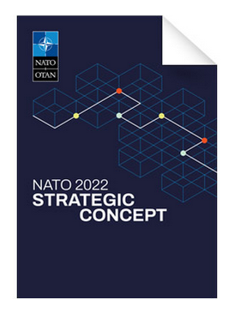
NATO: Core tasks
enshrined in Strategic Concept (2022)
Deterrence and defence
Crisis prevention and management
Cooperative security
+ Resilience (Art. 3)
both civil preparedness + military capacity
assured continuity of government and critical government services
resilient energy supplies
ability to deal effectively with uncontrolled movement of people
resilient food and water resources
ability to deal with mass casualties
resilient civil communications systems
resilient civil transportation systems
  „In order more effectively to achieve the objectives of this Treaty, the Parties, separately and jointly, by means of continuous and effective self-help and mutual aid, will maintain and develop their individual and collective capacity to resist armed attack“
7 baseline requirements for national resilience

Slide 25
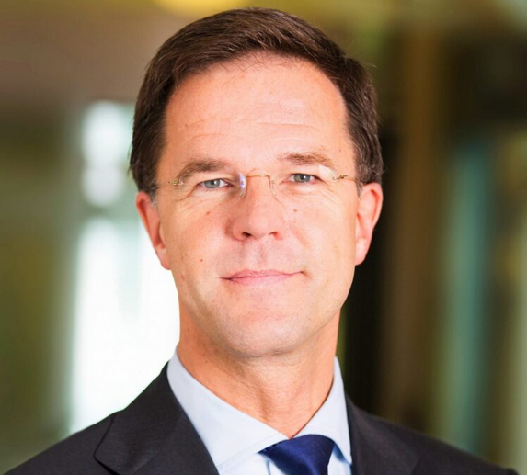
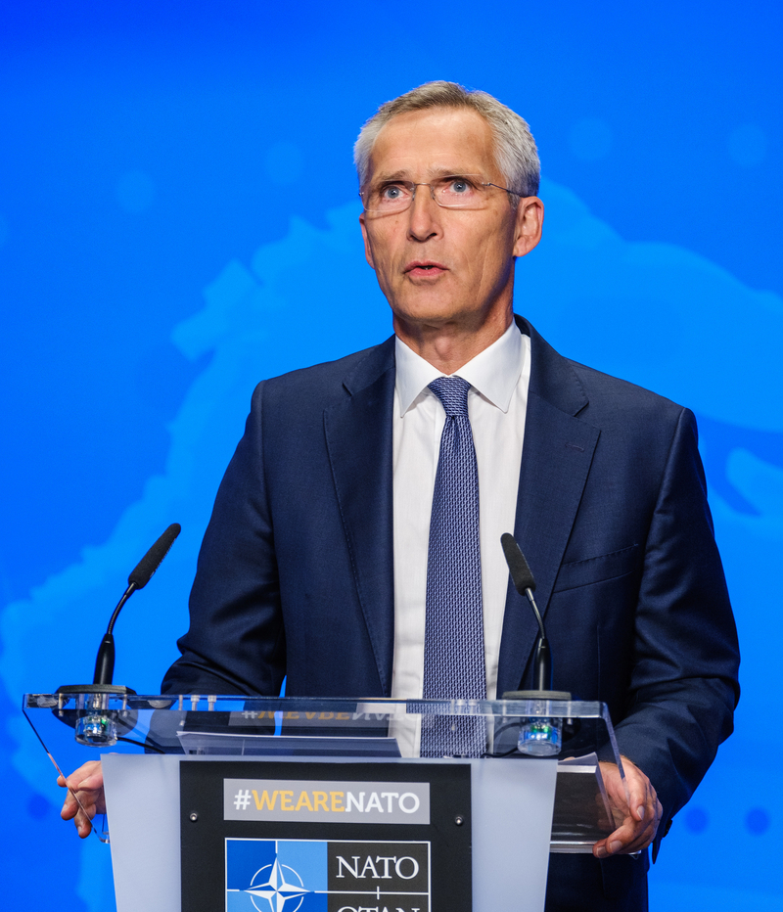
NATO: Structure
North Atlantic Council (the Council / NAC)
principal political decision-making body within NATO
oversees a wide network of committees and working groups
member states represented at different levels (Permanent Representatives, foreign or defence ministers, heads of state and government)
Secretary General
facilitates consulations and decision-making
principal spokesperson
chairs NAC + all major committees
head of International Staff

Slide 26
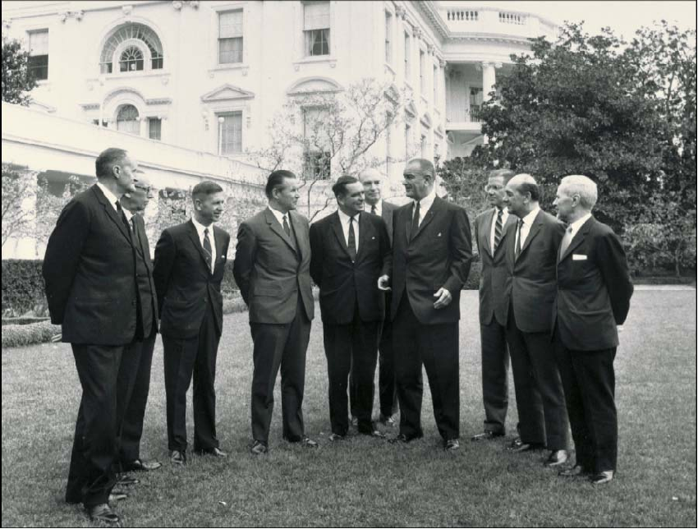
NATO: Structure
Nuclear Planning Group (NPG)
senior body on nuclear matters in the Alliance
reviews the NATO nuclear policy
discusses specific policy issues (nuclear arms control and nuclear proliferation)
all Allies members of the NPG, except for France
NATO Organization - overview
Organizations and agencies - see the list here

Slide 27
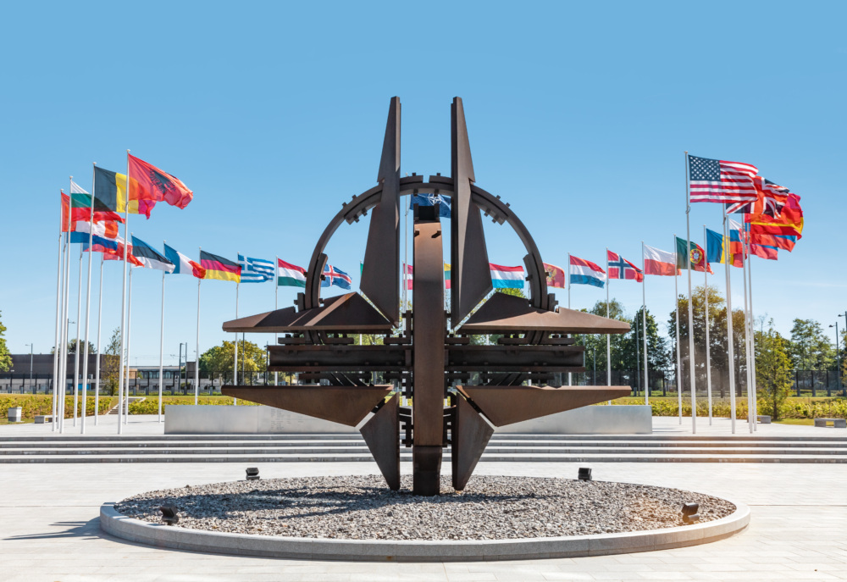
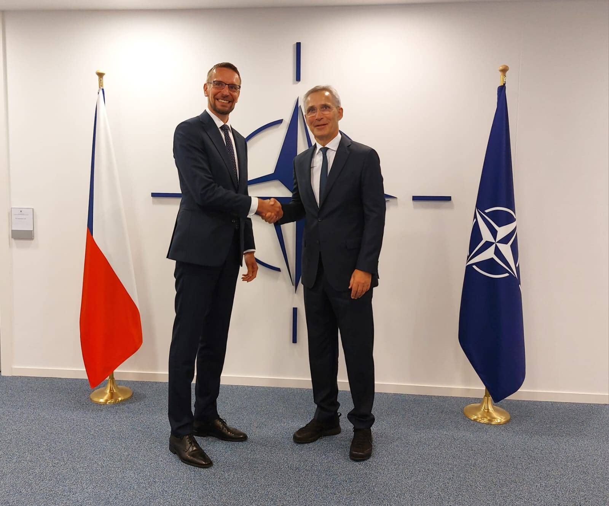
NATO: Civilian structure
NATO Headquarters (Brussels)
political and administrative centre of the Alliance
home to NAC, national delegations, offices/missions of partner countries = a venue for dialogue and cooperation
National delegations to NATO
represent MSs, contribute to the consultation process
each headed by an ambassador/permanent representative
International Staff - headed by the NATO SecGen
supports the NAC and national delegations at NATO HQ, helps implement decisions
David Konecký (Czech ambassador)
(Office of the SecGen, 8 divisions, independent offices)

Slide 28
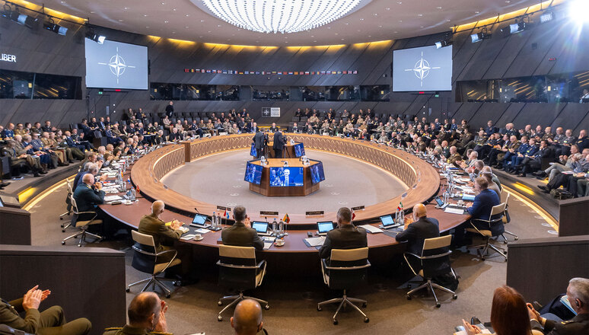
NATO: Military structure
Military Committee (MC)
senior military authority in NATO
Chiefs of Defence of member countries / military representatives (Milrep) of the Chiefs of Defence
provides the NAC and the Nuclear Planning Group with consensus-based military advice
provides the Strategic Commanders with guidance (military matters)
International Military Staff
executive body of the MC and the military command structure
strategic and military advice for the MC
ensures decisions/policies‘ implementation
(several divisions and offices)

Slide 29
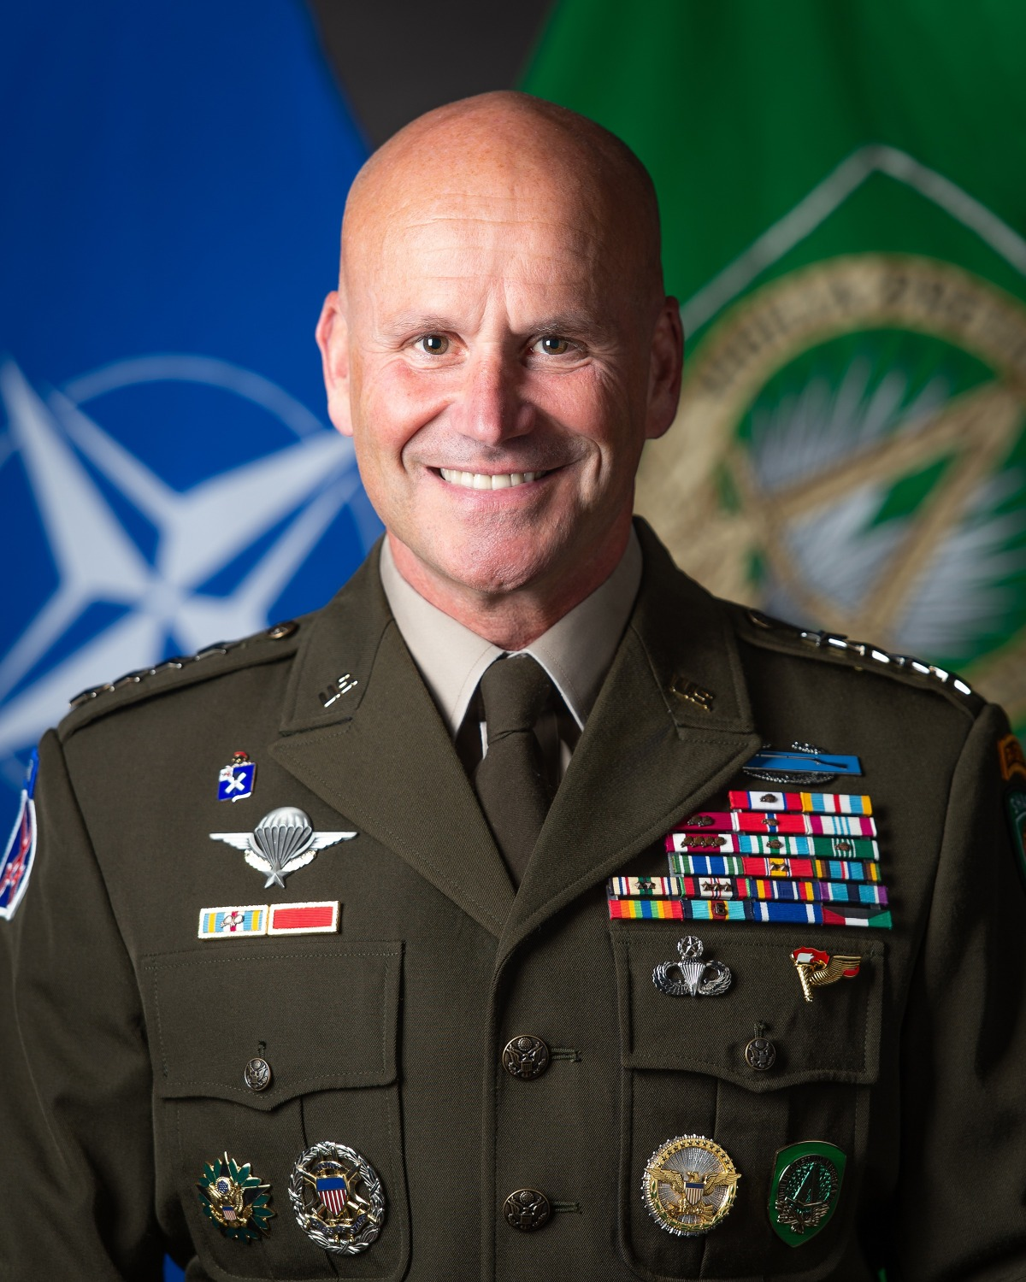
NATO: Structure
Supreme Allied Commander Europe General Christopher G. Cavoli
NATO Command Structure (NCS) - composed of ACO and ACT (= 2 strategic
commands)
A. Allied Command Operations (ACO)
planning and execution of Alliance operations, consists of several permanent HQs - strategic, operational and tactical levels
Strategic: Supreme Headquarters Allied Powers Europe (SHAPE) - headed by SACEUR (Supreme Allied Commander Europe)
Operational: Joint Force Commands (JFCs) in Brunssum, Naples and Norfolk
Tactical: Single Service Commands (SSCs) - Izmir (Land), Northwood (Maritime) and Ramstein (Air)

Slide 30
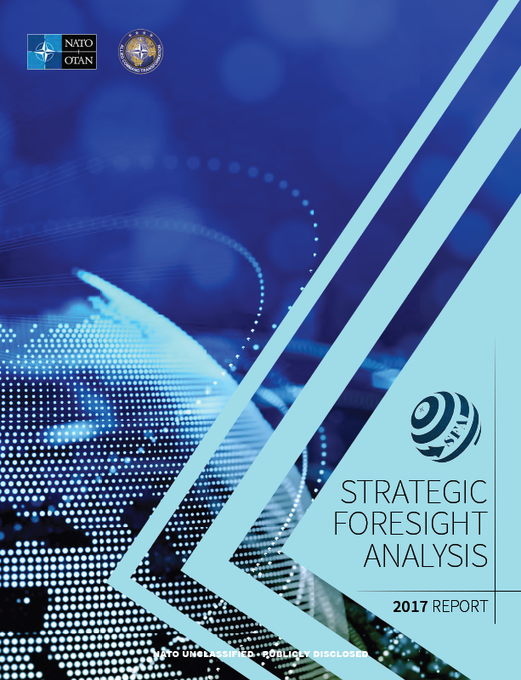
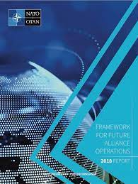
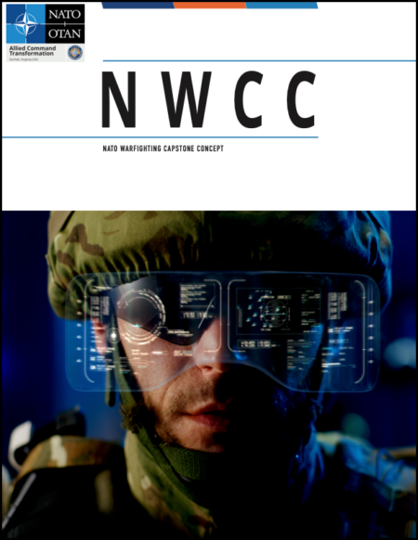
NATO: Structure
strategic foresight and planning
B. Allied Command Transformation (ACT, Norfolk)
leads the military adaptation of the Alliance (developing concepts, analysing security environment, defence planning, educating and training… )
headed by the Supreme Allied Commander Transformation (SACT)
Norfolk HQ + 3 subordinate entities: Joint Warfare Centre, the Joint Force Training Centre and the Joint Analysis & Lessons Learned Centre
educational and training facilities
Centres of Excellence and Partner Training and Education Centres

Slide 31

NATO Enlargement
a functioning democratic political system based on a market economy
the fair treatment of minority populations
a commitment to the peaceful resolution of conflicts
the ability and willingness to make a military contribution to NATO operations
a commitment to democratic civil-military relations and institutional structures
Art. 10 - „Open door policy"
How does a country join NATO?
  Accession talks with a NATO team
  Invitees send letters of intent to NATO (timetables for completion of reforms)
  Accession protocols are signed by NATO countries
  Accession protocols are ratified by NATO countries
  The Secretary General invites them to accede to the North Atlantic Treaty
  Invitees accede to the North Atlantic Treaty (national procedures)
  Deposition of their instruments of accession with the US State Department VIDEO
1995 Study on Enlargement - requirements to be fulfilled by potential members

