Slide 1
Regional Security
Lucie Konečná
BSSb 1105 International Security Policy
24/10/2024

Slide 2
Regional Security
Region is the area of interest to many fields of science.
Definition and characteristics of RS:
  ”System of mutual relations between countries in the region against the threats of instability, crises, armed conflicts and regional wars” (Kusztal A., 2017 - Theoretical foundations of regional security in international relations).
  Most frequently, security at the regional level is built based upon a system or an alliance operating within the defined region, and “regional security institutions are often, but not always, established on the basis of geographical boundaries of the region, at the interface of functional cooperation.
Criteria of regional security according to Kusztal:
  the military potential of states of a region and its technical and technological levels;
  the condition, strategy and the size of armed forces of countries in a region;
  the quality of management of a defense sector in states of a region;
  the character of borders between countries of a region and of external ones (geographical and political );
  political and military alliances of regional range;
  the role of political elites and rationality in choosing allies within - and beyond a region

Slide 3
Security architecture and relations among states
„An institutional system of organizing relations between states guaranteeing their security. It is based on the assumption that issues and problems related to the security of states cannot be solved individually.“
Cooperative security - ongoing effort to reduce the risk of war that does not target a specific state or coalition of states
Collective security - states avoid the use of force in mutual relations (two principles - the obligation to resolve all disputes by peaceful means, the prohibition of the use of force in mutual relations)
Collective defense - system of joint defense against external threats, i.e. against attacks by states that are not members of the organization

Slide 4
Evolution of security studies towards regional security - Critical Security Studies
Shift in the 90s (The first impulse - Toronto school - Strategies in Conflict: Critical Approaches to Security Studies)
Traditional security studies focused on military and state as a referent object
A shift in the definition of the referent object and threats
According to Waisova, there are two main characteristics of CSS:
  Exploring the differences between the Euro-Atlantic approach and that of Third World authors
  The concept of the individuals as a separate referent object
Mohammed Ayoob – subaltern realism
Discussion of the concept of security in the 90s - three groups
  A) group against changing the agenda (John Mearsheimer, Stephen Walt)
  B) group supporting the partial change (Schultz, Buzan?, Greenwood)
  C) group supporting radical reform (Ulman, Kegley, Kolodzej)

Slide 5
Evolution of security studies towards regional security – Toronto School
1994 - small conference at the York University entitled Strategies in Conflict: Critical Approaches to Security Studies
Keith Krause and Michael C. Williams - Critical Security Studies: Concepts and Cases
They began to questioning the concept of state as the main referent object – who or what is to be secured?
Set out agenda of CSS in three points:
a) referent object
b) security more than just a military security
c) changed the way how security was studied

Slide 6
Evolution of security studies towards regional security – Copenhagen School
1995 - Barry Buzan, Ole Weaver and Jaap de Wilde published book: Security: A New Framework for Analysis
Old vs. new concept of security
Resolves its incoherence by arguing that the social production of security is sufficiently stable to be treated objectively
Concept of sectoral security - military, political, economic, societal, environmental security
Concept of analytical levels/categories (international systems, international subsystems, units, subunits and individuals).
Concept of regional security complexes (4 basic principles)
Concept o Securitization

Slide 7
Theory of Regional Security Complexes
Concept of regional security complexes (4 basic principles):
  Composed of two or more states
  Geographically coherent grouping
  Mutual security dependency relationship (MSDR)
  MSDR deeply embedded, long term not permanent
„a group of states whose major security perspectives and concerns are so intertwined that the national security issues of each cannot be adequately analyzed or addressed separately“
Lower level security complex x Higher level security complex
Bufffer zones and states „inbetween“

Slide 8
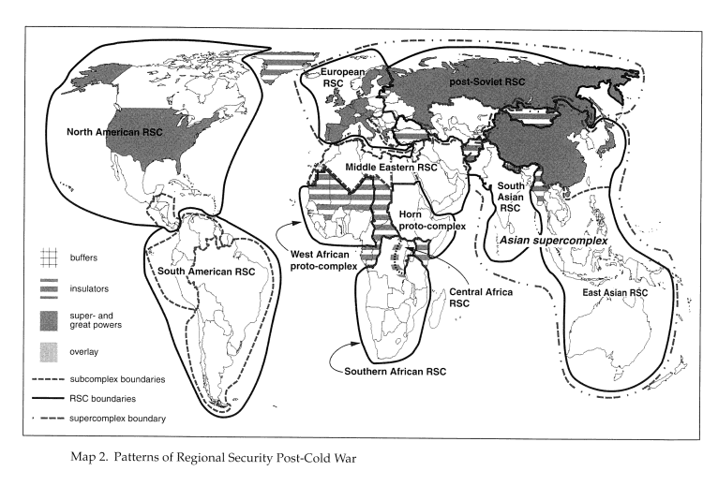
Copenhagen School – Regional Security Complexes

Slide 9
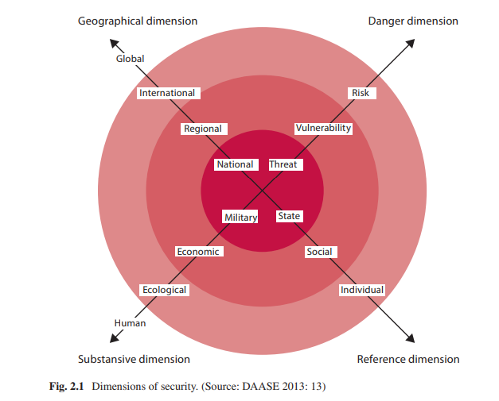
Security Dimensions

Slide 10
Regional Security Threats
The most prominent regional threats According to Eichler (2009):
  Military threats - regional conflicts, WMD proliferation and armed aggression
  Political threats - terrorism and organized crime, existence of dangerous dictatorial regimes, human rights violations and threats to internal politics by superpowers (NATO, USA, etc.).
  Economic threats - instability of world markets, uneven economic development and economic crisis.
  Ecological threats - changes in land and sea use; direct exploitation of natural resources; climate change; pollution and invasive species.

Slide 11
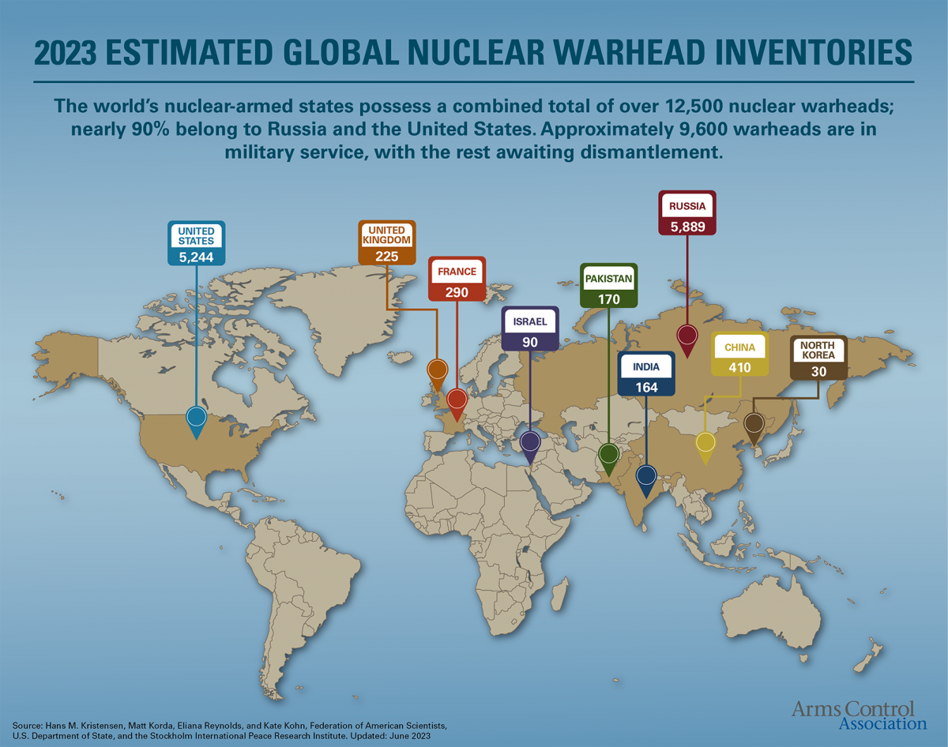
Regional Security Threats - WMD
NPT 1968 - the NPT non-nuclear-weapon states agree never to acquire nuclear weapons and the NPT nuclear-weapon states in exchange agree to share the benefits of peaceful nuclear technology and to pursue nuclear disarmament aimed at the ultimate elimination of their nuclear arsenals.

Slide 12
Regional Security Threats - Conflicts
An armed conflict is a contested incompatibility that concerns government or territory where the use of armed force between two parties, results in at least 25 battle-related deaths in one calendar year.
Conflict: clash between two actors who have incompatible interests.
Necessary features of conflict according to Holsti (1991):
  a) Actors of the conflict
  b) Area of the clash (incompatibility)
  c) Tension
  d) Conflict behavior
Conflict vs. War vs. Civil war

Slide 13
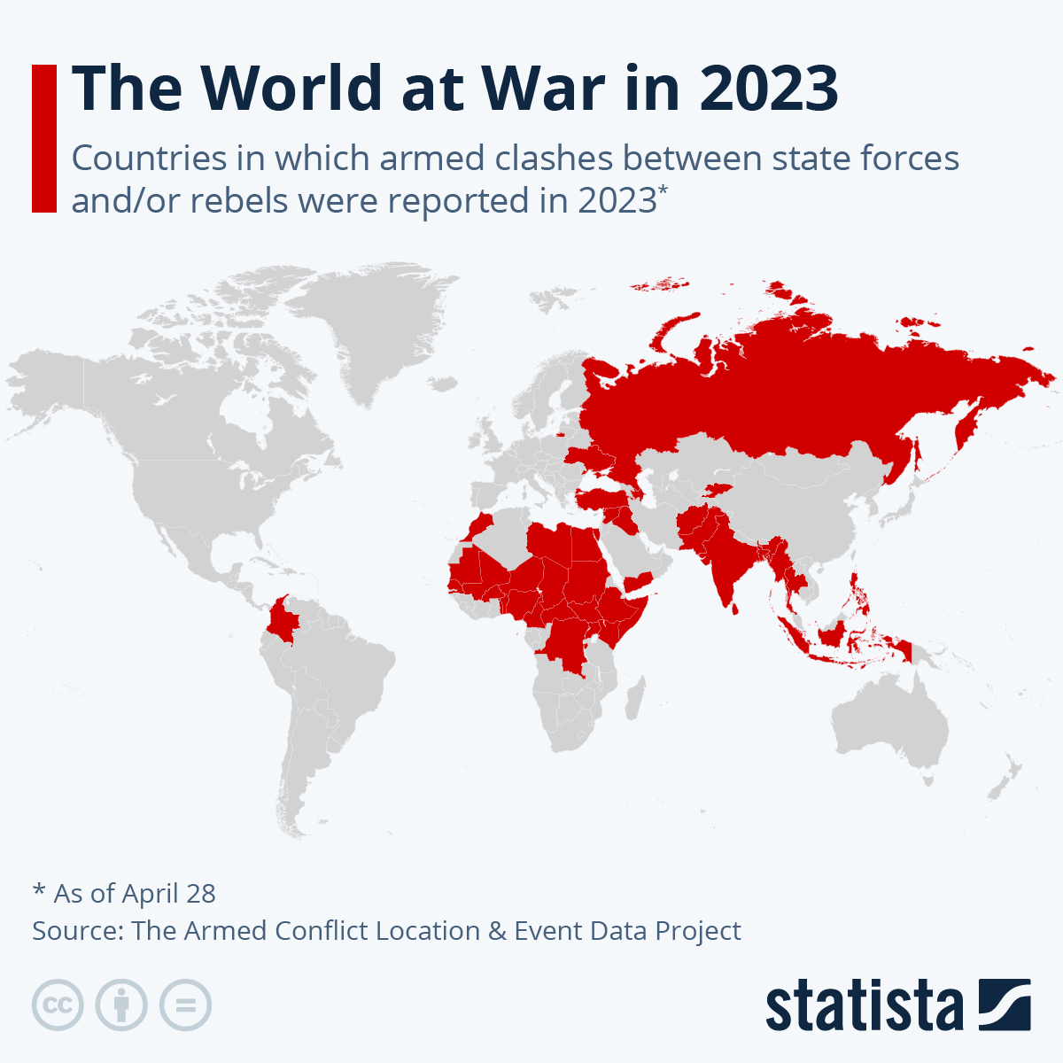
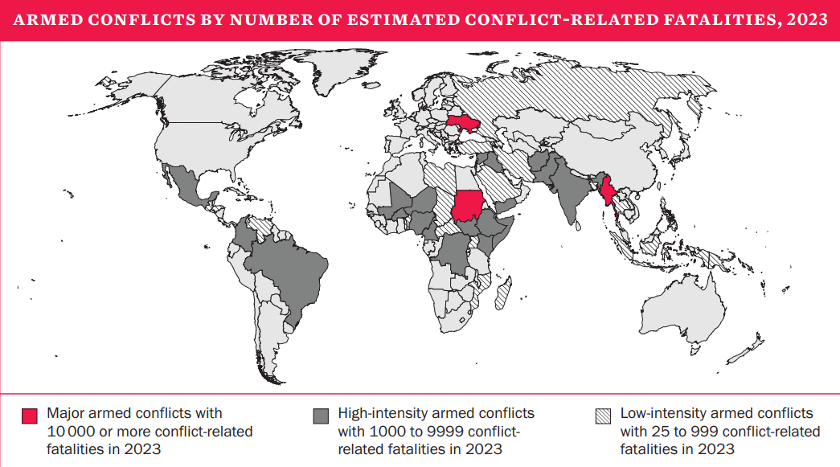
Regional Security Threats - Conflicts

Slide 14
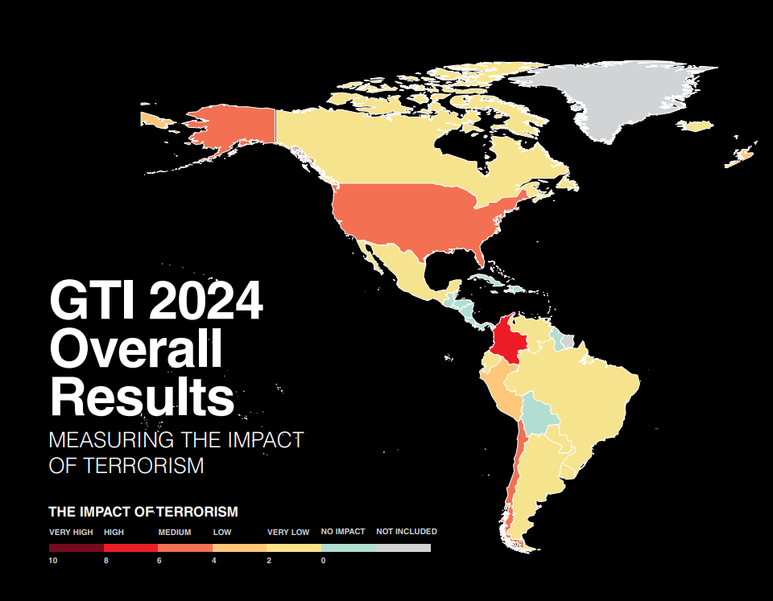
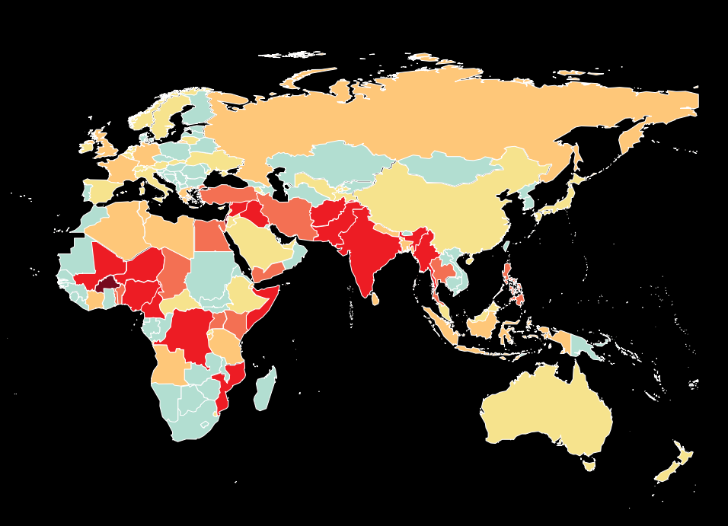
Regional Security Threats - Terrorism

Slide 15
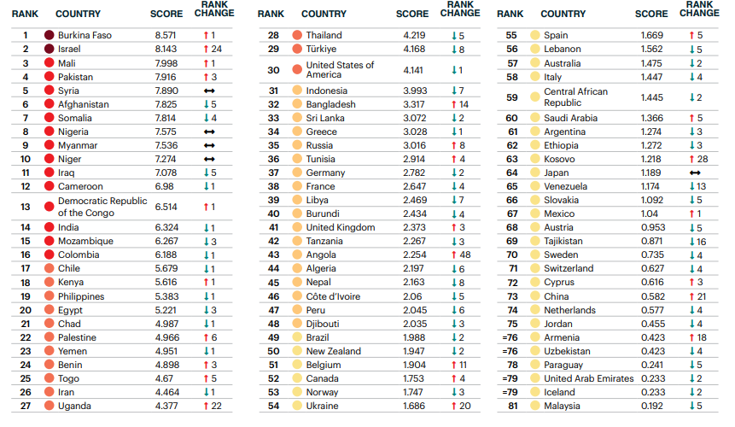
Regional Security Threats - Terrorism

Slide 16
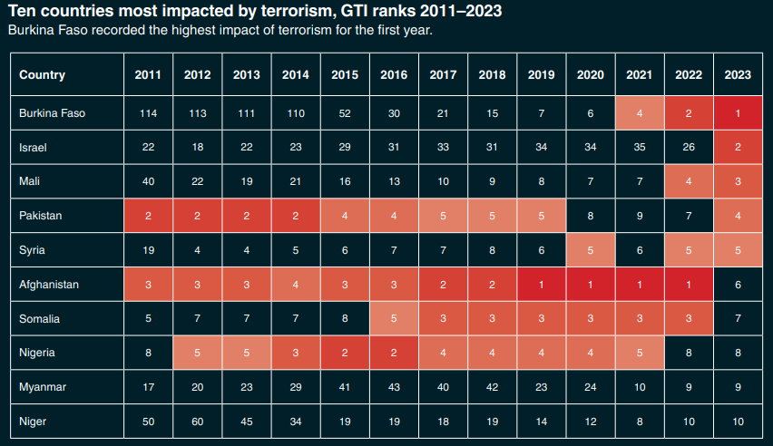
Regional Security Threats - Terrorism

Slide 17
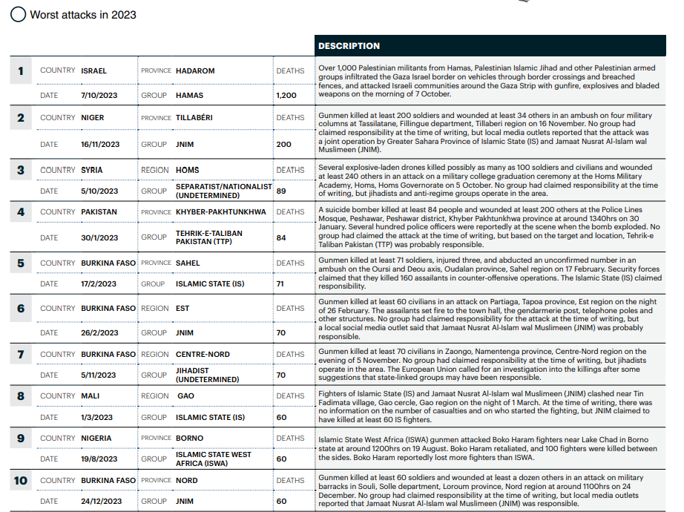
Regional Security Threats - Terrorism

Slide 18
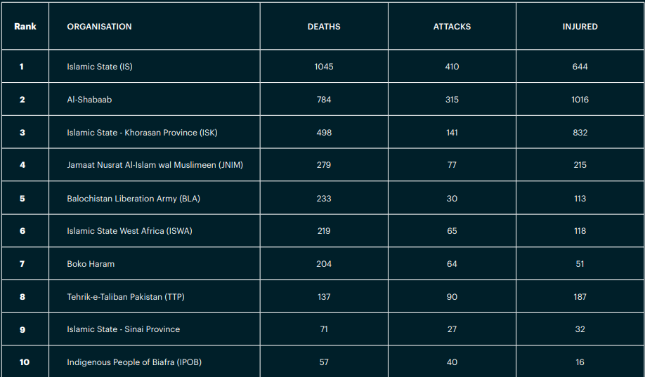
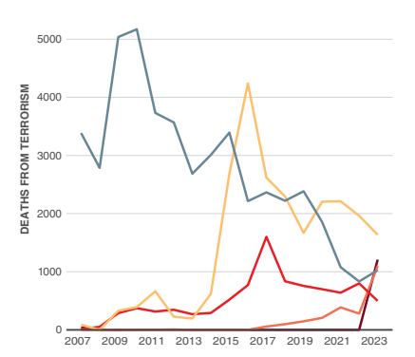
Regional Security Threats - Terrorism

Slide 19
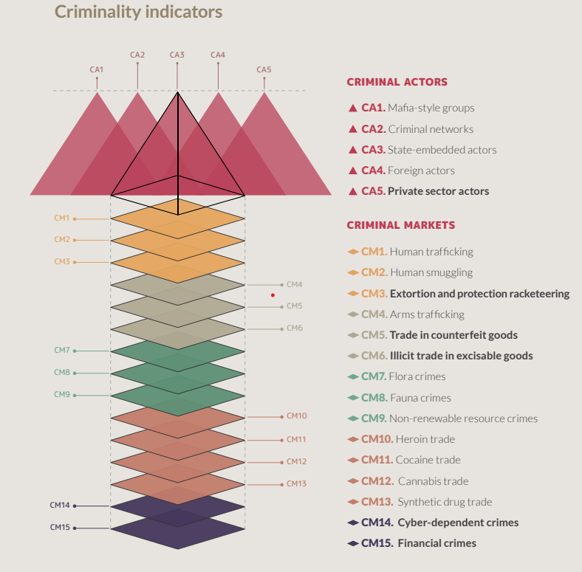
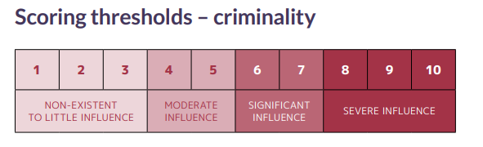
Regional Security Threats - Global Organized Crime Index

Slide 20
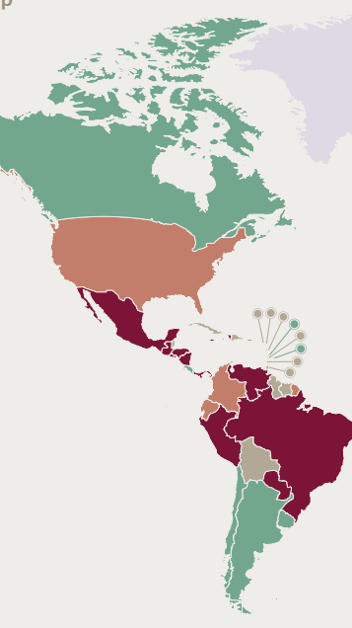
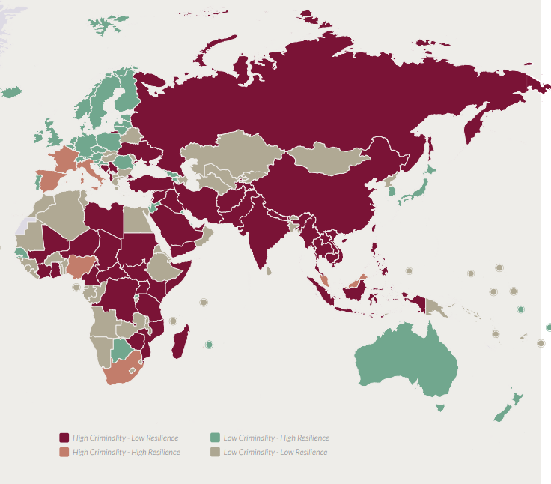
Regional Security Threats - Global Organized Crime Index

Slide 21
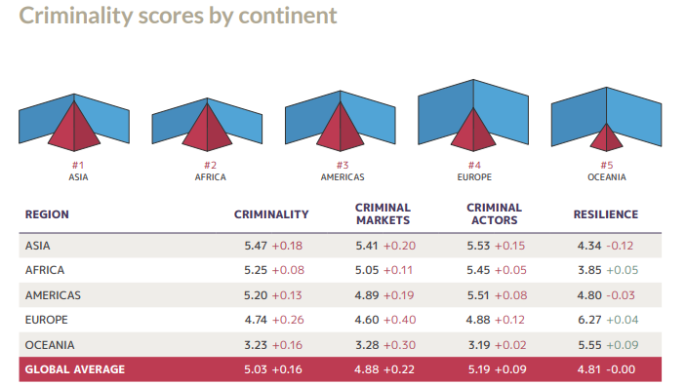
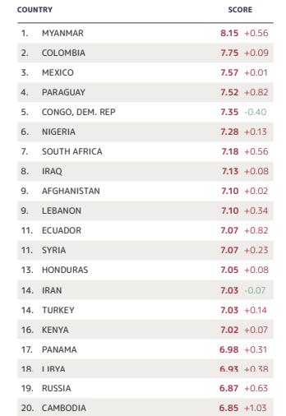
Regional Security Threats - Global Organized Crime Index

Slide 22
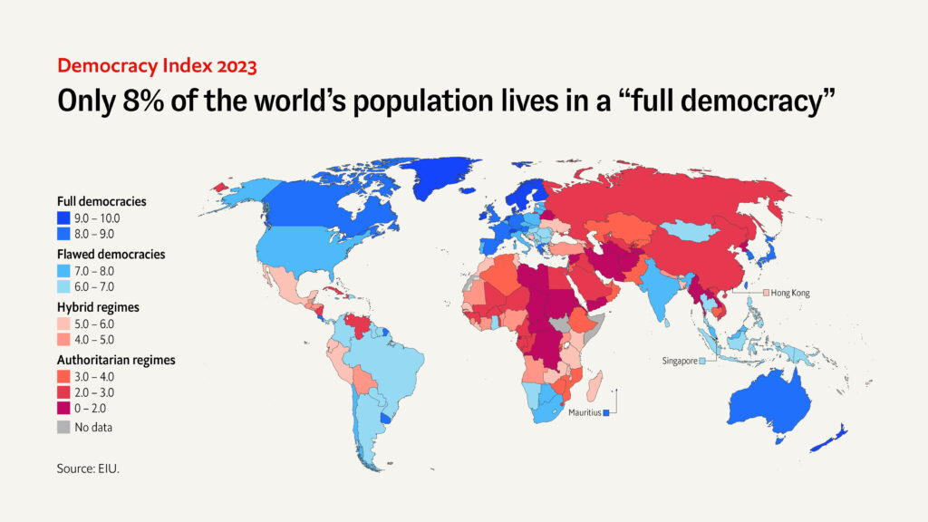
Regional Security Threats - Dictatorial regimes

Slide 23
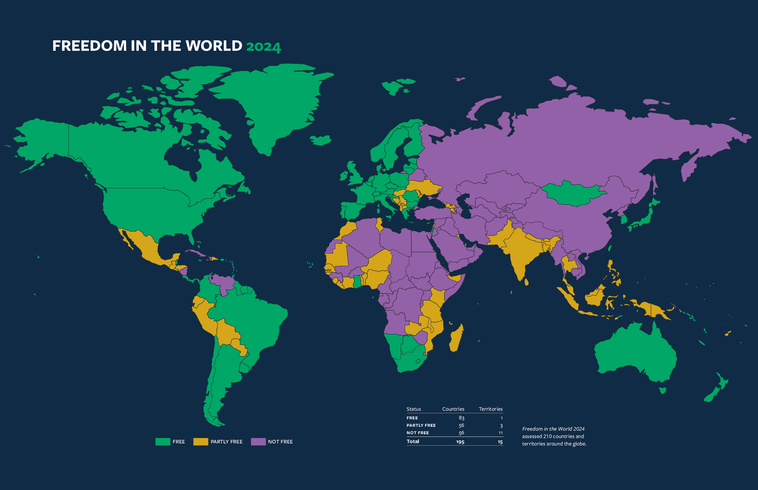

Slide 24
Regional Organisations
„Regional institutions are the regimes or formal organizations with membership limited to a specific geographical region or possibly two or more neighboring regions.“
Three types of regional organizations according to Kusztal :
  Multi-tasking organizations
  Organizations with economic profile
  Defensive alliances
Regional organisations vs. regimes
„International organizations are generally seen to be more formally specified institutions, with a secretariat, permanent office, and the like. International regimes have been defined as sets of principles, norms, rules, and decisions upon which actors' expectations converge (Krasner 1983).“
Security organisations:
  Cooperative security
  Collective security
  Collective defense

Slide 25
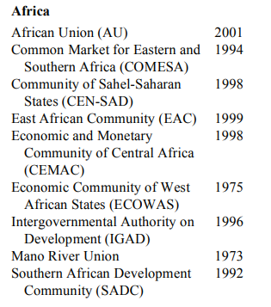
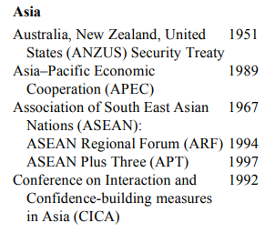
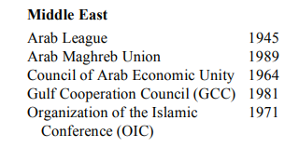
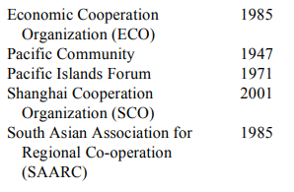
Regional organizations with security functions

Slide 26
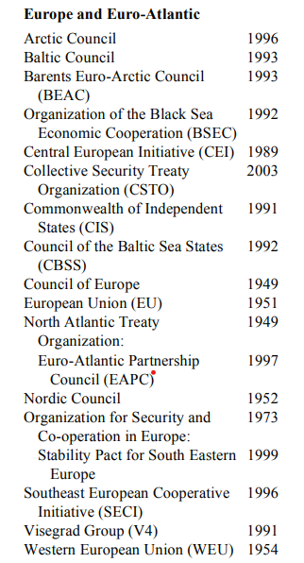
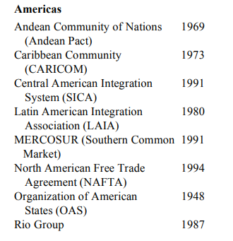
Regional organizations with security functions

Slide 27
Regional Organisations/Regimes - Asia
Arab League
  Cairo 1945, 22 member states
  „draw closer the relations between member states and co-ordinate collaboration between them“
  Council of the Arab League, Joint Defense Council, General Secretariat (Secretary General), Economic Council
Australia, New Zealand, United States Security Treaty (ANZUS)
  1951 trilateral agreement
  New Zealand was suspended from ANZUS 1986-2007
  AUKUS - Trilateral Security Partnership Between Australia, U.K. and U.S.
Association of South East Asian Nations (ASEAN)
  1961 - Association of Southeast Asia (ASA), 1967 ASEAN Declaration, 10 member states
  ASEAN's primary objectives are: "(1) to accelerate economic growth, social progress and cultural development in the region and (2) to promote regional peace and stability through abiding respect for justice and the rule of law in the relationship among countries in the region and adherence to the principles of the United Nations Charter.„

Slide 28
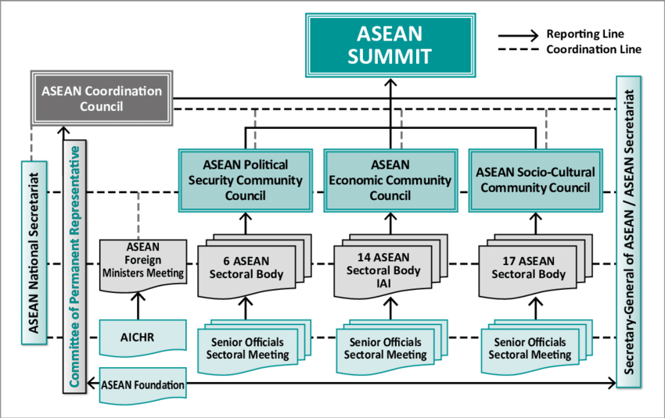
ASEAN Structure

Slide 29
Regional Organisations - Africa
Africa Union (AU)
  1963 Organization of African Unity (OAU), 2002 –AU, 55 member states
  Main administrative capital of the African Union is in Addis Ababa, Ethiopia
  Multiple goals: Accelerate the political and socio-economic integration of the continent; Promote and defend African common positions on issues of interest to the continent and its peoples; Encourage international cooperation, etc.
South African Development Community (SADC)
  Southern African Development Coordination Conference transformed into SADC in 1992
  Gaborone, Botswana, 16 member states
  „to achieve economic development, peace and security, and growth, alleviate poverty, enhance the standard and quality of life of the peoples of Southern Africa, and support the socially disadvantaged through Regional Integration.“
Economic Community of West African States (ECOWAS)
  1975, 15 member states, Abuja Nigeria
  „The aim of the Community is to promote co-operation and integration, leading to the establishment of an economic union in West Africa in order to raise the living standards of its peoples, and to maintain and enhance economic stability, foster relations-among Member States and contribute to the progress and development of the African continent.“
  The Economic Community of West African States Monitoring Group (ECOMOG) was a West African multilateral armed force established by the Economic Community of West African States (ECOWAS). 1990-2005.

Slide 30
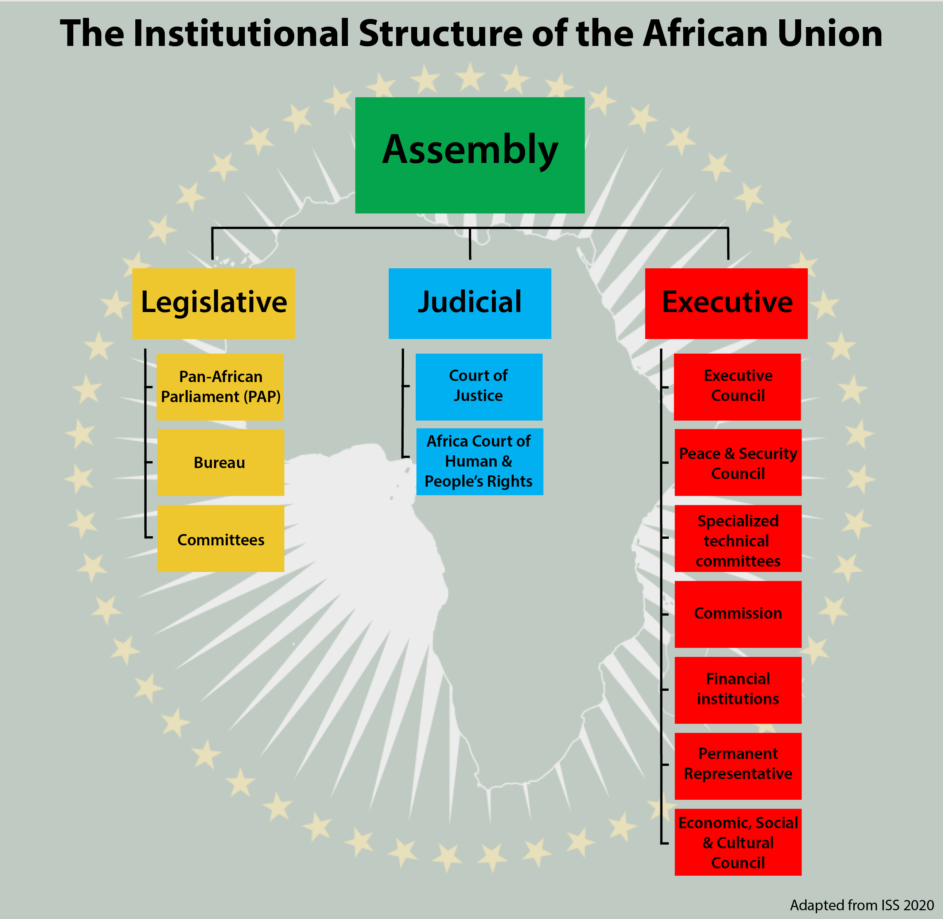
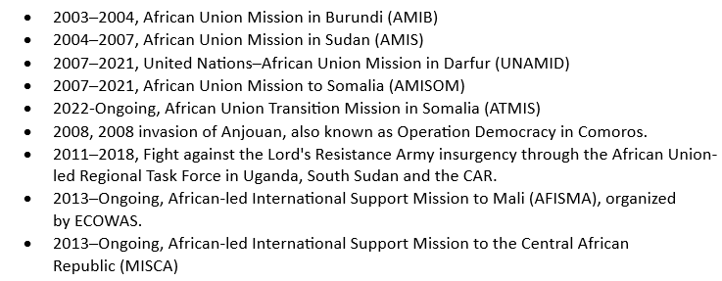
AU Structure

Slide 31
Regional Organisations/Regimes – America and Europe
Organisation of American States (OAS)
  1948 – Washington D.C., 35 member states
  „the premier regional forum for political discussion, policy analysis and decision-making in Western Hemisphere affairs. The OAS brings together leaders from nations across the Americas to address hemispheric issues and opportunities.“
North American Free Trade Agreement (NAFTA) x Agreement between the United States of America, the United Mexican States, and Canada (USMCA)
  1994, agreement signed by Canada, Mexico, and the United States that created a trilateral trade bloc in North America
  2020 - free trade agreement between Canada, Mexico, and the United States
Visegrad Group (V4)
  1991, Czech Republic, Poland, Slovakia and Hungary
  To advance co-operation in military, economic, cultural and energy affairs
  International Visegrad Fund, Non-institutionalized, regular meeting of top executives (Presidency lasts one year)

Slide 32
Thank you for your attention

