Slide 1
Violent Non-State Actors (VNSA)
Lucie Konečná
BSSb 1105 International Security Policy
30/9/2024

Slide 2
VNSA - General Info
Primary, secondary, and tertiary conflict actors
Interstate, Intrastate and Non-state/Sub-state conflicts
Violent Non-State Actors:
a) use violence to achieve their goals
b) are not integrated within formalized state structures
Violence that involves violent non-state actors is often described as unconventional
Violent non-state actors involved in a low-intensity conflict may prefer the status quo over negotiation and mediation because their power is much lower

Slide 3
Typology of War Participants
1. Members of the armed forces according to international law:
  Combatants – members of regular or irregular armed forces
  Non-combatants - not intended for combat duties (medics, clerics).
  2. Civilians
Real fighters in modern wars:
Conventional soldiers/army
Insurgents, guerrillas and rebels/partisans
Terrorists
Mercenaries, PSC/PMC
Foreign volunteers
Warlords
Child soldiers
Paramilitary units and death squads
Militias
Marauders

Slide 4
Factors Affecting the Rise of VNSA
End of Cold War and the emergence of a globalized world and modern technologies
Socioeconomic factors and absence of goods
Repressive politics
Poverty and income inequality
Weakness of security institutions
State collapse
Individual explanations (rural vs. urban, age, education, socio-economic status, unemployment, socio-psychological level)

Slide 5
VNSA Typology according to Williams
Insurgency
Militia
Paramilitary units
Terrorist groups
Warlords
Criminal organizations and gangs
Motivations and purpose
Strength and scope
Funding and access to resources
Organizational structure
Role of violence
Relationship between VNSA and state
Functions of VNSAs for members and supporters

Slide 6
VNSA Typology according to Ezrow
Insurgencies
Warlords and Marauders
Paramilitary units
Terrorist Organizations
Private military companies
Organized crime and gangs
Motivation
Strategy and tactics
Funding and access to resources
Organizational structure
Scope and power
Victims
Legitimacy and popularity

Slide 7
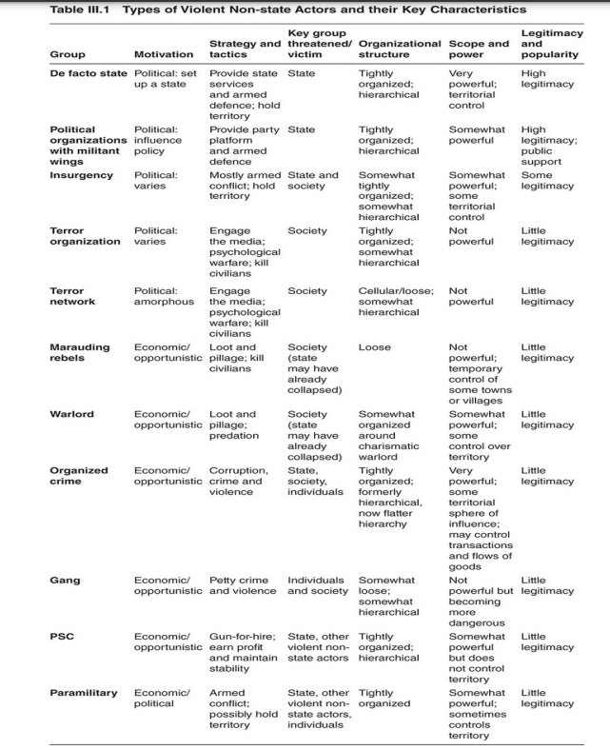

Slide 8
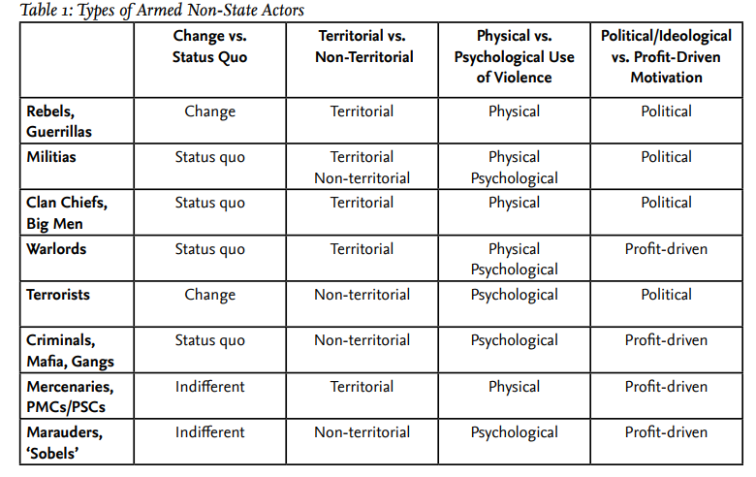
VNSA Typology according to Schneckener

Slide 9
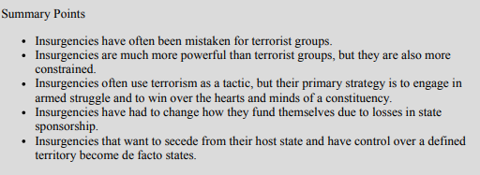
Insurgency
The primary raison d'être of these groups is to achieve some political goal
Territorial control
Strategy - irregular attacks and war of attrition
Hierarchical structure, in recent years there has been decentralization
A threat to the legitimacy of the state
Four basic types: liberationist, separatist, reformist/revolutionary, and religious/traditional.

Slide 10
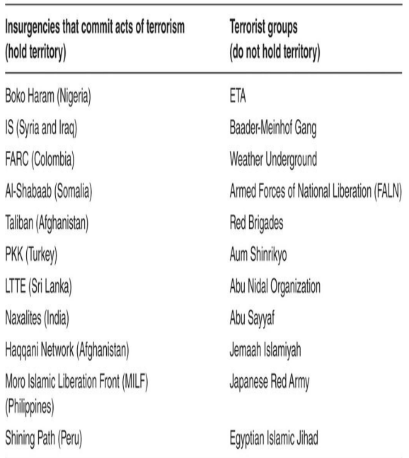
Insurgency

Slide 11
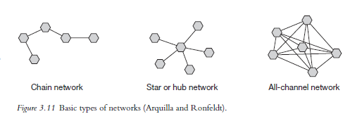
Terrorist Organizations
A deliberate form of politically motivated violence
Lack of territorial character
Low threat to state legitimacy (very little public support)
Strategy - psychological impact, shock a wide audience, attacks mainly on civilians
Structure - currently mainly network
Arquilla a Ronfeldt (2001) - Networks and Netwars: The Future of Terror, Crime, and Militancy
Zelinsky a Shubik (2008) – hierarchy, franchise, venture capital, a brand

Slide 12
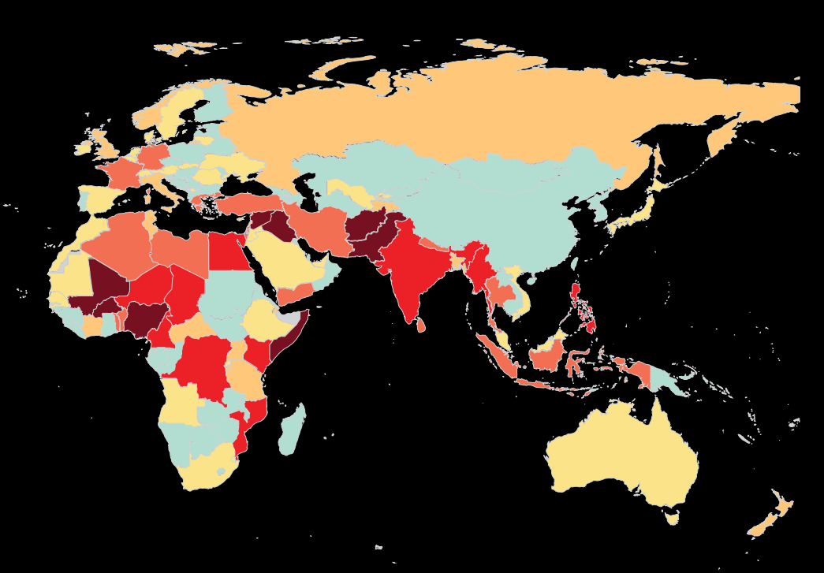
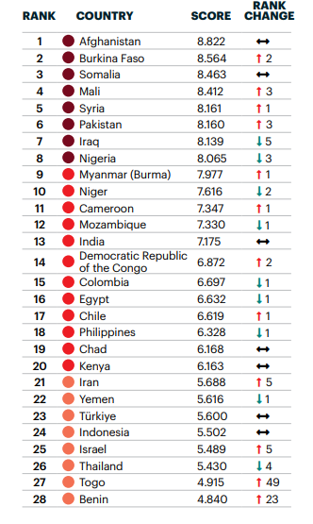
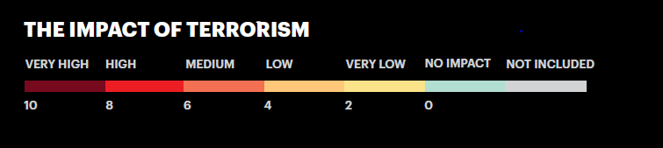
Trends of Contemporary Terrorism (2023)

Slide 13
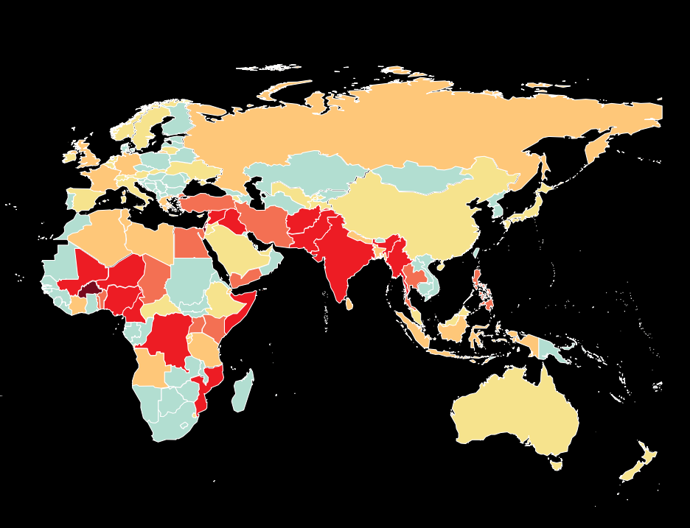
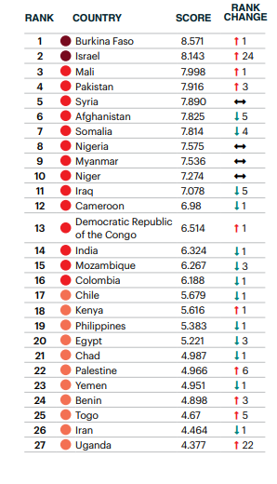
Trends of Contemporary Terrorism (2024)

Slide 14
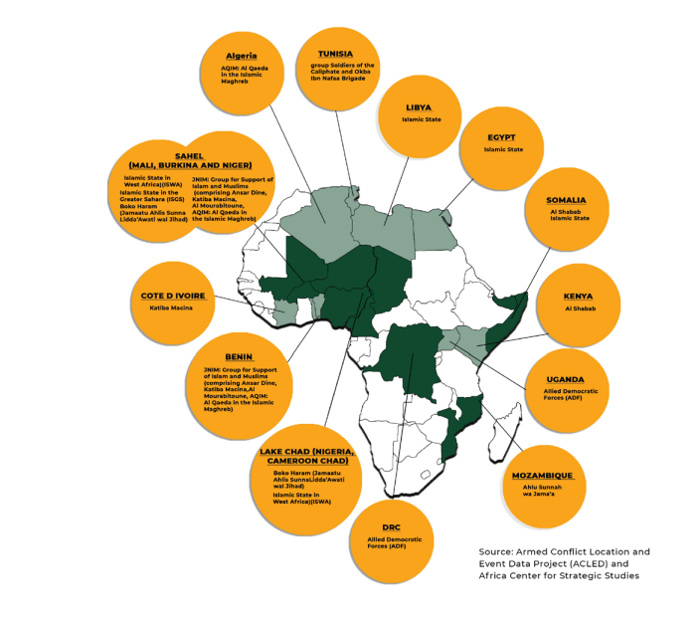
Trends of Contemporary Terrorism - Africa

Slide 15
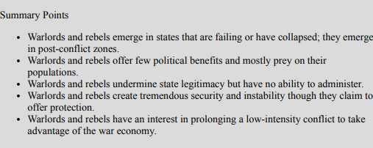
Warlordism
Primarily economically motivated violence
Strong territorial character
Hierarchical structure - headed by a charismatic leader
A threat especially to weak states
Strategy - marauding terror, unpredictable and random violence

Slide 16
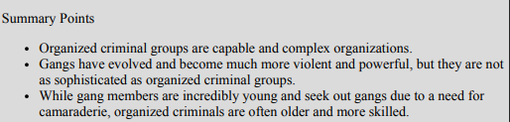
Organized Crime and Gangs
Economic motivation
Often transnational
Hierarchical and network structure
„Organized criminal group’ shall mean a structured group of three or more persons, existing for a period of time and acting in concert with the aim of committing one or more serious crimes or offences established in accordance with this Convention, in order to obtain, directly or indirectly, a financial or other material benefit.“
Strategy - use of violence to achieve economic goals, attempt to avoid media attention, violence especially in times of uncertainty
The effort to subvert the structures of the state - they do not want to completely destroy the state

Slide 17
Organised Crime - Definition
OCG defining characters according to Šmíd:
a) hierarchical structure/organisation
b) business continuity
c) corruption
d) violence
e) illegal activity
f) penetrating economic markets
g) membership exclusivity
h) non-ideological
Mafia - type of OCG, arbitration of disputes/illicit agreements between criminals, political dimension.
Gang - territorial character, less sophisticated methods and activities.
Syndicate - illegal businesses on a larger, also international scale.

Slide 18
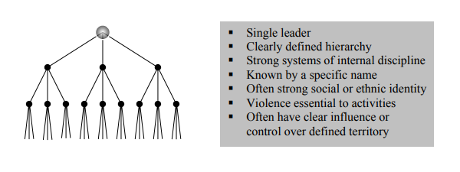
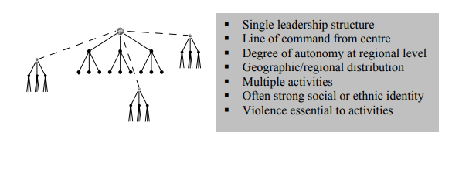
Typology of Organized Crime Groups
UNODC defining features: structure, size, activities, level of transborder operations, identity, level of violence, use of corruption, political influence, penetration into the legitimate economy and level of cooperation with other organizations.
A) Standard Hierarchy B) Regional hierarchy

Slide 19
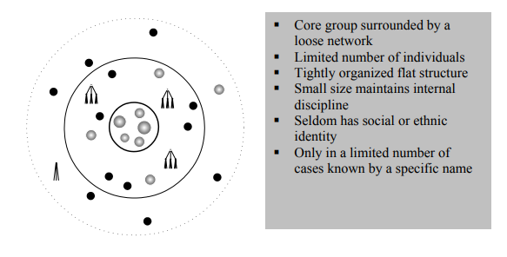
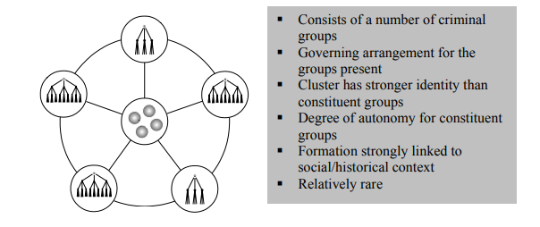
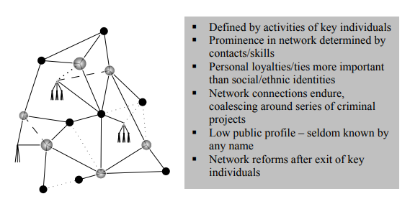
Typology of Organized Crime Groups
C) Clustered Hierarchy D) Core group
E) Criminal network

Slide 20
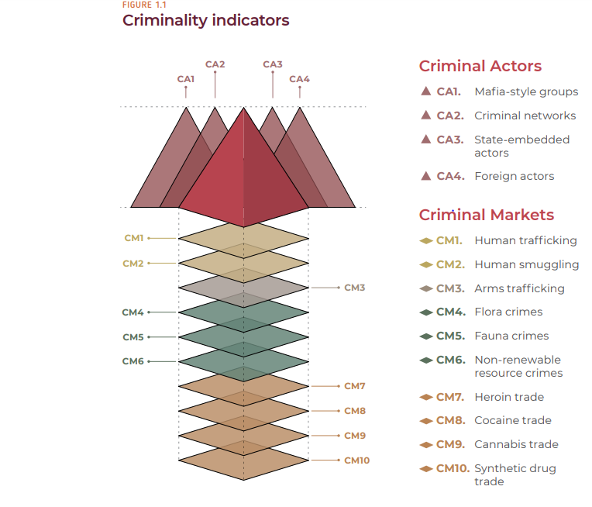
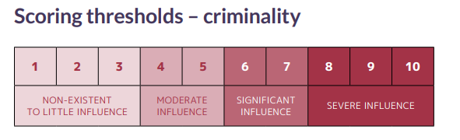
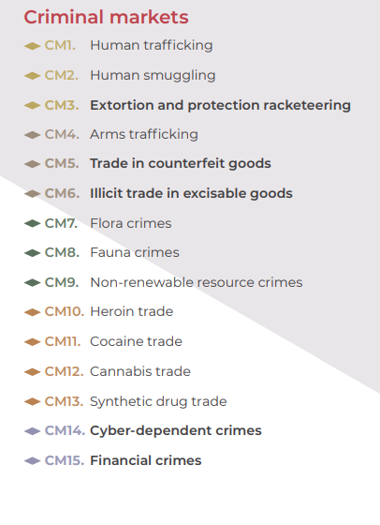
Global Organized Crime Index – Measurement and Typology

Slide 21
Private Military Companies
Economic motivation
Territoriality is related to the type of task/contract
Hierarchical structure
Strategy - they do not have long-term strategies, it always depends on the contract
Can threaten the state's monopoly on the use of violence, ineffective as a long-term solution
Executive Outcomes, Blackwaters/Academi, Wagner Group
United Nations Mercenary Convention 2001 (The convention extends on the Geneva Conventions Protocol I which in Article 47(1) states that a mercenary cannot be a lawful combatant or prisoner of war)
Mercenaries: foreigner, independence – not a member of the army, economic motivation, obscure recruitment, short-term/ad hoc tasks, engaged in combat
Military Providing Firms, Military Consulting Firms, Military Supporting Firms

Slide 22
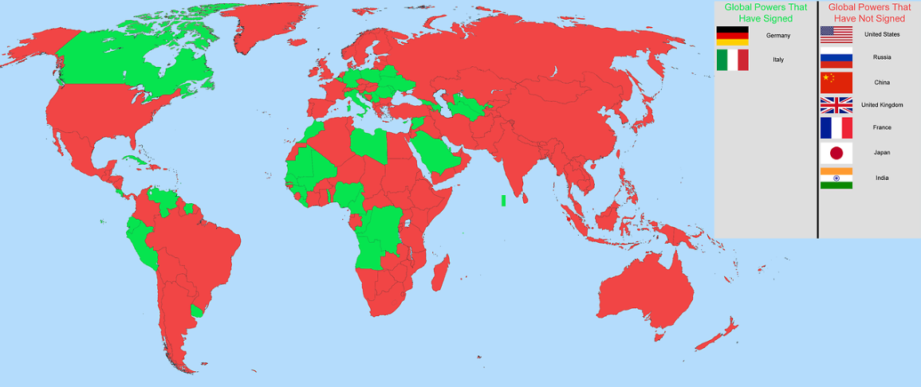
United Nations Mercenary Convention

Slide 23
Paramilitary units vs. Pro-government militia
Organized groups that operate alongside or in support of formal military forces, often composed of civilians or former military personnel. They are typically structured similarly to military organizations and may engage in combat, security operations, or law enforcement activities. While they may support state objectives, their operations can sometimes fall outside the jurisdiction of conventional military law, leading to varied levels of oversight and accountability.
Typology of Pro-government militias: Competition, Provider and Emergency.
 | Paramilitary Forces | PGMs
Government link | Official | Semi-Official, Informal
Functions | Regular and Irregular Activities | Rather Irregular Activities
Autonomy | Low | High
Example | National Gendarmerie, France | Janjaweed, Sudan

Slide 24
Thank you for your attention

