Slide 1

Modern Technologies and Conflicts
Space Security
23.10.2024
Marek Dvořáček

Slide 2
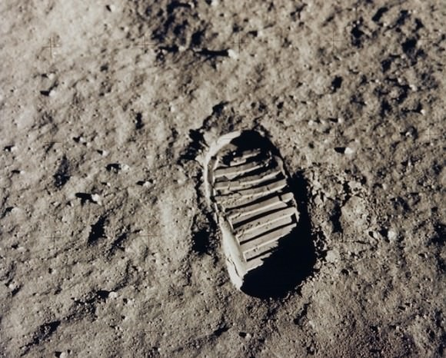
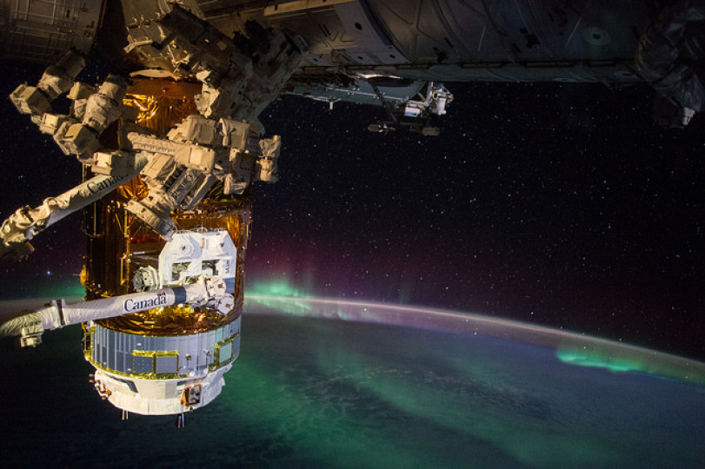

Slide 3
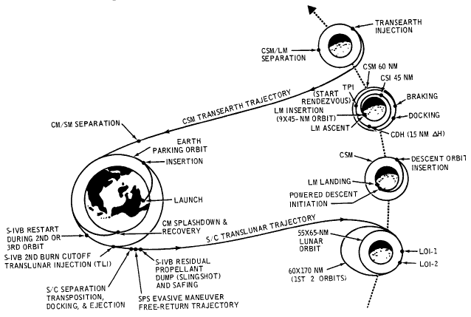
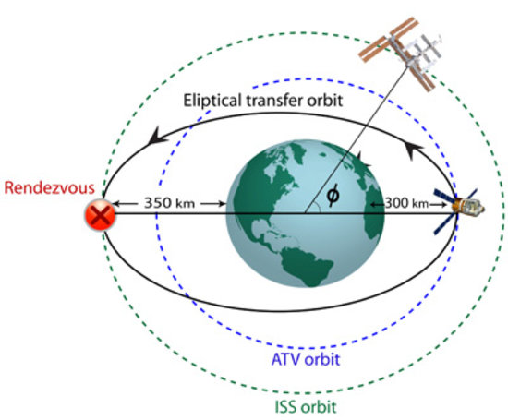
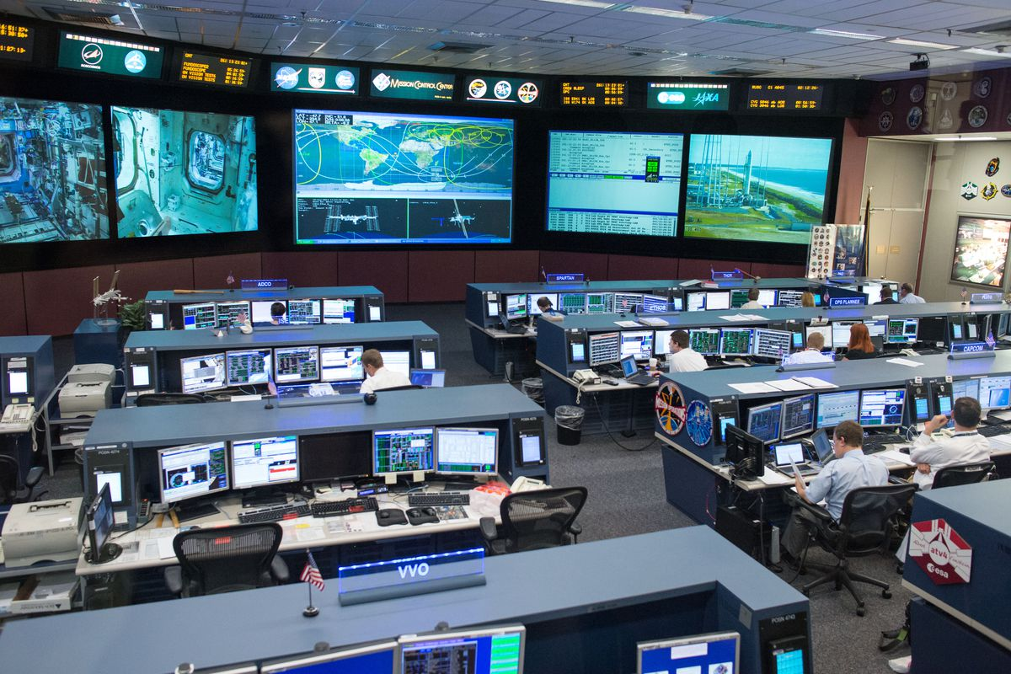
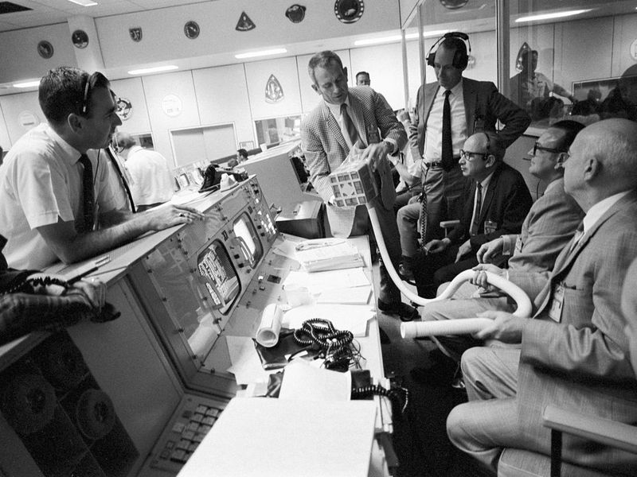

Slide 4

Neil Armstrong and Buzz Aldrin
Pete Conrad, Alan Bean,
Alan Shepard, Edgar Mitchell,
David Scott, James Irwin,
John Young, Charles Duke,
Eugene Cernan, Harrison Schmitt

Slide 5
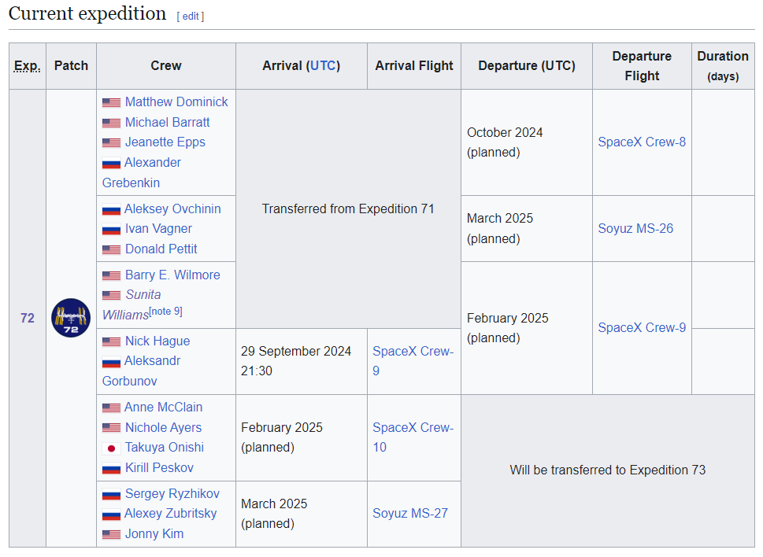
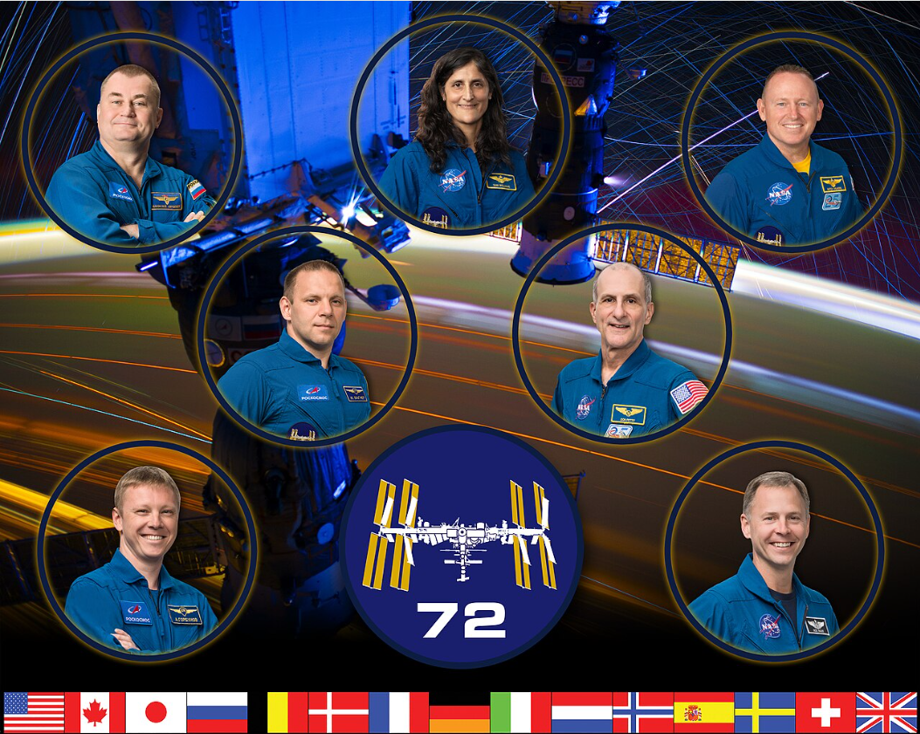
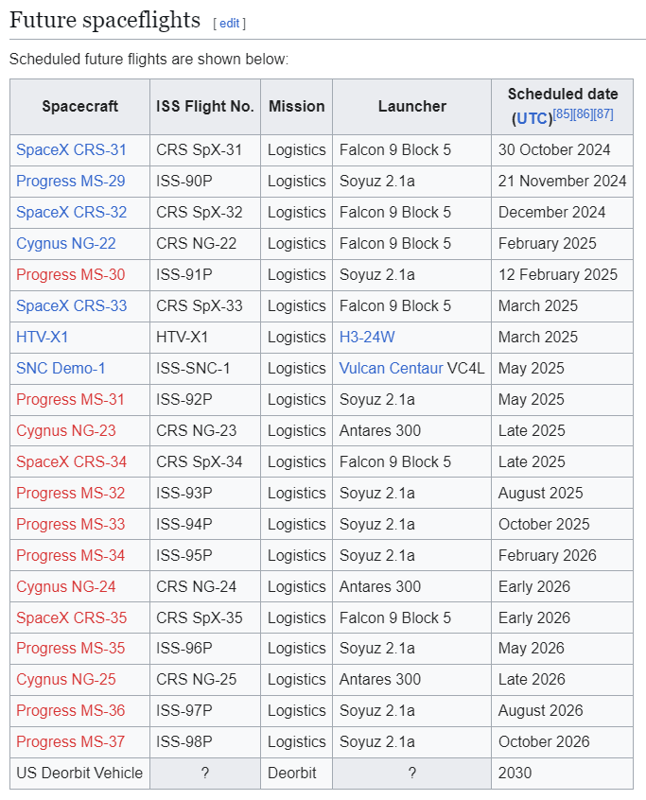
Notes:
Boeing Crew Flight Test, Starliner capsule, thrusters damaged, astronauts will ride down on the Space Crew-9 spacecraft in February 2025.
Barry E. Wilmore and Sunita Williams

Slide 6
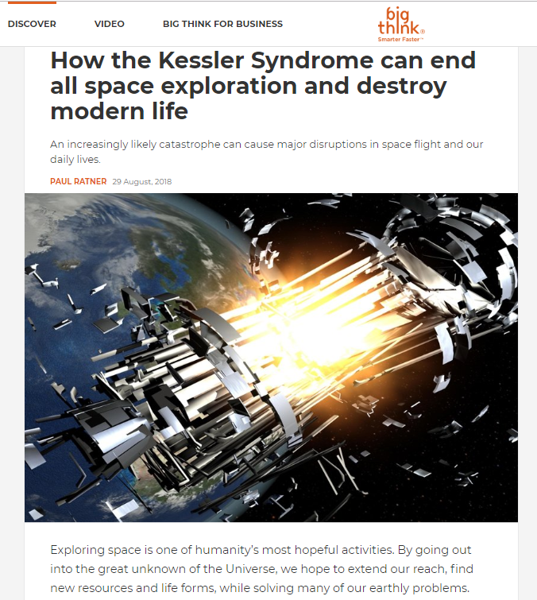
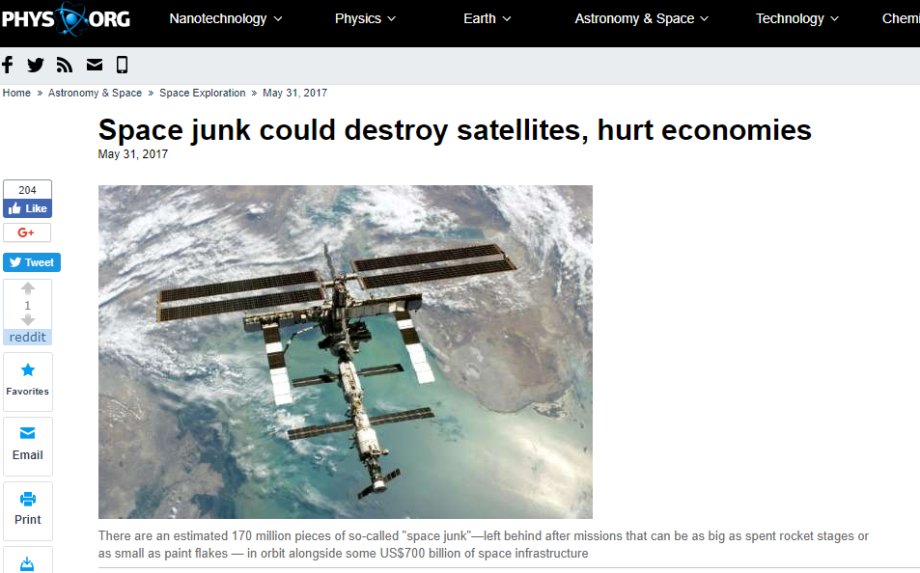
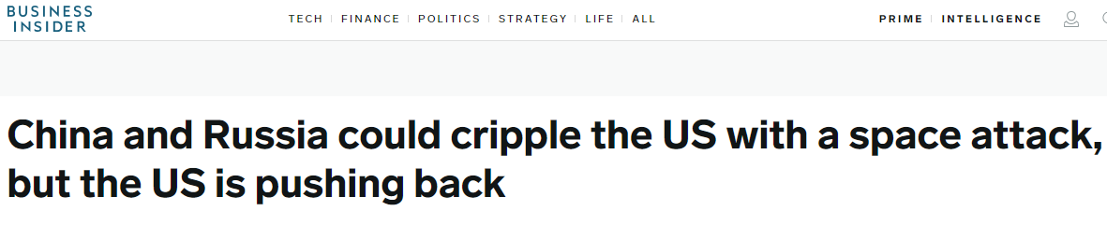
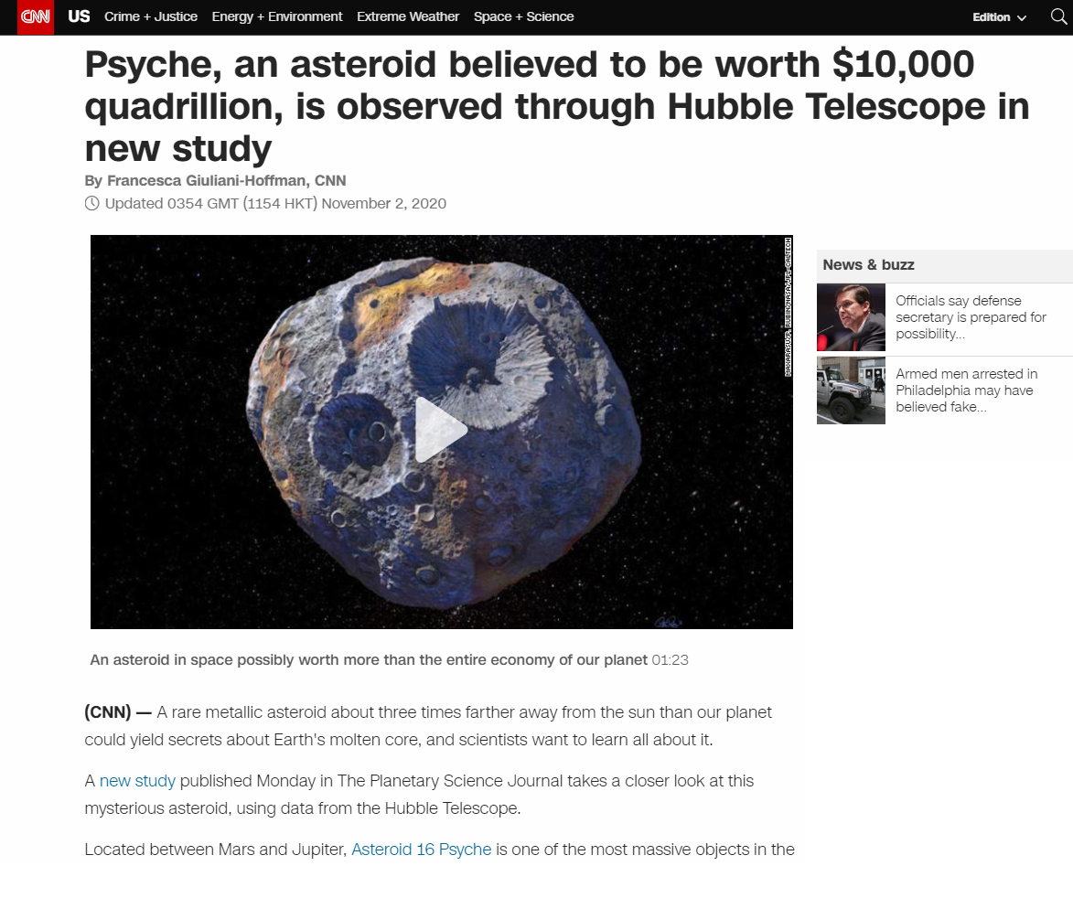
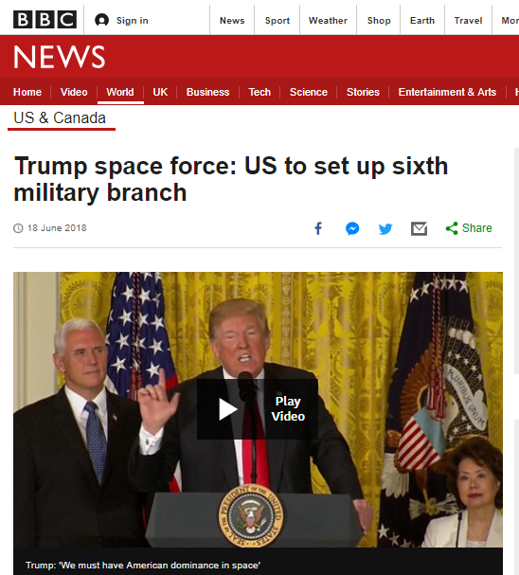
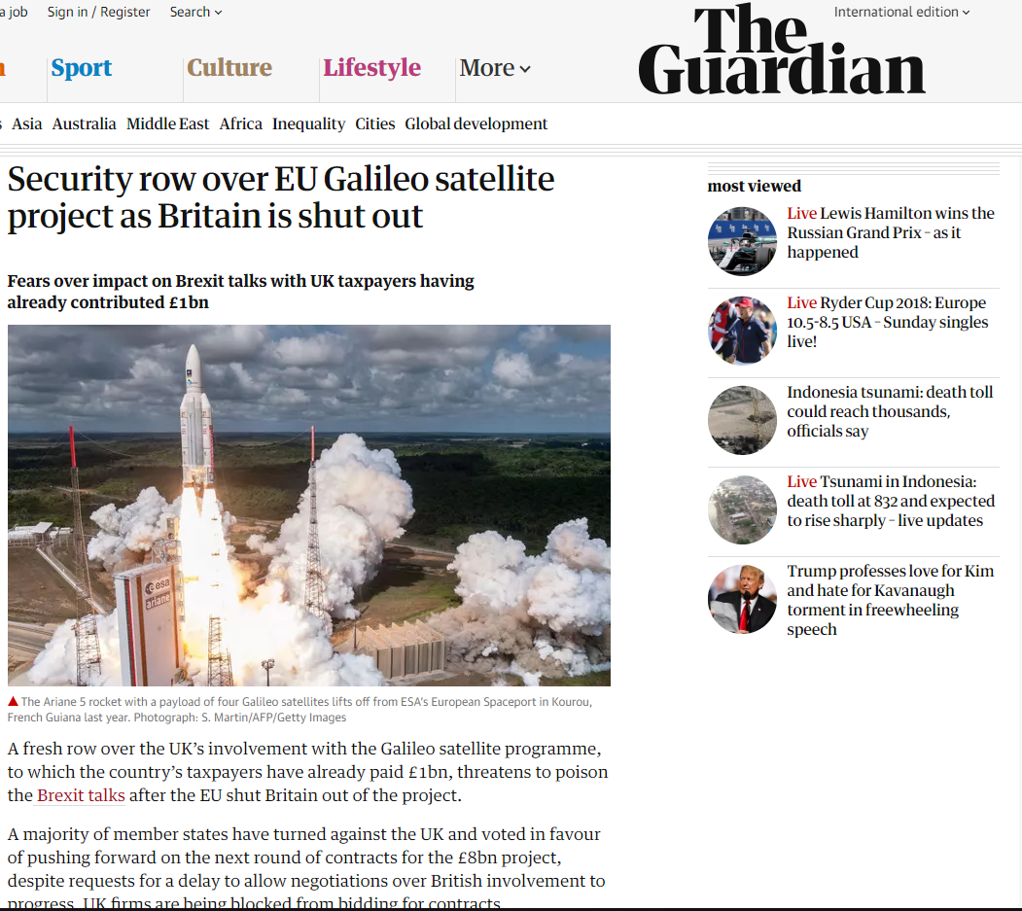
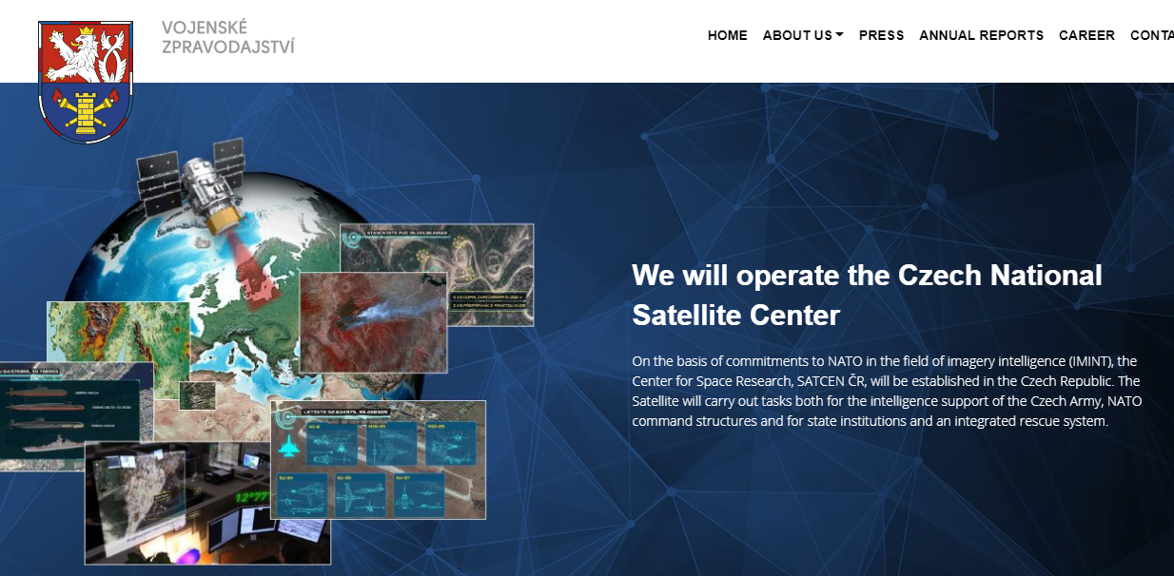
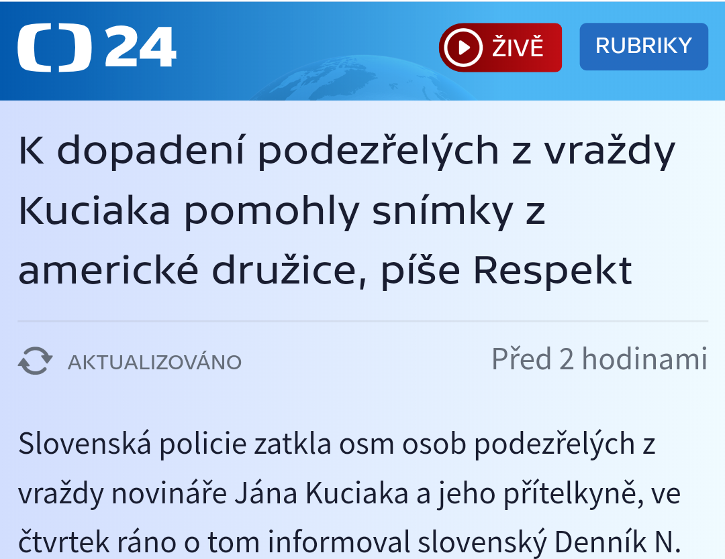
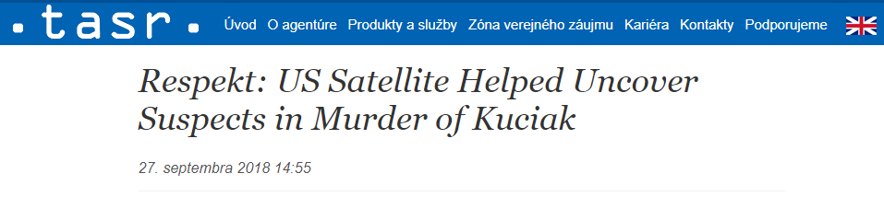
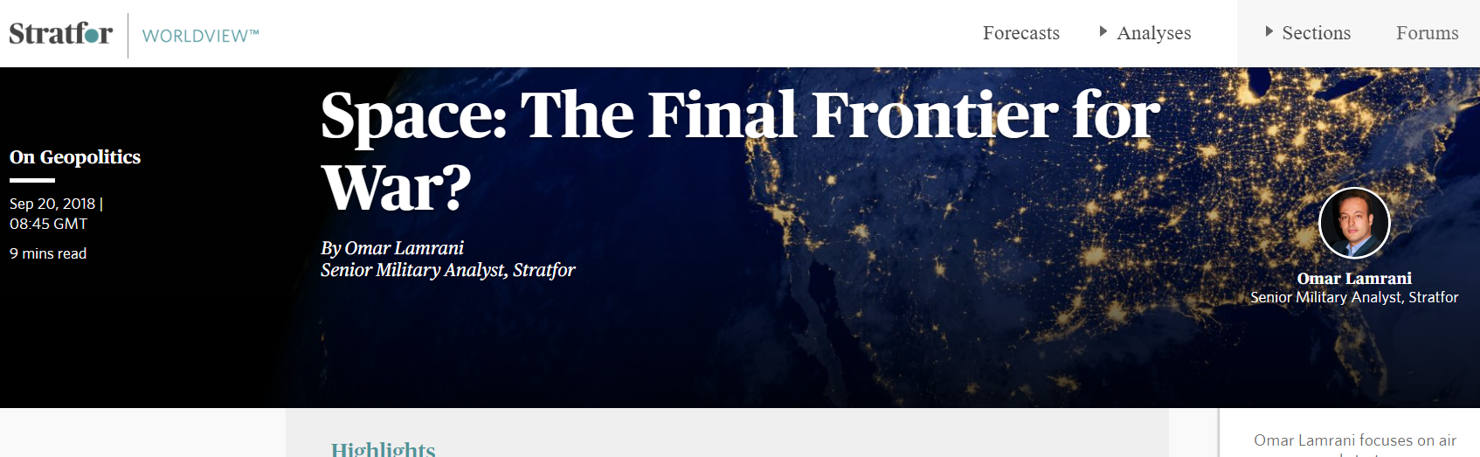

Slide 7
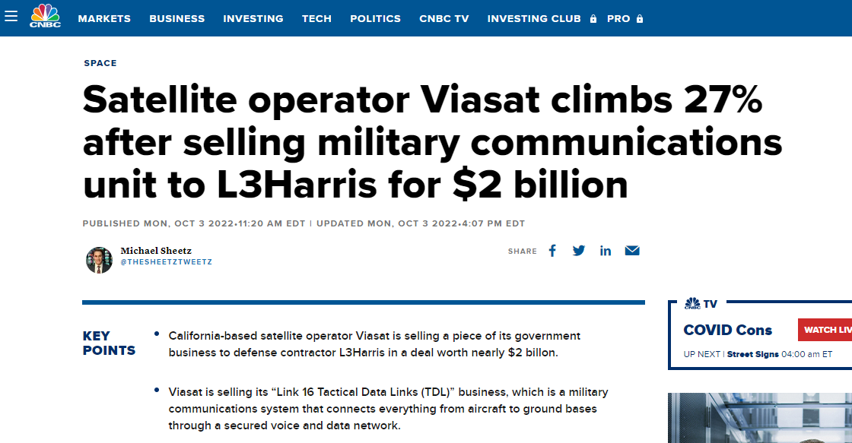
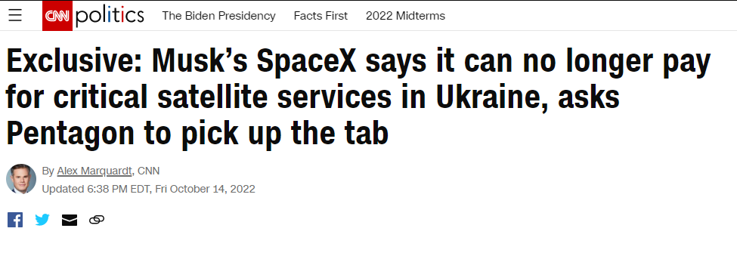
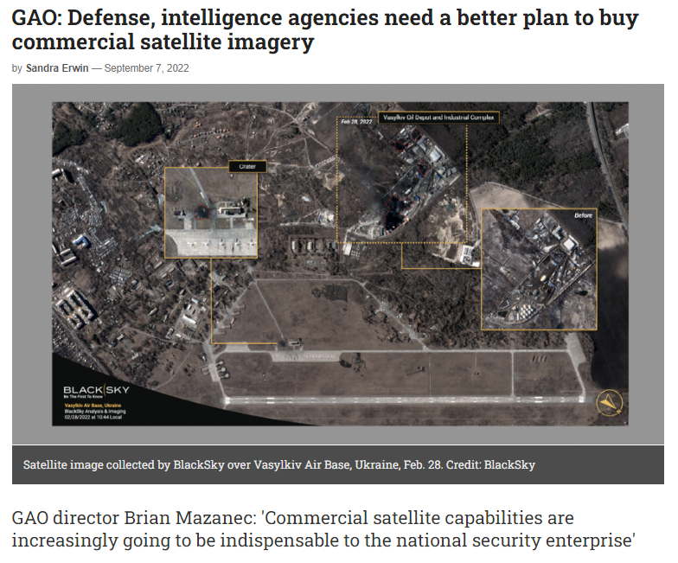

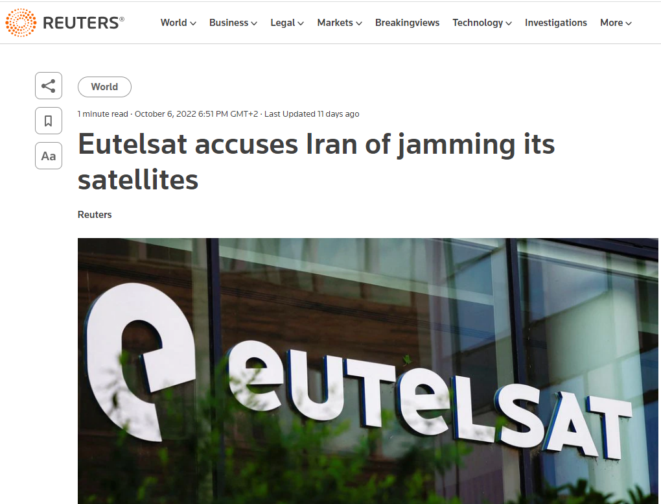

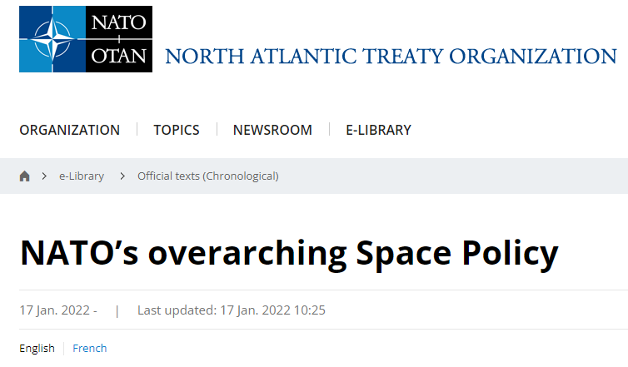
Notes:
Jamming - Typically, this is achieved by bombarding a satellite and/or its receivers with noise on the same radio frequency as its intended transmissions.
Eutelsat is among the world's largest satellite operators and broadcasts thousands of television and radio stations throughout Europe, the Middle East, Africa and Asia.

Slide 8
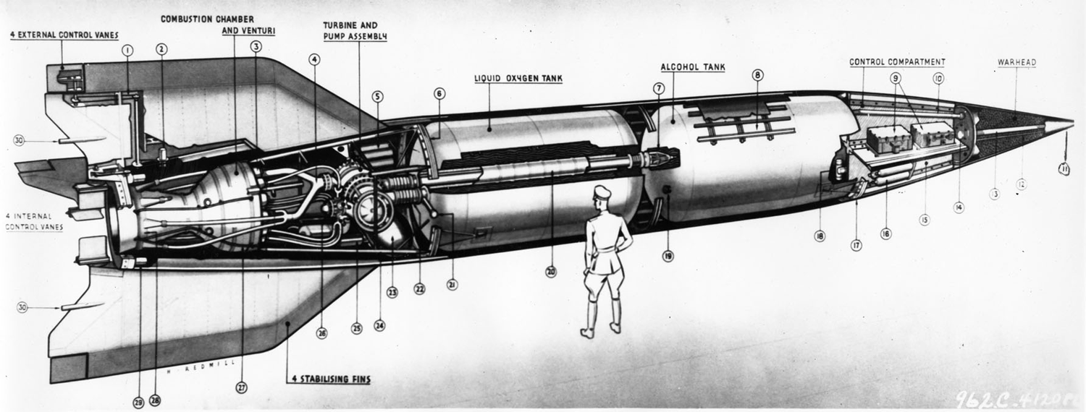
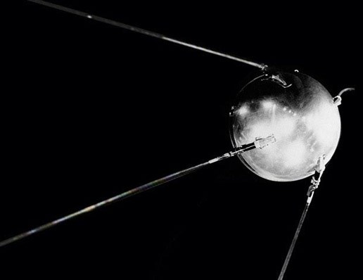
1) Outer space and Kármán line
the atmospheric boundary at the altitude of 100 km (62 miles)the highest achievable point for ordinary aviation: Aeronautics
the highest achievable point for ordinary aviation: Aeronautics
the lowest point under which the atmosphere is too dense for a spacecraft to remain on a stable orbit without a continuous pull of its drive: Astronautics
(altitude where the speed necessary to aerodynamically support the airplane's full weight equals orbital velocity (assuming wing loading of a typical airplane). In practice, supporting full weight wouldn't be necessary to maintain altitude because the curvature of the Earth adds centrifugal lift as the airplane reaches orbital speed)
2) history – 1942
- Vergeltungswaffe 2
- 1957
Sputnik-1

Slide 9
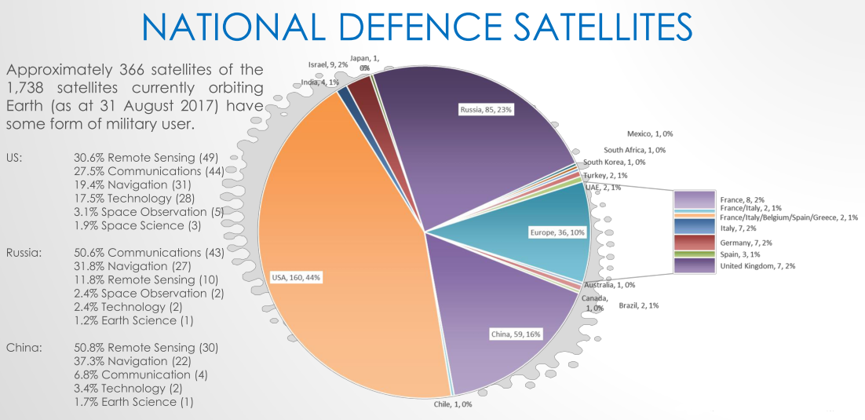
Satellites

Slide 10
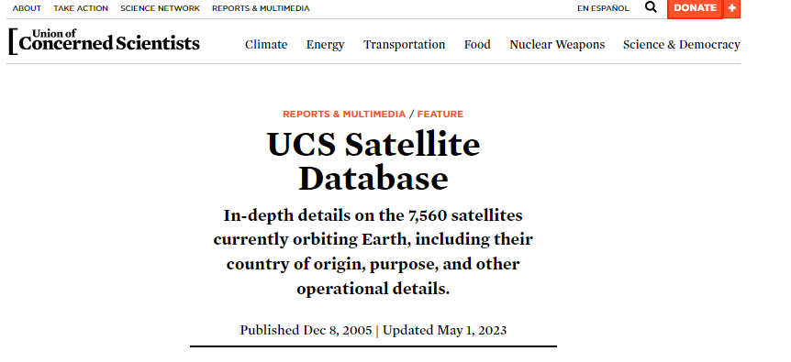
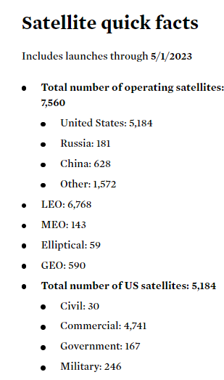
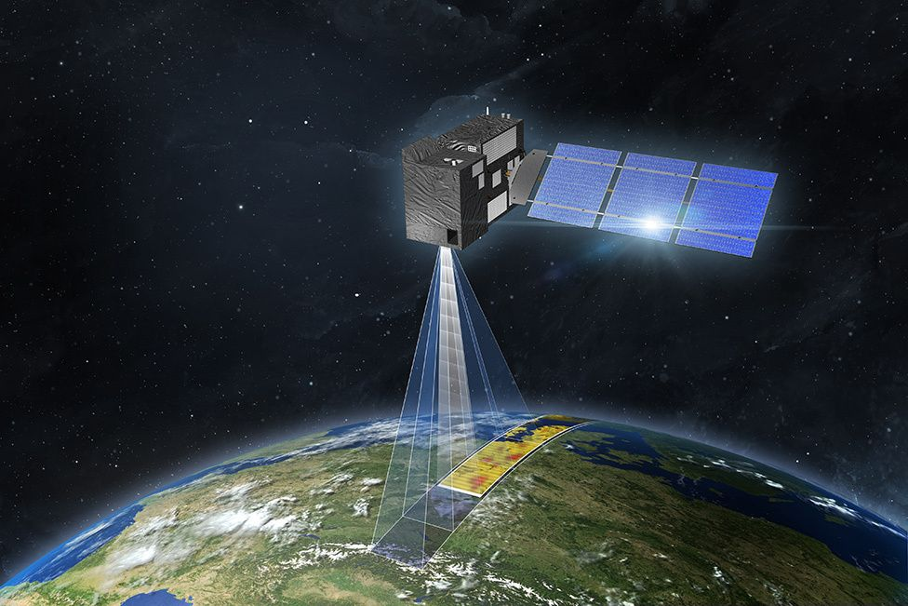
Satellites

Slide 11
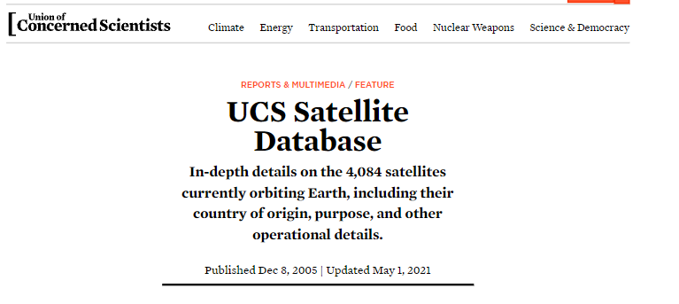
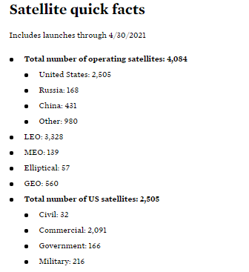
Satellites

Slide 12
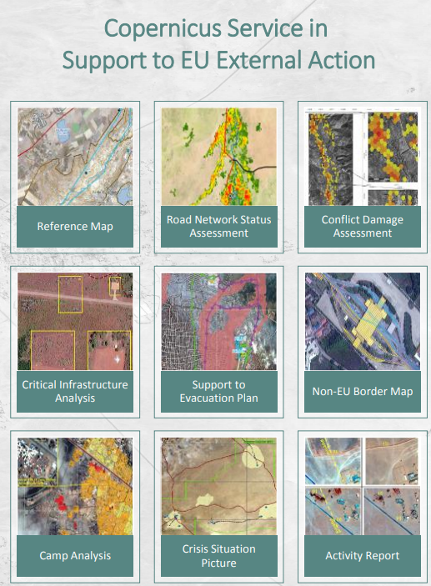
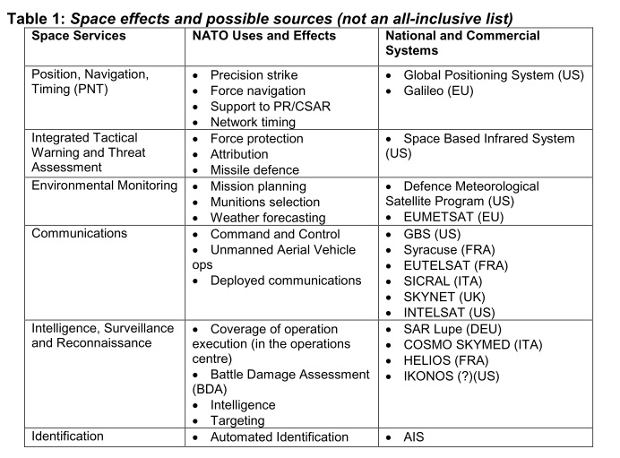
GeoInt

Slide 13
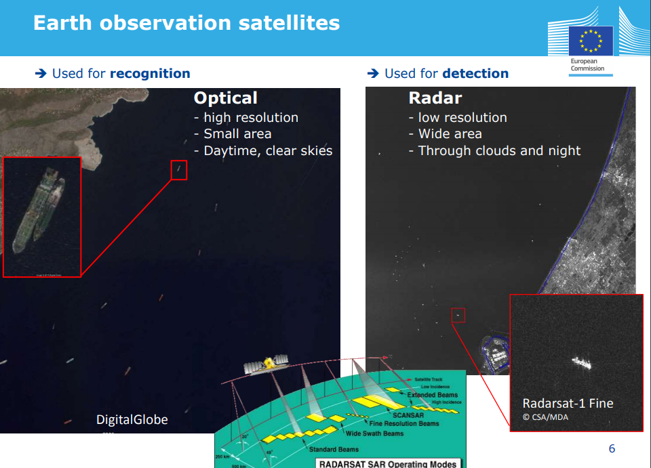
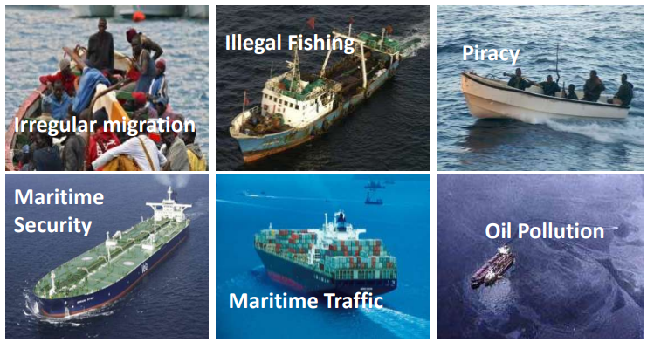

Slide 14
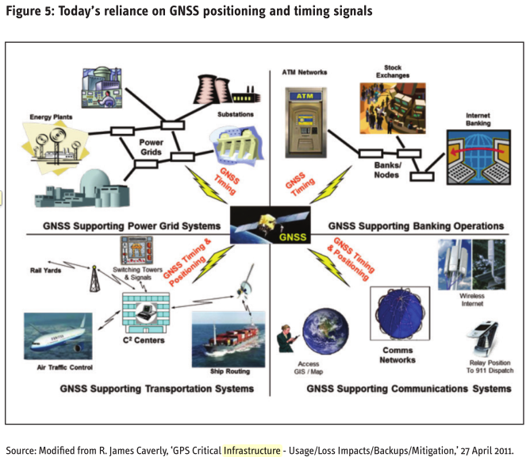

Slide 15
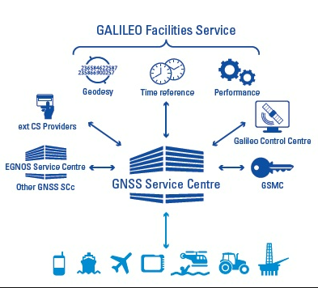

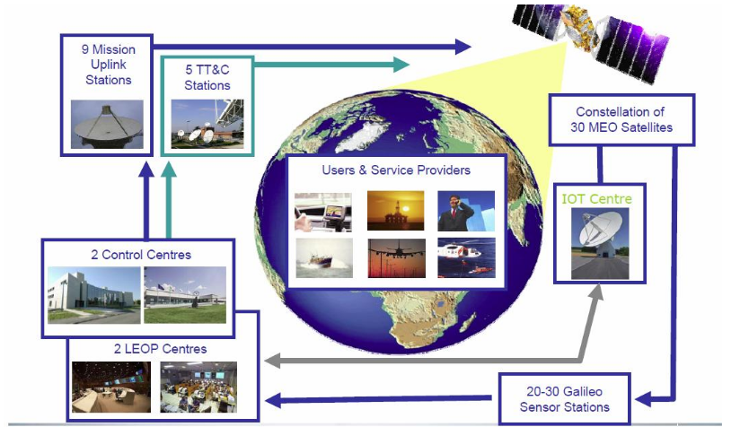


Slide 16
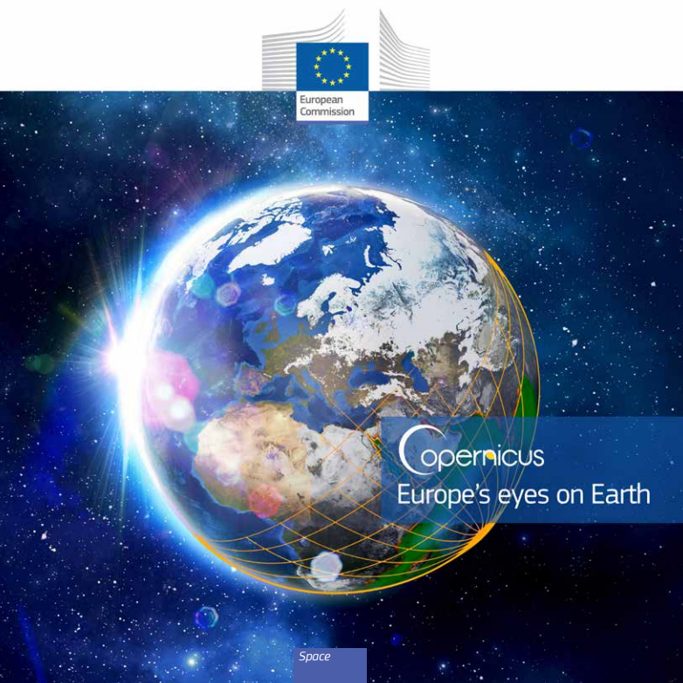
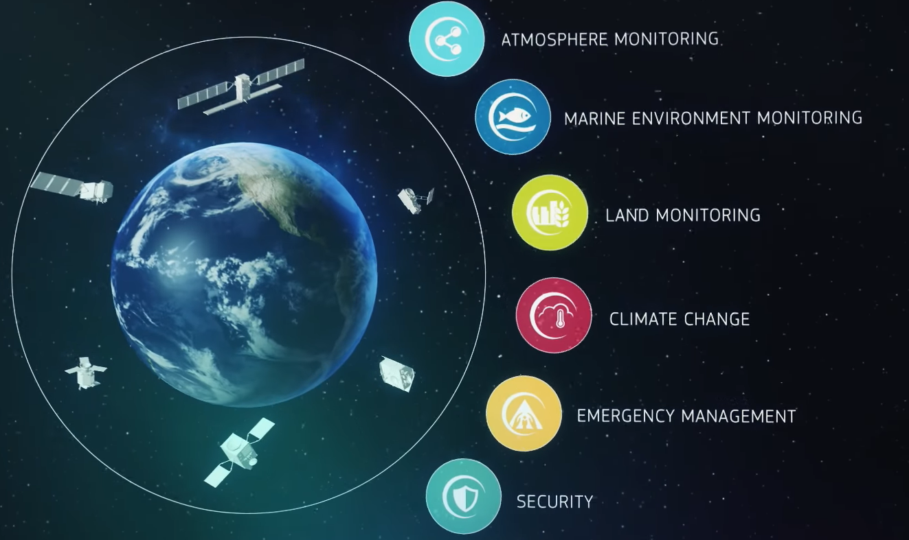
Copernicus
https://www.youtube.com/watch?v=MGJss4lDaBo

Slide 17

Support to EU External Actions (implemented in partnership with the European Union Satellite Centre and the Emergency Management Service);
Maritime surveillance (implemented in partnership with the European Maritime Safety Agency, EMSA);
Border surveillance (implemented in partnership with FRONTEX).

Slide 18
Space Security Definition:
„Secure and sustainable access to space and its use, as well as freedom from threats emanating from space.“
Definition based upon Outer Space Treaty principles (of 1967)
Outer space should remain freely sustainable for all to peaceful use now and in the future
Clay Moltz:
the ability to place and operate assets outside the Earth’s atmosphere without external interference, damage, or destruction
The three dimensions of space Security by Jean-François Mayence:

Slide 19
Three dimensions - interrelated areas
I) Outer space for security:
Satellite systems contributing to security and defence initiatives
II) Security in outer space:
Keeping space assets and infrastructure intact against natural and human risks. Maintaining sustainable development
III) Security from outer space:
Protecting humanity and the environment from natural threats and risks originating in outer space

Slide 20
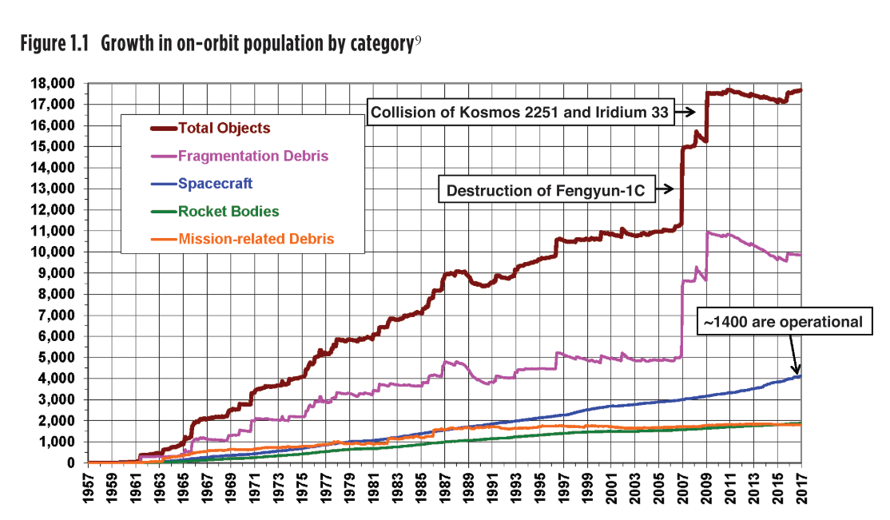
Risks and threats
1) Space debris
  Kessler syndrome
2) Anti-satellite weapons
  Conventional
  Nuclear
  Direct energy – radiofrequency, microwave and laser techniques
    Jamming / disruption / destruction
3) Cyber
Only non-kinetic capabilities are actively being used in current military operations

Slide 21
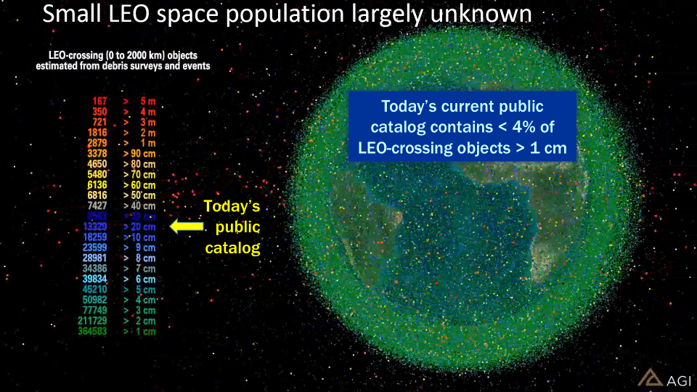

Slide 22
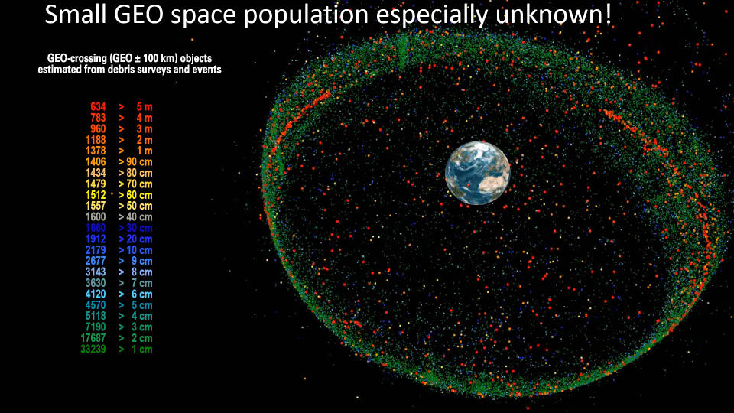

Slide 23
Sinks
Sources
Natural decay (atmospheric drag, solar radiation pressure, lunisolar perturbations)
Launches (rocket bodies, payloads, mission related objects)
Fragmentations (explosions, collisions)
Active Removal (de-orbit, non-propulsive maneuvers)
Non-fragmentation debris (surface degradation, solid rocket motor particles)

Slide 24
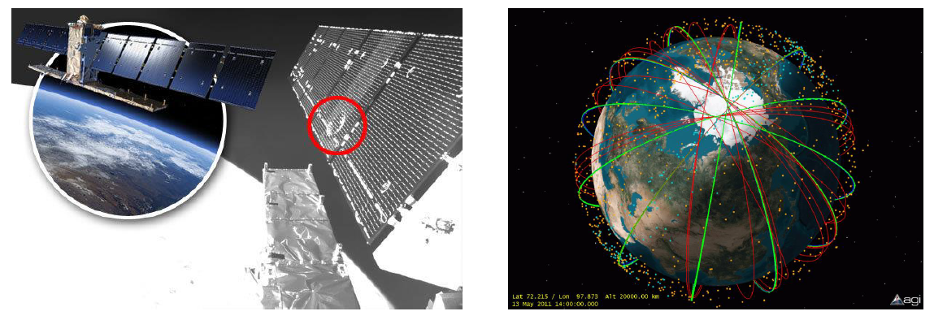
Space Debris
Space Surveillance & Tracking / Space Situational Awareness
  radars and telescopes
Conjunction Assessment or Collision Avoidance (CA)
  Based on ephemeris and a catalog of objects, predict potential collisions in space and inform operators (e.g. Sentinel 1A 2016) or Cosmos 2251 Iridium 33 collision 2009 Iridium Cosmos Satellite Collision Bing video

Slide 25
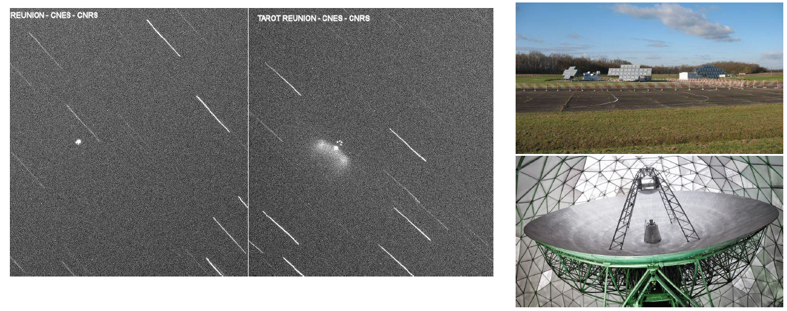
Space Surveillance & Tracking / Space Situational Awareness
Objects are detected and tracked/monitored by a range of radars and telescopes, military, civilian, commercial

Slide 26
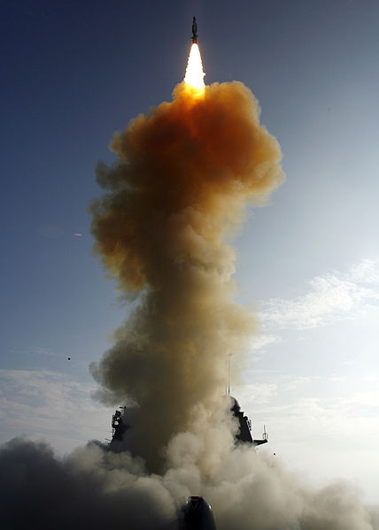
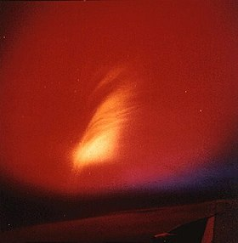
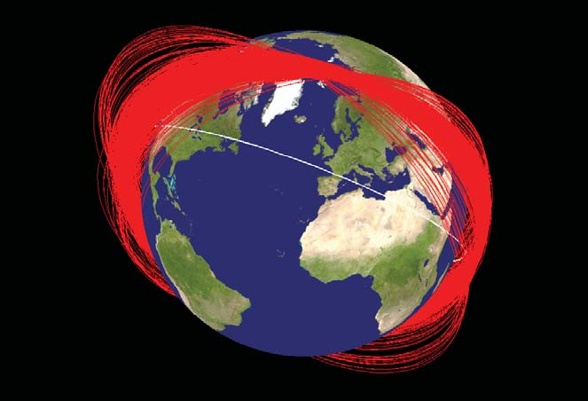
Starfish Prime SM-3 missile Fengyun-1C
1962 2008 2007
Notes:
2019 Mission Shakti
2021 Russia conducted a direct-ascent anti-satellite (DA-ASAT) test

Slide 27
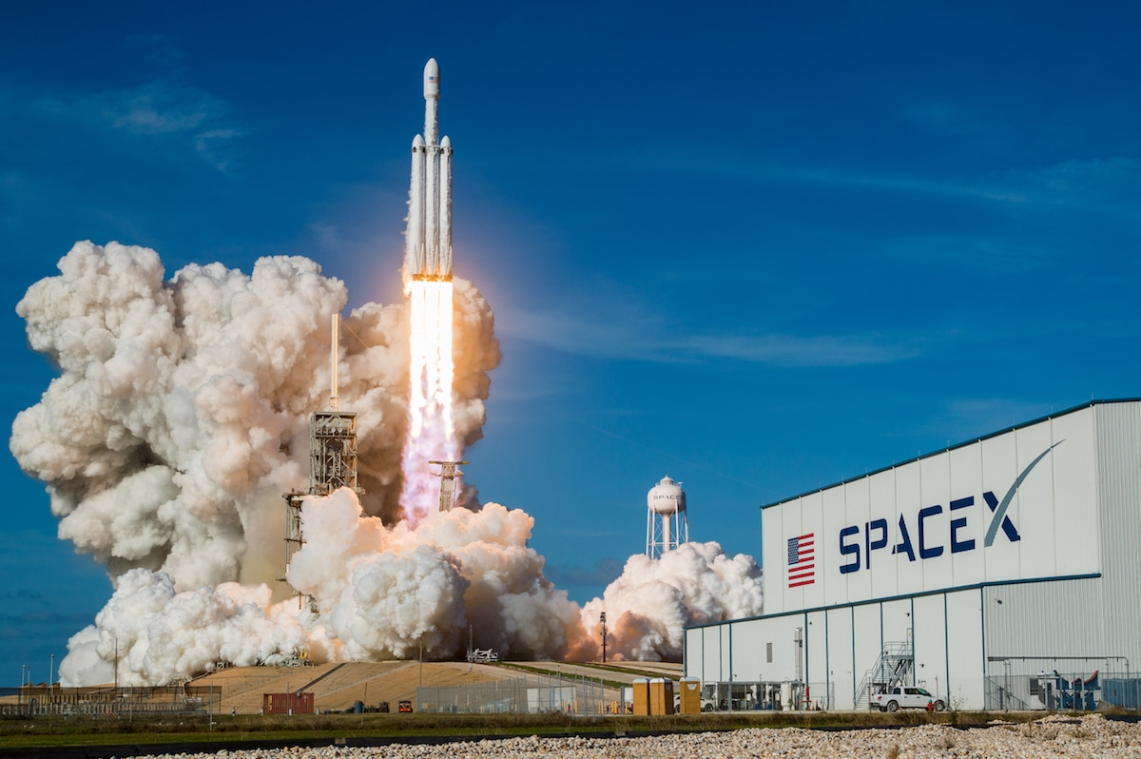

Current trends
Privatisation + commercionalisation
Turism
Asteroid mining?
Growing number of actors
NewSpace /
Space 4.0

Slide 28



Slide 29




Hayabusa2 – asteroid sample return mission
Rosetta Mission - a detailed study of comet

Slide 30


Asteroid Bennu
Start 2016, collection 2020, September 2023 return to Earth
250 grams material, goal of mission was 60 grams

Slide 31
NewSpace
Technological progress = large amount of actors and assets
  Cheaper development, production and operation of satellites and launchers
Various industrial sectors - such as IT companies, investment and media companies
New approaches, emphasis on innovation, lowering the overall price due to competition
Products are not perfect but sufficient
  Priority is given to a lower price before a perfect performance, reliability and endurance
More efficient and simpler manufacturing processes
  Cheaper components, 3D printing, open source software, adaptable production model

Slide 32

What topics to follow?
Private sector
Legal system
Miniaturization – microsatellites
Evolution of autonomous systems
Antisatellites system
Planetary Defence
Fifth NATO operational domain

Slide 33
http://spacesecurityindex.org/ssi_editions/space-security-2019/
https://espi.or.at/news/public-espi-report-64-security-in-outer-space-rising-stakes-for-europe
https://edition.cnn.com/2020/10/31/us/psyche-asteroid-ultraviolet-trnd-scn/index.html?utm_source=fbCNNi&utm_content=2020-10-31T15%3A09%3A31&utm_medium=social&utm_term=link&fbclid=IwAR19p6YUeNxv4B8Vv7fWfgDbpIIt8I55LSgBrAPq31f4wa48AJuRXIkzaOQ
https://www.thespacereview.com/article/4056/1?fbclid=IwAR3iKGDTs9VY3y2DXMz4hhxAmKSXeosjxS056AkAInx62W5ht1aA_PLIc5w
https://www.japcc.org/portfolio/space-natos-newest-operational-domain/
https://spacenews.com/pentagon-issues-new-strategy-to-defend-u-s-dominance-in-space/
https://www.brookings.edu/blog/order-from-chaos/2020/04/22/nato-and-outer-space-now-what/
https://arstechnica.com/science/2020/04/mission-extension-vehicle-succeeds-returns-aging-satellite-into-service/
https://phys.org/news/2020-03-planetary-defenders-validate-asteroid-deflection.html
MAYENCE, Jean-Francois. 2010. Space Security: Transatlantic Approach to Space Governance
MOLTZ, James Clay. 2011. The Politics of Space Security: Strategic Restraint and the Pursuit of National Interests
DRMOLA, Jakub a Tomas HUBIK. 2018. Kessler syndrome: System dynamics model. Space Policy. Dostupné také z: http://linkinghub.elsevier.com/retrieve/pii/S0265964617300966
https://www.businessinsider.com/space-race-anti-satellite-china-russia-war-us-2017-07#ampshare=http://www.businessinsider.com/space-race-anti-satellite-china-russia-war-us-2017-07
http://www.thespacereview.com/article/3331/1
https://www.ted.com/talks/will_marshall_the_mission_to_create_a_searchable_database_of_earth_s_surface
ASBECK, Frank, 2015. Policy Framework for Space Security Activities in the EU. In: Youtube.com [online]. Dostupné z: https://www.youtube.com/watch?v=xGKdT8oYBX0
THE UK MILITARY SPACE PRIMER. 2010. An introduction to potential military uses of space. [online. Dostupné z: https://assets.publishing.service.gov.uk/government/uploads/system/uploads/attachment_data/file/33691/SpacePrimerFinalWebVersion.pdf
SATCEN EU. 2018b. EU Satellite Centre Annual Report 2017. European Union Satellite Centre [online]. Dostupné z: https://www.satcen.europa.eu/key_documents/EU%20SatCen%20Annual%20Report%2020175af3f893f9d71b08a8d92b9d.pdf
https://www.nasa.gov/press-release/nasa-confirms-dart-mission-impact-changed-asteroid-s-motion-in-space

