Slide 1
Modern Technologies and Conflicts
AI and autonomy at war
Jakub Drmola

Slide 2
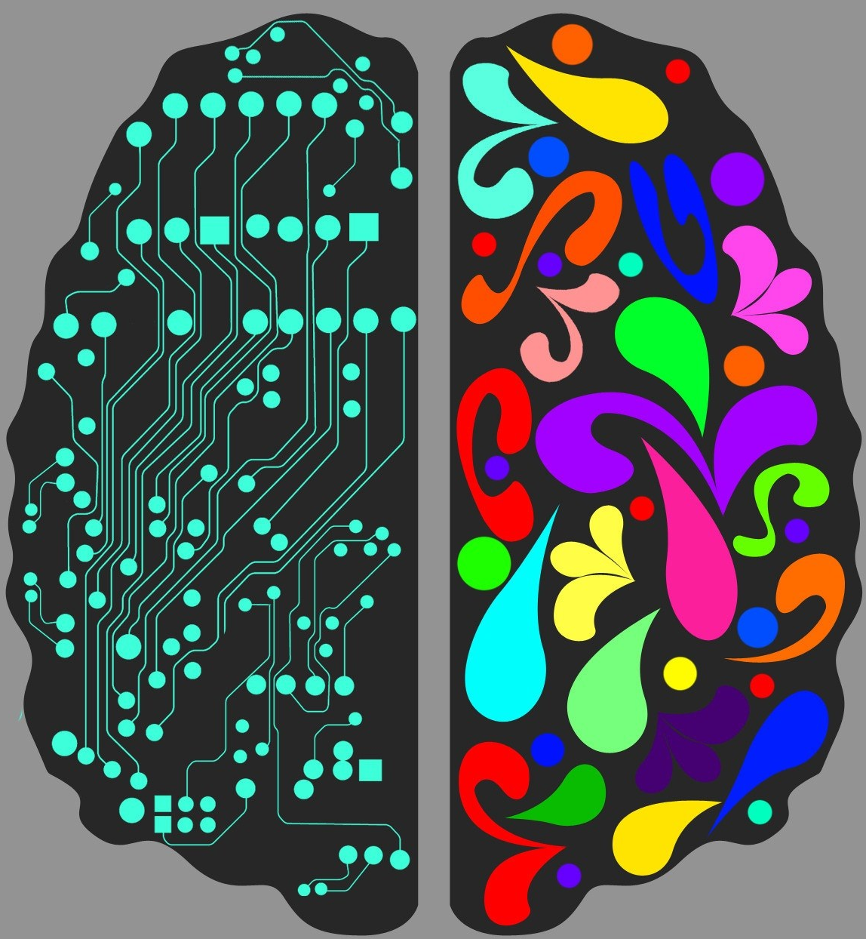
Some basics
what is intelligence and consciousness?
RC/unmanned/autonomy/AI?
types of AI?
  strong/general AI
  vs
  weak/narrow AI
what about physical form?

Slide 3
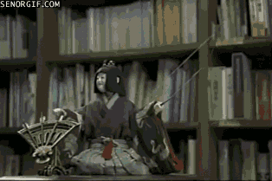
History of autonomy
mechanical automata since middle ages
  Digesting Duck, Leonardo's mechanical knight, Karakuri
biological automata since 19th cent.
  Frankenstein, R.U.R.
accelerated progression after WW2
  Turing, von Neumann, Minsky, …
exponential since 90s

Slide 4
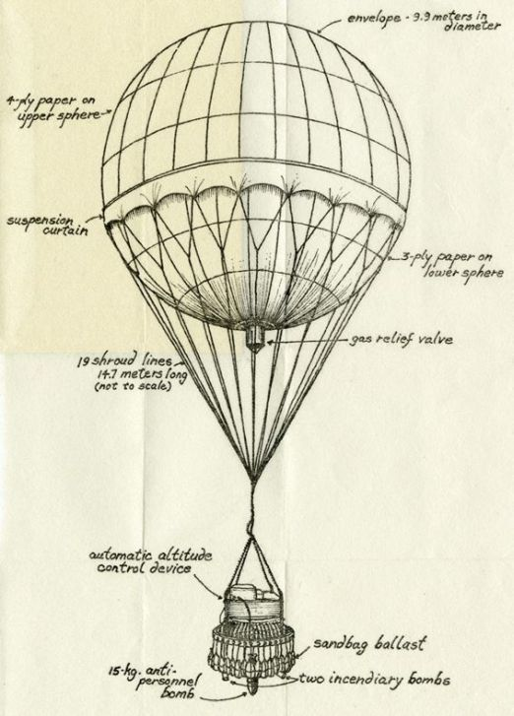
History of autonomy in warfare
before WW1: hot-air balloons
  observation and bombing
interwar: aerial practice targets
during WW2: remote control of all types
  both wired and wireless
  air, land and sea -based
  V1 and V2?

Slide 5
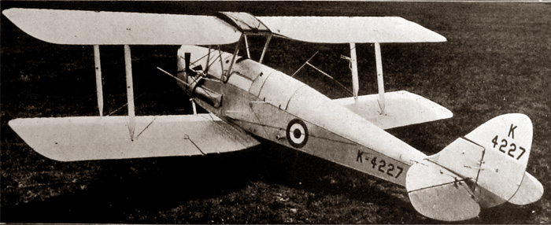
and https://www.youtube.com/watch?v=I_dr0arBltU
https://www.youtube.com/watch?v=QTXk42_hT20

Slide 6
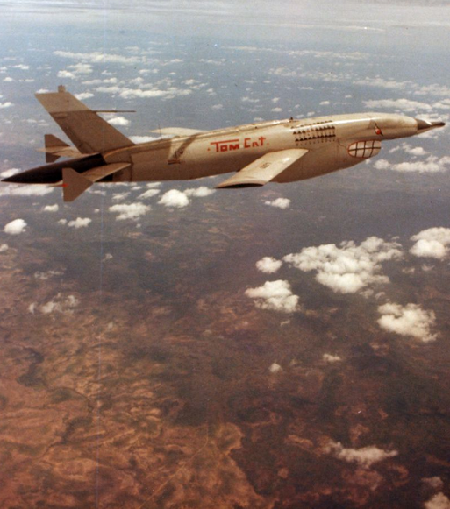
Cold War
target practice, decoys and reconnaissance
  with jet engines too
modern era of drones/UAVs began during the 80s, in the Middle East

Slide 7
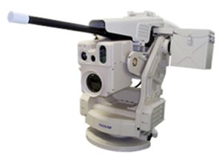
Present
remote control is commonplace
growing autonomy
  locomotion a sensors
„human in the loop“ principle
fire-and-forget systems
still not true intelligence
FPV

Slide 8
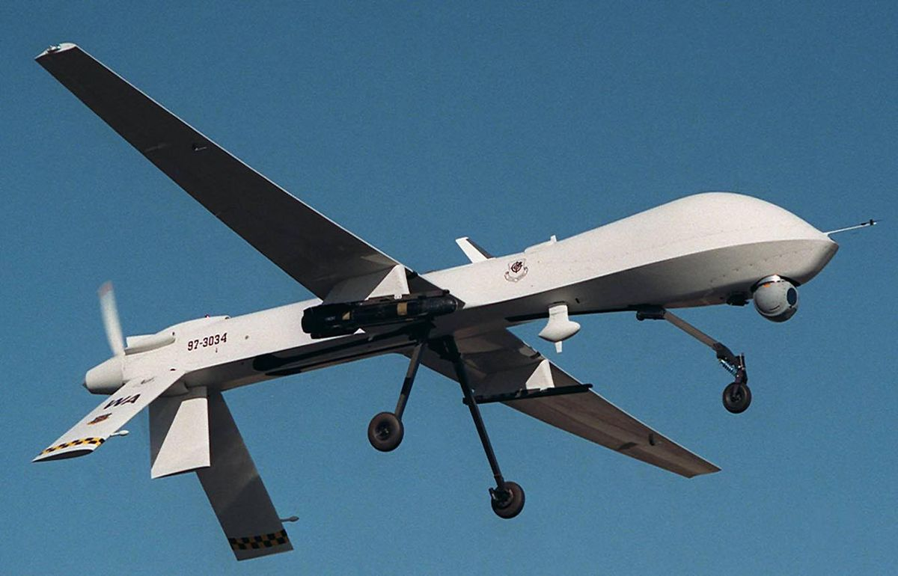
https://www.youtube.com/watch?v=kw3m7bqrQ64

Slide 9
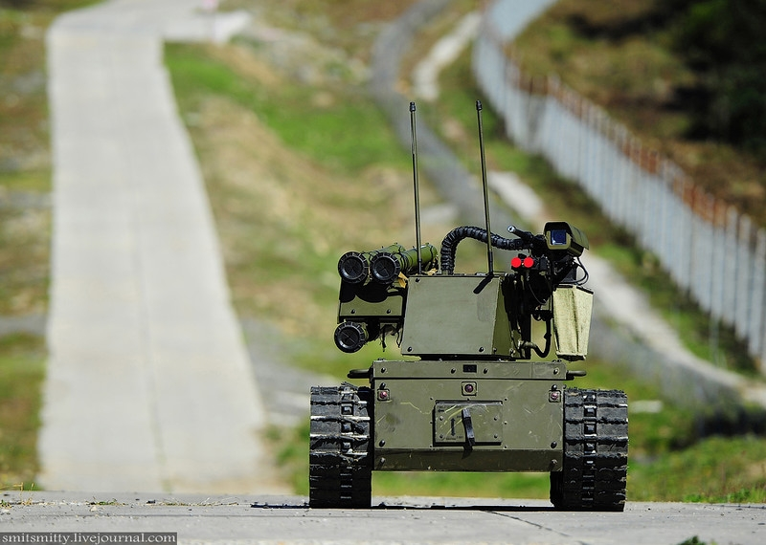

Slide 10
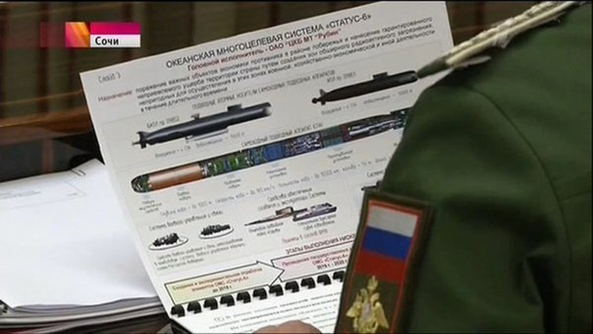

Slide 11
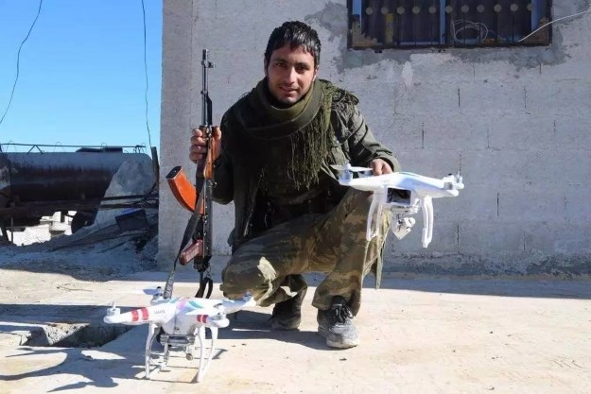
Commercial drones
terrorists, guerillas etc.
  reconnaissance, targeting, smuggling
  direct attacks
commercial drones are cheap, available and easily modified
perfect example of horizontal proliferation of dual-use tech
https://twitter.com/Militarylandnet/status/1559972440029249536
https://twitter.com/front_ukrainian/status/1721790378049695989

Slide 12
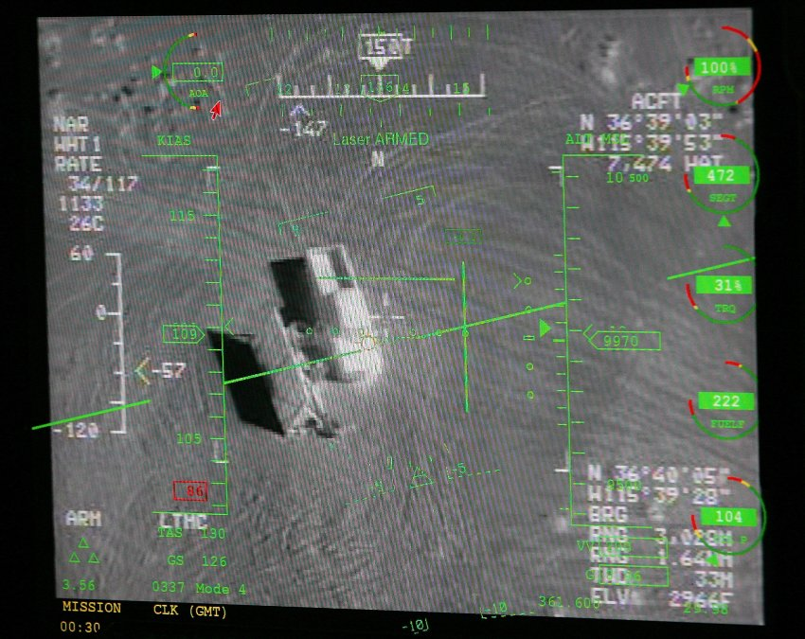
Problems?
lower conflict-threshold
collateral damage
„gamification“
dehumanization
psychological impacts
political and cultural fallout

Slide 13
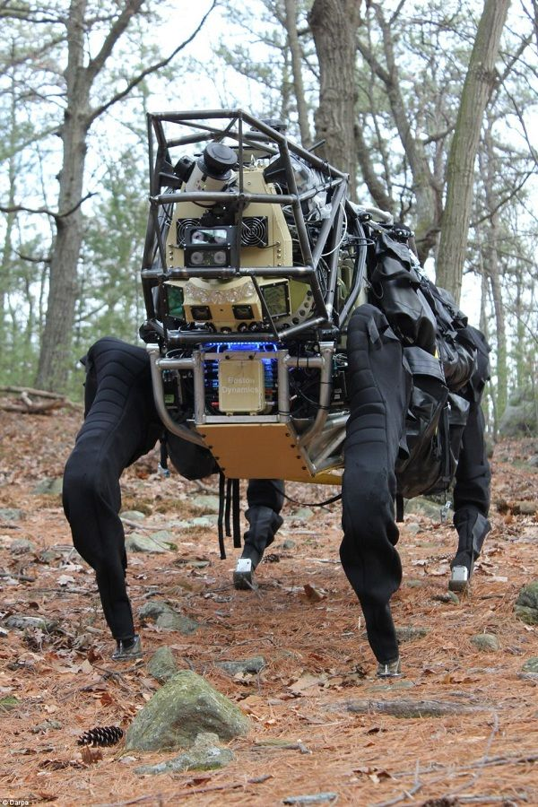
Near future
growing autonomy across the board
  https://www.youtube.com/watch?v=h449oIjg2kY
closer integration and mixed units
autonomous swarms
first autonomous kill?
arrival of true AI?

Slide 14
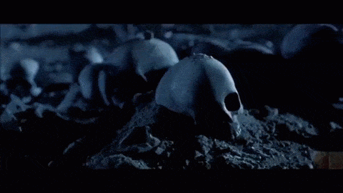
https://www.youtube.com/watch?v=HTPIED6jUdU

