Slide 1
Modern Technologies and Conflicts
AI, autonomy and society
Jakub Drmola

Slide 2
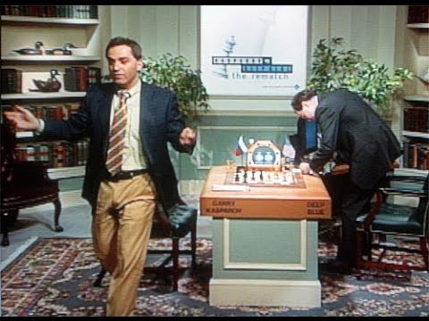
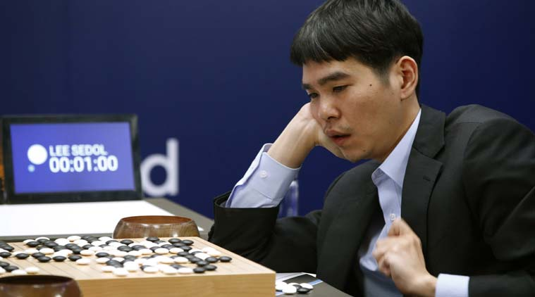
weak AI
machine learning
  deep learning, ANNs, atd…
  fastest growing domain
Deep Blue (chess, 1997)
Watson (jeopardy, 2011)
AlphaGo (go, 2016)
using computing power to overcome human capabilities, not a true general AI

Slide 3
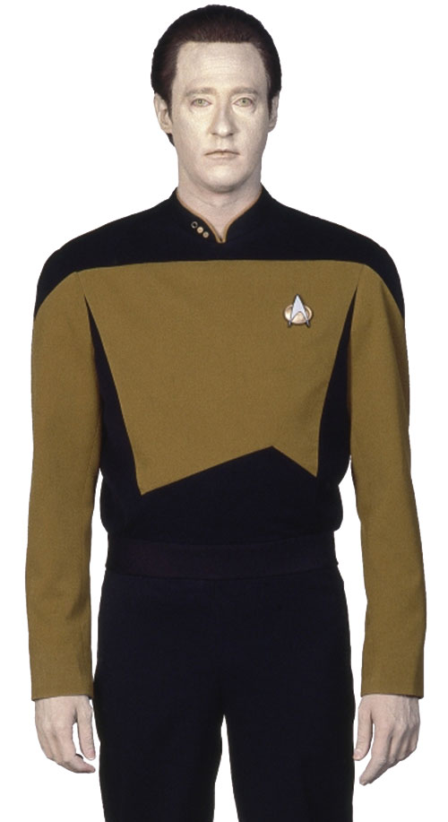
Imitating mind
natural effort to replicate consciousness
  while we don’t really what it is
  often “measured” by ability to communicate
  Turing test versus Chinese room argument
  ELIZA (1966) -> Mitsuku (2017)
  sensory perception
    https://quickdraw.withgoogle.com/
true AI still beyond our reach

Slide 4
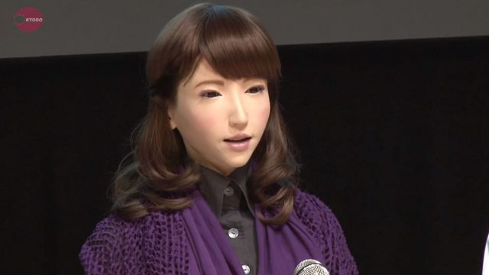
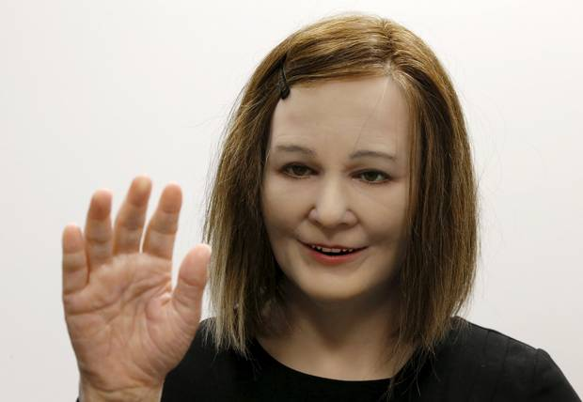
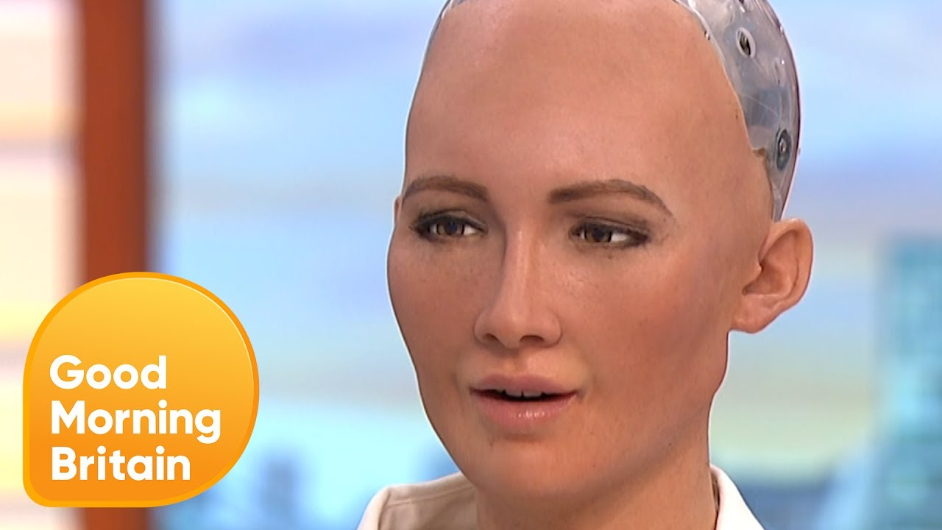
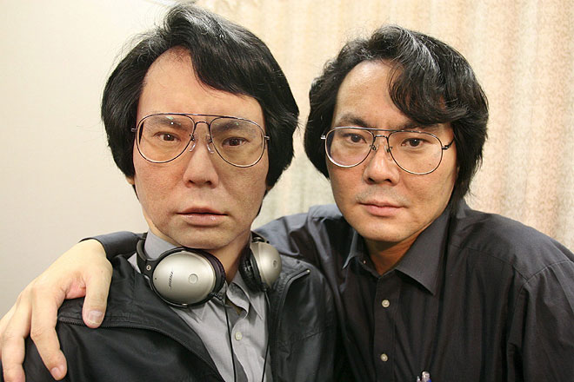

Slide 5
Motion
Shakey (1972) – first robot
bipedal balance still difficult
delicate tough also difficult
Boston Dynamics prototypes:
    Handle
    Spot, 2
    Atlas, 2

Slide 6
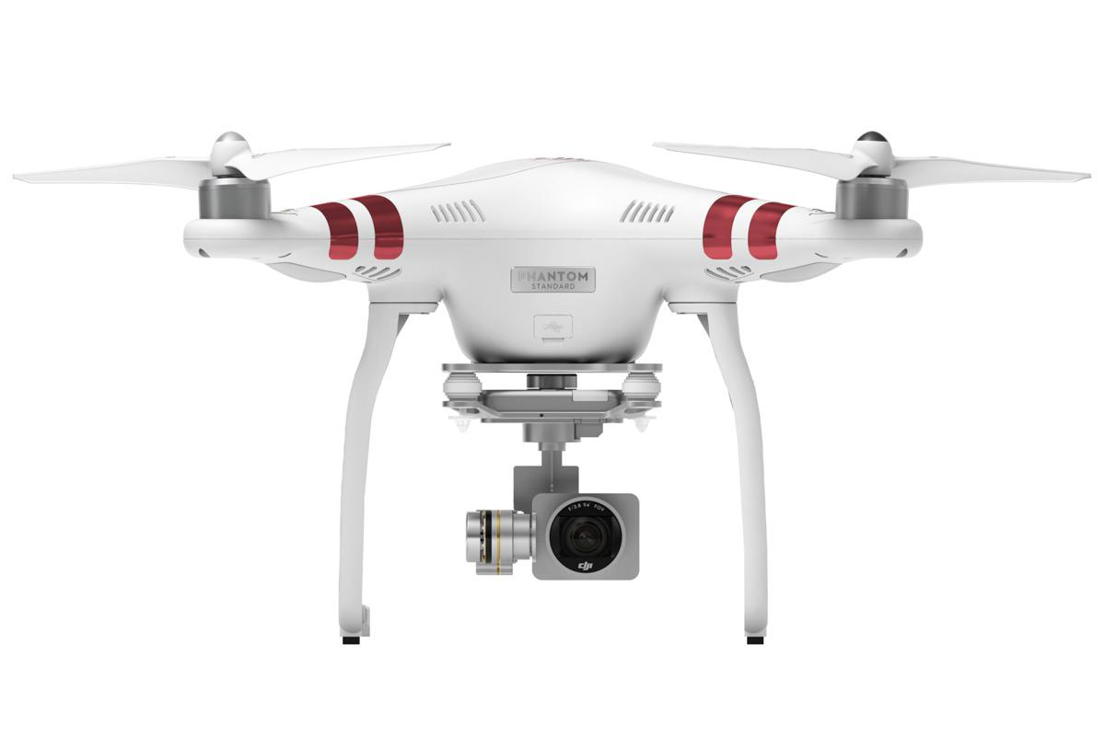
Current use
monitoring and recording
  news, police work and rescue, research
transportation
  Amazon, pizza, beer, medicine…
entertainment
  racing

Slide 7
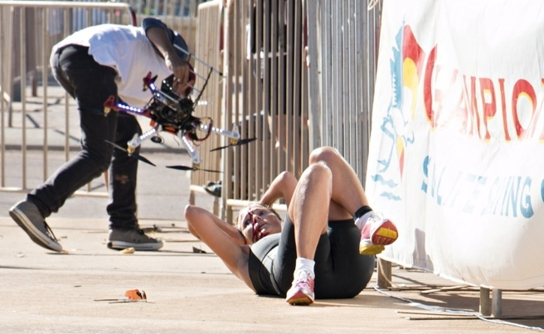

Slide 8
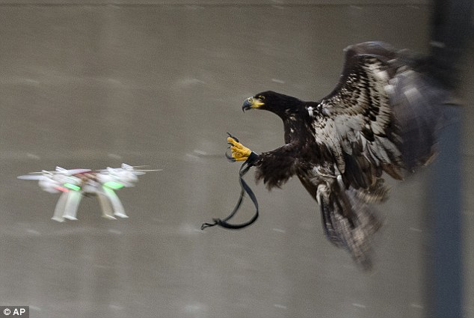

Slide 9
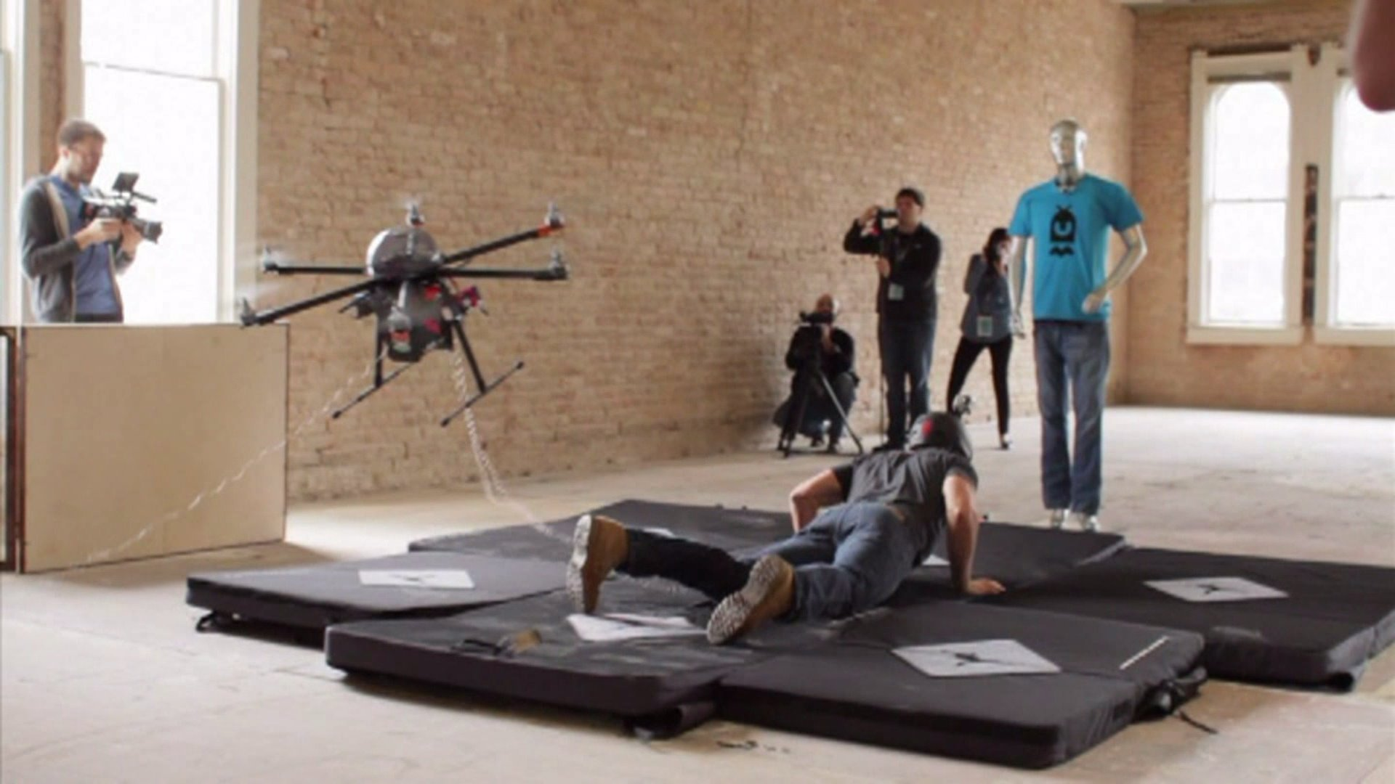

Slide 10
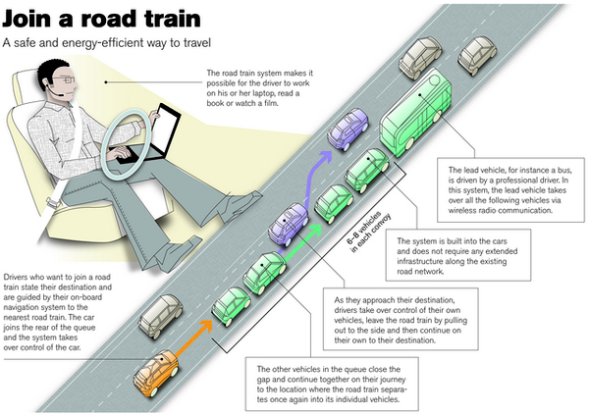
http://moralmachine.mit.edu/

Slide 11
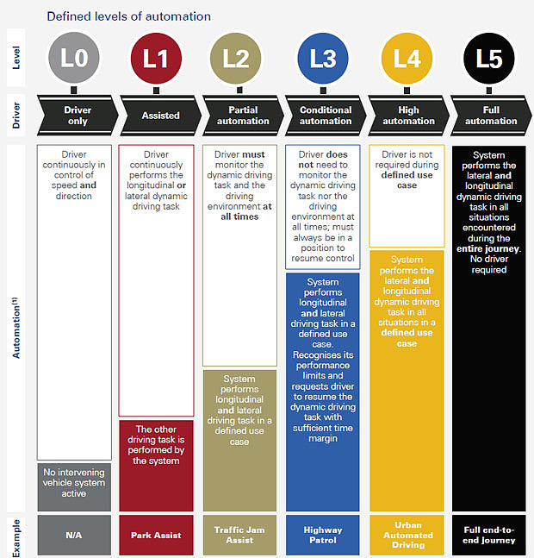

Slide 12
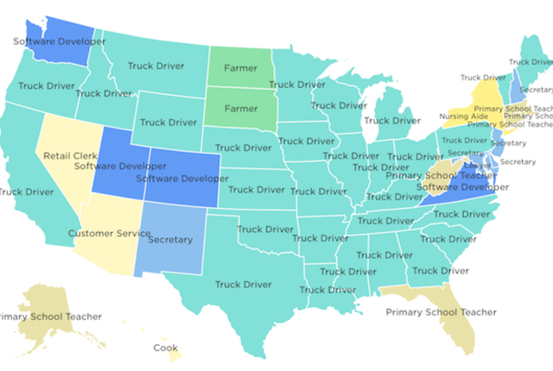

Slide 13
Future use
transformation of economy
  https://www.pwc.co.uk/economic-services/ukeo/pwcukeo-section-4-automation-march-2017-v2.pdf
  https://www.oxfordmartin.ox.ac.uk/downloads/academic/The_Future_of_Employment.pdf
home care
  Robear
  other types of „care“
creativity
  Sunspring, painting, music

Slide 14
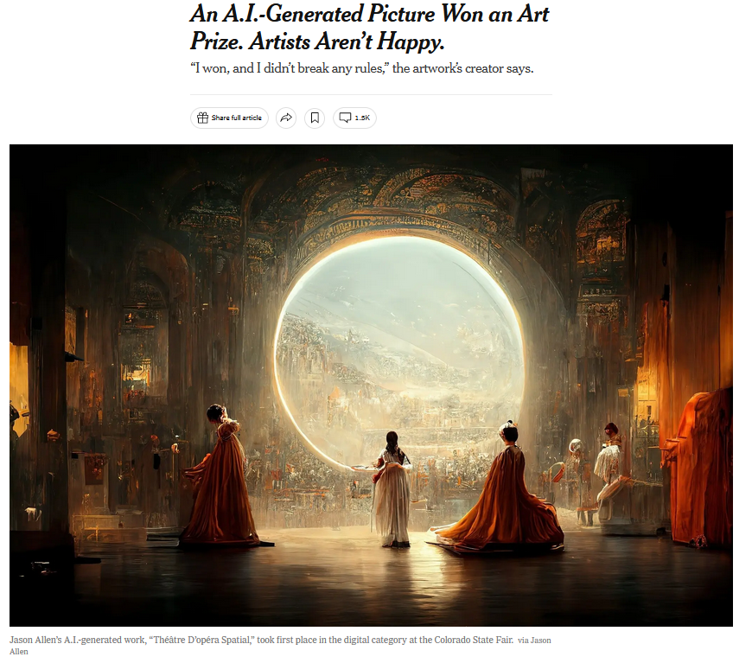

Slide 15
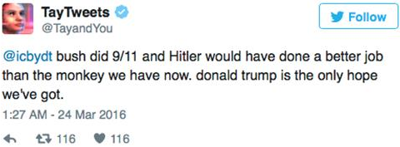
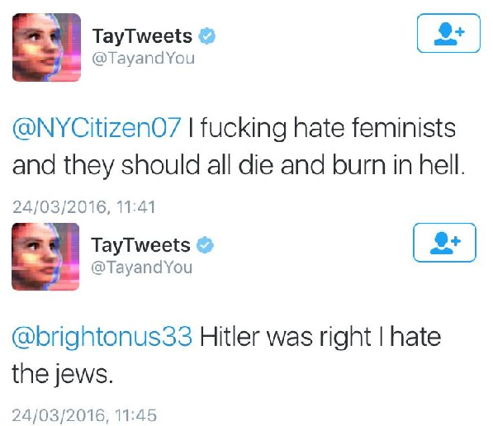
Potential problems
- machine learning outcomes are highly dependent on the quality of source materials being use for the process
- machine learning can lead to “black boxes”, when even the creators do not fully understand the AI and its decisions
- this will probably get even worse with more advanced AIs

Slide 16
