Slide 1

e-Governance & Cybersecurity
Logan Carmichael
University of Tartu (Estonia)
6th November 2024

Slide 2
Lecture Plan
Core Concepts
What does e-governance look like?
What are the cybersecurity considerations around e-governance?
What does this look like in action?
The future of cybersecurity and e-governance

Slide 3
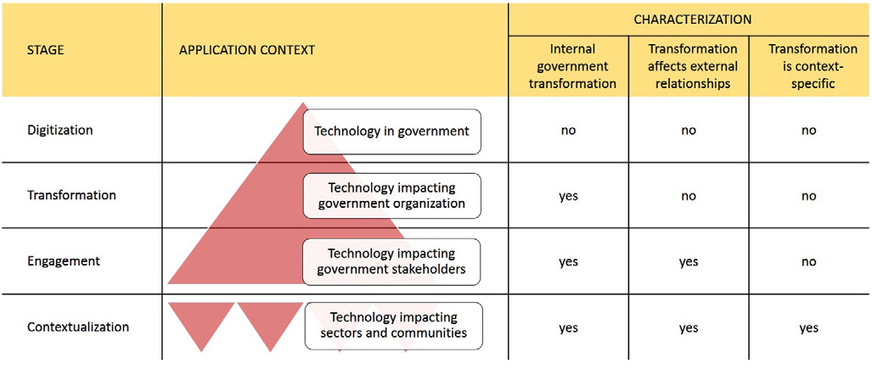
Core Concepts
e-Governance: government services that are provided electronically to citizens, which assume an interactive dynamic between the government and its citizenry
Cybersecurity: the security of technological systems and software, preventing manipulation or disruption, but also the protection of information contained in these systems
Cybersecurity governance: the institutional and
organisational structures and decision-making
related to cybersecurity

Slide 4
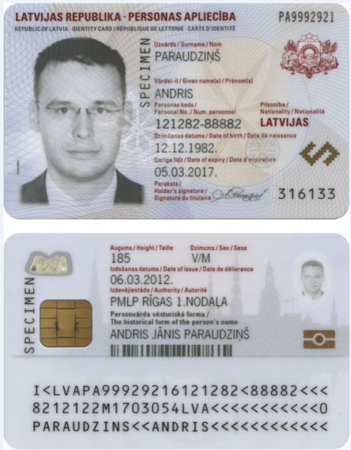
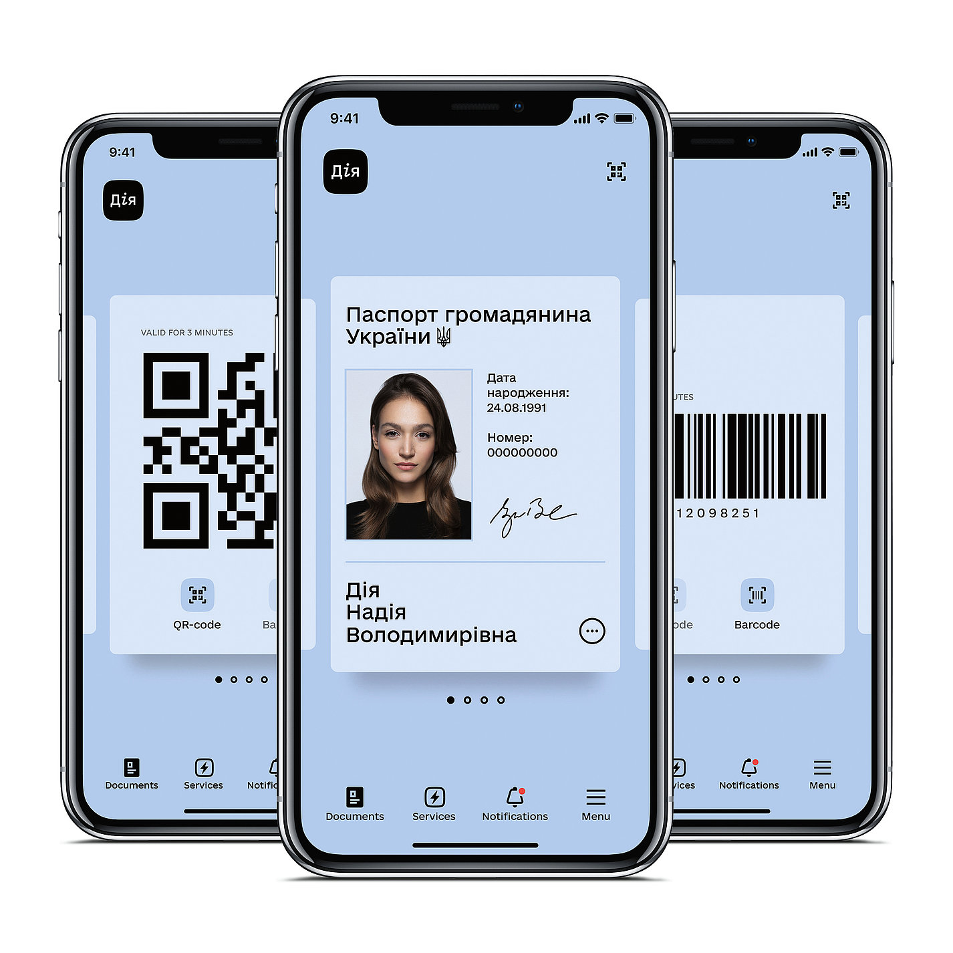

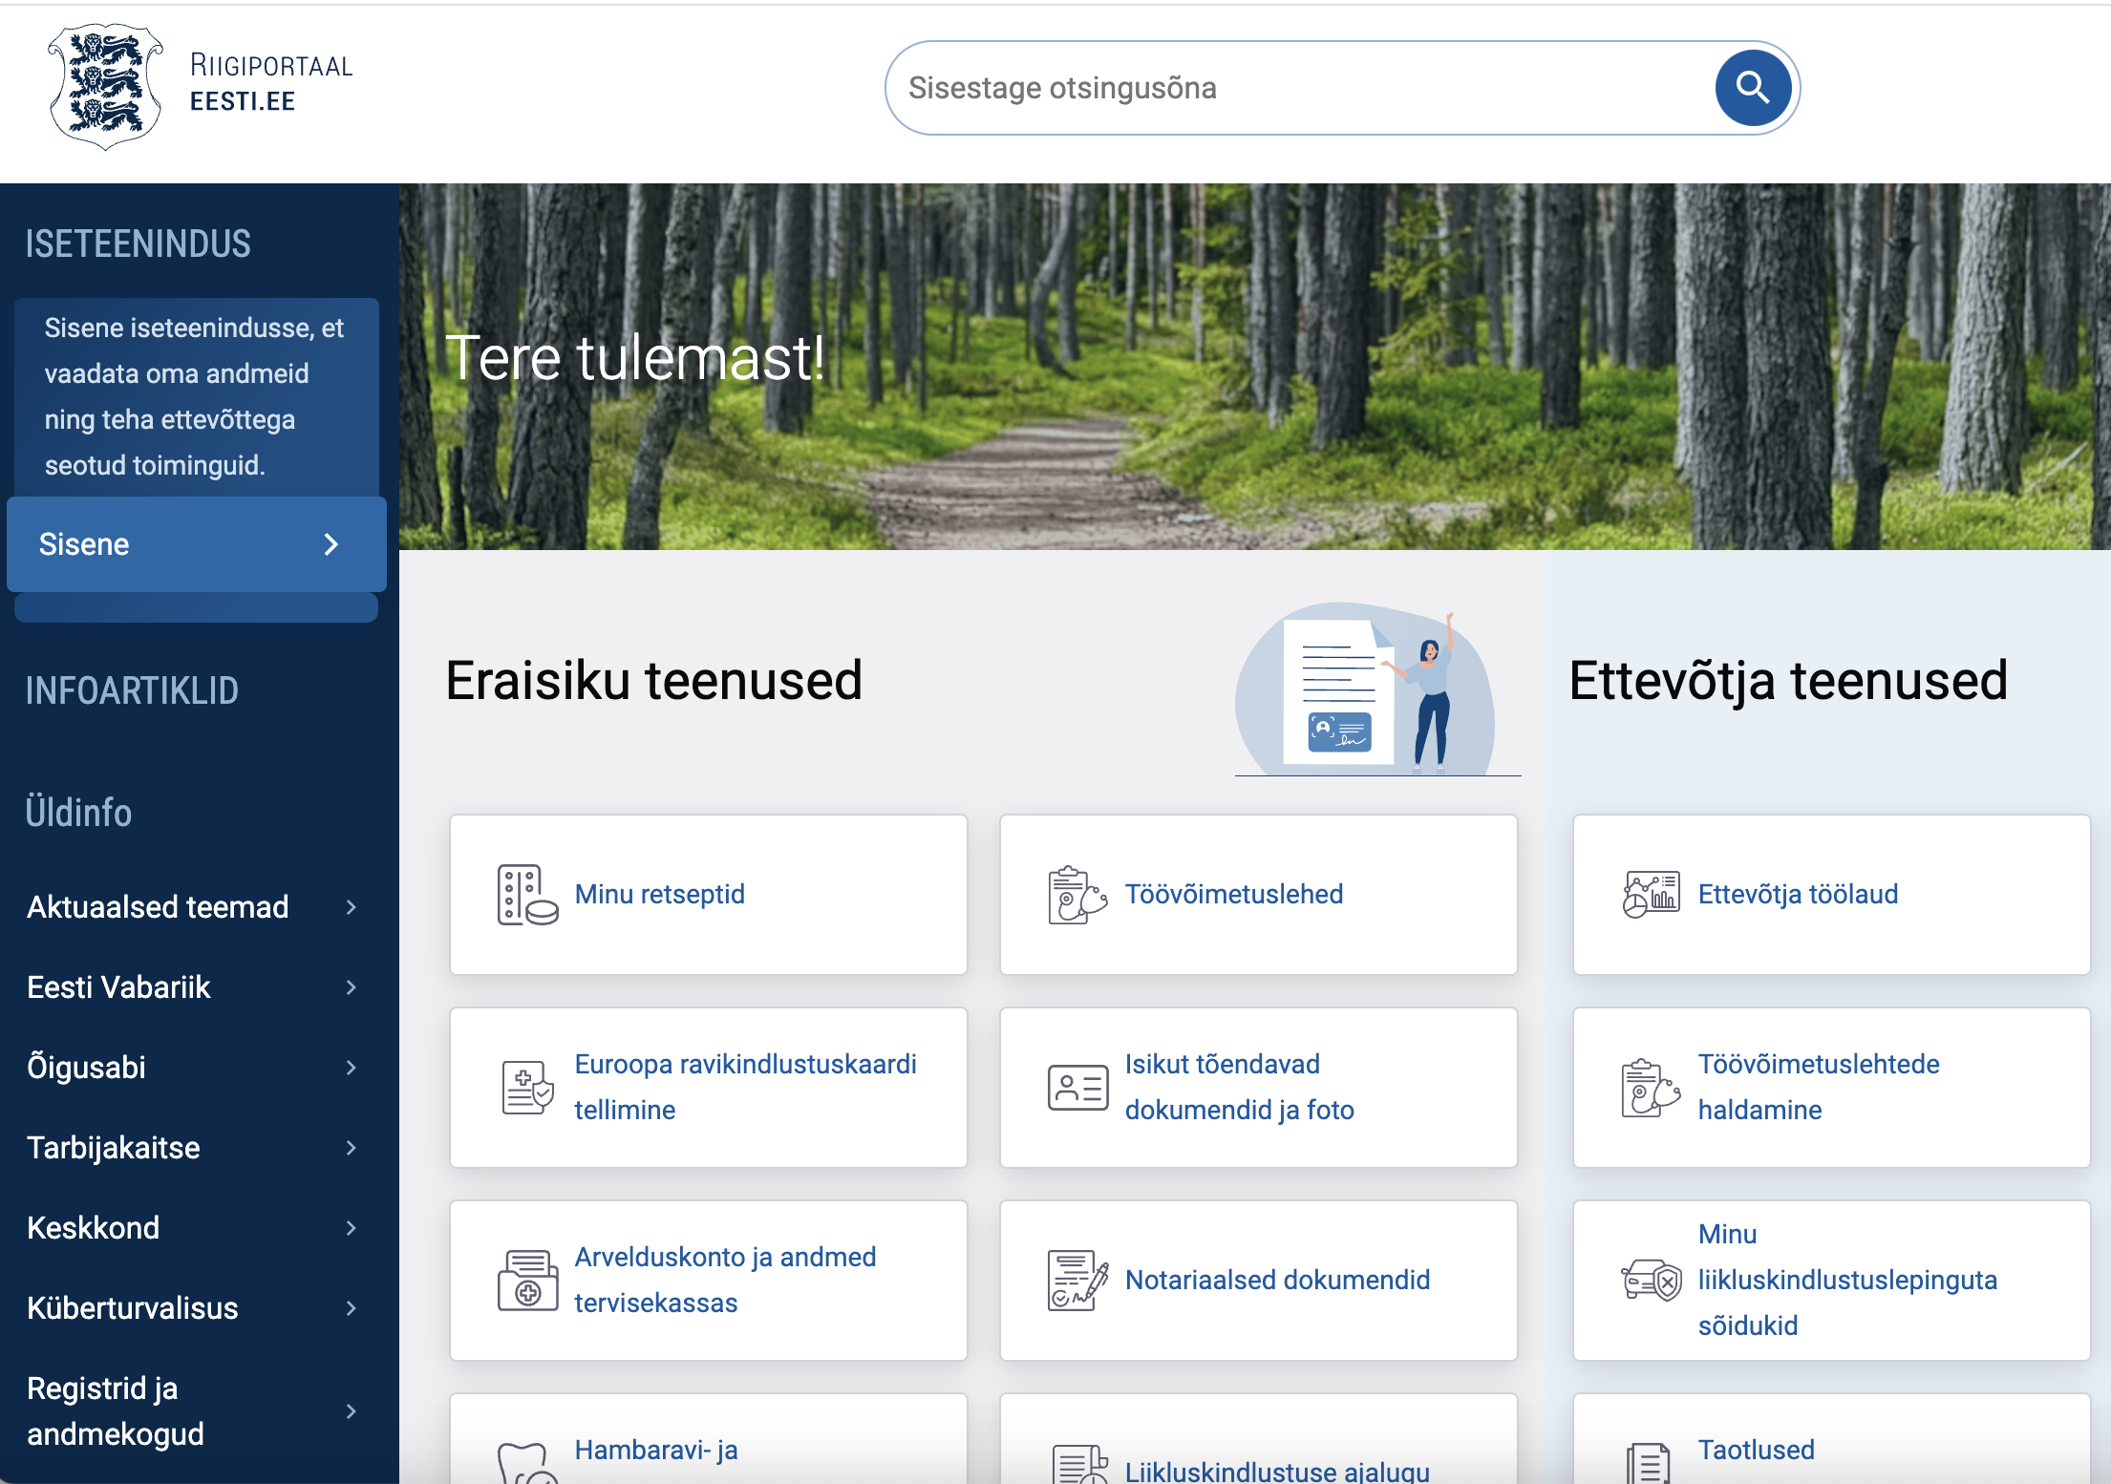
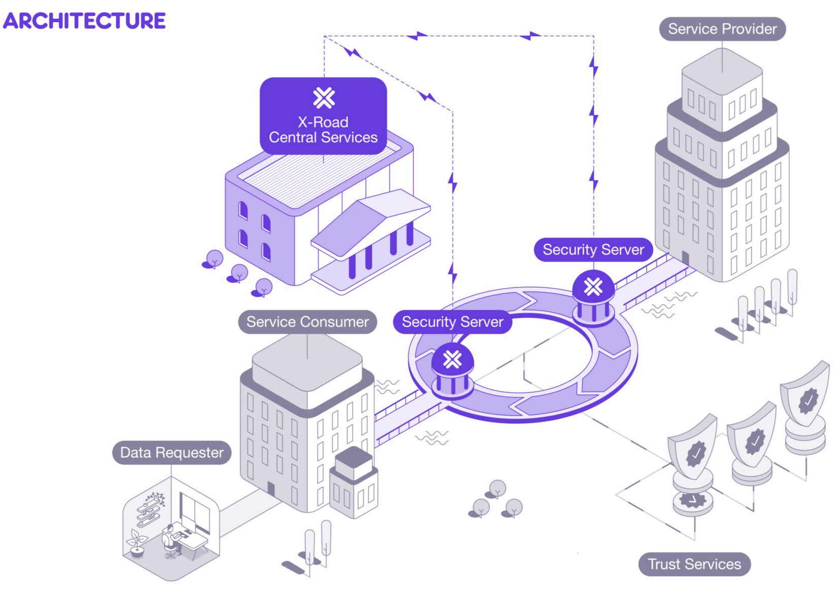
What does e-governance look like?
Internet voting
Electronic Identification (eID)
Service platforms/portals
Data Exchange Platforms

Slide 5

e-Governance and Cybersecurity
How are digitalisation and cybersecurity interconnected? What must be considered when securing e-governance provisions?
Systems/
Technology
People/Users
Decision-Makers

Slide 6
Systems/Technology
Appropriate technology for the cybersecurity threat landscape
  Routine security updates, all the way up to large-scale softwares and infrastructures
Constant investment and improvement into technologies (this is linked with decision-makers, who typically must sign off on funding)
Sufficient technical expertise to maintain systems and deal with incidents
e-Governance case study: internet voting – cryptographic setup, vote recast, authentication methods, desktop vs. mobile voting

Slide 7
People/Users
The average user of e-governance provisions does not have training in cybersecurity or related fields, but a great deal of onus falls on them
Cyberattacks often prey on this lack of tech and cyber hygiene awareness
How can you train your citizenry? How do you deliver messaging? These are also questions for decision-makers
e-Governance case study: governments have attempted to run information campaigns on various platforms, but there is not yet a surefire way to broach this

Slide 8
Decision-Makers
Ultimately responsible for technology and users
Large number of stakeholders involved, across government ministries/agencies, as well as private sector via public-private partnerships
Shift to an increased role of software designers as decision-makers
e-Governance case study: AI uses in e-governance; when implemented, typically politicians or bureaucrats do not have the expertise to configure artificial intelligence implementations, therefore the software designers play an elevated role; also decision to delay mobile internet voting

Slide 9
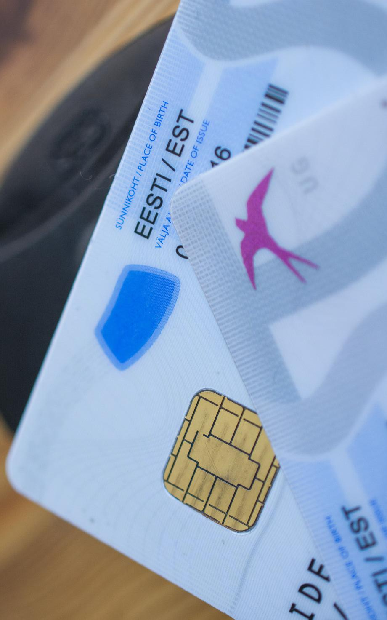
e-Governance & Cybersecurity in Crisis: Estonia’s eID Crisis
Key generation vulnerability→ Government announcment of crisis→ Patch found and crisis averted
Czech researchers found a ‘return of the coppersmith’ vulnerability in eID cards of 800,000 Estonians (as well as in Austria, Spain, and elsewhere)
Clear and transparent government communications while a patch was sought
Upcoming local elections, as well as fears of fraudulent activity; dark web monitored for exploits
Patch found and deployed by RIA, ’crisis’ did not eventuate

Slide 10
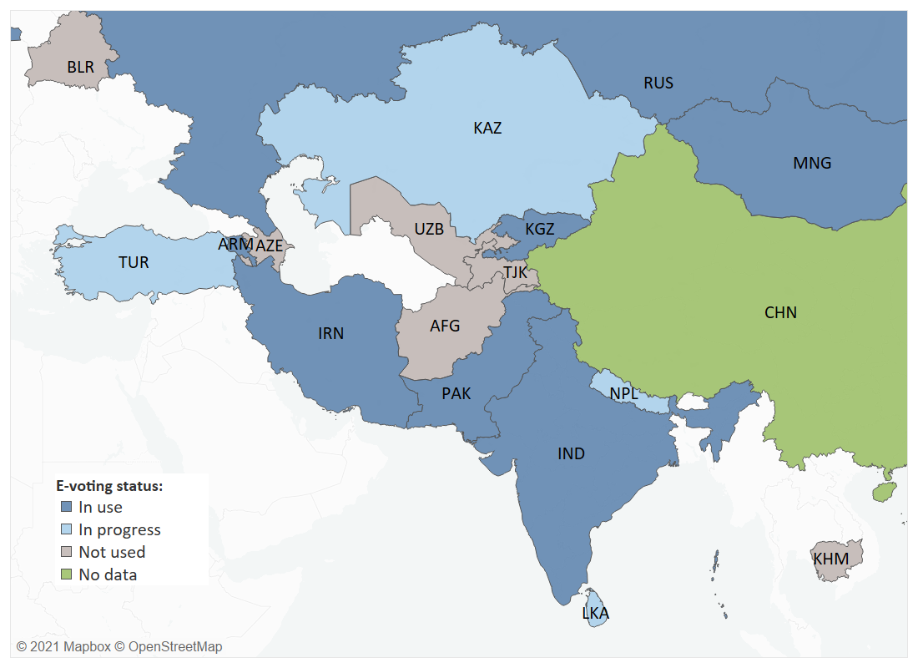
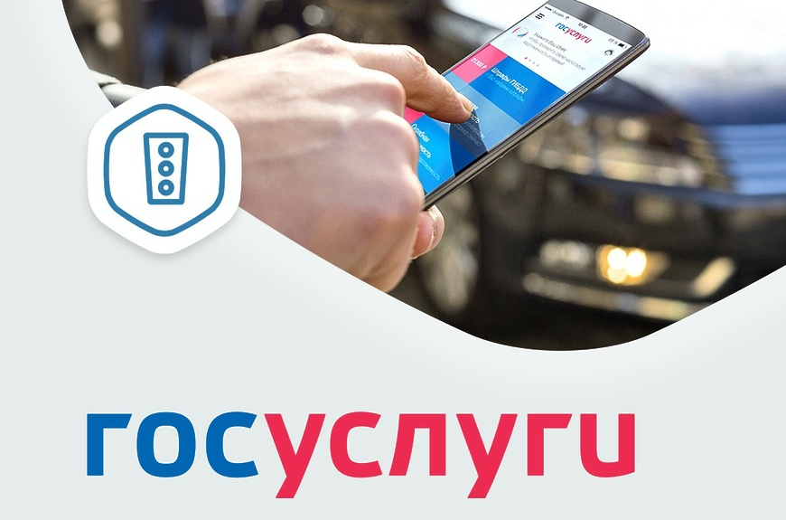
The Future of e-Governance and Cybersecurity: Non-Democracies
e-Governance provisions are increasingly being used in non-democratic settings
  Internet voting in Russia
  Gosuslugi portal in Russia
  Biometrically enabled eID in China
Russia and China see themselves as diffusers of technological innovations in their neighbourhood

Slide 11
The Future of e-Governance and Cybersecurity
Cybersecurity is ever-evolving, and never guaranteed:
As countries across the world continue to digitalise, their ‘surface area’ for cyberattacks also increases
  Rollout of entirely new digital governance systems (ie. Oman), or new versions of various services (ie. Estonia and mobile eesti.ee app, later i-voting)
In the past half-decade, cyberattacks have increased in their frequency and sophistication
  While DDoS was a major concern in 2007, technology has improved, but malware attacks, including ransomware, are on the rise

Slide 12
Thank you for your attention! Questions?
Let’s keep in touch!
logan.emily.carmichael@ut.ee

