Slide 1
Research Basics and Research Design I
Methodology of Conflict and Democracy Studies

Slide 2
Aim of this lecture
Introduction to research and methodology
How to do research?
What is a good research?
Basic concepts that you need to know

Slide 3

Order VS Chaos

Slide 4
Where to begin?
Identification of the topic?
Asking questions?
Formulation of hypotheses?
Data availability check?
Calculation of costs?

Slide 5

Step by Step
1. Topic and goals (+ reading)
2. Research questions (+ reading)
3. Hypotheses (+ reading)
4. Methods (+ reading)
5. Data collection
6. Data analysis
7. Results

Slide 6

Topic and Inspiration
College courses
Extracurricular activities
Your future career
Discussions with others
Reading

Slide 7
Research Questions
RQ give focus, set boundaries and provide direction
Only relevant RQ required
What / How / Why:
  What – description, characteristics of social phenomena
  Why – causes and reasons
  How – explanation, change
RQ point to data, i.e., RQ affect the data collection and analysis

Slide 8
Research Questions
Well formulated questions help the research and vice versa
Empirical criterion:
  What data we need to answer the question?
If RQ do not lead to certain data, there is no way to answer the questions

Slide 9
Research Questions
Beware of normative RQ
Is it correct to apply gender quota?
Was the election of E. Macron a good decision of French citizens?
Normative RQ cannot be answered using empirical data
Solution – modification of RQ (this changes also their content)
Do French citizens think that electing E. Macron for president was a good decision?

Slide 10
Hypotheses
Do we need them?
Do we always need them?

Slide 11
Does more transparency of institutions lead to higher satisfaction of citizens with democracy?
More transparency of institutions leads to higher satisfaction of citizens with democracy.
Does the amount of sugar affect the willingness of people to drink tea?
The amount of sugar affects the willingness of people to drink tea.

Slide 12
Hypotheses
Logical conjecture about the nature of relationships between two or more variables expressed in the form of a testable statement (O’Leary 2004)
Hypotheses are derived from theory
Main elements:
  Testability
  Relationship between at least two variables
  Expectation backed by the literature
‘Increasing unemployment rate leads to higher local support of far right parties.’
‘Terrorist attacks with victims increase the fear of society to a higher extent than terrorist attacks without victims.’

Slide 13
Hypotheses
Not a necessary part of any research
Hypotheses are used for testing theories
Key questions:
  Does the theory suggest a relationship between variables?
  Does it suggest the direction of such relationship?
Placing hypotheses before the theory is senseless

Slide 14
Logic of Research
Two main ways – inductive and deductive
Inductive:
  Explorative, search for patterns
  Main aim is generalization and formulation of new theories
Deductive:
  Builds on previous knowledge
  Main aim is to test existing theories

Slide 15
Logic of Research
Inductive | Deductive
Observation, data collection | Theory → hypotheses
Search for patterns | Test of hypotheses
Generalization, new theories | Confirmation / rejection of theories

Slide 16
Theory
A set of statements that collectively describe and explain a phenomenon, its causes or consequences
These statements are at a higher level of abstraction than simple facts
Objective - not only to describe but also to explain
Explanation based on ‘if A then B’ logic
Theory is nothing more than a set of causal laws and hypotheses (Van Evera)

Slide 17
Variables
A way to store concepts from the social reality
Elements of each variable:
  Label – name / description
  Values – denominations of occurrence of the variable
Example – a variable concerning income:
  Label – ‘income’
  Values – expression in a certain currency (EUR, USD, GBP etc.)

Slide 18
Variables
Main role of research – identify and explain causal relationships between variables
We distinguish between:
  Independent (explanatory) variables – suggested cause
  Dependent (outcome) variables – suggested consequence
Higher inflation decreases probability of government to win election
  Identify the variables
  Which one is independent, and which one is dependent?

Slide 19
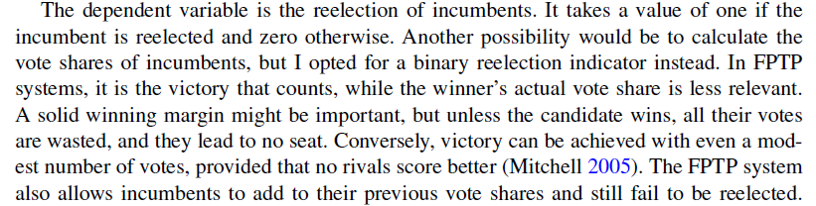
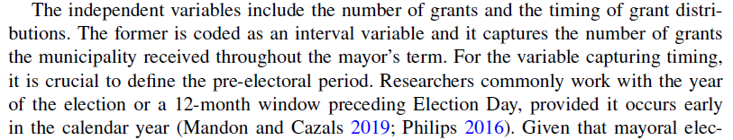



Slide 20
Causality
Basically, what this course is all about
Causal effect:
  Change in the value of a dependent variable if the value of an independent variable changes
Causal mechanism:
  Explanation of the link between cause and effect
  Clarifies the nature of the relationship between independent and dependent variables

Slide 21
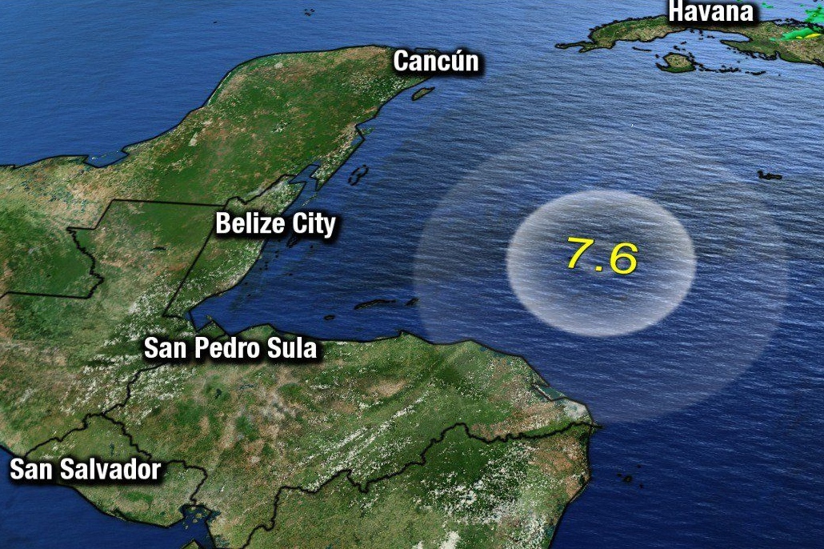



Slide 22

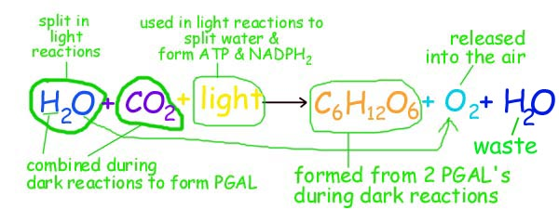
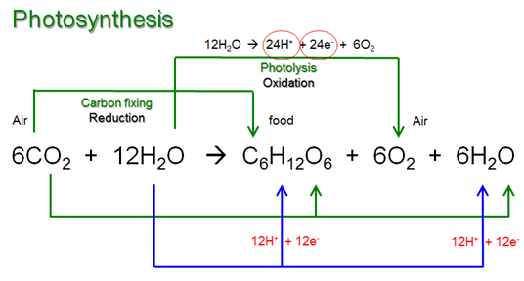


Slide 23
Hypothesis 1: ‘More life experience leads to a better career.’
What is ‘life experience’?
What is a ‘better career’?
Hypothesis 2: ‘Higher GDP allows countries to follow more ambitious national interests’
What are ‘national interests’?

Slide 24
Operationalization
Transformation of concepts into measurable items
By operationalizing we define measurement of social phenomena that is hardly (or not at all) measurable directly
Europeanization, good character, tasty food, wonderful color, right-wing extremist

Slide 25
Compare these definitions
1. A nice person – a person who is kind and caring and who everyone likes
2. A nice person – a person who smiles at least ten times a day and when other people are asked how they like him/her, this person receives a mean value of at least 8 on a 0-10 scale
Which of these two helps you more to identify a nice person in the real world?

Slide 26
Operationalization
Terrorist group
Electoral success
Tasty food
Popularity
Successful exam
Educated person

Slide 27
Be a Researcher
Topic: Popularity of Stranger Things in contemporary art industry.
Find some research questions
Formulate hypotheses (we assume that we have a theory)
Operationalize

Slide 28
Be a Researcher
Topic: Occurrence of violence in Europe due to high inflation.
Find some research questions
Formulate hypotheses (we assume that we have a theory)
Operationalize

Slide 29
Some Good Rules to Follow
1. Well set goals (and the topic) spare you time and energy
2. Methods are not your goals, but only the tools to achieve your aims
3. Proper reading is a must
4. Research design and planning is essential

