Slide 1
Cybersecurity
Part 1 – overview and state activities
Jakub Drmola

Slide 2
Cybersecurity is hard

Slide 3
Characteristics to note when attack occurs
actors involved
who did it? who is the target? states/companies/teenagers in basement?
methods used
how did they do it? what type of attack? what was really lost or damaged?
motivation
why did they do it? what was their goal? what did they really accomplish?
which are easy/hard to know and why?

Slide 4
Actor types
ideology
hacktivism militias
cyberterrorism
espionage
sabotage
individual
state
identity theft
financial crime
profit

Slide 5
Examples
ideology
Anonymous SEA
???
PLA 61398
Equation
Group
individual
state
Russian Bussiness Network, vDOS
profit

Slide 6
Attacks
ideology
#OP Payback Estonia
2007
???
Flame
Stuxnet
individual
state
DDoS for hire
scams
ransomware
profit

Slide 7
C-I-A triad of what is actually being attacked
Confidentiality
Integrity
Availability
examples?

Slide 8
Key distinctions
attack for profit or politics?
executed/planned as covert or overt?
what is target losing/what is the attacker gaining?

Slide 9
Main problems
attribution of attacks
and therefore deterrence
non-territoriality
and therefore law enforcement
asymmetry
of actors
of defence/offense

Slide 12
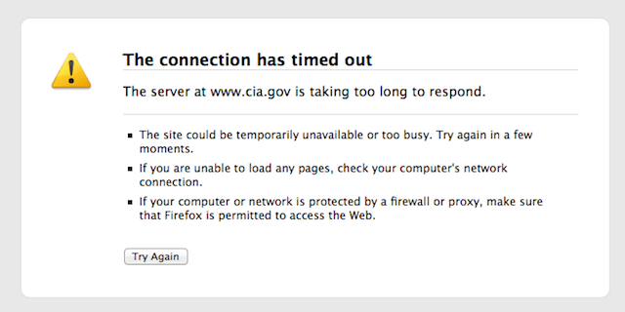

Slide 13
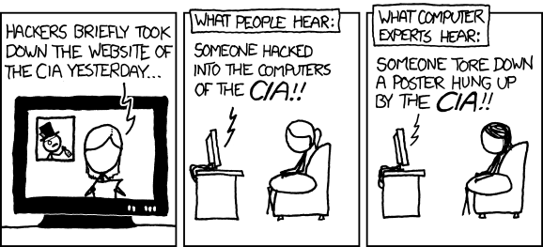

Slide 15
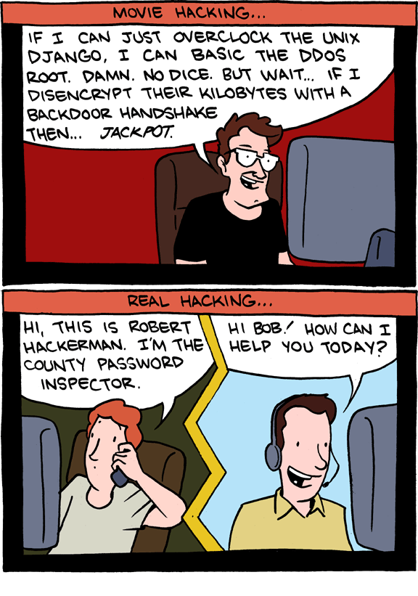

Slide 16
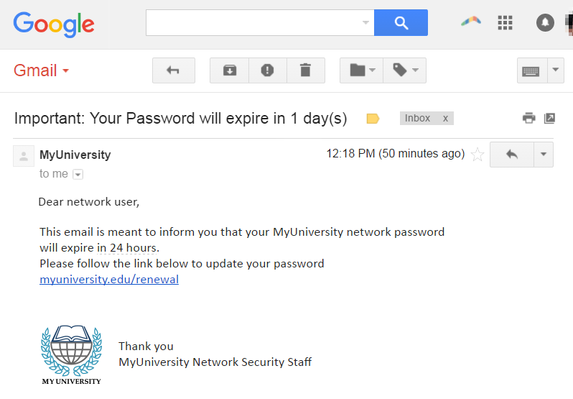

Slide 19
 | PIN | Freq
#1 | 1234 | 10.713%
#2 | 1111 | 6.016%
#3 | 0000 | 1.881%
#4 | 1212 | 1.197%
#5 | 7777 | 0.745%
#6 | 1004 | 0.616%
#7 | 2000 | 0.613%
#8 | 4444 | 0.526%
#9 | 2222 | 0.516%
#10 | 6969 | 0.512%
#11 | 9999 | 0.451%
#12 | 3333 | 0.419%
#13 | 5555 | 0.395%
#14 | 6666 | 0.391%
#15 | 1122 | 0.366%
#16 | 1313 | 0.304%
#17 | 8888 | 0.303%
#18 | 4321 | 0.293%
#19 | 2001 | 0.290%
#20 | 1010 | 0.285%

Slide 21
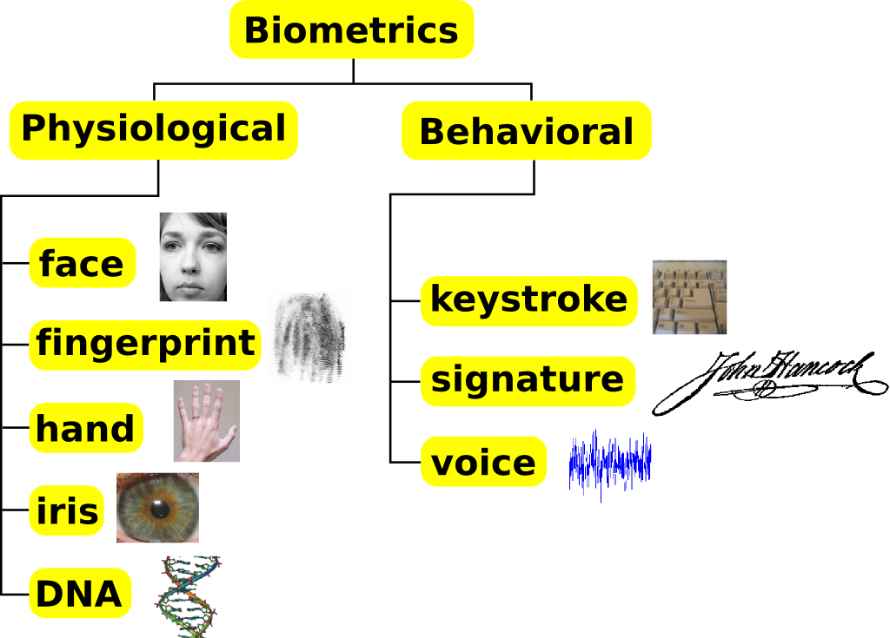

Slide 22
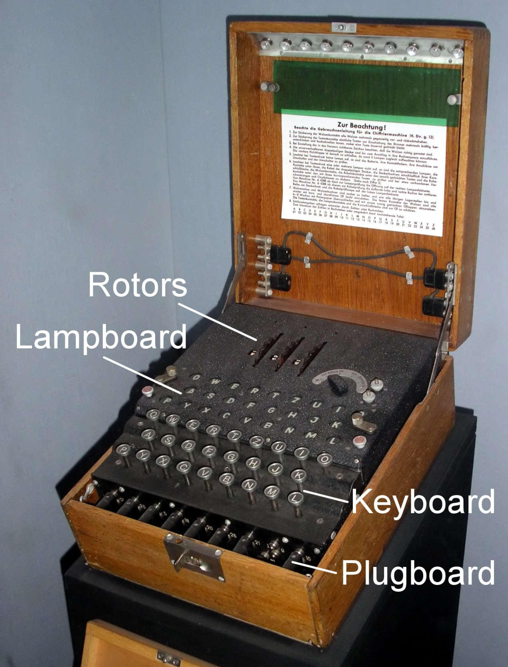

Slide 23
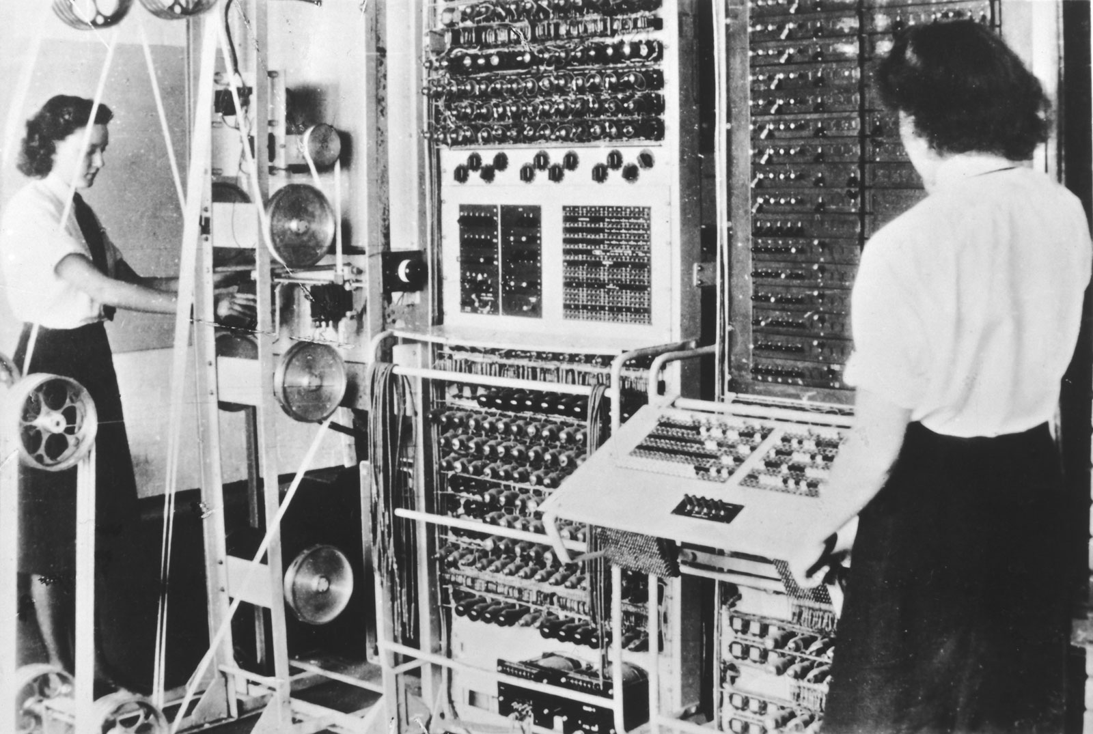

Slide 24
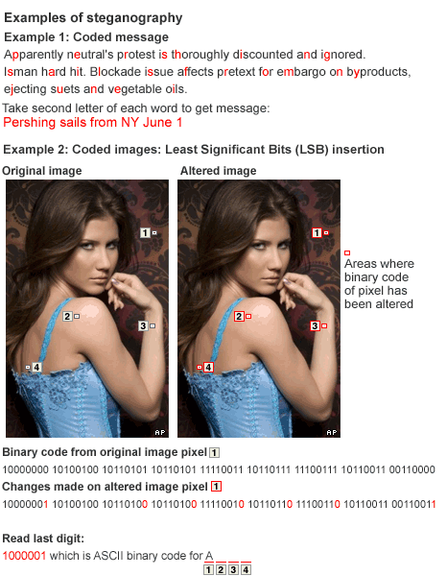

Slide 25
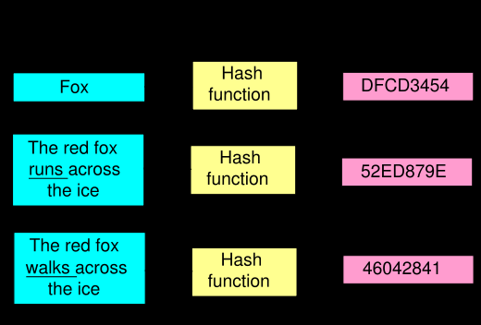

Slide 26
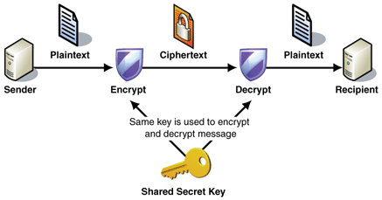

Slide 27
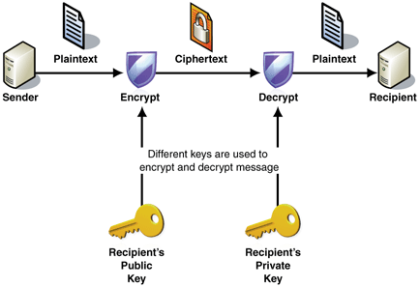
Notes:
937*643=602491
521*911=474631

Slide 28
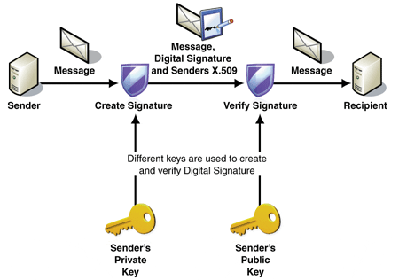

Slide 29
Cybersecurity
State activities and APTs

Slide 30
Espionage
attack on confidentiality
Flame, Red October
Purpose:
Economic espionage
Strategic espionage
Tactical espionage
https://apt.securelist.com/#secondPage

Slide 31
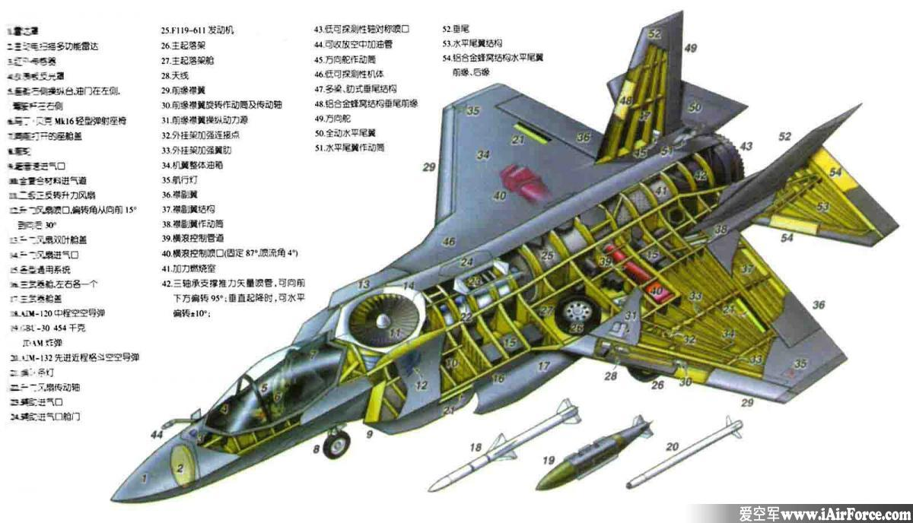

Slide 32
Domestic surveillance
also attack on confidentiality (but targeted inward)
Prism
law enforcement, population control
efforts to limit cryptography - CryptoWar

Slide 34
Censorship
attack on availability
Great Firewall of China
content control (porn? drugs? IP piracy? dissent?)
quite common, often via blacklists

Slide 35
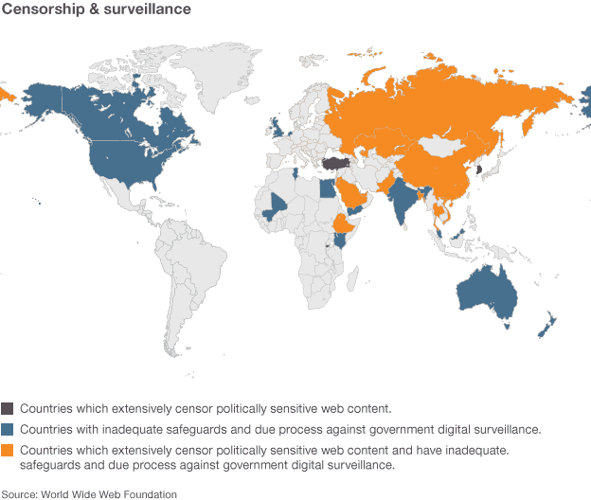

Slide 36
Sabotage
attack against data integrity
destruction of something, usually data
Stuxnet, Shamoon
still quite rare
“kinetic barrier”

Slide 37
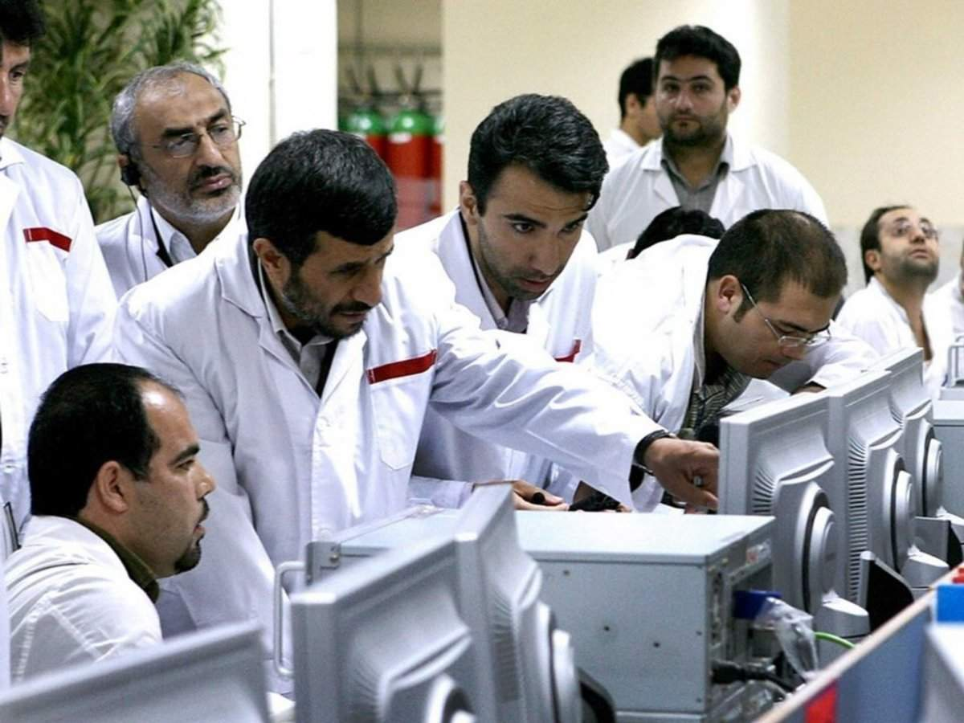

Slide 38
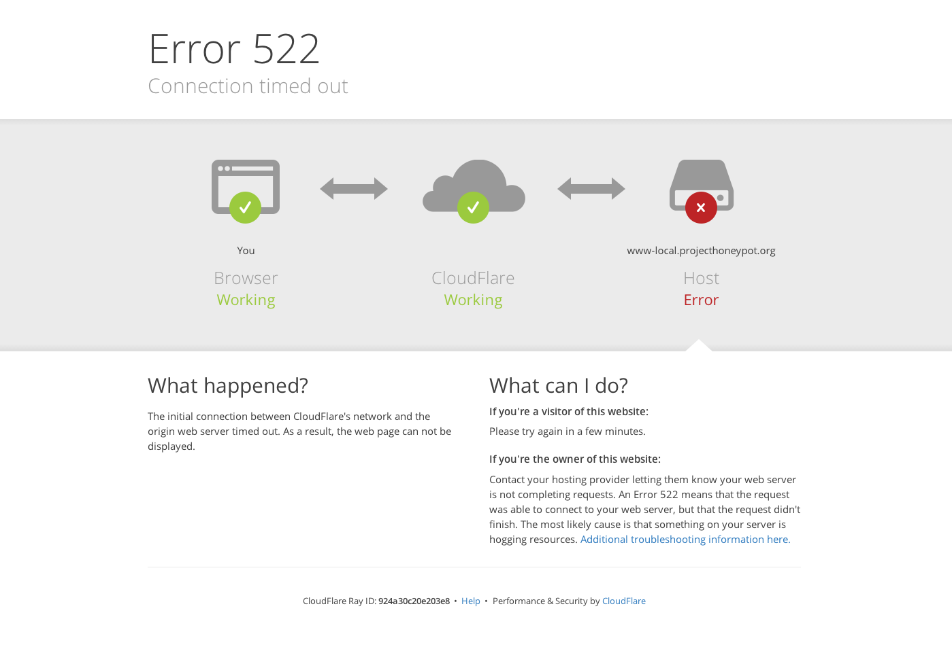

Slide 39
 | confidentiality | integrity | availability
internal | surveillance | - | censorship
external | espionage | sabotage | suppression

Slide 40
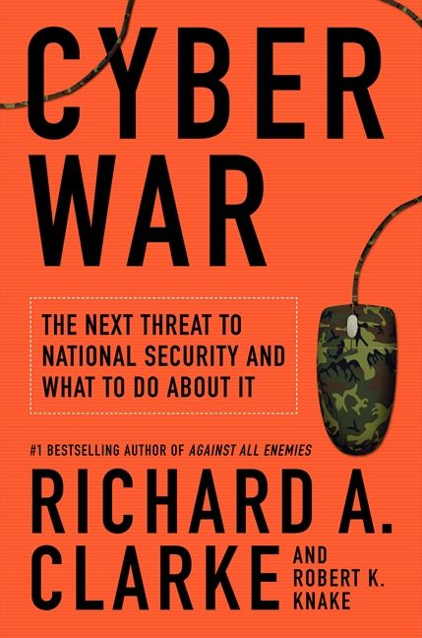
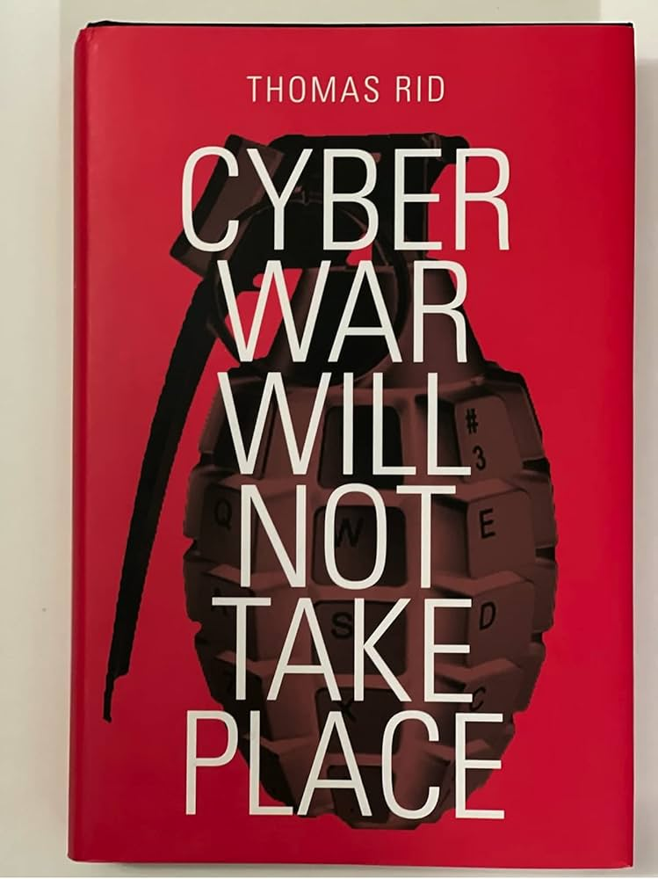

Slide 41
Cyberwar?
Controversial concept A watered-down concept? A question of real impacts and severity "The use of computers and the Internet to wage war in cyberspace. A set of large-scale, often politically or strategically motivated, related and mutually provoked organised cyberattacks and counterattacks.” (Jirásek, Novák and Požár 2013)

Slide 42
What is War?
e.g: At least 2 armed forces (at least one regular) Organization in battle, organization of defense, strategically planned attacks A certain level of continuity of armed operations War from 1,000 casualties/calendar year
should cyberwar be a subset of this?

Slide 43
Violence?
Clausewitz's concept of war? Is instrumental violence with a political aim present? "A war in which no one risked his life would be a tournament, a game..." (Huyghe 2011) Cyber attacks as a manifestation of secondary violence (RID 2013)

Slide 44
The attribution problem
Cyberattacks are currently problematic to attribute to actors Attribution to State actors Rid: "History knows no unattributed wars" Gartzke: “Politically motivated conflict will be attributed”

Slide 45
Continuity
War is not an isolated phenomenon! The requirement for a long-term organized strategy
- Is long-term cyber warfare possible?
Is it possible to win a war through cyber means?

Slide 46
Cyber weapons?
Not bullets and shrapnel, but ones and zeros Weapons of Mass Disruption (In)ability to cause permanent damage, to subjugate, to conquer? Limited capabilities by target type Gartzke's "perishable nature of CW"

Slide 47
Forms of cyber operations (E. Gartzke)
as a Substitute
- takes place instead of a conventional one
as a Complement
- in support and in conjunction of a conventional one
as an Independent tool
- to achieve completely separate results

Slide 48
Types of cyberattack (by T. Rid)
- Sabotage
- Espionage
- Subversion
is any of that war?

Slide 49
Cyberwar?
So what is cyber warfare? Is it possible to win a war through cyber means? Are espionage and sabotage acts of war?

