Slide 1
The kinetic part of “hybrid” warfare
Jakub Drmola

Slide 2
Irregular warfare
- or asymmetric warfare
- or guerilla warfare
- or insurgency
- or partisans

Slide 4
Features of irregular warfare
Compared to conventional (regular, symmetrical, …) warfare:
mobility and flexibility, there is no front
avoiding direct and open battle
poorly armed and equipped, dependent on external support and spoils
political, telluric
Compared to terrorism:
control of territory and population
targets enemy military and government
imitated military structure
willing to engage when advantegous

Slide 5
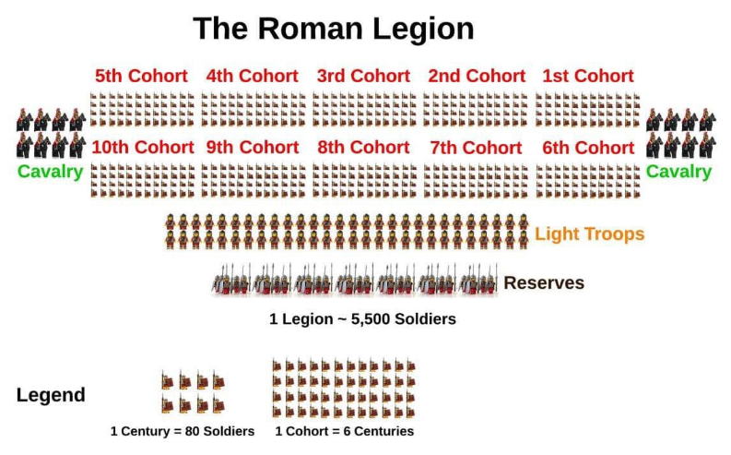
Long term perspective
asymmetric/irregular warfare is actually the original, “normal” warfare
characteristic for tribal conflicts and so is “counterinsurgency”
it is referenced in the oldest records
conventional/regular warfare is comparatively recent invention
it requires “civilization”
historically more visible and attractive

Slide 6
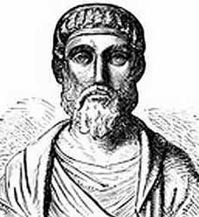
“They are very quick in their operations of exceeding speed and fond of surprising their enemies. They suddenly disperse and then reunite and again after having inflicted vast loss upon the enemy, scatter themselves over the whole plane in irregular formations, always avoiding a fort or an entrenchment.”
Ammianus Marcellinus, 375AD

Slide 7
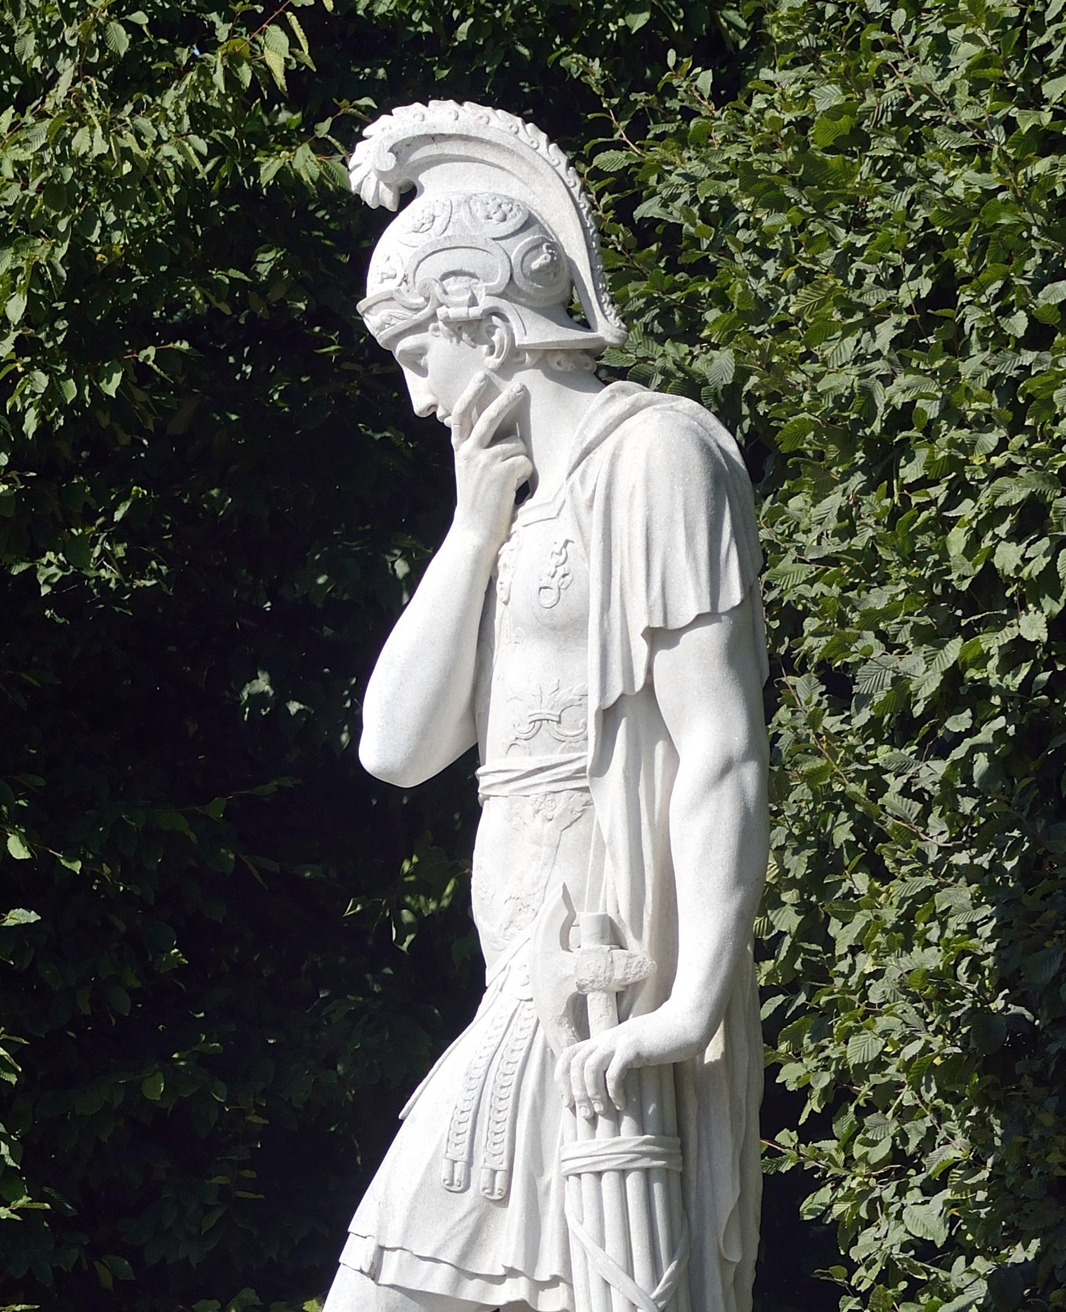
Oldest period
Sun Tzu (6th century B.C.)
“An army may be likened to water, for just as flowing water avoids the heights and hastens to the lowlands, so an army avoids strength and strikes weakness.”
“The supreme art of war is to subdue the enemy without fighting.”
Quintus Fabius Maximus Verrucosus (3rd century B.C.)
adopted “Fabian strategy” after initial Hannibal’s victories
avoiding direct battle, attacking supply routes, war of attrition
time must be on the side of defender
military success, political disaster
Zealots and Sicarii in Judea (1st century A.D.)
guerrilla warfare against Roman Empire

Slide 8
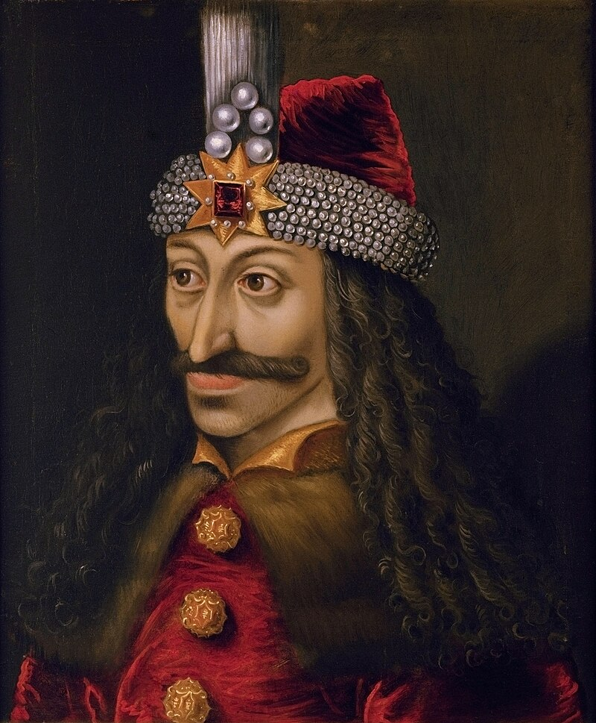
Middle ages
some bits of asymmetric warfare can be seen during the Hundred Years’ (1337-1453) and Thirty Years’ (1618-1648) wars
anti-Ottoman resistance in the Balkans
colonial wars
Irish resistance 1594-1603

Slide 9
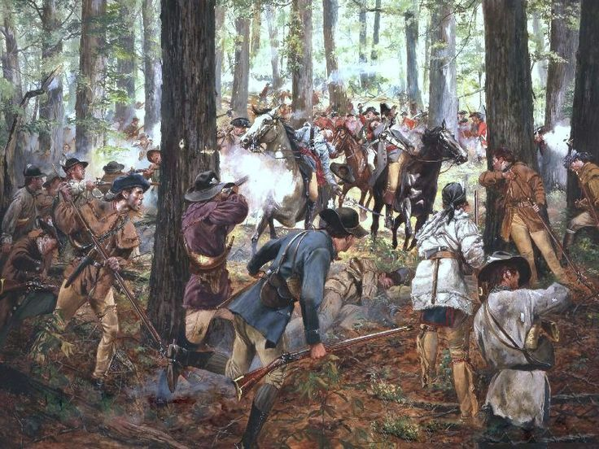
American War of Independence (1775–1783)
almost perfect conditions for asymmetric warfare
attacks on supply routes, officers, etc.
war was eventually decided back in London due to lack of support

Slide 10
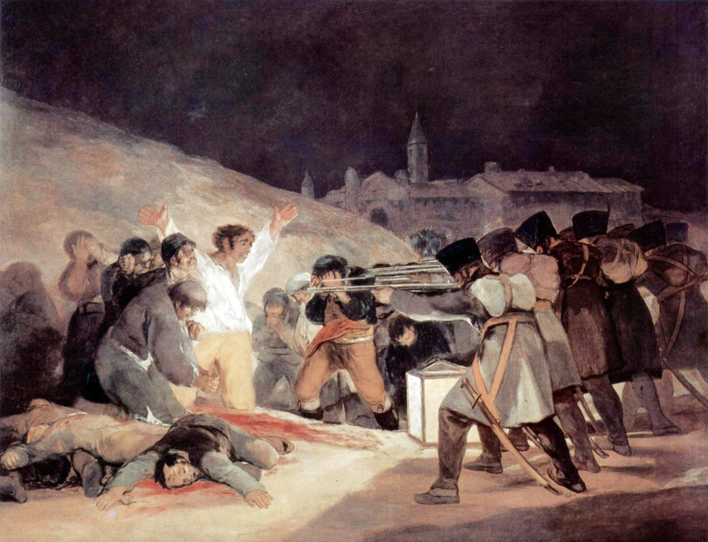
Napoleon’s Spanish “ulcer“ (1807-1814)
"It is manifest that, though a great army may easily defeat or disperse another army, less or greater, yet it is not in a like degree formidable to a determined people, nor efficient in a like degree to subdue them, or to keep them in subjugation–much less if this people, like those of Spain in the present instance, be numerous, and, like them, inhabit a territory extensive and strong by nature. For a great army, and even several great armies, cannot accomplish this by marching about the country, unbroken, but each must split itself into many portions, and the several detachments become weak accordingly, not merely as they are small in size, but because the soldiery, acting thus, necessarily relinquish much of that part of their superiority, which lies in what may be called the engineer of war; and far more, because they lose, in proportion as they are broken, the power of profiting by the military skill of the Commanders, or by their own military habits. The experienced soldier is thus brought down nearer to the plain ground of the inexperienced, man to the level of man: and it is then, that the truly brave man rises, the man of good hopes and purposes; and superiority in moral brings with it superiority in physical power."
- William Wordsworth

Slide 11
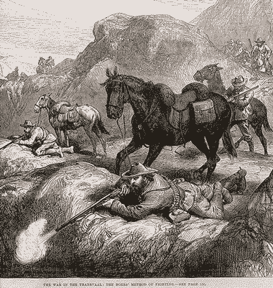
Modern Era
American Civil War (1861-1865)
both sides legitimized local guerillas
option to prolong the war
Franco-Prussian War (1870-1871)
“francs-tireurs” – French anti-Prussian guerrillas in captured territory
Boer Wars (1880-1881, 1899-1902)
both wars highly asymmetrical
Boers very effective “mobile snipers”
British army adapted well (camouflage, fortifications, protected supply routes, razing enemy supplies, concentration camps, pursuit units, armoured trains)
decent conditions of surrender

Slide 12
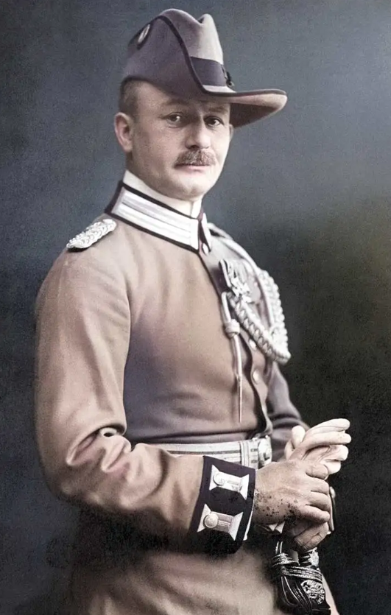
The Great War
T.E. Lawrence (and Gertrude Bell)
tried to create anti-Ottoman Arab revolt
“successful”, consequences still felt today (Sykes-Picot line)
Germany tried the same thing against India (Niedermayer expedition)
Paul von Letow-Vorbeck
undefeated German colonel in Tanzania
waged asymmetric war against much larger British army in Africa
goal was to force Entente to keep forces in Africa
no supplies, lived off the land
https://youtu.be/4iKHwHPpIKQ?t=2280

Slide 13
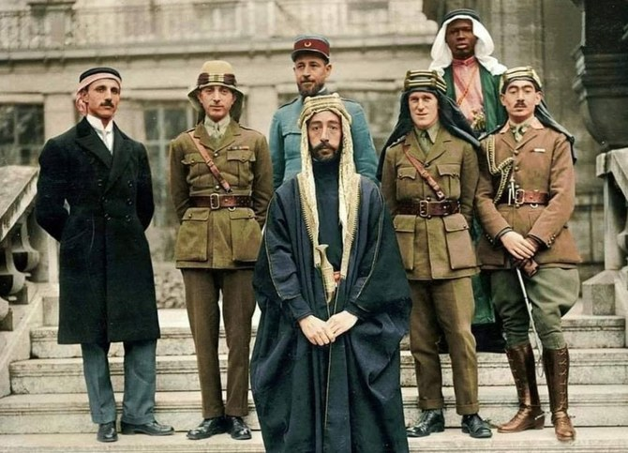
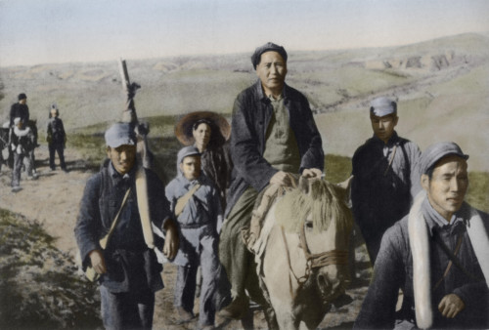
Thinkers and theoreticians
- T. E. Lawrence (1888-1935)
“War upon rebellion is messy and slow, like eating soup with a knife.”
“We were an influence, an idea, a thing invulnerable, intangible, without front or back, drifting about like a gas? Armies were like plants, immobile as a whole, firm-rooted, nourished through long stems to the head, we might be a vapor, blowing where we listed.”
- Mao Zedong (1893-1976)
“The people are the sea that the revolutionary swims in”
“The enemy advances, we retreat; the enemy camps, we harass; the enemy tires, we attack; the enemy retreats, we pursue.”
3 steps of revolutionary war
- Ernesto ‘Che’ Guevara (1928-1967) “foco”
“Guerrilla warfare is used by the side which is supported by a majority but which possesses a much smaller number of arms for use in defense against oppression.”

Slide 14
Role of terrain
geography and climate
mountains, forests, swamps?
or deserts, islands, plains?
international borders
where? how long? with whom?
what about coastline?
population centers
cities as a specific type of terrain
type of economy
industrial/agrarian
concentrated/dispersed
modern/developing country

Slide 15
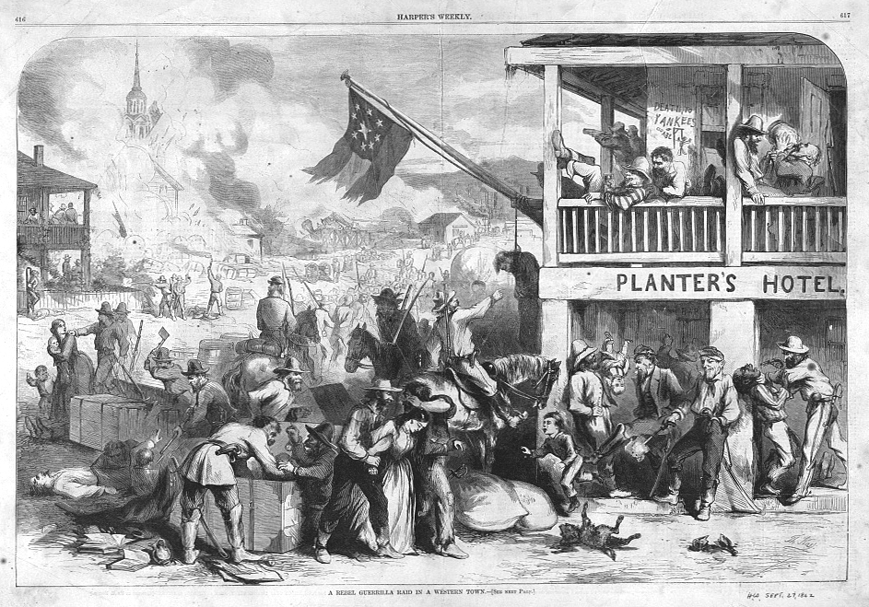
Role of population
control of population is more important than control of territory
it is source of money, information, fighters, and any other kind of support
goal of the guerilla is to take control over the population at the detriment of government

Slide 16
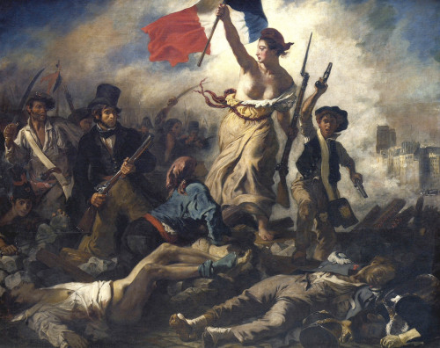
Role of cause
what are they fighting for or against
decisive factor regarding:
control of population
external support
internal resistance
best cause is one that brings you maximum number of supporters and also weakens the enemy as much as possible
it will differ case by case
its importance declines with duration and escalation

Slide 17
Role of entropy
laws of nature are helping the irregulars
all systems and strucutres naturally tend towards decline and disorder (entropy increases over time, second law of thermodynamics)
maintenance takes effort, resources and time
therefore destroying things is cheaper and easier than building them or protecting them
this makes war relatively easier for guerillas
the aim is to bleed out the government
H. Kissinger: „The conventional army loses if it does not win. The guerrilla wins if it does not lose.“

Slide 18
How to fight against it?
in general, countermeasures are more effective in the beginning but also harder to justify
once they can be justified, it might be too late
cannot do much with the terrain, but try to control key points
chasing guerillas across forests and mountains with regular forces rarely works
special operations can work, but depend on: intelligence, terrain and surprise, cooperation of local population
control population
good<---> bad, build schools or execute people
isolate it from the guerillas, or even move it
it’s a competition for their support
mobilize your supporters

Slide 19
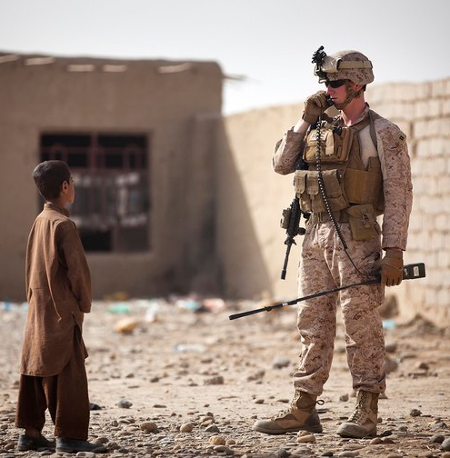
Counterinsurgency theory
1. Assume military control of the area
2. Soldiers live with the people
3. Control movement of population (census)
4. Eliminate local supporters of the rebels
5. Elect new, loyal local leaders
6. Test their loyalty, organize home defence militias
7. Educate and politicize locals
8. Destroy rest of the guerillas
it is order-sensitive and dependent on chosen area

Slide 20
Other things to note
people’s actions align with their interests, but are not always rational
most will not openly support what they percieve to be the losing side
if guerillas cannot lay down their arms and get amnesty, they will just keep fighting
population control can easily turn into counterproductive brutality
there is huge difference between local and expeditionary counterinsurgency
history lessons are always forgotten, mistakes are always repeated
because armies hate to fight like this
they prefer conventional, symmetrical war
some “rebels” are not political but just profit-driven (warlords)

Slide 21
Further conflicts
partisans and occupation resistance movements during WW2
France, Poland, Yugoslavia, and many others
Chinese revolution and Mao’s Long March
de-colonization wars
Africa and Asia
Vietnam War
Afghan War

Slide 22
Videos
Algiers - /p00txp61/
Paris - /p00txp44/ (4:00)
Bin Hao - /p00txnyc/
Vietnam 1 - /p00txp2s/
Vietnam 2 - /p00txnwv/
Iraq - /p00txqjt/ (2:00)

