Slide 1

Conceptualization of Information Warfare
When two do the same, it is not the same

Slide 2
Outline
Introduction
Key concepts
NATO approach
US approach
Russian approach
Chinese approach
Conclusion

Slide 3


Slide 4
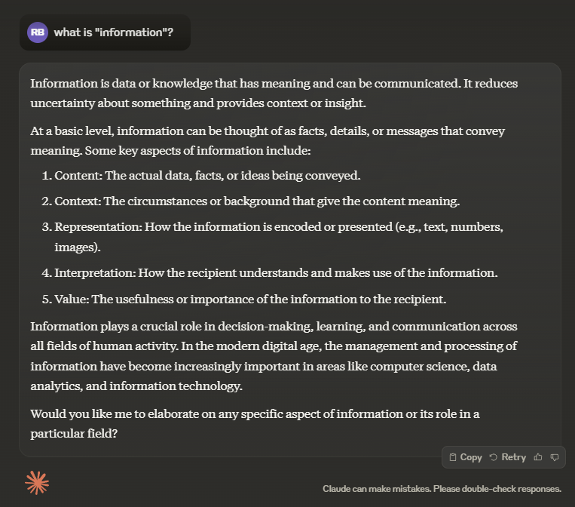
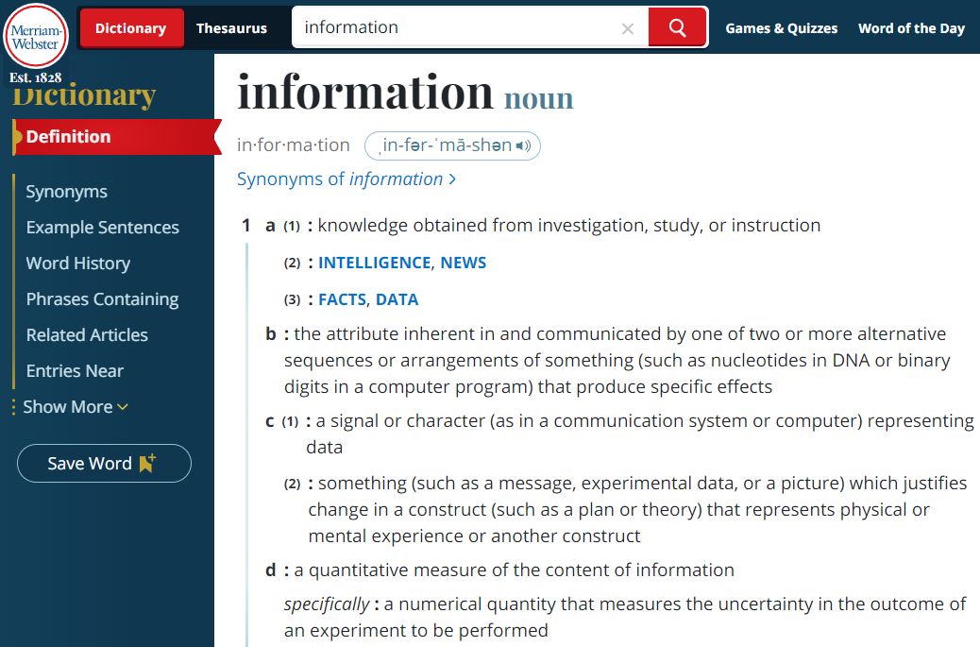

Slide 5
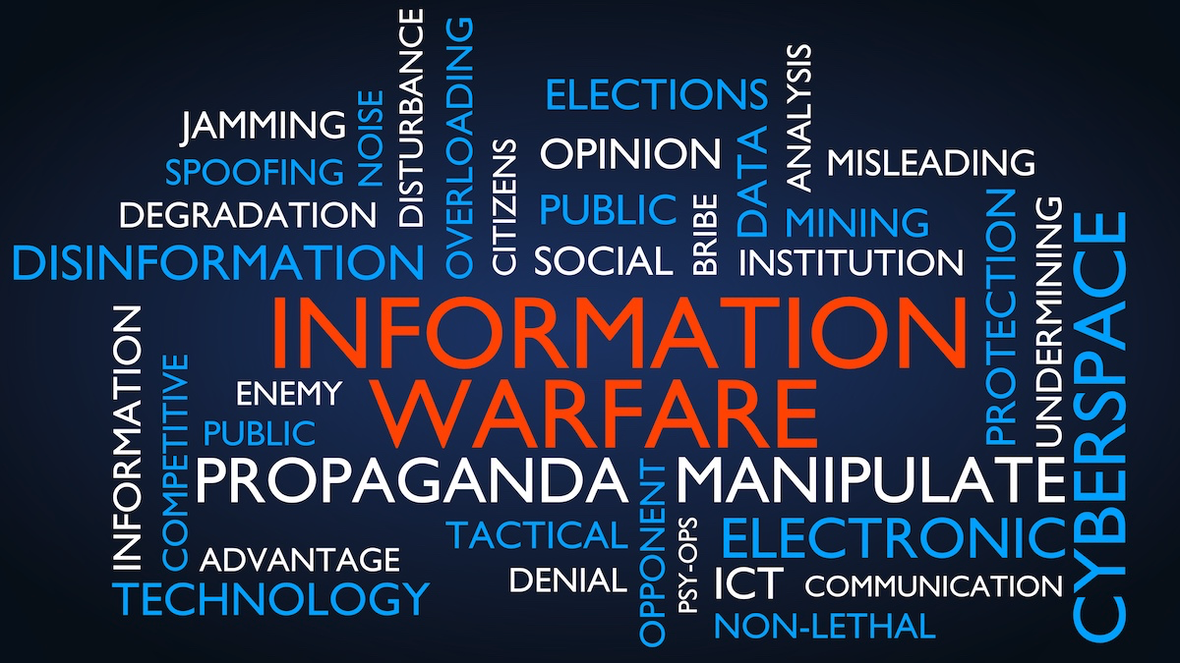

Slide 7
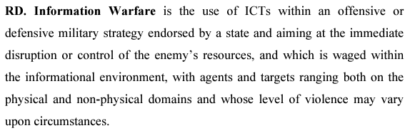
Taddeo, Mariarosaria. "Information warfare: A philosophical perspective." Philosophy & Technology 25 (2012): 105-120.

Slide 8
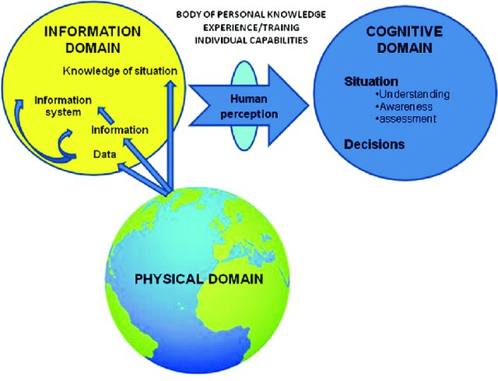
Key concepts
Information Environment:
  Physical: Hardware, infrastructure
  Informational: Data, media
  Cognitive: Human perception and
  decision-making
Cyber Domain:
  Network layer: Physical network
  infrastructure
  Logical layer: Software and protocols
  Cyber-persona layer: Digital representations
  of individuals

Slide 9

Information vs. Hybrid Warfare

Slide 10
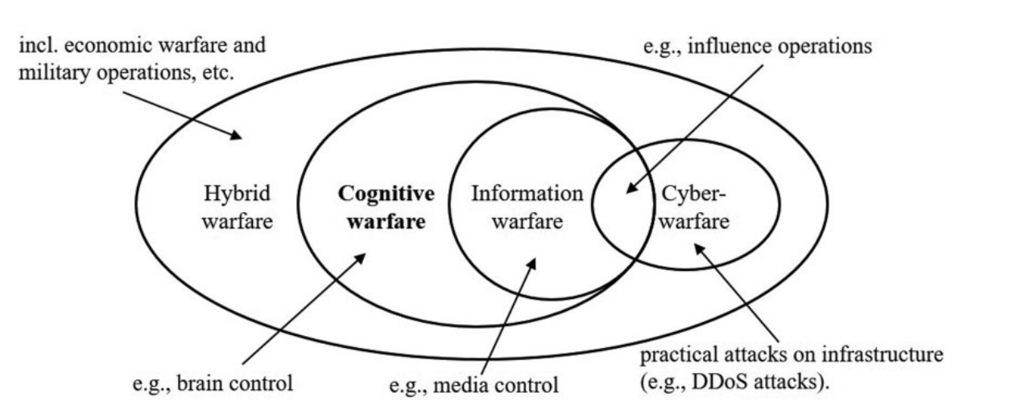

Slide 11
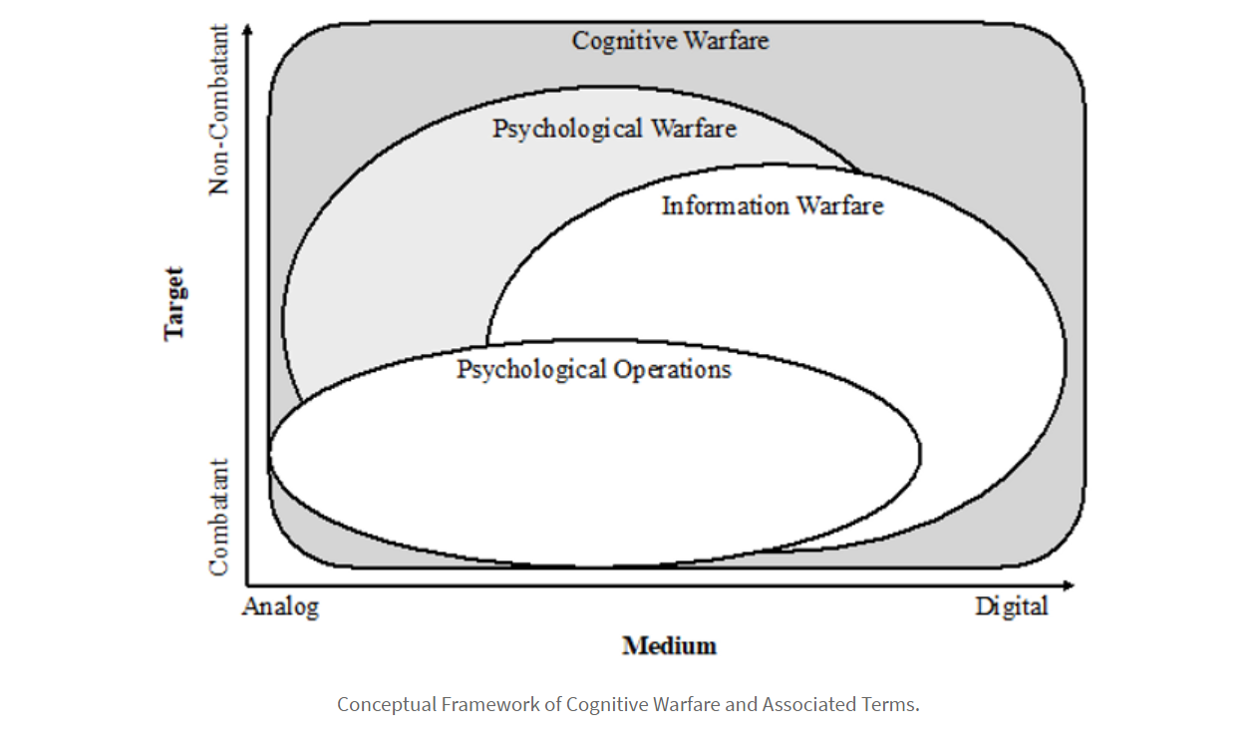

Slide 12
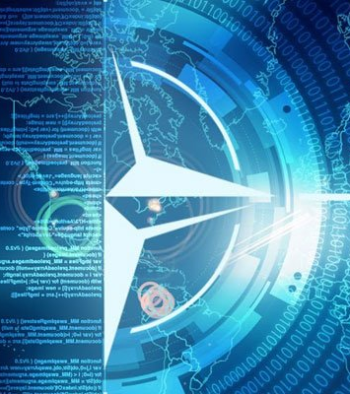
NATO approach to Information Warfare

Slide 13
Conceptual Overview of Information Warfare in AJP-3.10
Info Ops is a military function to provide advice and coordination of military information activities in order to create desired effects on the will, understanding and capability of adversaries, potential adversaries and other NAC approved parties in support of Alliance mission objectives. (AJP-3.10)
Focus on Information Space: IW targets both the technical and psychological aspects of information to achieve strategic objectives.
Continuity Across Conflict Spectrum: IW is not confined to active hostilities but is used continuously, including during peacetime, to shape the strategic environment.

Slide 14
Components of Information Warfare in NATO Doctrine
Information Operations (IO): A core element that encompasses actions to gain and maintain information superiority.
Cyber Operations: Focuses on securing and exploiting the cyber domain, both offensive and defensive, as a key aspect of IW.
Psychological Operations (PSYOPs): Aimed at influencing the perceptions and behaviors of target audiences.
Electronic Warfare (EW): Involves manipulating the electromagnetic spectrum to disrupt adversary capabilities and protect friendly operations.

Slide 15
Strategic Objectives of Information Warfare
Influence and Dissuade Adversaries: IW is used to shape adversaries’ decisions by influencing their information environment
Support Deterrence and Defense: Creates strategic ambiguity and disrupts adversary plans, thereby enhancing NATO’s deterrence
Enhance Decision-Making Superiority: Aims to ensure that NATO forces have accurate, timely information while disrupting the adversary’s decision-making process.
Protect NATO Information and Networks: Focuses on safeguarding critical information and maintaining operational security.

Slide 16
Application and Challenges of Information Warfare
Multi-domain Application: IW must integrate across land, sea, air, space, and cyber domains to be effective.
Adapting to Emerging Threats: The rise of digital technologies and adversary capabilities requires constant adaptation of NATO’s IW strategies.
Countering Disinformation: A key challenge is countering disinformation and influence operations from adversaries.
Importance of Resilience: Building resilient information systems is crucial to withstand and recover from IW attacks.

Slide 17
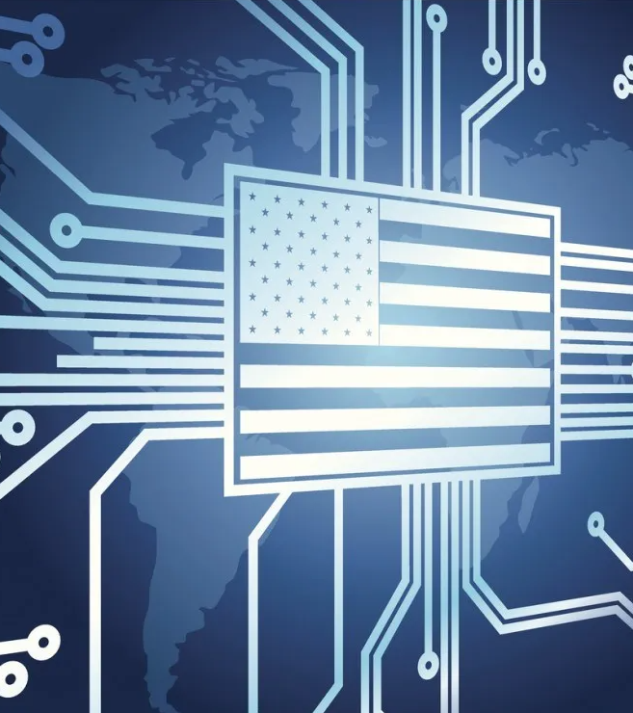
US approach to Information Warfare

Slide 18
US Perspective on Information Warfare
U.S. uses the term Information Operations (IO) within the Department of Defense.
Focuses on influencing or disrupting adversary decision-making during crises.
Prioritizes defense of its own information systems.
Emphasizes specific operations rather than a holistic IW approach.

Slide 19
Components of U.S. Information Operations (IO)
IO integrates Electronic Warfare (EW), Computer Network Operations (CNO), and Psychological Operations (PSYOP).
Includes military deception and operational security (OPSEC).
Supports other military activities like civil affairs and public affairs.
Aims to degrade, disrupt, or influence adversary actions.

Slide 20
Theoretical Foundations
Systems Theory: Viewing adversaries as complex adaptive systems
Network-Centric Warfare: Emphasizing information sharing and situational awareness
Cognitive Psychology: Understanding human decision-making processes and biases
Social Influence Theory: Leveraging principles of persuasion and attitude change

Slide 21
Evolving Paradigms
From Message-Centric to Behavior-Centric: Shifting focus from what is said to what actions are influenced
Narrative Warfare: Recognizing the power of compelling stories in shaping perceptions
Cognitive Maneuver: Moving beyond physical domains to operate in the cognitive space
Weaponized Information: Treating information as a form of "soft power" with tangible effects

Slide 22
Challenges for the U.S. in Adapting to IW
Balancing effectiveness with democratic values and international norms
Addressing the fine line between influence and manipulation
Considering long-term consequences of information operations on global stability
Navigating the challenges of attribution and plausible deniability in the information domain

Slide 23
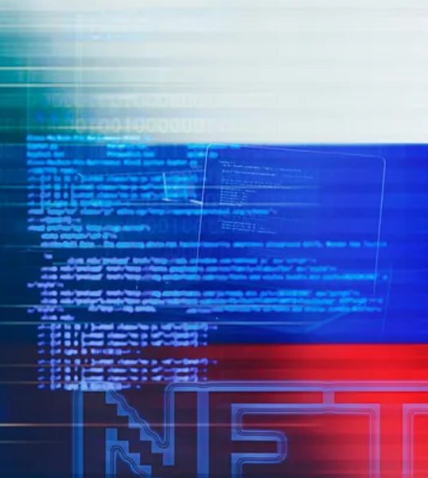
Russian approach to Information Warfare

Slide 24
Early Russian Approach to Information Warfare
Russian military divided IW into Information Technical and Information Psychological.
Information Technical: Focuses on cyberwarfare, including electronic countermeasures.
Information Psychological: Involves mass media, propaganda, and psychological tools.
Aimed at influencing public perception and morale.

Slide 25
Evolution of Russian Information Warfare Doctrine
Post-2010: Shift towards unifying both aspects under a broader IW strategy.
Emphasizes IW as a constant activity, applicable in both peace and conflict.
Aims to secure national objectives by influencing adversaries’ information systems.
Focused on manipulating societal and psychological conditions.

Slide 26
Defining Information Warfare in Russian Doctrine
Modern Russian doctrine views IW as a tool for achieving political, economic, and military goals.
IW is conducted continuously—during peace, crisis, and war.
Uses all resources to both attack adversaries’ information systems and defend its own.
Focus on influencing the opponent’s perceptions and actions

Slide 27
Objectives of Russian Information Warfare (Bolton, 2021)
Deep Penetration and Reflexive Control: Influences decision-making by distorting facts.
Creating Permissive Environments: Establishes narratives favorable to Russia.
Undermining Societal Stability: Weakens target societies, increasing Russia's relative power.
Applied in both peacetime and wartime to shape political outcomes.

Slide 28
Key Elements of Russian Information Warfare
Uses disinformation, propaganda, and psychological manipulation.
Aims to exploit societal divisions and erode trust in institutions.
Targets both leadership and public perception to create confusion.
Seeks to weaken adversaries without direct military engagement.

Slide 29
The Role of Reflexive Control in IW
Reflexive control is a core tactic in Russian IW.
Seeks to influence decision-making by introducing false premises.
Manipulates the target's understanding of reality to achieve desired outcomes.
Often employed covertly to mask true intentions.

Slide 30

Chinese approach to Information Warfare

Slide 31
Chinese Perspective on Information Warfare
Distinguishes between "information war" (broader, ongoing process) and "information warfare" (specific operations)
Focuses on influencing adversary's will and capabilities across various situations
Views psychological warfare as a key component of modern warfare
Emphasizes the cognitive domain as a critical battlespace in future conflicts

Slide 32
Emerging Technologies in Chinese Information Warfare
Prioritizes advanced computing: big data and information processing
Explores brain science applications, particularly brain imaging
Investigates cognitive modeling to predict adversary decision-making
Continues interest in legacy concepts: sonic weapons, laser weapons, subliminal messaging, holograms
Aims to integrate AI for "intelligentized warfare"

Slide 33
Objectives and Applications of Chinese IW
Degrade adversary leadership decision-making
Weaken adversary troops‘ will to fight
Undermine adversary public support for war
Undermine adversary government from within
Support deterrence through manipulated content and cognitive modelling
Develop non-lethal weapons for psychological effects
Leverage social media manipulation for public opinion warfare

Slide 34
Conclusions

Slide 35
Future Directions in Information Warfare
Increasing reliance on artificial intelligence for personalized psychological operations.
Growth of the Internet of Things (IoT) expands the attack surface for IW.
Enhanced data analytics enables precise targeting of information campaigns.
Potential for escalation as IW capabilities become more advanced and integrated.

Slide 36
The Role of Information Warfare in Modern Conflicts
IW has become a central component of geopolitical competition.
Its effects are felt in both military and civilian domains.
Understanding IW is crucial for developing effective countermeasures.
Strategic integration of IW is essential for maintaining global influence and security.

Slide 37
Thanks for your attention!
Questions?

