Slide 1

Progressive slovakia

Slide 2
contents
1. FUNDAMENTAL PARTY INFORMATION
2. PARTY HISTORY
3. MAIN PERSONALITIES
4. EUROPEAN AFFILIATION
5. POWER IN EUROPE
6. NATIONAL POLITICAL LANDSCAPE POWER
7. PROGRAMME POINTS
8. AN IDEOLOGICAL ANOMALY
9. SOURCES

Slide 3
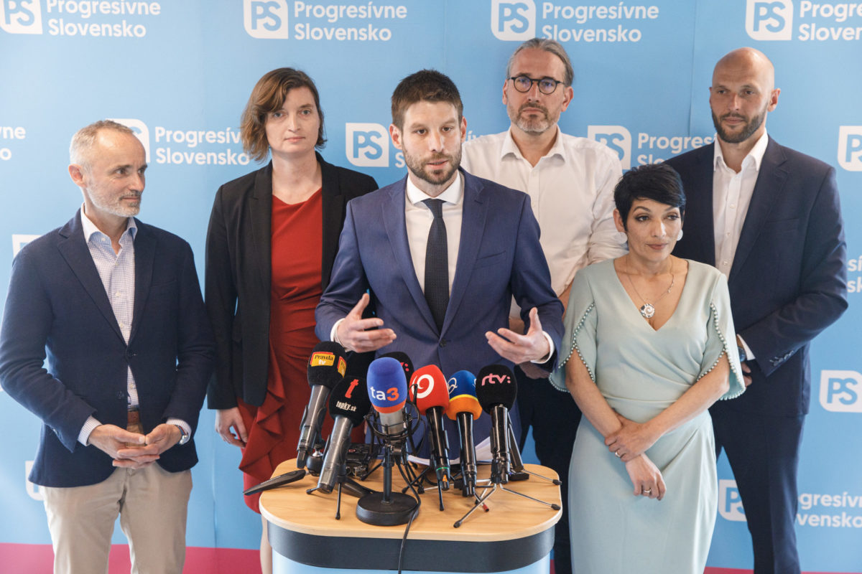
Fundamental party information
Social-liberal; centre-left
Progressive
Slovakia

Slide 4
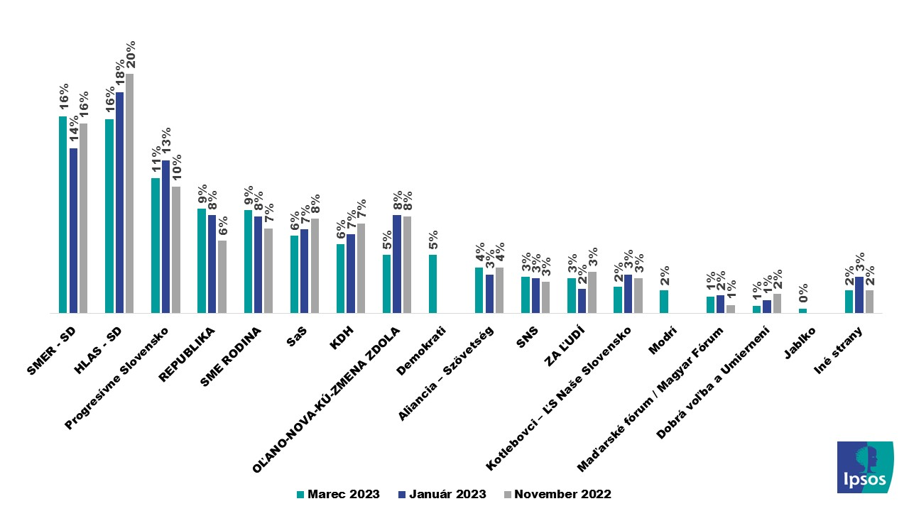

Slide 5
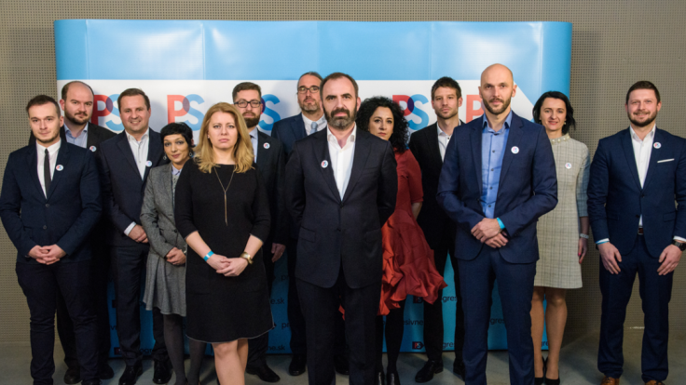
Party history

Slide 6
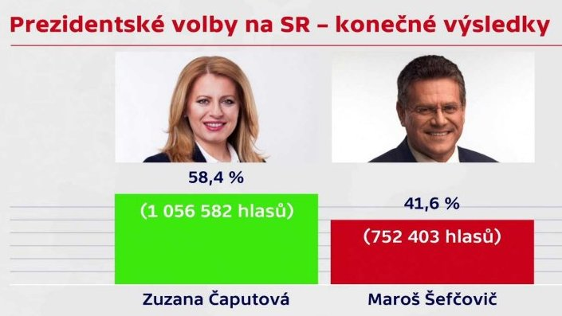

Slide 7
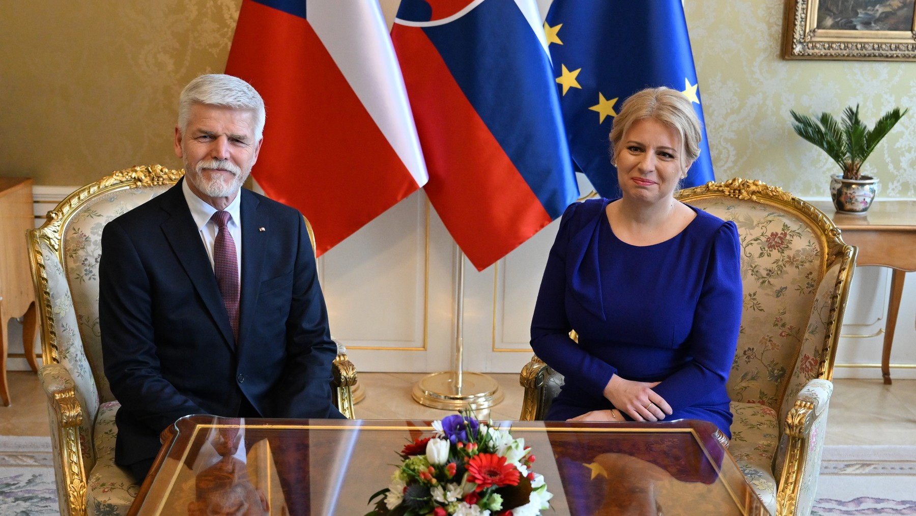

Slide 8
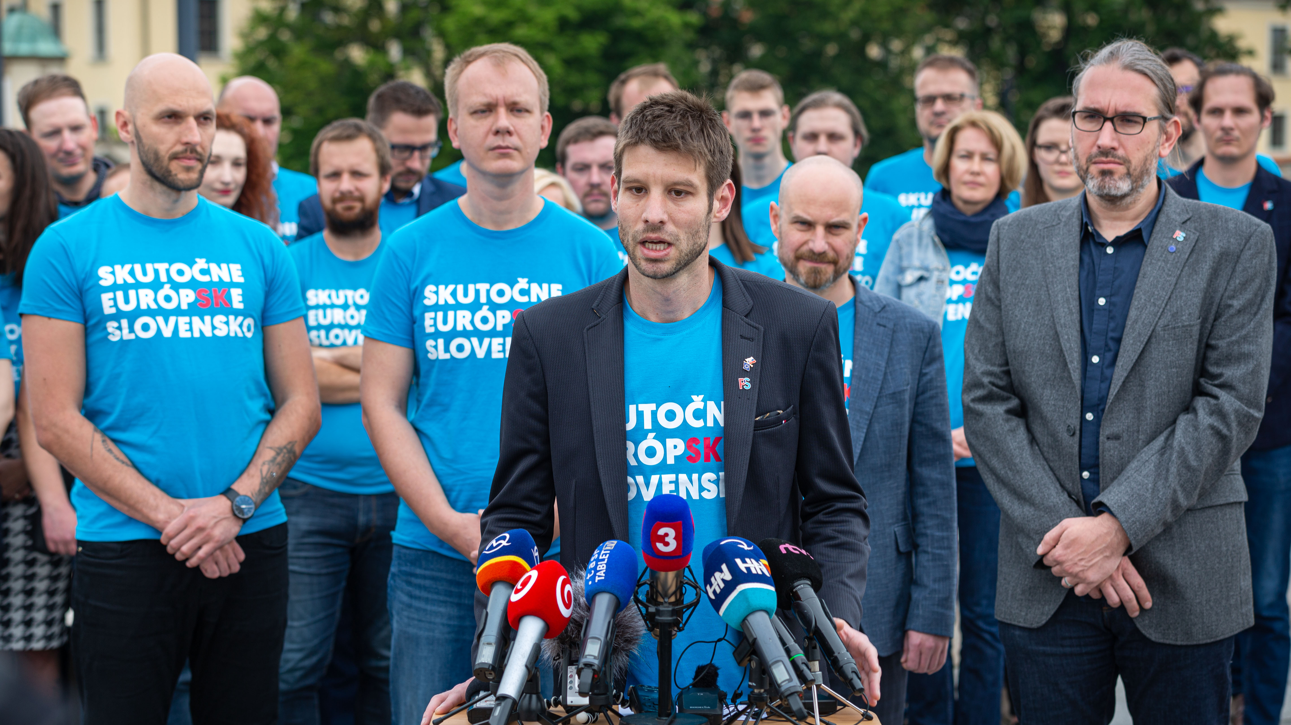

Slide 9
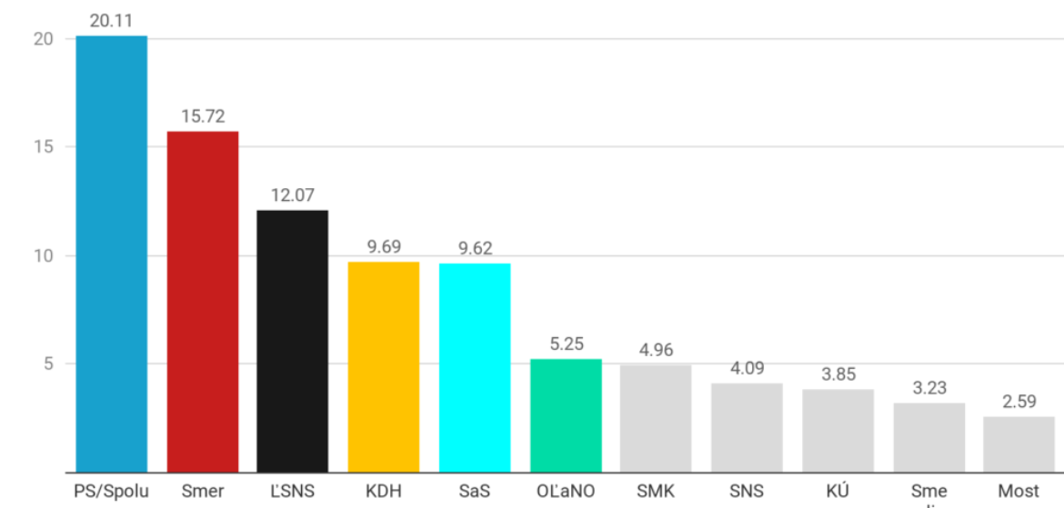

Slide 10
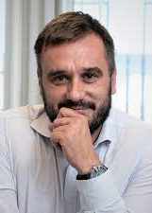
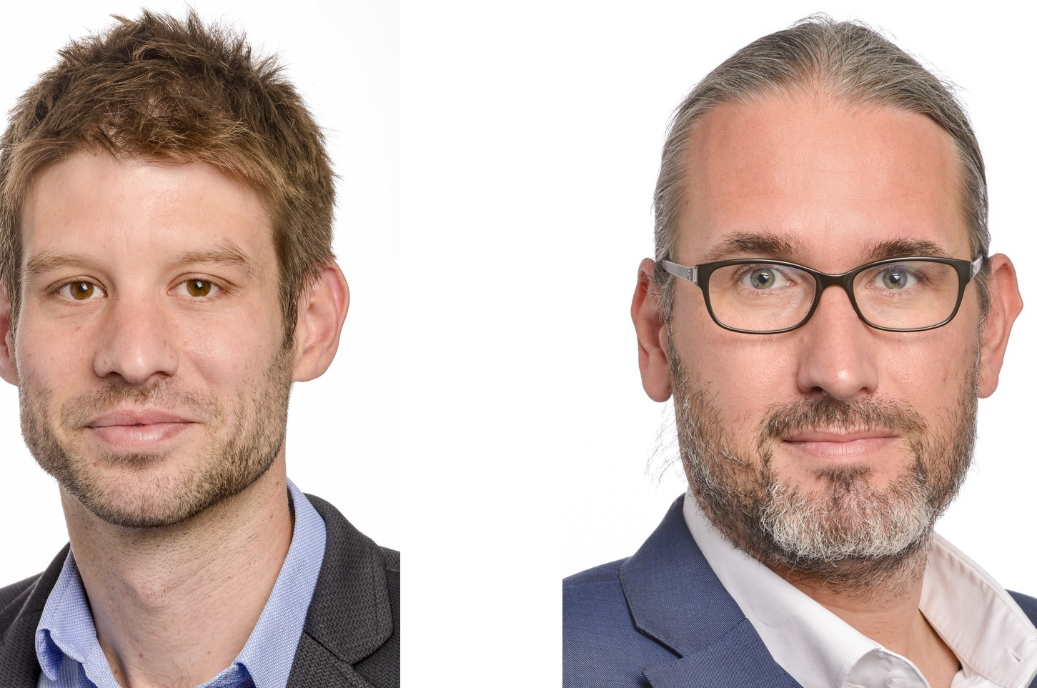

european affiliation
3/14 MEPs
Michal Šimečka - EP Vice-President
Martin Hojsík – Party Vice-President
Michal Wiezik

Slide 11


Slide 12
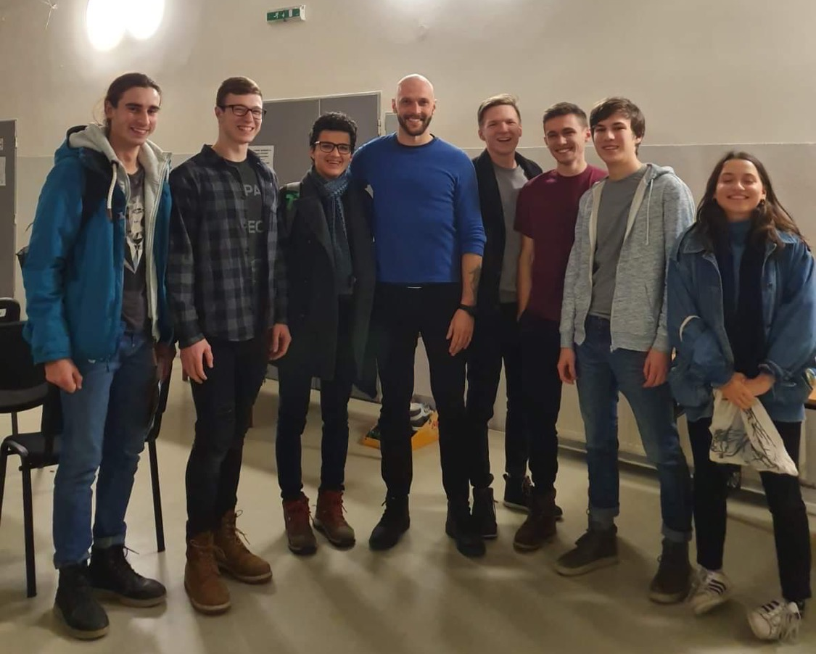

Slide 13
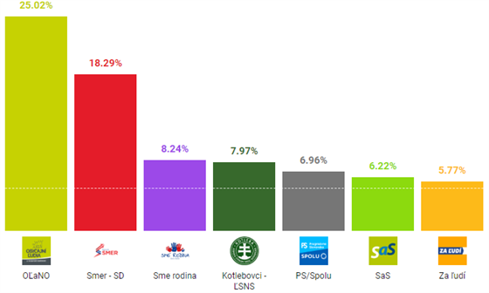

Slide 14
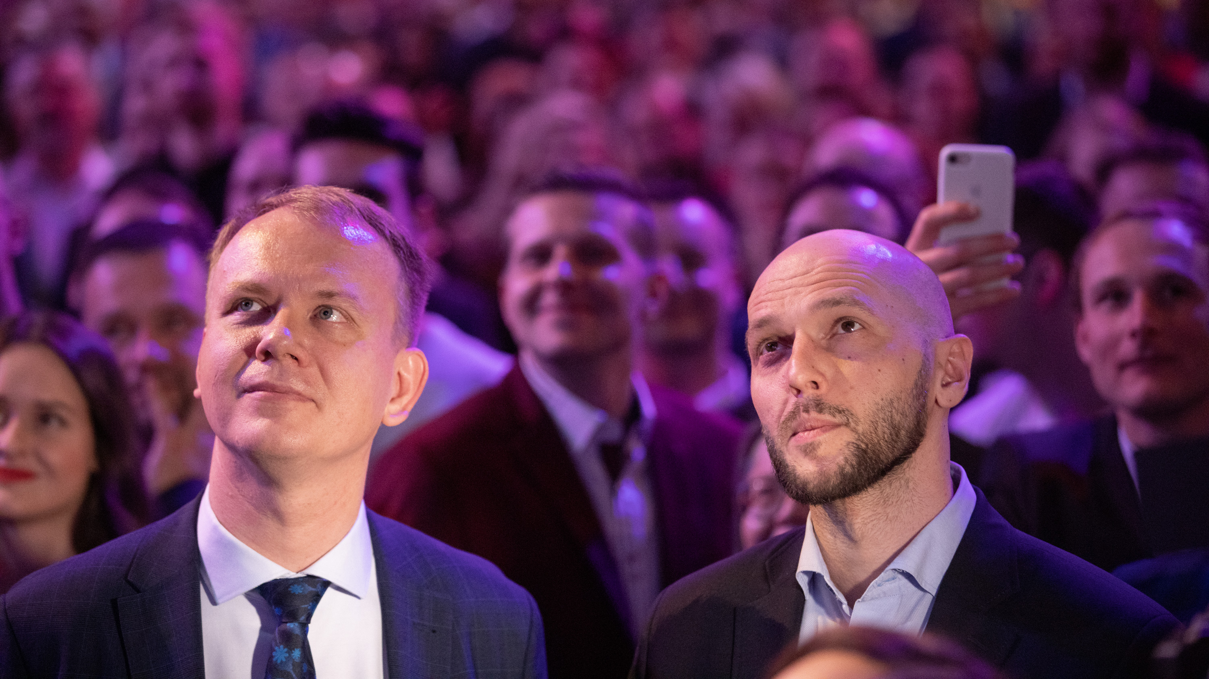

Slide 15
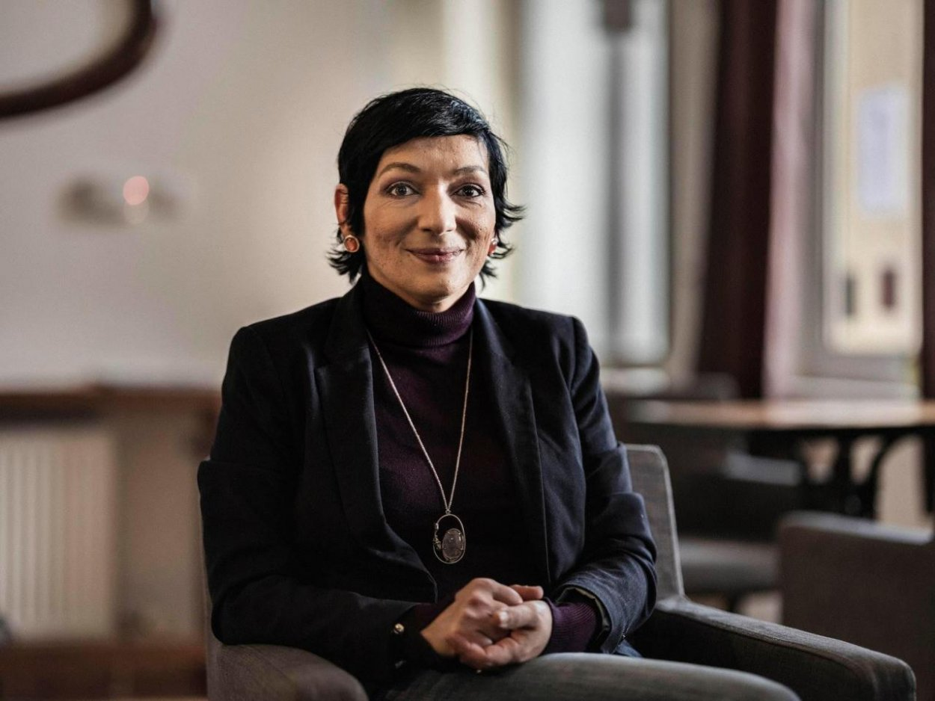
NEW PARTY PRESIDENT (2020-2022)
Irena Bihariová

Slide 16
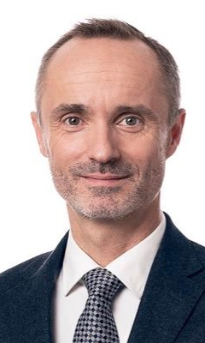
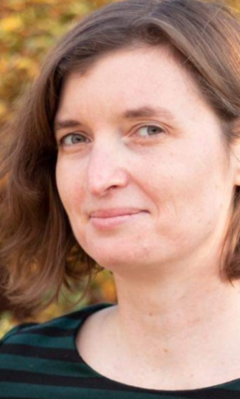
ADDITIONAL Main personalities
Lucia Plaváková – Party Chancellor and Vice-President
Tomáš Valášek – Party Vice-President

Slide 17
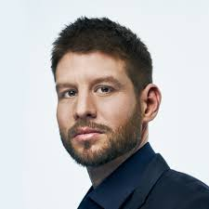

Slide 18
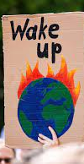
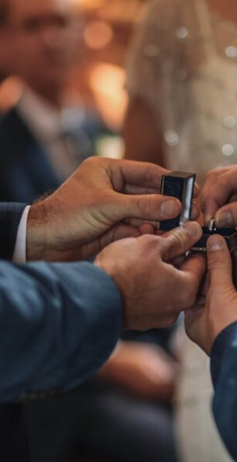
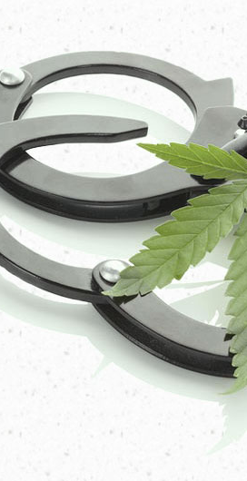
3 Programme points
Registered partnerships
Marijuana decriminalisation
State of climate crisis declaration

Slide 19

Anomaly?

Slide 20
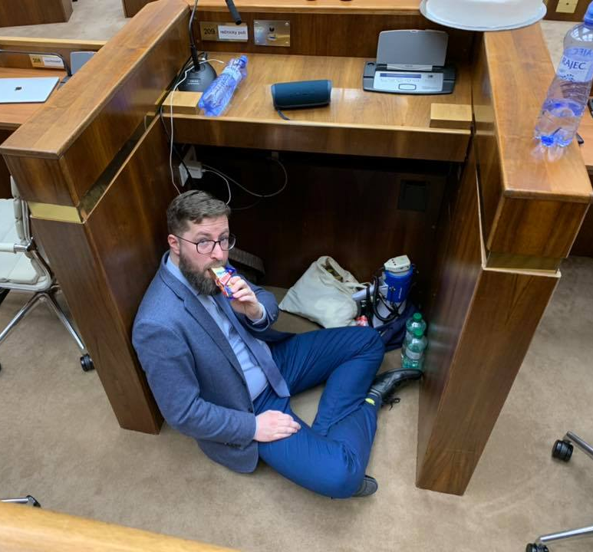
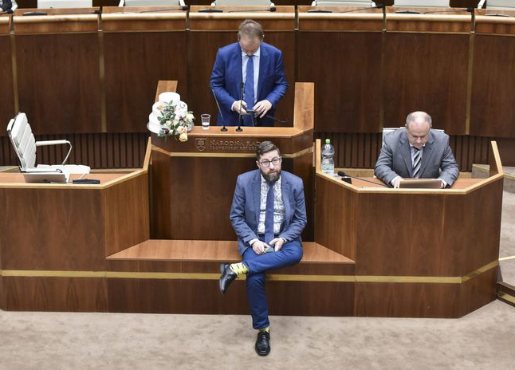
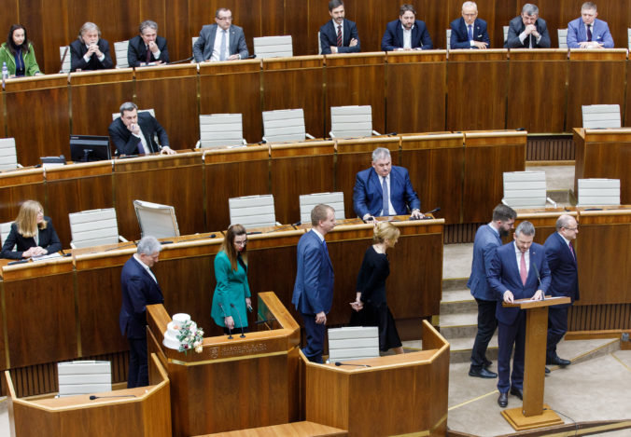

Slide 21
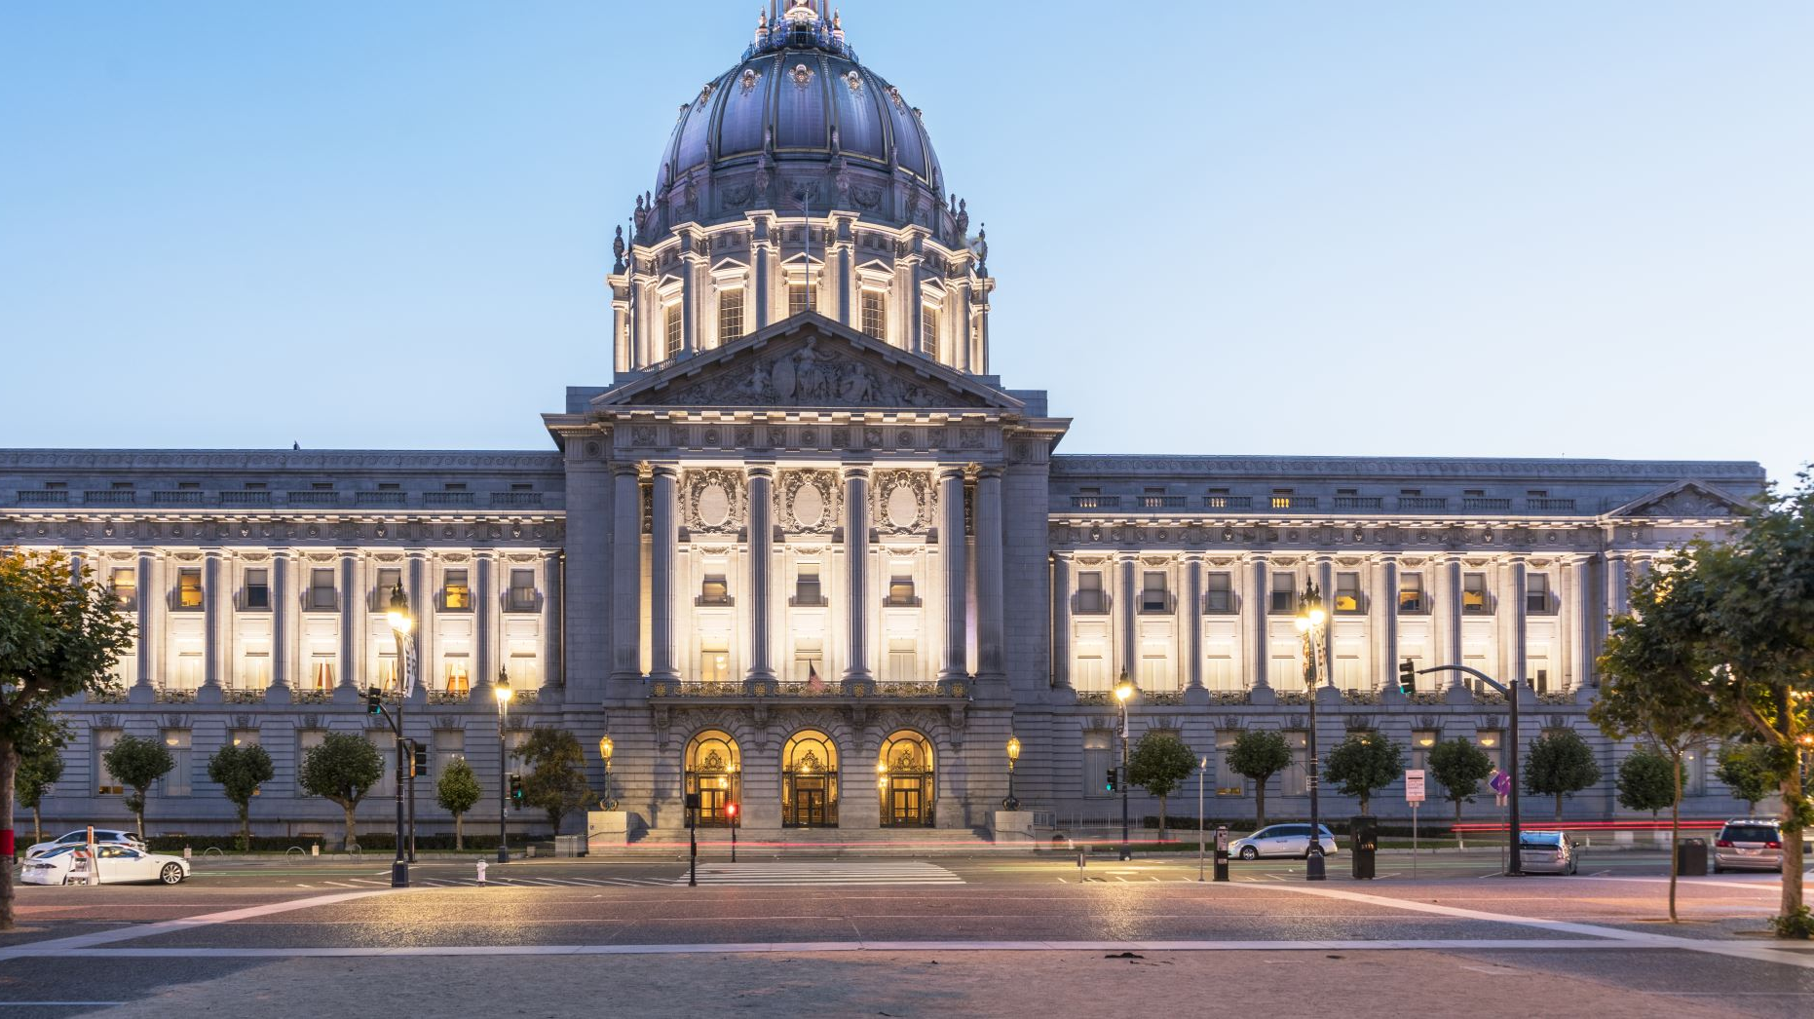
Discussion Questions
Given the rise and strength of populist, not-really-pro-Western political parties in both Slovakia and the Czech Republic – do you think progressive politics have a place in our current political spectrum and why?
Which of the mentioned programme points would you consider to be the most significant and why?

Slide 22
Sources
Progresívne Slovensko (2023). Dá sa to. Accessed from: https://www.dasato.sk/sk/ (01.05.2023)
Progresívne Slovensko (2023). O nás. Accessed from: https://www.progresivne.sk/o-nas/ (01.05.2023)
Renew Europe Group (2023). Parties: Progresívne Slovensko. Accessed from: https://www.reneweuropegroup.eu/parties/progres%C3%ADvne-slovensko (01.05.2023)
Wikipedia (2023). Progresívne Slovensko. Accessed from: https://sk.wikipedia.org/wiki/Progres%C3%ADvne_Slovensko (01.05.2023)

Slide 23
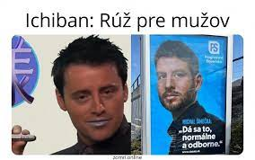
Thank you for your attention!

